Slide 1
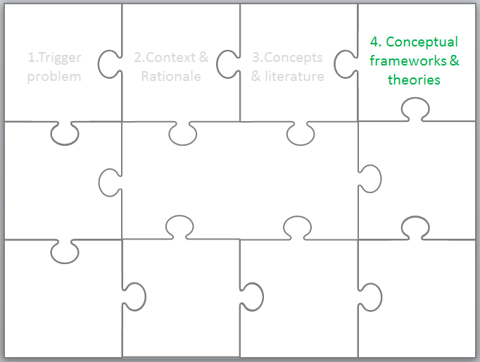
4. Conceptual frameworks & theories
EDN6015F
Glenda Cox &
Cheryl Hodgkinson-Williams
3-8 February 2014

Slide 2
4. Conceptual frameworks & theories
1.Trigger problem
2.Context & Rationale
3.Concepts & literature

Slide 3
Once upon a time …
Other researchers related these ideas / concepts together using … (conceptual framework)
Interestingly they used … theory to try and explain …
… and this has given me the idea to use … in my study

Slide 4
Purpose
The main purpose of the conceptual and/or theoretical framework section of your proposal and minor dissertation is to explain the key concepts of your research in relation to each other and identify and use an established theoretical position to help explain your research findings.
Although you possibly have your own theories that might explain the phenomenon you are investigating, with only 25 000 words you will not have space to propose and justify a new theory (keep this for the PhD!)

Slide 5
“For many students, their research question emerges from theoretical debates in their field, and they draw from these in order to undertake their own projects. The key concepts are drawn from relevant theory which then needs to be discussed in the thesis itself, with key ideas defined closely. For the purposes of the proposal, it is necessary to discuss very briefly what theoretical ideas will be drawn on, and attempt to define key concepts as tightly as possible. Not all studies foreground an explicit theoretical base to the same degree. Some emphasise a broader empirical engagement. In this case, there remains the need for an analytic framework to be developed, which defines key concepts, demonstrates how these link together and identifies the variables that will be selected as indicators of these concepts (i.e. how these concepts are to be recognised in the data). (UCT Faculty of Humanities Guidelines for Research, p2)

Slide 6
Conceptual frameworks and theoretical perspectives
Conceptual frameworks
Theoretical perspectives
What is a conceptual framework and how does it relate to a theoretical perspective?

Slide 7
Conceptual framework (1)
A conceptual framework “explains, either graphically or in narrative form, the main things to be studied – the key factors, constructs or variables – and the presumed relationships among them. Frameworks can be rudimentary or elaborate, theory-driven or commonsensical, descriptive or causal” (Miles and Huberman (1999: 18)

Slide 8
Conceptual framework (2)
A conceptual framework is the either implicit or explicit loose grouping of the selection of concepts used in a research study. It can be devised by one person for the specific use in his/her research or be developed by a group of researchers to help clarify the concepts used in a collaborative study. It is an untested or minimally tested idea of how the concepts may be related.

Slide 9
Activity
Can you identify a conceptual framework in any of the
readings we have referred to in the previous day?
research stories that have been presented so far?
annotated bibliographies that have been written up?

Slide 10
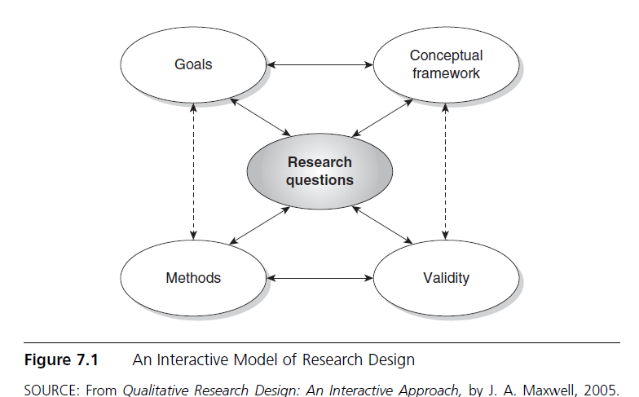
Example of a conceptual framework (1)

Slide 11
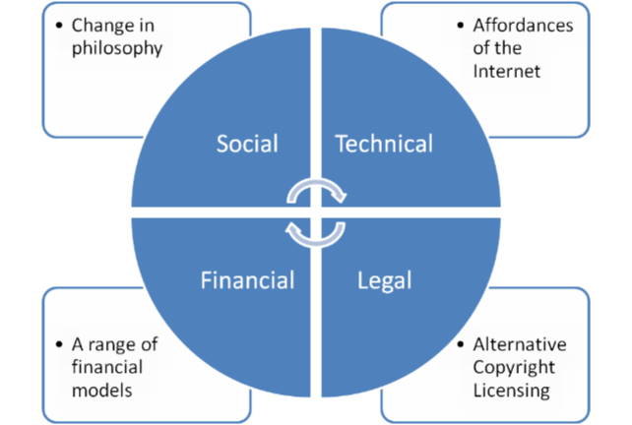
Example of another conceptual framework (Enablers of OER)
Hodgkinson-Williams (2010)HOD presentation

Slide 12
Slightly different
Technically
Drupal & specialist programming from Telementa
Legally
Creative Commons Licensing
Socially
Support from DVC
Financially
Grant from Shuttleworth Foundation
Dublin Core – metadata
Seminars & Workshops
Surveys
Grants to lecturers
Hodgkinson-Williams (2011) Open Educational Resources at the University of Cape Town

Slide 13
Anticipated & Additional Challenges
Technical
Economic
Infrastructure
Legal
Copyright challenges
Social
Lack of technical skills
Interoperability
Meta data standards
Development costs
Maintenance costs
Raising funds
Unwillingness to share
Assuring quality
Broadband
Incentives - time
Pedagogic skills
Lack of awareness of copyright
Embedded copyright
Unwillingness to use
Range of strategies
Hodgkinson-Williams (2010) Benefits and challenges to Higher Education Institutions (presentation to COL).

Slide 14
Same framework- different visualisation
Type | Anticipated challenges* | Additional challenges
Technical | Lack of broadband and other technical innovations Interoperability | Metadata standards
Economic | Lack of resources to invest in broadband, hardware & software Difficulties in covering cost for developing OER or sustaining an OER project in the long run | The sad demise of Utah State University’s OER initiative indicative of the precariousness of OER projects Extending strategies to provide an income stream for OER Raising funds to undertake OER research
Social | Absence of technical skills Unwillingness to share or give away intellectual property Unwillingness to use resources produced by someone else Assuring quality in open content | Dealing with ‘unwanted’ outside contacts (MIT report 9%) Lack of time to devoted to producing shareable materials Research privileged over the development of teaching materials Lack of incentives Skills to select appropriate OER and re-use or re-mix it
Legal | Prohibition to use copyrighted material without consent Lack of awareness among academics regarding copyright issues | Dealing with 3rd party copyright issues
Summarised By Hodgkinson-Williams from OECD (2007:70); Hylén (2006:); Yuan et al. (2008)

Slide 15
What is the value of conceptual frameworks?
Help you to
identify and refine the concepts that you are wanting to investigate
define your literature search and structure your literature review
select suitable data collection methods
identify potential explanatory theories

Slide 16
Conceptual frameworks in your dissertation
You will have a conceptual framework in your minor dissertation – even though you may not be conscious of it! As you select previous empirical research to write about you are implicitly creating a conceptual framework in your writing of how these ideas relate to each other!
The challenge is to do this consciously and deliberately an make this clear to your reader!

Slide 17
Theoretical perspective (1)
Kurtines and Silverman (1999 cited in Kawulich 2009:37) define theory as:
“an explanatory statement used to help explain and understand relations among variables, how they operate and the processes involved”
Strauss (1995 cited in Maxwell 2008) suggests that
“theory provides a model or map of why the world is the way it is” (1995 cited in Maxwell 2008:223, Italics in the original)

Slide 18
Theoretical perspective (2)
Kerlinger (1970 cited by Cohen et al 2007: 12) defines a theory as a “set of interrelated constructs [concepts], definitions, and propositions that present a systematic view of phenomena by specifying relations among variables, with the purpose of explaining and predicting the phenomena”.

Slide 19
Discipline specific theory
As Kawulich points out: “various disciplines tend to use particular theories more often than others” (2009:41)
The challenge we face in ICT in Education research is that it is usually applied in some disciplinary area, so although ‘Education-specific’ theories might be helpful, the focus of the research may include other theories from other disciplines.

Slide 20
Activity
Can you identify a theoretical perspective in any of the
readings we have referred to in the previous day?
research stories that have been presented so far?
annotated bibliographies that have been written up?

Slide 21
Identifying theories
In the title: Olakulehin, F.K. & Singh, G. (2013). Widening access through openness in higher education in the developing world: A Bourdieuian field analysis of experiences from the National Open University in Nigeria. Open Praxis, 5(1), 31-40.
In the abstract
In the introductory section
In the discussion

Slide 22
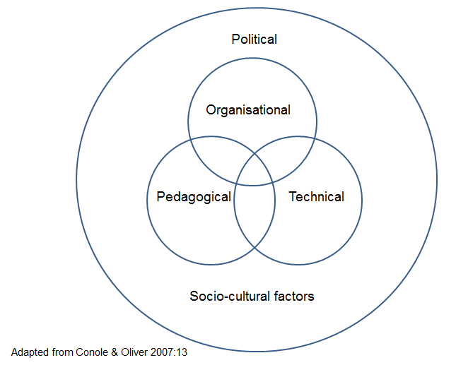
Research interests can inform theoretical choice
Which is your key research interest?
Pedagogical
Technical
Organisational
Socio-cultural
Political
Various theoretical perspectives are used for various research interests

Slide 23
What theories will help inform pedagogical research?
Psychological theory – Learning theory (e.g. Constructivism, Connectivism), Activity theory, Mayer’s Cognitive Theory of Multimedia Learning, Theory of Planned Behaviour
Educational theories – Curriculum theory (e.g. Bernstein), Pedagogical theory, assessment theory, evaluation theory, instructional/learning design theory, (e.g. TPCK) elearning (e.g. Laurillard’s conversational framework)
Sociological theories – e.g. Communities of Practice, Structuration theory, Social Realism (Archer), Critical race theory, Bourdieu, Foucault

Slide 24
What theories will inform technical research?
Computer Science – Hardware, software, connectivity (e.g. Computer Practice Framework)
Information Systems – Human computer interaction (e.g. Affordance theory, Technology Acceptance Theory), systems design
Media studies – interaction

Slide 25
What theories will inform organisational research?
Systems theory (e.g. Chaos/Complexity theory)
Management studies
Organisational psychology – Change management (e.g. Soft Systems Methodology Checkland), organisational cultures (e.g. McNay)

Slide 26
What theories will inform socio-cultural research?
Philosophy – ontology, epistemology
Sociology- gender, power, innovation (e.g. Roger’s diffusion of innovation theory)
Linguistics- language
Notes:
Ontology is the philosophical study of the nature of being, becoming, existence, or reality, as well as the basic categories of being and their relations.
Epistemology is the branch of philosophy concerned with the nature and scope of knowledge and is also referred to as "theory of knowledge".

Slide 27
What theories will inform political research?
Politics – power
Economics – funding models
Educational policy – national and provincial policy and practice

Slide 28
What is the value of theoretical perspectives?
Kawulich suggests that the “theoretical viewpoint guides [her] thinking in developing questions, selecting participants, collecting data in various ways, in analysing that data and in presenting it” (2009:41)
If you don’t have a theory up-front, then you have to develop some analytic framework to make sense of your data anyway!

Slide 29
Is there atheoretical research?
Although there are those (e.g. Thyer 2001 cited in Kawulich 2009) that believe there is atheoretical research, we are of the opinion that while there maybe research that does not have an explicit theoretical perspective that there is always at least a personal set of assumptions, reasons or beliefs that are implicit in any research.
In other words, there is no completely atheoretical research – researchers always do things for a reason!
The challenge it to make these explicit and/or implicit theories overt so that others can understand and judge your research

Slide 30
Analytical framework
Either your conceptual framework or theoretical framework will help you devise your Analytical framework that you will use in your data analysis. It usually provides more detail of how you classified your various concepts.
This can be a study-specific framework or it can relate directly to analytic frameworks used in other studies.

Slide 31
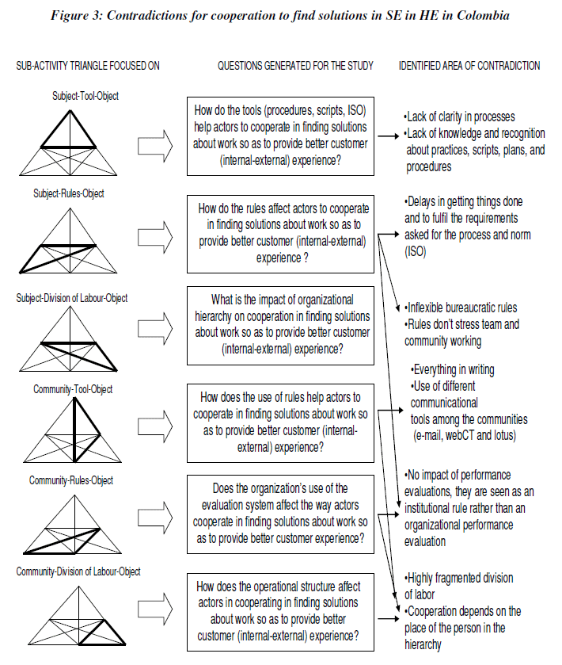
Analytical framework
Oliveros et al (2010)Contradictions and power play in service encounters: An Activity Theory approach. Cad. EBAPE.BR vol.8 no.2 Rio de Janeiro June 2010
Notes:
http://www.scielo.br/scielo.php?script=sci_arttext&pid=S1679-39512010000200011

Slide 32
Key issues
What IS it that you are trying to understand? Identify this FIRST and then read about how other have tried to explain IT (whatever IT is in your research) and then decide on your theoretical perspective.
Starting from a theory first (e.g. I am going to use Activity Theory – no matter what), will limit what you focus on – and is a bit back-to-front!

Slide 33
Conceptual frameworks and theoretical perspectives
Conceptual frameworks
Theoretical perspectives
Conceptual frameworks | Analytic framework | Theoretical perspectives
Loosely associated concepts | Identification of concepts in the data | Tightly explained concepts
Often once-off | Maybe once-off or used and extended by other researchers – essential for comparative studies | Adopted by a extensive group of researchers over a period of time
Used to describe potential relationships | Description of concepts evident in the data | Used to explain and predict relationships

Slide 34
References
Cohen, L, Manion, L & Morrison, K (2007) Research Methods in Education. 6th edition. London: Routledge.
Czerniewicz, L. & Jaffer, S. (2007). Framing the issues, interventions and investigations of the Elearning Initiatives. Draft document prepared Partnership for Higher Education in Africa.
Kawulich, B. (2009) The role of theory in research. In M. Garner, C. Wagner & B. Kawulich (Eds.). Teaching Research Methods in the Social Sciences. (37-47). Burlington, VT: Ashgate.
Hodgkinson-Williams (2010) Benefits and Challenges of OER for HEI,s. Available onine: http://www.col.org/SiteCollectionDocuments/OER_BenefitsChallenges_presentation.pdf
Maxwell, JA (2008) Designing a qualitative study. In Bickman, L & Rog, D.J (2008) The Sage handbook of applied social research methods, London: Sage. Available online: http://www.corwin.com/upm-data/23772_Ch7.pdf (Last accessed 24 January 2009).
Miles MB & Huberman, AM (1999) Qualitative Data Analysis: An Expanded Sourcebook(2nd Edition). Sage.
Olakulehin, F.K. & Singh, G. (2013). Widening access through openness in higher education in the developing world: A Bourdieuian field analysis of experiences from the National Open University in Nigeria. Open Praxis, 5(1), 31-40.
Oliveros, M., Halliday, S., Posada, M., & Bachmann, R. (2010). Contradictions and power play in service encounters: And activity theory approach. Cadernos EBAPE.BR, 8(2)
UCT Faculty of Humanities Guidelines for Research. Available online: http://www.humanities.uct.ac.za/downloads/humanities/postgrad/gradschool/navthesis/start/research_proposal.pdf
Webb, M (2010) Models for exploring and characterising pedagogy with information technology. In A. McDougall, J. Murnane, A Jones & N. Reynolds, Researching IT in Education: Theory, Practice and Future Directions. (pp 91-109). London: Routledge.

Slide 35
Written by Cheryl Hodgkinson-Williams
cheryl.hodgkinson-williams@uct.ac.za in 2013 and adapted in 2014 by Glenda Cox
This work is licensed under a Creative Commons Attribution 4.0 International License.

