Slide 1
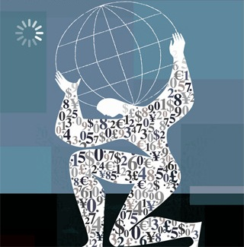
South Africa In A Changing World: Current World Economic Trends And Crises
Dr. Mark Ellyne
UCT Summer School 2012
Notes:
I set world perspective; my colleagues talk more about SA
My background

Slide 2
Lecture Outline
Some general world trends of the last 30 years
Economic transmission of crises
International imbalances
The Sub-Prime financial crisis
The Euro crisis and Greece
Implications for South Africa

Slide 3
I. The World Is Growing Rapidly

Slide 4
Living Standards Are Rising
Notes:
Measured in current dollars—some of this is inflation

Slide 5
II. Economic Geography of the World Economy is Shifting
Notes:
Observation 2

Slide 6
Geography of World Economy is Shifting
 | 1980 | % Share | 2010 | % Share
USA | 2,888 | 26.0 | 14,527 | 23.1
European Union | 3,652 | 34.1 | 16,242 | 25.8
South American | 845 | 7.9 | 4,834 | 7.7
Asia | 667 | 6.2 | 9,536 | 15.2
China | 203 | 1.9 | 5,878 | 9.3
Africa | 277 | 2.6 | 1,049 | 1.7
South Africa | 81 | 0.8 | 364 | 0.6

Slide 7
III. The World Economy is More Integrated
World trade is growing 50% faster than nominal GDP
International capital flows are growing faster than trade
Telecommunications/internet makes international investment opportunities more easily available
Notes:
Obs 3

Slide 8
IV. Is the Economy is More Volatile?
Reinhart and Rogoff, This Time Is Different
“... financial crises are nothing new.”
“There have been at least 250 sovereign default episodes during 1800-2009”
“ Today’s emerging market countries did not invent ... repeated sovereign defaults. Rather, a number of today’s now-wealthy countries had similar problems when they were emerging markets.”
Notes:
This time is different = most dangerous 4 words, justified booms

Slide 9
Volatility Remains in Commodities
Notes:
1980 – 2002 Oil price variation = $18-38 = 100%; food = 125-75 = 50%
2002 – 2011 Oil price variation = $38 - $100 = 150%; food = 75 – 175 = 150%

Slide 10
V. More Economic Convergence?
Notes:
Seems to be somewhat more convergence, ie closer tracking to the mean

Slide 11
Inflation Has Been Variable but Converging

Slide 12
Observations
World growing strongly
Economic geography changing
World is more integrated
Volatility remains
More convergence?

Slide 13
VI. Economic Transmission Mechanisms
How are shocks transmitted internationally?
Trade-related (traditional) linkages
Financial and Contagion linkages

Slide 14
Traditional Shock Transmission to Africa – Foreign Demand
Lower demand from Rest of World —especially advanced economies — reduces demand for African exports (and vice versa)
IMF estimates that a 1% slowdown in GDP in the rest of the world leads to a 0.5% slowdown in SSA
Notes:
Trade demand
Elasticity of African exports <1 because commodities

Slide 15
Traditional Shock Transmission to Africa - Other
International prices affect African import and export prices
Economic conditions in advanced economies affect foreign aid levels
Economic conditions in advanced countries affect worker remittances to Africa

Slide 16
Financial Transmission
Interest rate is key mechanism for
international economic transmission
With capital mobility, interest rates of small countries tend to move toward the interest rate of large open economies.
Raising the interest rate in a small country tends to strengthen the exchange rate, and/or increase capital inflows.
Notes:
Cite SA as example

Slide 17
Balance Sheet Effects Commercial Risk
Assets | Liabilities
Commercial Loans | Deposits
Government Bonds | = Net Worth (>0) (Shareholder capital) (Reserves/past profits)
Bad loans → | Net Worth ↓
 | Reduce Capital
Notes:
Net worth must be >= Capital
Bad loans reduce net worth

Slide 18
Balance Sheet Effects: Foreign Borrowing & Exchange Risk
Assets (Rand) | Liabilities (Rand)
Commercial Loans | Deposits
Government Bonds
 | Shareholders Capital
Domestic Loans | Borrow $ Funds
Valuation Effect (-)
Notes:
Borrow $ cheaply & invest locally
East Asian story

Slide 19
Balance Sheet Effects Foreign Investment & Exchange Risk
Assets | Liabilities
Commercial Loans | Deposits
Government Bonds
Invest in Foreign Assets
Bad Loans (-)
Valuation Effect (-) | Net Worth ↓
 | Shareholders Capital ↓
Notes:
Use local deposits to make $ investments
Could have bad investment + exchange losses => capital losses

Slide 20
Contagion
A liquidity crunch in an advanced economy can spread to smaller markets as economic agents (individuals + companies) look for cash.
A contagion effect may result when economic agents believe that a crisis in one country will occur in other similar countries.

Slide 21
VII. Global Imbalances Problem
The exchange rate should adjust to ensure the tendency toward current account balance, so country’s current account balance cycles around 0 for stability.
Sustained deficits (or surpluses) for long periods indicate some other serious structural problem.
Notes:
1st intl problem

Slide 22
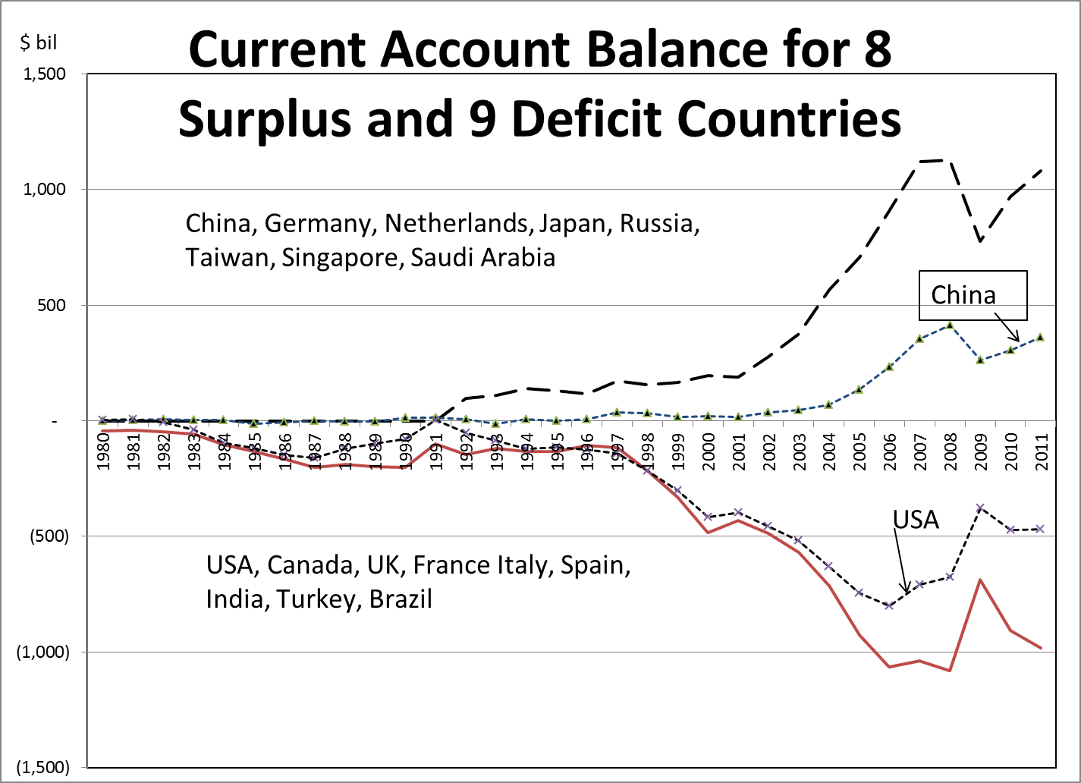
Persistent Current Account Surpluses And Deficits are a Problem

Slide 23
Implications of Current Account Balance
Current account Deficit → capital account borrower, or debtor
(and vice versa: Surplus → Creditor)
Deficit → Currency depreciates
[Surplus → Currency appreciates]
But what about China and USA?

Slide 24
China - USA Symbiosis
China has large surpluses so its currency should appreciate
China loans USA large amounts of money (by buying US government treasury bills) to continue trade imbalance without adjusting
And, China’s exchange rate is fixed to US$

Slide 25
Is China Adjusting

Slide 26
Is China Adjusting?

Slide 27
Same China Story with South Africa?

Slide 28
Is China Helping or Hurting Us?
Persistent large surplus → exports are too cheap?
Who receives the benefits?

Slide 29
VIII. 2008-09 Financial Crisis
What happened?
US and international banks invested in US subprime mortgage bonds because they provide good return
Quality of those bonds deteriorated
Banks have balance sheet imbalance — fewer assets than liabilities (deposits)
Liquidity Crunch

Slide 30
2008-09 Sub-Prime Financial Crisis
What to do?
Raise more capital from shareholders
Takes money out of system
Stop lending and call in loans
Fewer loans mean less economic growth
Issue: Is this systemic risk that requires official intervention?

Slide 31
“Moral Hazard” Question
Let them go bankrupt
Bailouts encourage bad behaviour of banks
Must be consequences for risky behaviour
Bailout needed
To protect others and prevent panic widespread financial meltdown
Must restore profitability of banking system
Notes:
Moral hazard is action is protective action that risks negative behaviour--insurance

Slide 32
Official Response to Financial Crisis
Central bank buys bad assets at full value; i.e. swaps bad bonds for good government treasury bills, thereby improving solvency of banks
Fed reduces interest rates to stimulate lending
Government provides fiscal stimulus to offset reduction in private sector activity
Side effects: rising government debt

Slide 33
Consequences
Banks stop lending to reduce risk, become profitable, and rebuild their balance sheets: reduce bad debts, increase capital and cash, raise profits. Result is recession.
Government stimulus creates rising government debt and fear of debt crisis.
Should we be fighting recession or debt crisis?
Notes:
We cant decide if we should be fighting recession or debt crisis!

Slide 34
IX. Greece & the 2011 Euro Crisis
What Happened
Rising Greek government debt service created an expanding budget deficit
Market perceived government inability to pay debt service
Government can no longer sell treasury bonds at same low interest rate thus making deficit worse
Debt trap: need to run fiscal surplus just to get out of debt; Can’t grow out of your debt/GDP ratio
Notes:
A debt trap can occur if the nominal interest rate (i) is greater than the nominal growth rate of GDP (g+π).
Debt/GDP = (1+i) Debt
(1+g)(1+π) GDP

Slide 35
2011 Euro Crisis
What to do
Cut government deficit → raise taxes and cut spending (ouch!)
Have European Central Bank buy Greek treasury bonds at low interest rate = “Bailout”
Make all holders of Greek debt take a “Haircut” (i.e. forgive debt)
Greek must leave Euro and devalue currency to reduce domestic demand and stimulate exports

Slide 36
Why Leave the Euro? Flexible Exchange Rate Adjusment
If country has high inflation or its production costs become uncompetitive at the existing exchange rate, it should depreciate to make exports cheaper and imports more expensive
Depreciation→ M↓ and X↑

Slide 37
Adjusting With a Fixed Exchange Rate
To stimulate private sector activity while contracting public sector, must reduce unit labour costs to make Greek economy more internationally competitive
If you can’t devalue currency, must cut wages

Slide 38
But…Is This Just a Greek Problem?
Who is holding Greek debt?
EU commercial banks are threatened
Is this a European sub-prime crisis?
If the EU is current account is in balance, should surplus countries in EU also be adjusting?
How to ensure that Greek government behaves in the future?

Slide 39
Meaning for South Africa
SA is an open economy that has a current account deficit and financial account surplus, owing to its large financial sector and stock exchange.
It is subject to international trade shocks and financial contagion.
Thus, good economic policy is necessary to avoid contagion effect.

Slide 40
Characteristics of South Africa Economy
South Africa’s fiscal deficits are 3-5% of GDP, which are moderate.
Government debt is about 48% of GDP, which is a safe level.
Inflation is moderate (4-7%) and the real interest rate (interest rate-inflation) is low.
The exchange rate is volatile.

Slide 41
Questions and Discussion
World trends – is anything new?
Global imbalances – who’s fault is it?
The subprime crisis and financial asset shocks – can we prevent another one?
The Euro Crisis – who will save the euro?

