Slide 1










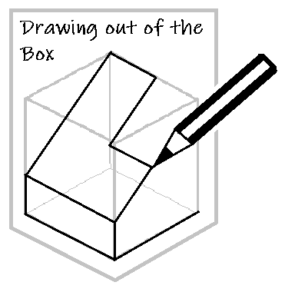
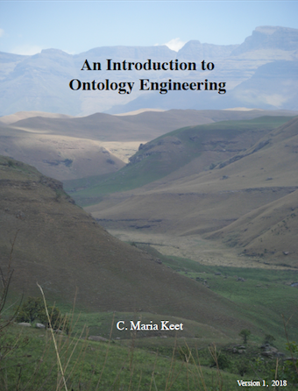
Open textbook case studies: social justice and agency
Glenda Cox, Michelle Willmers and Bianca Masuku
OE Global Milano, 2019

Slide 2


This work is carried out with the aid of a grant from the International Development Research Centre, Ottawa, Canada.
It is licensed under a Creative Commons International 4.0 licence.

Slide 3
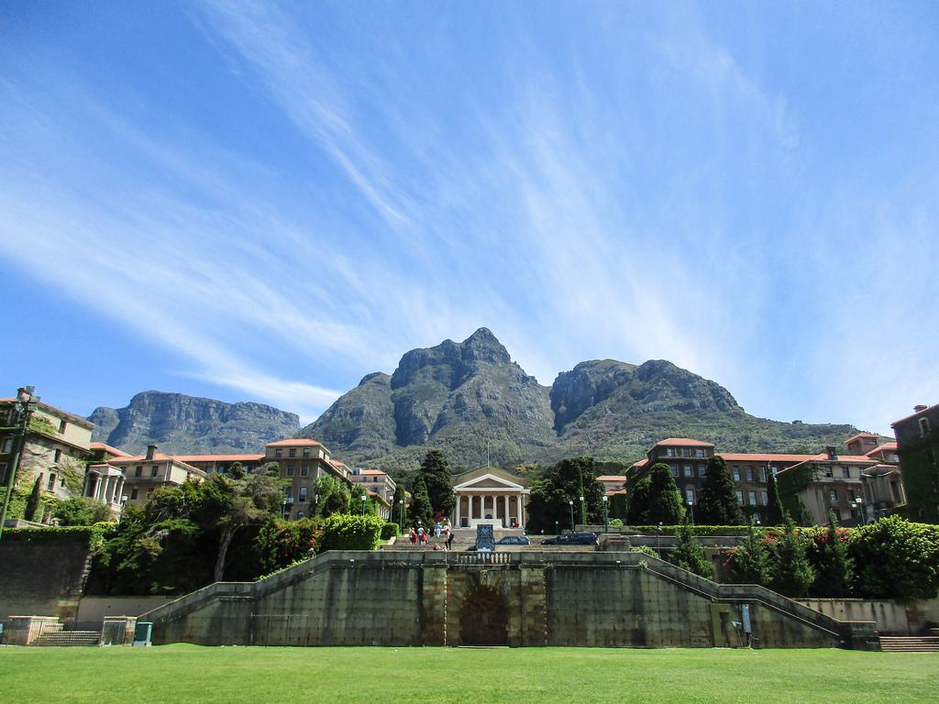
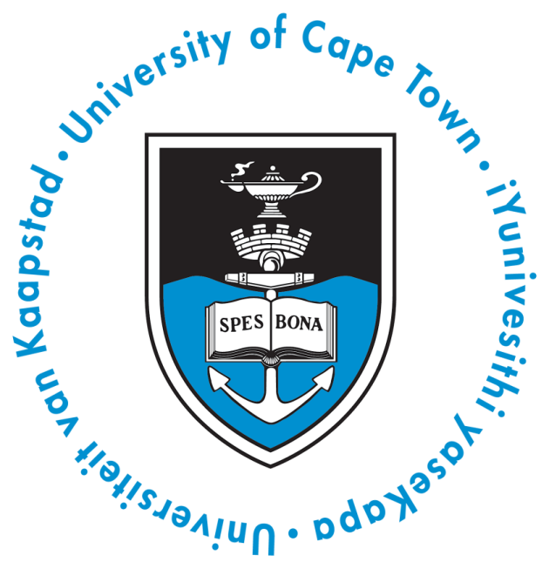

27 993 STUDENTS
4808
STAFF
Notes:
The local organizing committee is from the University of Cape Town
27 993 students and 4808 staff
Residential with increasing blended and online approaches

Slide 4
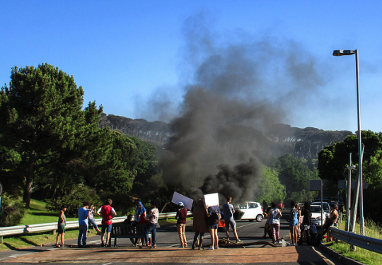
Fees must fall, Picture by Ian Barbour; Wikimedia, CC BY-NC-SA https://www.flickr.com/photos/barbourians/22697273532/in/photostream/

Slide 5
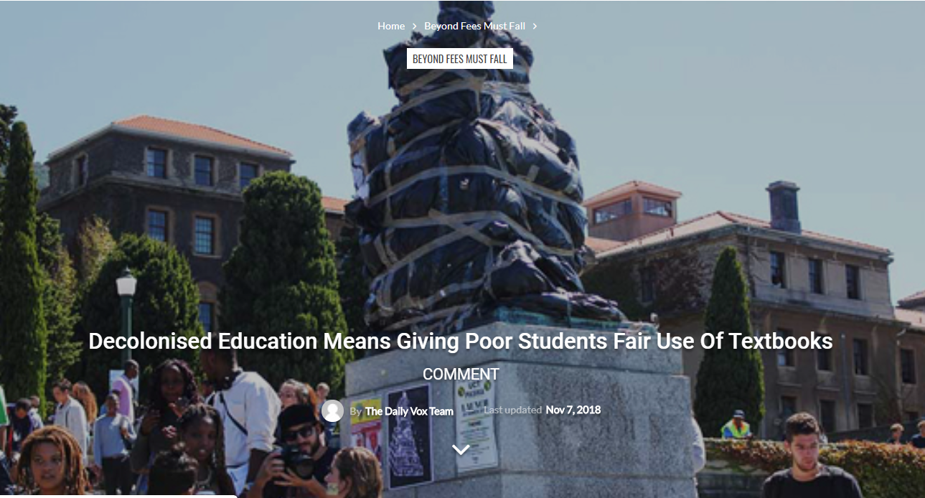
Textbooks as a social justice issue in the South African higher education context: challenges of access and representation
Notes:
https://www.thedailyvox.co.za/decolonised-education-means-giving-poor-students-fair-use-of-textbooks-thabiso-bhengu/

Slide 6
Primary objective of the DOT4D initiative:
  To contribute to a broader social justice agenda in the South African higher education system by improving equitable access to appropriate and relevant learning resources.

Slide 7
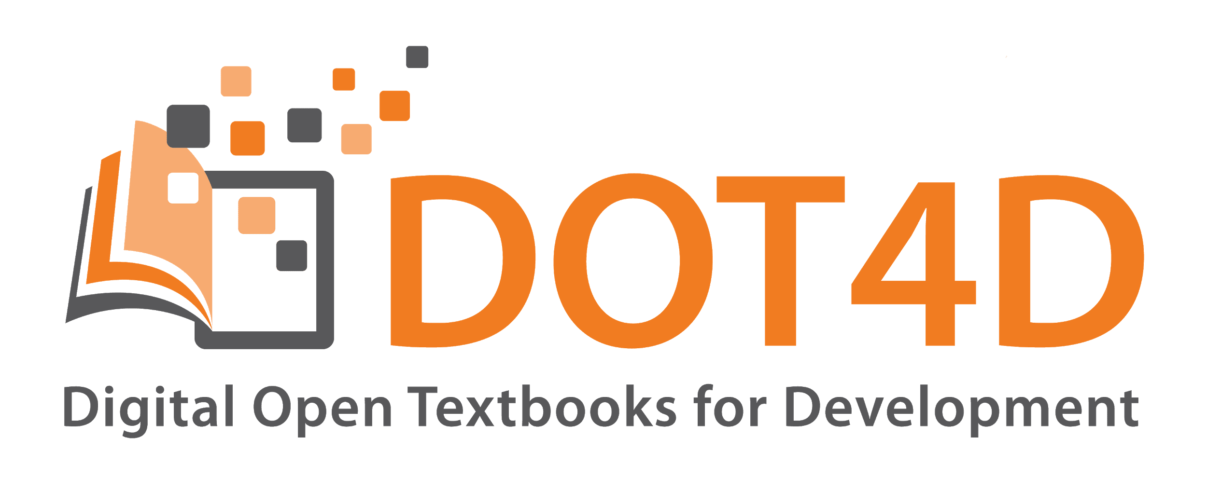
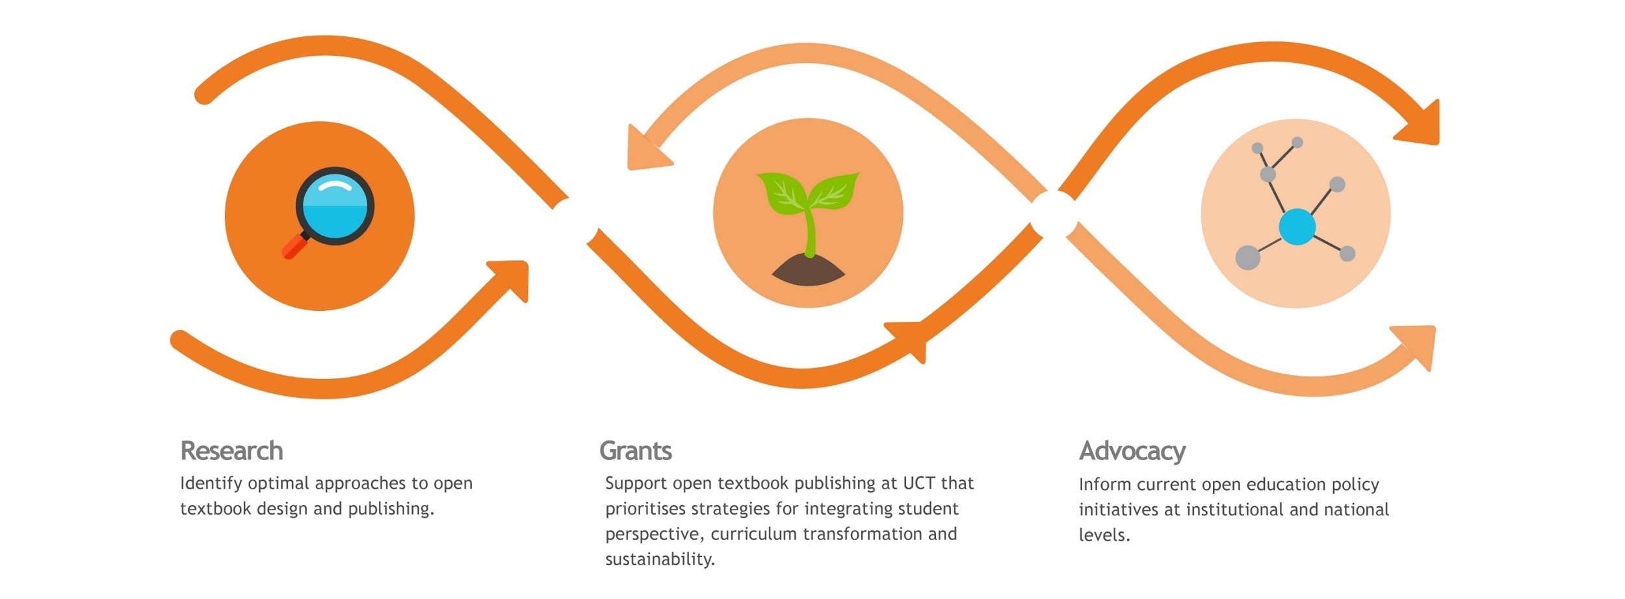
http://www.dot4d.uct.ac.za/
Notes:
Project specific objectives:
Articulate and identify the best approaches to designing an open textbook.
Support open textbook publishing activity at UCT that prioritizes strategies for integrating student perspective, curriculum transformation, and sustainability.
Inform current textbook publishing policy-development initiatives at institutional and national levels.

Slide 8
Research

Slide 9
What is social justice?
“
Social justice is a concept that requires the organisation of social arrangements that make it possible for everyone to participate equally in society. Fraser (2005) considers social justice as ‘participatory parity’ economically, culturally and politically.
”

Slide 10
Fraser’s (2005) framework of Social Justice
Dimension | Injustices | Affirmative response Addresses injustice with ameliorative reforms | Transformative response Addresses the root causes of inequality
Economic | Maldistribution of resources: economic inequality
Cultural | Misrecognition attributes of people & practices accorded less respect, status inequality
Political | Misrepresentation Lacking right to frame discourse

Slide 11
Social Justice framework (Nancy Fraser, 2005)
Cultural: Misrecognition
Attributes of people & practices accorded less respect, status inequality
Political: Misrepresentation
Lacking right to frame discourse, lacking power to make decisions
Economic: Maldistribution
of resources: economic inequality
Injustices in current textbook practices
Cost and value Inequality of access
Textbooks from the Global North
Lack of power/lack of voice of for eg. students in materials
Affirmative response
Transformative response

Slide 12
Grants

Slide 13
Open textbook grants at the University of Cape Town
Primary Criteria:
Curriculum transformation:
Localisation of an existing textbook
Writing a new textbook for our context
Multilingualism: translation of text or use of local language examples
Inclusion of student voices: as authors and/or as editors
Technological innovation
Pedagogical innovation
Secondary criteria:
Collaboration with multiple authors, Sustainability: a plan for versions and multiple authors, Range of disciplines
Notes:
We received 17 proposals and had a rigorous set of criteria and a limited amount of funds

Slide 14
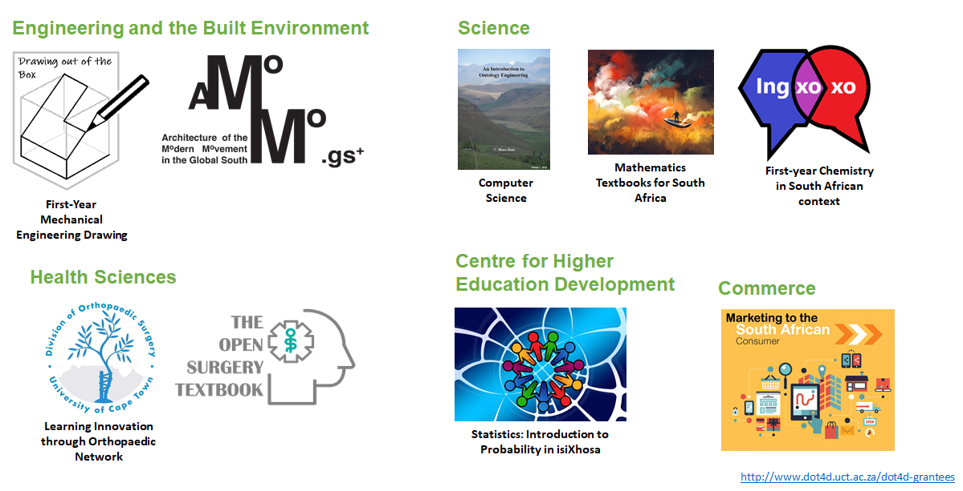
DOT4D grantees

Slide 15
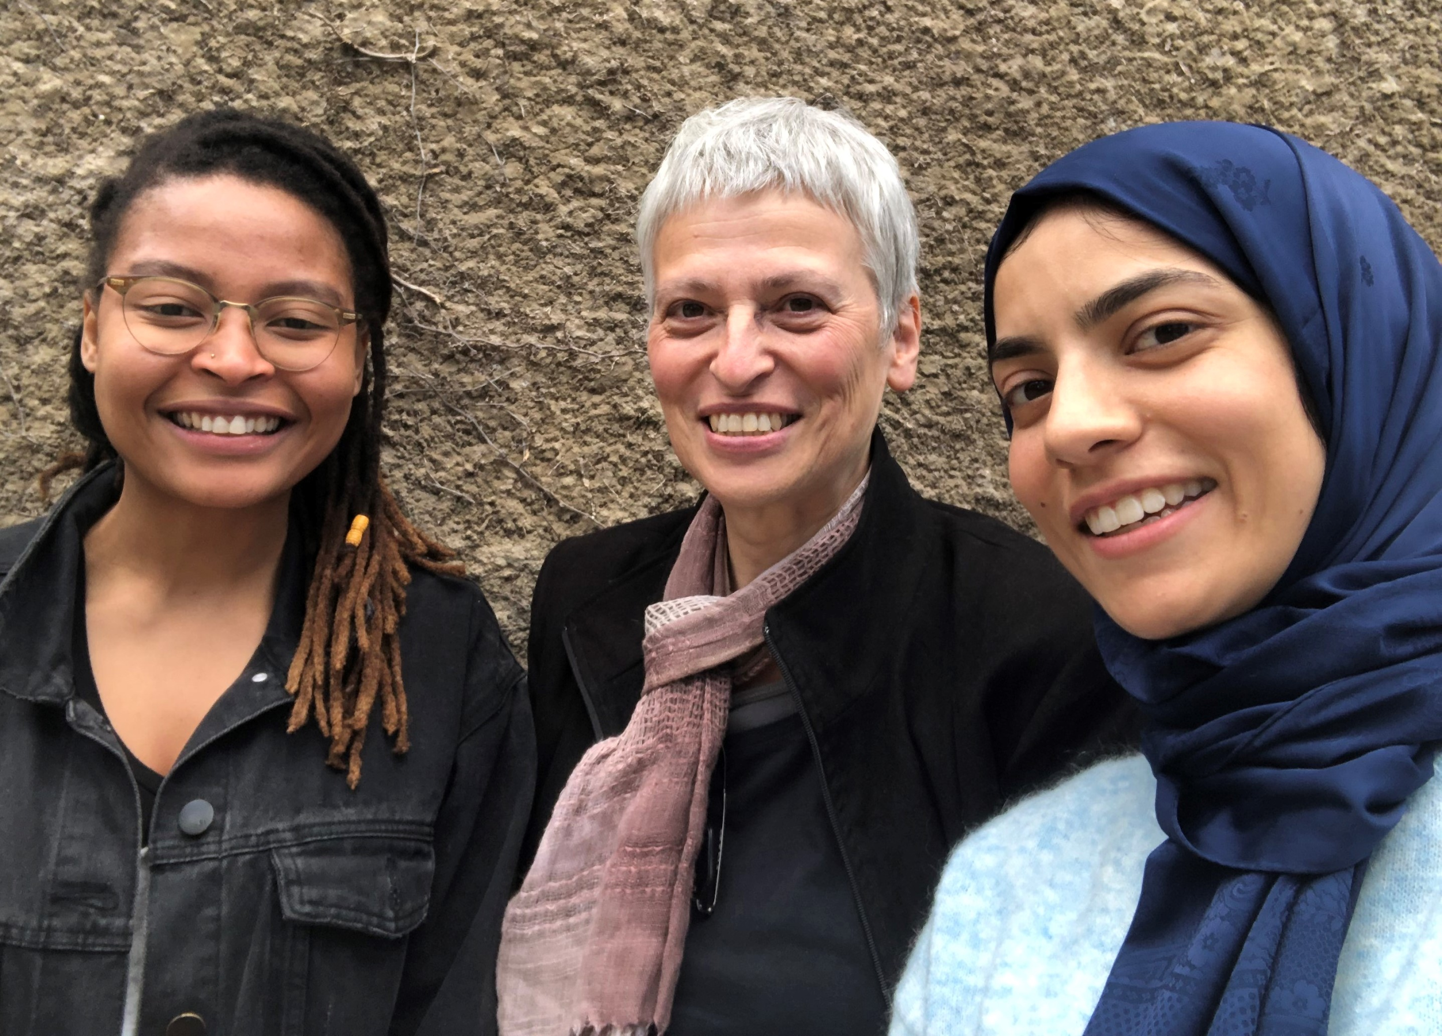
School of Architecture Planning and Geomatics
Architecture of the Modern Movement in the Global South
“It’s about surfacing what is relevant to our context”
Valerie, Stella and Maashitoh
Notes:
Template that students populate
Students find or take a photo and gather information
Prototype of Global South buildings

Slide 16
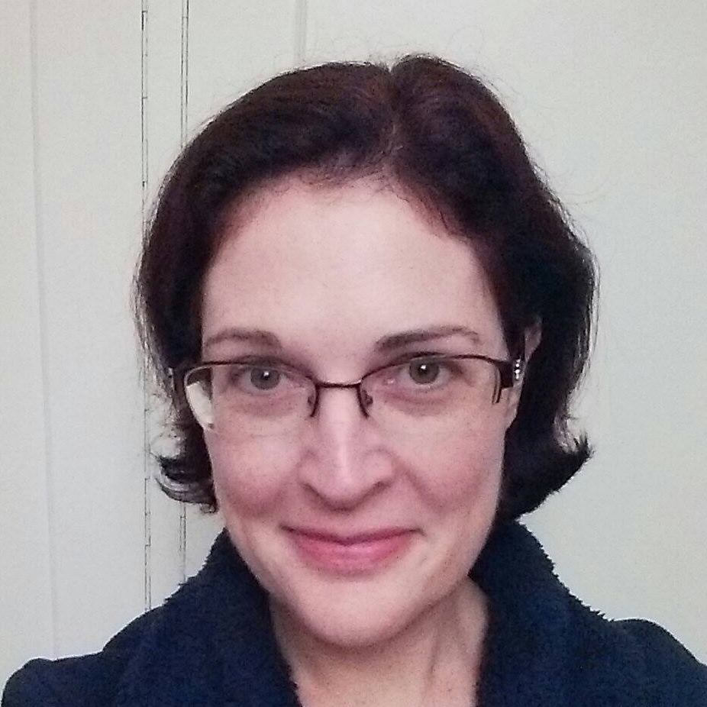
Mathematics
Mathematics textbooks for South Africa
“It’s about teaching, thinking about what you need to teach … you need to teach thought processes”
Claire
Notes:
How:
...which will be openly licensed, culturally and linguistically inclusive and tailored for the South African school-leaver.
...will include techniques for thinking about and writing mathematics, with a particular focus on making the language of mathematics more accessible.

Slide 17
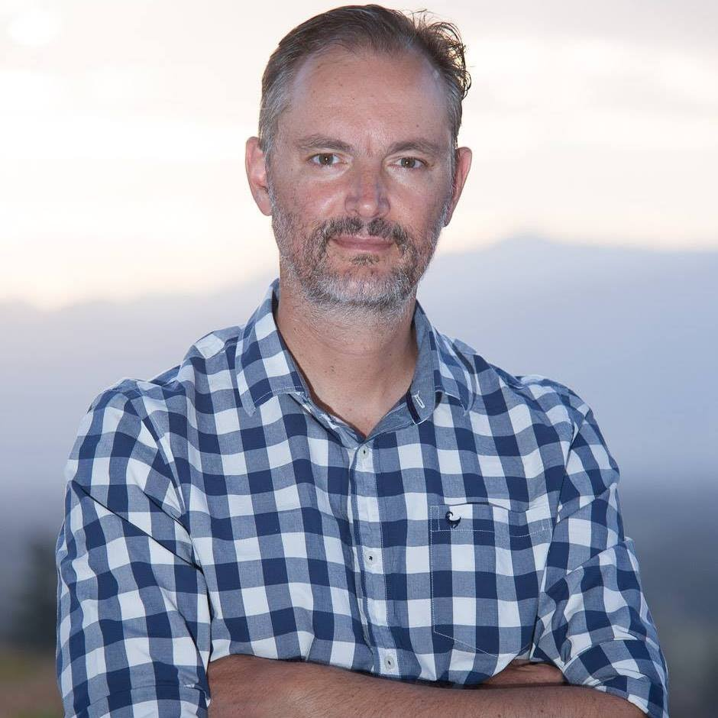
Health Sciences
“Knowledge needs to be out there and easily reachable without charge to the end user”
Juan
Notes:
….will engage young doctors and domain experts..., while fifth- and sixth-year medical students will evaluate the content and suggest changes required in order to make the resource fit for purpose in a local context
...content will be converted into video tutorial format and delivered through the Instagram social media platform, making it low-bandwidth friendly and available wherever medical service delivery is required

Slide 18
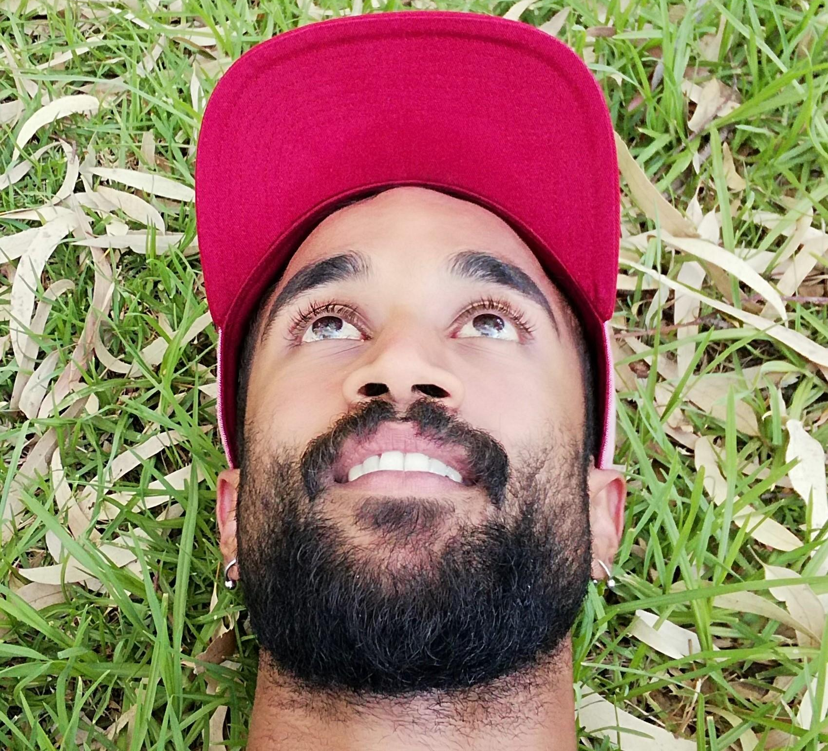
Engineering and the Built Environment
First year Mechanical Engineering drawing
“I will always lend an ear to what students have to say and try to implement feedback in my approach to teaching as well as the textbook I am developing”
Kensley
Notes:
Senior Tutor

Slide 19
Agents (open textbook authors)
What motivates them?
What drives them despite no recognition or encouragement?
How can we support these champions?

Slide 20
Goals for 2020
Global: Our aim is to map out 9 models of OT development.
National: Organise a stakeholder event in South Africa to build community and also include government representatives (research to policy objective)
Institutional: 1) Support to Deputy Vice Chancellor who is determined to include recognition of OER and OT creation in Ad hominem criteria
2) First University of Cape Town OT Award (monetary and acknowledged at end of year graduation

Slide 21
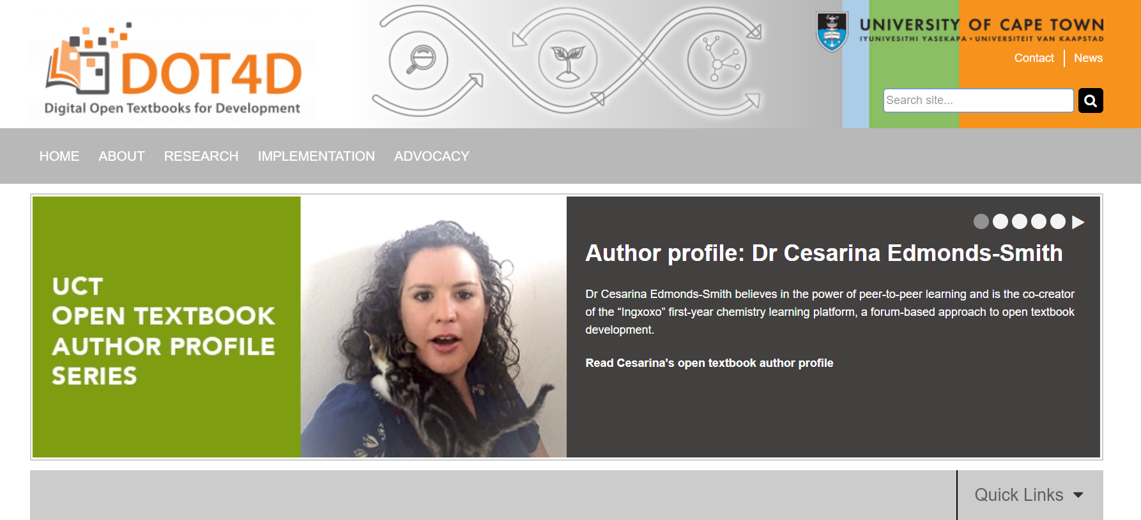
Thank you for listening

Slide 22
Reference
Fraser, N. (2005). Reframing justice in a globalizing world. New Left Review, 36, 69–88. Retrieved from https://newleftreview.org/II/36/nancy-fraser-reframing-justice-in-a-globalizing-world

