Slide 1
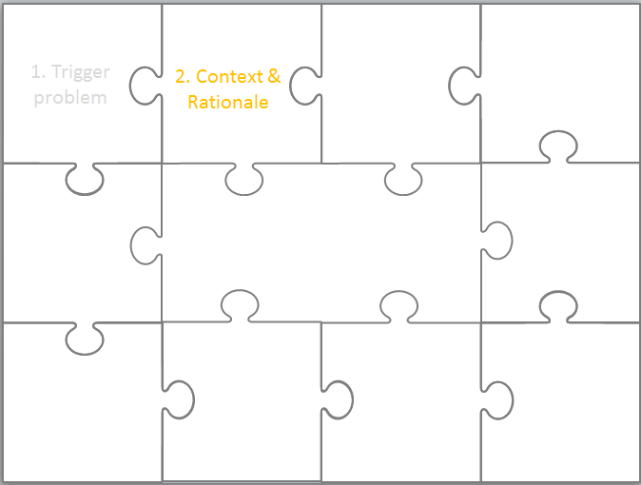
3. Concepts and empirical research
3. Concepts & empirical research
EDN6015F
Cheryl Brown
3-8 February 2014

Slide 2
3. Concepts & empirical research
1. Trigger problem
2. Context & Rationale

Slide 3
Once upon a time I was …
At the moment other people are also concerned about … which they describe as … They think that … because they found that … They related these ideas together using …

Slide 4
Purpose
The main purpose of the ‘Literature review’ section in your dissertation is show that you have a thorough understanding of the field and thereby situate your research within the broader academic literature.

Slide 5
Faculty Guidelines – literature review for proposal
“ ... you need to have read sufficiently in the field to justify your research question (Why is it important? Have other academics taken up this question in the same or similar ways? How do current debates in your own field of study bear on your research question? Your literature review must assist you in addressing these issues. It will provide information on how your own, or related, research questions have been investigated by other academics in your own (and other, related) fields.” (UCT Faculty of Humanities Guidelines for Research, p2)

Slide 6
Activity 1
In groups brainstorm for 5 minutes what role a literature review can have in terms of doing and writing about research.
Report back

Slide 7
Activity 2
Take another 5 minutes on your own and skim read the article by deWaard et al. Read just the sections that refer to background and literature (highlight in green)
Think about what types of literature have the authors reviewed
What the main concepts are which they refer
What aspects of their research do they provide background literature about.
Notes:
People with number 1s focus on issue 1, etc. 2s on issue 2 etc. Work in individually but each indiv reports back what they found to the group. CB takes notes on board

Slide 8
Why defining key concepts critical
Example: Access and Use Project
Conceptual Framework
There are a number of key concepts that inform this project particularly around issues of computers in learning and teaching, and accessibility. In obtaining baseline information for questions 1&2 on the use of computers we need to broaden our view of access to include more than just physical access like what where, when and how people getting access and examine “thicker” conceptions such as whose getting access, what are they accessing and why the are accessing it.
Access
Waschauer offers a framework of technology for social inclusion based on the similarities between ICT access and literacy. He believes ICT access cannot rest on the provision of a device (a one off purchase like a computer) or conduit (something that needs to be provided on a regular basis eg electricity or telephone). If we expand Waschauer’s categories to include some of the concepts about criteria for access as outlined by Burbles and Callister (2000) then we probably have quite a comprehensive framework for analyzing access related issues.
Physical resources (computers and telecommunications) eg This includes the technical aspects of access like what computers are being used, where they are located, do they have the capacity to do what’s required (ie bandwidth, software etc), can people get to them when they need to, etc
Digital Resources (relevant content online in various languages) eg is the information understandable ie not just in terms of language but also in terms of effectiveness of what they find when they use the technology. This could also be broadened to include design ie the form that the information takes
Human Resources (Literacy and education) eg peoples attitude to computers – confidence, interest in, prior experiences, previous training? At
Notes:
Revisit report back. #2
Then select one concept which ple all came up with from the paper eg Open, connectedness, interaction and unpack how this was addressed ito Literature and methodology and theory etc
Provide example and then talk about why concpets and constructs so NB in proposal.

Slide 9
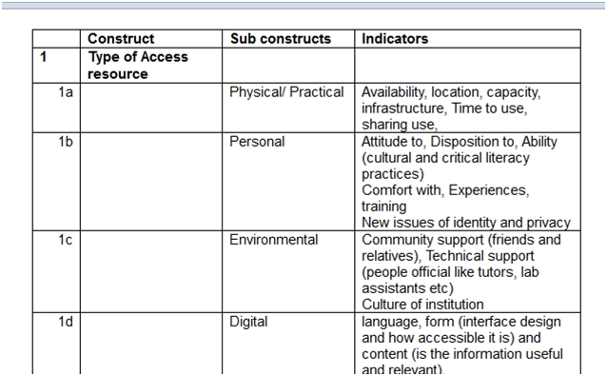

Slide 10
When do you do a literature review?
Could argue that literature is core to your entire proposal and thesis
Help inform your research problem & questions
Revisit before you start data collection – to help with what questions to ask
When you have your findings to help you understand what they mean.
When you are writing conclusions so you know why your thesis is similar or different to other research

Slide 11
References
deWaard, I., Abajian, S., Gallagher, M.S., Hogue, R., Keskin, N, Koutropoulos, A. & Rodriguez, O.C. (2011). Using mLearning and MOOCs to understand chaos, emergence, and complexity in education. The International Review of Research in Open and Distance Learning, 12(7), 94-115.
Hartas, D. (2010). Chapter 6: Doing a literature review. In D. Hartas (Ed.). Educational Research and Inquiry: Qualitative and Quantitative Approaches. (p 96-109). London: Continuum.
Mouton, J. (1996). Chapter 18: conceptualisation (defining key concepts). Understanding social research. (p114-118). Pretoria: J.L van Schaik.
Maxwell, J.A. (2008). Designing a qualitative study. In Bickman, L. & Rog, D.J. (2008) The Sage handbook of applied social research methods, (pp. 214-253). London: Sage. Available online: http://www.corwin.com/upm-data/23772_Ch7.pdf (Last accessed 12 January 2013).
UCT Faculty of Humanities Guidelines for Research. Available online: http://www.humanities.uct.ac.za/downloads/humanities/postgrad/gradschool/navthesis/start/research_proposal.pdf

Slide 12
Written by Cheryl Brown
cheryl.brown@uct.ac.za
in 2013
This work is licensed under a Creative Commons Attribution 4.0 International License.

