Slide 1




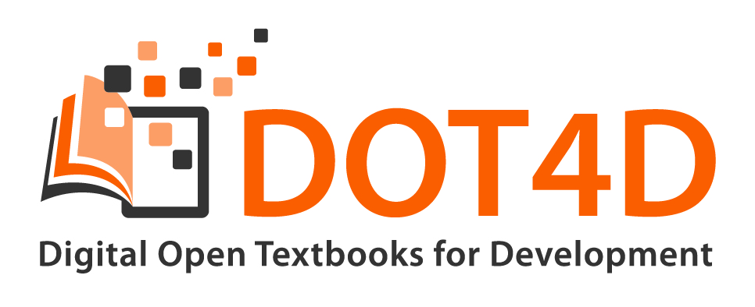
Participatory Pedagogy and Open Textbook Publishing Journeys:
Emerging Models at the University of Cape Town
By Glenda Cox, Michelle Willmers & Bianca Masuku
Digital Open Textbooks for Development project, Centre for Innovation in Learning and Teaching,
University of Cape Town
16 November 2020

Slide 2


This work is carried out with the aid of a grant from the International Development Research Centre, Ottawa, Canada.
It is licensed under a Creative Commons Attribution 4.0 International licence.

Slide 3
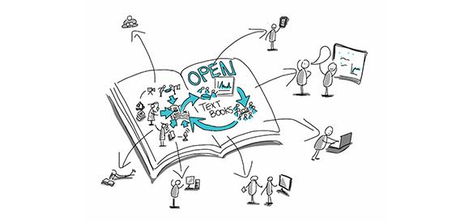
Definition
Open textbooks are digital, freely available collections of scaffolded teaching and learning content published under an open licence on platforms and in formats that provide affordances for content delivery on a range of devices, the integration of multimedia, and incorporation of content from varying sources through collaborative authorship models. In some instances, they also provide affordances for print and low bandwidth access strategies.

Slide 4
PARTICIPATORY PEDAGOGY AND OPEN TEXTBOOK JOURNEYS

Slide 5
Social justice approach
Social justice is a concept that requires the organisation of social arrangements that make it possible for everyone to participate equally in society. Fraser (2005) considers social justice as ‘participatory parity’ economically, culturally and politically.
Cox, G., Masuku, B. & Willmers, M. 2020. Open Textbooks and Social Justice: Open Educational Practices to Address Economic, Cultural and Political Injustice at the University of Cape Town. Journal of Interactive Media in Education, 1 (2):pp. 1–10. Available at: https://open.uct.ac.za/handle/11427/31887

Slide 6
Drivers/motivation | Social Justice dimension (Fraser, 2005) | Affirmative/ameliorative response
Affordable access | Economic (maldistribution of resources) | Saving students money
Multilingualism | Cultural (misrecognition of culture and identities) | Terminology in Chemistry and Statistics translated into local languages
Curriculum transformation | Cultural (misrecognition of culture and identities) & Political (misrepresentation or exclusion of voice) | Inclusion of local cases and examples, making textbooks relevant Collaboration with colleagues and students (empowering and giving voice)
Pedagogical innovation | Political (misrepresentation or exclusion of voice) | Two examples of changing ‘classroom’ practice to deliberately include students as content creators

Slide 7
Drivers and social justice imperatives
Abimbola | Claire | Kensley | Stella | Michael | Maria | Jonathan | Tim | James | Ingxoxo | Juan
Curriculum transformation Affordable access OEP | Curriculum transformation Affordable access | Curriculum transformation Affordable access | Pedagogical change Curriculum transformation | Curriculum transformation Affordable access | Affordable access OEP | Curriculum transformation Affordable access | Curriculum transformation Multilingualism | Curriculum transformation Affordable access | Pedagogical change Curriculum transformation Multilingualism | Affordable access OEP Curriculum transformation
Affordable access
Curriculum transformation
Pedagogical change
OEP
Multilingualism
2
1
8
7
2

Slide 8

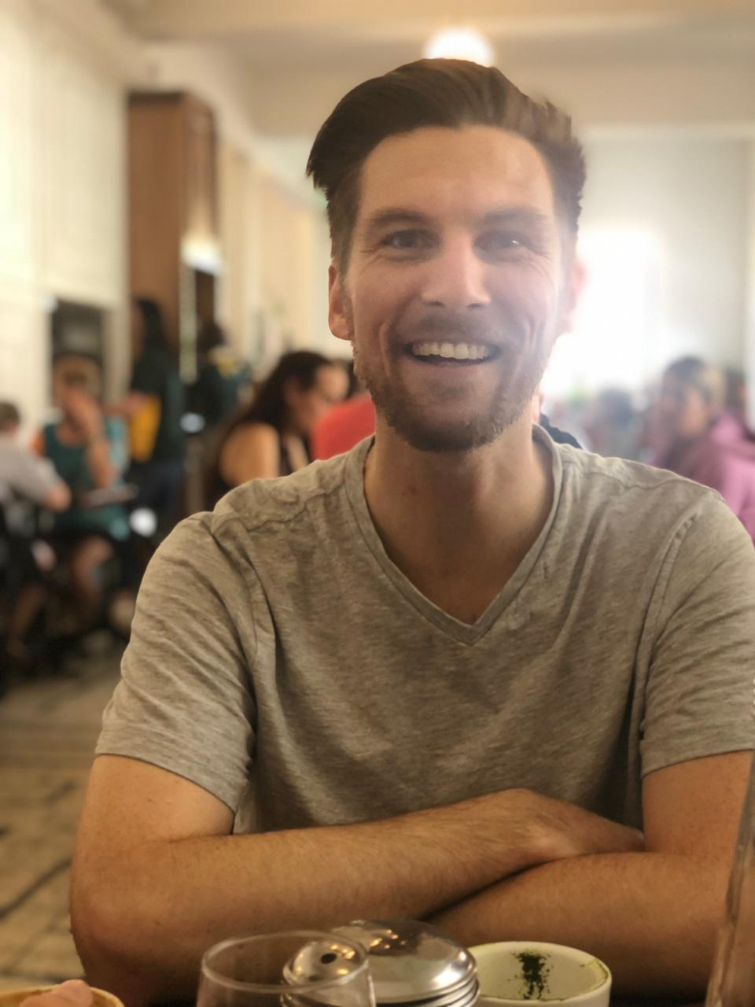
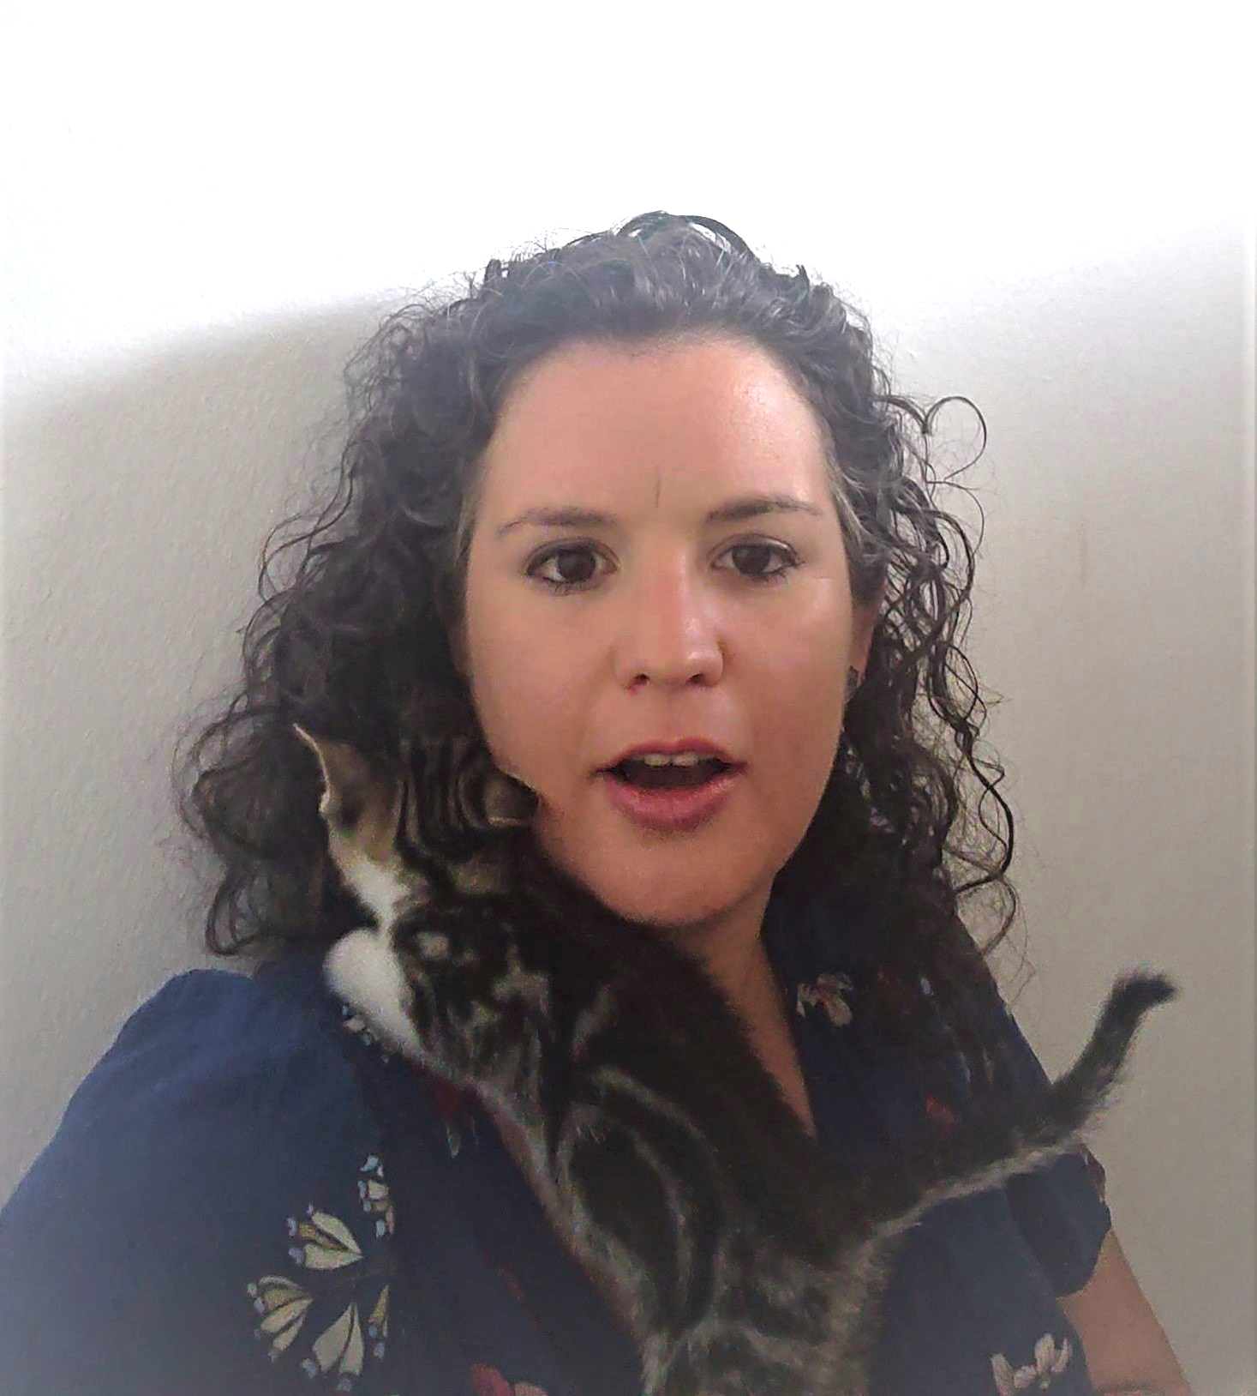
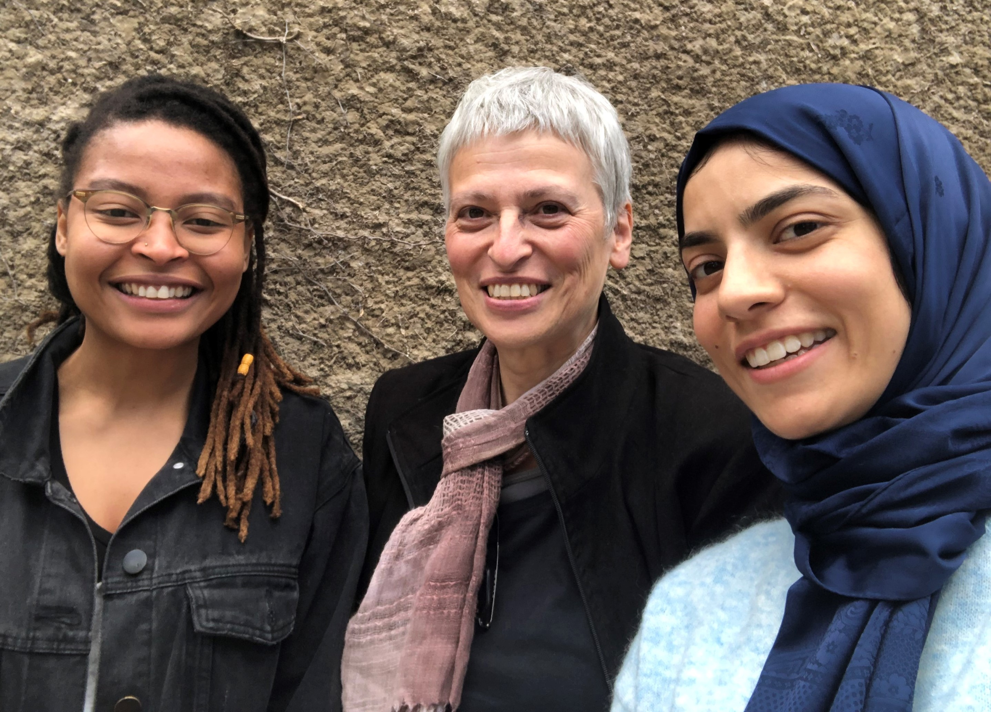
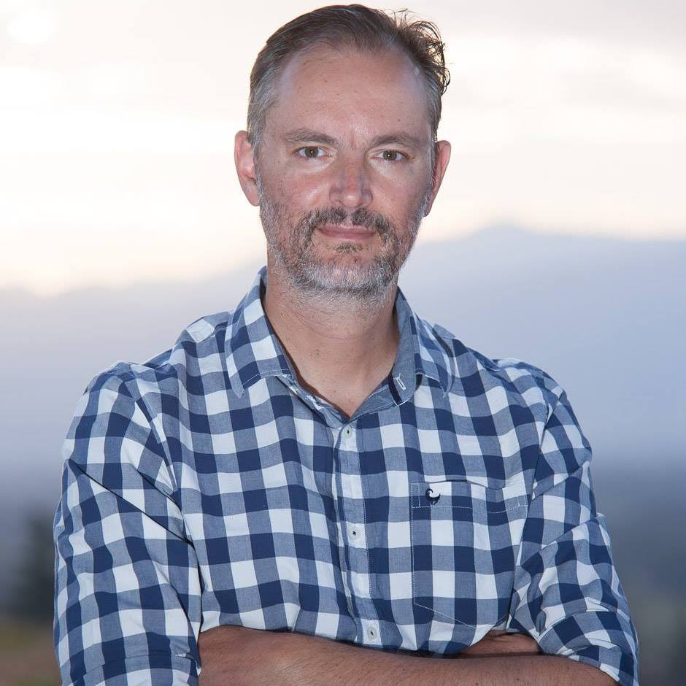
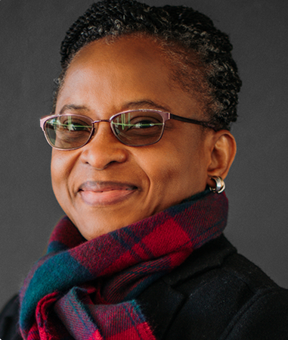
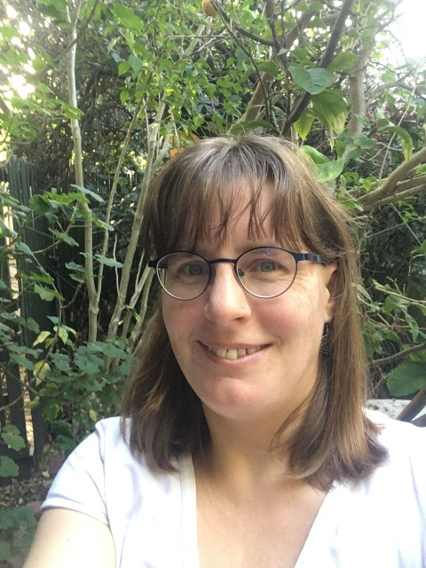
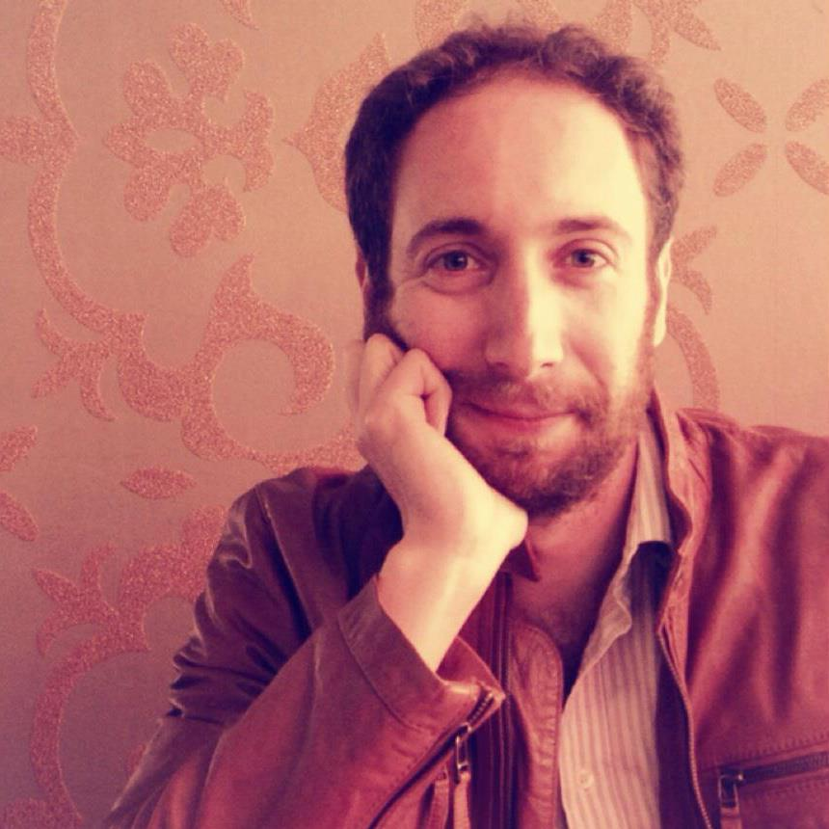
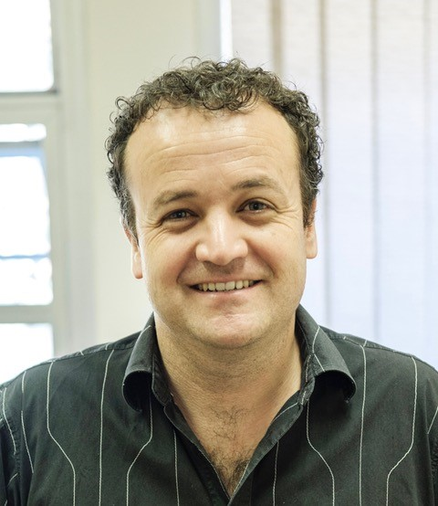
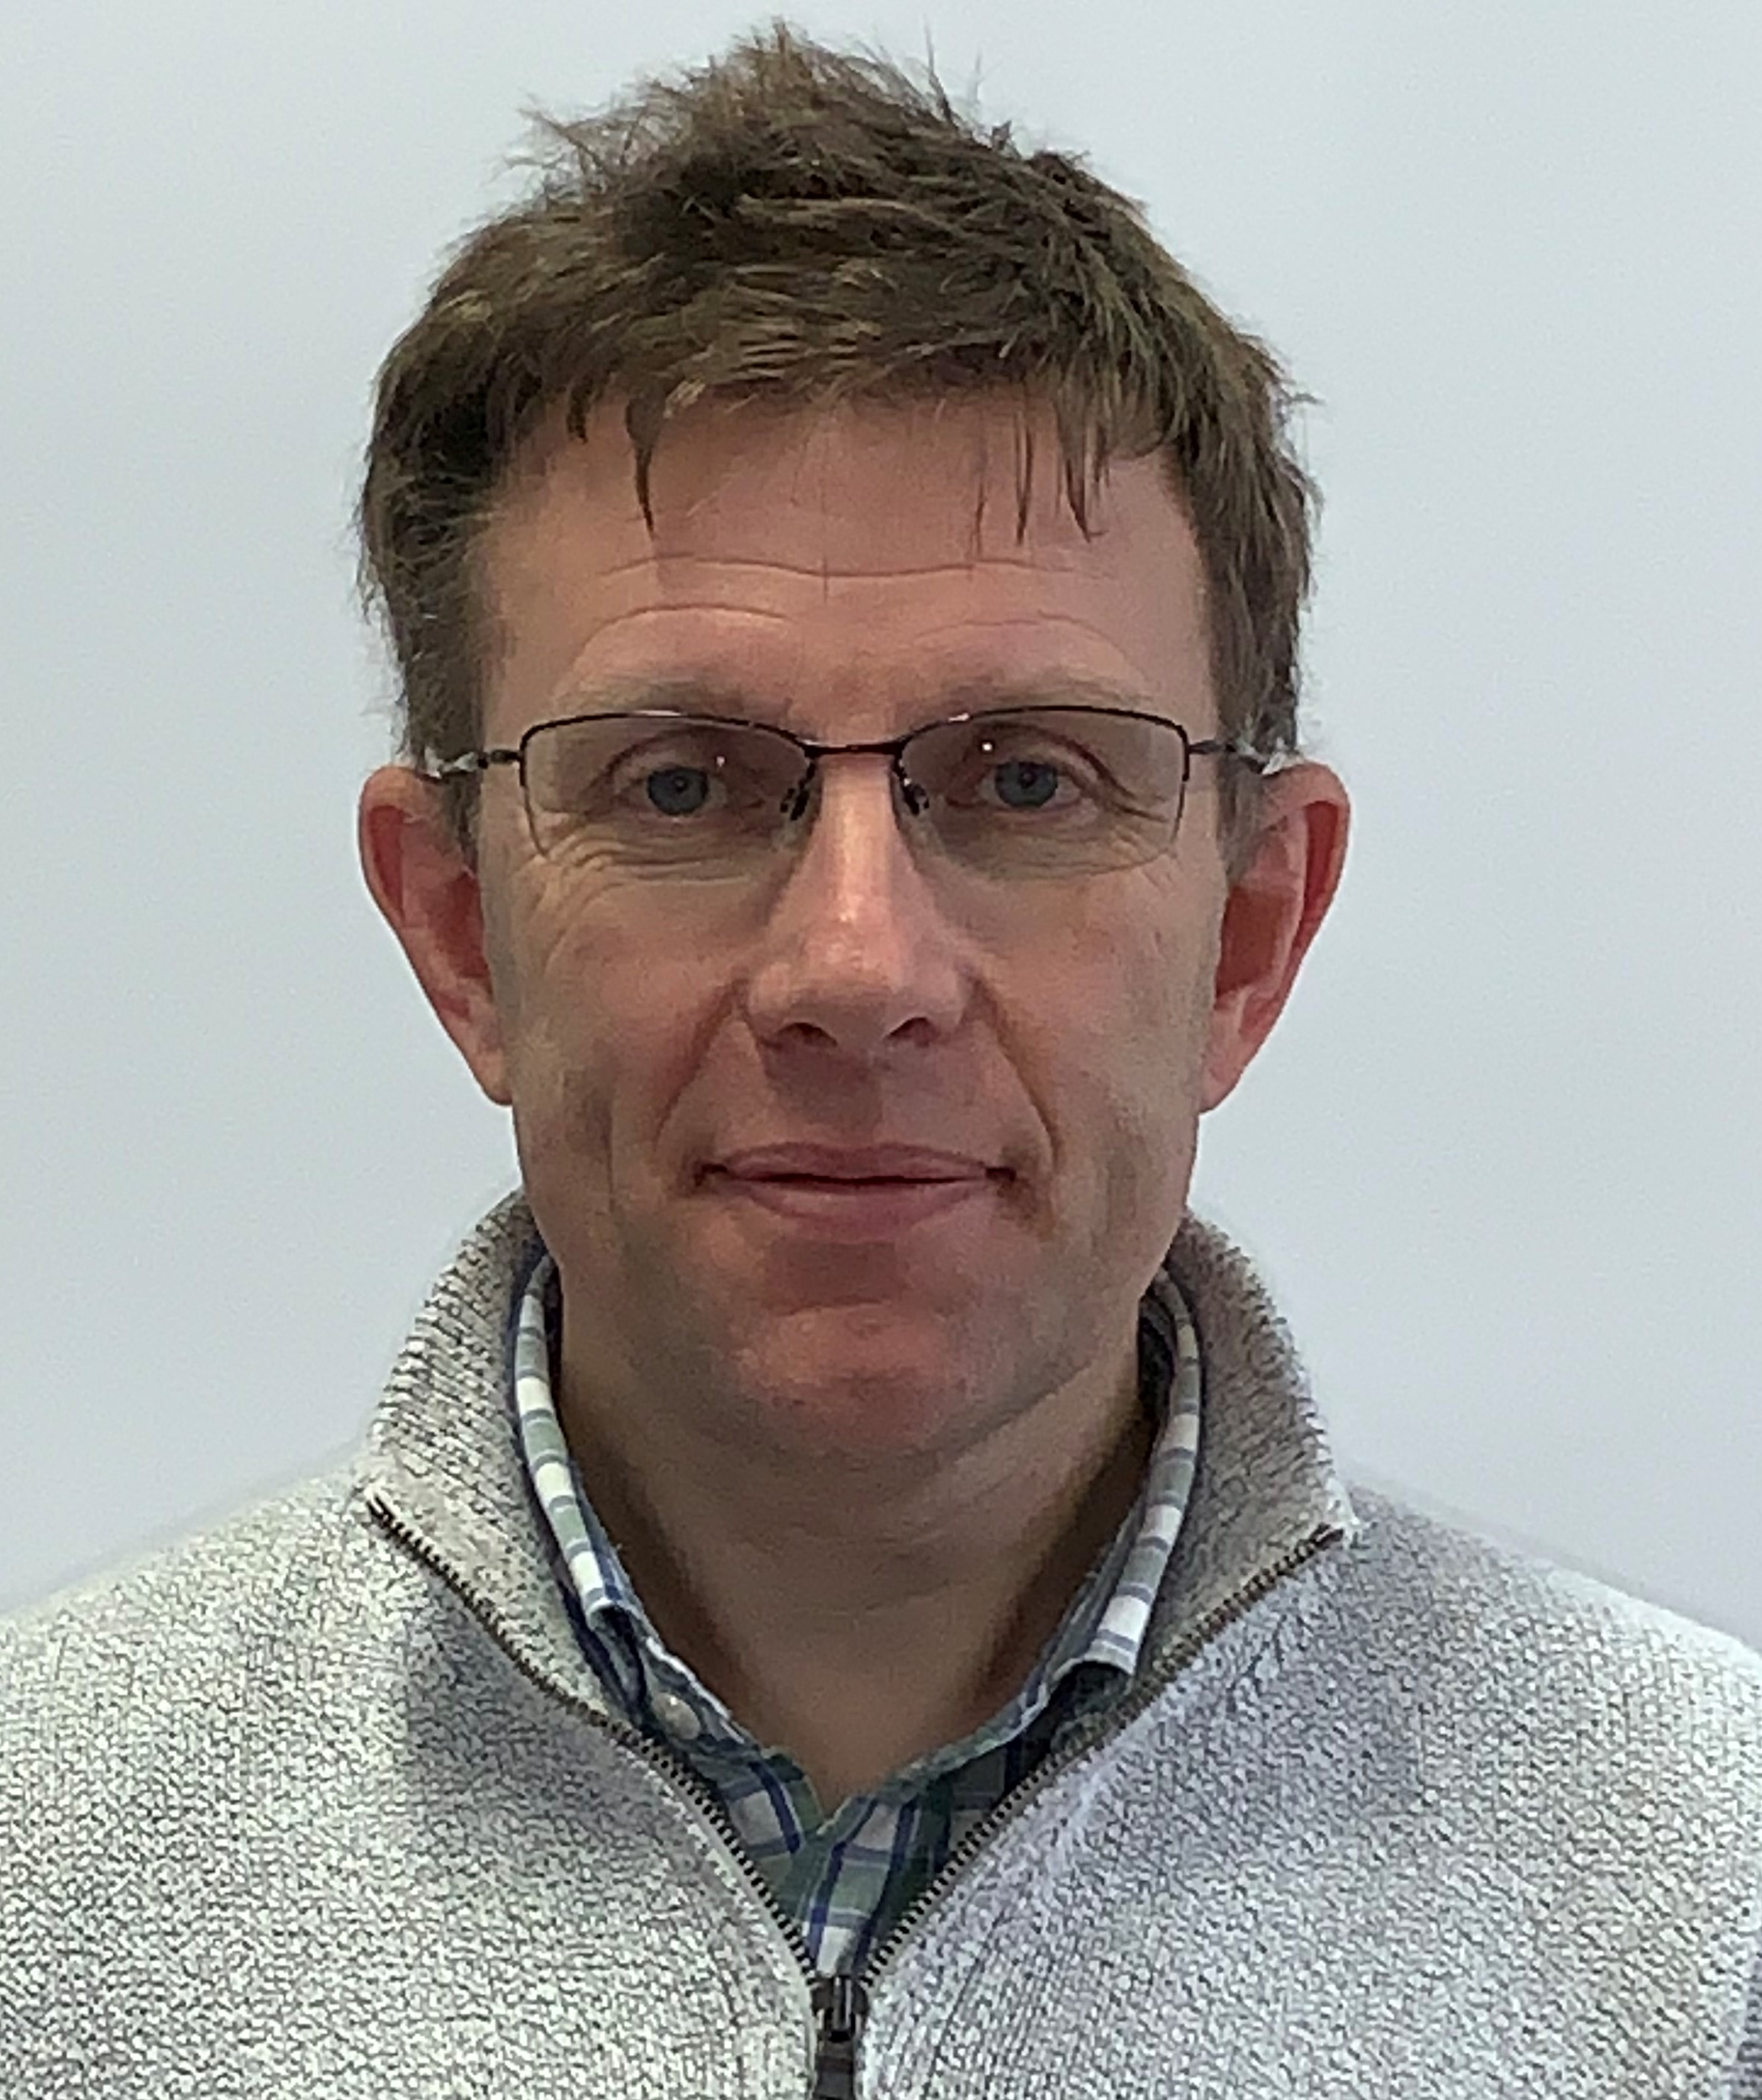
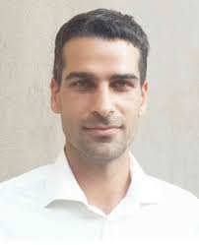
UCT open textbook authors in the DOT4D study
Kensleyrao Apajee
Mechanical Engineering
Chris Barnett & Cesarina Edmonds-Smith
Chemistry
Stella Papanicolaou
Architecture
Dr Juan Klopper
Surgery
A/Prof. Abimbola Windapo
Construction
A/Prof Maria Keet, Computer Science
Jonathan Shock, Mathematics
Dr James Lappeman, Marketing
Tim Low,
Statistics
Dr Michael Held, Orthopaedic Surgery
Dr Claire Blackman Mathematics
Notes:
This cohort of academics comprised the sample for this study, comprised largely of grantees from the DOT4D grants programme.
Authors used varying approaches to varying degrees of success (based on their context).

Slide 9
DEVELOPING MODELS BASED ON AUTHORSHIP, QUALITY ASSURANCE AND PUBLICATION PROCESSES

Slide 10
Authorship models
Abimbola | Claire | Kensley | Stella | Michael | Maria | Jonathan | Tim | James | Ingxoxo | Juan
Solo author + student involvement | Solo author + student involvement | Solo student author + UCT intermediary support | Lead author as editor-in- chief with student co-authors | Lead author as editor-in- chief with student and colleague co-authors | Solo author + student involvement | Lead author as editor-in- chief with student and colleague co-authors | Content development facilitator with student and colleague co-authors | Lead author as editor-in- chief with colleague co-authors | Content development facilitator with student and colleague co-authors | Lead author as editor-in- chief with colleague co-authors
Solo author + student involvement
Solo student author + UCT intermediary support
Lead author as editor-in-chief with student co-authors
Lead author as editor-in-chief with student and colleague co-authors
Content development facilitator with student and colleague co-authors
3
Content review
1
1
2
4
Graphics production

Slide 11
Quality assurance models
Abimbola | Claire | Kensley | Stella | Michael | Maria | Jonathan | Tim | James | Ingxoxo | Juan
Student review Publisher peer review Professional editing and proofreading Professional layout and design | Student review Proofreader | Supervisor review Institutional Intermediary editorial support | Student review Institutional Intermediary editorial support Institutional Intermediary publishing support Professional layout and design | Delphi consensus study Colleague review Community review | Student review Colleague review | Student review Colleague review | Student review Colleague review | Student review Colleague review Institutional Intermediary editorial support Institutional Intermediary editorial support Professional layout and design | Student review Colleague review | Student review Colleague review
Delphi consensus study
Institutional intermediary editorial support
Institutional intermediary publishing support
Student review
Colleague review
9
7
1
3
2
Supervisor review
Publisher peer review
Professional editing and proofreading
Professional layout and graphic design
2
3
1
1

Slide 12
Publishing models
Abimbola | Claire | Kensley | Stella | Michael | Maria | Jonathan | Tim | James | Ingxoxo | Juan
External publisher | Author as self-publisher | Author as self-publisher | Initiative as self- publisher | Initiative as self- publisher | Author as self-publisher | Author as self- publisher | Initiative as self- publisher | UCT Libraries + institute as co-publishers | Initiative as self- publisher | Author as self- publisher
Author as self-publisher
Initiative as self-publisher
UCT Libraries + institute as co-publishers
External publisher
5
4
1
1

Slide 13
WHY DO YOU WANT TO CREATE AN OPEN TEXTBOOK?
EMERGING PATHWAYS

Slide 14
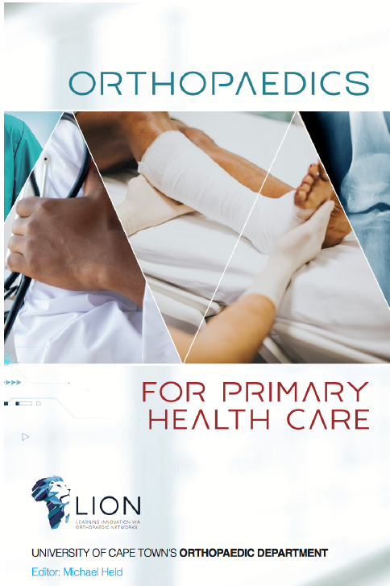

Publishing
Initiative as self--publisher
Authorship
Lead author as editor-in-chief + students and colleagues
Curriculum Transformation (Collaboration) Model
Resourcing:
DOT4D grant R30 000 ($1 945)
DOT4D publishing consultation
Quality assurance
Students and colleagues

Slide 15
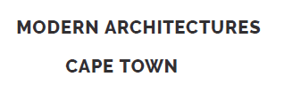

Publishing
Initiative as self-publisher
Initiative as self-publisher
Authorship
Lead author as editor-in-chief with student co-authors
Content development facilitator with student and colleague co-authors
Pedagogical Change Model
Resourcing
Modern Architectures
DOT4D grant R66 000 ($4 277)
DOT4D publishing support
Ingxoxo
DOT4D grant R73 180 ($4 742)
Quality assurance
Student review, institutional intermediary editorial support, institutional Intermediary publishing support
Students and colleagues

Slide 16

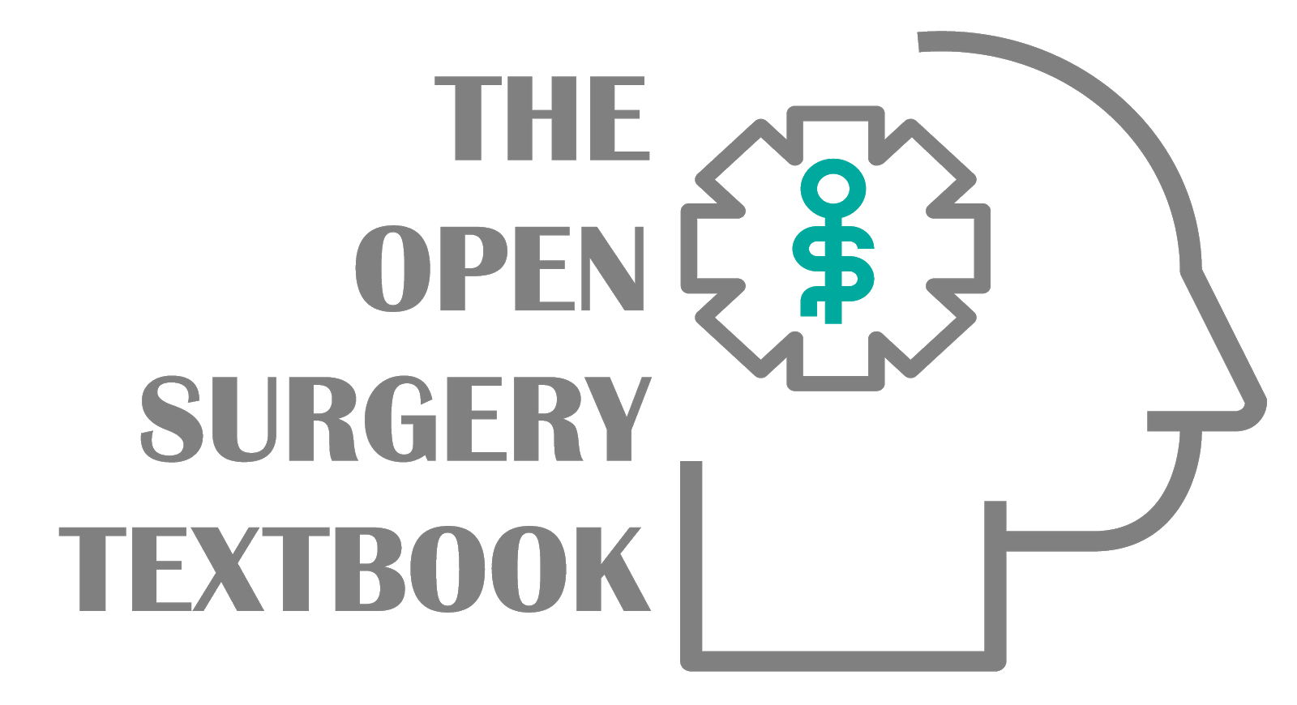

What didn't work?
Publishing
Authorship
Solo authorship + students
Lead author as editor-in- chief with colleague co-authors
Solo student author + UCT intermediary support
Student empowerment / Pedagogical change /
Curriculum transformation
Resourcing
Mechanical Engineering Drawing
DOT4D grant R21 900
($1 429)
DOT4D publishing support
Mathematics MAM1000W
DOT4D grant R20 000
($1 295)
Open Surgery Textbook
DOT4D grant R60 000
($3 880)
Why?
- In 3 cases solo authorship did not work (but it can work)
- Time and timing
Quality Assurance
Student and proof reader or intermediary
Student review, Colleague review
Supervisor review
Institutional Intermediary editorial support

Slide 17





Publication processes
Authorship approaches
Models for digital open textbook development in higher education
Quality assurance mechanisms

