Slide 1
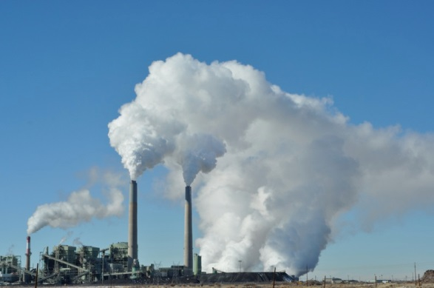
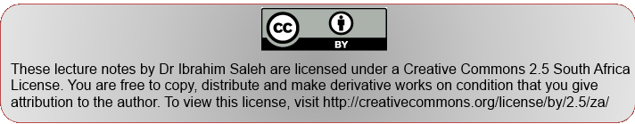
Media and National Development Policy
Dr. Ibrahim Saleh
Image by: glennia

Slide 2
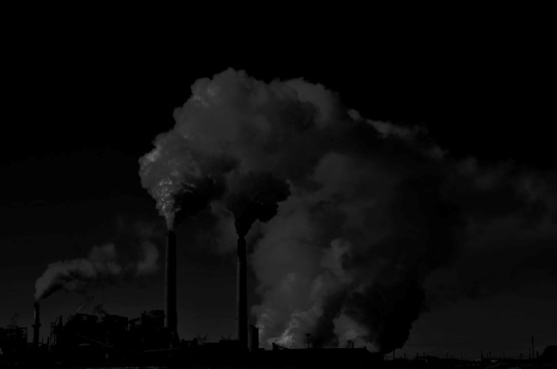
Bill McKibbin’s The End of Nature, warns in tones of prophetic urgency about the consequences of our denial of the climate change underway. For instance, in January 1995, a section of ice the size of Rhode Island had broken off the Larsen ice shelf in Antarctica.

Slide 3
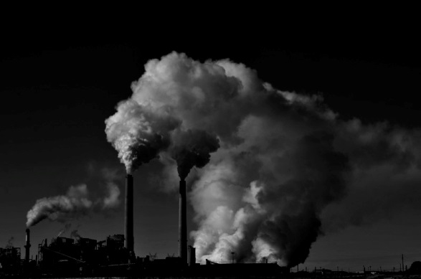
Thesis Statement
In a context where climate change is threatening to wipe off livelihoods of billions of people, the media is crucial for the dissemination of truthful information on weather forecasts and disaster warning to the public within the climate information cycle (Mare, 2011).
Both traditional and citizen centric media are important devices in the climate information cycle as information disseminators, mobilisers, translators, environmental scanners, platforms for debate and fora for intercultural learning.

Slide 4
Three Dimensions
Freedom of speech, access, and the dynamic of inclusion/exclusion:
Public engagement with the media, and interaction between citizens themselves, whether or not it is formalized
Structural
Representational
Interactional
Media outputs and the levels of fairness, accuracy,
completeness, pluralism of views, agenda setting, & ideological tendencies.

Slide 5
Media, Politics and Climate Change
Media and journalistic practices have become a key factor in political communication (Plasser, 2005).
The emerging discussion on "mediatisation"(Lundby 2009) focuses on three factors: the growing fusion of media, political and social "reality ", the increasing perception of politics (both by the people and politicians themselves) through the media and the orientation of political action and behaviour towards the rules of the media systems (Jarren et al. 1998).

Slide 6
Public Risk & Climate Change
Public risk perceptions are a crucial driver of natural hazards policy and management response (Kellstedt, Zahran & Vedlitz 2008). The average citizens do not fully understand ecological risks.
But perceptions of climate change risks correspond strongly with demographic, ideological, identity-related and institutional trust variables (O’Connor, Bord, Yarnal, & Wiefek 2002).
News reporting is a key contributor in shaping both policy discourse and public understanding of risks. Media shape the way people rank problems and make sense of their everyday choices. Local practices of journalism also affect translations between science and policy (Weingart et al. 2000).

Slide 7
Climate Sceptics
A tiny band that refers to about a dozen scientists, most of whom enjoy a questionable reputation among other scientists, rarely publish in peer-reviewed journals, and perceive no conﬂict of interest in accepting payment from the business section in trillion-dollar-a-year coal and oil industry (Keller, 1999).
Managed to position themselves as a counter pole to the 2500 scientists comprising the United Nations Intergovernmental Panel on Climate Change (IPCC).

Slide 8
In March 2009, Katherine Richardson, a marine biologist and convener of the International Scientific Congress on Climate Change in Copenhagen, Denmark, emphasized the urgent need to rethink the current communication strategy (Abano 2009):
  We want you [the media] to understand what we really know about climate change and its potential consequences and what we can do about it, so that you can make this available to society at large. We’re not always good at talking to you and explaining ourselves in non-technical language but we want to talk to you. So if you don’t understand, please ask (Richardson 2009).

Slide 9
Ups and Downs: From Cape To Cairo
Despite the severity of climate-related impacts on economies and livelihoods, climate change mediation is silent, or even absent despite Africa’s position as the least developed continent as estimated by climatologists that it will be one of the hardest hit areas in the coming decades.
Mutere (1991) in (Boafo, 1991) that,
"… Environmental issues constitute a relatively marginal concern in most African newspapers, radio and television news, and current affairs programs. Much more attention is given to national politics, labour disputes, the arts, and business."

Slide 10
Mediatisation of Climate Change
"Changing attitudes towards climate change is not like selling a particular brand of soap – it’s like convincing someone to use soap in the first place. "
Climate change has become an issue of concern for media in recent years.
Development journalism treats audiences as citizens, while prioritising public listening.

Slide 11
Climate Change: state of affairs
Climate change remains an add-on beat to the traditional newsroom beats such as politics, business, sports and entertainment (Mare, 2011).
Representations and news discourses of climate change are framed within the strictures/restrictions of the global scientific hegemony which gives primacy to alarmism, technocratic jargon, and officialdom.
News coverage of climate change in Africa helped creating, reproducing and circulating of top-down approaches.
Media ecology obfuscates the role of indigenous knowledge systems and constricts voices of the poor in local debates.
Advocacy and translation role of media is constrained by the dearth of science journalism, news commodification, media
commercialisation, and urban bias of newsrooms.

Slide 12
Challenges of media reporting of climate change in Africa
Climate change knowledge is not sufficiently shared between different actors and the general public.
Deliberative citizenry on climate change discourses is the missing link in current advocacy strategies.
The average citizen has no trust in the media platforms and their agendas, objectives, while there is no considerations for the different media demographics of different contributing communities.
Media Remain a space for the privileged elite: who gets to speak in media? How to break down the barriers that prevent people from sharing information?

Slide 13
So What?
Citizens cannot remain abreast of all available information at all times. So they tend to seek only the information that they feel necessary on a day to-day basis-in this case, a "burglar alarm" model is envisioned.
The " digital-civic divide, " emerges out of the developing tension between increasingly varied forms of participation and the core information needs of a functioning participatory public spheres.

Slide 14
African media landscape suffers from many complicating factors; including the legacies of colonialism, strong state-control over the public sphere, low rates of literacy and technological capacity shape (Saleh, 2012).
Journalism in Africa is trapped within the gap between; on the knowledge produced by climate science, and the political media realities. This includes the links between local elites and global climate politics, as well as the hard realities of everyday life and survival (Saleh 2010)

Slide 15
Conclusive Remarks
Media adaptation to climate change directs the coverage into less threatening to the elite system that supports these media outlets.
Until then, from Cape Town to Cairo reporters are still in the position to have to write stories mostly toned with the "classic journalism norms of drama " between negotiating countries.
The recent focus on African journalism has been too oriented too much toward technology, paying too little attention to news production routines and practices.

Slide 16
References
Abano, I.V. 2009. Imelda V. Abaño on CLIMATE INFO AND REPORTERS WORLDWIDE. Available: http://northwardho.blogspot.com/2009/04/imelda-v-abano-on-climate-info-and.html.
Boafo, S. K. (1991). Communication technology and dependent development in sub-Saharan Africa. Transnational Communications–Wiring the Third World. London: Sage Publications, 103-24.
Keller, C. (1999). The heat is on: Apocalyptic rhetoric and climate change. Ecotheology: Journal of Religion, Nature & the Environment, 5, 4058
Kellstedt, P. M., Zahran, S., & Vedlitz, A. (2008). Personal efficacy, the information environment, and attitudes toward global warming and climate change in the United States. Risk Analysis, 28(1), 113-126.
Lundby, K. (Ed.). (2009). Mediatization: concept, changes, consequences. Peter Lang.
Mare, A. 2011. Climate change, mediation and mediatisation in southern Africa: Toward climate and environmental journalism. Paper presented at the AfricaAdapt Climate Change Symposium, 9–11 March, Addis Ababa, Ethiopia.

Slide 17
Mutere, A. (1991). Health and Environmental Concerns in Africa. In Boafo, K. S. T (Ed.). (1991).Module on Specialised Reporting. African Council for Communication Education, Nairobi, 39-46
O'Connor, R. E., Bord, R. J., Yarnal, B., & Wiefek, N. (2002). Who wants to reduce greenhouse gas emissions?. Social Science Quarterly, 83(1), 1-17.
Plasser, F. (2005). From hard to soft news standards? How political journalists in different media systems evaluate the shifting quality of news. The Harvard International Journal of Press/Politics, 10(2), 47-68.
Sarcinelli, U., & Saxer, U. (1998). Political communication in a democratic society . O. Jarren (Ed.). Westdt. Publisher. Weingart, P., Engels, A., & Pansegrau, P. (2000). Risks of communication: Discourses on climate change in science, politics, and the mass media. Public Understanding of Science, 9, 261–283.

