Slide 1
Osman Aldirdiri
Open Sudan
University of Khartoum
o.dirdiri@gmail.com
@aldirdiri

Slide 2
Data Sharing in the medical field is a Basic Survival Need

Slide 3
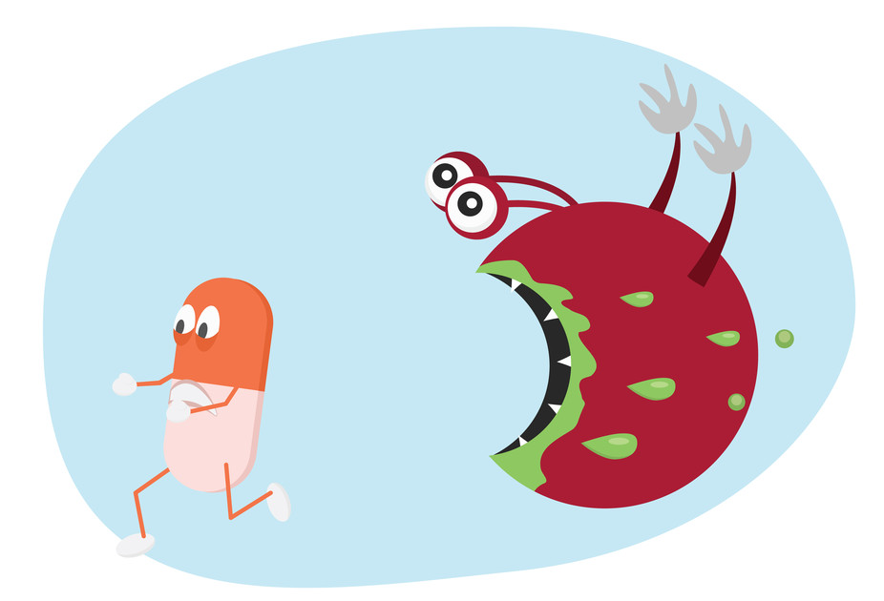
Antimicrobial resistance (AMR) is the ability of a microbe to resist the effects of medication previously used to treat them. This broader term also covers antibiotic resistance, which applies to bacteria and antibiotics.

Slide 4
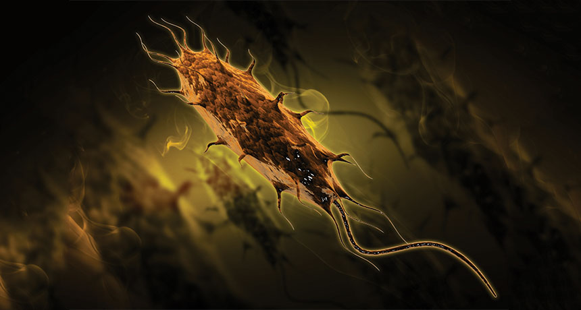
News
Microbiology,
Health
Bacteria resistant to last-resort antibiotic appears in U.S.
Gene from E. coli strain could spread to other bacteria
By
Meghan Rosen
6:03pm, May 27, 2016

Slide 5
Big pharmaceutical companies are spending far more on marketing than research
By Ana Swanson February 11, 2015
Prescription drugs are a massive market: Americans spent $329.2 billion on prescription drugs in 2013. That works out to about $1,000 per person in the U.S., as John Oliver pointed out in his show on Sunday night.
Oliver also mentioned that nine out of 10 big pharmaceutical companies spend more on marketing than on research. León Markovitz of Dadaviz found and graphed those figures from healthcare research firm GlobalData in the graphic below. The amounts spent on sales and marketing are shown in orange, while the amounts spent on research and development are in blue.

Slide 6
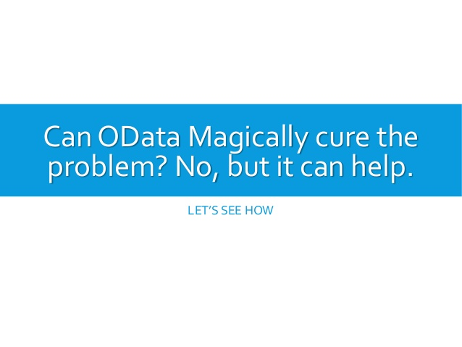

Slide 7


Slide 8
Cancers figure among the leading causes of morbidity and mortality worldwide, with approximately 14 million new cases and 8.2 million cancer related deaths in 2012. The number of new cases is expected to rise by about 70% over the next 2 decades.
By WHO

Slide 9
Play This Smartphone Game To Help Combat Alzheimer's
Sea Hero Quest
The game was designed through a partnership between Alzheimer's Research UK, Deutsche Telecom, University College London and the University of East Anglia. Researchers, who hope to reach at least 100,000 players by the end of the year, say even just a few minutes of play can be of service.

Slide 10
On ground activities
- Open Data
- Open Access
- Open Education

Slide 11
Thank You
o.dirdiri@gmail.com
@aldirdiri

