Slide 1



Academics’ online presence
Assessing & shaping your visibility
Laura Czerniewicz
September 2012

Slide 2
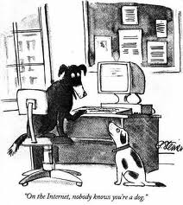
Still true?
On the Internet, nobody knows you're a dog
Peter Steiner, New Yorker 1993
http://www.flickr.com/photos/ben_lawson/155595430/
Notes:
Peter Steiner published by The New Yorker on July 5, 1993

Slide 3
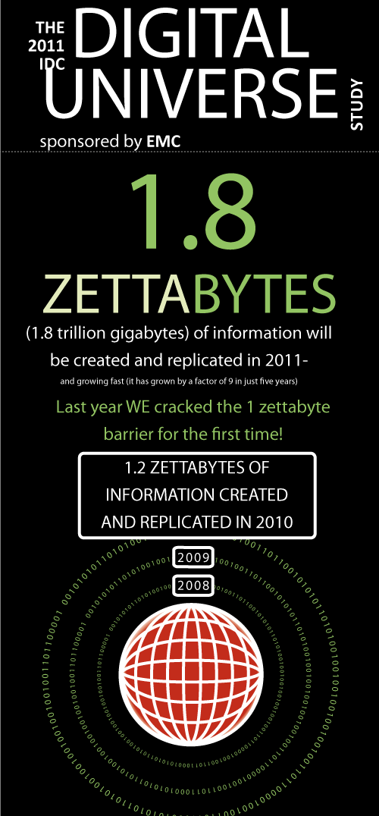
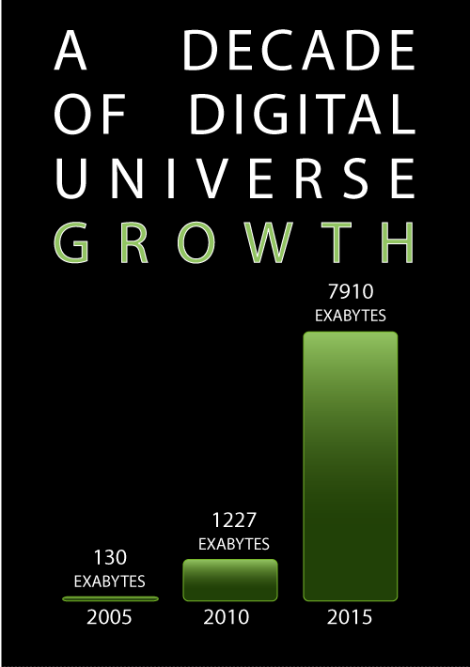
IDC Report: The 2011 Digital Universe Study: Extracting Value from Chaos, June 2011
http://www.emc.com/collateral/demos/microsites/emc-digital-universe-2011/index.htm
Notes:
IDC Report: The 2011 Digital Universe Study: Extracting Value from Chaos, June 2011
http://www.emc.com/collateral/demos/microsites/emc-digital-universe-2011/index.htm

Slide 4
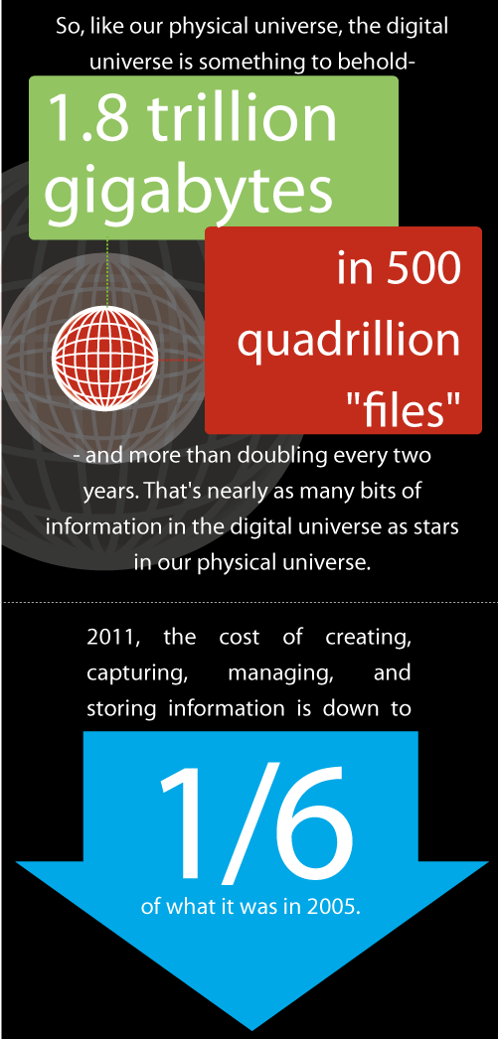
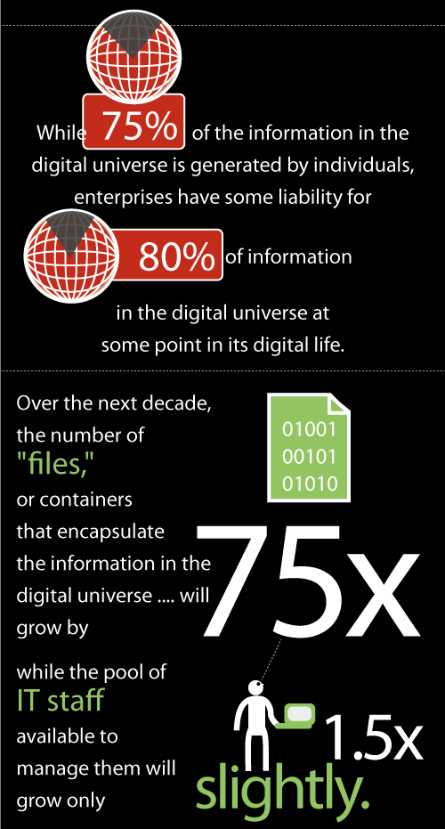

Slide 5

What is your digital footprint?
What is your digital shadow?
Notes:
Sarah Goodier photo July 2012

Slide 6
Take control
Digital footprint- the content you create
Digital shadow- content created about you
  The amount of information that individuals create themselves (digital footprint) is far less than the amount being generated about them (digital shadow)

Slide 7
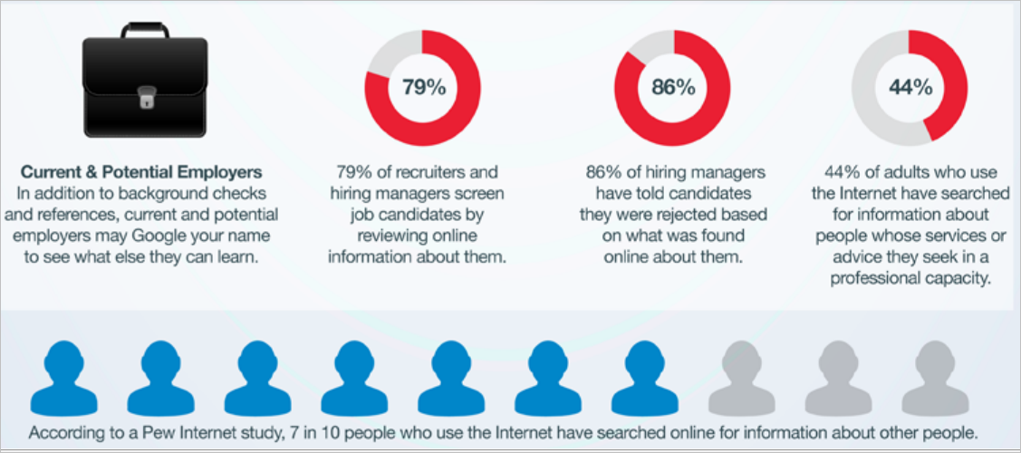
Notes:
Who is looking for you?

Slide 8
Consider
What do you want your digital footprint to look like?
What kind of online presence
do you want?

Slide 9
Ways of thinking
About online presence

Slide 10
PRESENCE
Extent to which you as the scholar are visible to others online
Building Blocks of the Networked Scholar
SHARING
Extent to which you allow users to exchange and distribute your information
CONNECTIONS
The relevance and appeal of your work to others
The honeycomb of building blocks can be used to assess your level of online connectivity as a scholar.
They are not exclusive and neither need all be present.
They are constructs that allow us to make sense of different aspects of a networked scholar.
IDENTITY
The extent to which others can identify you online as a scholar
CONVERSATIONS
Extent to which others engage with you and you with others
REPUTATION
Your online standing and the extent to which you influence others
GROUPS
The extent of your engagement with communities
ADAPTED FROM
Social media? Get serious! Understanding the functional building blocks of social media
Jan H. Kietzmann, Kristopher Hermkens, Ian P. McCarthy, Bruno S. Silvestre
Business Horizons (2011) 54, 241—251
*Read the article here*
Notes:
Adatpted from Alfred Hermida
The Networked Scholar University of British Columbia,
Worldviews Conference, Toronto, June 16 2011

Slide 11
Scholarly primitives & the open researcher
Discovering
Annotating
Comparing
Referring
Sampling
Illustrating
Representing
“…basic functions common to scholarly activity across disciplines, over time, and independent of theoretical orientation.”
John Unsworth. "Scholarly Primitives: What Methods Do Humanities Researchers Have in Common and How Might Our Tools Reflect This?" "Humanities Computing, Formal Methods, Experimental Practice" Symposium, Kings College, London, May 13, 2000. http://jefferson.village.virginia.edu/~jmu2m/Kings.5-00/primitives.html
Notes:
From Chan, Leslie Global Perspective on Open Research (Slide 28), http://www.slideshare.net/lesliechan/globlal-perspective-on-open-research-a-birds-eye-view
Presentation at the Scholarly Communication in Africa Programme and OpenUCT, University of Cape Town, August 5, 2011

Slide 12
















Brainstorm/ generate ideas
Edit images
Find Research Materials
Take Notes/
Annotate Resources
Compare Resources
Discovering
Annotating
Comparing
Referring
Sampling
Illustrating
Manage bibliographic information
Make a dynamic map
Representing
Blogging
Twitter
Notes:
Notes on tools described in slide:
Bubbl.us: “a simple and free web application that lets you brainstorm online” (Free, web-based)
FreeMind: ”Java-based mindmapping software” (Free, cross-platform)
BASE: ”multi-disciplinary search engine for academically relevant web resources.” OAI service provider (Free, web-based)
Google Scholar: “can search across many disciplines and sources: peer-reviewed papers, theses, books, abstracts and articles, from academic publishers, professional societies, preprint repositories, universities and other scholarly organizations” (Free, web-based)
GIMP: ”GNU Image Manipulation Program. It is a freely distributed piece of software for such tasks as photo retouching, image composition and image authoring” (Free, cross-platform)
Picnik: browser-based tool for editing images; provides "one-click fixes, including auto- fix, exposure, colors, and red-eye. And the others, like rotate, crop, resize, and sharpening" (Web-based, free; via ProfHacker)
EverNote: an application that allows you to capture information of any kind anywhere and synchronize it across all of your devices: "Take snapshots, read to-do lists, record audio whenever and wherever you like." (Free, with premium service available; cross-platform)
Google Notebook: Take notes. Clip text and images from Google Books and other sources. Share your notebooks. [NB: Google announced that it is no longer actively developing Google Notebook but will continue to maintain service.] (Free, web-based)
Virtual Lightbox: "a software tool for comparing images online...All users participating in a common Lightbox session see the same images in the same on-screen configuration at the same time." (Free, cross-platform)
EndNote: "Web-based tool for managing and citing references in papers and creating bibliographies...integrates the following tasks into one program: Search bibliographic databases on the Internet; organize references, images, PDFs and other files; construct your paper with built-in manuscript templates; watch the bibliography and figure list appear as you write" (Commercial, web-based)
Mendeley: "Free social software for managing and sharing research papers. It is also a Web 2.0 site for discovering research trends and connecting to like-minded academics." (Free, Windows/Mac/Linux)
Google Maps: allows you to view maps and directions, with practical applications for transportation and diverse viewing options to further specify location (Free, web-based)
Open Street Map: "a free, editable map of the whole world...allows you to view, edit and use geographical data in a collaborative way from anywhere on Earth" (Free, web-based)
WordPress : free hosted blogging solution that uses excellent open source blogging software.
Tumblr: a blog that "lets you effortlessly share anything. Post text, photos, quotes, links, music, and videos, from your browser, phone, desktop, email, or wherever you happen to be. You can customize everything, from colors, to your theme's HTML. Even use your own domain name." (Free, web-based)
Twitter: a "microblogging" service that allows you to write short messages about your thoughts and experiences and find out what your friends and colleagues are up to (Free, web-based)
List of tools sourced from: Digital Research Tools (DiRT) by Lisa Spiro - https://digitalresearchtools.pbworks.com/w/page/17801672/FrontPage

Slide 13
Sharing – the defining concept
Opening scholarship through sharing
Sharing as multiplying, not dividing
Sharing used to mean exchange, now means exchange AND distribution
Forms of sharing (Latour)
  Intermediaries transport messages (content, code, meaning) with-out transforming them.
  Mediators transform, translate, distort, and modify the meaning or the elements they carry
Wittel, A (2011) Qualities of Sharing and their Transformations in the Digital Age in
International Review of Information Ethics Vol. 15 (09/2011)
Notes:
Wittel, A (2011) Qualities of Sharing and their Transformations in the Digital Age in International Review of Information Ethics Vol. 15 (09/2011) Special Issue on the Ethics of Sharing September 2011

Slide 14
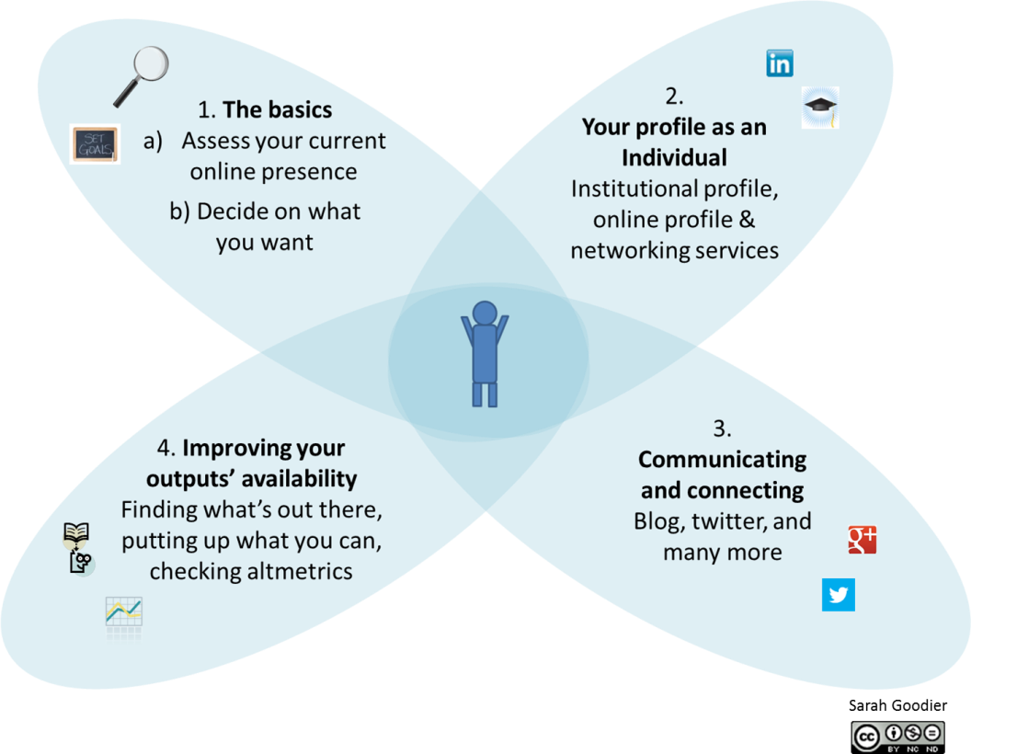
The process

Slide 15
Assess
Assess & monitor your general online presence

Slide 16
Assess & monitor
Regular Google searches
On-going Google alerts of your name
Measure your digital footprint

Slide 17
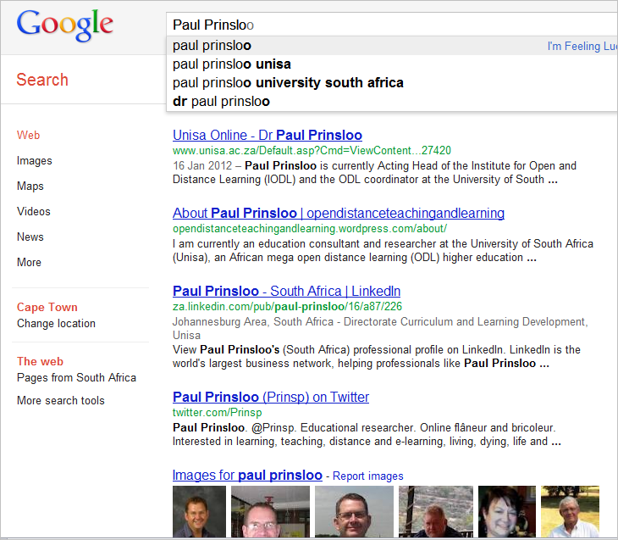
Example

Slide 18
Analyse the results
How many of the results are relevant?
What types of results come up?
  Are all of them from your institutions?
  Publications?
  Online profiles?
If the results are obviously nothing to do with you, would that be obvious to someone else looking for you?
Consider what you would like to appear

Slide 19
Consider your profile/s
Profiles
  LinkedIn
  Academia.edu
  Facebook?
  Your institution
  Google Scholar
Decide on a main profile
Improve and maintain it
Link the others
Notes:
As of 2 August 2012, LinkedIn had 175m⁺ professionals from around the world, 44m⁺ of these members from Europe, Middle East and Africa (as of February 17, 2012; http://press.linkedin.com/about)
As of the end of June 2012, Facebook had 955 million monthly active users. Approximately 81% of these users are from outside the USA and Canada (http://newsroom.fb.com/content/default.aspx?NewsAreaId=22).
As of 31 August 2012, Academia.edu had 1,794,003 academics have signed up to their service (http://www.academia.edu/about).

Slide 20
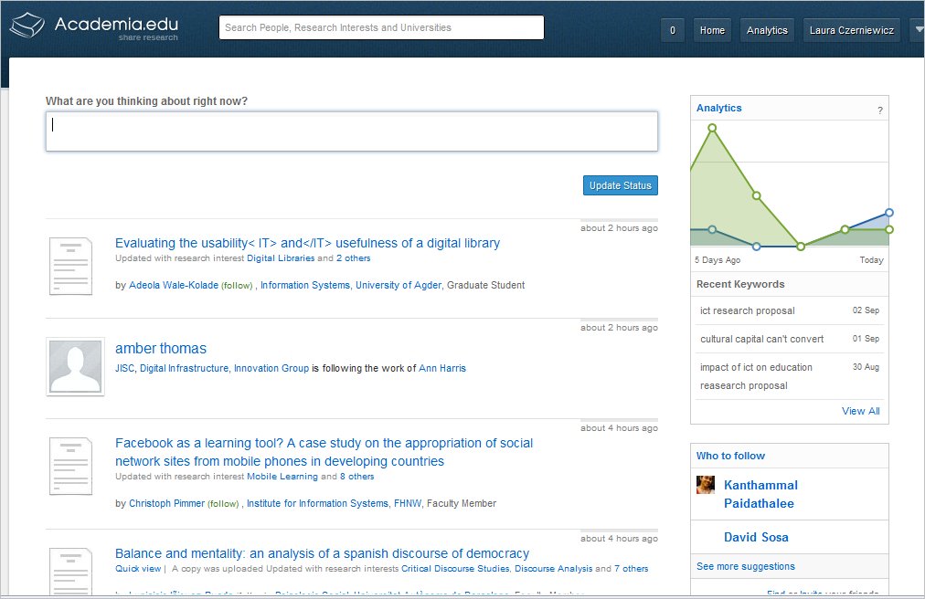
Academia.edu

Slide 21
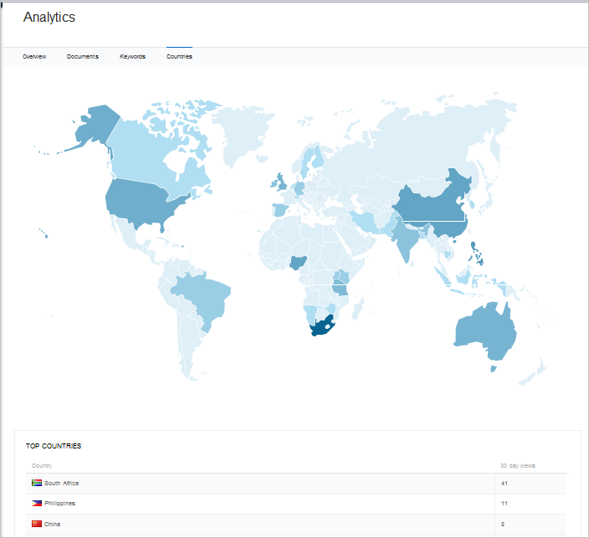

Slide 22
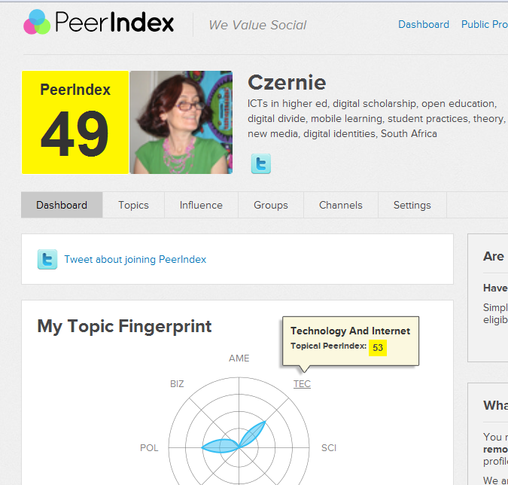
Social media analytics
Notes:
Decide if this is valuable. Wikipedia.PeerIndex is a London-based company providing social media analytics based on footprints from use of major social media services (currently Twitter, LinkedIn, Facebook and Quora). Part of an emerging group of Social Media Analytics providers[2], PeerIndex helps social media contributors assess and score their influence and benefit from the social capital they have built up. PeerIndex currently tracks ca. 45 million Twitter profiles, making the company one of the leaders in its sector.
PeerIndex was founded in 2009 by Azeem Azhar, a former journalist and Reuters executive, Ditlev Schwanenflügel, a former McKinsey consultant and Bill Emmott (the former Editor-in-chief of The Economist) backed by a number of internet investors.

Slide 23
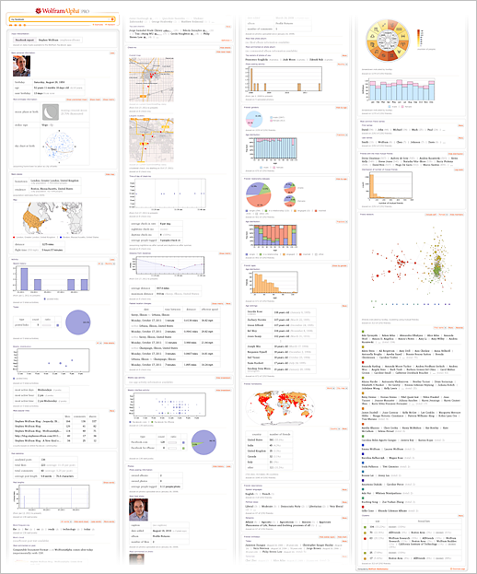
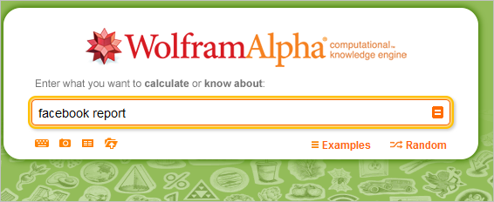
Facebook analysis
http://blog.stephenwolfram.com/2012/08/wolframalpha-personal-analytics-for-facebook/

Slide 24
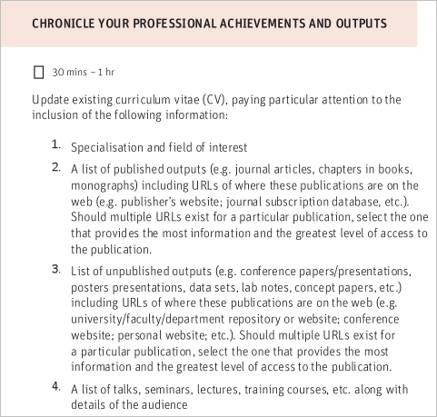
Improve your profile
Van Schailkwyk, F Profiling academics online
http://www.slideshare.net/scap_uct/pao-scap-toolkit
Profiling Academics Online: Online Profiling Toolkit

Slide 25
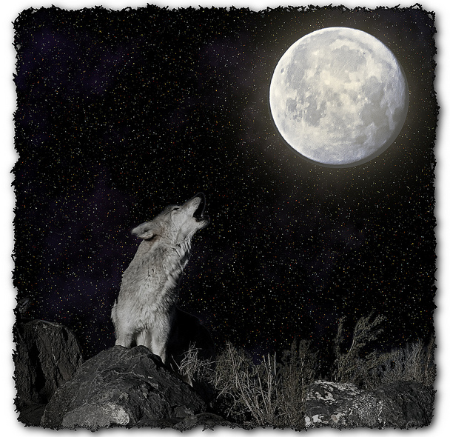
My question is
“Am I making an impact?”
http://www.flickr.com/photos/cindy_mc/6967806783/ Thanks to Sam Gross
Notes:
Thanks to Sam Gross’ New Yorker cartoon

Slide 26
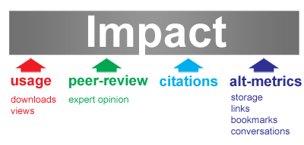
Broaden impact
Notes:
Jason Priem, University of North Carolina-Chapel Hill (@jasonpriem)
Dario Taraborelli, Wikimedia Foundation (@readermeter)
Paul Groth, VU University Amsterdam (@pgroth)
Cameron Neylon, Science and Technology Facilities Council (@cameronneylon)
http://altmetrics.org/manifesto/
26 October 2010

Slide 27
Consider
What changes would you like to make in your online profile/s?
What are your options?
What is realistic?

Slide 28
Get your outputs out there
Maximise the visibility of your work

Slide 29
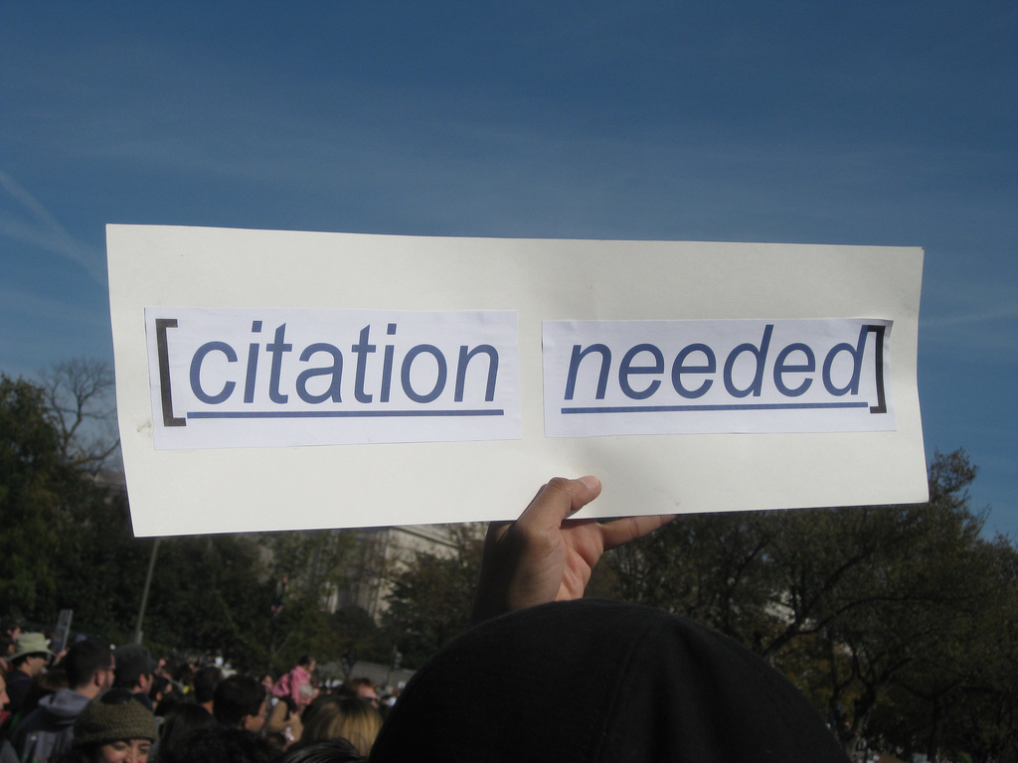
http://www.flickr.com/photos/87913776@N00/5129607997 CC-BY
Notes:
Academics need their work to be available and read in order to make this impact, read and citations are the measure of this

Slide 30
Go as open as you can
Put journal articles you can online
  Check out Sherpa Romeo for publisher archiving policies
Archive
  in repositories
  In subject portals and aggregators
Publish in open access journals
Open everything – all scholarly output possible (teaching, popular etc)

Slide 31
Open access & increased citations
Open access publishing increases visibility, opportunity for use and possibility of impact
Majority of studies have shown an increase in citations arising from open access
  Of the 35 studies surveyed, 27 have shown a citations advantage (the % increase ranges from 45% increase to as high as 600%), 4 showing no advantage
Swan A (2010) The Open Access Citation Advantage: Studies and Results to Date. Available at http://eprints.ecs.soton.ac.uk/18516/

Slide 32
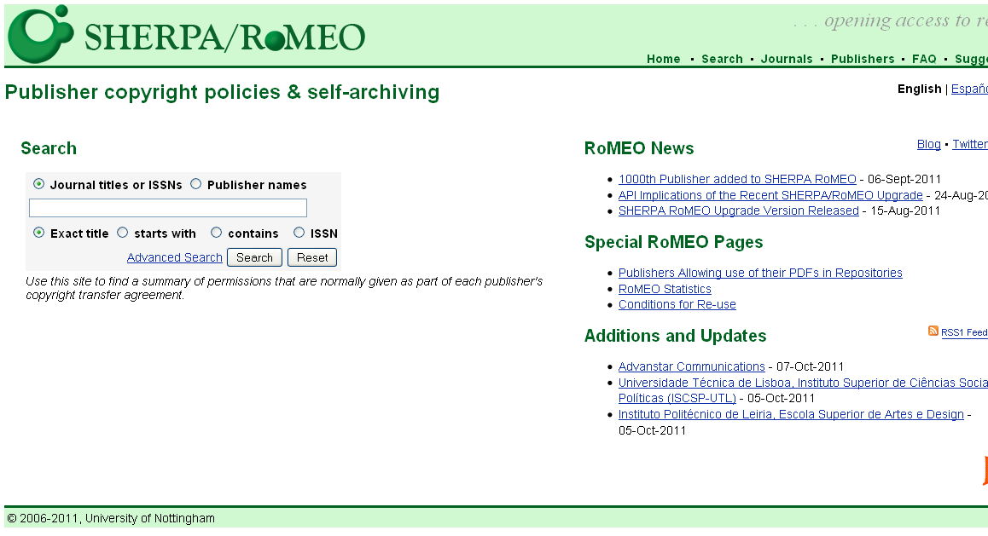
Check the self-archiving agreement of existing journal articles

Slide 33
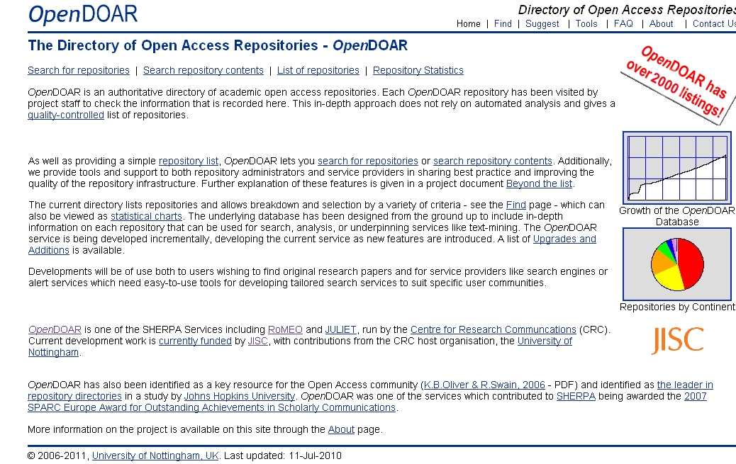
Archive in open access repositories

Slide 34
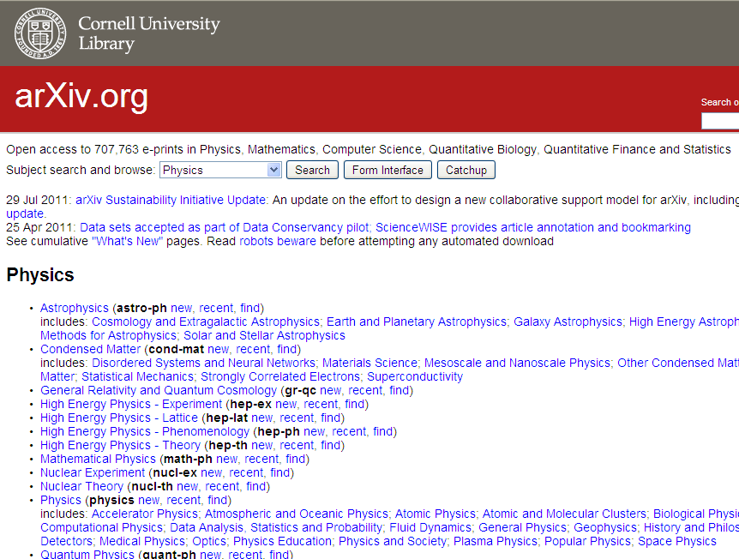
Use discipline-specific archives

Slide 35
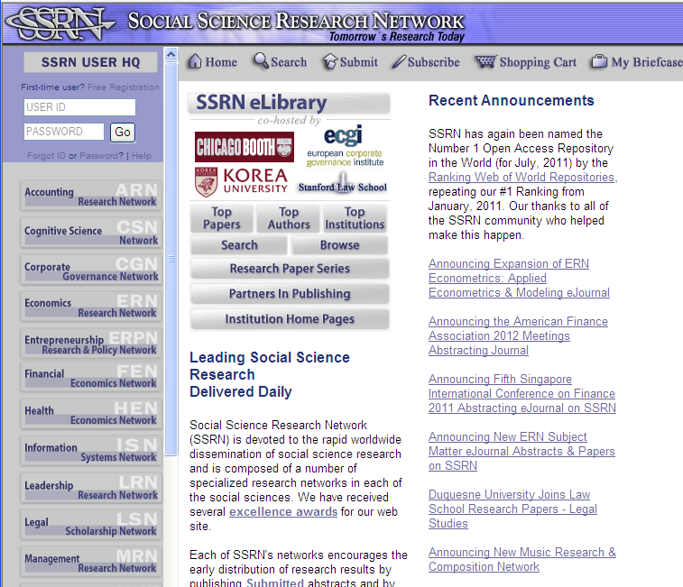

Slide 36
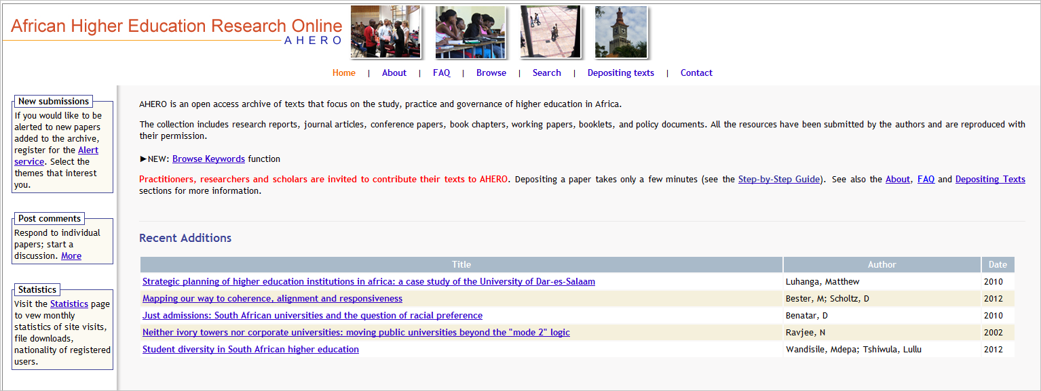

Slide 37
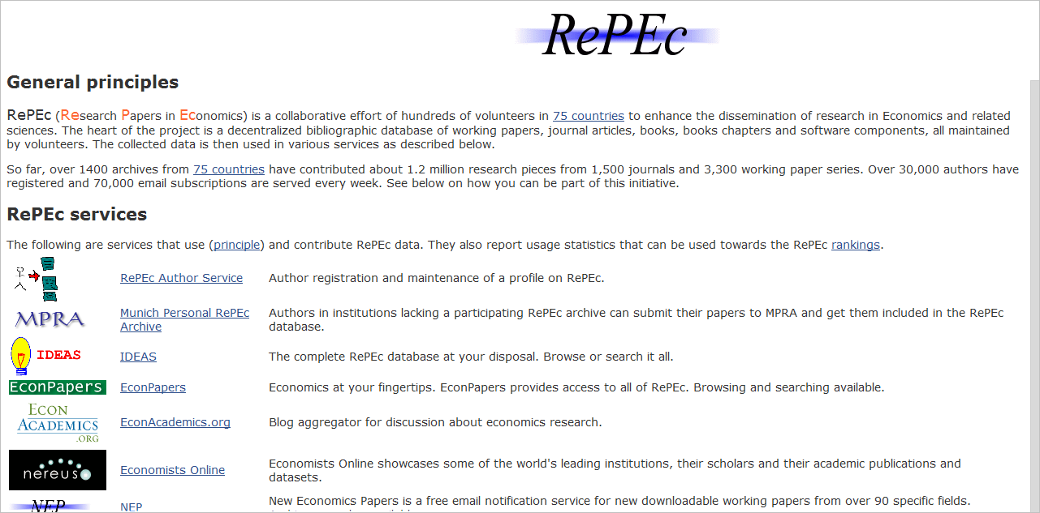

Slide 38
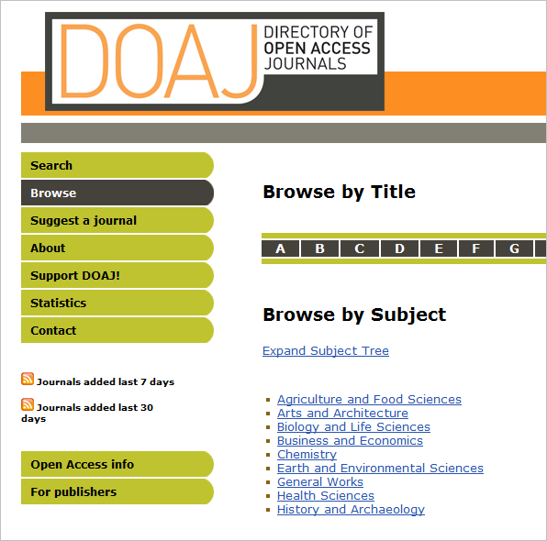
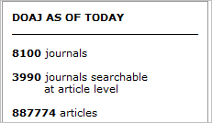
Publish in open access journals

Slide 39
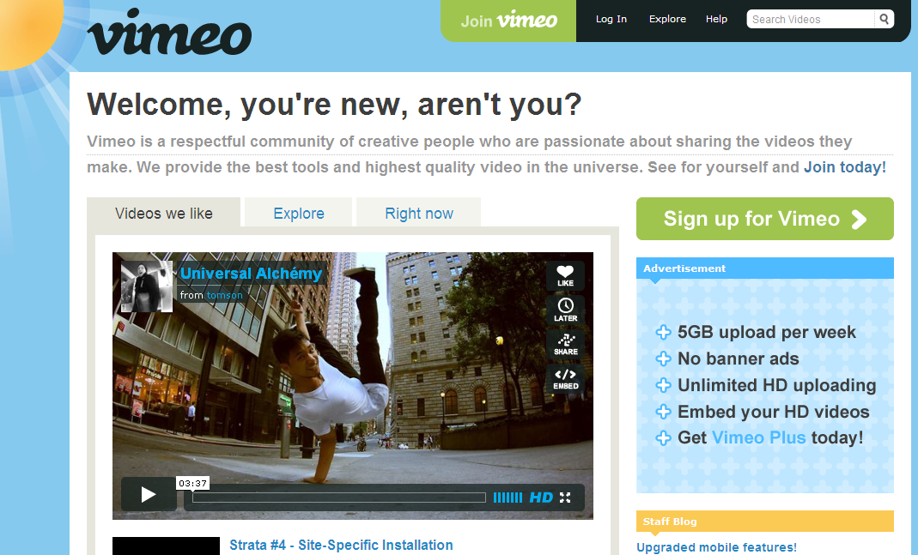
Upload videos & podcasts
Notes:
As of December 2011, Vimeo attracts 65 million unique visitors per month and more than 8 million registered users.[8] Fifteen percent of Vimeo’s traffic comes from mobile devices

Slide 40
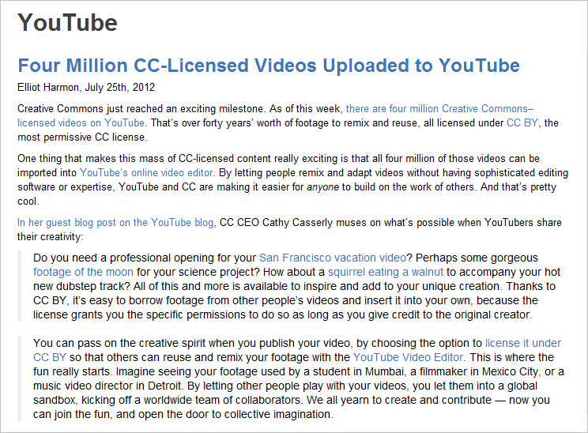
Notes:
http://creativecommons.org/weblog/entry/33421

Slide 41
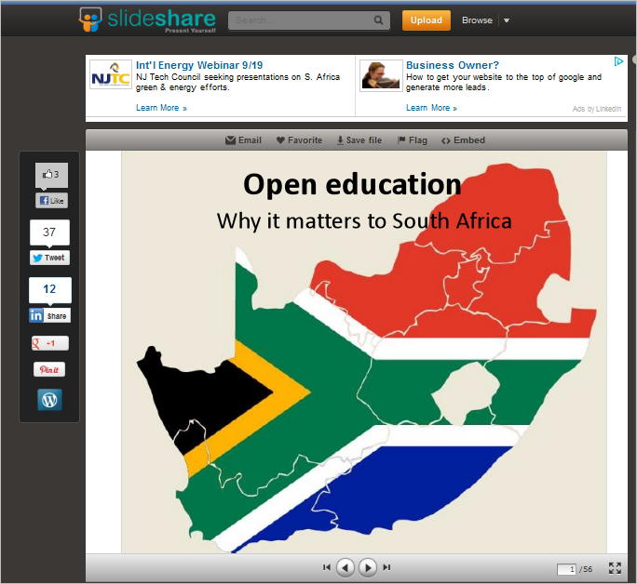

Upload presentations
http://www.slideshare.net/laura_Cz/why-open-education-matters-in-south-africa

Slide 42
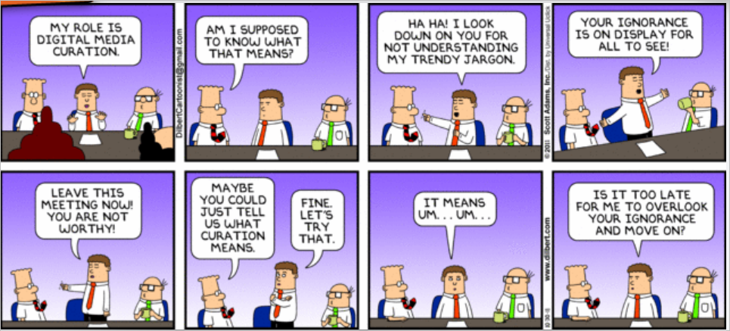
Make sure your resources are properly curated
Notes:
Dilbert http://dilbert.com/strips/comic/2011-10-30/

Slide 43
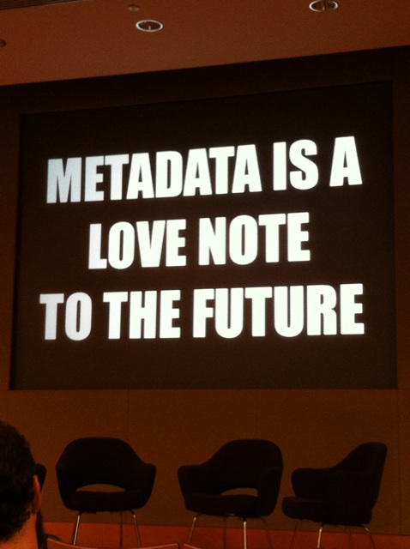
Maximise discoverability
Take metadata seriously
“Well said! "metadata is a love note to the future" from @textfiles talk via @nypl_labs & @kissane http://t.co/FjvCLVUZ

Slide 44
Consider
What can you realistically do to get more of your resources online?
Do you have funds to pay for help?
Is there someone in your university who can assist?

Slide 45
Connect & communicate

Slide 46
Social bookmarking
The value of social bookmarks
  Delicious
  CiteUlike
Useful for you across devices
Builds connections
Consolidates your presence

Slide 47
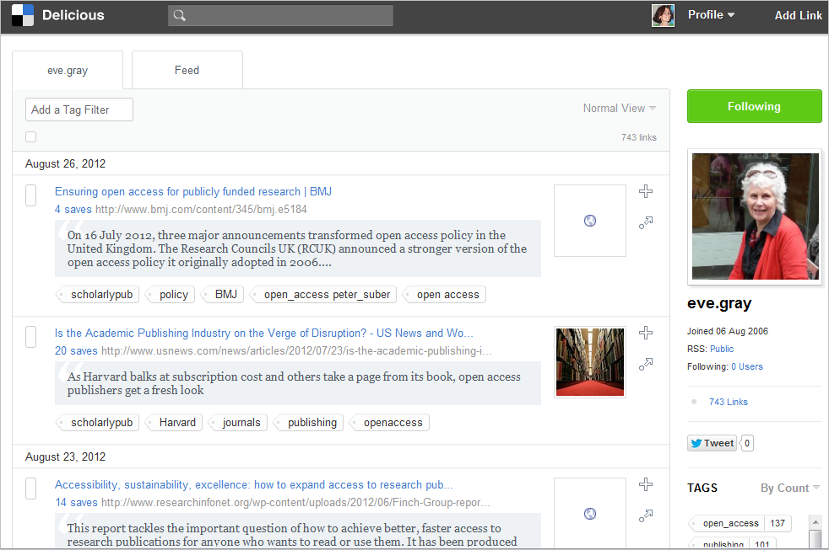
Example: delicious

Slide 48
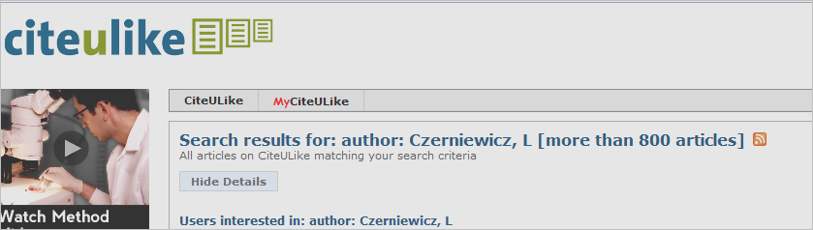
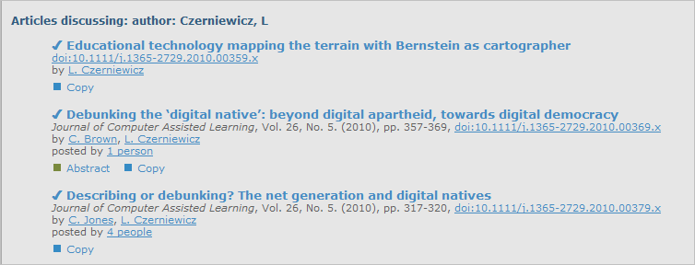
Example:citulike

Slide 49
Resources & community sites
More than social bookmarking
  Diigo
  Mendeley
  Research Gate

Slide 50
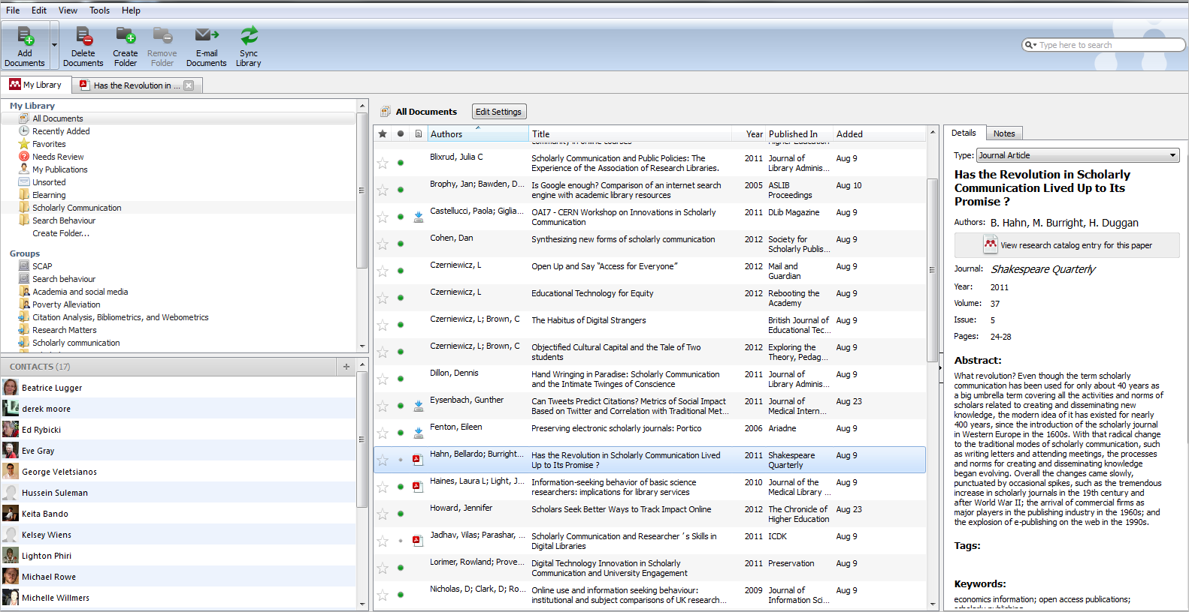
Mendeley
community
Notes:
Mendeley is not just a reference management tool, its also an academic social network. Similar to CiteUlike, in that you can manage your papers and citations online, Mendeley goes a step further with its desktop software. You can organise your research papers on your computer by dragging and dropping them into Mendeley Desktop, which will extract all the relevant citation information automatically, and you can sync this library with Mendeley online so you can access it anywhere. In Mendeley you can annotate and highlight points of interest in your pdfs. You can also collaborate with others online, through groups (public or private), and discover new research. Mendeley even has an iPhone app, so you can access and read your papers anywhere.

Slide 51
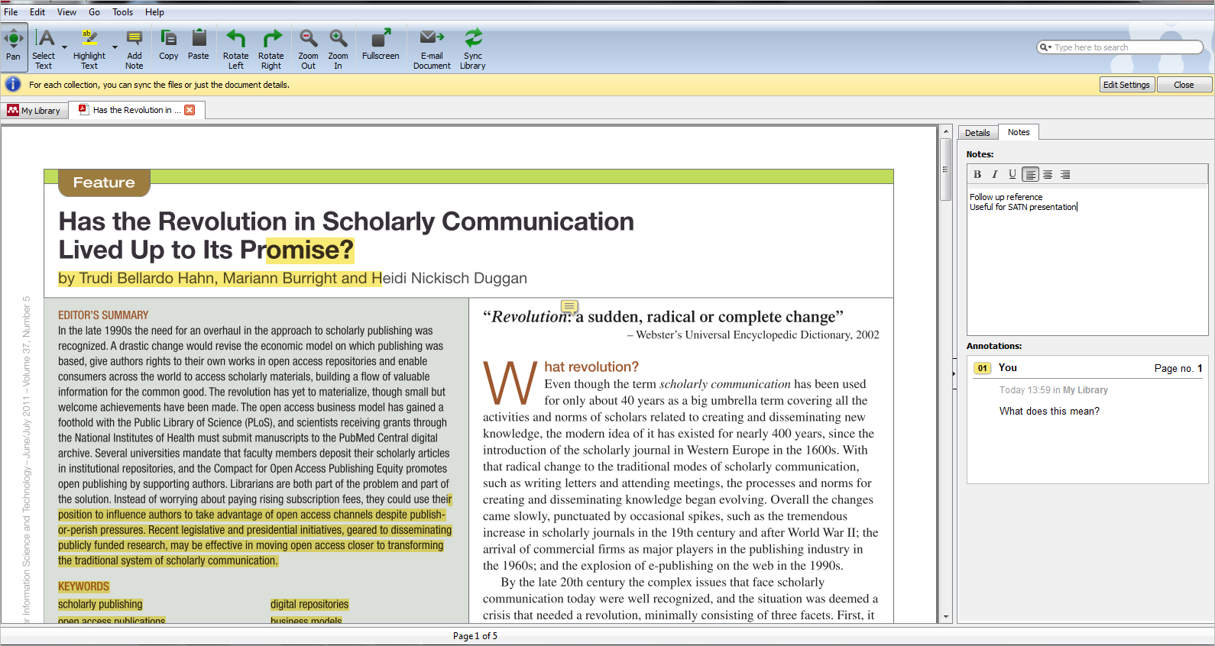
device agnostic

Slide 52
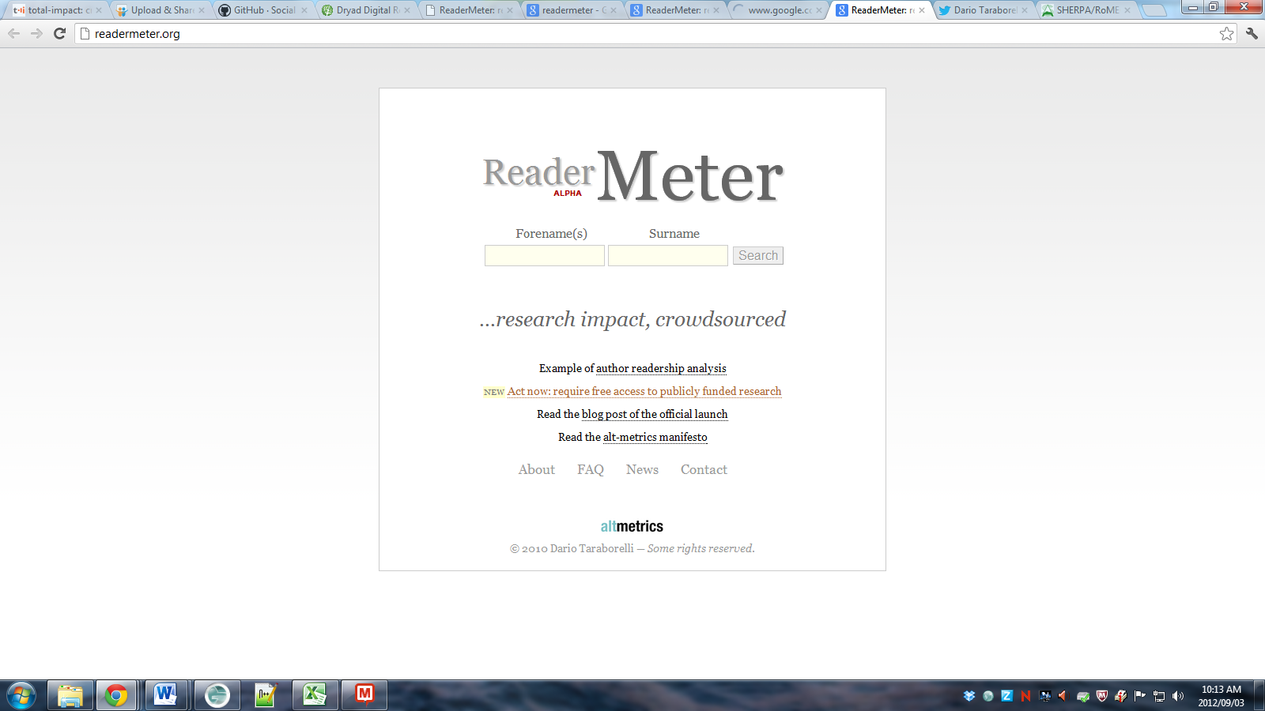
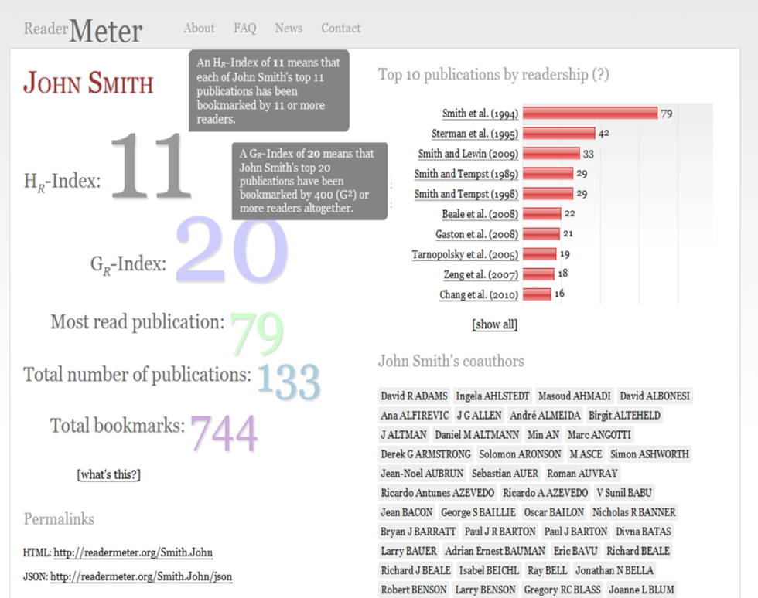
Mendeley analytics

Slide 53
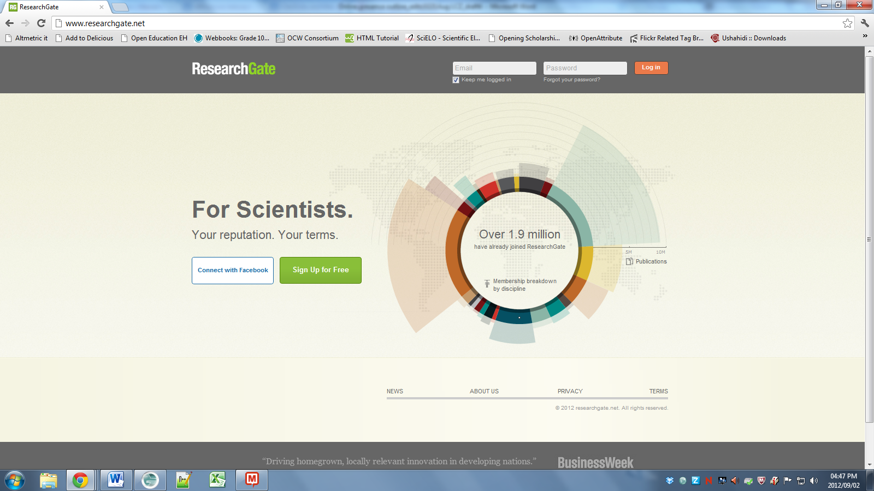
Notes:
With over 1.9 million people signed up to ResearchGate, with the largest disciplines being ~427 000 people from Medicine and ~356 000 from Biology, this online platform for connecting and collaborating with other scientists from around the world is no small network. (http://www.researchgate.net/)

Slide 54
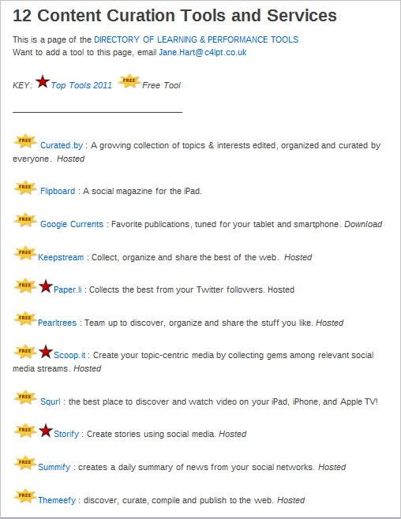
Make your name as a curator
http://c4lpt.co.uk/directory-of-learning-performance-tools/content-curation-tools-and-services/

Slide 55
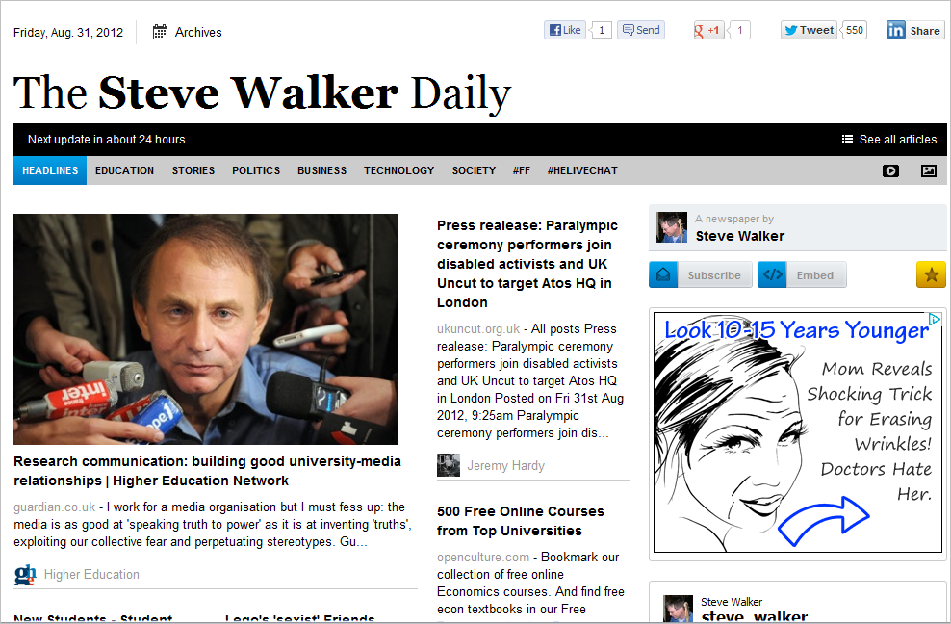
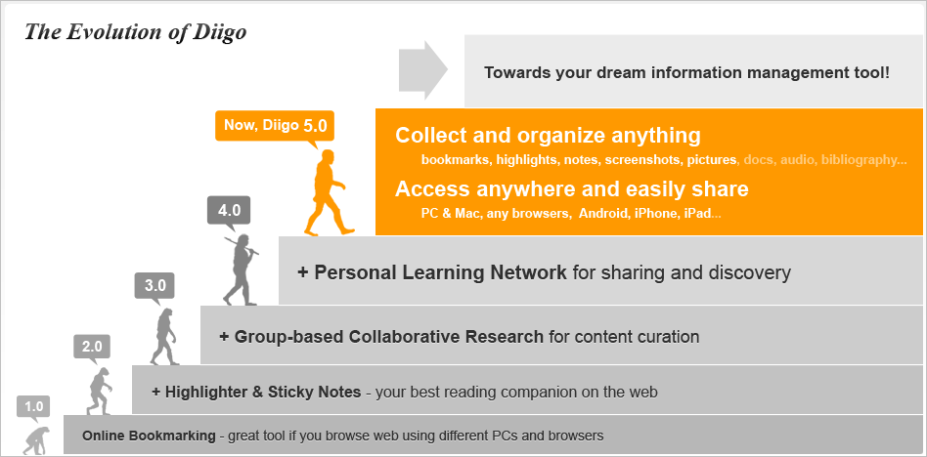
Notes:
http://paper.li/steve_walker

Slide 56
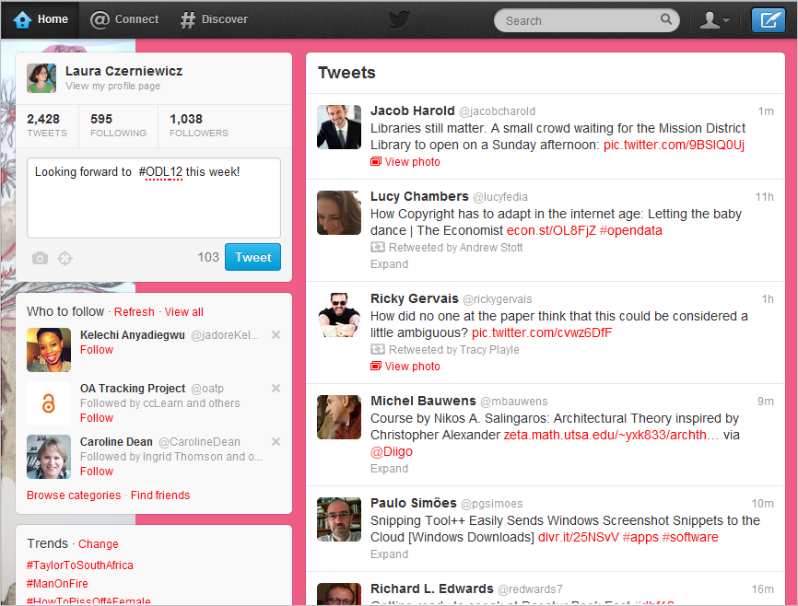
Get on to Twitter

Slide 57
Some Twitter guidelines
Get into a routine
It is legit to retweet your tweets especially if rephrased
Provide updates from special events
Use hashtags
Follow others / reciprocate
Promote your Twitter profile through your email signature, business card, blog posts etc.
Being careful with Twitter
Tweet about each new publication, website update or new blog that the project completes.
Ask for feedback
Link to a URL of publication, presentation, podcast etc
Tweet about new developments of interest
Retweet interesting material
Use Twitter for ‘crowd sourcing’ research activities
Mollet, A; Moran, D and Dunleavy, P (2011) Using Twitter in university research, teaching and impact activities, LSE Research Online

Slide 58
Blogging as a scholarly activity
Create and write a blog
  For colleagues, community and/or students
Scholarly blog aggregators
  Research blogging
Notes:
http://pubs.acs.org/cen/science/87/8733sci3.html
Examples of Web 2.0 in scholarly communication
Blogs
Blogging began during the mid-1990 4but did not really take off until the arrival of free,
easy-to-use web-based software in 1999. Initially associated with the personal journal and
with self-referential commentary on the web itself, the blog in fact can be thought of as a
web platform suitable for almost any kind of content. The key features of this platform are: a
simple content management system allowing users to create and post content (including rich
media such as images, audio and video) to the web without technical knowledge; persistent
deep links to individual articles; the ability of readers to leave comments on posted articles;
the trackback, which automatically appends to the article a link to (and typically a brief
extract from) other articles that reference it 5. Although a few influential blogs do not allow
comments (typically because of the costs of removing unwanted comments such as spam or
abusive content) it is the last two features that give blogs their social power, converting
them from one-way publishing platforms to a web of interlinked conversations.
There are generally thought to be about 100-1500 scientific blogs. For instance, the
aggregator site Postgenomic covers 750-800 blogs. Its statistics page shows that about 300
of these blogs are active in any given week and the total number of posts averages about
2000 per week6. Neither of these figures shows current signs of growth (if anything, the trend
may be slightly downwards). Within chemistry, the site Chemical Blogspace performs a
similar function to Postgenomic. It reports about 60 blogs active per week and an average
total of 150-160 new posts per week.
http://mrkwr.files.wordpress.com/2009/05/ware-web-2-0-and-scholarly-communication-preprint.pdf

Slide 59
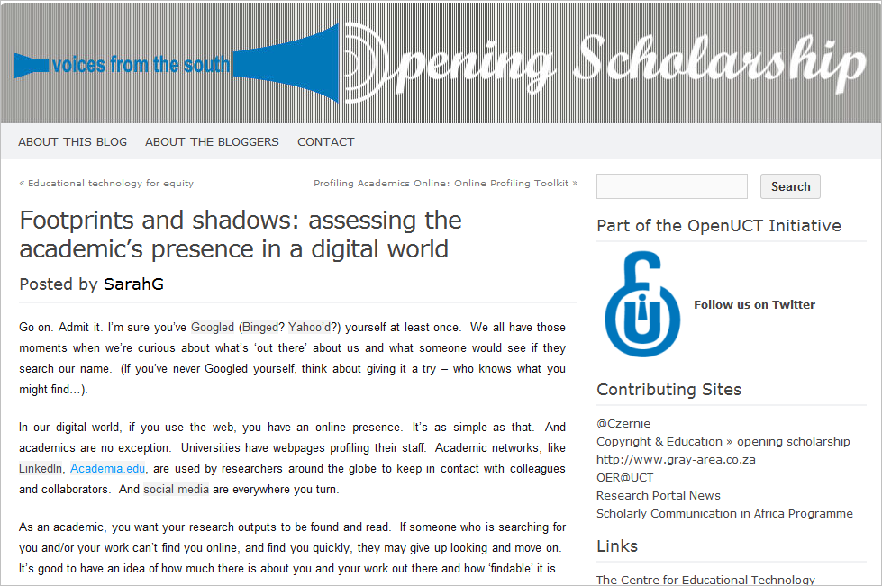

Slide 60
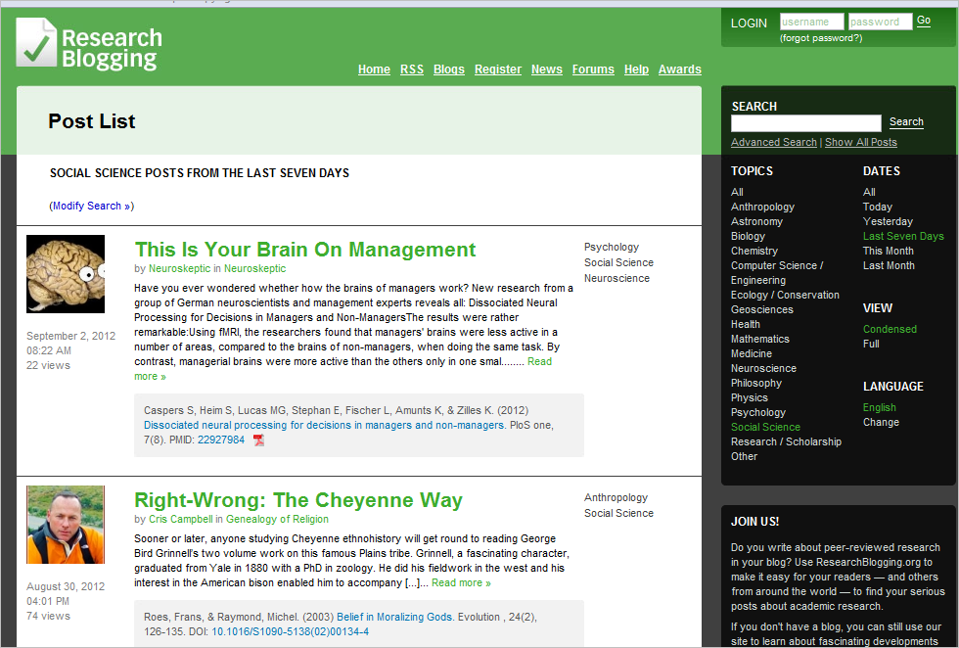
Notes:
-

Slide 61
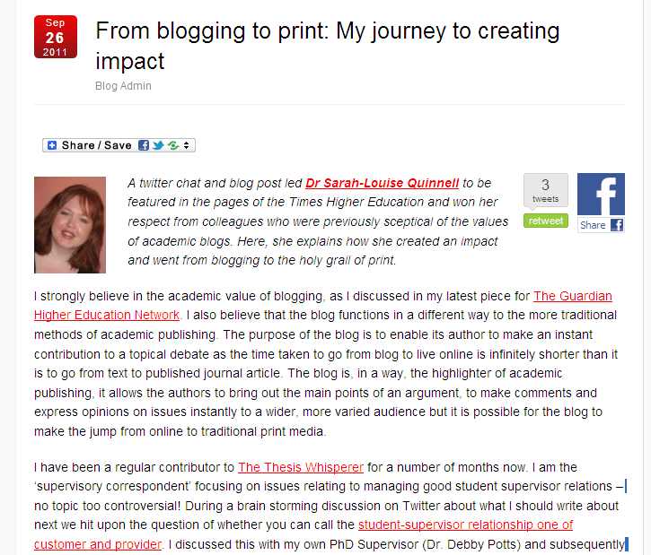
http://blogs.lse.ac.uk/impactofsocialsciences/2011/09/26/blogging-to-print/

Slide 62
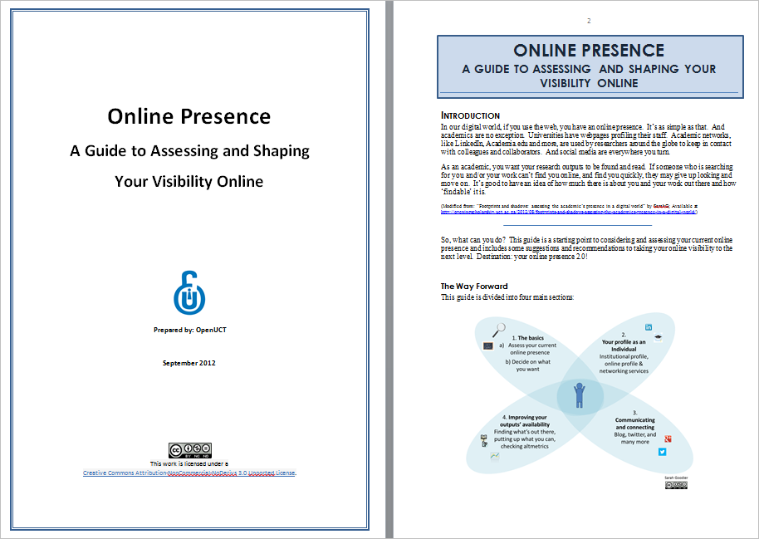
All this & more

Slide 63

Thank you
http://lauraczerniewicz.uct.ac.za
@czernie
Notes:
This work is licenced under the Creative Commons Attribution-Share Alike 2.5 South Africa License. To view a copy of this licence, visithttp://creativecommons.org/licenses/by-sa/2.5/za/ or send a letter to Creative Commons, 171 Second Street, Suite 300, San Francisco, California 94105, USA.

