Slide 1
The roadside work-seeker phenomenon in the South African informal construction sector
ARCOM 32nd Conference
Manchester City Hall, UK
5-7 September 2016
Sylvia Hammond
Paper #3319

Slide 2

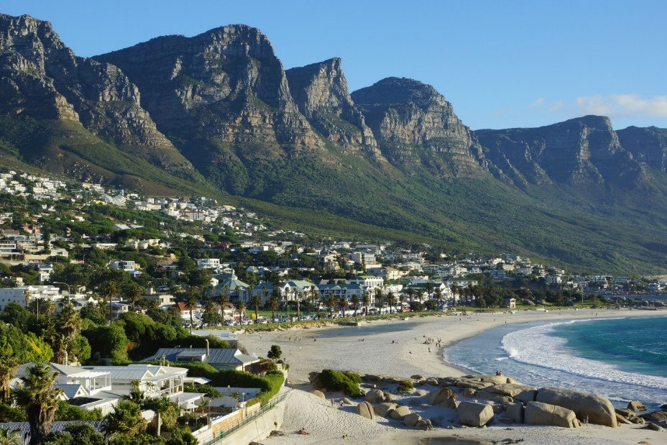
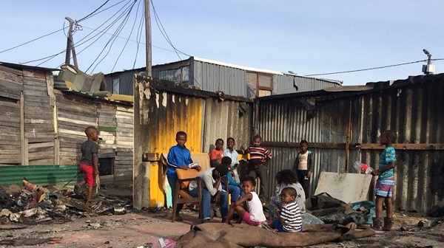
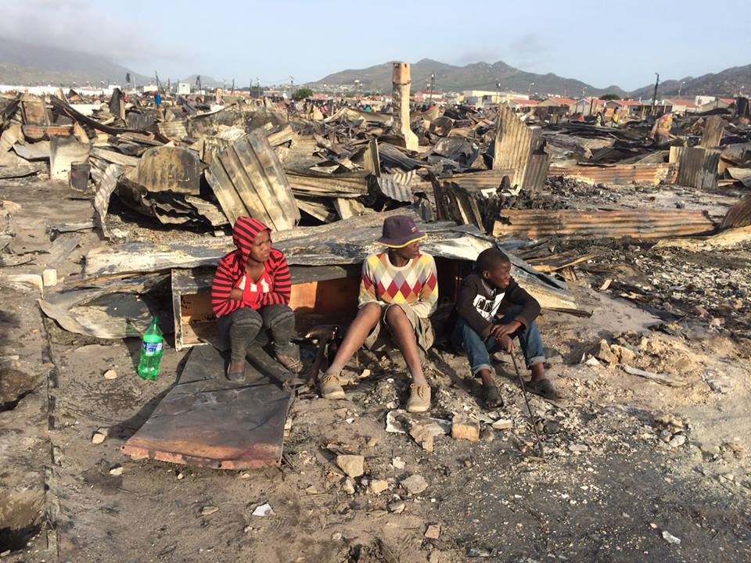
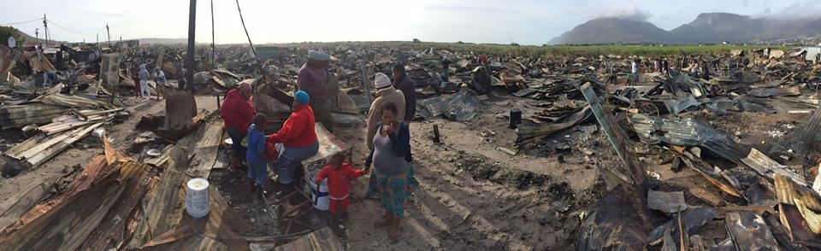
Context - Cape Town South Africa

Slide 3
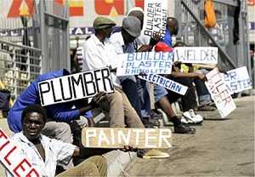
The roadside work-seekers
Who are they – national & inter-national migrants
How are their skills acquired – vocational school & post school or none
What work is on offer – LOSC & micro contractors
Who chosen – differs unskilled & semi-skilled
Under what conditions – dignity & choice
Why are they there
  Lack of access to finance
  Lack implementation RPL
  Lack acknowledgement formal qualifications

Slide 4
Obstacles and barriers
Employment transformation legislation
  Employment Equity – affirmative action
  Broad-based Black Economic Empowerment - scorecard
  Skills development – non-participation
Migration legislation –
  Scarce skills – entry visa & work permit – new draft bill
  Nationalism – xenophobia – the irony
  Practical issues of border control

Slide 5
Commonalities & divergence SA the UK & Europe
South Africa
Migration – African inward
Skills – scarce artisan
Xenophobia – competition jobs
Unemployment = 26.6%
Infrastructure development
LOSC & maintaining dignity
Social security – UIF
Transformation
UK & Europe
Yes but Europe two-way
Yes but better literacy & numeracy
Brexit - the foreigner – the other
Unemployment = 4.9% & 9.6%
More technological development
“White van” recruitment
Social security = attraction
Social value
Conclusions: Need to integrate migration & labour legislation - bills
Integrate skills transfer into contracts & mandate recognition & payment for skills

Slide 6

The future towards Social Value
How to achieve construction sector potential through work – compared to job - creation
& skills acquisition
Thank you for your time & attention

