Slide 1
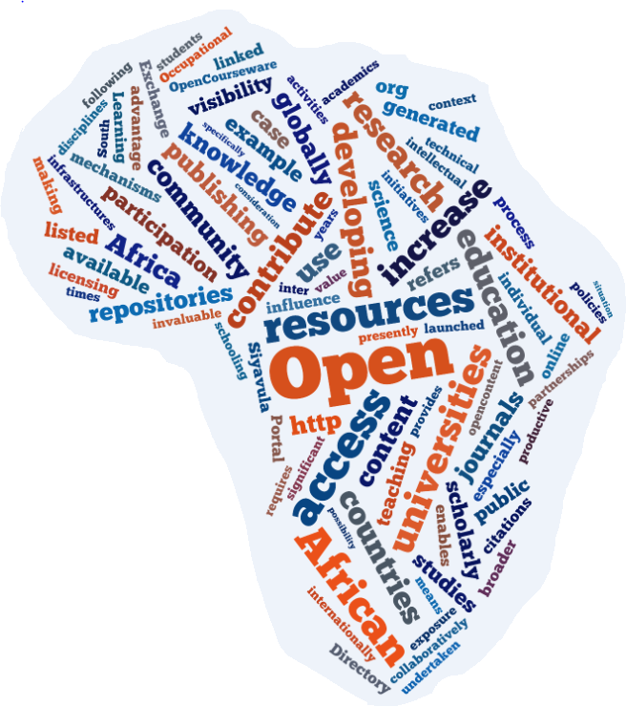
ICTs in Higher Education
Current issues for African universities
Laura Czerniewicz
The role of African Universities in Development
October 2011, Sandton Convention Centre Johannesburg

Slide 2
African HE at a glance
Current est. 1 billion population
Lowest tertiary enrolment rate in the world at 5%
  Compared to OECD targets of 50-60% and ‘Asian tiger economies’ of 30-40%
Numbers of tertiary enrolments more than tripled in 20 years, imposing great strain
-- 1985 (800,000 enrolments) to 2002 (3 million)
200 public universities in Sub-Saharan Africa (UK alone with 60 million population has 126 universities and over 1 million enrolments)
Private tertiary providers emerging to fill demand gap and over-burden in public sector
Materu, P., (2007), “Higher education quality assurance in sub-Saharan Africa: status, challenges, opportunities and promising practices”, A Report for the World Bank: Washington.

Slide 3
African Participation
Africa - 2.3% of world’s researchers
169 researchers per one million inhabitants
Investment in research and development in Africa stands at 0.9%
Excluding South Africa, intensity in research and development in Sub-Saharan Africa is 0.3%
Africa generates 0.4% of global content,
  even a discipline considered productive contributing only 0.12%.
Dulle and Minishi-Majanja 2009 and http://tinyurl.com/6czxv6e

Slide 4
Technology context

Slide 5
Key trends in Learning Technology - the Horizon Report
The abundance of resources and relationships made easily accessible via the Internet is increasingly challenging us to revisit our roles as educators in sense-making, coaching, and credentialing.
People expect to be able to work, learn, and study whenever and wherever they want.
The world of work is increasingly collaborative, giving rise to reflection about the way student projects are structured.
The technologies we use are increasingly cloud-based, and our notions of IT support are decentralized.
Johnson, L., Smith, R., Willis, H., Levine, A., and Haywood, K., (2011). The 2011 Horizon Report. Austin, Texas: The New Media Consortium.

Slide 6
Key trends - the Horizon Report
Digital media literacy continues its rise in importance as a key skill in every discipline and profession.
Appropriate metrics of evaluation lag behind the emergence of new scholarly forms of authoring, publishing, and researching.
Economic pressures and new models of education are presenting unprecedented competition to traditional models of the university.
Keeping pace with the rapid proliferation of information, software tools, and devices is challenging for students and teachers alike.

Slide 7
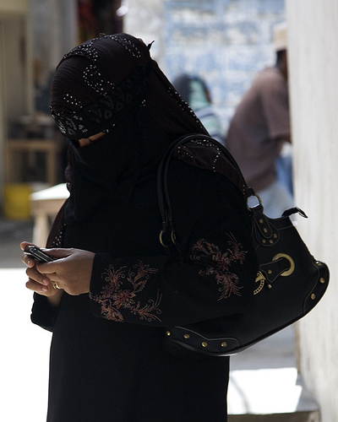
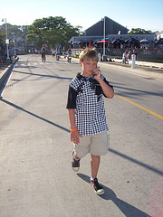

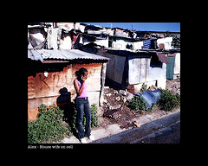
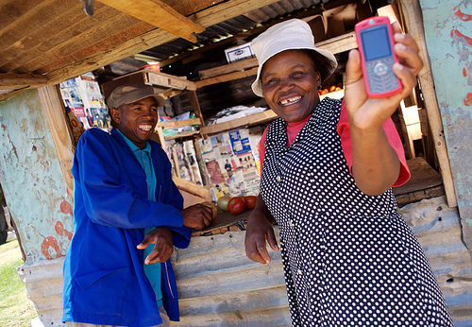
Mobiles

Slide 8
Mobiles broadly
Non-WAP enabled cell phones
WAP phones
Also
Smartphones
Tablets (eg iPads)
Ereaders
“always-connected” devices, ie sim enabled devices

Slide 9
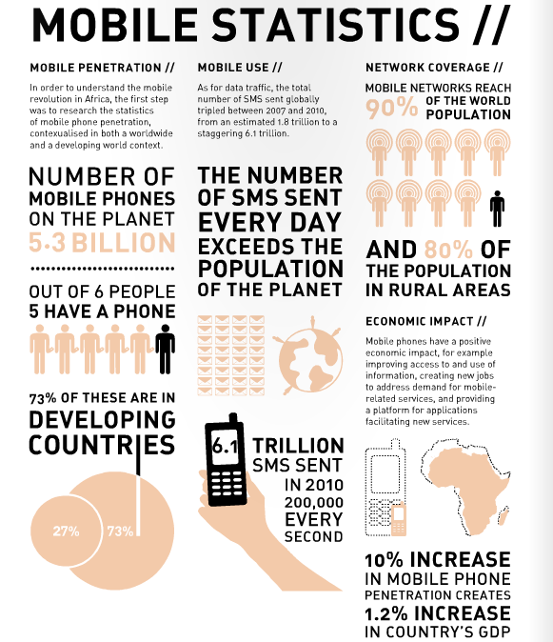
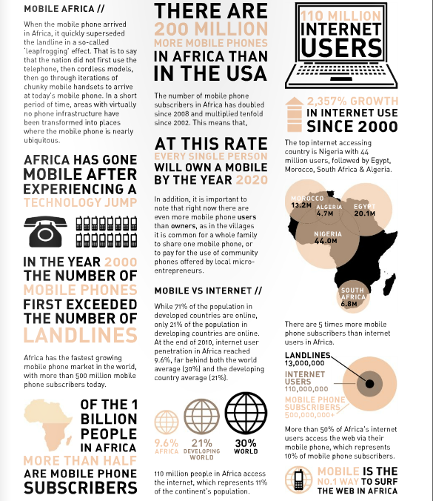
Notes:
Jenni Parker

Slide 10
The stats
500 million+ mobile phone subscribers in Africa today, more than half of the continent’s population.
Of the 110 million Africans who do use the internet, more than half do so via their mobile phone
Mobile cell coverage is at nearly 90% of the population
Notes:
Jenni Parker 2011, MOBILE, LEARNING TOOLKIT\
The Mobility 2011 research project, conducted by World Wide Worx and backed by First National Bank, reveals that 39% of urban South Africans and 27% of rural users are now browsing the Internet on their phones. The study excludes “deep rural” users, and represents around 20-million South Africans aged 16 and above. This means that at least 6-million South Africans now have Internet access on their phones.
The most dramatic shift of all, however, is the arrival of e-mail in the rural user-base and its growth among urban users. There has been a substantial shift among the latter, with urban use rising from 10% in 2009 to 27% at the end of 2010. While the percentage growth among rural users is lower, the fact that it was almost non-existent a year before means the 12% penetration reported for 2010 indicates mobile e-mail becoming a mainstream tool across the population.
While cameras, diaries and games continue to dominate the list of features used on phones, FM radio and music players have become part of a mobile “Big Five”. However, there is a significant difference in the features preferred by urban and rural phone users. Three quarters of urban respondents (75%) use their phone cameras, but little more than half of rural respondents (55%). Music players on the phone get the vote of 53% of urban users, versus 36% of rural users. Surprisingly, the gap is reversed when it comes to games on the phone: 54% of urban users enjoy these, compared to 65% of rural users

Slide 11
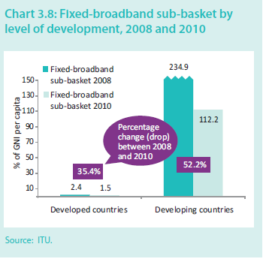
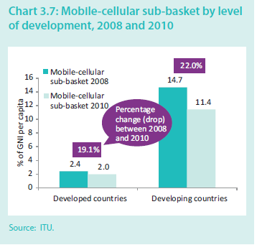
Relative costs
In developed countries, people pay about 2% of monthly salary for cell phone services
In developing countries, people pay about 11%% of monthly salary for cell phone services
Prices decreasing faster in developing countries
Notes:
ITU 2011

Slide 12
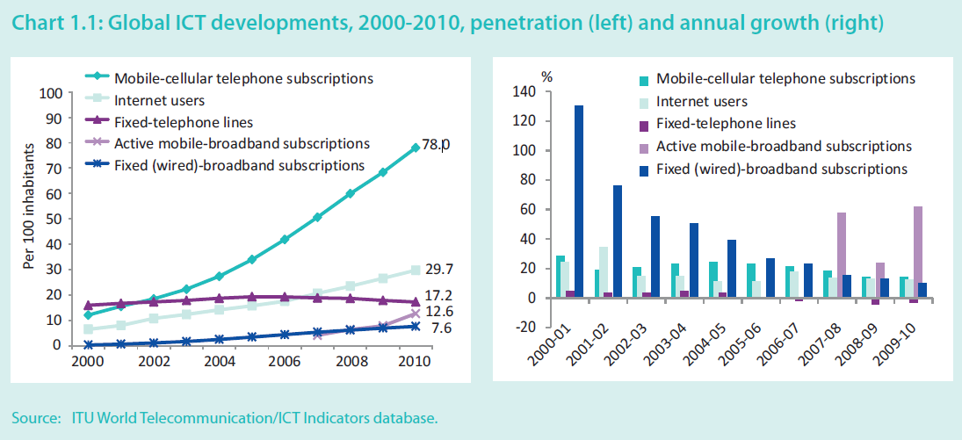
Penetration & growth
Notes:
ITU 2011

Slide 13
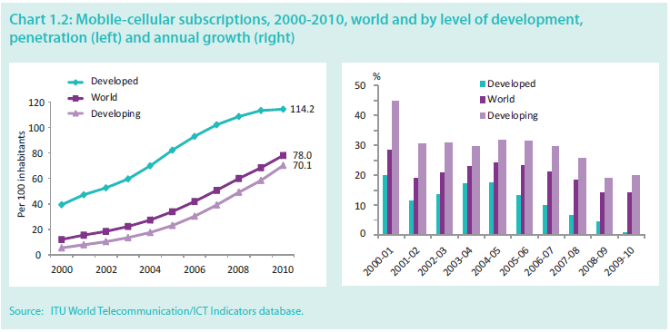
Mobile cellular subscriptions

Slide 14
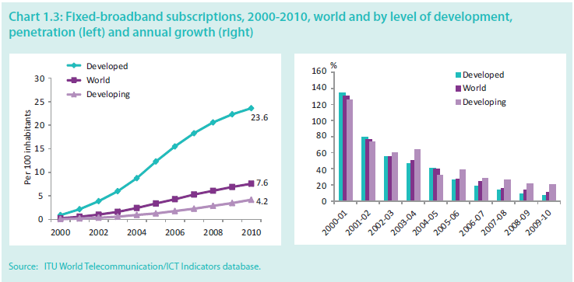
Fixed broadband subscriptions

Slide 15
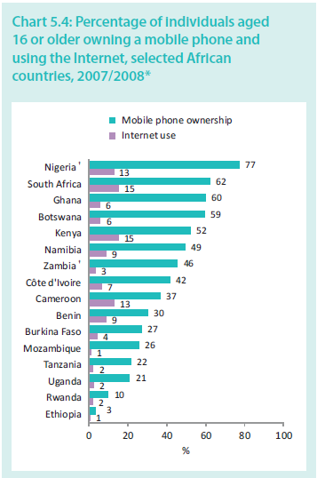
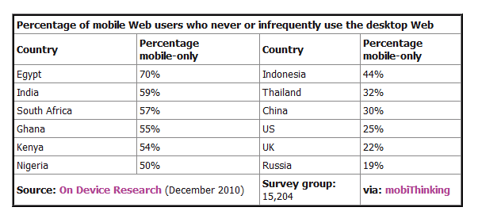
Mobile (& mobileweb) dominance
In 2009, 78% of South African students accessed the Internet via their cell phones (Kornberger, 2009)
dotMobimobiThinkingmobiForgeready.mobiDeviceAtlasgoMobi
Notes:
Measuring the Information Society ITU 2011
Specific details of cell phone ownership and use by all South African students are not available. Research amongst school children research shows that 98-99% of high school learners across all school types owned a cell phone (Tustin, D, van Aardt, I & Shai, 2009, New media usage and behaviour among adolescents in selected schools of Gauteng, UNISA).

Slide 16
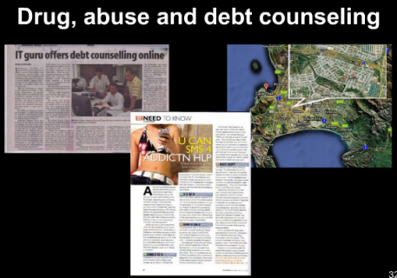
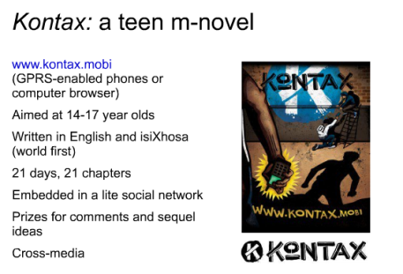
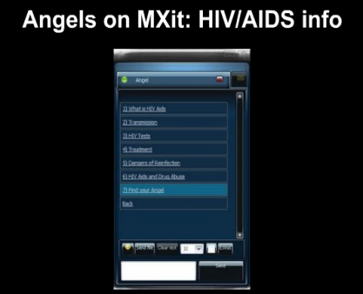
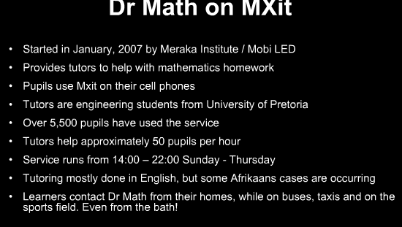
Numerous m-learning cases
Much experimentation, many small-scale innovations
Indira Ghandi National Open University (India) offers courses on mobile phones to more than 2.5 million students
But mlearning not mainstreamed in universities, has not realised its potential
Notes:
From Horizon Report 2011
And Mobile Education Landscape Report 2011 GSMA

Slide 17


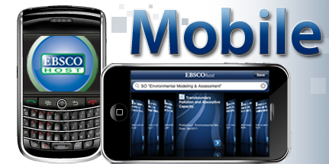
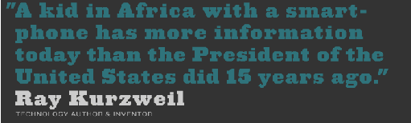
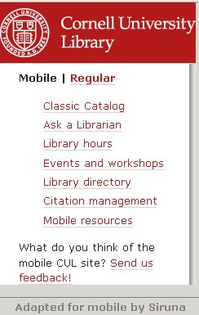
The rise of smartphones
Estimate for SA 8 million
Estimate for SA students 70%
Rise in APS
/
Tarrant, September 2011, memeburn; Student Village 2011
Notes:
Kurwel quote from http://lonewolflibrarian.wordpress.com/2011/10/17/how-opencourseware-is-democratizing-the-college-classroom-10-17-11
Apps images from Information 2.0 and Beyond: Where are we, where are we going? Kristen Purcell, Ph.D.Associate Director, Research Pew Internet Project Presented at APLIC 44th Annual Conference March 29th, 2011 Washington, DC
With millions of smartphones in South Africa, where are all the apps?
19
inShare
By Hilton Tarrant: Columnist
http://memeburn.com/2011/09/with-millions-of-smartphones-in-south-africa-where-are-all-the-apps/?utm_source=feedburner
A recent survey conducted amongst 693 students across 6 universities in South Africa showed that 70% had Smart Phones (StudentVillage 2011

Slide 18
Digital content explosion

Slide 19
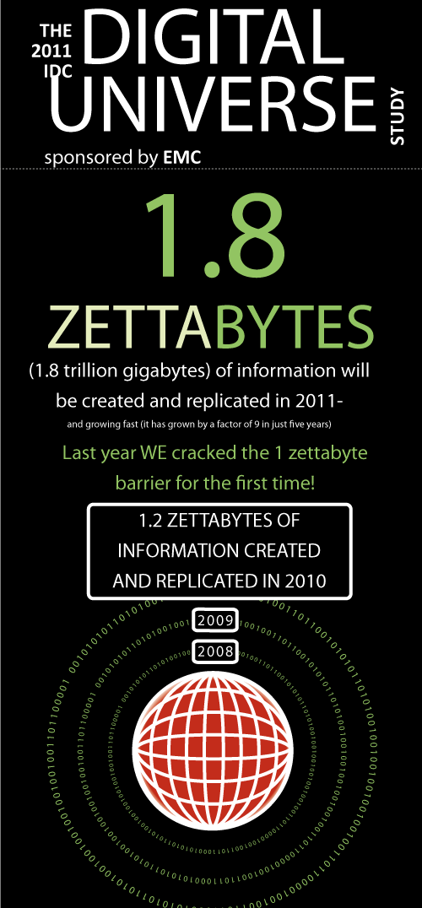
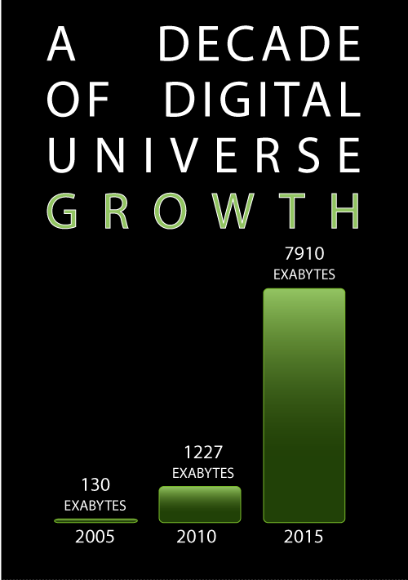
IDC Report: The 2011 Digital Universe Study: Extracting Value from Chaos, June 2011
http://www.emc.com/collateral/demos/microsites/emc-digital-universe-2011/index.htm
Notes:
IDC Report: The 2011 Digital Universe Study: Extracting Value from Chaos, June 2011
http://www.emc.com/collateral/demos/microsites/emc-digital-universe-2011/index.htm

Slide 20
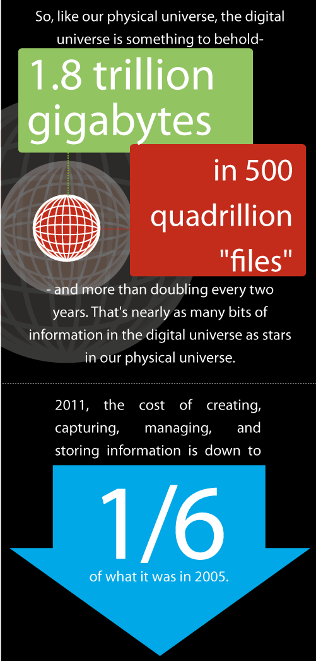
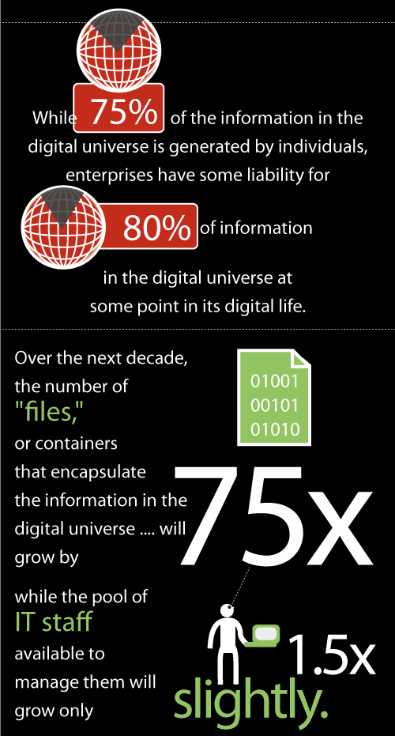

Slide 21
The shift to openness

Slide 22
Why Open education?
Access to knowledge
Participation
Visibility
Influence
Quality
Academics’ agency

Slide 23
Open education
Open content
Open education resources
Open access
Open research
Open science
Open data
Open licensing
Open scholarly practices
Notes:
Open content refers to both teaching and research resources (with the term „open education resources‟ referring specifically to teaching resources).
• Open research is about making transparent all aspects of the research process, including data, methodology, analysis and outputs.
• Open licensing is a mechanism of intellectual property rights protection which enables access and/or re-use under varying conditions while attributing the original author.

Slide 24
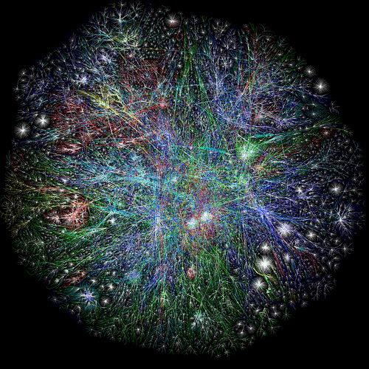

Affordances of the Internet
  Openness has been stimulated by the Internet which has provided an opportunity for information and services to be shared, used and re-used in ways not conceivable (or affordable) in a paper-based environment.
http://www.flickr.com/photos/curiouslee/3485479724/
Cheryl Hodgkinson-Williams 2010

Slide 25
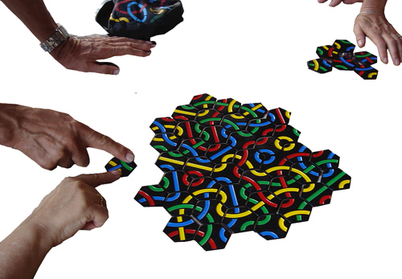
The concept
… is based on the philosophical view of knowledge as a collective social product and the desirability of making it a social property (Prasad & Ambedkar cited in Downes 2007:1).
http://www.flickr.com/photos/jordigraells/2098331968/
Cheryl Hodgkinson-Williams 2010
Notes:
<div xmlns:cc="http://creativecommons.org/ns#" about="http://www.flickr.com/photos/jordigraells/2098331968/"><a rel="cc:attributionURL" href="http://www.flickr.com/photos/jordigraells/">http://www.flickr.com/photos/jordigraells/</a> / <a rel="license" href="http://creativecommons.org/licenses/by/2.0/">CC BY 2.0</a></div>

Slide 26
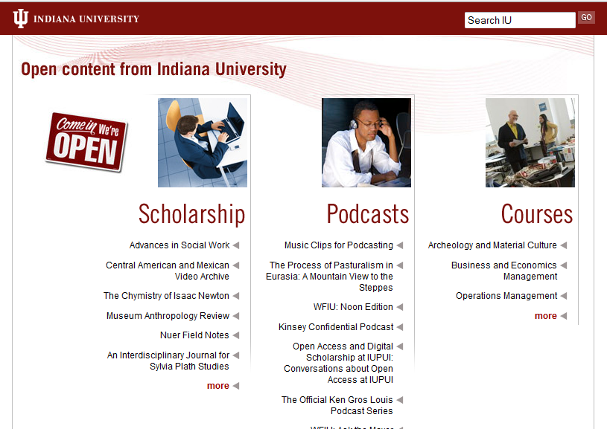
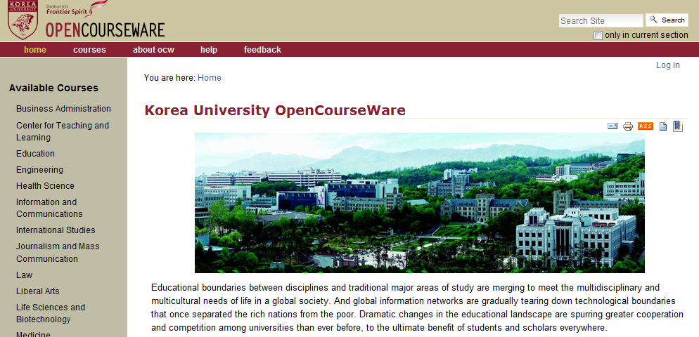
Open content: Access to knowledge
  African universities get access to scholarly knowledge from all over the world

Slide 27
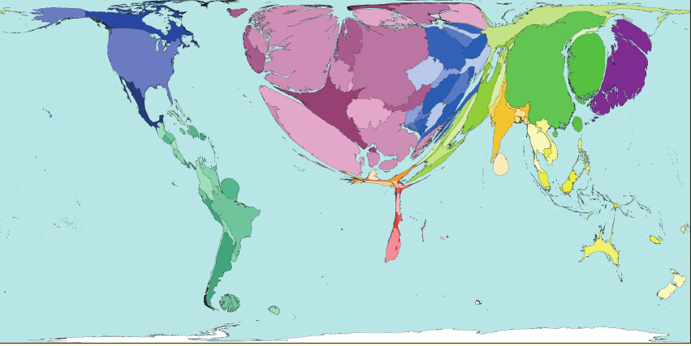
WorldMapper: Book Publishing
Notes:
• Data are from the United Nations Educational,Scientific and Cultural Organisation’s on-linestatistics, 2005.
• *Territories for which data have been estimated are not shown in the table.
• New books and pamphlets are shown, not
http://www.sasi.group.shef.ac.uk/worldmapper/posters/worldmapper_map343_ver5.pdfwww.worldmapper. Org
This map shows the distribution of book and pamphlet titles published, not the number of copies sold.
Western Europe dominates this map due to the high number of new books and pamphlets published in 1999. A book is defined as having at least 50
pages, a pamphlet has 5 to 49 pages. In 1999 there were a million new book titles worldwide. The most new titles were produced in the United
Kingdom, China and Germany. The world rate of new titles is 167 being published per million people per year.

Slide 28
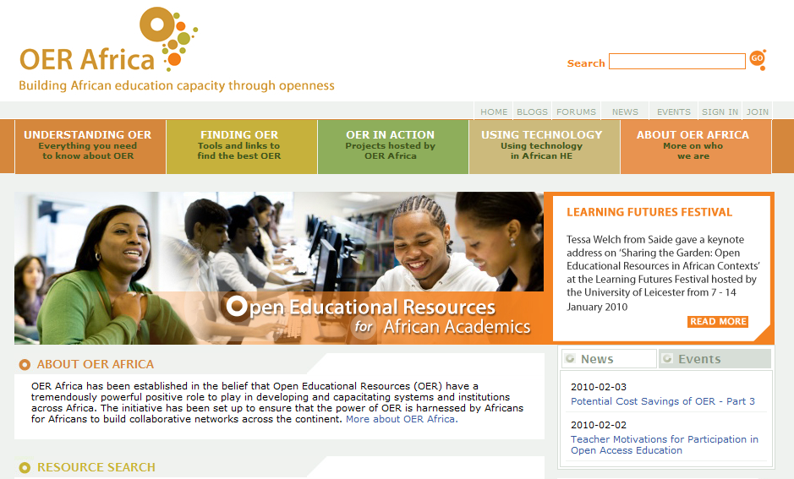
Open content: Contribute to knowledge
  African universities contribute scholarly knowledge
“Our sources of information are the same. The way that we think is dominated by monolithic groups . If we don’t assert ourselves we are going to be swallowed up by other players.” Dr Peter Mwikisa
51 repositories in 15 African countries
Notes:
At the individual level, a university can contribute resources while also building its own institutional profile. The University of Cape Town‟s OpenContent Directory (http://opencontent.uct.ac.za/) presently makes available 142 resources from 48 departments in the university. Usage statistics indicate that since its launch in February 2010, visitors have accessed resources 28,921 times. About two-thirds of the site‟s visitors are from African countries – of the 31,712 visitors from 166 countries, 20,841 were from 42 African countries.
In addition to access, the open imperative also enables participation and collaboration. An example is the African Virtual University (AVU) which through its Open Education Resources Portal provides an example of both community building and contribution. Through the AVU Portal launched in January 2011, the AVU has made available 219 open educational modules in three languages (largely in maths and science). These were developed collaboratively by clusters in 10 African countries and the resources have been downloaded by 142 countries, with significant numbers from Brazil and the United States (Diallo 2011). The Portal has been internationally recognised, receiving the Best Emerging Initiative Award in the OpenCourseware People.s Choice Awards in 2011.

Slide 29
Open licensing
Previously copyright was binary: All rights retained or public domain
Copyright © |  | Public domain
Now alternative licensing options such as the GNU General Public License and Creative Commons provide a range of options where some rights are reserved
Copyright © | Some rights reserved | Public domain

Slide 30



Open Access
the form of online publishing where access is free for the user
The SHERPA/RoMEO service provides a listing of publishers' copyright conditions as they relate to authors archiving their work on-line.
http://www.sherpa.ac.uk/
OpenDOAR is an authoritative directory of academic open access repositories.
http://www.opendoar.org/
2085 repositories
The Public Library of Science is a non-profit organization of scientists and physicians committed to making the world's scientific and medical literature a freely available public resource.
http://www.plos.org/
The Directory of Open Access Journals indexes free, full text, quality controlled scientific and scholarly journals.
http://www.doaj.org/
7070 journals 2011
Notes:
http://openaccessenvironmentalist.wordpress.com/2009/04/04/what-is-open-access-2/
http://www.plos.org/
The Directory of Open Access Repositories (DOAR) now lists 2,085 repositories globally, of which 51 repositories are found in 15 African countries.
Insert image of DOAR

Slide 31
Open access & increased citations
Open access publishing increases visibility, the opportunity for use and the possibility of impact.
Majority of studies have shown an increase in citations arising from open access.
Of the 35 studies surveyed, 27 have shown a citations advantage (the % increase ranges from 45% increase to as high as 600%), with only 4 showing no advantage
Swan A (2010) The Open Access Citation Advantage: Studies and Results to Date. Available at http://eprints.ecs.soton.ac.uk/18516/

Slide 32
Open access & developing countries
The influence of free access on citations is twice as large for the poorer countries in the developing world compared to richer countries as measured by per capita GNI
Evans J and Reimer J (2009) Open Access and Global Participation in Science. Science 323(5917): 1025

Slide 33

Open Research
Replicable (transparency - method)
Reusable (results free for re-use and appropriation)
Replayable (tools available for appropriation)
Collaborative
Interdisciplinary
Granular
Immediacy factor
Crowdsourcing

Slide 34


Slide 35
Open education: benefits
Access to knowledge
Participation
Visibility
Influence
Quality
Academics’ agency

Slide 36
Conclusion
Monitor changing environment
Exploit existing technologies
Build cyberinfrastructure to enable openness

Slide 37



Laura.Czerniewicz@uct.ac.za
Twitter: czernie
This work is licensed under the Creative Commons Attribution-Share Alike 2.5 South Africa License. To view a copy of this license, visit http://creativecommons.org/licenses/by-sa/2.5/za/ or send a letter to Creative Commons, 171 Second Street, Suite 300, San Francisco, California, 94105, USA.

