Slide 1

Open Educational Resources at the University of Cape Town
By Thomas King, 13 March 2014
This work is licensed under a CC-BY 4.0 Unported license.

Slide 2
The Vice-Chancellor’s Open Educational Resources Adaptation project
Goal: support lecturers interested in sharing educational resources openly and increase the number of resources in the OpenContent directory.
Funded by the Vice-Chancellor’s fund, for 1 year
And composed of 1 project coordinator, one student coordinator, and six student facilitators, one from each Faculty.
Method: Student facilitators actively solicit content from lecturers within their faculties bas

Slide 3
Sourcing
Student facilitators (and the student coordinator) approached lecturers to solicit teaching and learning materials
Masters students selected due to their combination of:
content knowledge: knowing what would be worthy potential OER, and;
personal relationships with lecturers: knowing who to contact.
This process took time!
Not all lecturers know about Open… anything, really
Not all lecturers can see the value of sharing
And some lecturers are actively antagonistic to the concept

Slide 4
Adapting
Copyright clearance
Identify third-part copyright
Identify rights status of said copyrighted material
Replace
Remake
Request permission
Pedagogical choices
Not all content works in an online, decontextualised space
Students therefore make some choices – in consultation with the lecturer – about removing or reworking some content entirely.
Quality issues
Fixing typos, adding reference sections, general tidying-up.

Slide 5
Upload & Moderation
OpenContent is designed to be user-friendly for uploading content, using PeopleSoft and a relatively restricted set of metadata fields.
Once content changes have been made, or a lecturer uploads their own content, it joins a moderation queue before being published.
The project team at CILT moderate the resources, checking that the metadata matches the content, ensuring all fields are adequately filled, and publish the resource or remit back to the author if there are any problems.

Slide 6




Original by Shihaam Donnelly
Adapted by Thomas King

Slide 7
Disclaimer!
I am an anthropologist/ educational technologist, not a copyright lawyer.
I cannot therefore offer legal counsel, advice, or representation
(In case that should be relevant)
(… but it won’t be)

Slide 8
What is Copyright?
A set of exclusive rights, granted to the author, regarding a specific work, including:
Right to reproduce
Right to adapt
Right to distribute or sell
Right to publish
Right to perform or broadcast
Freedom to transfer the rights
Freedom to grant permission to use the work in a specified manner

Slide 9

Copyright law and its implications for the educator
Copyright is automatically assigned
In SA, it persists 50 years
Copyright owners may transfer their rights or grant individuals permission to use the work
And most importantly: copyright applies to items, not ideas.

Slide 10
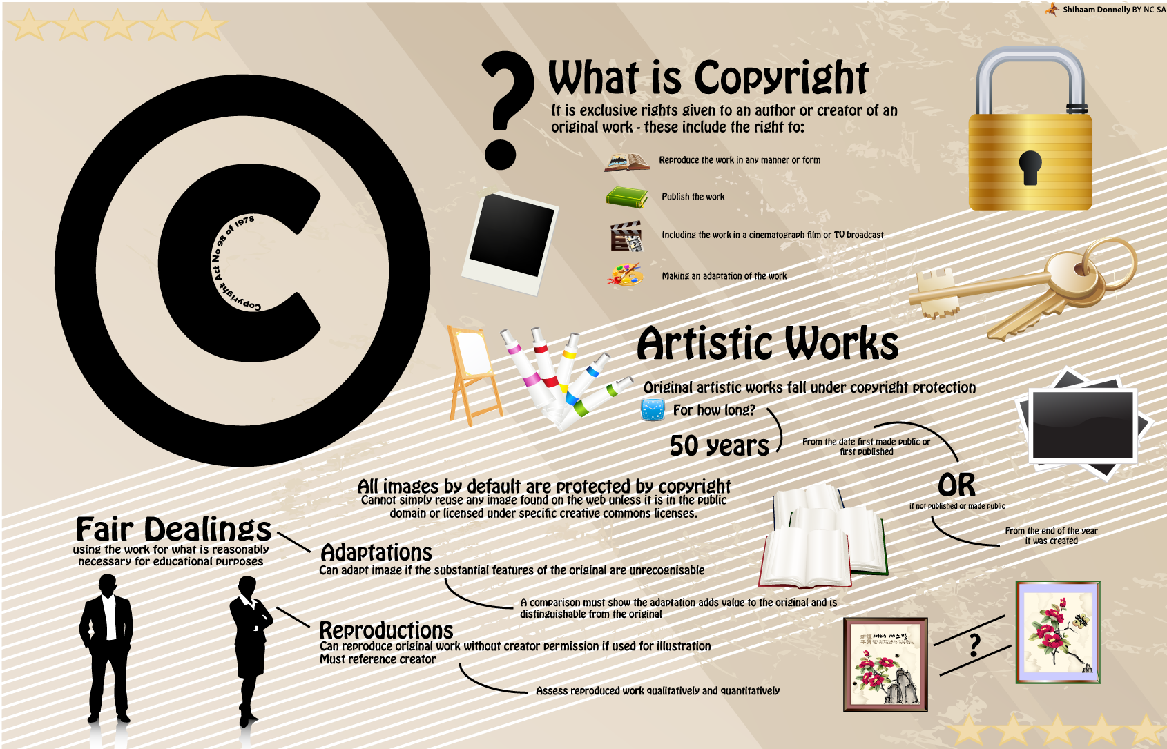
Notes:
http://education-copyright.org/copyright-in-digital-images/

Slide 11
Fair dealing in education
Section 12 of the Copyright Act allows for fair dealing (in America: Fair Use)
The use of copyrighted work without permission from the copyright holder for illustrative purposes
Name of author and source must be mentioned
Educators can use copyrighted materials in the classroom for illustrative purposes, but are limited in that they cannot share their materials online
No clear definition of what constitutes fair use
Various factors considered when determining fair use

Slide 12
Adaptation / Revision
Remember, copyright refers to discrete items, not ideas or concepts
You can rework an copyrighted image, graph or visualisation to fit your teaching context, so long as that reworking constitutes a qualitative change.
But still, reference the source!

Slide 13
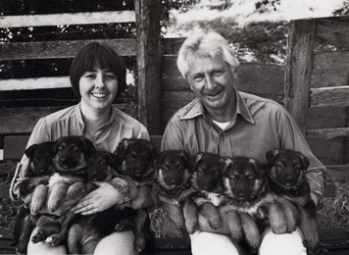
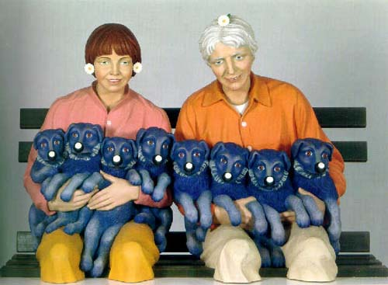
Notes:
Images sourced from http://observatory.designobserver.com/entry.html?entry=6467

Slide 14
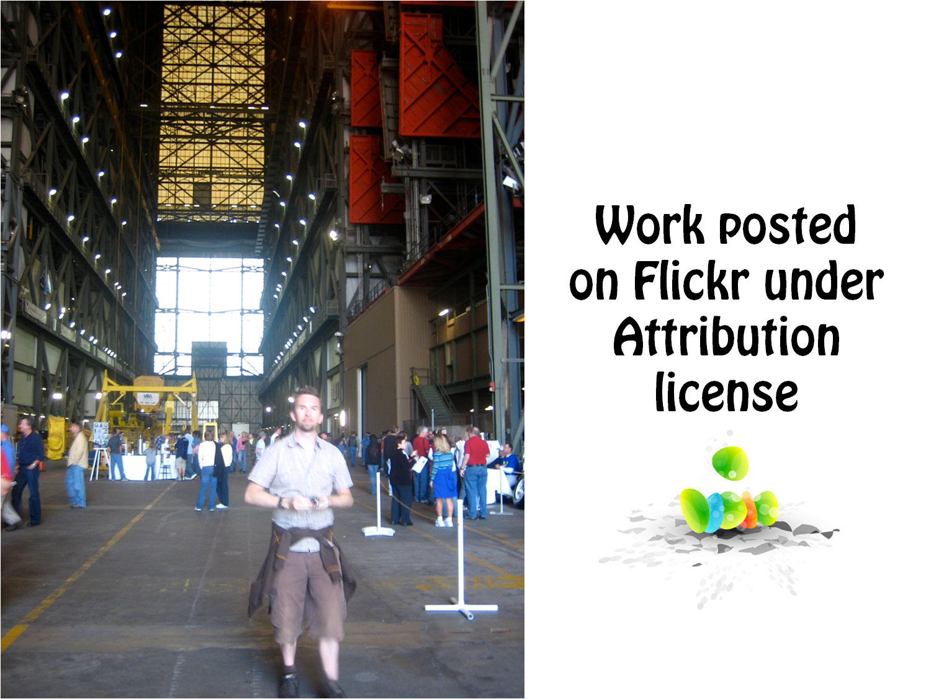
Notes:
Andy in the Vab by Adactio is under a Creative Commons Attribution License
Go to: http://www.flickr.com/photos/adactio/301112397

Slide 15
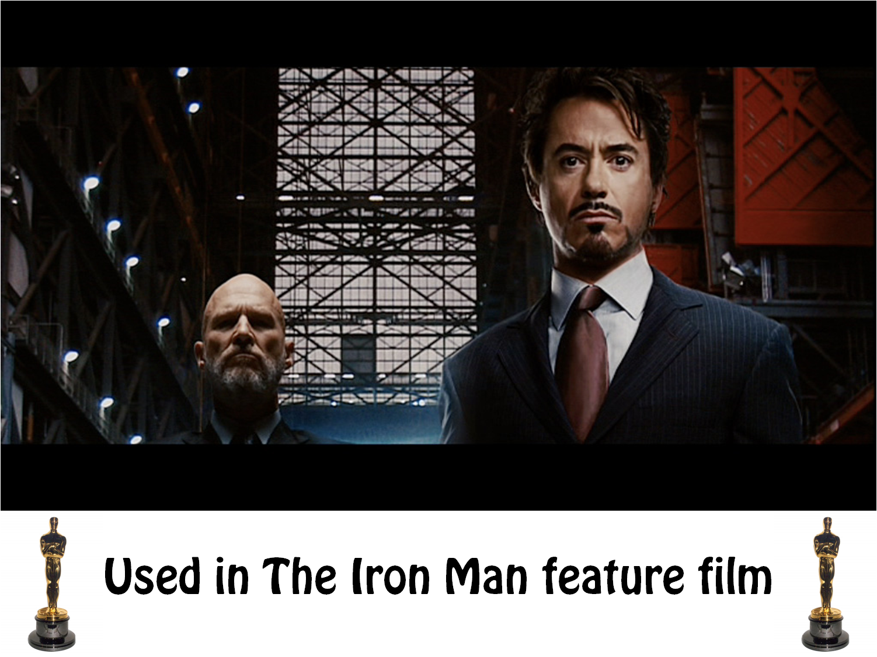

Slide 16
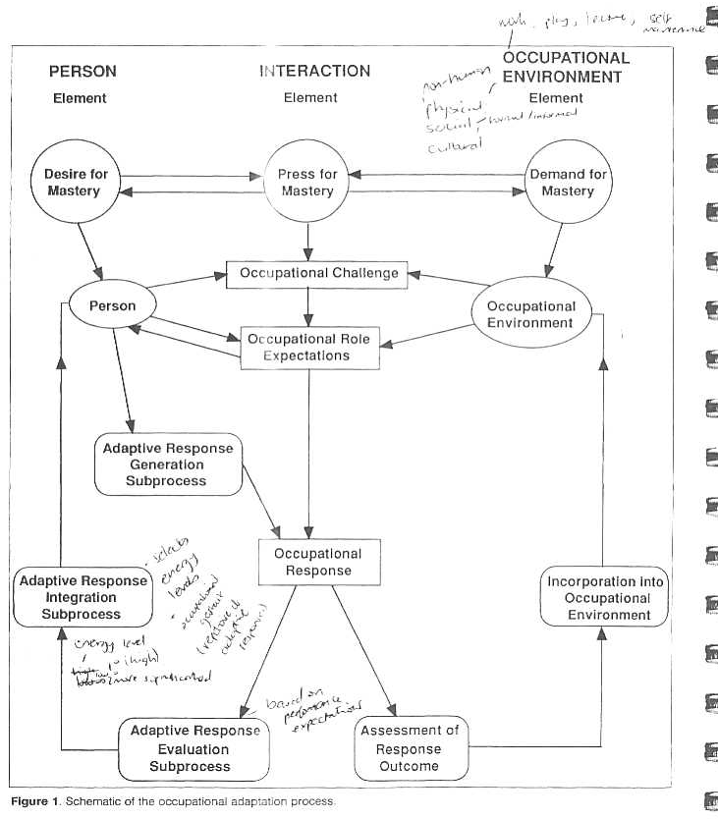

Slide 17
Press
for
Mastery
Demand for Mastery
Desire
for Mastery
Occupational Challenge
Occupational Environment
Persons System
Occupational Role Expectations
Incorporate Into Occupational Environment
Occupational Response
Generate Adaptive Response
Assess
Response
Outcome
Evaluate Outcome
Integrate Learning
Schematic of the Occupational Adaptation Process

Slide 18
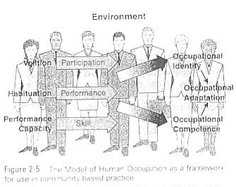

Slide 19

Environment
Volition
Participation
Occupational Identity
Habituation
Performance
Occupational Adaptation
Performance Capacity
Skill
Occupational Competence
Model of Human Occupation as a Framework for use in Community-Based Practice

Slide 20



Slide 21









Slide 22
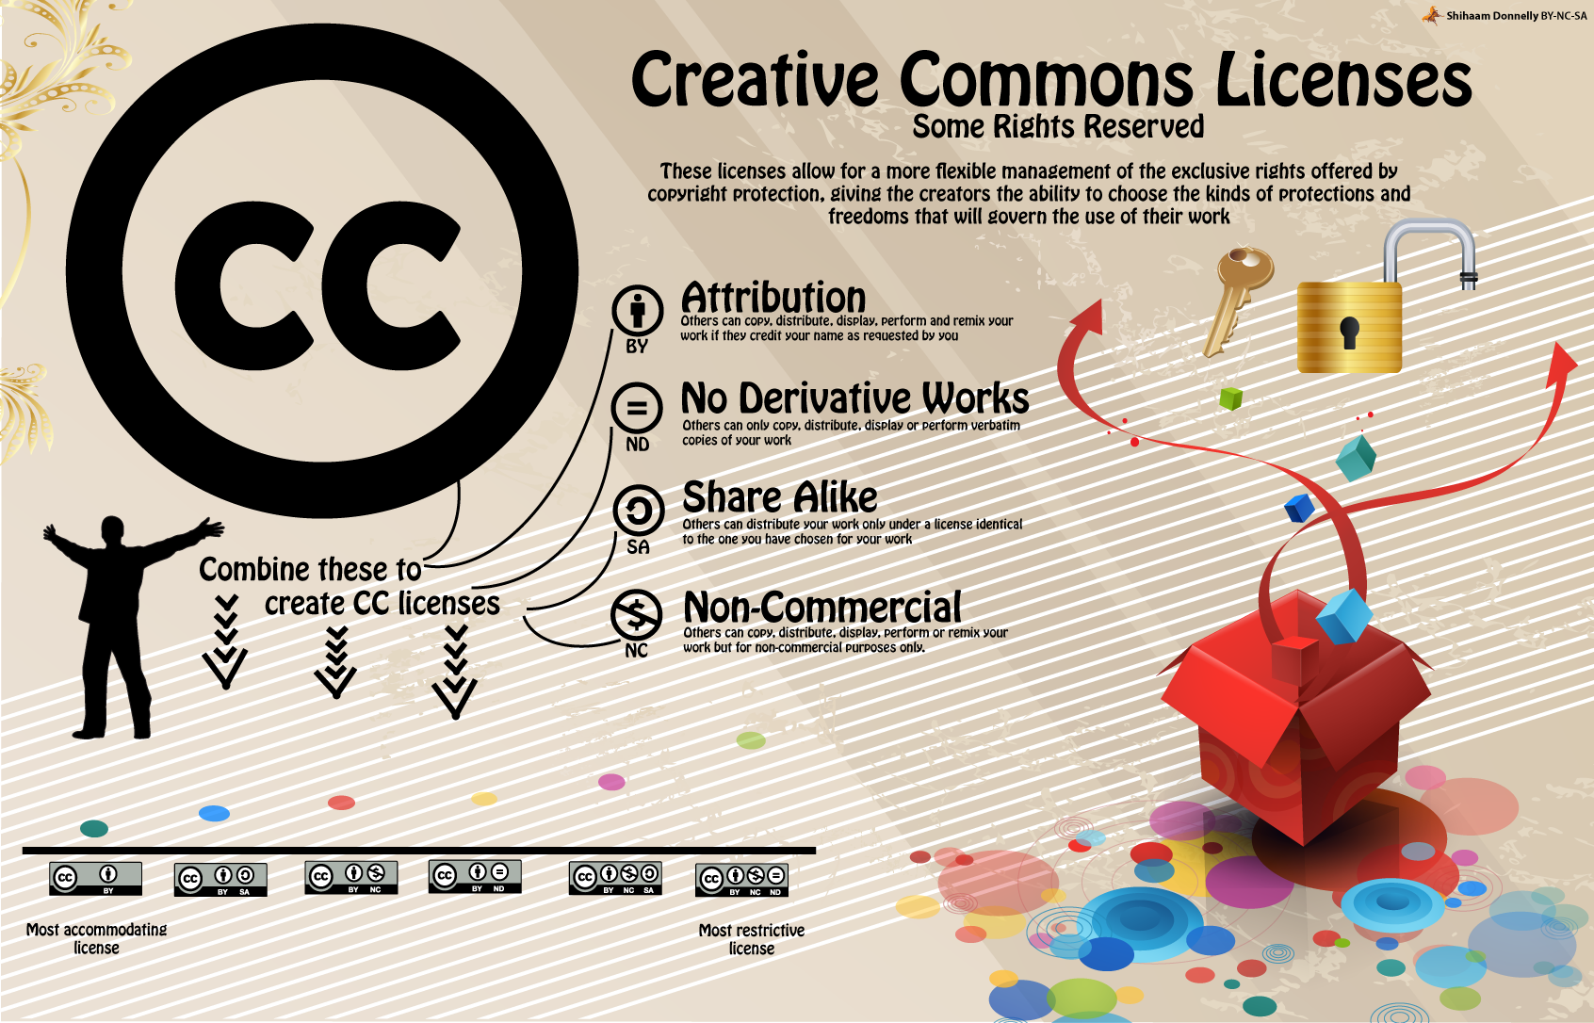

Slide 23


Notes:
http://education-copyright.org/finding-open-stuff-workshops/

Slide 24
If anyone is feeling worried, remember a basic academic tenet:
“Don’t claim others’ work as your own.”
That’s what it really boils down to, in the end.

