Slide 1



Publishing an academic book
EMERGING RESEARCHER PROGRAMME 2024
By Michelle Willmers
Publishing & Implementation Manager
Digital Open Textbooks for Development project, Centre for Innovation in Learning and Teaching,
University of Cape Town
11 November 2024

Slide 2
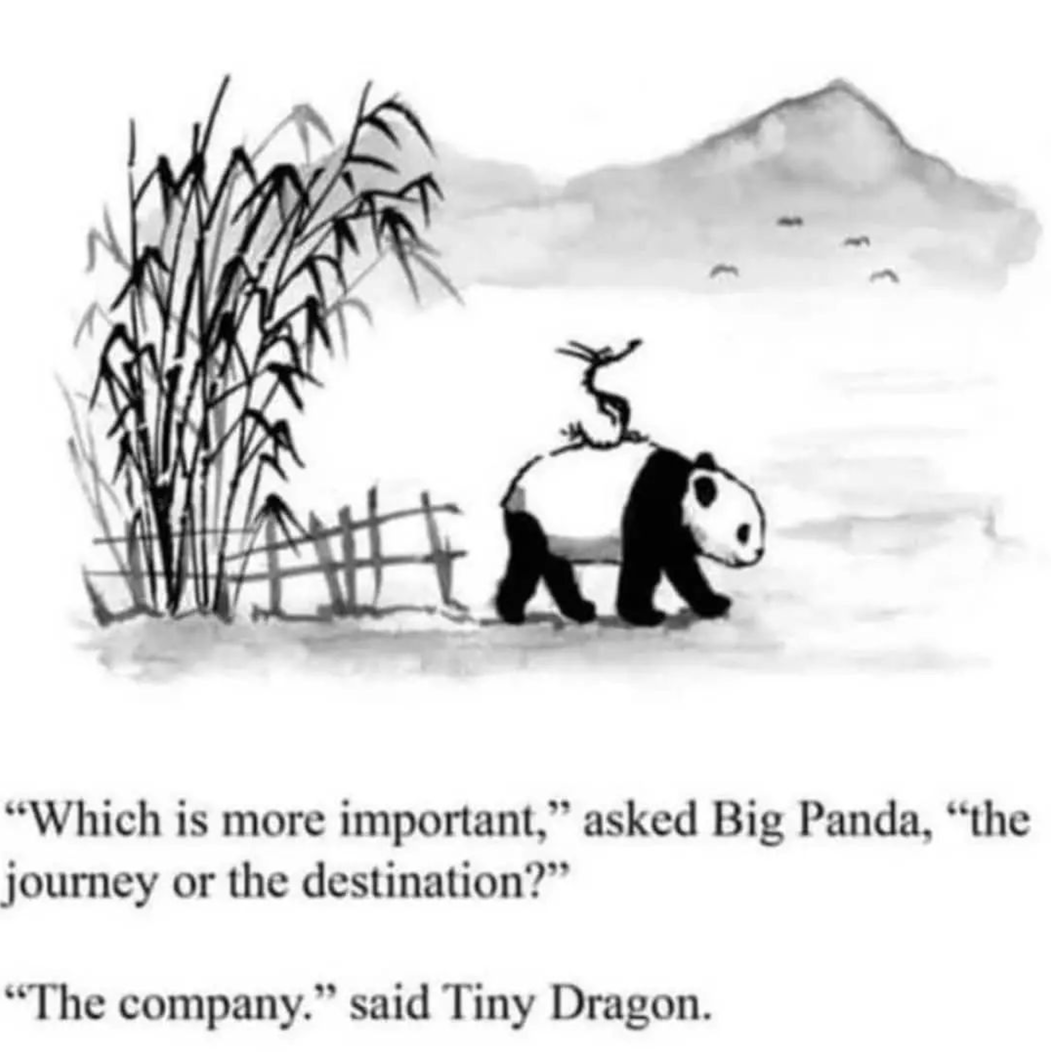

Slide 3
So you want to publish an academic book?

Slide 4
1. Why?
Addressing a particular niche area which is not viable for marketplace publishers (field building)
Publication count
Community-building
Promotion
Grant requirement
Pedagogical innovation
“It’s critical that it gets out there … and I want control over how it is delivered”
“There isn’t anything like it out there”
Challenging hegemony of corporate publishing
“I can’t do my job without it”
Multilingualism imperatives
Platform to profile divergent voices or particular Global South perspective
Curriculum transformation / localisation
Affordable access
Platform to encourage emerging / unpublished authors
Accessibility

Slide 5
Social justice drivers for book production at UCT
Affordable access
Curriculum transformation
Multi- lingualism
Locali- sation
Pedagogical innovation
Notes:
Key imperatives map to the dimensions presented in Nancy Fraser’s (2005) work on social justice
In our context (DOT4D cohort of grantees), authors/ academics identified particular injustices within their classroom contexts that drove/ encouraged them to adopt open textbook development

Slide 6
2. For whom?
Who is my primary audience?
Scholar to scholar
Community
Practitioners
Students
Policy-makers
Funders
What is my idea of “impact” or “success”
Citation
Funding
Field building
Growing community of practice
Network building
Developmental impact
Improved student pass rate
What data or evidence of impact / success can I gather?
Citation
Usage data (on content and host platform)
Student performance data
Community surveys / reviews
Network expansion (e.g. social media followers)

Slide 7
3. How?
From scratch or repurposed?
How will I manage copyright of third-party content?
How will I manage copyright of source content?
Is there an openly available (CC licensed) work that I can use as the foundation?
Solo
Solo author with intermediary engagement
Solo author with colleague involvement
Solo author with student involvement
Collaborative
Lead author as editor-in-chief with colleague co-authors
Content development facilitator with colleague co-authors
Content development facilitator with colleague authors
Lead author as editor-in-chief with student involvement
Lead author as editor-in-chief with student co-author
Content development facilitator with student co-authors
Content development facilitator with student authors

Slide 8
Do you want to be the author, the editor or the publisher?

Slide 9
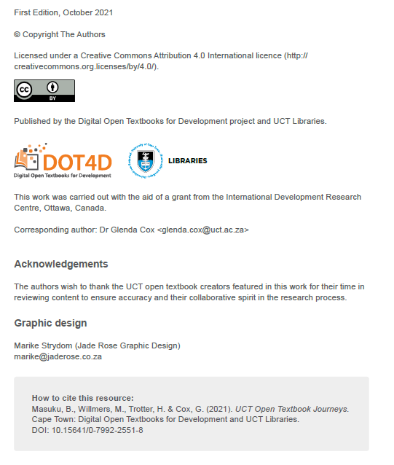
A book’s imprint page provides a record of publishing details.
It also (re)presents the conditions (or ethos) under which the work is released.

Slide 10
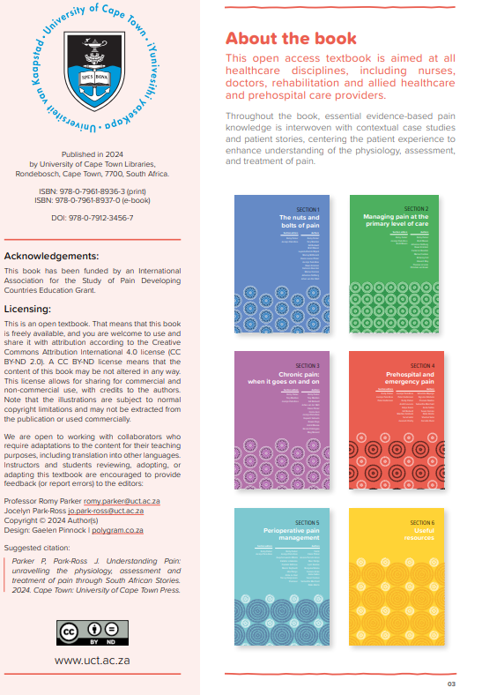
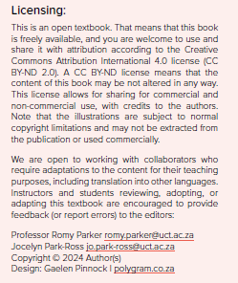

Slide 11
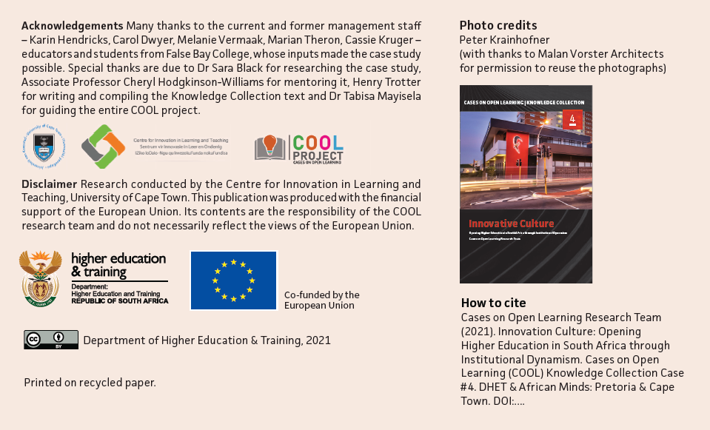

Slide 12
Collaborative authorship approaches to book production

Slide 13
Where do I start?
Before you can write, you need to scope and conceptualise. As you get into thinking about the content you want to produce and how you are going to do so, it is useful to capture your thinking in scoping or concept document.
1. What are the implications of the problem you are trying to address for your authorship strategy?
How will you include colleague and student collaborators?
What percentage of the work do you expect your different kinds of collaborators to do?
What kind of support will authors require?
2. Try to maximise efficiency from the outset.
Check to see if there is (good/appropriate) content you (legally) reuse from elsewhere.
Make use of stylesheets and templates to streamline your editorial process.
Provide clear ‘Instructions to Authors’ so that your collaborators are all on the same page.
Bring someone on board to project manage and curate the process.

Slide 14
Also, you need to think about…
Copyright and licensing
Some full-text content can be legally shared in your teaching or everyday work context, but you cannot legally retain or reshare it publicly. Educate yourself on basic principles of copyright and open licensing. Seek help in your library/institution if you’re not sure.
Resourcing
You need to think about the resourcing you will require to execute your plan, so it is useful to articulate a budget (even if you don’t have any money!). When you have a budget, it makes looking for funding a little easier.
Capacity building
This is a new area of work for most and some people need a little more help and support in the writing process than others, particularly if they writing in a language that is not their home language. What can you provide in terms of mentorship and developmental editing?

Slide 15
What about quality?

Slide 16
“Quality” = fit for purpose

Slide 17
Quality assurance approaches used in UCT book publishing processes
SCOPING
IN CONTENT DEVELOPMENT
IN PRODUCTION
POST-PUBLICATION
Delphi consensus study
Student review and testing
Institutional intermediary editorial support
Peer review: community
Delphi consensus study
Community, colleague & student consultation
Colleague review
Peer review: colleagues
Community, colleague & student review
Institutional intermediary publishing support
Student review and testing
Peer review: students
Professional resource design and production
Professional editing and proofreading

Slide 18
What are the possible publishing approaches?

Slide 19









Publishing models and partners in the UCT landscape
Author as publisher
Research unit / department / Initiative
UCT Libraries
External publishers
Colleagues
External commercial publishers
Students
External non-profit publishers
Funder publishers
Read more about the history of UCT Press
https://open.uct.ac.za/bitstream/handle/11427/29107/Case_Study_4_UCT_Press.pdf?sequence=1&isAllowed=y

Slide 20
Any questions?

Slide 21
How sustainable is it?

Slide 22
Time
Significant time commitment
Protracted cycles of time
Collaboration takes time.
Processing student-authored content can take much longer than content produced by academic peers.
Processes do not neatly align with academic calendar(s), collaborator or grant funding timeframes.
Life happens.

Slide 23
Recognition and reward
UCT Vision 2030 positions open knowledge production and sharing for social justice as a key aspect in meeting its central mission
UCT Ad Hominem promotion system varies across faculties in terms of recognition of independently published work. Review process underway in line with Vision 2030 strategic approach.
Small grants programmes within the university (～R20k) for teaching innovation and curriculum change initiatives effective for stimulating activity and engaging students.

Slide 24
> Innovation > Development of new skill sets and professional identities in line with 21st century scholarship > Deeper exploration and understanding of what scholarly engagement/ communication truly is and what it entails > Laying new career paths > Collaboration and Global South knowledge contribution
Some positive outcomes
MANTRA: PROCESS OVER PRODUCT

Slide 25
Don’t even know where to start?

Slide 26
Develop a concept document to articulate your vision
1. Why?
2. For whom?
3. How (and with whom)?
4. Authorship approach
5. Quality assurance approach
6. Publishing approach
Copyright and licensing
Marketing
7. Resourcing / budget
8. Partners

