Slide 1

Open data: Who takes responsibility?
Daniel Hook
Digital Science
6th December 2016, Open Access Symposium, University of Cape Town
@danielintheory, 0000-0001-9746-1193
Notes:
Cross European Collaboration….Miloslav

Slide 2
Manifesto
Capture early…
Publication is no longer about a final record of work… its about a conversation regarding your data
Capture everything…
Small data, not just scientific data but all research data
Share early…
…wherever ethically allowable
Structure the data and get a persistent ID
Notes:
Misses subtlty…I also want to think about open data and open access as synonyms…they’re not but many of the same thoughts apply. They are two tightly coupled things and often one makes very little sense without the other.

Slide 3
Is there a hole in our data strategy?
Processing / Curation
Discovery “wavefront”
Closed / Embargo
Open
Undiscovered / Un-mined
Notes:
Punchline – if we don’t open the data up…then it sets us back in time…the width of that annulus is everything!

Slide 4
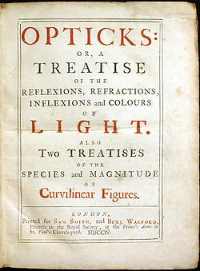
Leaving it to the academics?
Notes:
- Work done 1670/80s Newton specifically waited until 1704 to publish Opticks so that his rival Robert Hooke didn’t get to comment, having died in 1703…
- Shoulders of giants
- Left to academics – curiosity driven research…

Slide 5
From Open Data to Open Ideas?
Notes:
Professor Sir Tim Gowers FRS, University of Cambridge…same university, same subject…completely different approach…of course…the system *is* a problem – Tim has a fields medal, 1998 (at 35), FRS 1999 (at 36), knighthood 2012 (at 49). Of course, he can give away his ideas…he has nothing to lose! We’ll come back to that point…

Slide 6
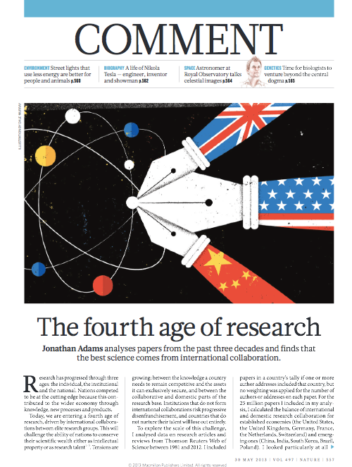
The fourth age of research…
Individual
Institutional
National
International
Notes:
So, according to my colleague Jonathan Adams, we are in the fourth age of research (1. working alone… 2. collaborating locally, 3. collaborating nationally. 4. collaborating internationally) But…there is another axis – when do we choose to share our data? I would argue that we’re still very much in the the first age of data sharing – people still try to keep competitive advantage… so we lose small data because it doesn’t get shared early – by its very nature it’s more volatile (in the computer scientists sense of the word)… The polymath project…mathematicians are typically unfettered by data considerations, their ideas are much more significant in terms of their research outputs…yet they managed to start creating an ethos of sharing…

Slide 7
The fourth age of research…
The unregulated era
The era of evaluation
The era of collaboration
The era of impact
Notes:
Cynical view - At odds with previous slide (we’re going backwards)…impact tends to be less international and less collaborative

Slide 8

In the hands of institutions?
Notes:
- Institutions are sychizophrenic – librarians…provosts…
What do institutions care about?
- Continuing to exist
- Attracting good people so that more good people will come
- somwhere lower on their list, after international ranking, student intake, student rankings, new building proejcts, ensuring that fdacilities allows them to do world-class research… comes Open Access / Open Data – it is an important concept and “close to the heart” hence it is on the agenda…which, given other pressures is completely amazing!
- But to imagine that an institution will invest heavily in this area for the many years that are required…it’s not sustainable for the institution in the long term…

Slide 9
In the hands of publishers?
Notes:
Gutenberg…publishers aren’t that bad…but honestly, while they *are* an important part of the academic process as an “impartial third party”, precisely because they are neither institutions, nor government, they don’t have the power to change the academic establishment…apart from in one respect..changing business models…

Slide 10
In the hands of governments?
Notes:
Governments, bizarrely also don’t care….same concerns as institutions…they want to be nationally competitive

Slide 11

In the hands of technologists?
Notes:
Data curation / data provenance / automated approaches…we don’t have a vested interest…we want to sell tools to everyone…we want data to be a “Big thing” because we’re all dreamers…

Slide 12
In truth, we must all play our part...
Governments
Publishers
..and funders, should impose well-thought out mandates on research associated with public-
and charity-funded research
Innovate new business models
that allow data to be freely available and that still preserves academic freedom
Researchers
Technologists
Should think responsibly about
what data can be made available
to stop other researchers needing
to “reinvent the wheel”…when
using someone elses data,
be generous!
Improve technology solutions so
that data can not only be stored by provenence bet preserved and curation be more automated
Notes:
New challenges…. Small data is the problem…this is what gets lost…

Slide 13
In truth, we must all play our part...
Institutions
Engage with technology – don’t assume that a digital repository will automatically “innoculate” you against OA…this is a bigger issue and you need to think
facilitate culture change…
outreach programs to help change the culture and educate young academics about the positive side of sharing data
MAKE SOMEONE A PROFESSOR FOR SHARING DATA!
Notes:
New challenges…. Small data is the problem…this is what gets lost…

Slide 14
Are we, and should we be “open by default”?
Notes:
Well…one way that we used to open data recently was to analyse the UK Brexit situation…

Slide 15
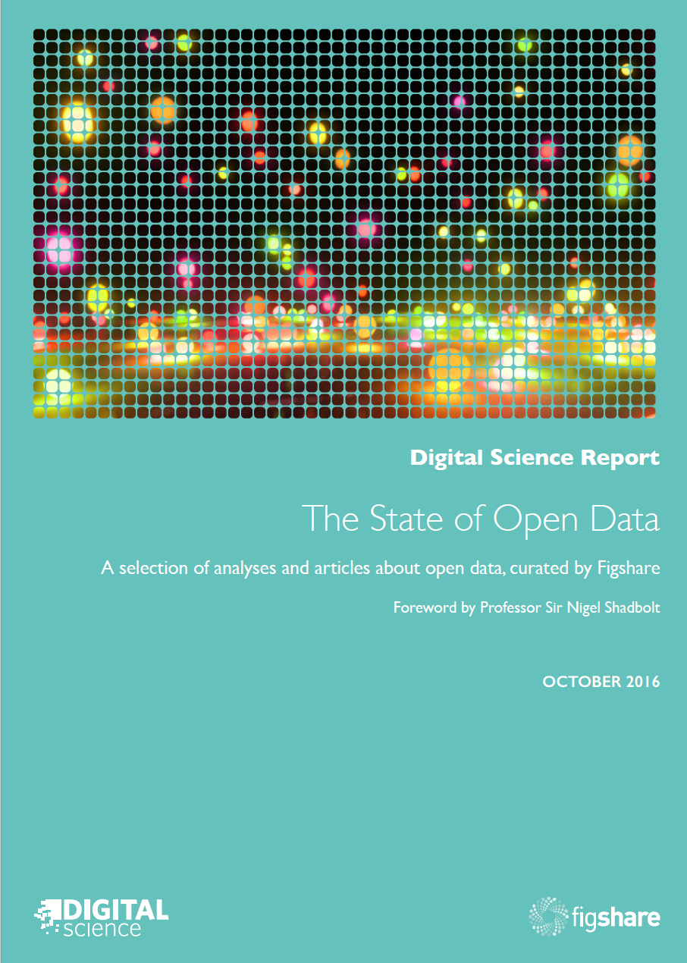
Results of a survey carried out in collaboration with
SpringerNature and Digital Science. Circa 2000 faculty
and staff surveyed about their relationship with open
data.
Forward by Sir Nigel Shadbolt, Founder of the Open
Data Institute in the UK
Articles from experts and practitioners:
Why Open Data Now? Big Data, Knowledge
Production and the Political Economy of Research
Open Data Will Save Lives – Notes from the AllTrials
Campaign for Clinical Trials Transparency
Practical Steps for Increasing the Openness and
Reproducibility of Research Data
Emerging Policies for Open Research Data in the US
Building Trust – The State of Open Data in Burkina
Faso
The State of Australian Research Data – Systems
are ready but where are the incentives?
Can Japan Catch up? Fostering Culture, People, and
Community for Research Data
The Bird in Hand: Humanities Research in the Age of
Open Data.

Slide 16

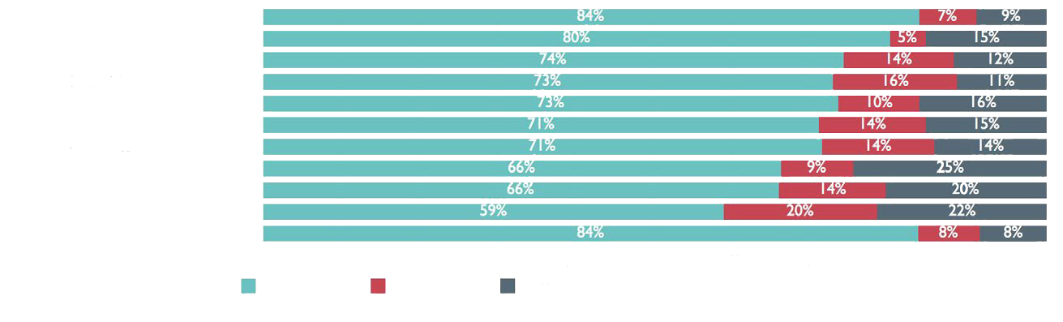
Awareness

Slide 17
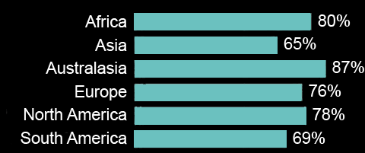
Awareness

Slide 18
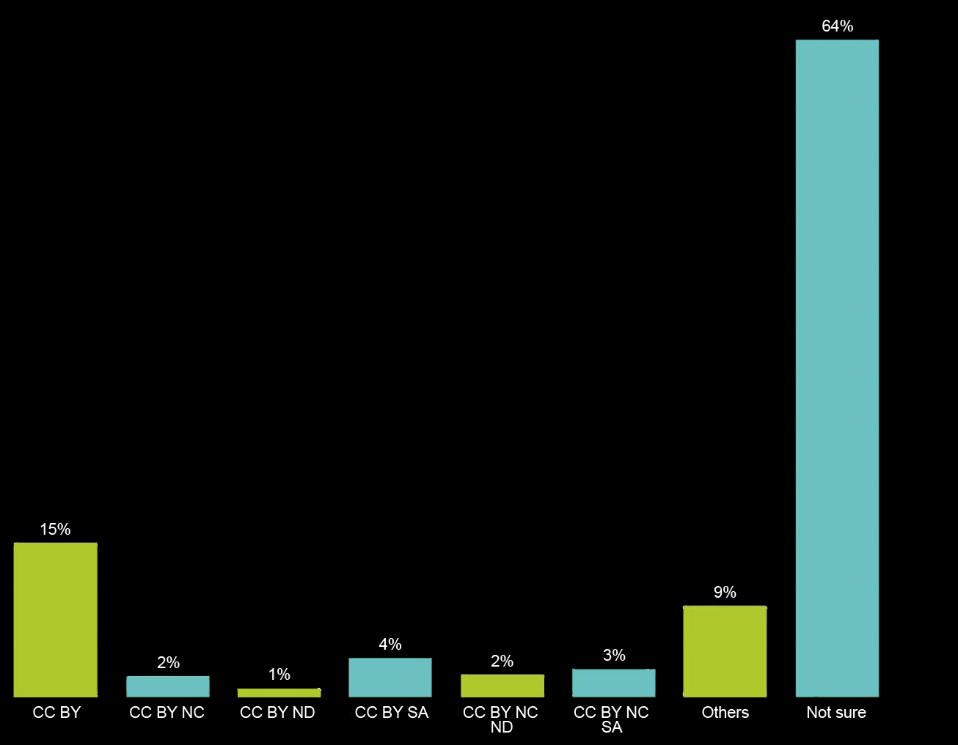
Understanding

Slide 19
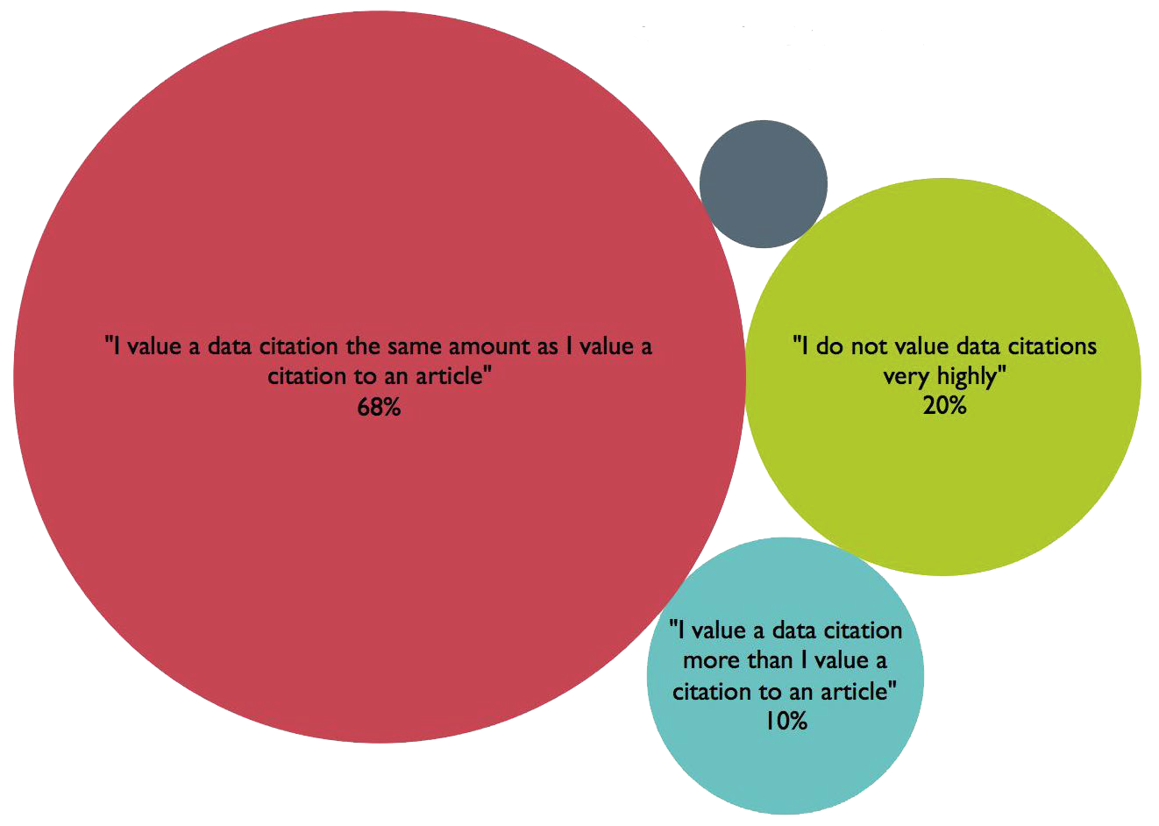
Acceptance
Notes:
Key outcomes of the report….

Slide 20
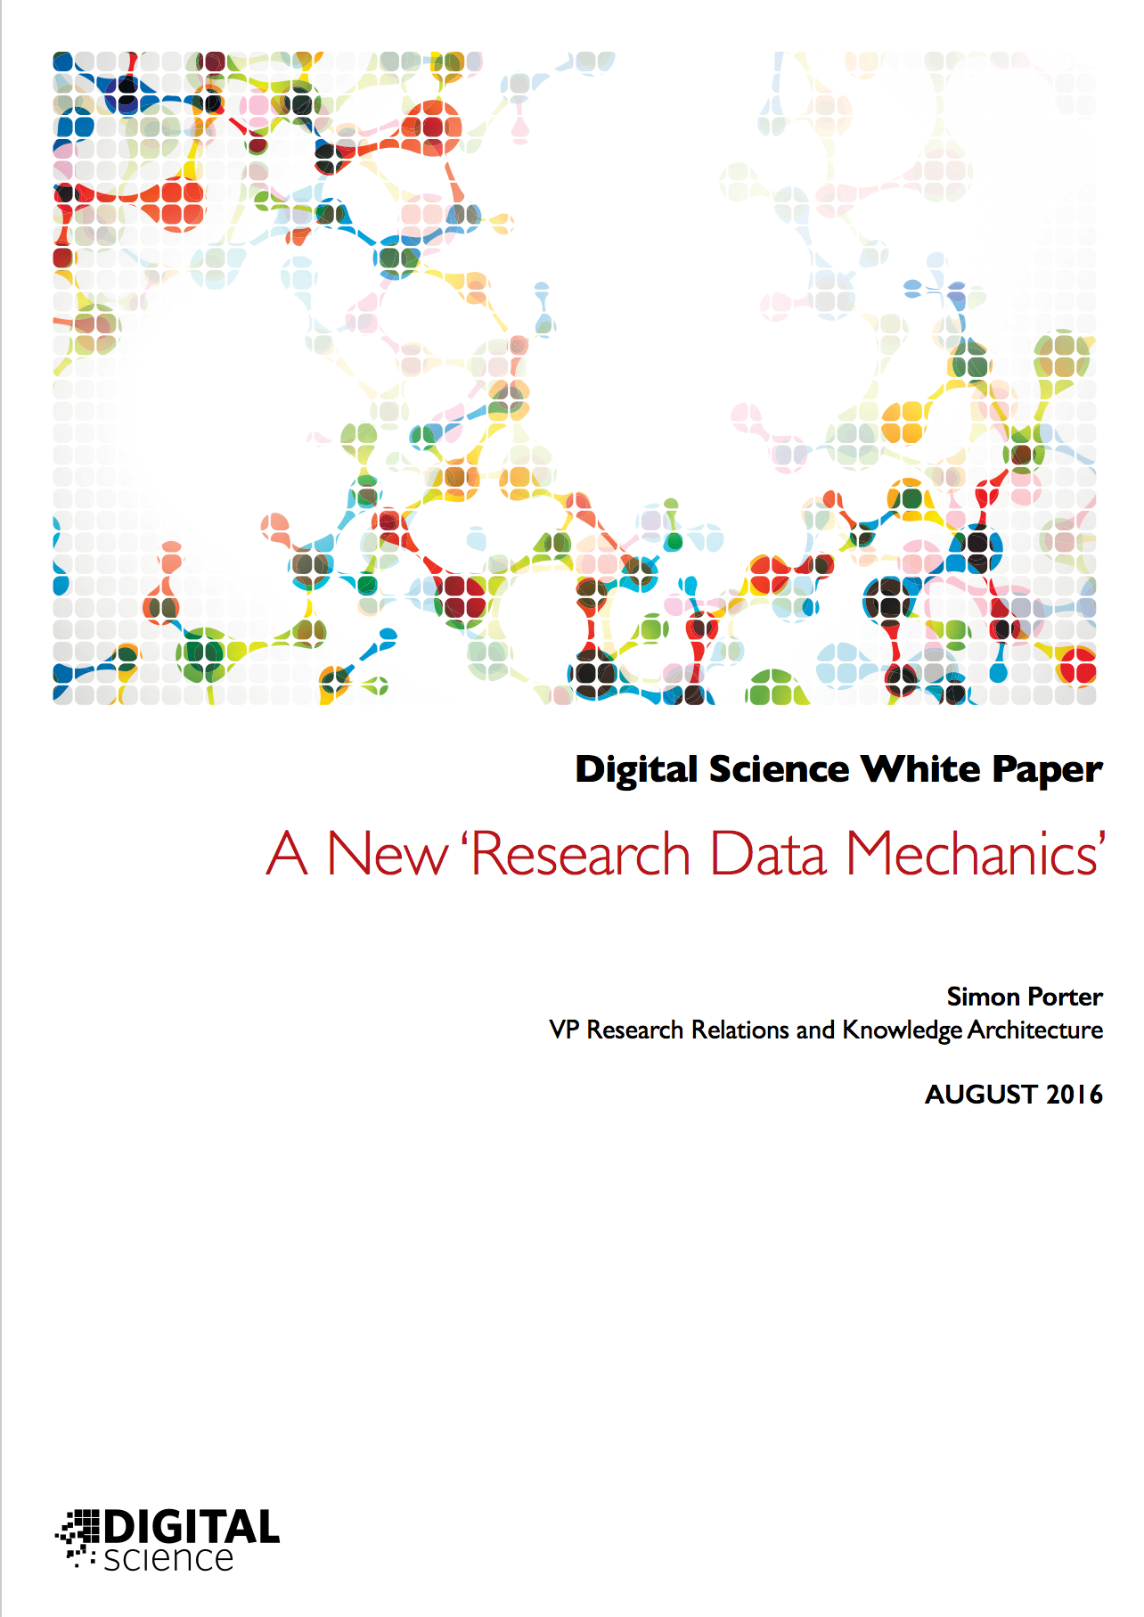
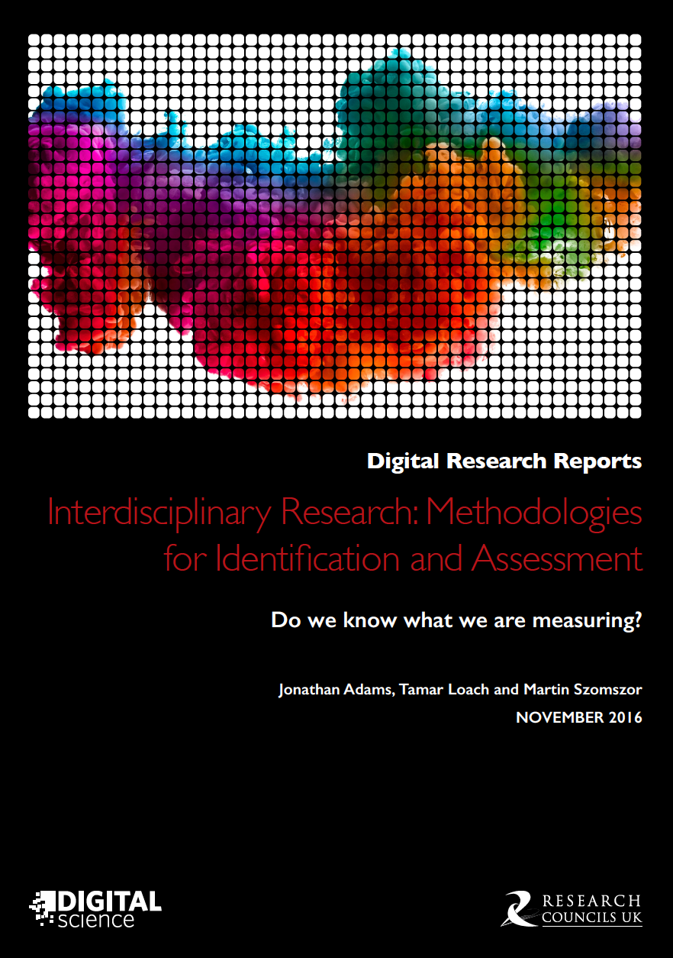
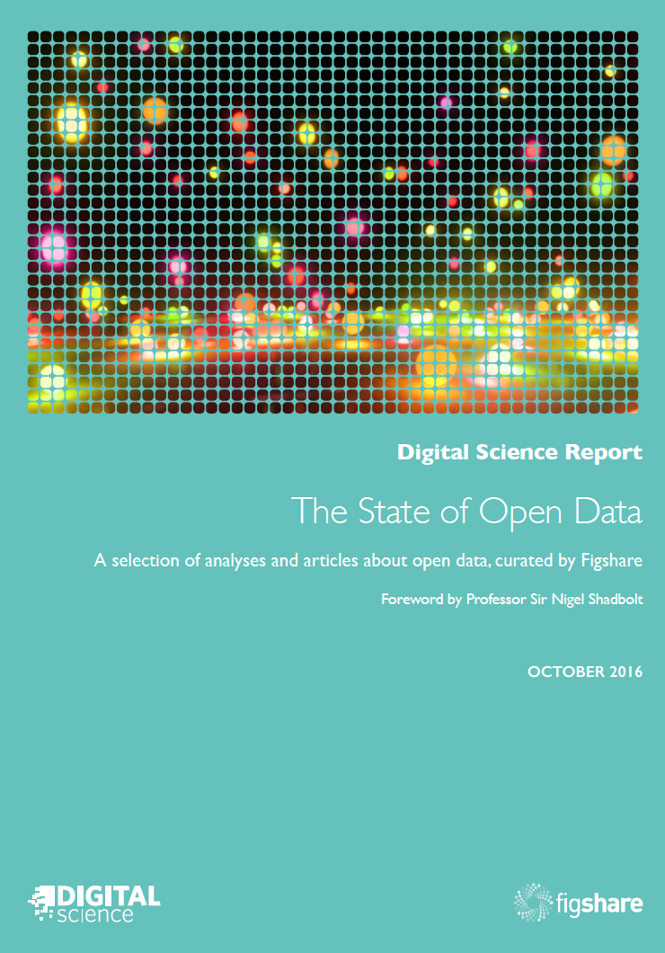
Whitepapers
Research Reports
“Science” Reports
Longer pieces explaining how
Digital Science thinks about
the space in which we work.
Designed to explain our ethos
and approach.
Topical pieces that do deep
dives into issues of interest
to our community. For
example: use of altmetrics,
research/science policy,
collaboration.
Product aligned reports that
centre around particular use
cases, studies or surveys. For
example: the Figshare State of
Open Data report and survey

Slide 21
Thank you

