Slide 1



Publishing an academic book
EMERGING RESEARCHER PROGRAMME 2021
By Michelle Willmers
Publishing & Implementation Manager
Digital Open Textbooks for Development project, Centre for Innovation in Learning and Teaching,
University of Cape Town
17 May 2021

Slide 2


This work is carried out with the aid of a grant from the International Development Research Centre, Ottawa, Canada.
It is licensed under a Creative Commons Attribution 4.0 International licence.

Slide 3
What this is not...
How to get published

Slide 4
So you want to publish an academic book?

Slide 5
1. Why?
Addressing a particular niche area which is not viable for marketplace publishers (field building)
Publication count
Community-building
Promotion
Grant requirement
Pedagogical innovation
“It’s critical that it gets out there … and I want control over how it is delivered” (need)
“There isn’t anything like it out there” (novelty)
Challenging hegemony of corporate publishing
Multilingualism imperatives
Platform to encourage emerging / unpublished authors
Platform to profile divergent voices or particular Global South perspective
Curriculum transformation / localisation
Affordable access
Accessibility

Slide 6
2. For whom?
Who is my primary audience?
Scholar to scholar
Community
Practitioners
Students
Policy-makers
Funders
What is my idea of “impact” or “success”
Citation
Funding
Field building
Growing community of practice
Network building
Developmental impact
Improved student pass rate
What data or evidence of impact / success can I gather?
Citation
Usage data (on content and host platform)
Student performance data
Community surveys / reviews
Network expansion (e.g. social media followers)

Slide 7
3. Do you want to be the author or the publisher?

Slide 8
Authorship models at UCT
Solo author + colleague involvement
Lead author as editor-in-chief with colleague co-authors
Content development facilitator with student and colleague co-authors
Solo author + student involvement
Lead author as editor-in-chief with student co-authors
Lead author as editor-in-chief with student and colleague co-authors

Slide 9
Publishing models at UCT
Author as self-publisher
Initiative as self-publisher
UCT Libraries
External publisher
UCT Libraries + institute / initiative / author as co-publishers
External publisher + institute / initiative / author as co-publishers

Slide 10
4. Who are your partners in the process?

Slide 11
Publishing partners in the UCT publishing landscape
Colleagues
Research unit / Department
Funders
External publisher
Colleagues and students
UCT Libraries
UCT Press
Research Office
Read more about the history of UCT Press
https://open.uct.ac.za/bitstream/handle/11427/29107/Case_Study_4_UCT_Press.pdf?sequence=1&isAllowed=y

Slide 12
You need to be guided in your publishing decision-making process by:
Your original intention / strategy / mission
  Including which audience you are trying to reach and what your idea of impact is
Realistic approach to resourcing limitations
Relationship with partners
  Acknowledging dependencies as part of risk management
  Challenges of student involvement

Slide 13
These considerations should also dictate your approach towards:
Copyright and licensing
©
Level of inclusivity, collaboration and transparency in your process
PUBLISHING ETHOS

Slide 14
The growing universe of open source publishing tools and platforms

Slide 15
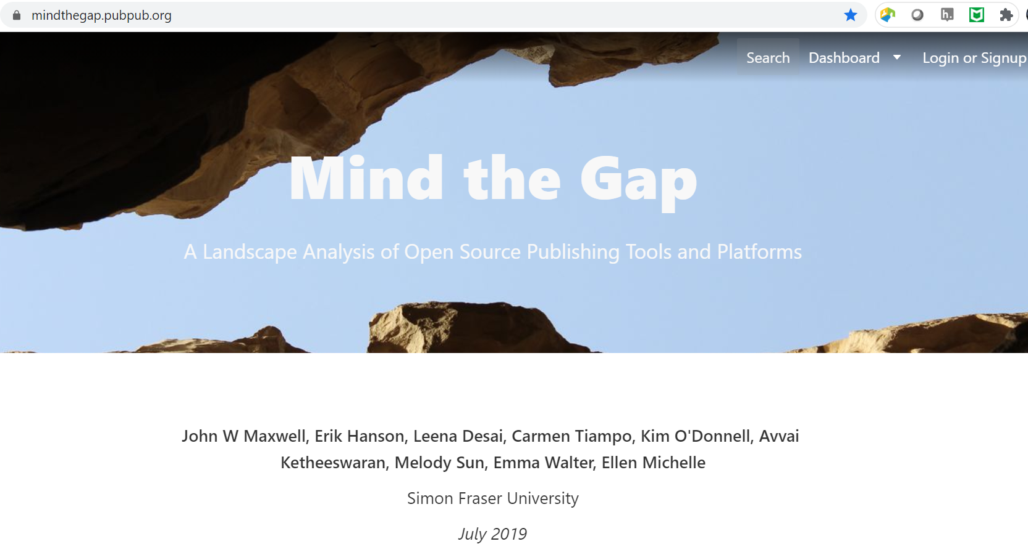
So you want to publish an academic book?
https://mindthegap.pubpub.org/

Slide 16
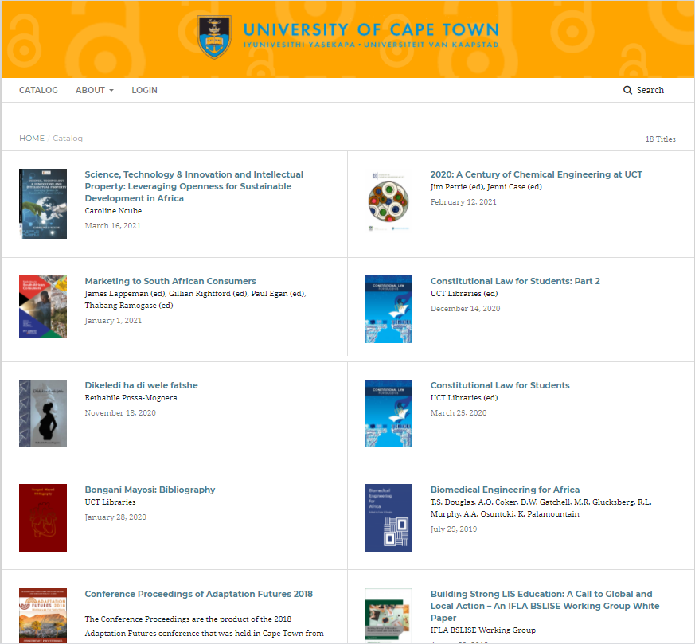
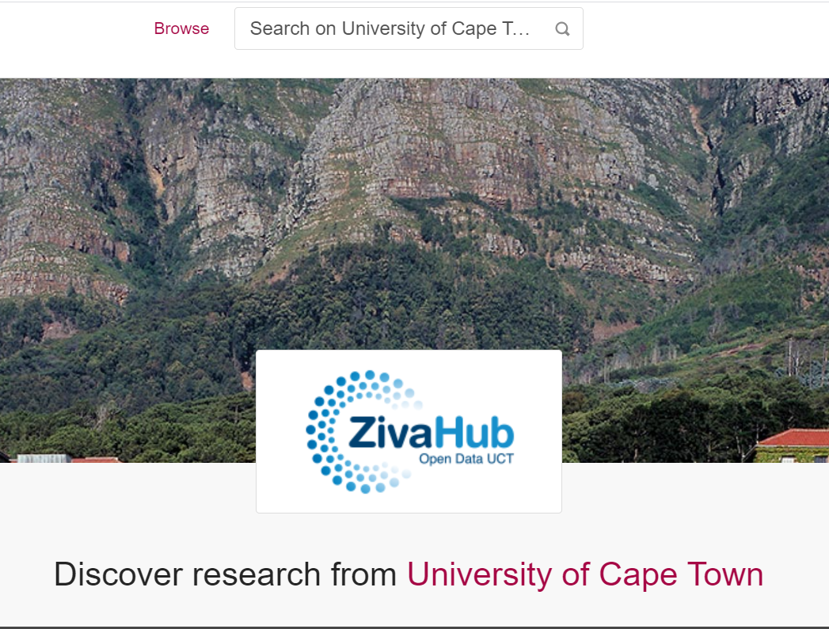
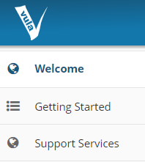


https://zivahub.uct.ac.za/
UCT Libraries Open Access Continental Publishing Platform
https://openbooks.uct.ac.za/uct/catalog
https://open.uct.ac.za/

Slide 17
What about quality?

Slide 18
Quality assurance approaches used in publishing processes at UCT
Delphi consensus study
Institutional intermediary editorial support
Research Office
UCT Libraries
Faculty Librarians
CILT
Professional editing and proofreading
Colleague review
Peer review
Community focused
Formal internally managed with publisher
Formal externally managed by publisher
Professional layout and graphic design
Student review
Survey
Supervisor review
Scoping phase
Institutional intermediary publishing support

Slide 19
And how sustainable is it?

Slide 20
TIME
Significant time commitment
Protracted cycles of time (collaboration takes time!)
Processes do not neatly align with academic calendar(s), collaborator or grant funding timeframes

Slide 21




SUPPORT
Research Office /
Research Support Hub

Slide 22
RECOGNITION AND REWARD
UCT Vision 2030 positions open knowledge production and sharing for social justice as a key aspect in meeting its central mission
UCT Ad Hominem promotion system varies across faculties in terms of recognition of independently published work
Growing emphasis on open access and developmental impact as important area of scholarly impact and funder criteria

Slide 23
Don’t know where to start?

Slide 24
