Slide 1
Lecturer: Eduard Campbell
E-mail: CMPEDU001@myuct.ac.za
March 2015
This work by Eduard Campbell is licensed under aCreative Commons Attribution-NonCommercial-ShareAlike 4.0 International License.

Slide 2
How do we integrate digital literacies into a lesson plan?

Slide 3
A look at the theory again…
Reflection
Exit if the barriers will overwhelm the instructional goal
Instructional Goal
Instructional Approach
Instruction
Can you overcome the constraints?
Tool Selection
Constraints
Affordances
Contribution to Instruction
Exit if using pencil & paper only
Source: Adapted from Hutchison and Woodward, 2014

Slide 4
How do we apply the planning cycle to a lesson plan?

Slide 5
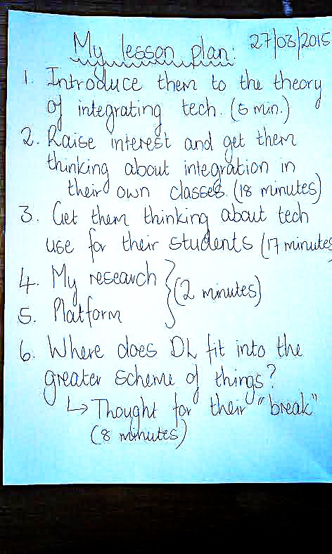
✔
Video?

Slide 6
What are the affordances of showing examples of “good” and “bad” videos in this specific class?

Slide 7
✔
✔
Video?
Image?

Slide 8
Remember the OVERALL class too – keep balance in mind

Slide 9
✔
✔
Video?
✗
Image?

Slide 10
What resources/activities can we use at this point of the class that will fit in with the overall class and that fits the learning outcome?

Slide 11
Group work: Technology use for YOUR LEARNERS
In groups of 5: compile a lesson plan for a grammar or short story class where you synthesize one or more of the tech “ideas” below with the digital resources you draw from the hat. You may get ideas from the internet using your phones or laptops if you want. Be creative!
Ideas:
Facebook groups… twitter feeds... screen adaptations… description of video/computer game… digital museum!… short movie… presenting their own lesson plan… picture books… online marketing campaigns… designing an app… collaborating… google docs… shooting a video… writing a song… recording a song

Slide 12
✔
✔
Video?
✔
Group work and use of own devices for internet searches
✔
Spoken
…
Video?

Slide 13
References
Hutchison, A. & Woodward, L. (2014). A Planning Cycle for Integrating Technology into Literacy Instruction. Reading Teacher, 67(6), 455-464. DOI: 10.1002/trtr.1225.

