Slide 1

Learning Analytics
New thinking supporting educational research
Andrew Deacon
Centre for Innovation in Learning and Teaching
University of Cape Town
3rd Learning LandsCAPE Conference, 14-16 April 2015, Cape Town
Notes:
I am talking about what we might do with the increasing volume of data from educational institutions.
My name is Andrew Deacon and I work at the UCT’s Centre For Innovation in Learning and Teaching.
I am interested in learning analytics and analysing educational data. I work on some large assessment projects. Today I am looking broadly the promise of learning analytics from by perspective at a South African university.
Analytics is a buzzword that encompasses the analysis and visualisation of big data. Current interest results from the growing access to data and the many software tools now available to analyse this data in Higher Education, through platforms such as Learning Management Systems. This seminar provides an overview of current applications and uses of learning analytics and how it can help institutions of learning better support their learners. The illustrative examples look at institutional and social media data that together provide rich insights into institutional, teaching and learning issues. A few simple ways to perform such analytics in a context of Higher Education will be introduced.

Slide 2
Outline
What is changing with ‘analytics’
Three ways educational data is analyzed
New questions in educational research
Changing roles of analytics
Notes:
Social Network Analysis and Learning analytics are emerging research area.
These range from a narrower perspective on researching learning activities to a broader view looking at learning environments in general. I am using the broader definition. This is a common understanding of the term. Other terms include educational analytics and academic analytics.
I also look at the data landscape is a broad way, considering both institutional data and data from beyond the university.
The toolsets I consider have a more narrowly focus. I am only considering those that could be used on standard computers using freely available software and UCT licenced software. Here I am thinking of R, SPSS, STATISTICA, NodeXL and Excel.
In the data we are looking at tends. That is to understand the past and then help predict the future.
There is also the challenge of presenting the data in engaging ways.
And imagining the future scenarios.

Slide 3

Learning Analytics
  … is the measurement, collection, analysis and reporting of data about learners and their contexts, for purposes of understanding and optimising learning and the environments in which it occurs.
https://tekri.athabascau.ca/analytics

Slide 4
Learning Analytics
data explosion at micro level – enriching and enriched by meso and macro levels
Macro
regional / national
Meso
institution / faculty
Micro
student / course / activity

Slide 5
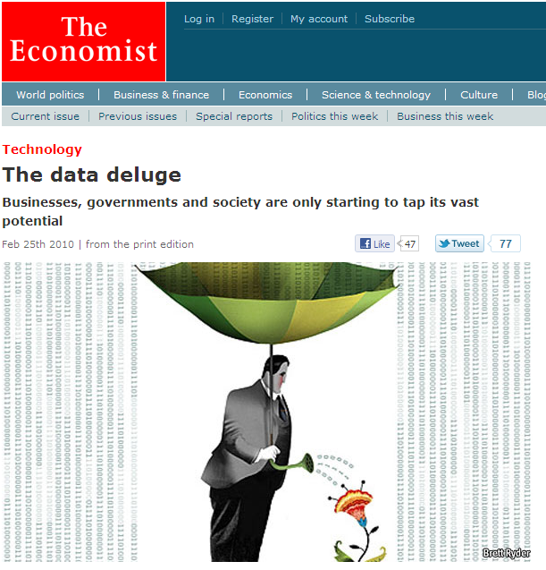
Age of Big Data
Source: The Economist
Notes:
We are in the age of big data.
Vast amounts of data are being collected in business and research contexts.
Analytics techniques are behind the customization of services and experiences. Analysing this has received considerable media attention. Collaborative filtering and recommendation systems are used on the web drawing on historical data to suggest books or movies you may enjoy. Insurance companies use data to develop early warning systems for life insurance policies.
Similar trends are starting to happen in educational contexts, although less dramatically.

Slide 6
LinkedIn: ‘Hottest Skills of 2014’
Source: LinkedIn Official Blog
Notes:
http://blog.linkedin.com/2014/12/17/the-25-hottest-skills-that-got-people-hired-in-2014/

Slide 7
How new is Learning Analytics?
Established: systemic testing, assessment, learning design, retention
Emerging: data sources, volume of data, model discovery, personalisation, adaptivity

Slide 8
Analytical Tools
Micro to Meso: Three approaches to educational data

Slide 9
Three approaches to educational data
Psychometrics
placing measures on a scale (e.g., in assessment)
Educational Data Mining
focus on learning over time (e.g., in school)
Learning Analytics
typically wider contexts (e.g., university-wide)
Notes:
The Abbé de Lacaille wanted to verify the shape of the earth in the southern hemisphere. Between 1751 and 1753 he measured a 137 km arc of meridian between Cape Town and Aurora north of here. The results suggested the earth was egg-shaped rather than oval. In 1838,
Thomas Maclear repeated the measurements. He found that de Lacaille had failed to take into account the gravitational attraction of the nearby mountains. The earth was oval.
http://en.wikipedia.org/wiki/Nicolas_Louis_de_Lacaille
There is always this concern about measurement error. The book “Measure of all Things” describes how the length of a metre was calculated. The idea was to measure the circumference of the earth through the polls. The length of a metre would be 1 / 40,000,000 th of this distance. Pierre Méchain and Jean-Baptiste Delambre surveyed the meridian arc from through Paris from the North Sea coast to the Mediterranean sea coast. This took six years, between 1792 and 1798.
http://en.wikipedia.org/wiki/History_of_the_metric_system
This helped stimulate research to account for measurement errors. In the nineteenth century this developed into a new science of probability and statistics. This was mainly used in astronomy to improve measurement accuracy.
Adolphe Quetelet attempted to apply these ideas to social science which he called a "social physics". He was fully aware of the overwhelming complexity of social phenomena, and the many variables that needed measurement. His goal was to understand the trends underlying phenomena such as crime rates, marriage rates or suicide rates. He wanted to explain the values of these variables by other social factors. These ideas were rather controversial at the time who held that it contradicted a concept of freedom of choice.
http://en.wikipedia.org/wiki/Adolphe_Quetelet
For much of the twentieth century the driving force was new theories to get the most information out of data. Often it was difficult to collect very large datasets. …
Today we live in an era of big data. …

Slide 10
[1] Rasch: Guttman Pattern
A | B | C | D | E | F | Total
1 | 1 | 1 | 1 | 1 | 1 | 6
1 | 1 | 1 | 1 | 1 | 0 | 5
1 | 1 | 1 | 1 | 1 | 0 | 5
1 | 1 | 1 | 1 | 0 | 0 | 4
1 | 1 | 1 | 1 | 0 | 0 | 4
1 | 1 | 1 | 1 | 0 | 0 | 4
1 | 1 | 1 | 1 | 0 | 0 | 4
1 | 1 | 1 | 0 | 0 | 0 | 3
1 | 1 | 1 | 0 | 0 | 0 | 3
1 | 1 | 0 | 0 | 0 | 0 | 2
1 | 0 | 0 | 0 | 0 | 0 | 1
0 | 0 | 0 | 0 | 0 | 0 | 0
11 | 10 | 9 | 6 | 3 | 1

Slide 11
Rasch: Item

Slide 12
Rasch: Person-Item Distribution

Slide 13
Rasch: Item DIF - detected
The unexpected stands out

Slide 14
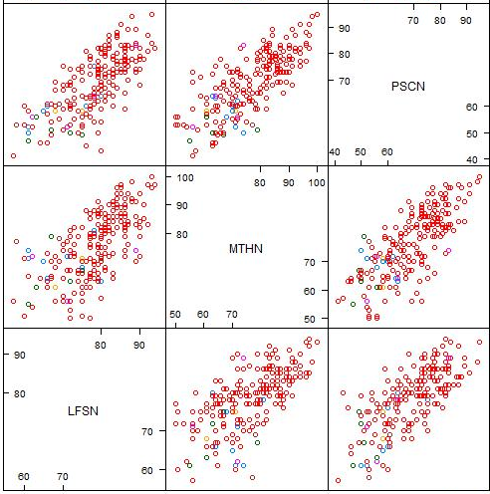
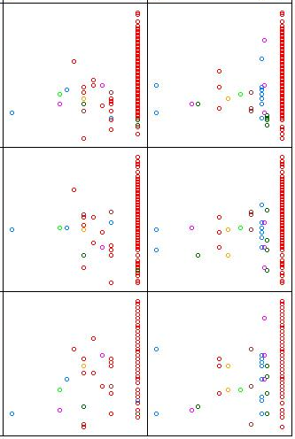
[2] Data Mining: Patterns
Year 1 %Passed
Year 2 %Passed

Slide 15
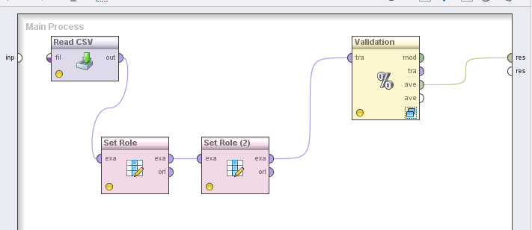
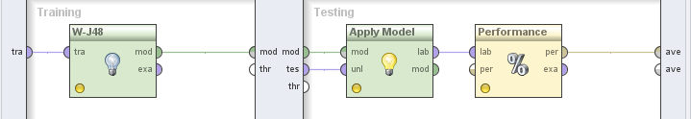
Data Mining: RapidMiner
Will search for relations and assess how good the model is

Slide 16

[3] Developing learning analytics
Notes:
So how easy is this to apply? There are many challenges.
Our first analysis used data from a large year long residential course with roughly 600 registered students. This course site on the learning management system alone generated nearly 30,000 user generated events each month.
This was one of the fist explorations of this data in relation to academic analytics. Activity logs from the LMS were more traditionally used to optimize the LMS and monitor global performance.

Slide 17
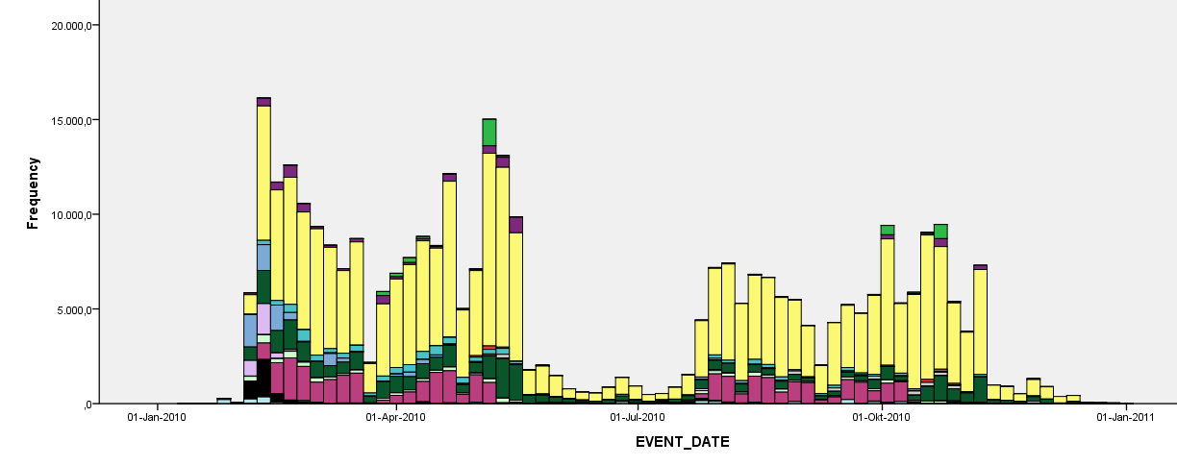
Students’ use of Vula in a course
Submission of assignments
Submission of assignments
Polling of students
Site visits
Content accessed
Chat room activity
Sectioning of students
Notes:
This is a visualization of Vula activity over a year in a course. The bar height indicates the number of events, such as the number of essay submissions. The colours identify the tools such as the assignment tool (light green) and site visits (yellow).
The strong patterning is a feature. Basically students do what they are told and behave like students.
The holidays and assessments follow the university calendar.
Although there were weak positive relationships with success on the course, there is a lot that is difficult to account for without deeper knowledge about expectations of students.

Slide 18

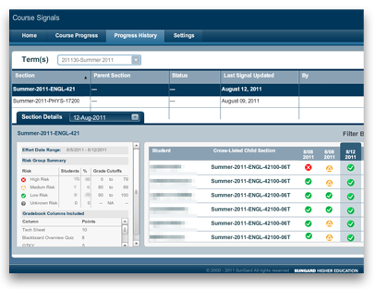
Purdue University's Course Signals
Early warning signs
provides intervention to
students who may not
be performing well
Marks from course
Time on tasks
Past performance
Source:
http://www.itap.purdue.edu/learning/tools/signals
Notes:
Purdue University's Course Signals is a widely cited example of new learning analytics. A number of similar projects exist and in some cases are used routinely. Now a commercial producte.
Course Signals combines predictive modelling with data-mining techniques.
It looks at three factors:
Marks obtain in the course
Time on task in the course
Past performance
From a student perspective:
It provides real-time feedback
Interventions start early - as early as the second week of class
It provides frequent and on-going feedback
http://www.itap.purdue.edu/learning/tools/signals/

Slide 19
Advisors – U Michigan
Advisors are key element
Data from LMS
  Measures to compare students
  (LMS performance and LMS usage)
  Classifications
  (<55% red and >85% green)
  Visualizations of student performance
Engagement with advisors
  Dashboard
Notes:
Stephanie Teasley
http://www.youtube.com/watch?v=Mvjhsr8FzdM&feature=youtu.be

Slide 20
Measures to compare students
LMS Gradebook and Assignments
  Student score as percentage of total
  Class mean score as percentage of total
LMS Presence as proxy for ‘effort’
  Weekly total
  Cumulative total

Slide 21
Classifications of cohort
  Comparisons are intra-class
Performance | Change | Presence Rank | Action
>= 85% |  |  | Encourage
75% to 85% | < 15% |  | Explore
 | >= 15% | < 25% | Explore
 | >= 15% | >= 25% | Encourage
65% to 75% | < 15% | < 25% | Engage
 | < 15% | >= 25% | Explore
 | >= 15% |  | Explore
55% to 65% | >= 10% |  | Explore
 | < 10% |  | Engage
< 55% |  |  | Engage

Slide 22
Advisor support
Shorten time to intervene
  Weekly update
  Contact ‘red’ students
  Useful to prepare for consultation
Contextualizing student performance
  Longitude trends (course and degree)
  Identify students who don’t need support
Learning analytics simply helps inform the intervention

Slide 23
Asking New Questions
Micro to Macro: Examples from MOOCs and social media

Slide 24



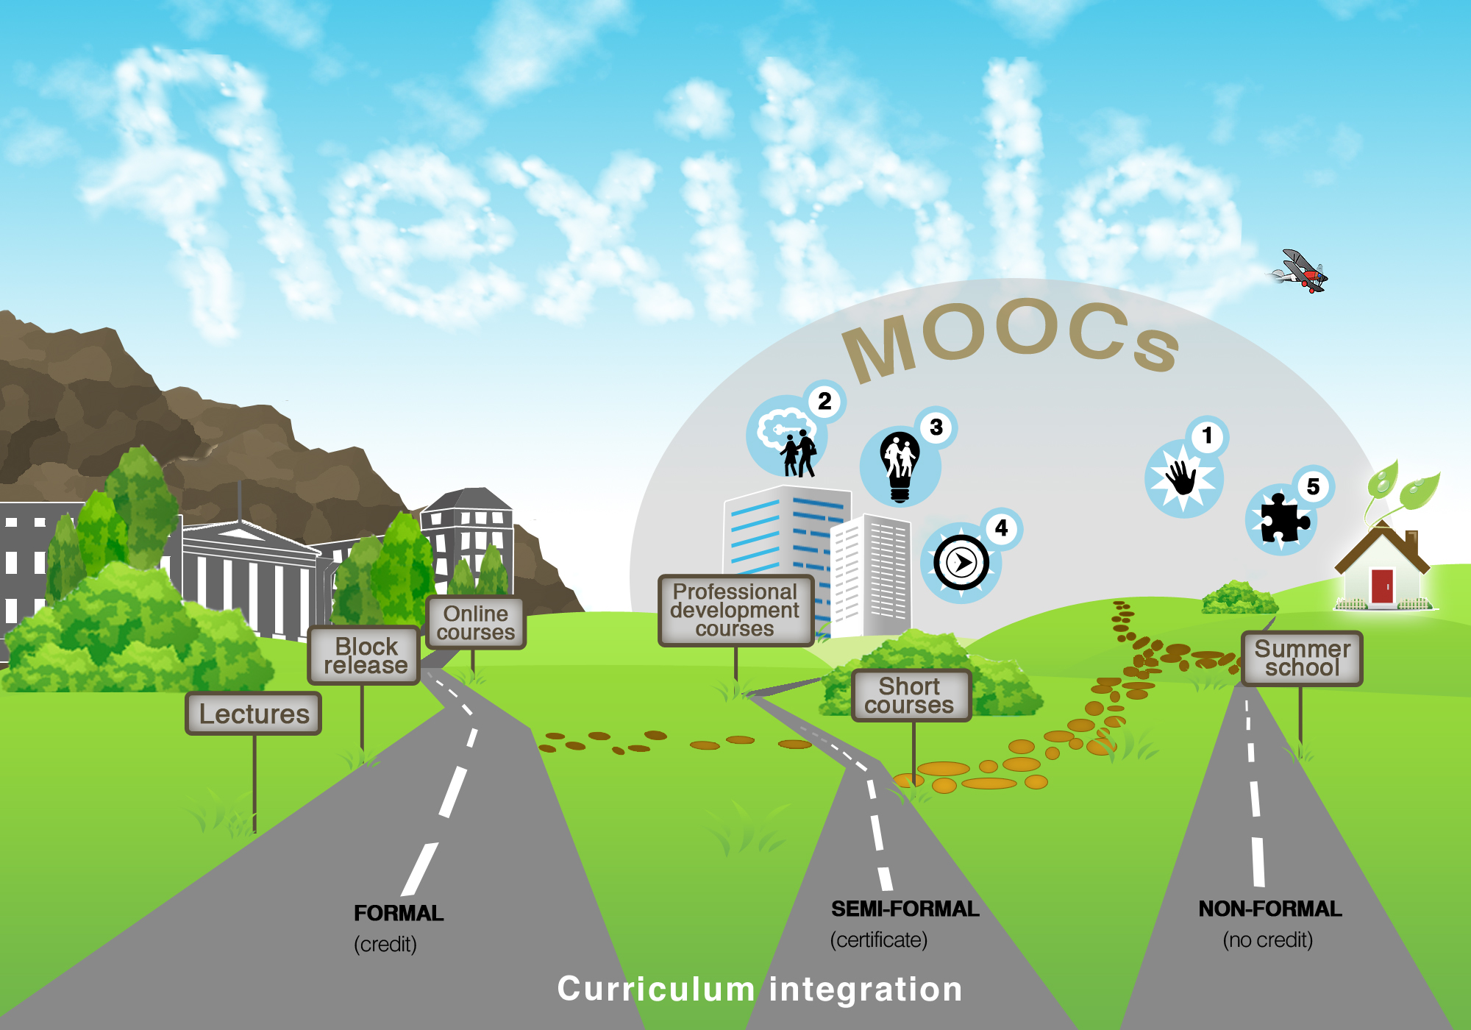
Notes:
Landscape re-imagined with MOOCs and now in the picture.

Slide 25
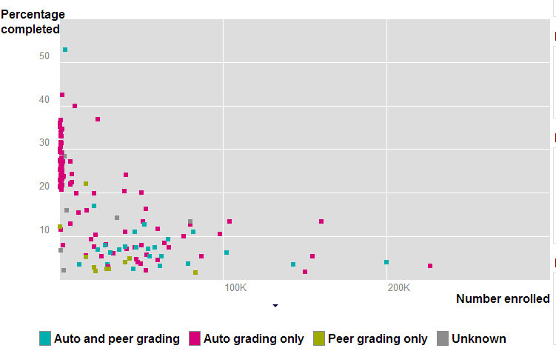
MOOC Completion Rates
http://www.katyjordan.com/MOOCproject.html
Notes:
http://www.katyjordan.com/MOOCproject.html

Slide 26
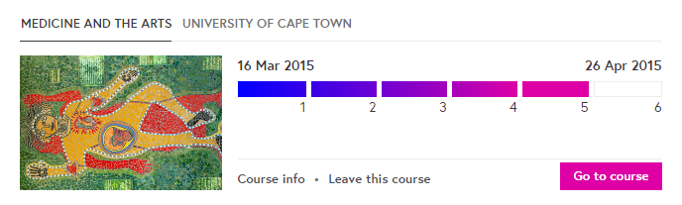
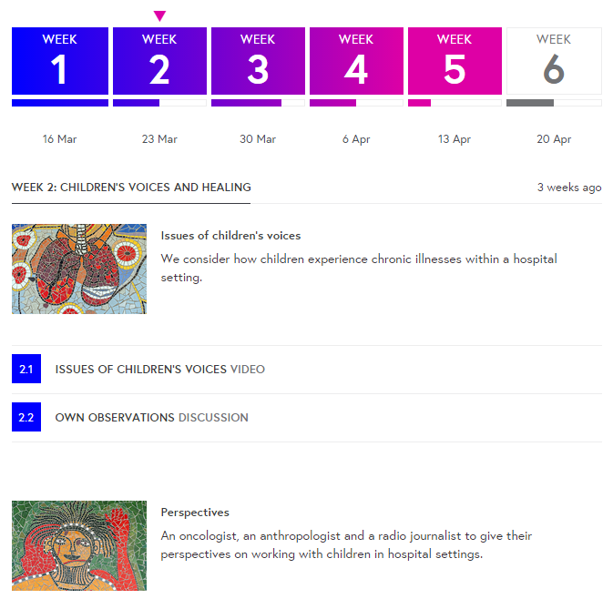


Slide 27
Critical Temporalities
Week 1
Week 2

Slide 28
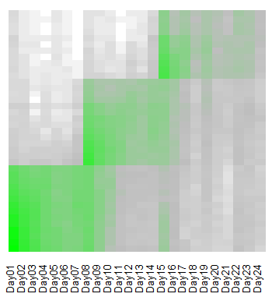
Week 3
E-mail reminders at start of weeks
Week 2
Week 1

Slide 29
Social Learning

Slide 30
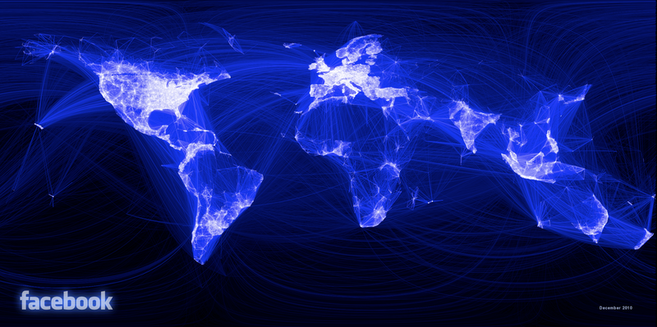
Facebook: all friend relationships
Paul Butler http://www.facebook.com/notes/facebook-engineering/visualizing-friendships/469716398919
Notes:
Earlier in the year a Facebook intern produced the following visualisation using a large sample of Facebook’s ‘friend’ relationships.
This is not a map.
Rather a white dot is generated for each location and an edge line for a friend relationship between two locations.
A few regions are invisible, but this does show just how connected we are.

Slide 31
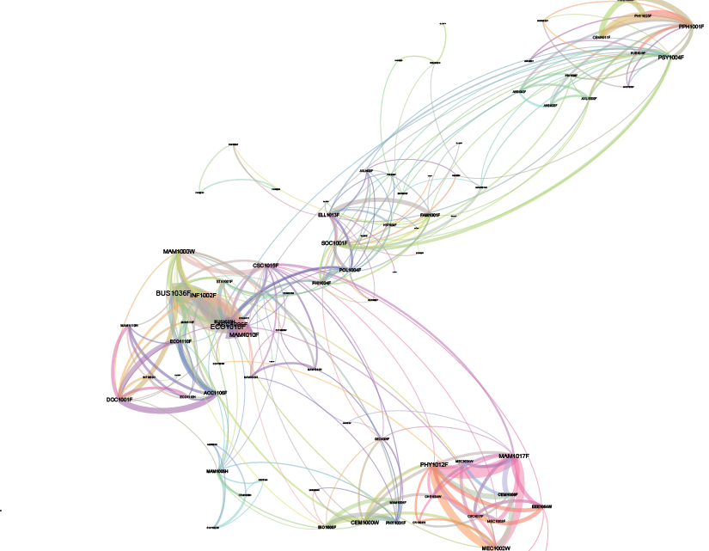
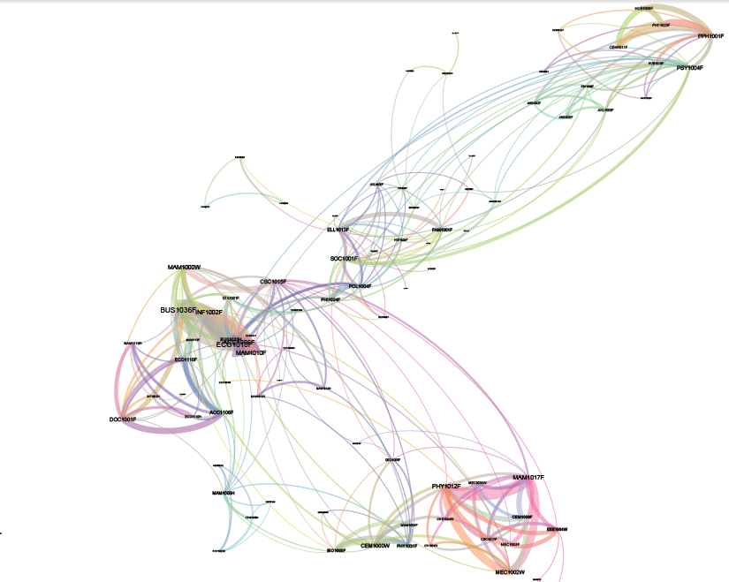
1st year course combinations at UCT
Health
Sciences
Commerce
Humanities
Science
Engineering

Slide 32

[3] UCT and social media
Prominent links to:
  Facebook
  Flickr
  LinkedIn
  Twitter
Notes:
UCT is placing photos and videos taken at important events on Flickr and YouTube.
It maintains groups on Facebook and LinkendIn.
While it does not tweet, UCT does monitor Twitter.
This is in addition to the many students and staff who all network online for different purposes.
The online presence represents an acknowledgement of the importance of social media sites.
At UCT, supposedly 20% of the total student bandwidth is directed to Facebook.
Globally Facebook has over 500 million users, including 3 million business pages.
Collectively there are over 5 billion status updates, photos, comments, and other bits of content being shared.
The other social media sites have similarly impressible figures.
This activity represents a staggering amount of information about how people act.
Data relating to such activity has traditionally been closed or inaccessible.
To an extent this is changing.
Some of this data is publically accessible and open for analysis.

Slide 33
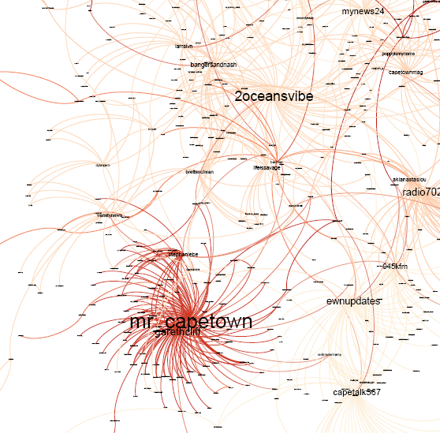
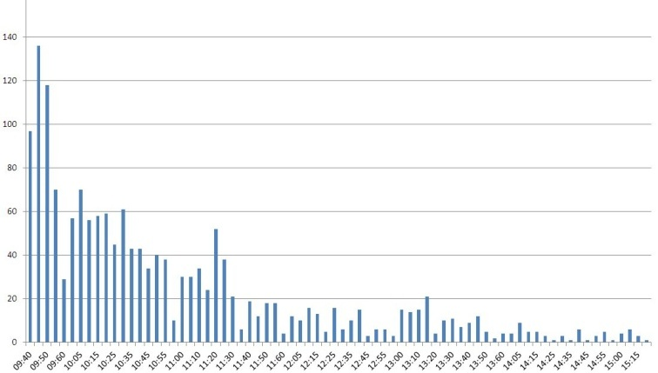
Twitter: helicopter crash at UCT
Peak of 140 tweets
in 5 minutes
Media organisations tweets get re-tweeted
Crash or hard-landing?
2 hours after the event
Notes:
The helicopter crash-landed around 9 o’clock on a Wednesday morning, the 3rd of August.
This was perfect timing for a viral event.
Soon Twitter and Facebook were flooded with messages and pictures.
In our dataset, this peaked at 140 tweets in a five minute period.
Within two hours it was almost all over.
Not everyone was a witness.
The news was being re-tweetedand ended up being relayed across the city and the world.
The network shows how media outlet’s tweets got to be re-tweeted widely.
Mr_CapeTown’s tweet was the most widely re-tweeted.
He is a media consultant and contacted us, being rather pleased with his status.
Understandably the UCT Marketing Department had wanted to avoid any panic.
They thus describe the event as a hard landing as no one was injured.
The actual tweets were not nearly as measured.
Very worried parents soon call the university,
imagining building burning and their children in hospital.
In reality UCT cannot issue a press release within the time that this event took to die on twitter, let alone influence the messages getting out.

Slide 34
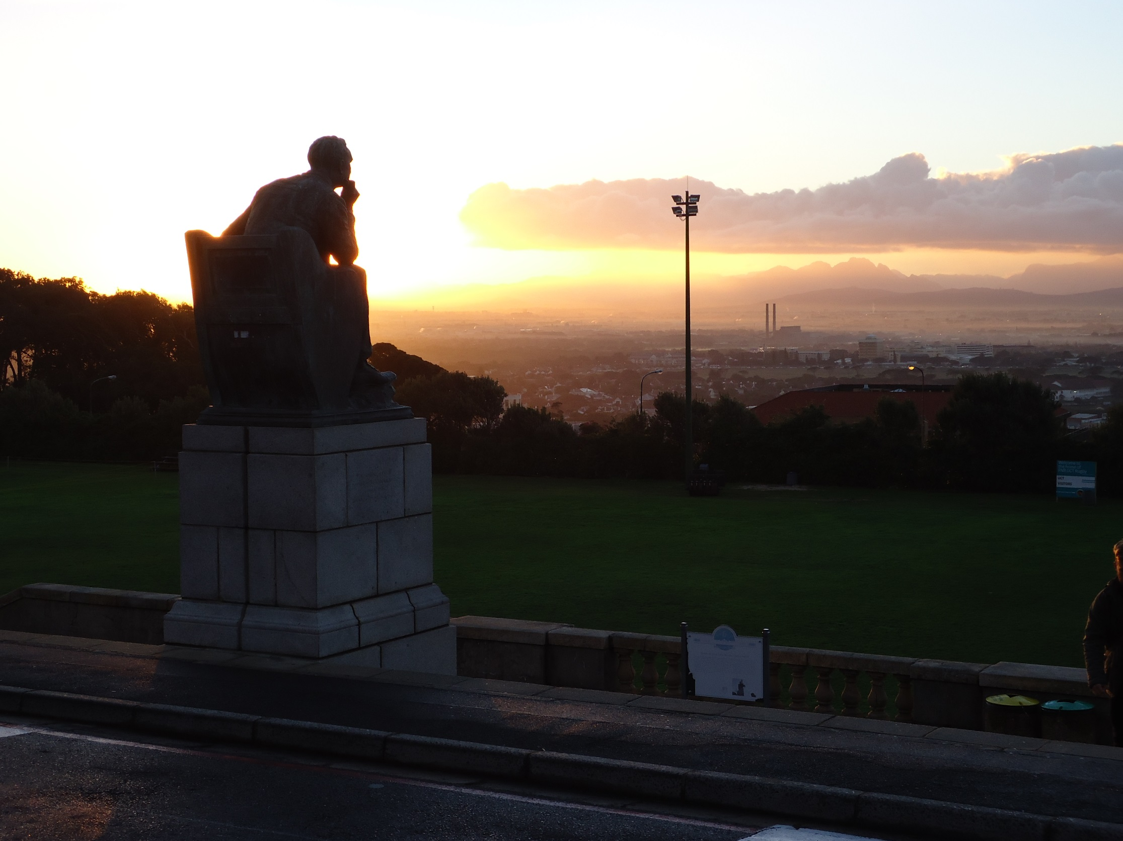
Twitter: #RhodesMustFall #UCT
Ian Barbour - http://www.flickr.com/people/barbourians/

Slide 35
Twitter: viral #UCT

Slide 36
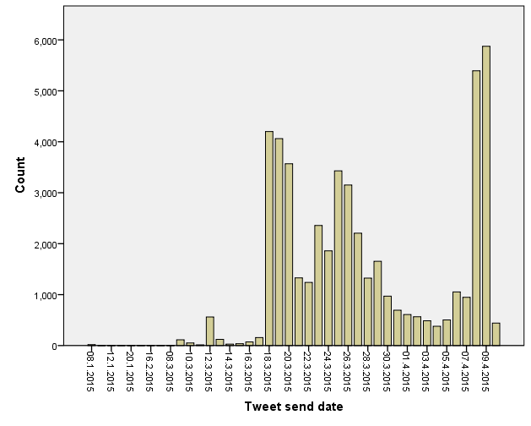
UCT on Twitter
Occupy UCT’s administration building
Statue protest starts
Statue moved

Slide 37
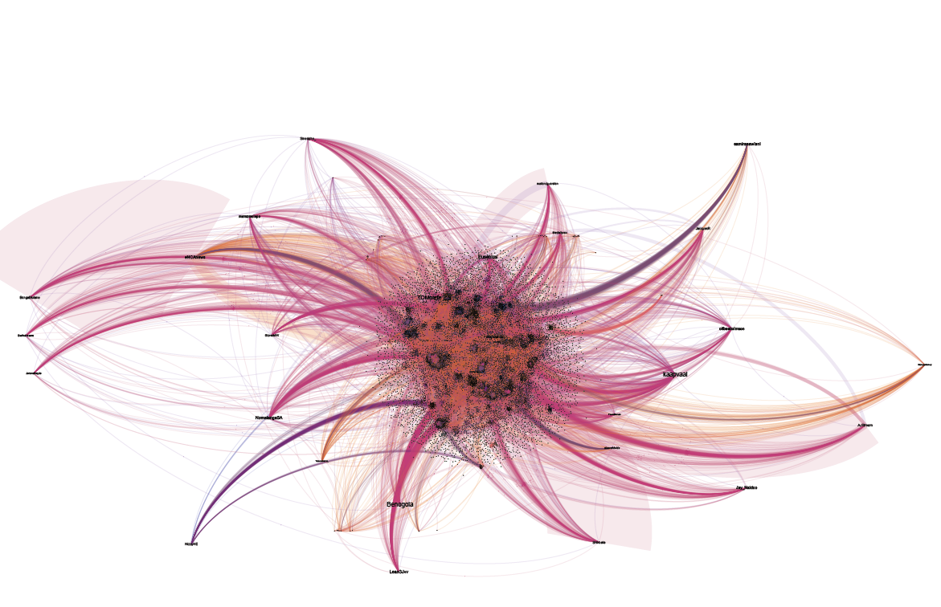
Amplifying #RhodesMustFall
Mail & Guardian
eNCA news
Sisanda Nkoala

Slide 38
Changing roles of analytics
A future with more data

Slide 39
Correlation and causation
Correlation does not imply causation
  Covariation is a necessary but not a sufficient condition for causality
  Correlation is not causation
  (but could be a hint)
Notes:
We must always remember that correlation does not imply causation.
Although it may be a hint about what to investigate further.

Slide 40
Concerns about Big Data thinking
Does Big Data…
  change the definition of knowledge
  increase objectivity and accuracy
  analysis improves with more data
  make the context less critical
  availability means using the data is ethical
  reduce digital divides
See (Boyd & Crawford 2012)

Slide 41
Future scenarios
Analytics informing educational research:
  Identifying unusual patterns - raising questions
  Searching for patterns in data – testing models
  Supporting experts – developmental cycle
  New questions in new contexts
  Remember the ethical considerations
Analytics opened up:
  Good free / open source software is available
  Good learning materials (e.g., MOOCs) on analytics
Notes:
We have looked at much more than we presented here.
It has been in support of research

Slide 42
Software references
Gephi – network analysis, data collection
NodeXL – network analysis, data collection
TAGS – Twitter data collection (Google Drive)
Word cloud – R package (wordcloud)
RapidMiner – Data mining, predictive analytics
Excel – spreadsheet, charts
R – statistical analysis, graphs
RUMM – Rasch analysis

Slide 43
Literature references
Boyd, D., Crawford, K. (2012) Critical Questions for Big Data, Information, Communication & Society, 15:5, 662-679
Dawson, S. (2010) ‘Seeing’ the learning community: An exploration of the development of a resource for monitoring online student networking. British Journal of Educational Technology, 41(5), 736-752.
Deacon, A., Paskeviciusat, M. (2011) Visualising activity in learning networks using open data and educational analytics. Southern African Association for Institutional Research Forum, Cape Town.
Berland, M., Baker, R.S., Blikstein, P. (in press) Educational data mining and learning analytics: Applications to constructionist research. To appear in Technology, Knowledge, and Learning.
Hansen, D., Shneiderman, B., Smith, M.A. (2011) Analyzing Social Media Networks with NodeXL: Insights from a Connected World, Morgan Kaufmann Publishers, San Francisco, CA.
Tufte, E. (1981) The visual display of quantitative information. Cheshire, Conn.: Graphics Press.

Slide 44





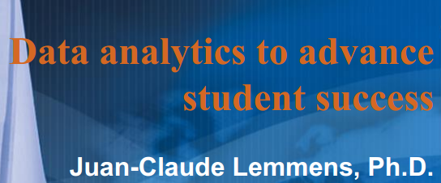
South African references

