Slide 1




An inequality lens on educational technology focusing on institutional policy
Laura Czerniewicz /@czernie and Kyle Rother
10 May 2016

Slide 2
Equality
“capability to function fully as a human being”
(Therborn 2013)
Inequalities are inherently unjust and immoral, violation of human dignity
“Inequalities are produced and sustained socially by systemic arrangements and processes, and by distributive action, individual as well as collective. It is crucial to pay systematic attention to both.”
(Therborn 2013)

Slide 3
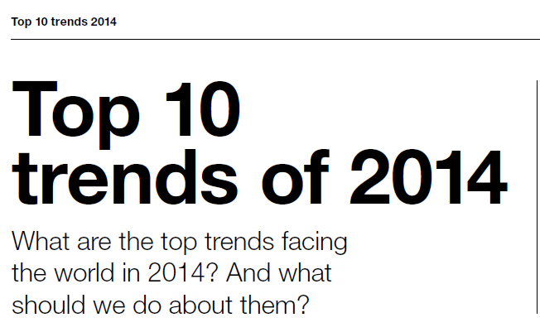

  Increasing inequality is the number one challenge facing North America

Slide 4
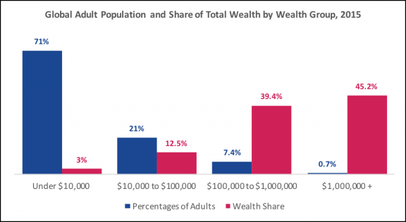
Credit Suisse Research Institute, Global Wealth Report 2015, October 2015 http://inequality.org/global-inequality/

Slide 5
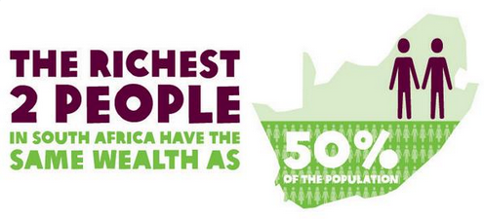
South Africa
The wealth of Johann Rupert and Nicky Oppenheimer, is equal to 26.5-million South Africans, poorest 50 percent .
Seery & Arendar 2014
Notes:
South Africa remains the most unequal country in the world with the two richest South Africans (Johann Rupert and Nicky Oppenheimer, according to Forbes) having wealth equal to the poorest 50 percent (i.e. 26.5-million people) of the country, according to an Oxfam global inequality report.

Slide 6
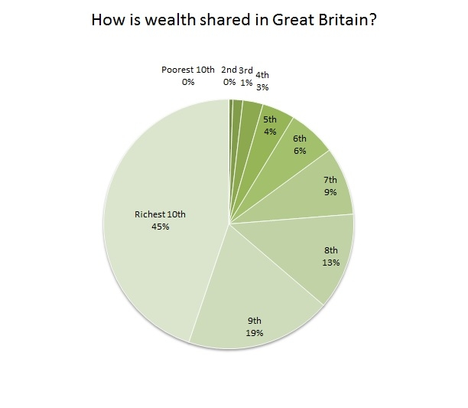
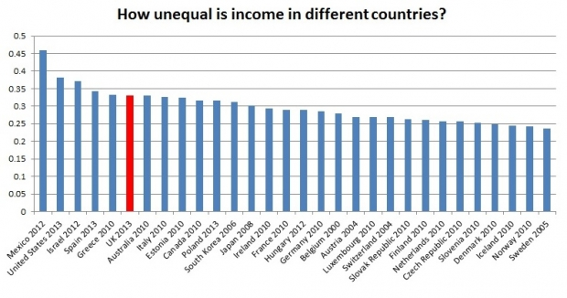
UK
Income distribution OECD countries
How unequal is income in different countries?
https://www.equalitytrust.org.uk/scale-economic-inequality-uk
Notes:
Organisation for economic co-operation and development

Slide 7
Higher education: South Africa
.In brief:
Participation rates over 50% for white students, but only 13% for African students
White students twice as likely to graduate in 5 years
Only 5% of African youth succeed in any form of higher education
Only 25% of students graduate in regulation time, and more than half of students who enroll in universities never graduate
(Fisher & Scott 2011)

Slide 8
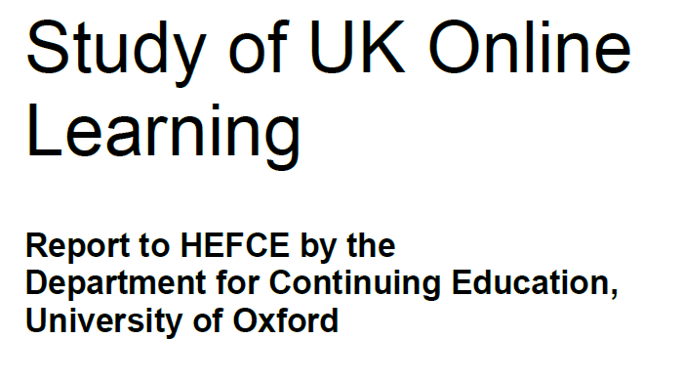
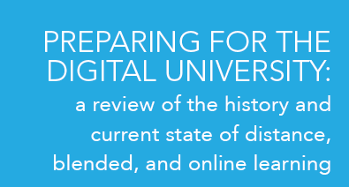



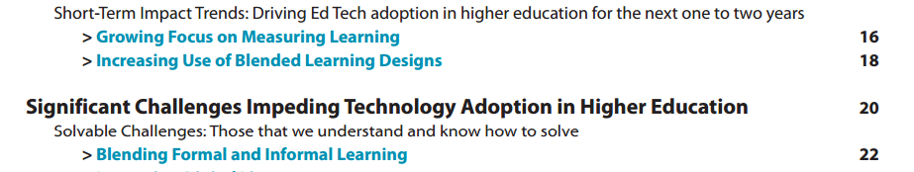
And yet….
in HE - where universities are going online -
there is no mention of inequality
Notes:
Horizon Report The university is currently accepting proposals from faculty for new courses, conferences, or workshops on four themes: social mind, inequalities and social justice, energy and society, and governance.34
The Bill & Melinda Gates Foundation has been integral to advancing the field. Through a vast network of partners and grantees, they are investing in adaptive learning193 and digital courseware194 solutions that enable personalized learning and promote greater student success and equity195 in higher education
0 Many countries have responded with initiatives prioritizing STEM training, yet critics of this movement defend studies of the humanities as promoting ethical inquiry and social justice.221

Slide 9
In the light of these trends
How do university educational technology documents represent issues of inequality?

Slide 10
Policy matters
Policy
“the allocation of goals, values and resources”
(Codd, 1988)

Slide 11
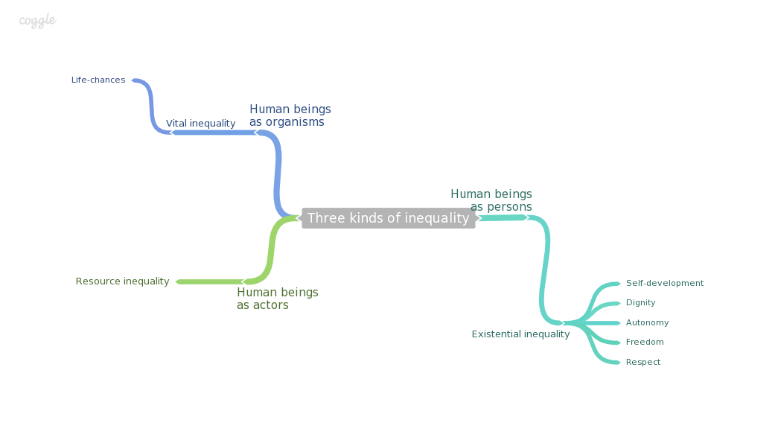
Therborn’s Typology
Therborn (2013) identifies three different types of inequality
http://thecrankysociologists.com/2014/05/27/book-review-the-killing-fields-of-inequality/

Slide 12
Vital Inequality
Therborn defines Vital Inequality as “socially constructed unequal life chances of human organisms” (2013)
Link between life chances and education
  Poor people are less likely to be educated (Seery & Arendar 2014)
  Educated people live longer (Meara et al 2008)
  Parents of college graduates even live longer (Friedman & Mare 2014)
Educational deprivation is increasingly recognised as an important indicator in multiple indices of deprivation, poverty & inequality (Noble & Wright 2012)
Aspects of vital in/equality:
          Access
          Success
          Openness

Slide 13

Resource Inequality
Therborn defines Resource Inequality as “providing human actors with unequal resources to act” (2013)
Drawn on Bourdieu’s capitals to categorise the different types of resources a person would need to draw on through higher education
  embodied cultural capital (focus on capabilities and literacies)
  institutional capital (focus on certification and qualifications)
  objectified cultural capital (focus technologies, devices and tools)
  economic capital: (focus on costs, fees, and funding)
  social capital: (focus networks and collaboration)
  symbolic capital (focus on reputation and prestige)

Slide 14
Existential Inequality
Existential Inequality “unequal allocation of personhood, ie. of autonomy, dignity, degrees of freedom, and of rights to respect and self-development” (Therborn, 2013)
For Therborn, this is the most neglected type of inequality
These aspects of personhood can be understood as
  Self-development
  How staff and students are supported and enabled through an encouraging participatory environment
  Dignity
  How students and staff are treated as persons wrt disability, race, gender, language
  Respect
  How students and staff are treated as agents ito privacy and explicit or implied recognition of the value of teaching
  Autonomy
  The roles of students and staff and what choices and liberties they have or are afforded by technology ito student-centredness,
  academic freedom etc

Slide 15
Types | Categories
Vital inequality | access | residential
 |  | online
 | success | throughput
 | openness | OER, OA OEP
Resource inequality | embodied cultural capital | digital literacies/fluencies
 |  | information literacy
 |  | graduate capabilities
 | institutional cultural capital | certifications/qualifications
 |  | institutional recognition
 | objectified cultural capital | digital devices
 |  | connectivity
 | economic capital | costs
 |  | fees
 |  | funding
 | social capital | connections/communities
 |  | presence/visibility
 | symbolic capital | reputation
 |  | prestige
Existential inequality | self-development | participation
 |  | support
 | dignity | disability
 |  | race
 |  | gender
 |  | language
 | respect | Issues of privacy , surveillance
 |  | value of teaching /learning (ito tech)
 | autonomy | student/learning-centredness
 |  | academic freedom
Theory-led
analytical
framework

Slide 16
Methodology
Thirteen documents analysed
  6 UK institutions - Russell Group
  3 UK institutions - non Russell Group
  4 South African institutions
The document types: elearning, digital education, or technology enhanced learning strategy / policy documents
9 of 130 universities in UK
4 of 26 universities in SA
Both large distance education universities
  Open University (UK)
  Unisa (SA)

Slide 17
Institution name | Type | Name of policy (date)
University of Durham | UK RG | E-Learning Strategy (n.d.)
University of Glasgow | UK RG | E-Learning Strategy (2013-2020)
University of Leeds | UK RG | Digital Strategy for Taught Student Education (n.d.)
University of Liverpool | UK RG | Technology Enhanced Learning Strategy (2013)
University of Oxford | UK RG | Digital Strategy (n.d.)
University College London | UK RG | Strategy for e-learning at UCL (2012-2015)
University of Lincoln | UK non-RG, research-led | Digital Education Plan (2013)
University of Surrey | UK non-RG, research-led | Technology Enhanced Learning Strategy (2013-17)
Open University | UK non-RG ODL | Learning and Teaching Strategy (2012)
Unisa | SA comprehensive, ODL | ICT-enhanced Teaching and Learning Strategy (2011-2015)
Stellenbosch University | SA traditional, research-led | Strategy for the use of ICT in learning and teaching at Stellenbosch University (2013)
Walter Sisulu University | SA comprehensive, developing, teaching-led | Institutional e-Learning Strategy (2009/10-2011/12)
University of the Witwatersrand | SA traditional, research-led | eLearning strategy and tactics for the University of the Witwatersrand (2009)

Slide 18
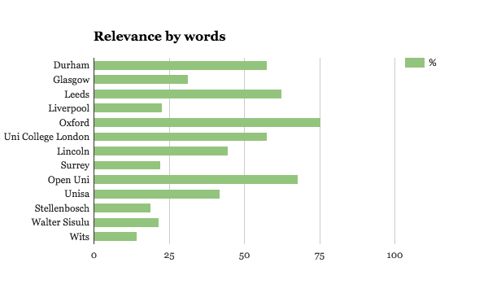
Relevance
This refers to the percentage of the document which was relevant to the equality/ inequality analysis
Appendices and implementation plans were not considered.

Slide 19
Findings: general
In all the documents
    “inequality” was never mentioned
    “equality’ was mentioned once
“Widening participation and equality – The University needs to continue to make a contribution to the widening participation agenda and support students from diverse backgrounds. New approaches to course design and the processes that support production and presentation will need to be assessed for their impacts on different groups of students, particularly those at entry level, so that the efficiencies, enhancements and transformations we make do not impede recruitment, retention and progression.” (Open Uni)

Slide 20
Findings: general
“Transformation” - 3 times
“ICT systems and technology have increasingly greater value if they are focused on renewal and transformation, and aligned in an integrated manner.” (Stellenbosch)
“The University of Surrey will be recognised as an international leader in the provision of technology enhanced learning and inspire staff and students in the transformation and enhancement of learning and teaching across the disciplines.” (Surrey)
“Three strategic areas of activity have been identified to drive forward the transformation of the learning and teaching experience across the institution.” (Surrey)
None ito demographic or curriculum transformation

Slide 21
Findings: general
“Equity” mentioned twice
“A successfully implemented strategy will enable the University to meet its strategic ambitions relating to reputation, excellence, equity of student experience and financial effectiveness.” (Liverpool)
“policies and practices (integrating into teaching and learning policy, assessment policy, incentives as part of performance evaluation and reward system, copyright of material, equity of access and experience)” (Stellenbosch)

Slide 22
Findings: general
Regional
Policies of South African institutions tend to show higher responses generally
More focus in South Africa on resource inequality
More focus in UK on existential inequality

Slide 23
Findings: absences
Notable absences
  sustainability
  social responsiveness
“This strategy aims to increase the focus of Unisa on providing innovative services to its students, to build a reliable and resilient technical infrastructure which is both cost-effective and sustainable, and to keep environmental costs to a minimum.”
“In addition, opportunities arise to contribute to the ‘public good’ by enhancing collaboration amongst academics and with other higher education institutions and organisations to expand the footprint of Stellenbosch University nationally and internationally.”

Slide 24
Findings: focus
In contrast - strong focus on efficiency. . .
There will be opportunities for staff and students to experience efficiencies in time and improved working practices and user experience” (Leeds)
“Enhance internal work processes. Technology can provide the efficiencies and flexibility that will allow us to develop more agile processes of curriculum design and delivery” (Open Uni)

Slide 25
Findings: focus
. . . and streamlining operations
“The University will work towards enabling students to discover and access eResources with minimum effort and delay, through the integration of internal systems and adoption of technologies which facilitate external interactions.” (Durham)
“Drive quality and efficiency in support and administration by delivering effective and integrated IT supported processes (One IT)” (Leeds)

Slide 26
Key Findings Vital Inequality
Access
Very strong focus on access as entrance
Relatively greater emphasis placed on this by non-RG and SA
SA institutions explicitly state that edtech is to be used to enhance face-to-face delivery
“ICT will be used to supplement the face-to-face classes. E-learning will facilitate teaching and learning in the constructivist approach, and will hopefully also promote life-long learning.” (Walter Sisulu)
“In the Wits context, its application domain will be in supporting and enhancing our established face-to-face approaches, and does not currently include reference to distance learning unless demand arises.”

Slide 27
Key Findings Vital Inequality
Success
Generally a much greater concern for success in SA institutions - roughly twice as many responses in a straight count than either of the other two, and almost four times as high as RG institutions on a weighted count.
“This strategy will also hopefully improve the students’ pass-rate and effectively the throughput rate.” (Walter Sisulu)
More focus on access into the system, than succeeding in the system
Access gets a weighted score of 45, compared to 14 for success

Slide 28
Key Findings Vital Inequality
Openness
There is a much stronger focus on openness in non-RG UK institutions (2.7 on a weighted score, compared to 1.8 and 1 in SA and RG respectively)
Purpose- the value of OERs for improving the quality of T&L
Also reputation
“Enhance the quality and diversity of material on the learning management system through the use of multimedia and open educational resources (OER).” (Lincoln)
“Providing a media rich learning and teaching environment with an increased range and quality of teaching resources, including free and open educational resources to which we contribute and from which we draw” (Wits)

Slide 29
Key Findings Resource Inequality
Skills and capabilities (embodied cultural capital)
Almost all institutions stress the need to develop literacies
not only for success at university studies, but also in later employment
Strong responder, both in terms of total mentions, as well as on a weighted count
There is an even split between digital literacy and information literacy (30 responses each), with graduate competencies coming in slightly lower (at 23)
Top three responders | total | weighted
access | 89 | 45
embodied cultural capital | 83 | 28
autonomy | 76 | 38

Slide 30
Key Findings Resource Inequality
UK generally more focused on deeper level information literacies and graduate competencies, while SA institutions more focused on ensuring all students have requisite entry-level digital literacies to succeed in their studies
“Our students will have the opportunity to practise and develop key high level digital skills whilst at the University, preparing them for work in technologically advanced jobs” (Leeds)
“It is not enough for our graduates to be technologically competent. In order to succeed in the current employment context they need to have a high level of digital literacy.” (Liverpool)
“For the purpose of this e-learning project, the main focus is capacitating these students on computer skills to make them ready for using e-learning.” (Walter Sisulu)
“Basic computer literacy is a requirement for effective and efficient acquisition of sound information literacy skills. For many undergraduates and postgraduates, computer and information literacies are not always sufficient to optimally take advantage of e-learning.” (Wits)

Slide 31
Key Findings Resource Inequality
Certification (institutional cultural capital)
Almost none
The only institution which explicitly references certification/qualification and recognition is Open Uni
“Additionally, in a market where students are choosing between providers, we need to make the structure and language of our offering understandable in the wider education market. This will signal a move to a qualification-based approach.”
“Provide the facility to manage a lifelong learning record. Effective use of technology will help learners to do this- providing links to formal qualifications as well as the capacity to support reflection and help them in identifying appropriate new learning outcomes”

Slide 32
Key Findings Resource Inequality
Tools and technologies (Objectified cultural capital)
General acknowledgement of the ubiquity of mobile, and the wide range of devices in use.
Strong focus on providing good connectivity both on and off campus
“Students and staff will be able to make effective use of powerful and rapidly evolving mobile devices to enhance learning, communication and impact.” (Leeds)
“Enable learners to use their own devices in institutional contexts and to personalise institutional services to meet their own requirements” (Open Uni)
“The University facilitates the availability of connectivity, Internet-enabled devices, software and electronic education resources for all staff and students, on and off campus.” (Stellenbosch)

Slide 33
Key Findings Resource Inequality
Objectified cultural capital cont.
Ownership : shift to BYOD
“Wherever possible, students will be encouraged to own computers or other personal computing devices.” (Wits)
“Increase, sustain and support affordable, secure and reliable access for students and staff (lecturers, markers, tutors, etc) to a range of appropriate technologies and software.” (Unisa)
“Financing of technology in the student’s hands.” (Stellenbosch)

Slide 34
Key Findings Resource Inequality
Economic capital
Focus on how edtech can help to offset costs
“A successfully implemented strategy will enable the University to meet its strategic ambitions relating to reputation, excellence, equity of student experience and financial effectiveness.” (Liverpool)
“This will increase flexibility and offer opportunities for course production and presentation to be managed more effectively, improving productivity and delivery timescales and be more cost effective.” (Open Uni)
But
“For schools that allocate teaching loads according to a model, eLearning contribution could be built into the model if staffing and funding level allow. eLearning preparation grants could provide another incentive.” (Wits)

Slide 35
Key Findings Resource Inequality
Economic capital cont.
Open Uni explicitly mentions changing funding arrangements in UK higher education, specifically the reduction of government spending
“We do know that the substantial reduction in Government spending will significantly affect the University’s future markets and offerings. The OU may thrive in this new market by continuing to deliver its core business, a high quality, lower cost, more flexible student learning experience. But to continue to do this will require increased efficiency and responsiveness in the processes of designing, developing and delivering an enhanced learning experience, and we need to ensure that the technologies that enable these activities are robust, reliable and fit for purpose.”
“Divergence in the UK funding arrangements: The overarching strategy should set the framework for learning and teaching for all OU students, with sufficient flexibility to meet the requirements of diverging policy agendas.”

Slide 36
Key Findings Resource Inequality
Networks and collaboration (aspects of social capital)
  Focus on the university in and as networks, and on CoPs
  Much more attention in the UK
“To continue to build capacity in all areas of elearning the University will maintain networks and communities of practice across the institution to develop, share and embed elearning practice. ” (Durham)
“An environment that connects and provides the opportunity for interaction for all the University’s communities and stakeholders, including staff, students, alumni, employers and the wider public.” (Lincoln)
“Support learners in building knowledge collaboratively and engaging in social learning” (Open Uni)
“Reduce isolation of the distance learner – between novice and expert, and between peers through online communities of learning and practice” (Open Uni)

Slide 37
Key Findings Resource Inequality
Reputation and prestige (symbolic capital)
Most dominant of all the capitals
is second only (by weighted count) to access overall
General focus on competitiveness, being “world class”, and enhancing reputation and status
“In a rapidly changing world, where higher education is becoming increasingly global in nature, it aims to put in place measures that will maintain and enhance the position of the University as a world-class place of research informed learning.” (Glasgow)
“The University will maintain parity (as a minimum) with competitor institutions who are moving forward rapidly in this area” (Leeds)
“eLearning is a sine qua non for a university aspiring to world class status.” (Wits)
“According to the majority of faculty members, a more comprehensive application of ICT in L&T will greatly strengthen SU’s esteem as a technologically advanced institution.” (Stellenbosch)

Slide 38
Key Findings Resource Inequality
Reputation and prestige (symbolic capital) cont.
Seen as a means of attracting and retaining the best applicants and students
“Recruit and support high quality applicants from all backgrounds” (Leeds)
Also linked to maintaining or expanding “market share”
“Increase our global market share.” (Open Uni)
Concerns around “corporate identity” and “brand awareness”
“More importantly for some is that ICT should not change the corporate identity (‘The Matie brand’) of SU. The SU trade-mark experience of generous contact between the student and the lecturer is of critical importance and may not be lost as a result of the technological mediation of L&T.” (Stellenbosch)

Slide 39
Key Findings Resource Inequality
Reputation and prestige (symbolic capital) cont.
A range of other concerns are co-opted into this, such as openness and access
“We also need to determine the role which the VLE is to play in promoting our global ambitions. Development of OER can provide the world with a window on our University and help create a global brand which will, in turn, help secure our future.” (Lincoln)
“Rivalry and competition in international higher and corporate education is increasing rapidly and technology is used to enhance the effectiveness of teaching and learning, e.g. by increasing access and harnessing the fast pace of technological advances.” (Unisa)

Slide 40
Key Findings Existential Inequality
Dignity
The lowest responding category overall
General focus on students with disability.
“E-learning can enhance learning opportunities for disabled students and can provide a more inclusive environment than is sometimes afforded by conventional teaching; however it also has the potential to exclude some learners if not designed carefully. It is essential that the needs of all learners are considered where fully online activities are introduced into courses.” (Uni College London)
“The University will continue to work towards developing systems to support access for all and ensure, in particular, that any potential conflicts to our commitment to support widening participation are addressed. The University commits to ensure that it is pro-active in addressing students' differing abilities to access technologies, either because of location, special needs or the cost of the technology needed to access the materials.” (Durham)

Slide 41
Key Findings Existential Inequality
Dignity.
Acknowledgment of need to fulfill legislative mandates
“Rigorous assessment of all digital technologies and services to ensure they meet statutory and University requirements for accessibility.” (Leeds)
The only other subcategory to receive any mention was language
“This comes at a time when we have seen a substantial growth in the proportion of students for whom English is a second or third language studying at the University. This has significant implications in the learning environment and the pedagogies deployed there. Comprehension within the classical lecture scenario is more challenging for these students who not only have to cope with the translation of the subtleties of complex ideas but often struggle to understand the accent of the lecturer. It is not surprising that the average level of comprehension for these students is well below that of native English speakers in this type of situation. For this group of students, recording of lectures can have a major impact because it allows them to review the lecture, to go over difficult phrases or concepts several times until they are clear on what is meant by the lecturer.” (Glasgow)

Slide 42
Key Findings Existential Inequality
Respect
Some mention of the ethics of learning analytics and data use…
“It is important to note that ethical issues will be considered when the students‟ information is being gathered, shared and stored in the electronic systems. Linking the support systems to the lecturer/student portal will enhance information management.” (Walter Sisulu)
“Contribute to and support the institutional discourse and policy development on the social, ethical, legal, and human use of technologies.” (Unisa)
“As ICT is increasingly integrated within the L&T processes, it will be essential to pay close attention to the challenges related to the electronic security of the technology platform within which all information systems are managed.” (Stellenbosch)

Slide 43
Key Findings Existential Inequality
Respect cont.
…a rare exception
“It is important to understand that technologies are not simply tools that we can employ to achieve particular ends as if they are objective/neutral entities. Technologies form part of mechanic assemblages in societies that serve to either control or democratise societies. At the micro-level of institution or classroom, pedagogical assemblages incorporating network technologies can therefore serve to control students (colonise desire) or serve to stimulate creativity and innovation so that the assemblages function to liberate and transform society. All education/pedagogical assemblages are multiplicities that integrate architectures (traditional or network technologies) and body parts (of students and lecturers) with brain chemistry and everything in between. It is our intention at SU that pedagogical assemblages of which network technologies form part will invigorate vectors/lines that open up new ways of learning, being and becoming.” (Stellenbosch)

Slide 44
Key Findings Existential Inequality
Autonomy
Overwhelmingly “student-centredness” - differing discourses
“Therefore, this strategy proposes a course of action which is 'based on the needs and demands of learners and their quality of educational experience'. In short, it is based on six key principles associated with this aim: connectivity, flexibility, interactivity, collaboration, student motivation (engagement), and extended opportunities.” (Durham)
“be customer driven, and tailored to individuals” (Leeds)

Slide 45
Conclusion
Issues of inequality and inequity are not separate from blended online education.
Equality is integral to networked learning and to education itself.
The discourse of the policy environment shapes what is possible and what becomes acceptable.
The goals, values and resource allocations of policies matter to real people in challenging, varied material circumstances.
Ensuring that equality considerations are incorporated into online learning is a matter of social justice.

Slide 46
References
CB Insights (2014) Global Ed Tech Financing Hits Record in Q1 2014. Retrieved from: https://www.cbinsights.com/blog/ed-tech-venture-capital-record/
Codd, J. (1988). The construction and deconstruction of education policy documents. Journal of educational policy. 3 (3), 235-48.
Equality Trust (2016) The Scale of Economic Inequality in the UK. Retrieved from: https://www.equalitytrust.org.uk/scale-economic-inequality-uk
Friedman E & Mare R (2014) The schooling of offspring and the survival of parents. Demography 51(4):1271-93. Available: http://dx.doi.org/10.1007/s13524-014-0303-z
Mansell R (2013) “Imagining the internet: Open, closed or in between”. In Enabling Openness: The future of the information society in Latin America and the Caribbean, F. Girard & B. Perini (Eds.). IDRC.
Meara E, Richards S & Cutler D (2008) The Gap Gets Bigger: Changes in Mortality and Life Expectancy, by Education, 1981–2000. Health Affairs 27(2):350-360. Available: http://doi.org/10.1377/hlthaff.27.2.350
Nagel D (2014) Spending on Instructional Tech To Reach $19 Billion Within 5 Years. The Journal. Retrieved from: https://thejournal.com/articles/2014/06/11/spending-on-instructional-tech-to-reach-19-billion-within-5-years.aspx
Noble M & Wright G (2012) Using Indicators of Multiple Deprivation to Demonstrate the Spatial Legacy of Apartheid in South Africa. Social Indicators Research 112(1):187-201. Available: http://www.carnegie3.org.za/papers/203_Noble_Using%20indicators%20of%20multiple%20deprivation%20to%20demonstrate%20the%20spatial%20legacy%20of%20apartheid%20in%20SA.pdf
Seery E & Arendar C (2014) Even it Up: Time to End Extreme Inequality. Oxfam. Retrieved from: https://www.oxfam.org/sites/www.oxfam.org/files/file_attachments/cr-even-it-up-extreme-inequality-291014-en.pdf
Therborn G (2013) The Killing Fields of Inequality. Cambridge: Polity Press.
Treanor J (2015) Half of world's wealth now in hands of 1% of population – report. The Guardian. Retrieved from: http://www.theguardian.com/money/2015/oct/13/half-world-wealth-in-hands-population-inequality-report
Wan T & McNally T (2015) Education Technology Deals Reach $1.6 Billion in First Half of 2015. EdSurge. Retrieved from: https://www.edsurge.com/news/2015-07-29-education-technology-deals-reach-1-6-billion-in-first-half-of-2015
Watters A (2015) Top Ed-Tech Trends of 2015: The Business of Ed-Tech. Hacked Education. Retrieved from: http://hackeducation.com/2015/12/23/trends-business

