Slide 1
Piecing together the research puzzle: A blended learning approach
Cheryl Brown &
Cheryl Hodgkinson-Williams

Slide 2
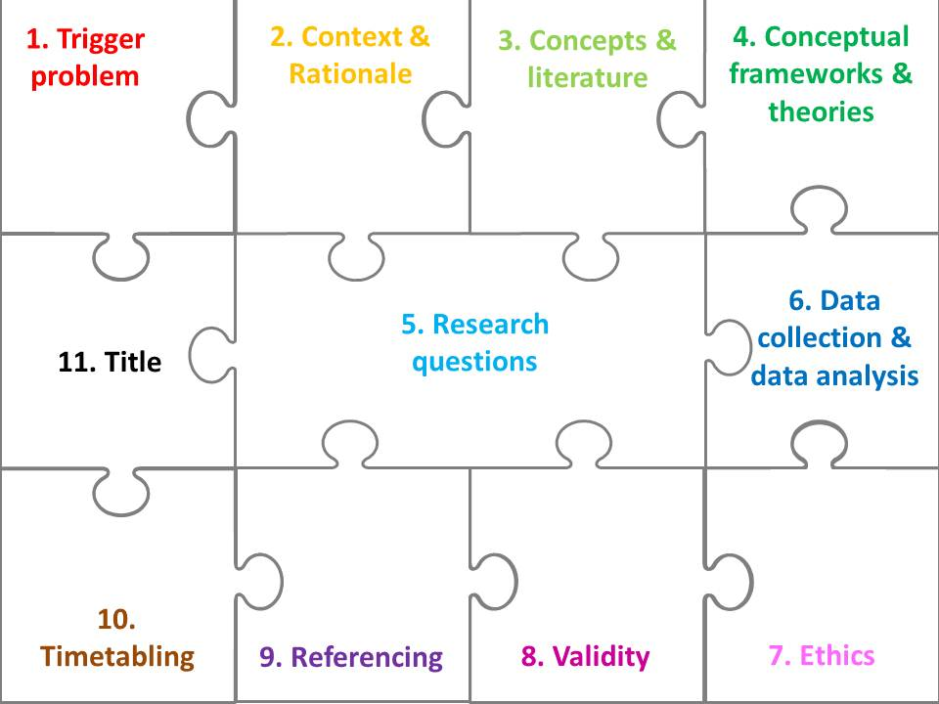
Notes:
CHW on puzzle and story

Slide 3
Once upon a time ... I was concerned about … (some problem) or I was intrigued by … (some possible opportunity) … because in my (context e.g institution, country) there is a real problem/possible opportunity because ...
At the moment other people are also concerned about … which they describe as … They think that … because they found that … They related these ideas together using …
Interestingly they used … theory to try and explain … and this has given me the idea to use … in my study… to try and understand why /how /to what extent ... Interestingly they used … (approaches & methodologies) to find out what was happening and this given me the idea to use … in my study.
I will approach … to participate in my study. They will be happy to participate as I can assure them of … (anonymity OR confidentiality) as I will conduct my research according to ...
Other people will trust my research findings because I have ... and I have identified all my resources accurately and honestly in my references in-text and in the list at the end of my dissertation … and provided examples of salient documents.
So I am going to do … first, second, third … and hand in my thesis titled … by …
Notes:
CHW on story

