Slide 1
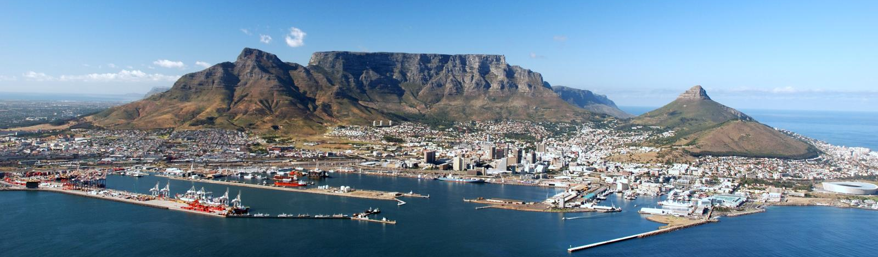
Open Access Textbooks
Personal Experience
Johan Fagan
Division of Otorhinolaryngology
University of Cape Town
South Africa
Notes:
Dr Myers is one of the best travelled surgical teachers in the world, and has through his travels, teaching and writing made an enormous contribution to head and neck surgery in the Developing World. He has asked me to give you a perspective of Head and Neck surgery in Africa and in the Developing World, to speak about its challenges and solutions, and to share with you what we are doing in Cape Town to address some of these challenges, and how you, the international community can contribute to improving Head and Neck surgery in the Developing World.

Slide 2
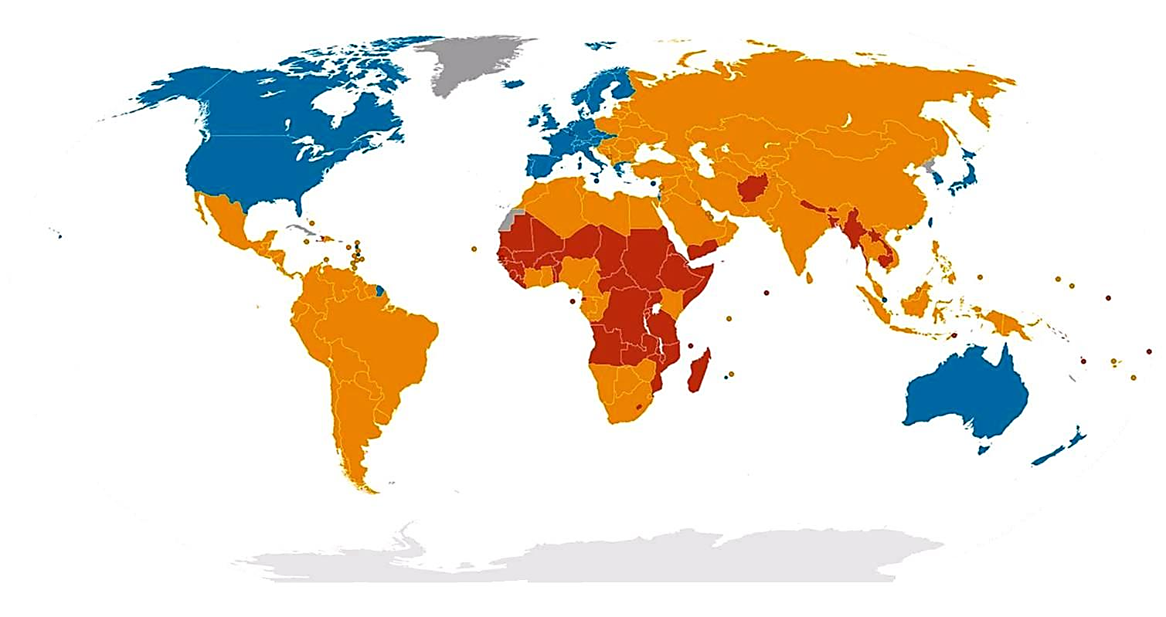
GNI
High Income Middle Income Low Income
Notes:
South Africa is a developing world country. When one colour codes the world according to GNI, you will note that the high income countries comprise only North America, western Europe, Australia, New Zealand and Japan.

Slide 3
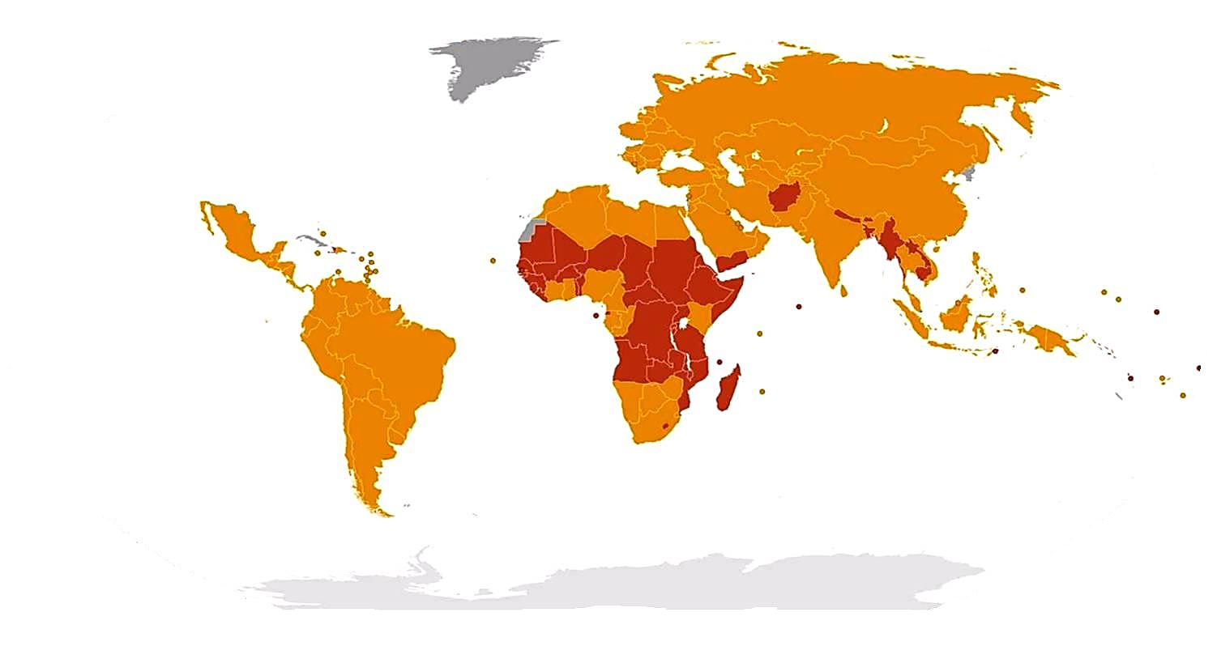
Developing World
High Income Middle Income Low Income
Notes:
The majority of the world is therefore of middle or low income and is classified developing world.

Slide 4

>50% World Population
Notes:
The developing world accounts for >50% of the world’s population.

Slide 5
Survey of ENT services in Africa: need for a comprehensive intervention
Fagan JJ, Jacobs M
Global Health Action, Volume 2 (2009) http://journals.sfu.ca/coaction/index.php/gha/article/view/1932
Notes:
What about HN services in Africa? I conducted a survey of ENT services in Sub-Saharan Africa in 2009, which I would like to share with you. The findings really opened my eyes to the tremendous challenges we face in Africa.

Slide 6
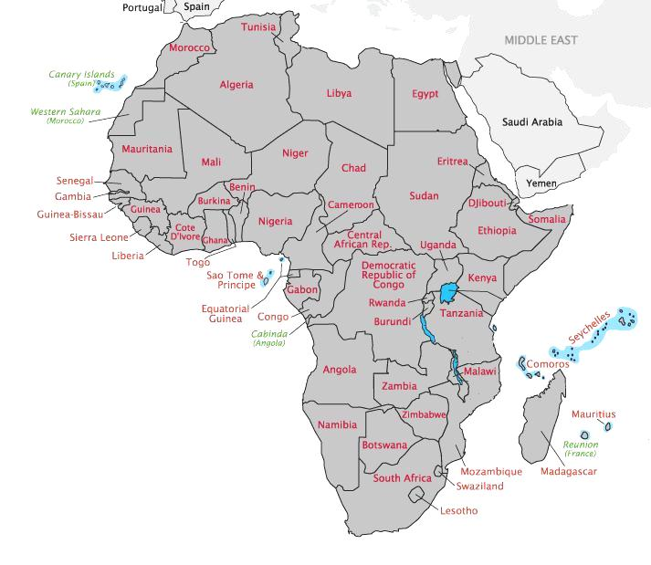
Notes:
A questionnaire was sent to ENT surgeons and audiologists in Sub-Saharan counties. I received responses from the 18 African countries indicated.

Slide 7
ENT surgeons / 100 000
Shortfall of ENTs = 15,220 (USA)
Notes:
In order to obtain the same ratio of ENTs in the 18 countries polled as that of the UK, one would have to train 4669 ENT surgeons.

Slide 8
Shortfall of Audiologists = 20,856
Notes:
the shortfall of 20856 audiologists, or

Slide 9
ENT Training Programmes
Notes:
A reason for this dire shortage of ENT surgeons is that of the countries surveyed, only 10 had their own ENT training programmes.

Slide 10
Audiology Training
Notes:
A reason for this dire shortage of ENT surgeons is that of the countries surveyed, only 10 had their own ENT training programmes.

Slide 11
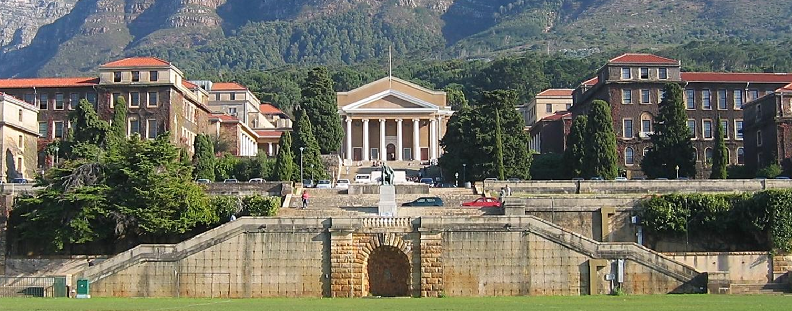
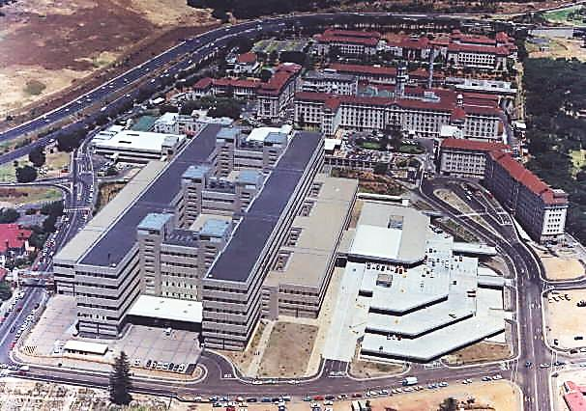
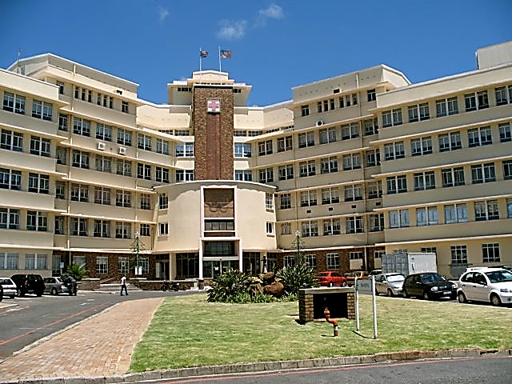
Groote Schuur Hospital
Red Cross War Memorial Children’s Hospital
University of Cape Town
African ENT Specialist Training
Notes:
I work and teach at Groote Schuur and Red Cross Children’s Hospitals in Cape Town. Both are public hospitals that provide care to the indigent and to low income patients from South Africa and from neighbouring countries. Groote Schuur Hospital is perhaps best known for the 1st Heart transplant that was done there in 1967.
We encounter a rich spectrum of pathology and provide high quality care and have access to sophisticated technology such as CO2 laser, PET scans, neuronavigation and modern radiation therapy techniques and interventional radiology. So we really are privileged to be in a position to practice 1st world medicine in a developing world setting.

Slide 12
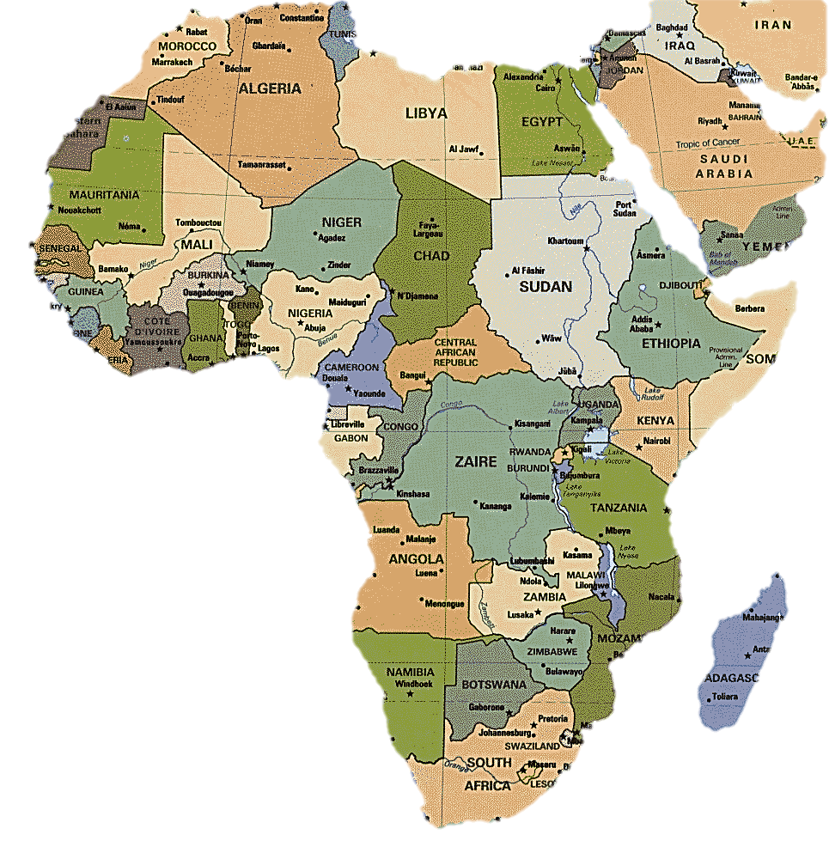
UCT ENT Residents (17)
86% in Africa
Past
Present
Notes:
We have trained ENT surgeons, either fully or partly, from numerous other African countries. We presently have residents from Botswana and Libya on our programme. What is particularly gratifying is that 86% have remained in Africa, which would be contrary to the situation had they trained in North America.

Slide 13
Groote Schuur Hospital
Red Cross War Memorial Children’s Hospital
University of Cape Town
Head & Neck Fellowship Programme
Notes:
I work and teach at Groote Schuur and Red Cross Children’s Hospitals in Cape Town. Both are public hospitals that provide care to the indigent and to low income patients from South Africa and from neighbouring countries. Groote Schuur Hospital is perhaps best known for the 1st Heart transplant that was done there in 1967.
We encounter a rich spectrum of pathology and provide high quality care and have access to sophisticated technology such as CO2 laser, PET scans, neuronavigation and modern radiation therapy techniques and interventional radiology. So we really are privileged to be in a position to practice 1st world medicine in a developing world setting.

Slide 14
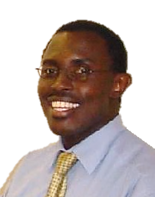
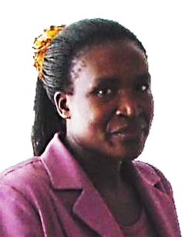
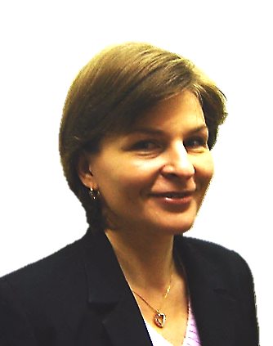
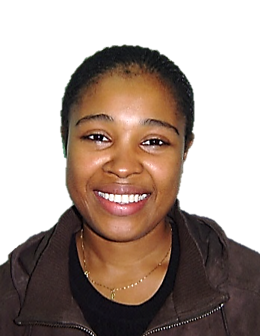
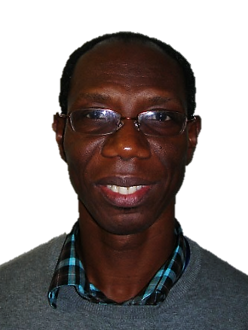
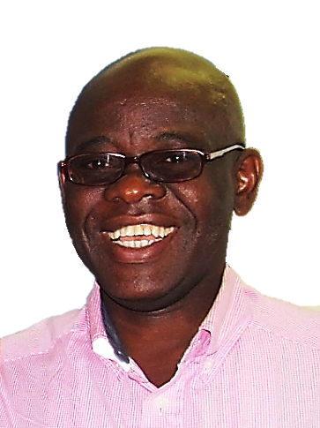
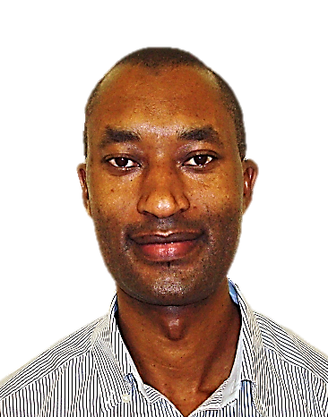
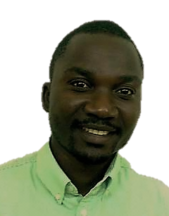
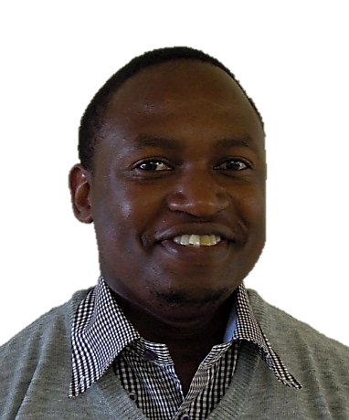
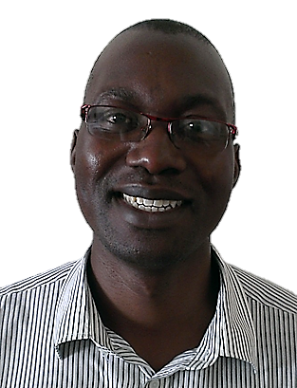
University of Cape Town / Karl Storz
Head & Neck Fellows
2005/6
Jeffrey Otiti
Kampala, Uganda
2006/7
Joyce Aswani
Nairobi, Kenya
2007/8
Anna Konney
Kumasi, Ghana
2008/9
Evelyne Diom
Dakar, Senegal
2009/10
Kenneth Baidoo
Accra, Ghana
2010/11
Paul Onakoya
Ibadan, Nigeria
2012/13
Rajap Mugabo
Kigali, Rwanda
2013/14
Patrick Noah
Blantyre, Malawi
2014/15
Victor Mashamba
D/E Salaam, Tanzania
2015/16
Innocent Kundiona
Harare, Zimbabwe

Slide 15
UCT Head & Neck Fellows
Qualified (10)
In Training
Future Fellows
Notes:
We have trained ENT surgeons, either fully or partly, from numerous other African countries. We presently have residents from Botswana and Libya on our programme. What is particularly gratifying is that 86% have remained in Africa, which would be contrary to the situation had they trained in North America.

Slide 16
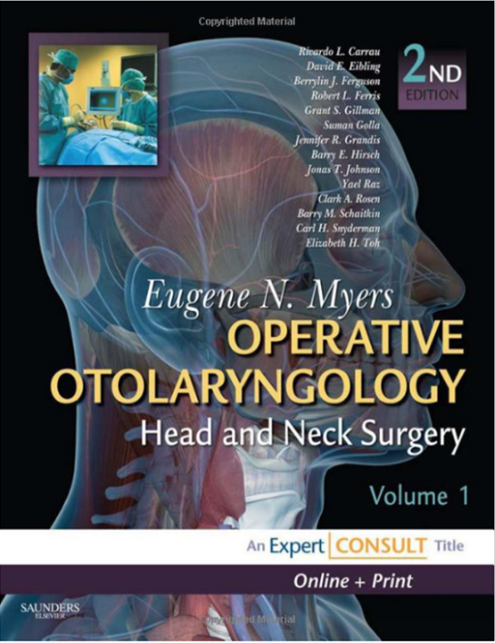
Challenges
Shortages of ENTs, audiologists
Limited access to Education & Training
Textbooks
  Unaffordable
  Content inappropriate
  for resource limited settings
$544
Notes:
It is evident that Africa and the Developing World have enormous challenges relating to the treatment of HN cancer that includes the vastness of the African continent and the developing world; the enormous BOD; the impact of poverty on health care delivery and treatment outcomes; the shortages and lack of opportunity for education and training of health workers; poor medical infrastructure; and the need to develop resource appropriate management algorithisms relating to how one prioritises pathology and patients in the face of an overwhelming BOD, and providing appropriate treatment

Slide 17
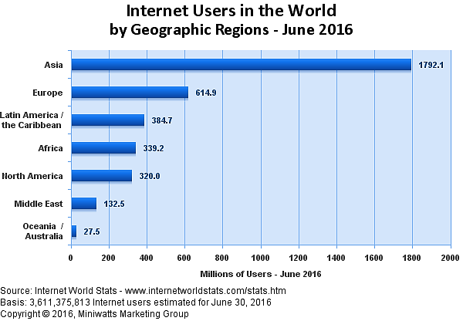
Opportunity

Slide 18
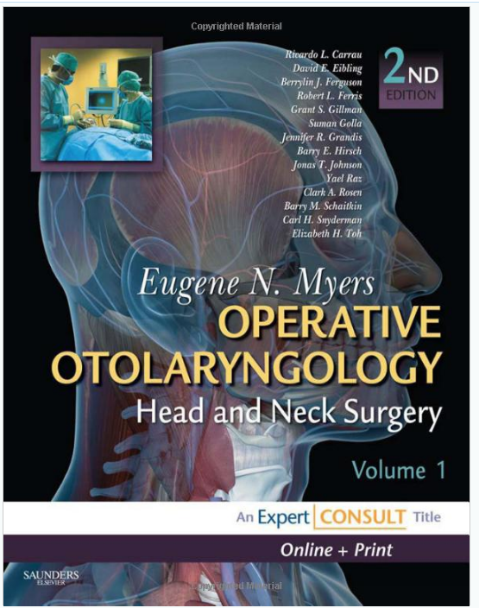
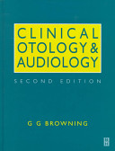

Slide 19
Open Access Atlas of Otolaryngology, Head and Neck Operative Surgery
Open Access Guide to Audiology and Hearing Aids for Otolaryngologists

Slide 20
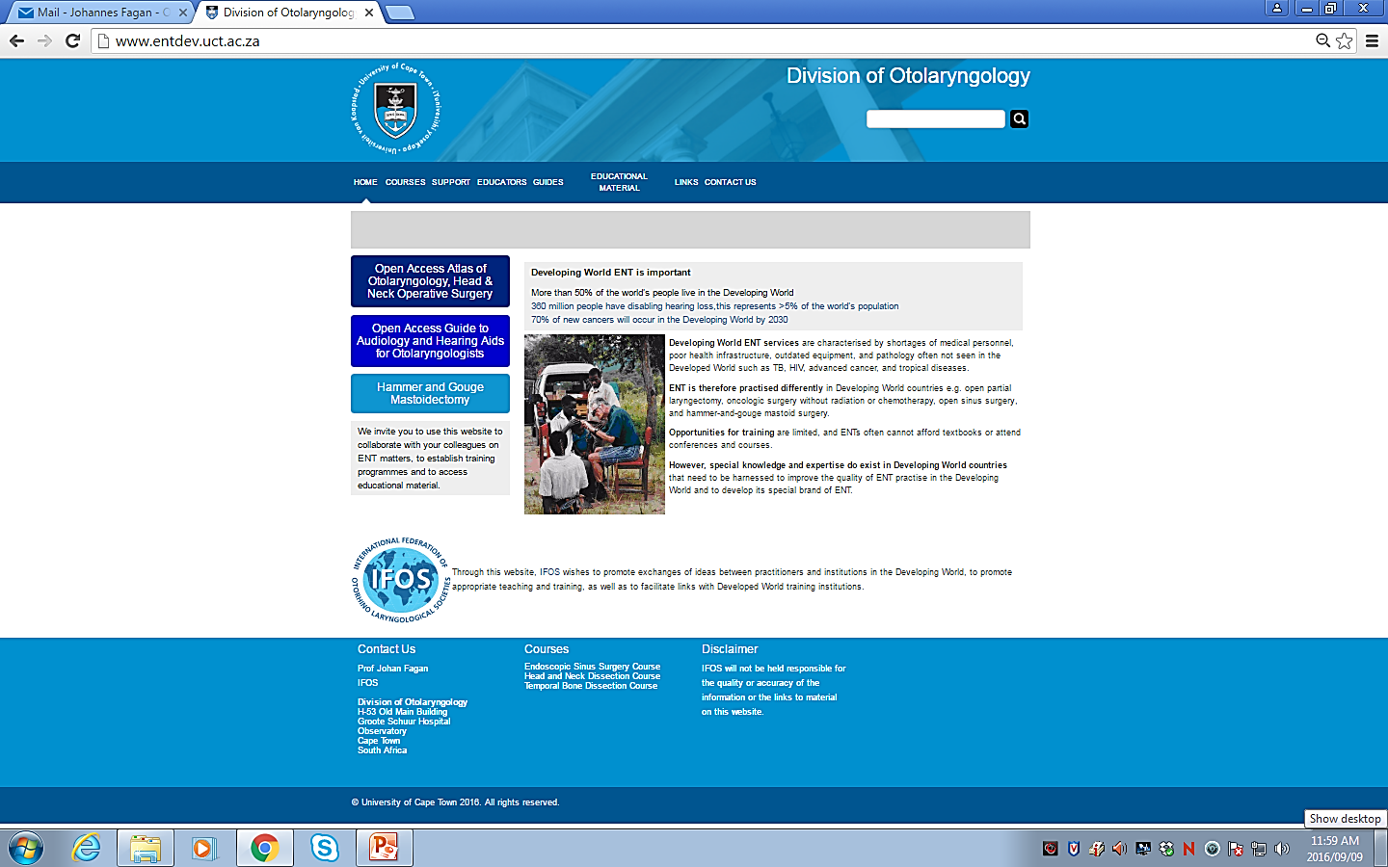

Slide 22
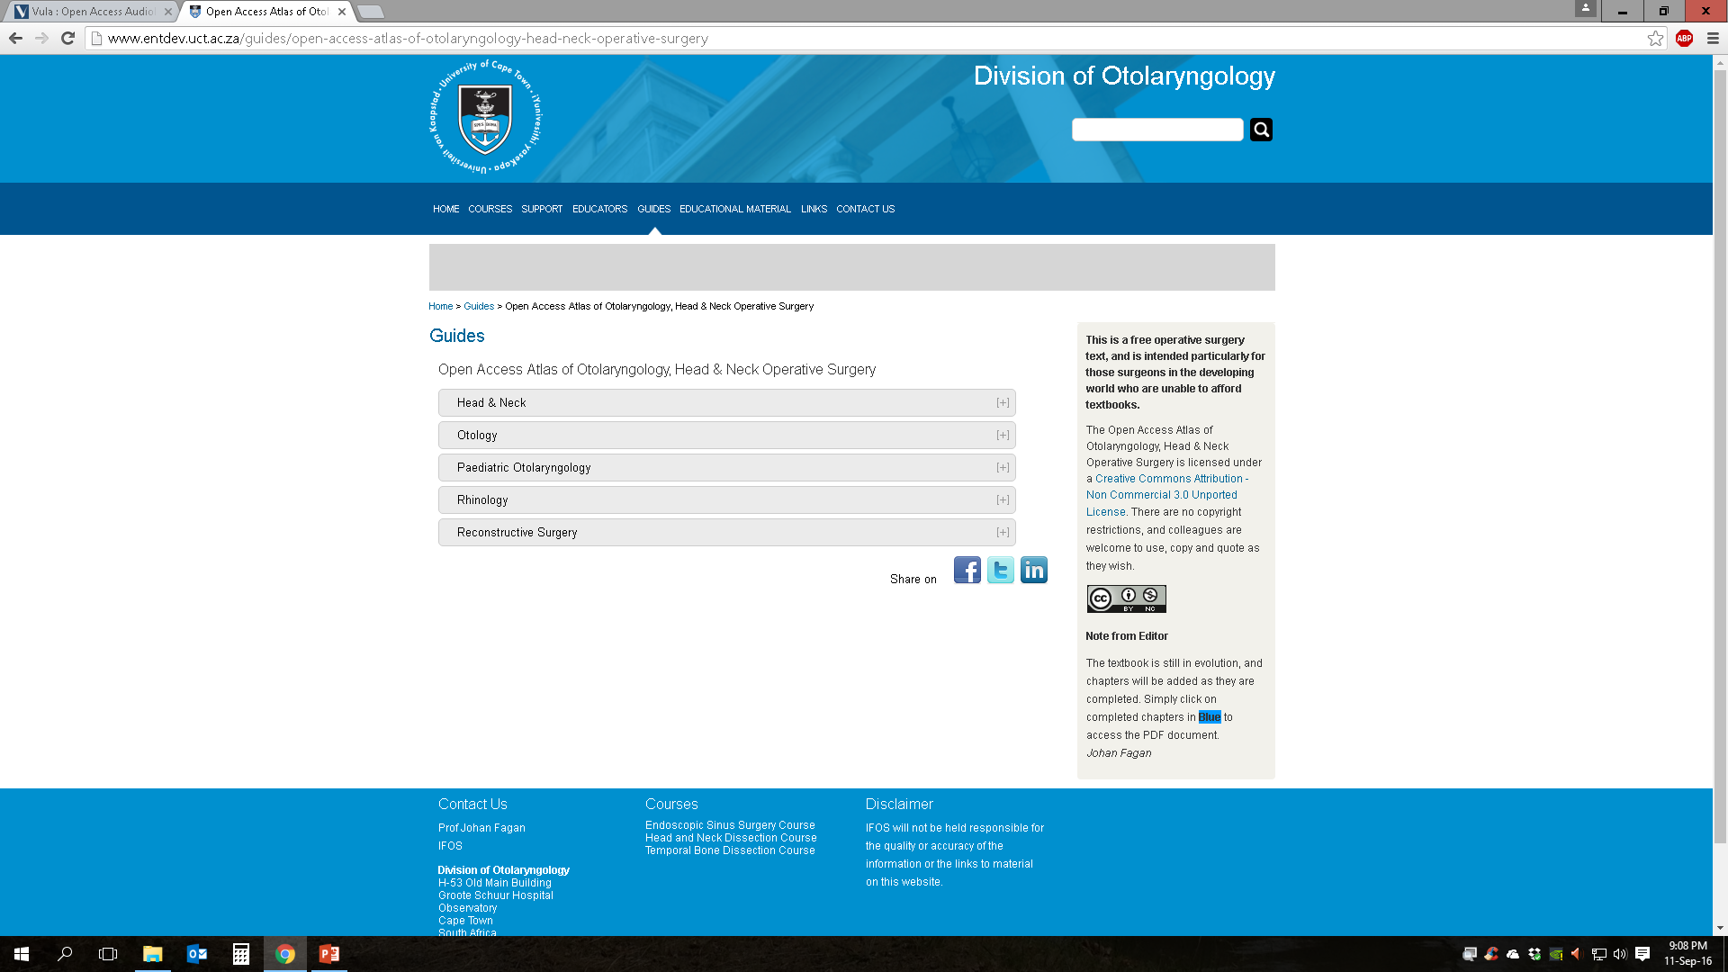

Slide 23
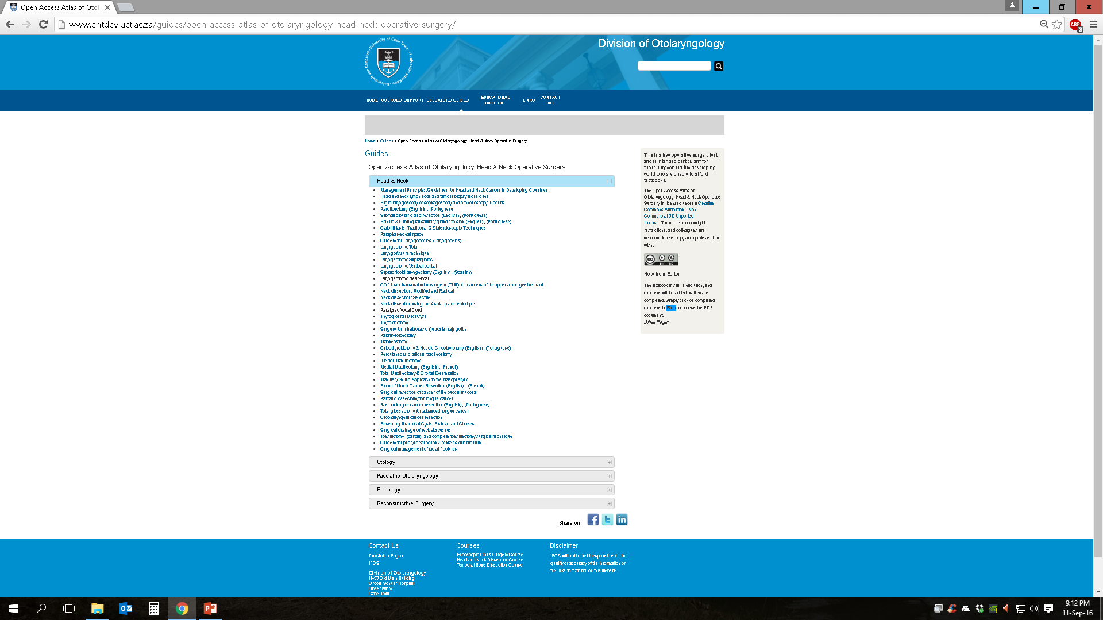

Slide 24
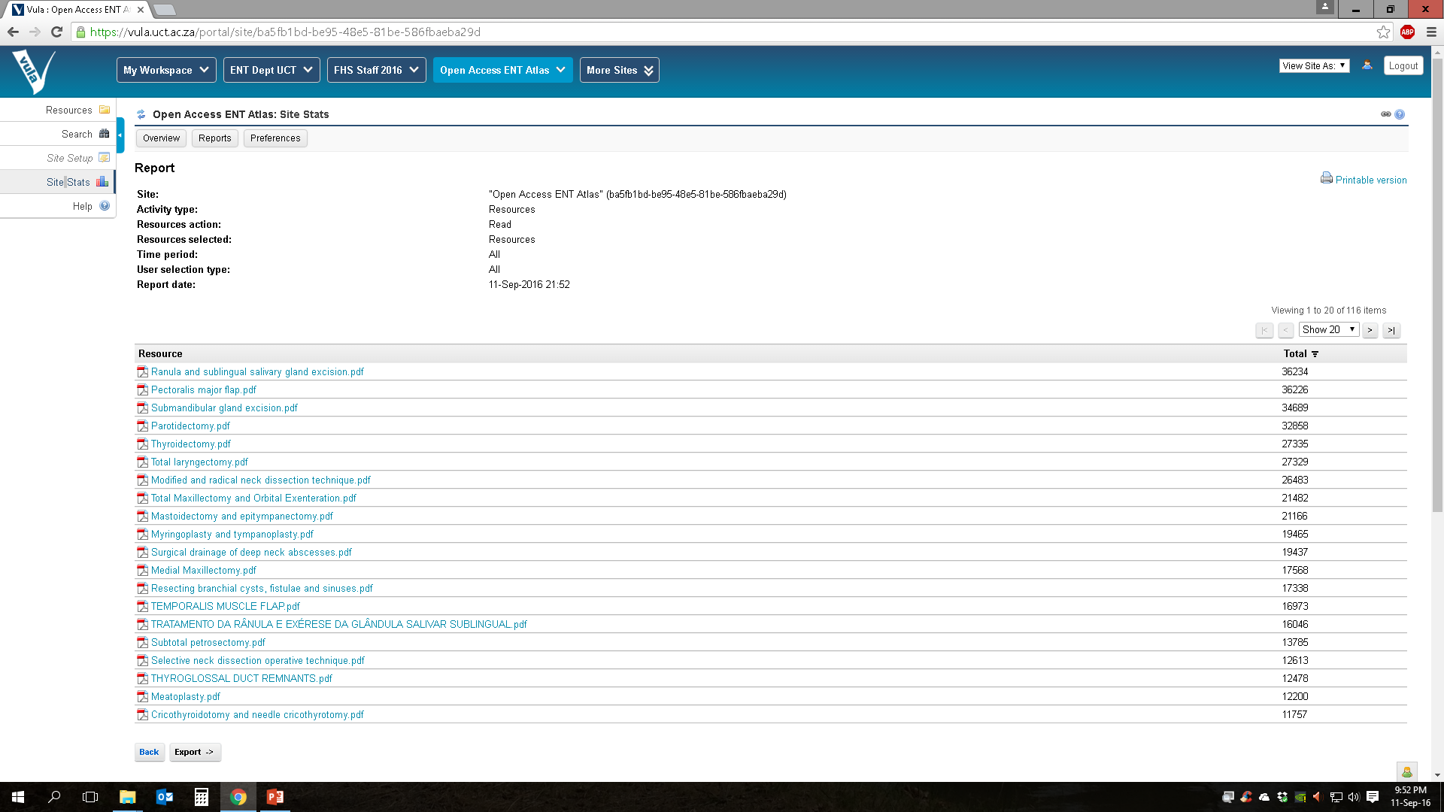

Slide 25


Permits copying, pasting, free use
Except commercial

Slide 26
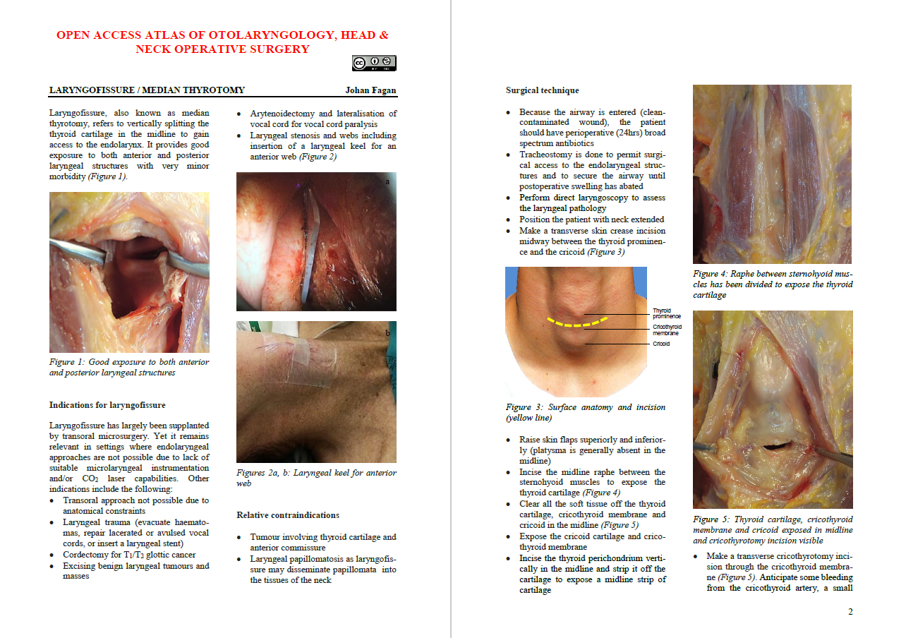

Slide 27
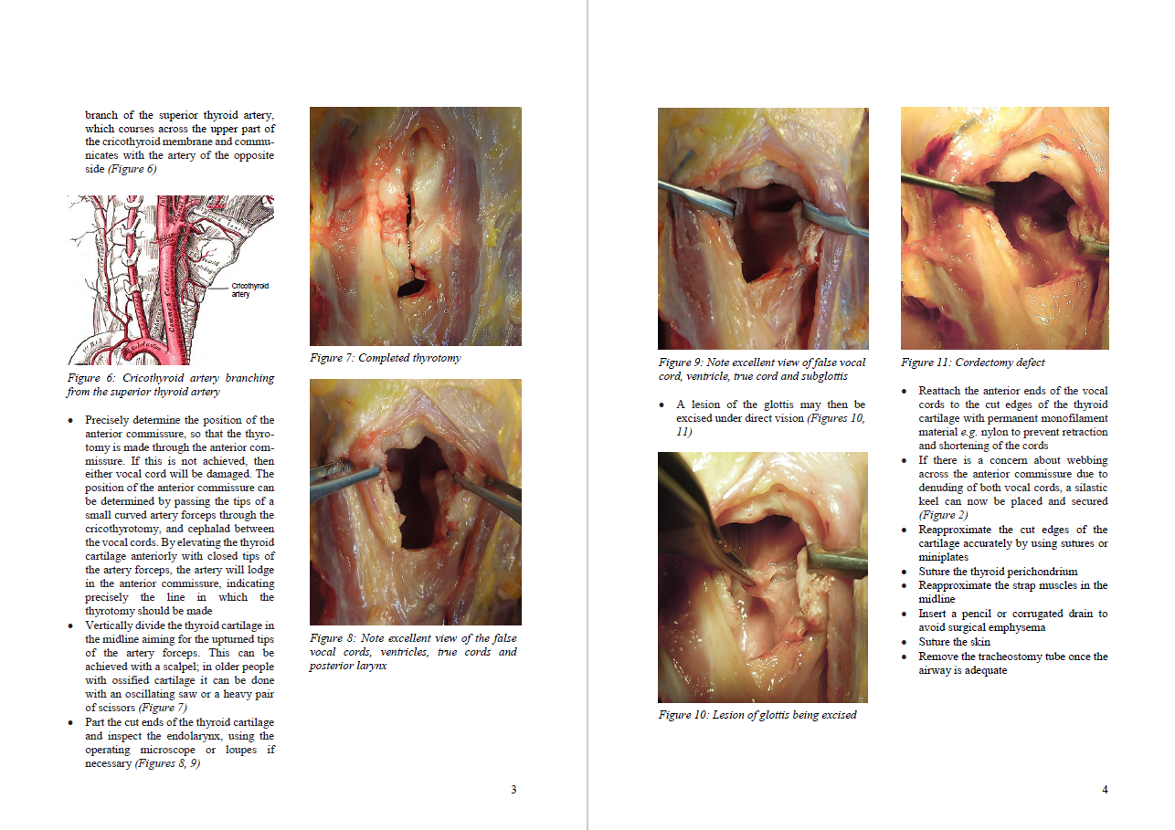

Slide 28
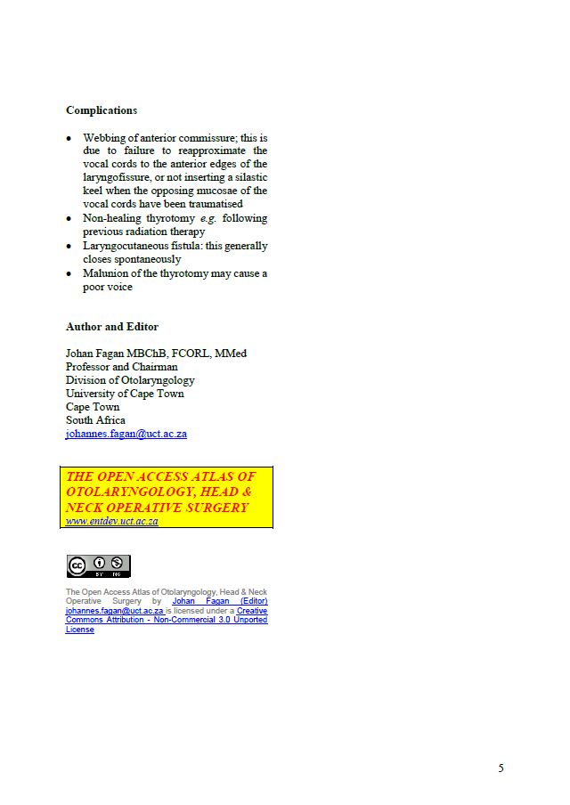

Slide 29
OPEN ACCESS ATLAS OF OTOLARYNGOLOGY, HEAD & NECK OPERATIVE SURGERY

Slide 30
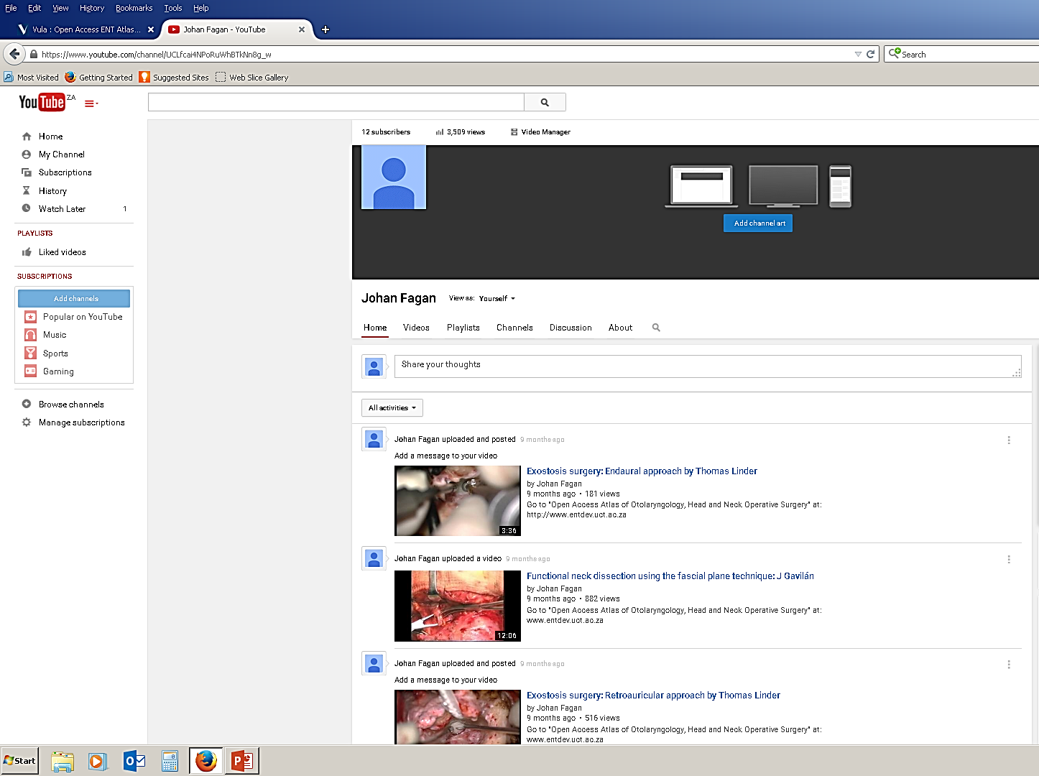

Slide 31
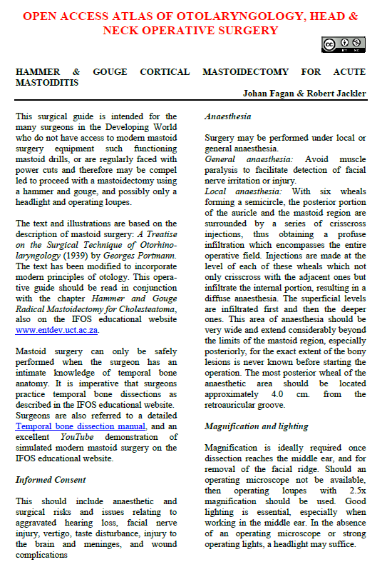
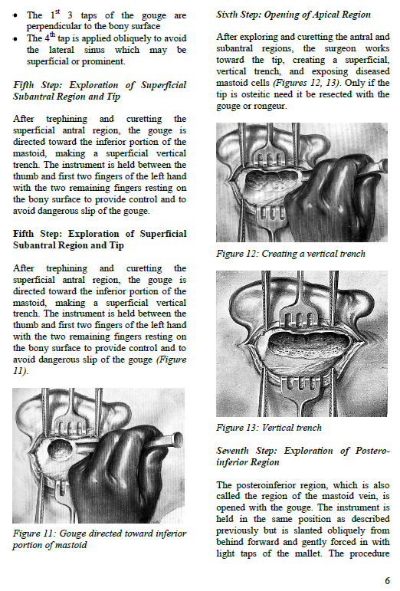

Slide 32
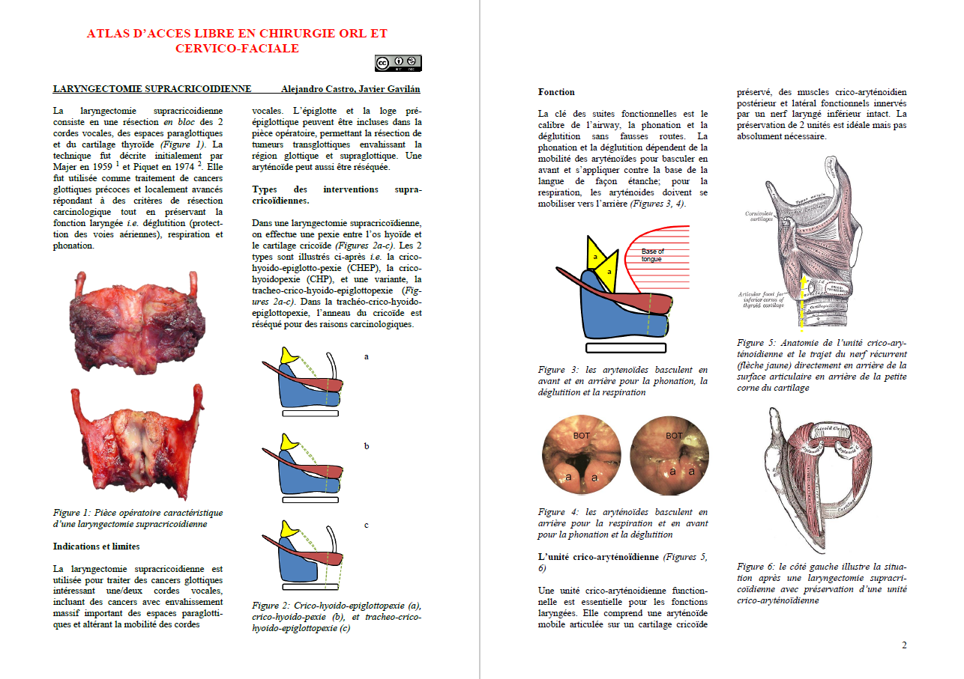

Slide 33
Outcomes

Slide 34
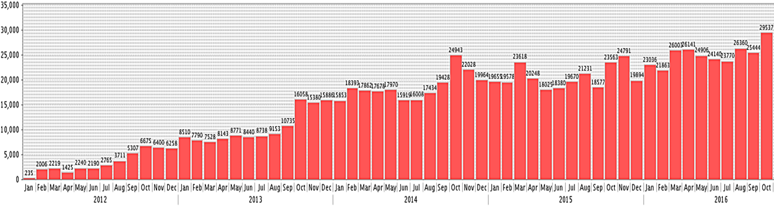
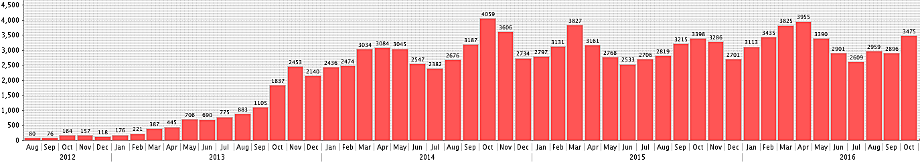
Open Access Atlas of Otolaryngology Head & Neck Operative Surgery
Open Access Guide Audiology & Hearing Aids for Otolaryngologists

Slide 35
>1,000,000 chapters downloaded
+/- 1000 chapters per day
Chapter downloaded every 90 secs
Many on 1st page of Google

Slide 36
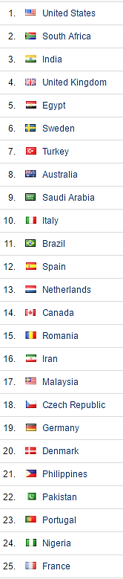
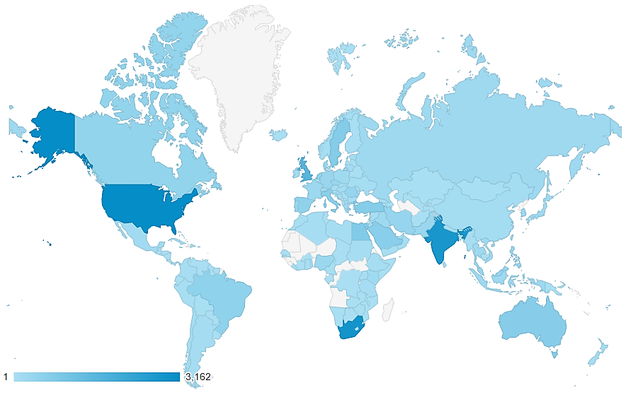
Open Access Books

Slide 37
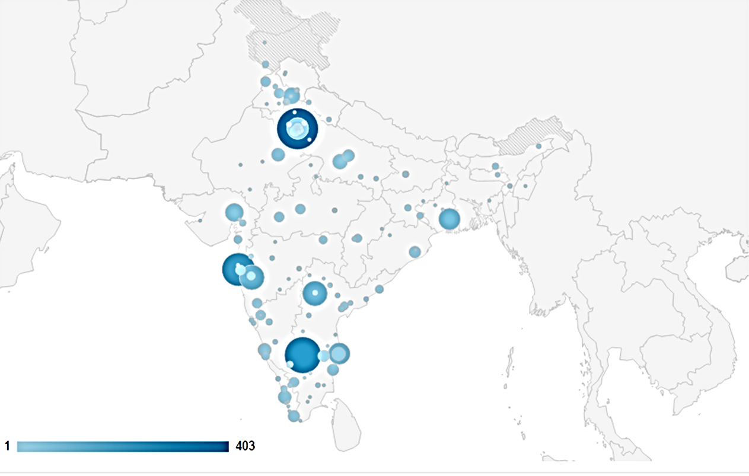
Open Access Books

Slide 39
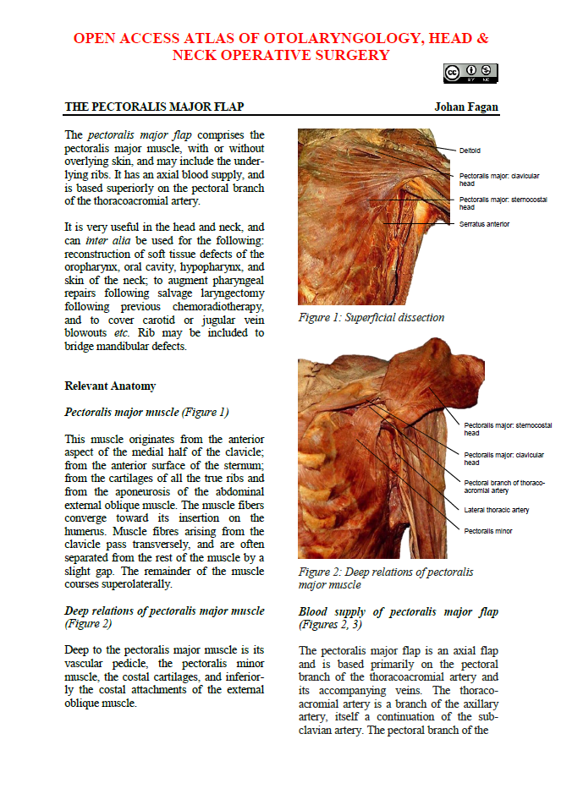
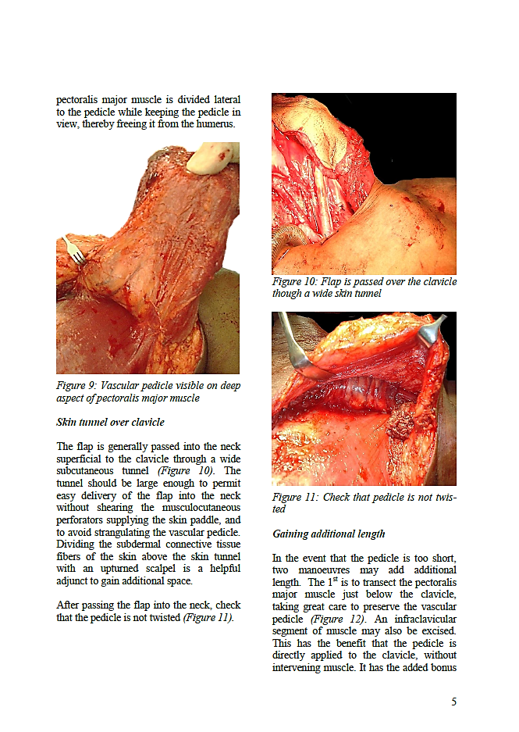

Slide 40
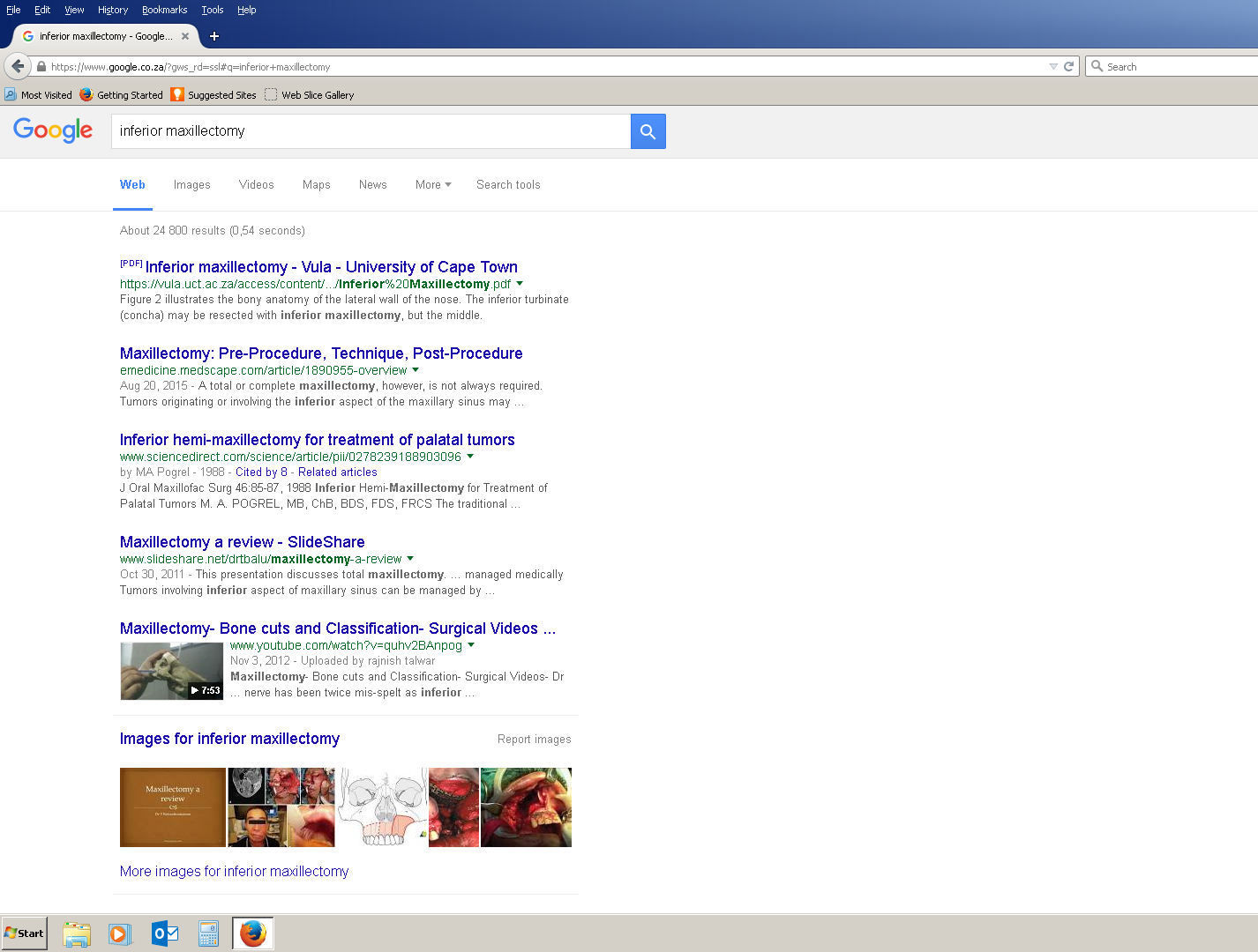

Slide 41
Future Developments
100 chapters completed….more being written
Mobile app?
  Mobile phone format
  Lower bandwidth
  Fundraising thru’ advertising?
  Maintain eBooks
  Fund Developing World ENT training and services

Slide 42
Summary
Zero cost (other than time)
Copyright
Authors & Societies eager to contribute
Chapter vs eBook format
  No need to first complete the whole book
  More searchable
International profile
  Authors
  UCT
Ideal for Developing World
Future of teaching and training

Slide 43
www.entdev.uct.ac.za

