Slide 1




Slide 2
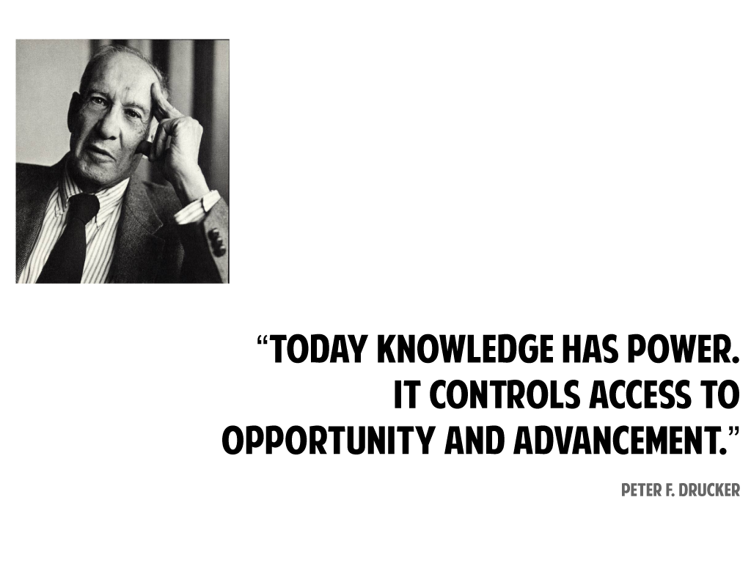

Slide 3
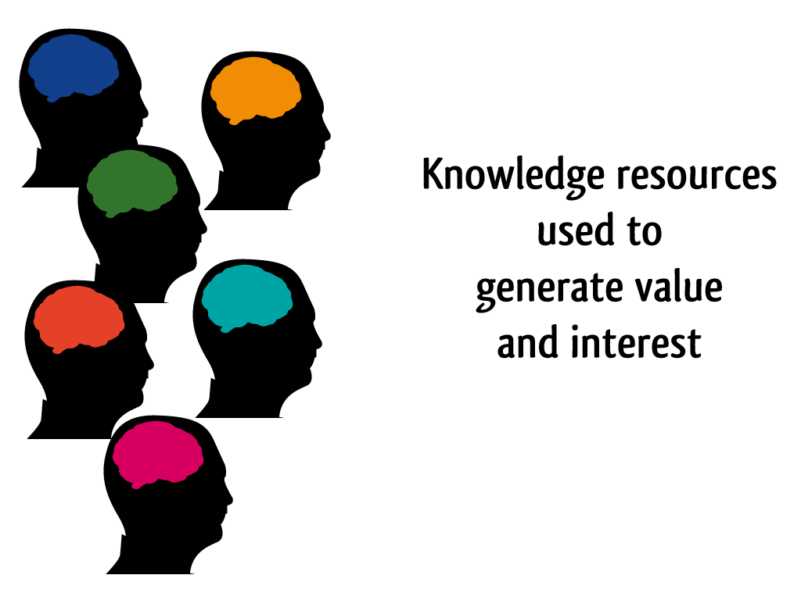

Slide 4
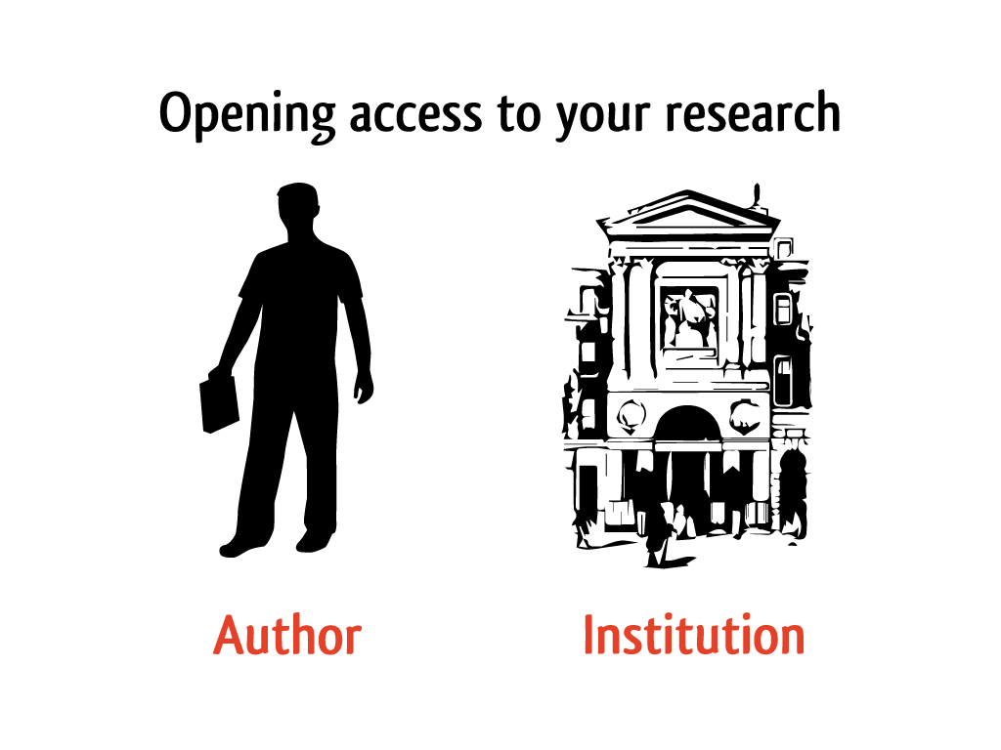

Slide 5
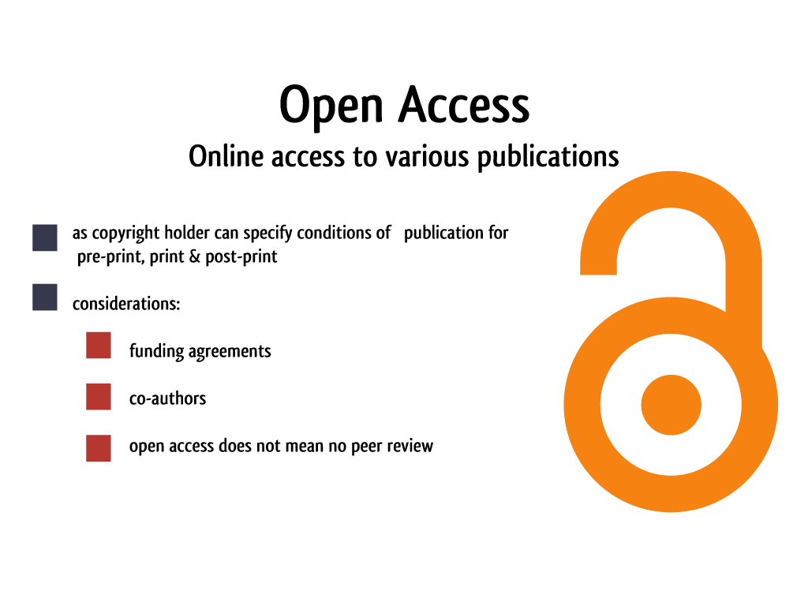

Slide 6
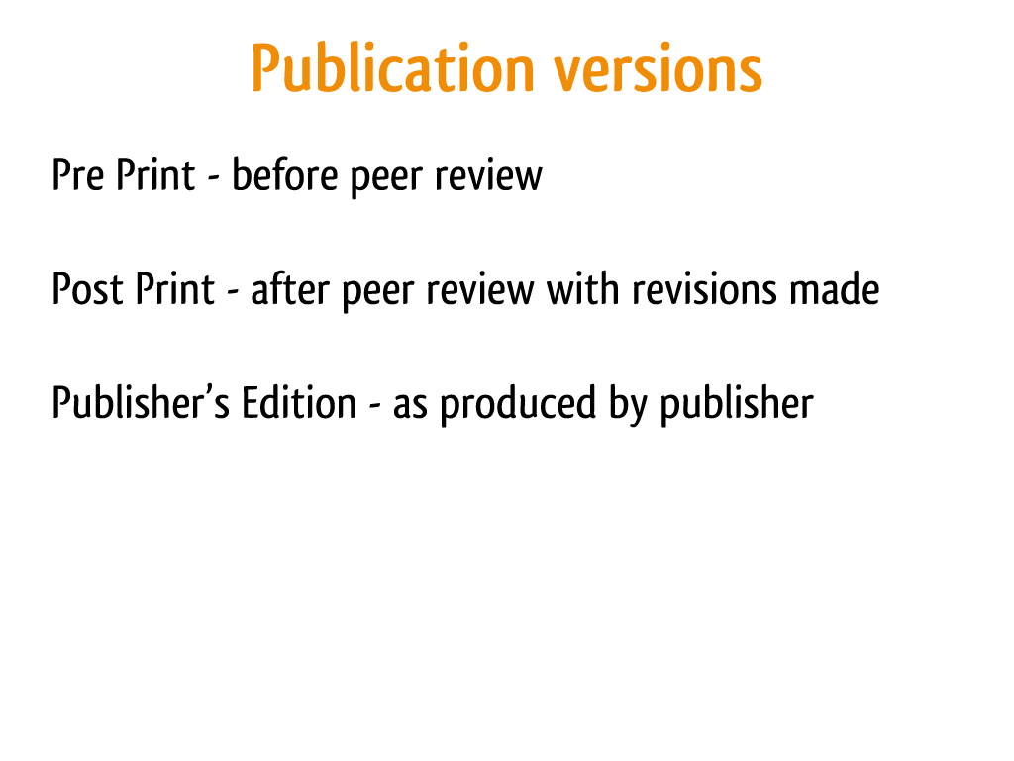

Slide 7
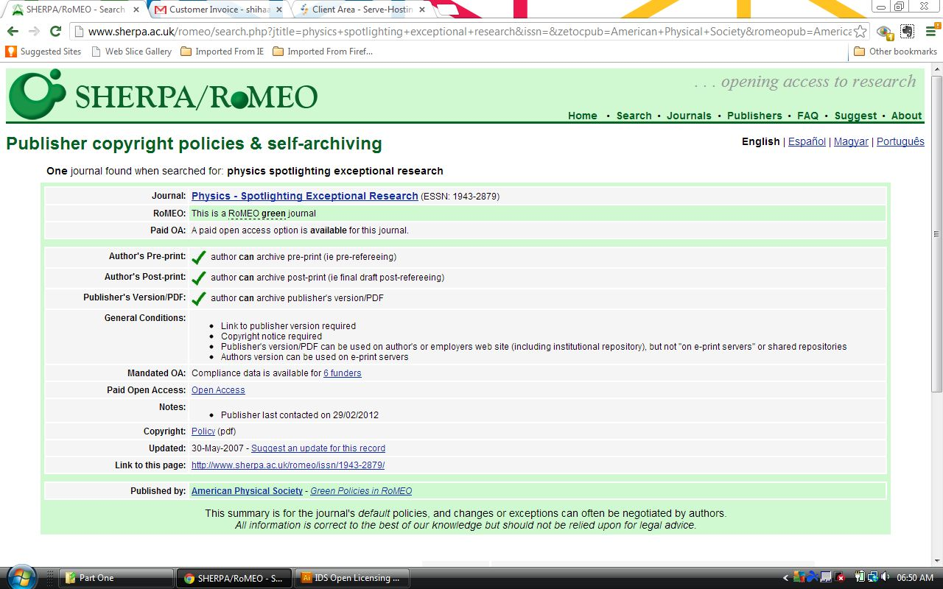
Notes:
www.sherpa.ac.uk/romeo

Slide 8
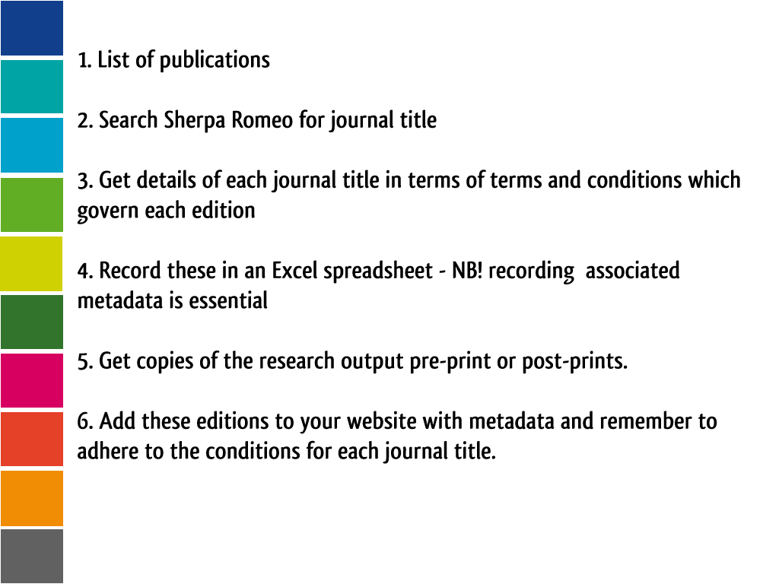

Slide 9
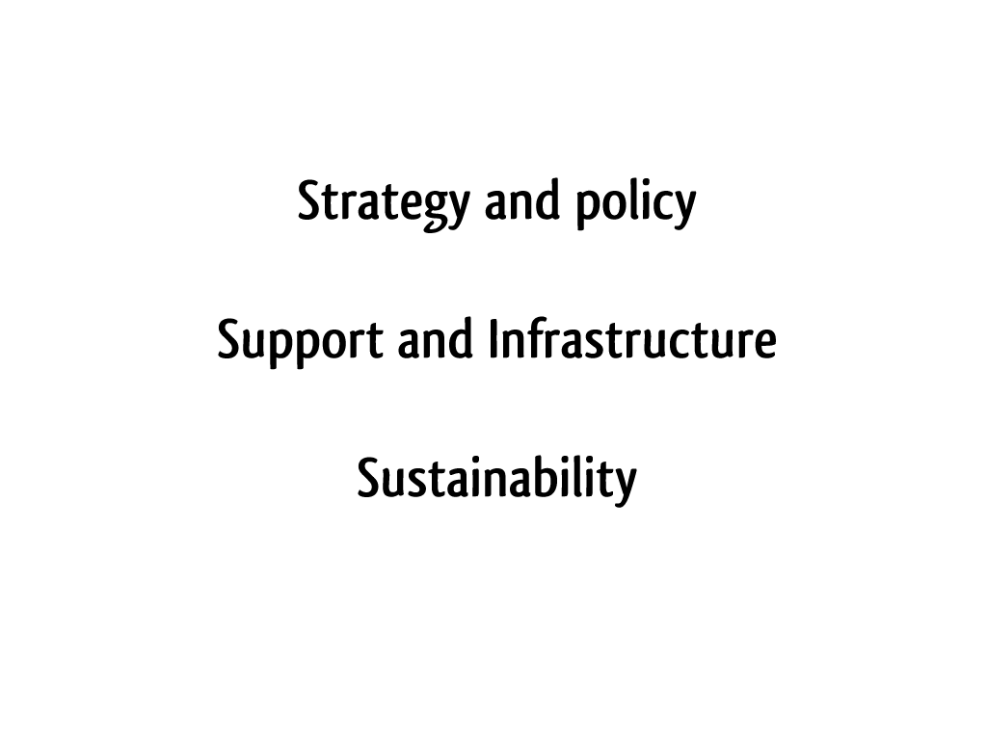

Slide 10
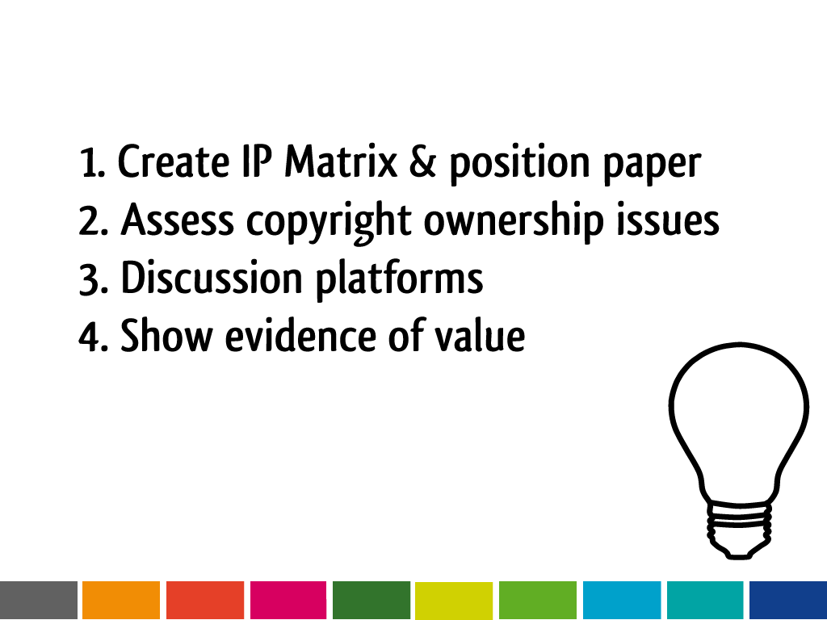

Slide 11
This work is licenced under the Creative Commons Attribution 2.5 South Africa License. To view a copy of this licence, visit http://creativecommons.org/licenses/by/2.5/za/
or
send a letter to Creative Commons, 171 Second Street, Suite 300, San Francisco, California 94105, USA.

