Slide 1
Introduction to Open Educational Resources (OER)
Michael Paskevicius
March 29, 2012
Presentation to:
EDN6099F: ICT in Education - Issues & Debates

Slide 2

Introduction
Originally from Canada; came to Southern Africa via Namibia where I did an internship for the Commonwealth of Learning 2005-2008
Began my coursework on the ICTs in Education course in 2009 . Completed dissertation on how open educational resources might be useful for social outreach in 2011
Educational technologist in the Centre for Educational Technology working on UCT OpenContent and OpenUCT
Research interests include learning and educational analytics, metadata for online resources, knowledge management, mobile learning, social media in education and open scholarship.

Slide 3
Question
How many of us have shared some form of media online?
How many of us have put some form of educational media online?
Do you consider how the content you share online is licensed for use by others?
How many have heard the term open educational resources?

Slide 4
Contrasting open and closed online resources
Part 1

Slide 5
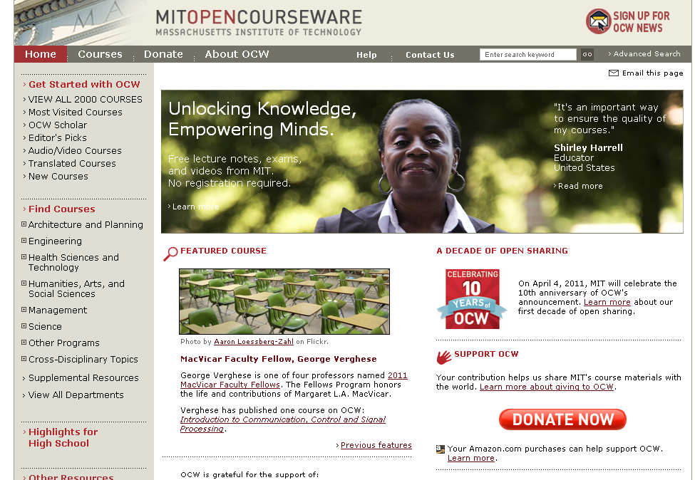

The origins of OER: MIT OpenCourseWare

Slide 6
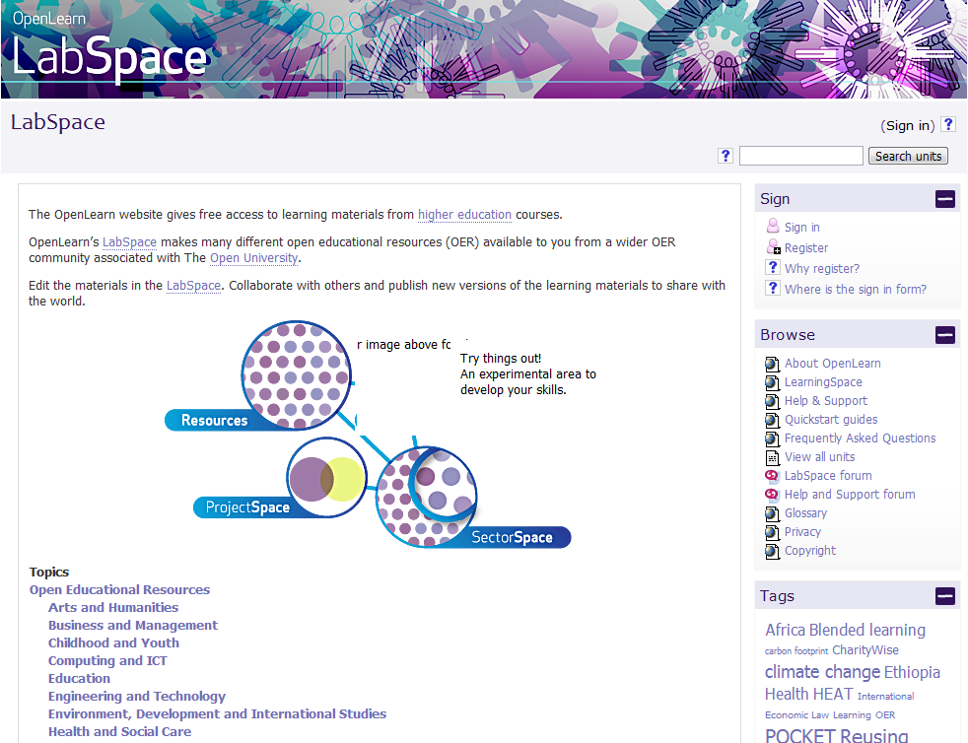
Open CourseWare: Open University

Slide 7
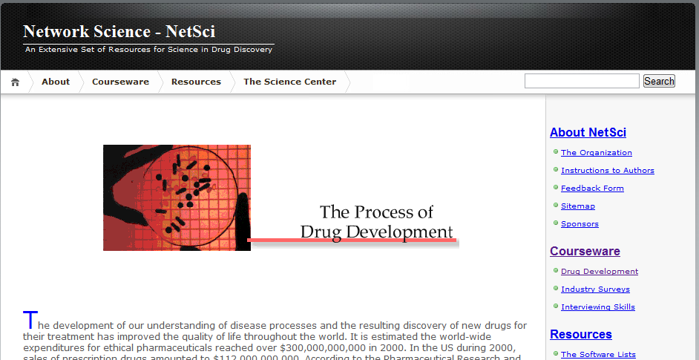
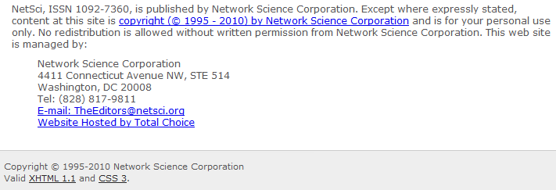

Copyright CourseWare: Network Science

Slide 8
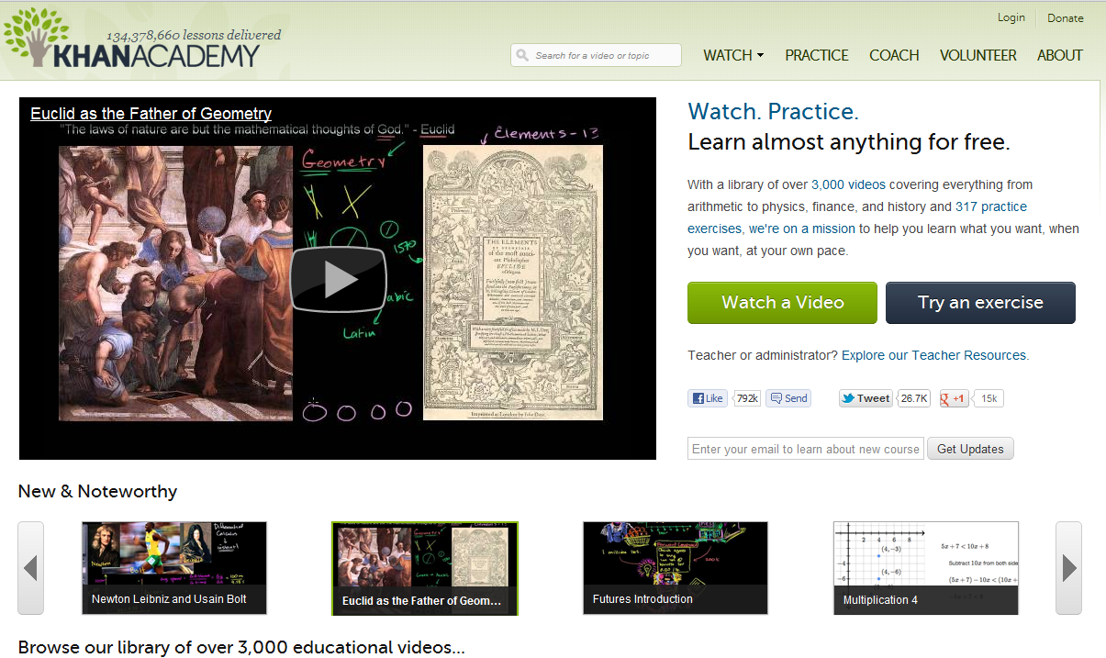
Open Video: The Khan Academy

Slide 9
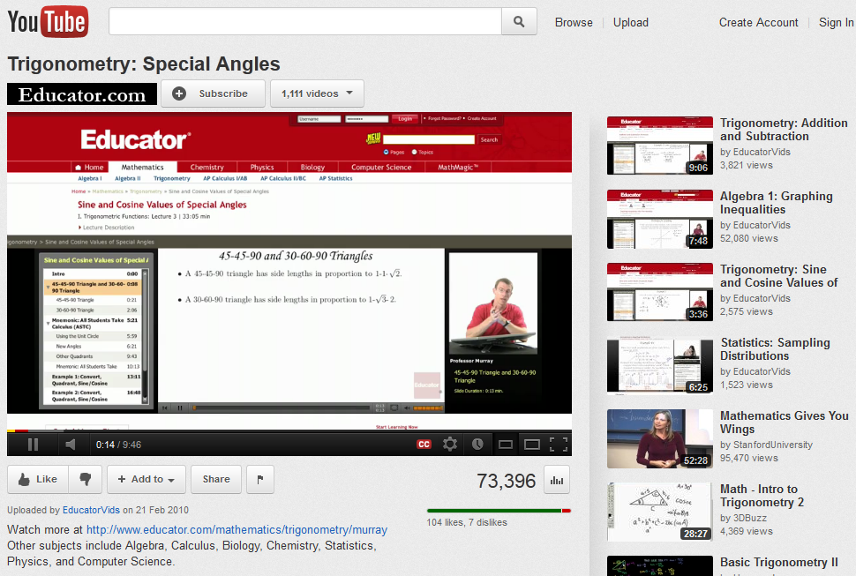
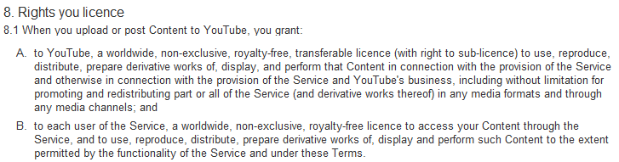
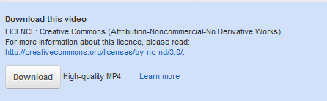
Mostly closed video: YouTube

Slide 10
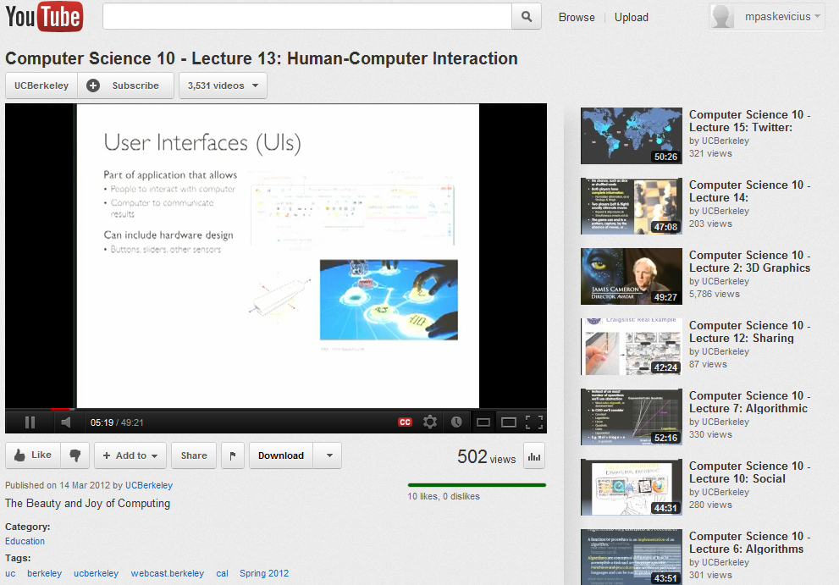
YouTube recently launched a Creative Commons option

Slide 11
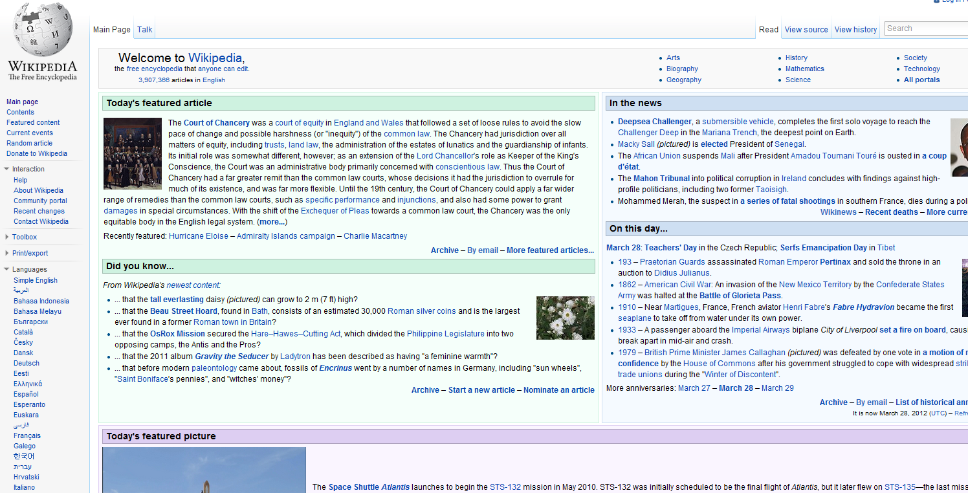

Wikipedia

Slide 12
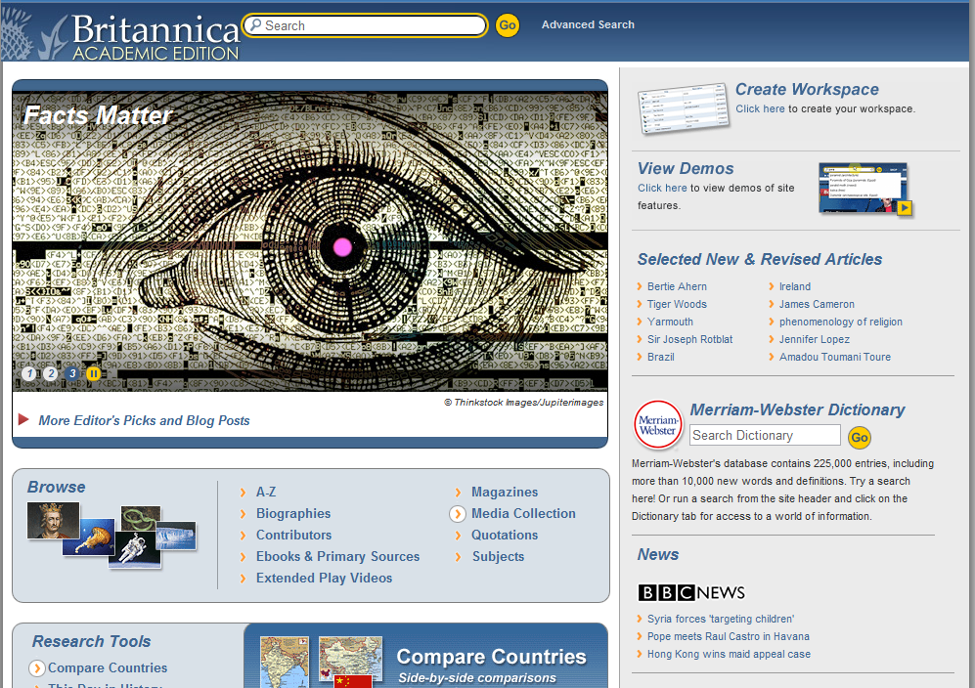
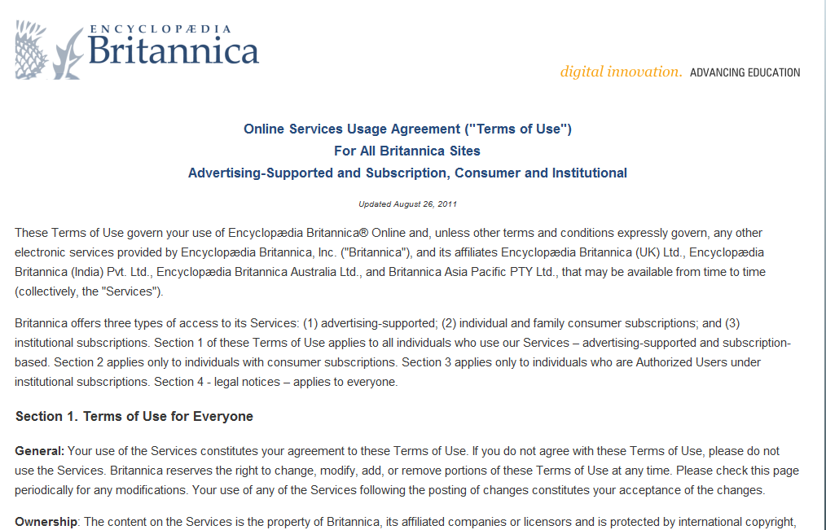
Encyclopedia Britannica

Slide 13
© Cancels the Possibilities
Of digital media and the internet
Internet
Enables
Copyright
Forbids
What to do?
Wiley, D. (2012) Openness and the Future. ETS Future of Assessment Conference. Presentation available: http://www.slideshare.net/opencontent/openness-and-the-future-of-assessment

Slide 14
open educational resources
Part 2

Slide 15
Open Educational Resources
Open Content / Open educational resources (OER) / Open Courseware are educational materials which are discoverable online and openly licensed that can be:
Shared freely and openly to be…
… redistribute and share again.
Shared
Redistributed
Used
… used by anyone to …
… adapt / repurpose/ improve under some type of license in order to …
Improved
Notes:
The key aspect of an OER is that it is both discoverable online – so that people can find it AND openly licensed - so that people can legally make use of it. OER includes texts, different forms of media, ideas, as well as documented teaching strategies/techniques or practices.
Advocates of openness would suggest that the value in OER is in its potential to support learning in many ways and in many contexts.

Slide 16



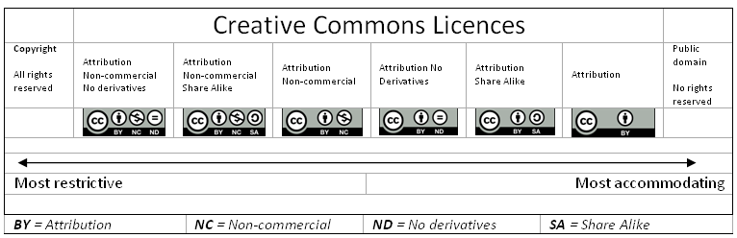
OER include Creative Commons licenses which allow for reuse
Notes:
16
How many have heard of Creative Commons? CC gives content creators control of the online resources they wish to allow others to reuse.
Nowadays, we are all creating digital artifacts – be it images from our cameras or cell phones, videos, documents, presentations, the list goes on. Without realizing it, we often designate our work under full copyright –without even really knowing why. This is because if we don’t specify an open license such as creative commons, we automatically retain full copyright.
So of you put something online, and don’t specify an open license, you retain full copyright which makes it problematic for others to use – although it is online for anyone to access.
Licensing is as simple as copying and pasting the license image onto your materials. CC gives us a range of licenses to operate which retains “some rights reserved” – note that CC always allows you to retain attribution.

Slide 17


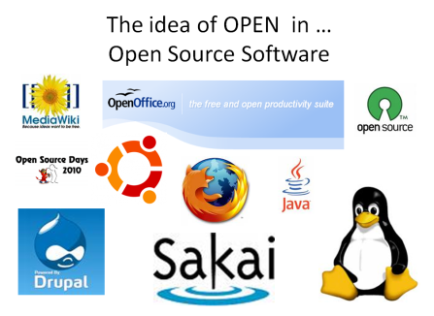

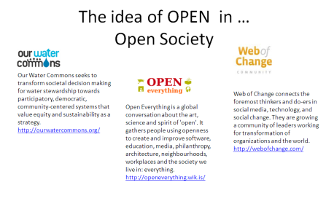
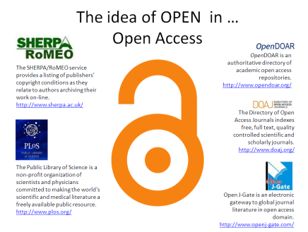
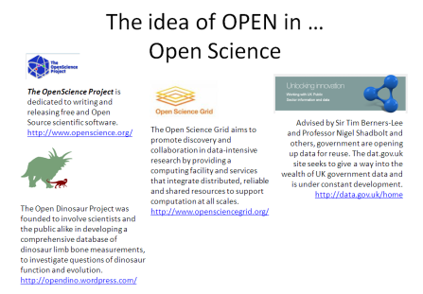


Open educational resources part of the “Open Movement”
Open Data
Open Source Software
The Open Movement
Open Society
Open Access
Open Science
Open Educational Resources
Open Licences
Notes:
So open educational resources are part of a larger open movement, which harnesses the affordances provided by the internet, and aims to increase access to information. Open access to research, open availability of data, open science for global collaboration, open source software are all part of this movement.

Slide 18





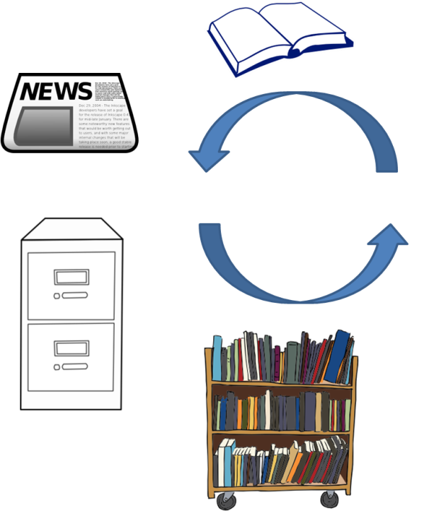









Towards open educational practices…
Notes:
A growing body of online content is now available under Creative Commons which means teachers anywhere in the world can discover, adapt, mix it with other resources, improve it and use it for teaching their students.
Open educational resources are materials which can be discovered online by teachers, and legally downloaded and used for teaching. This is because of the open license, typically Creative Commons, which enables the creators of content to designate it for reuse.
Open educational practices (OEP) is defined as use of openly licensed OER and online resources to raise the quality of education and training and innovate educational practices on institutional, professional and individual level (Conole, 2011)
Conole, G. (2011). Towards Open Educational Practices. e4innovation Blog posted Friday, January 7th, 2011. Accessed online: http://e4innovation.com/?p=406

Slide 19

…sharing beyond the classroom
Traditional sharing of teaching materials
Sharing educational resources as OER
Additional considerations:
Clearing of copyright issues
Formatting for web and accessibility for reuse
Addition of metadata
Publishing in repository or referatory
Educator
Creates
Learning activity
or resource
Publishes as OER on web
Shares
with students
and other faculty
Available to other faculties, students and institutions.
Other educators can now discover and reuse.
Adapted from Conole, G., McAndrew, P. & Dimitriadis, Y., 2010
Notes:
So what is meant to happen is a cycle of teaching material evermore being improved and shared. Plus it is all legal under the terms of the open license.

Slide 20
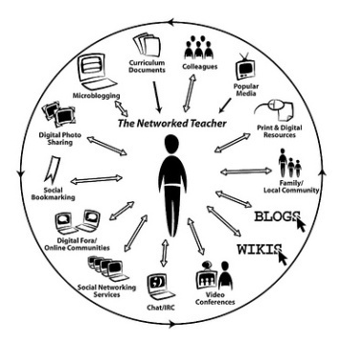
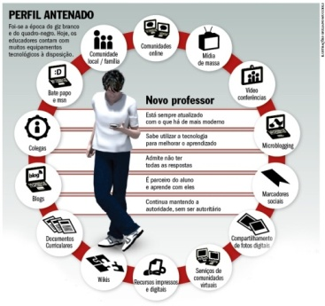
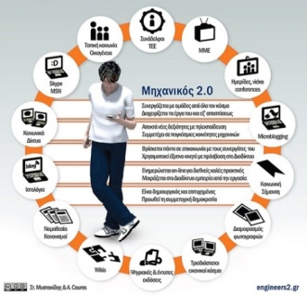
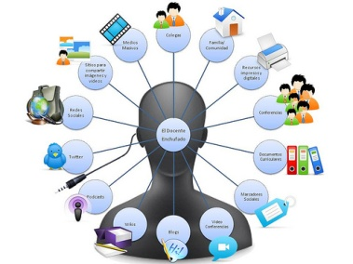
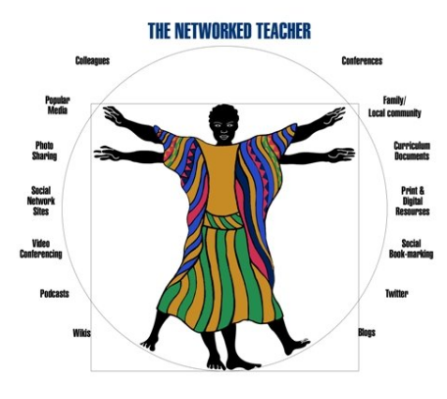
Example of OER development
Original diagram in a PhD thesis …
Improved and adapted for the Portuguese context …
Translated into Greek …
Adapted and translated to Spanish …
Adapted at the University of Cape Town
Notes:
Image 1: http://www.flickr.com/photos/courosa/2922421696/
Image 2: http://veja.abril.com.br/imagem/professorantenado.jpg
Image 3: http://www.flickr.com/photos/stylianosm/3706684606/
Image 4: http://www.flickr.com/photos/langwitches/3460307056/

Slide 21









Findings from my own research
Ambiguity around the terms of use when working with digital educational materials
Need for more explicit understanding of copyright
Opportunity to use open licenses such as Creative Commons
Systems needed to make digital educational materials discoverable to teachers
Need for metadata to describe resources
Importance of curation of digital materials
Challenge of collaborative authoring
Open educational practices may improve collaboration with other institutions
→ Opportunity for institutions to collaborate and share educational content
Notes:
A growing body of online content is now available under Creative Commons which means teachers anywhere in the world can discover, adapt, mix it with other resources, improve it and use it for teaching their students.
Open educational resources are materials which can be discovered online by teachers, and legally downloaded and used for teaching. This is because of the open license, typically Creative Commons, which enables the creators of content to designate it for reuse.
Open educational practices (OEP) is defined as use of openly licensed OER and online resources to raise the quality of education and training and innovate educational practices on institutional, professional and individual level (Conole, 2011)
Conole, G. (2011). Towards Open Educational Practices. e4innovation Blog posted Friday, January 7th, 2011. Accessed online: http://e4innovation.com/?p=406

Slide 22
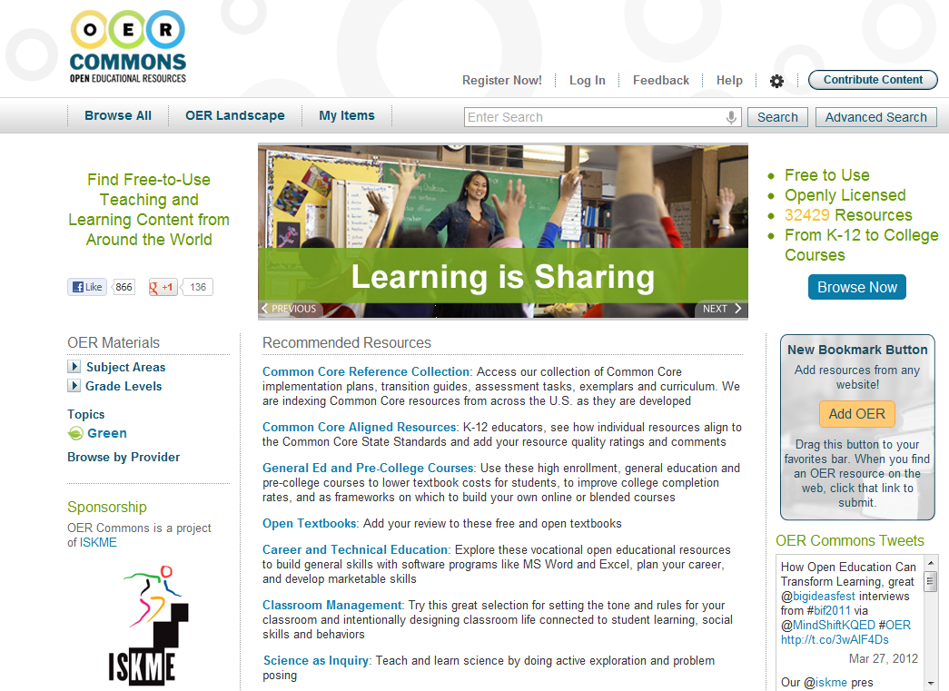
Aggregating content: OER Commons

Slide 23
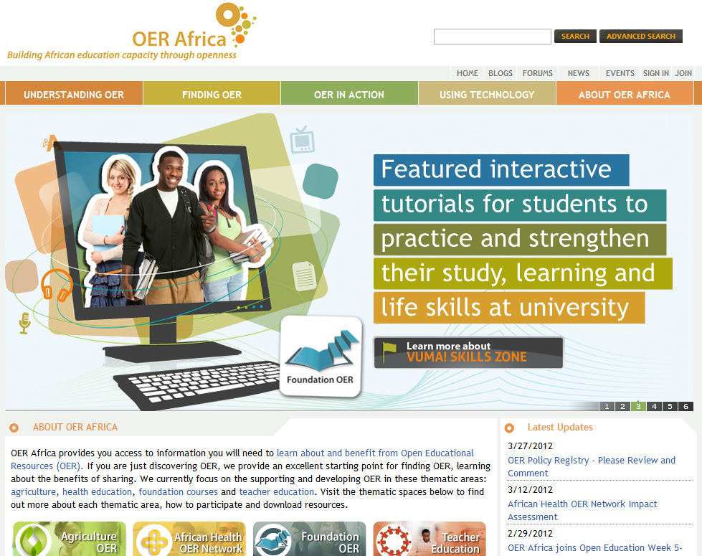
Collecting OER in Africa: OER Africa

Slide 24
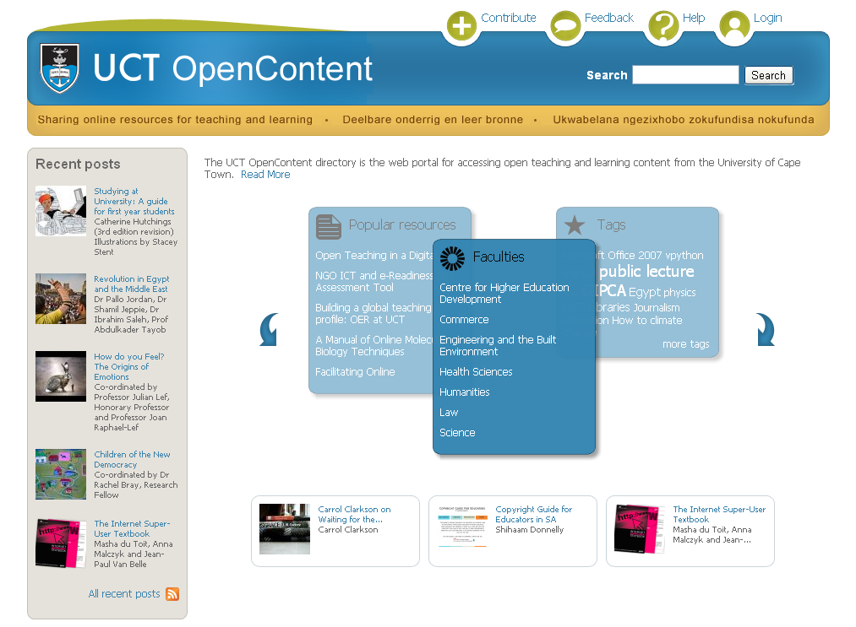
OER from UCT: OpenContent

Slide 25
What we have learned implementing UCT OpenContent
Sharing OER requires more than simply a facility for sharing
Requires change in academic practices
Academics generally want to get involved (sharing knowledge is second nature)
Shift question from:
  ‘why should I share my educational content?’
to
  ‘how can I stay in control of the process of my educational content being shared?’ (Butcher, 2010)
Butcher, N (2010) Open Educational Resources and Higher Education. http://oerworkshop.weebly.com/documents‐and‐papers.html
Notes:
Sharing OER requires more than simply a facility for sharing – there are plenty of options for people wanting to share these days.
It seems more important to focus on a change in academic practices, to ensure academics know the risks of sharing, use content they have the rights to share, and maximize exposure – if that is what they desire.
Shift question from
‘why should I share my educational content?’
to
‘how can I stay in control of the process of my educational content being shared?’ (Butcher, 2010)

Slide 26
Beyond OER: Open education
Part 3

Slide 27
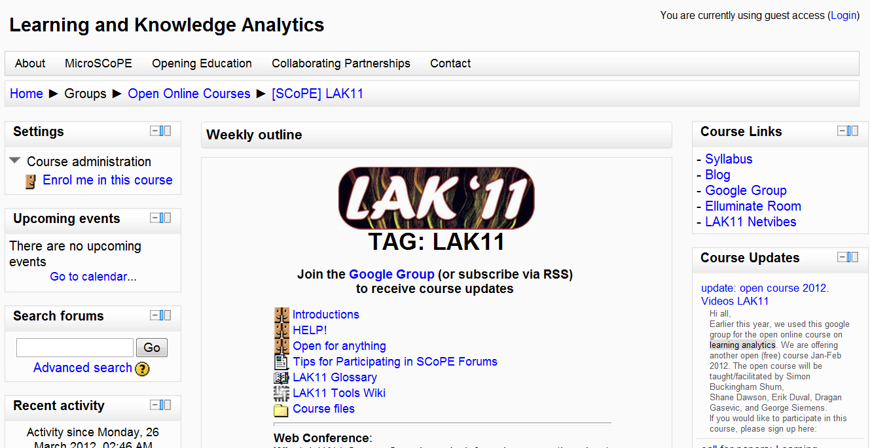
Massive Open Online Courses (MOOCs)

Slide 28
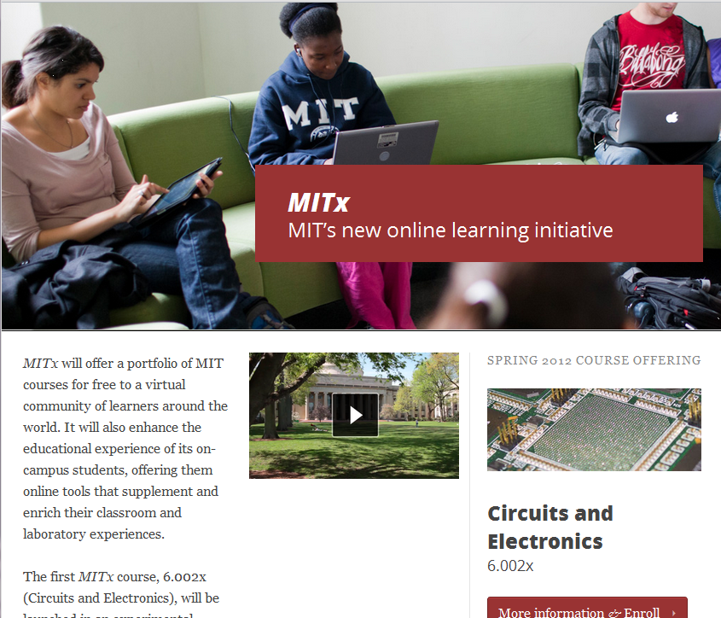
MITx: MIT’s latest open education project

Slide 29
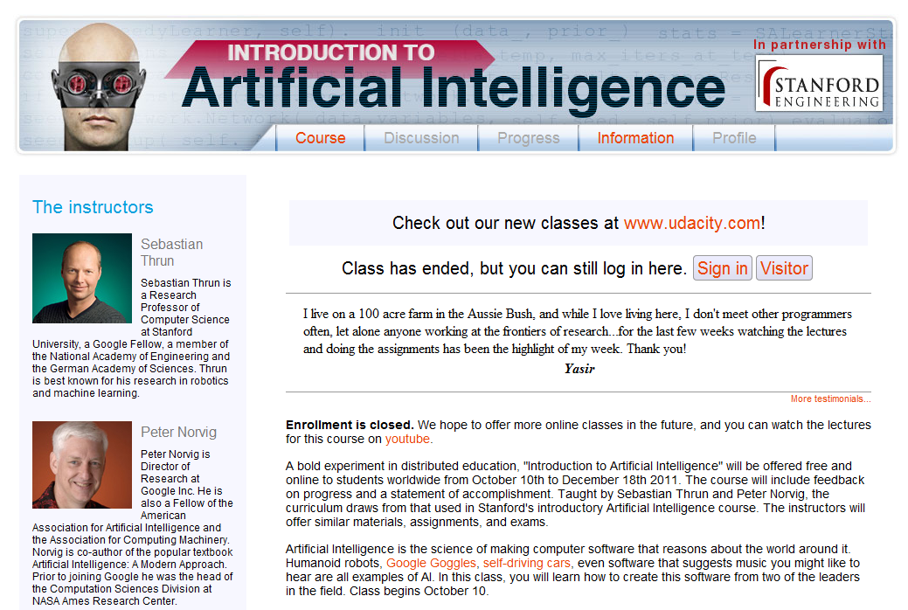
Stanford University: Introduction to AI

Slide 30
Why go Open?
What are the possibilities?
Part 4

Slide 31
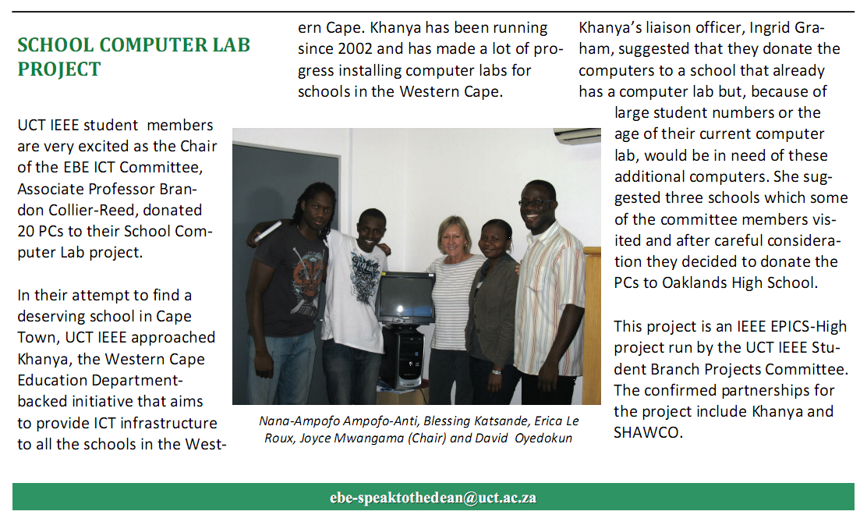
CHED Computer Literacy Guides
IEEE UCT chapter use the openly licensed CHED computer literacy materials to support training in a computer lab donated to a high school
http://www.ebe.uct.ac.za/usr/ebe/staff/april2010.pdf
Notes:
The first example is of the IEEE chapter using our CHED computer literacy guides for lab training. Students from the chapter actually wrote to us asking for permission to use the guides. We were able to say “yes absolutely!” they are freely available on our website and the Creative Commons license provides the terms for reuse.

Slide 32
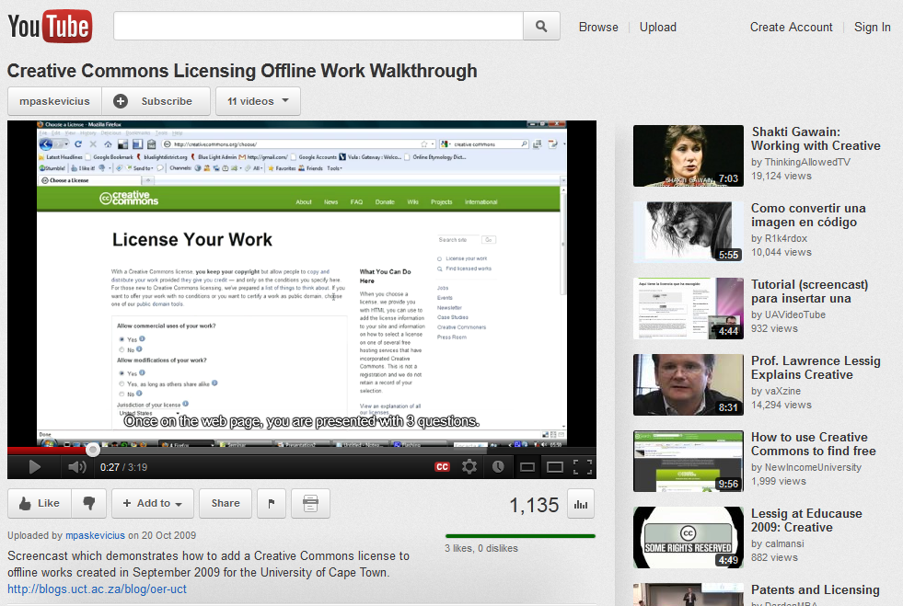
Creative Commons Licensing Screencast
Creative Commons licensing video is translated into Czechoslovakian, French, Italian and Spanish on YouTube
http://www.youtube.com/watch?v=-pvoie4ydSw
Notes:
Next we have a screencast which was created to help people apply the creative commons to offline works. The video was well received and has since been translated into Czechoslovakian, French, Italian and Spanish.

Slide 33
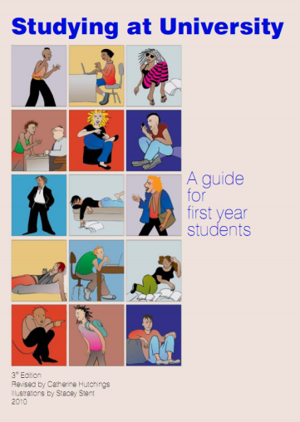
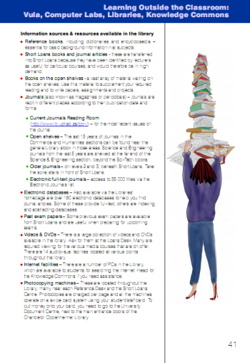
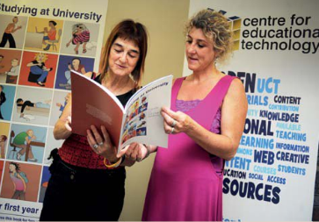
Studying at University: A guide for first year students
Used by Venda University and the University of the Western Cape with new students
Stellenbosch University uses some of the illustrations
The guide has been accessed over 3800 times via the directory and over 600 physical printed guides have been sold!
Notes:
Of course the A guide for first year students, which was a resounding success and has been used by the University of Venda and the University of the Western Cape to help new students acclimate to the university environment.

Slide 34
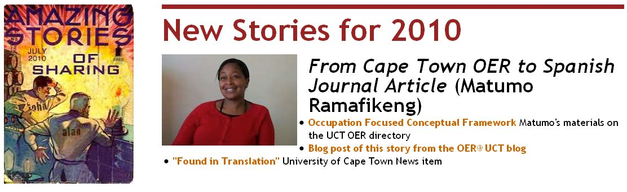
OpenContent becomes a Journal Article
Materials published as OER on OpenContent selected for publishing in the Journal of Occupational Therapy of Galicia, an open access journal for occupational therapists in the Spanish speaking world
http://blogs.uct.ac.za/blog/oer-uct/2010/12/06/sharing-knowledge-leads-to-opportunities
Notes:
One of our greatest stories of reuse was that or Matumo Ramafekeng, whose materials which were published as OER on OpenContent, were selected for publishing in the Journal of Occupational Therapy of Galicia, an open access journal for occupational therapists in the Spanish speaking world

Slide 35
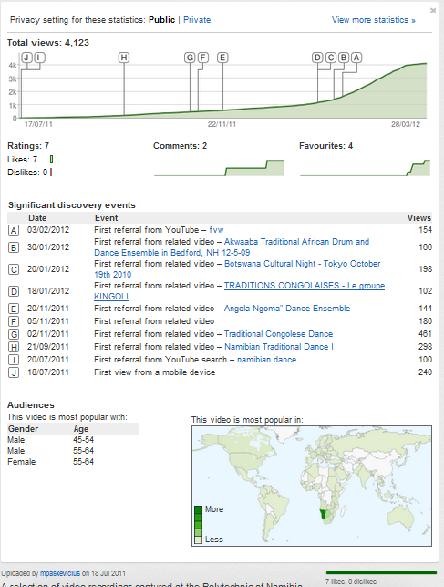
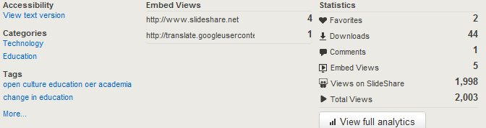
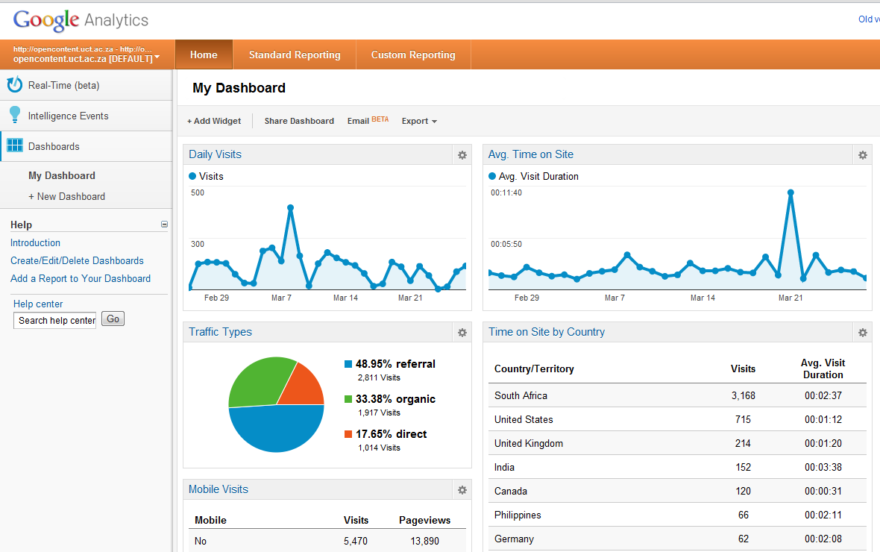
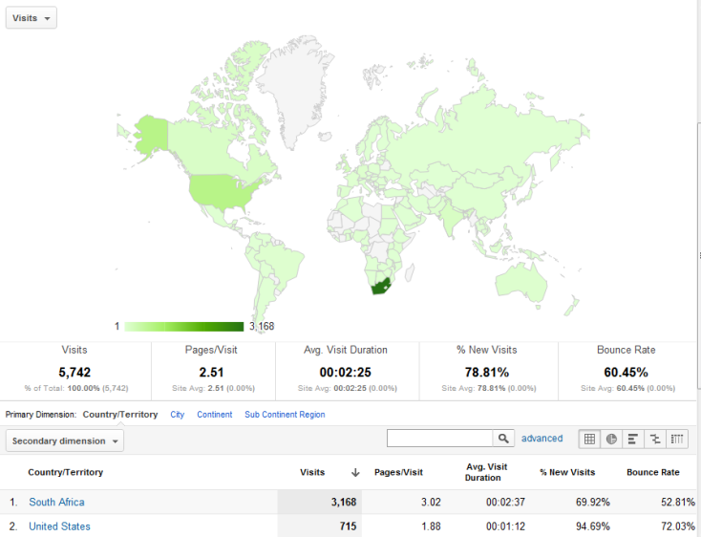
Measuring influence: Alternative metrics

Slide 36
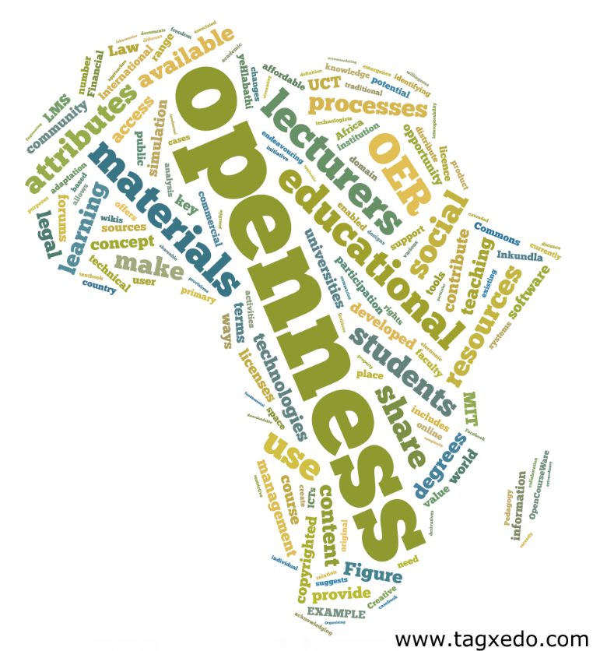
Closing note:
"When you learn transparently (and openly) you become a teacher“
Siemens, 2010
Siemens, G. & Matheos, K. (2010). Open Social Learning in Higher Education: An African Context. VI International Seminar of the UNESCO chair in e-learning; open social learning. Available online: http://www.youtube.com/watch?v=Oexie4cwpf8
Notes:
So often we are apprehensive about sharing our works in progress, our thoughts, our notes, our ideas. Technology today provides us many opportunities to share the process of our learning, rather than just the final product. We can share our reflections and ideas on blogs, our thoughts on Twitter or Facebook, and people can instantly comment and contribute to our own ideas. This goes for teaching materials as well, which are sometimes imperfect or not highly refined.
In sharing digital media, we may become teachers to someone who is interested in our work. As they follow our thought process, connect to our ideas and references, they may benefit tremendously from us openly sharing the process of our own learning.

Slide 37




Prepared by: Michael Paskevicius
Contact me: mike.vicious@gmail.com
OpenContent Directory: http://opencontent.uct.ac.za
OER UCT project blog: http://blogs.uct.ac.za/blog/oer-uct
Follow us: http://twitter.com/openuct
Follow me: http://twitter.com/mpaskevi
Presentations: http://www.slideshare.net/mpaskevi
This work is licensed under the Creative Commons Attribution-Share Alike 2.5 South Africa License. To view a copy of this license, visit http://creativecommons.org/licenses/by-sa/2.5/za/ or send a letter to Creative Commons, 171 Second Street, Suite 300, San Francisco, California, 94105, USA.

