Slide 1
Open Access :
Challenging the norm in Academia
Bernard Rentier
December 2016

Slide 2
Challenging the norm
The norm
The challenge
Keep research data personal
Publish in journals with highest Impact Factor as possible
Base Evaluation on publication numbers
Share research data
Make publications accessible without constraints
Base evaluation on compliance with sharing principles

Slide 3
Incentivising researchers to make their publications open
Install an institutional repository (IR)
Impose a mandate for the deposit
  from the official decision time on
  as many years back as possible
  as full text
  in latest author manuscript form
  keep in embargo as requested by contract
  release immediately after embargo period expires
Create positive incentives
  design « gadgets »
  support visibility officially
  introduce openness in evaluation criteria rather than « prestige » indicators
  make sure researchers become aware that IR is providing visibility (visits, downloads, citations)

Slide 4
Mandate strength vs Deposit efficiency
- Open access
- Restricted access
- Metadata only
- Not deposited
No mandate
Mandate
ULg mandate
PASTEUR4OA (2015) D 3.1 – Report on policy recording exercise

Slide 5
Incentivising researchers to make their publications open
Transform the evaluation procedures
  Introduce openness and sharing in evaluation criteria rather than « prestige » indicators
  Select quality over quantity
  Ask for 3-5 best choice of papers
  Investigate on real role in the team
  Reward cooperative behaviour
  Reward activities helping collectivity
Promote open source software use for research procedures
Promote open research data sharing

Slide 6
In all areas of human activity, motivation is linked to recognition and some form of reward.
Reward is based on judgement.
Judgement rests on assessment.
Hence assessment is a major element leading to reward and ultimately to motivation

Slide 7
Publications = the researchers’ production
Research papers are the primary tangible and lasting output of science, it is how researchers :
  communicate discoveries,
  are evaluated for hiring, promotion, and awards.
The current system has :
  changed little over centuries,
  largely failed to take advantage of new technologies enabled by the Internet.
It no longer serves the needs of scientists.

Slide 8
Are publications obsolete ?
The traditional system is:
  slow
  expensive
  arbitrary
  inaccessible

Slide 10
Can research be evaluated ?
E. Callaway, Nature 535, 210–211 (14 July 2016) DOI: doi:10.1038/nature.2016.20224

Slide 11
Can research be evaluated ?
E. Callaway, Nature 535, 210–211 (14 July 2016) DOI: doi:10.1038/nature.2016.20224

Slide 12
Can research be evaluated ?
E. Callaway, Nature 535, 210–211 (14 July 2016) DOI: doi:10.1038/nature.2016.20224

Slide 13
Can research be evaluated ?
Lariviere et al., bioRxiv preprint first posted online Jul. 5, 2016; doi: http://dx.doi.org/10.1101/062109.

Slide 14
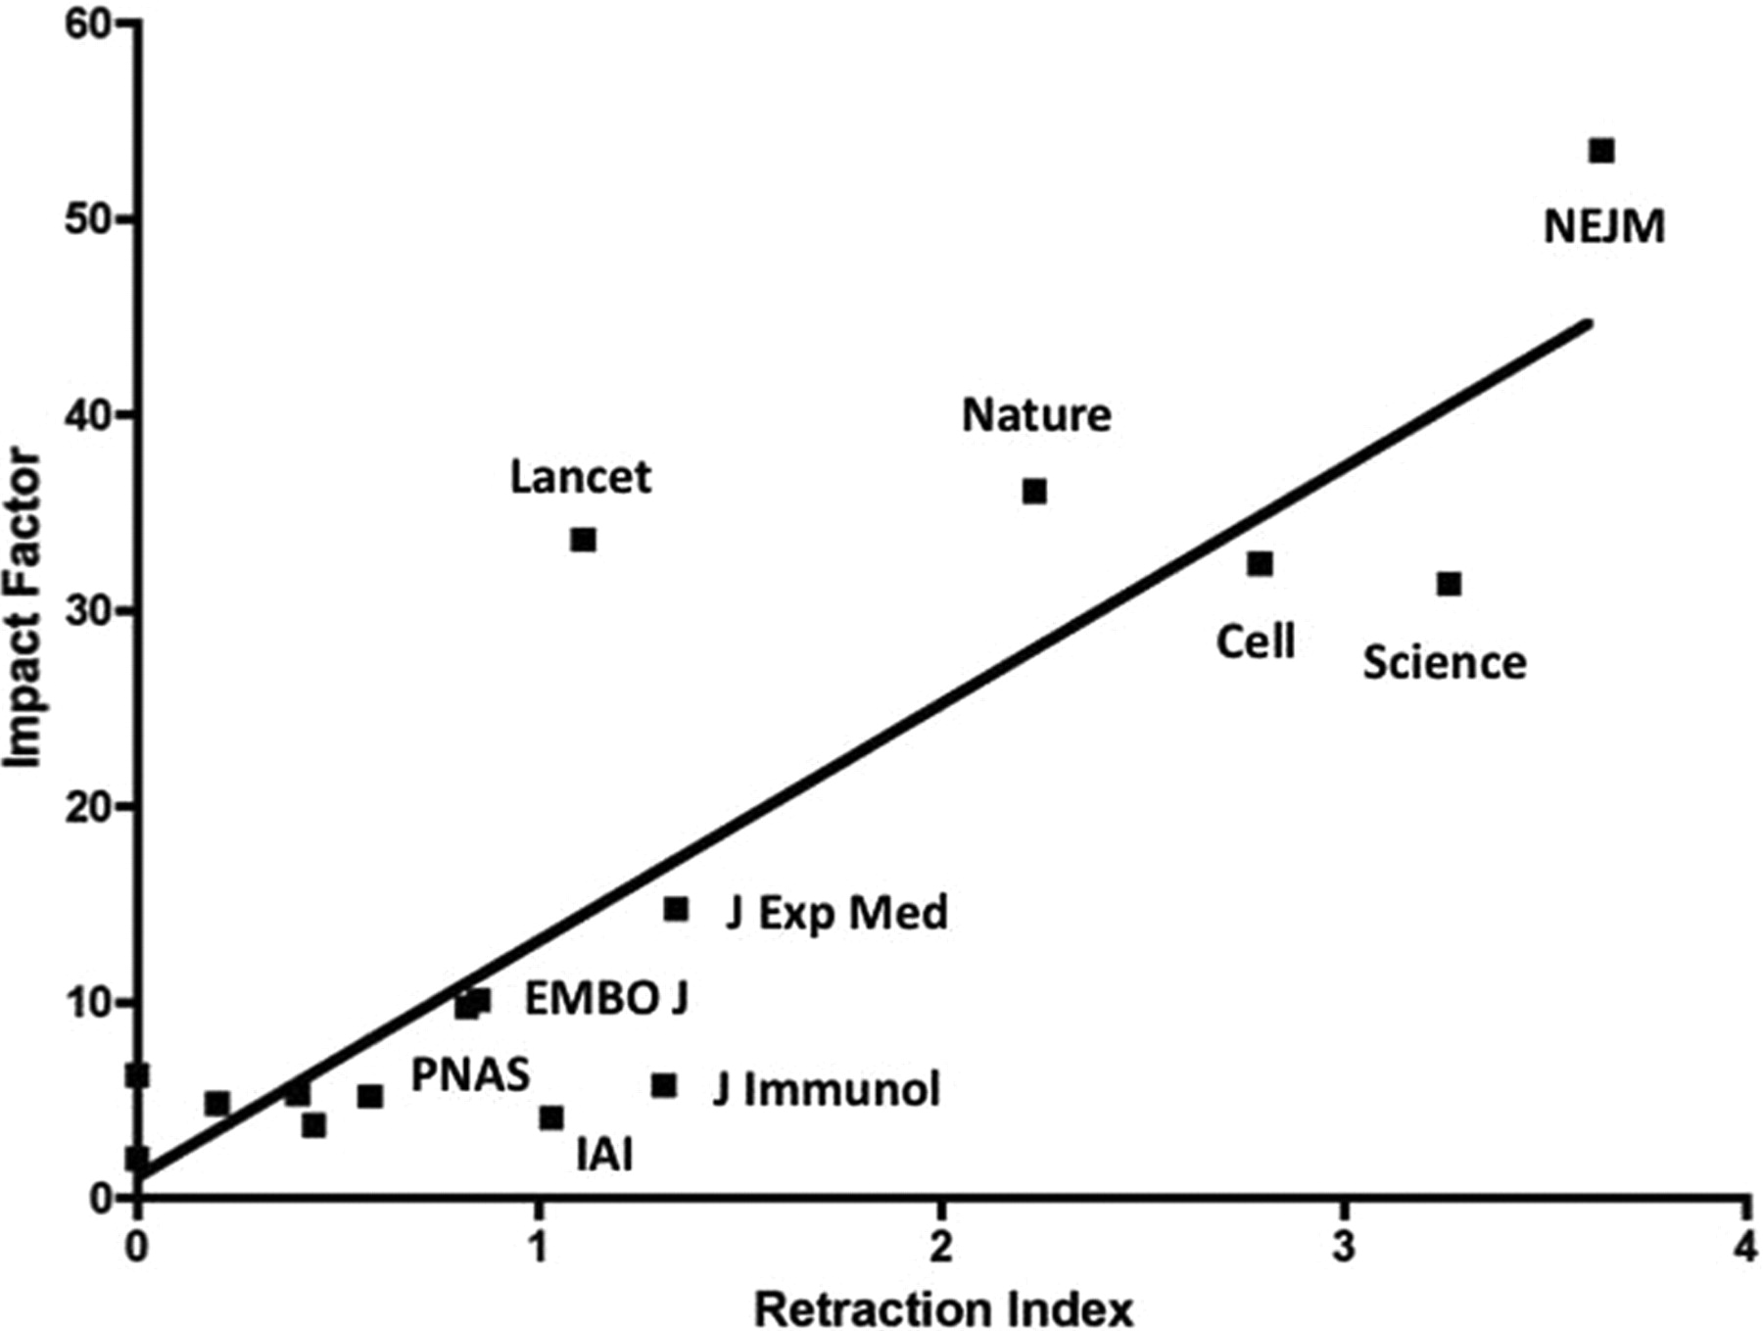
Impact factor-Retraction correlation

Slide 15
Perverse effects of the current system
Any evaluation procedure based on quantitative rather than qualitative measurements creates a trend to
overproduce :
  Too many articles
  Tendency to slice up
  Tendency to duplicate
  Fraud (plagiarism, falsification)
decrease the readership per paper
Retraction rate is increasing dramatically
Stress, burn out, carrier break up

Slide 16
Publications : what should be done ?
Researchers themselves should decide when a work is ready to be published
Authors should publish manuscripts outside of the current publisher-controled procedure by uploading work to pre-print servers prior to conventional peer review and generate comments from the scientific community. Pre-print publishing is already the norm in physics, mathematics, and economics (ArXiv)
Funders and other stakeholders should endorse the adoption of pre-prints

Slide 17
A few principles to develop in evaluation procedures
Use other criteria than publication numbers or journal ratings such as openness & sharing
  Open Access;
  Open Data;
  Material exchange;
  Time devoted to training of new researchers;
  Participation in communautary duties (logistics, administration);
  Any othe mission of general interest to the community.

Slide 18
Caution
Evolution of evaluation procedures must be global
  Or it may put your own scholars at risk
What to do until then ?
  Prepare sharing behaviours
  Favour Green open access

Slide 19
Thank you !

