Slide 1
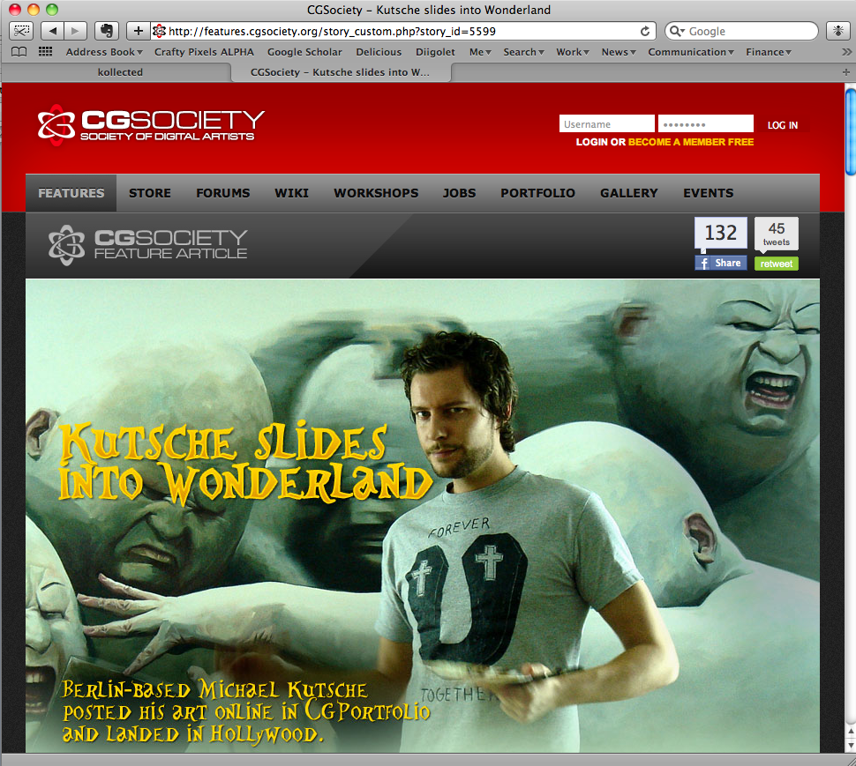
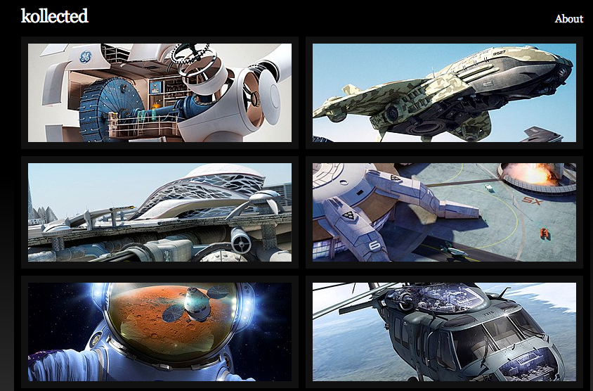
Researching Online Portfolio Social Networks @ High School
Visual Arts
Visual Design
Prepared by Travis Noakes, who asserts his moral
right as the author of this presentation.
© Travis Noakes 2010.
Notes:
Thanks for being here.

Slide 2
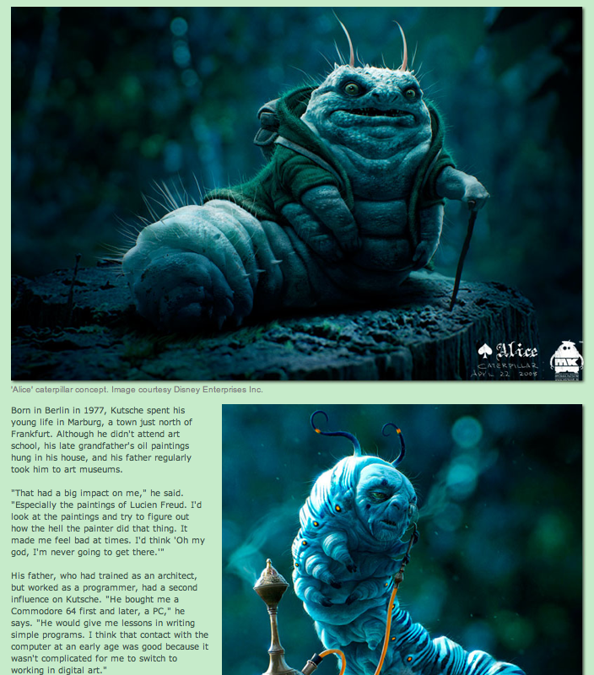
Online Portfolios can create significant opportunities for you
Berlin-based Michael
Kutsche posted his art
online in CGPortfolio and
landed in Hollywood!
http://features.cgsociety.org

Slide 3
What is an Online Portfolio Social Network (OPSN)?
An online community primarily focused on online publication of visual art, design, photography or videography.
Examples of OPSN include:
www.behance.net (creative portfolios, projects and collaborations)
http://carbonmade.com (a hassle-free online portfolio)
www.cgsociety.org (society of digital artists)
www.deviantart.com (a community of artists and art lovers)
www.flickr.com (share your photos. watch the world)
These differ in the prosumer software affordances they offer:
  Publish a creative C.V. (or link via OpenID)
  Share content (text, images, audio, video, code)
  Tag content
  Comment on content
  Rate content
  Remix “open” content
  Track online portfolio statistics

Slide 4
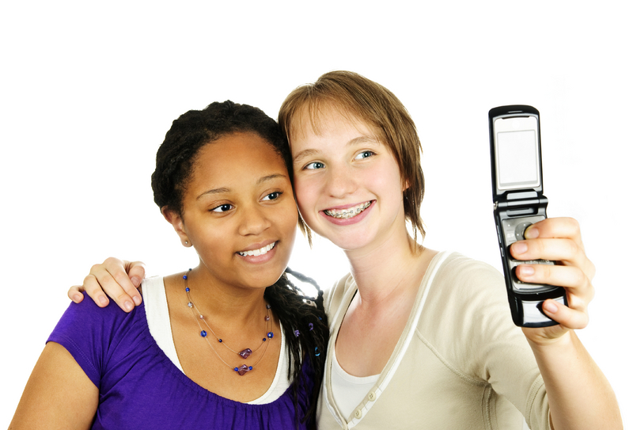
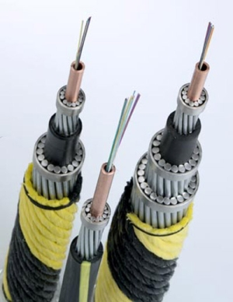
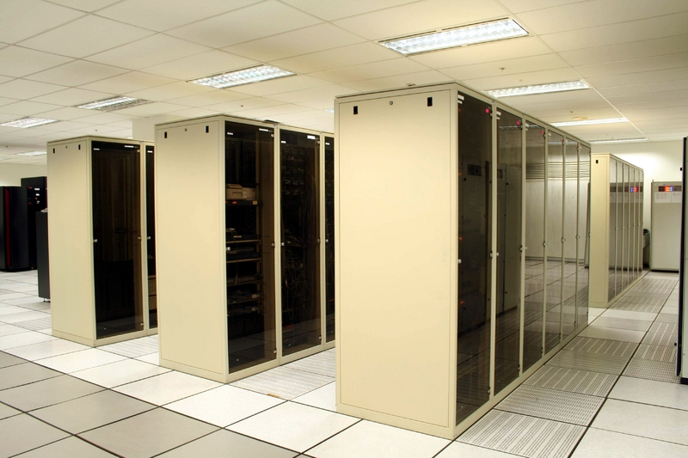
3 key trends = An “abundance culture” in digital media
Cheaper ICT
Faster bandwidth
Low storage costs
Notes:
- What is your school doing to make these trends your friends?

Slide 5
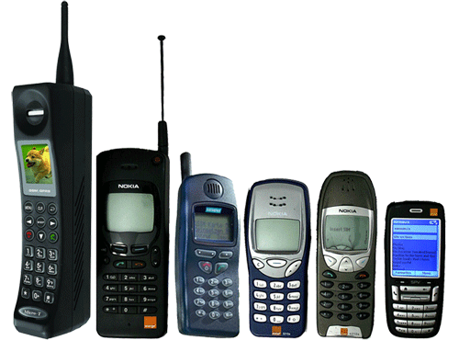
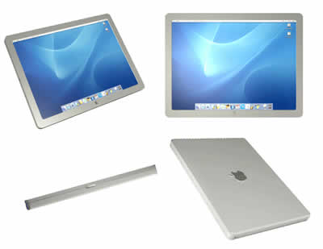
Cheaper ICT = means growing accessibility
Computer access at your school will soon be broader than computer labs and laptops.
Big growth in mobile phone, netbook and tablet users.
Increase in the number of networked home appliances,
including: televisions, gaming platforms and landline phones.
Notes:
So, does your Laptop Committee and Computer Labs need new names?

Slide 6
Attention economy = “freemium” storage
Notes:
How can your school benefit from the rise of cloud computing?
How can your students, teachers and administrators benefit from free storage?

Slide 7
Faster bandwidth = an end to the “passive” web
The international bandwidth
available to sub-Saharan Africa
will increase 120 times from
80 Gigabits per second (2008)
to 10 Terabits by the end of
2011 {due to six new cables
and an upgrade to SAT3}.
By 2013, any South African
with a mobile phone should
have access to broadband speed
that will allow the download of
a full-length movie in a few
seconds.
Notes:
- How will your school compete in the new, media-rich environment?

Slide 8



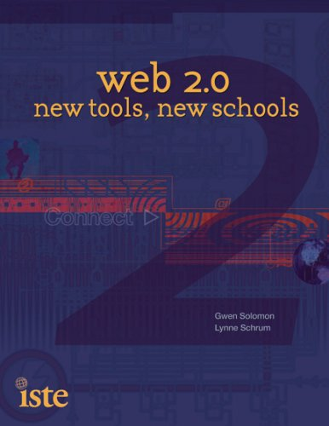
Passive consumers can change to active prosumers
Web 1.0 Web 2.0 What the change means for education
Licensed or purchased > Free = Easily adoptable
Expert publishers > Easy-to-publish = All have a voice
Isolated > Collaborative = Co-create knowledge
Unrated content > Rateable = Rate and share reviews
Single source > Mash-ups = Easily contrast information
Proprietary code > Open-source = Can be peer-reviewed
Copyrighted content > Shared content = Customise publications
Directory (taxonomy) > Folksonomy (tagging) = Personal meanings
Advertising > Word-of-mouth = Reputation management
Push content > Pull content = What interests me
Passive consumer > Interactive prosumer = Value can be co-created
Based on a table from the book Web 2.0: New Tools, New Schools
Notes:
The growth in unofficial, informal content is growing, led by two major trends. The first is the affordances of web 2.0 leading to prosumers replacing consumers; an active audience emerging online with more influence than the passive consumer of the past.
- What is your school doing to teach its students, teachers and administrators to be good prosumers?

Slide 9


Prosumer services are relevant @ School
Department of Education’s National Policy
Support OBE’s democratic objectives
Help bridge the digital divide
Address the relevance gap, in part
Help bridge the participatory gap
Accommodate diverse students’ needs
(especially introverts and non-conformists)
Notes:
Digital literacies are an important part of E-education policy and will assist the DOE in supporting democratic ideals, whilst addressing the relevance and participatory gaps. Using digital media in the classroom also leads to better results with non-conformists and introverts.

Slide 10

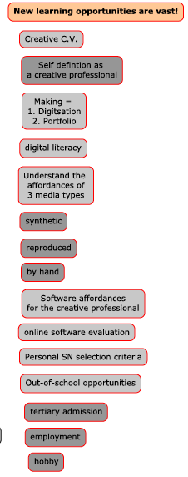
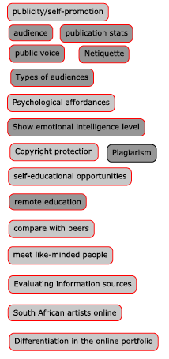
OPSN could support new learning opportunities for you

Slide 11
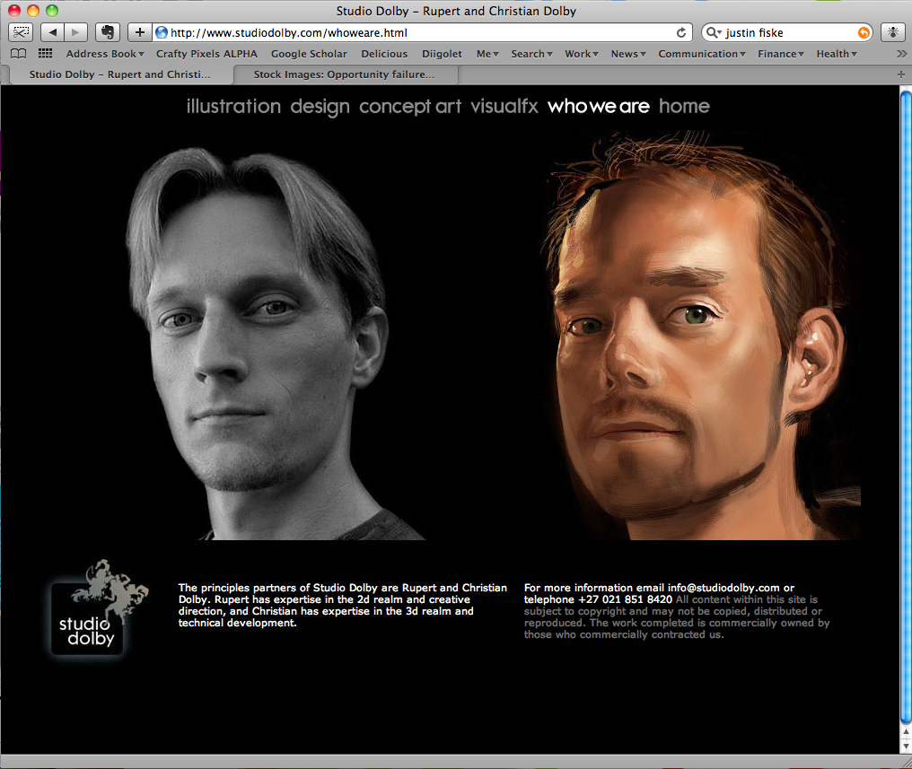
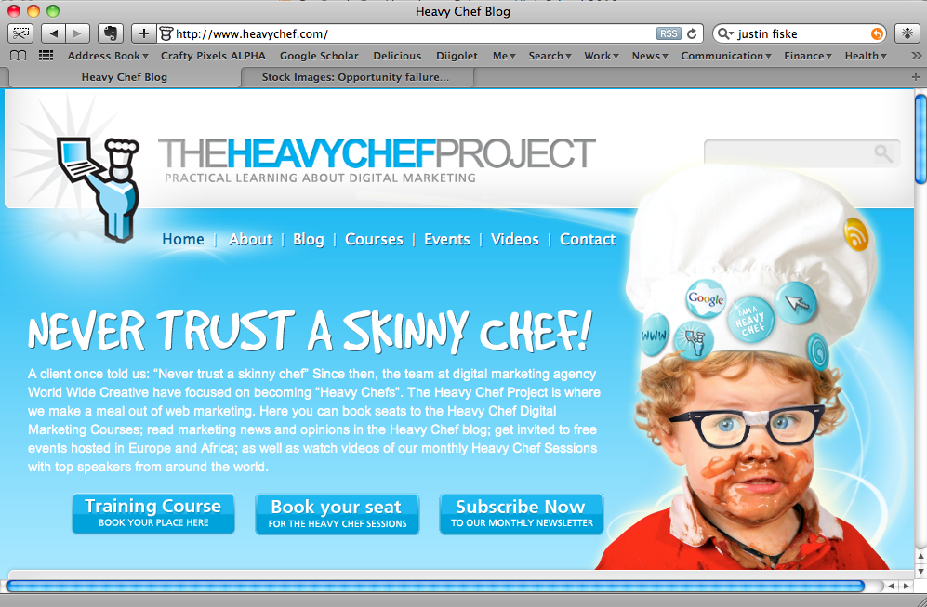
But… will your school accept OPSN software?
Factors that influence adoption in any well-resourced South African High Schools:
Does the software have the support of relevant staff?
  Does the software support significant events at school?
  Does the software benefit the school?
  Which individuals adopt it and what are their roles?
Are the costs of adopting the software acceptable to the school?
  What does the software cost to establish?
    How much does it cost to train new users?
    Is the equipment to support the software’s use readily
    available?
    Are appropriate support materials in place?
  What does the software cost to maintain
  and update?
  What are the costs (personnel, hardware, etc.)
  in supporting the software’s use in the curriculum?

Slide 12

And… will you find it useful?
Will the software be accepted by the users?
Is the software useful?
  Does it fit in with the personal work needs of educators?
  Does the software add value to the learning content?
Is the software usable?
  Is the user interface easy to use?
  Is the software easy to learn?
  Does the software handle errors well?
Does the software make education easier and better?
  Does it fit in with the classroom environment?
  Does it fit in with educational procedures?
  Do educators and students have the time needed to use the
  software and does it support a better educational experience?

Slide 13

Thanks for your help ☺ !
Stock imagery bought from www.dreamstime.com
Design by Travis Noakes

