Slide 1
3. Concepts and empirical research
Class Activity 1
EDN6015F
Glenda Cox &
Cheryl Hodgkinson-Williams
3-8 February 2014

Slide 2
Narrowing down to the key concept/s
What do you want to MEASURE, UNDERSTAND and/or EXPLAIN? In other words, what is the PHENOMENON in which you are interested?
Have other researchers been interested in measuring, understanding or explaining this same phenomenon? If so, what word/s did they use to describe this phenomenon – what key CONCEPTS did they use?

Slide 3
An example
I am interested in understanding how and under what circumstances university students use Facebook for academic purposes
I suspect that other researchers have looked as this as Facebook is not that new anymore … so I will need to research around “use of Facebook”. Let me try Google …

Slide 4
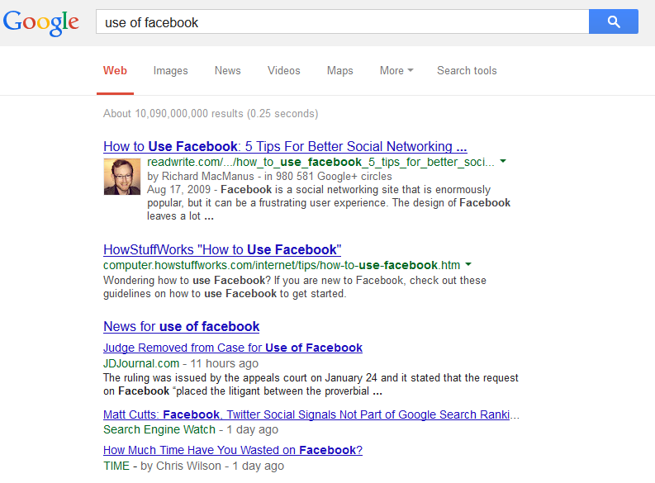
Google search on concept use of Facebook
10 090 000 000 results

Slide 5
This is too broad! Maybe a more abstract term to describe use of technology -“technology acceptance”? Let me try Google again …

Slide 6
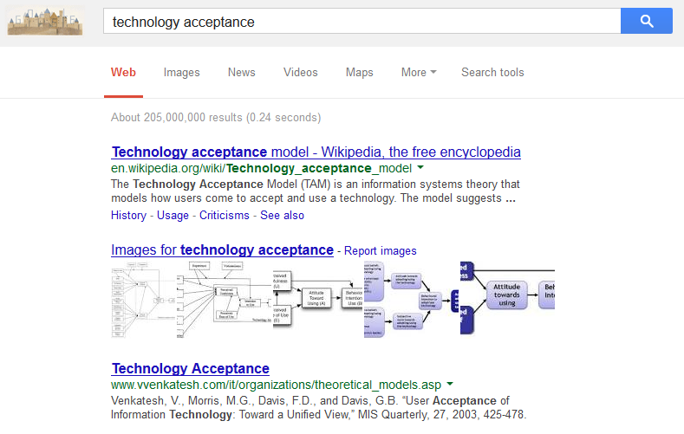
Google search on concept technology acceptance
205 000 000 results

Slide 7
Far too many hits and still too general – maybe Google Scholar?
TIP: Access Google Scholar through UCT Library Portal and there will be MANY more links (NOT all though) to resources in the UCT Library

Slide 8
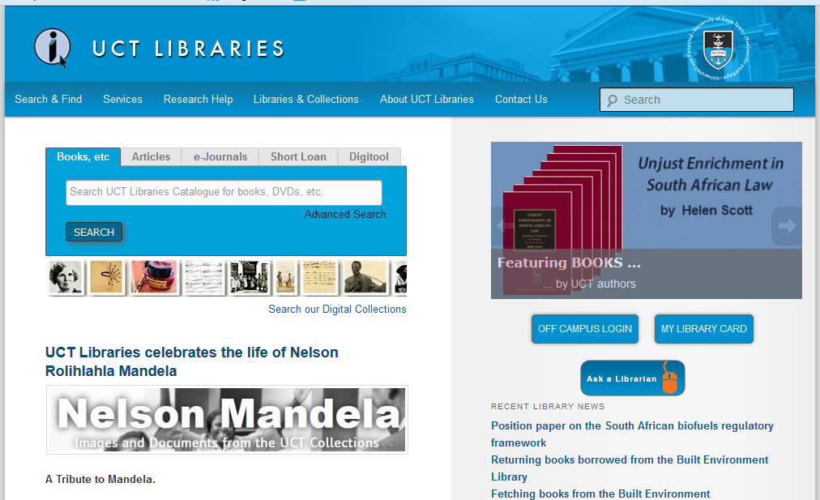
Access UCT Libraries

Slide 9
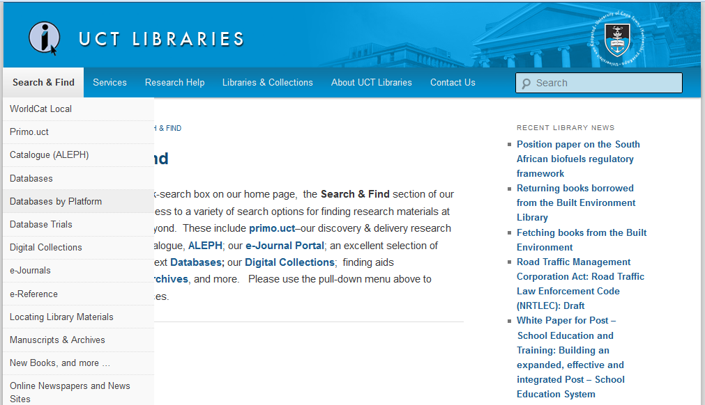
Select Search & Find
Select Databases by Platform

Slide 10
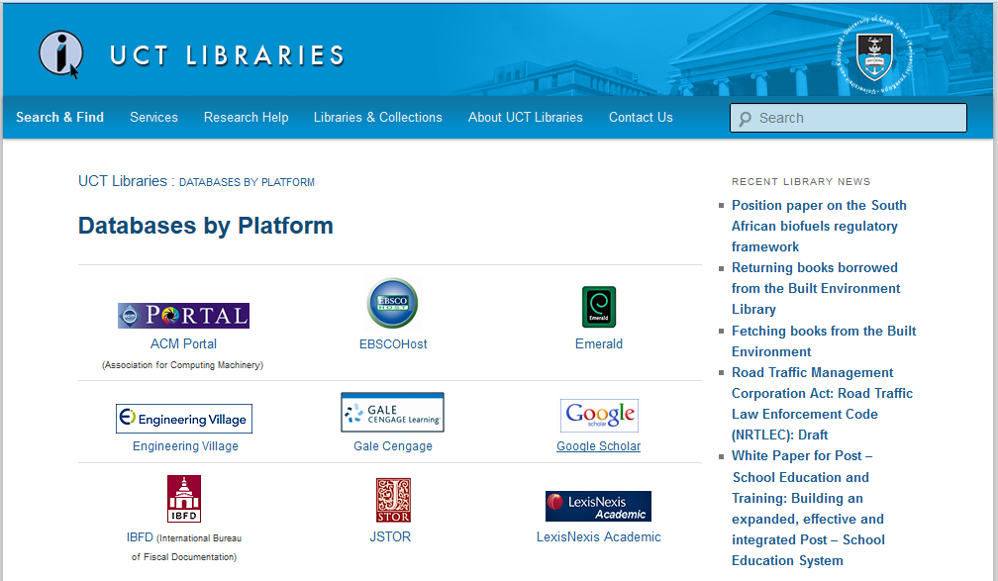
Select Google Scholar

Slide 11
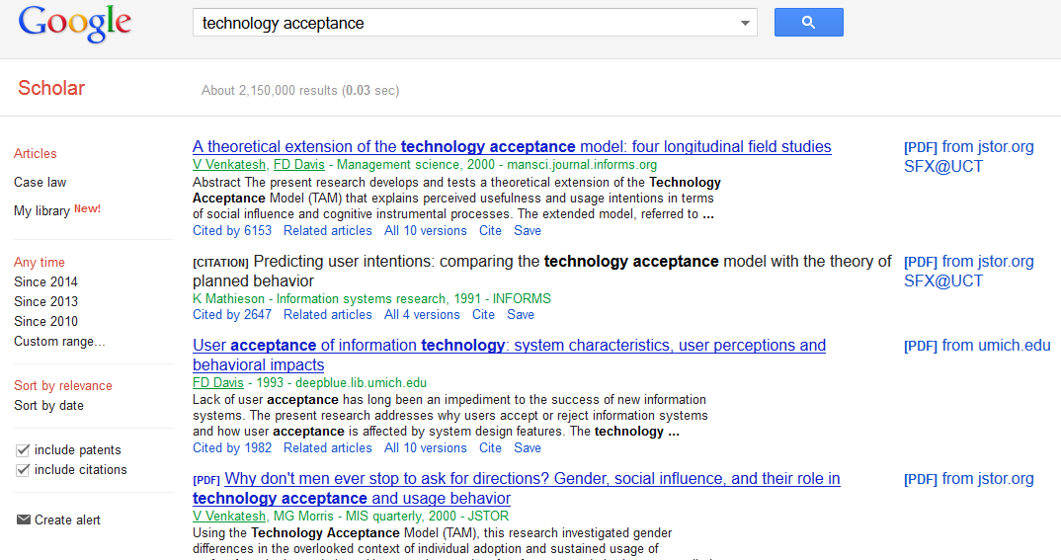
Google Scholar (via UCT) search on concept technology acceptance
2 150 000 results

Slide 12
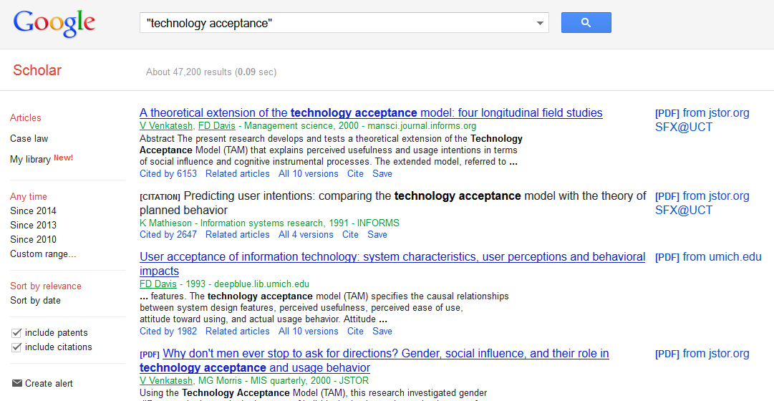
Google Scholar search on concept “technology acceptance”
47 200 results

Slide 13
I want articles that link the concepts to a theory and make the underlying theory explicit! So I best add “theory” as well!

Slide 14
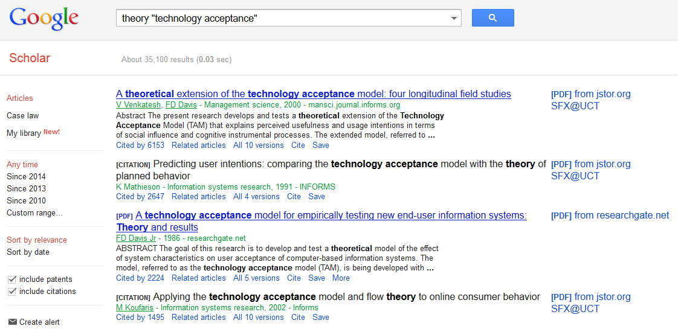
Google Scholar search on concept theory “technology acceptance”
35 100 results

Slide 15
I want to “build on the work of others”, so I will look for the most recent resources 1st

Slide 16
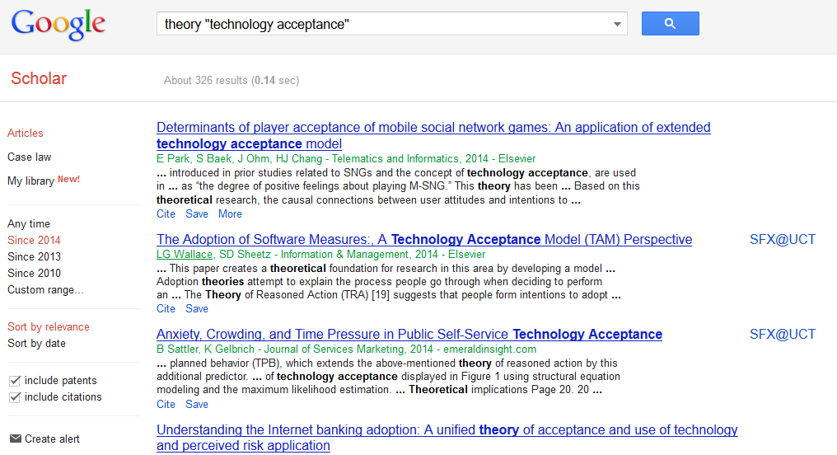
Google Scholar search on concept theory “technology acceptance” (Since 2014)
326 results

Slide 17
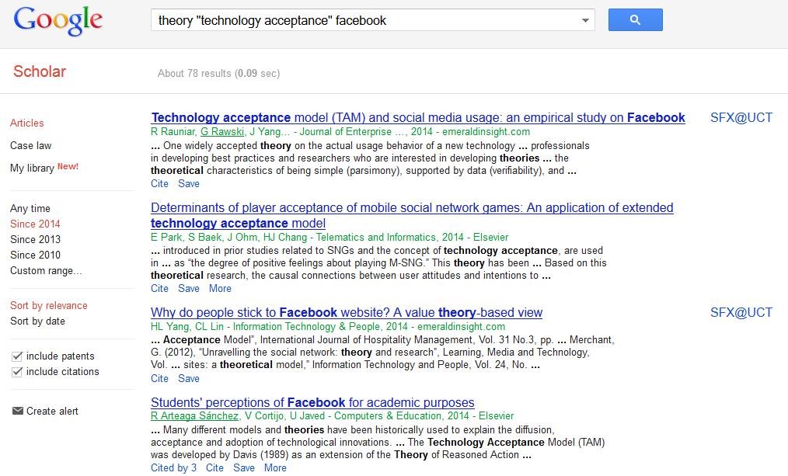
Google Scholar search on concept theory “technology acceptance” facebook
78 results
Click here to UCT Library

Slide 18
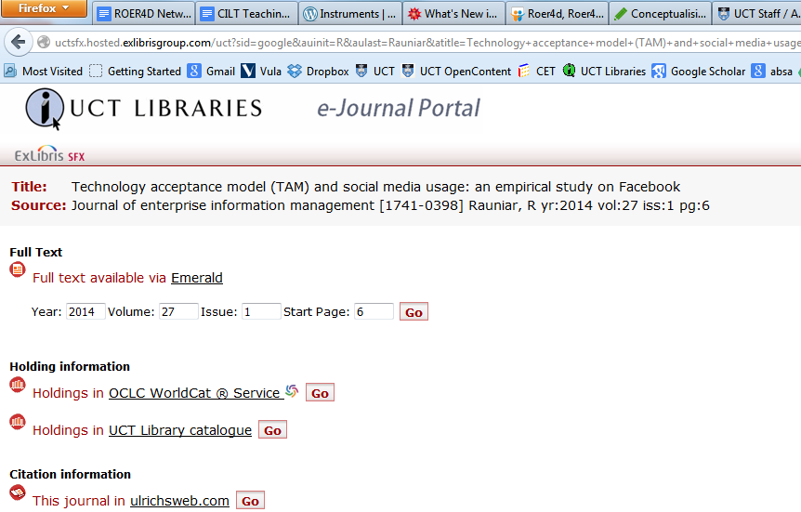
Link directly to article in UCT Library

Slide 19
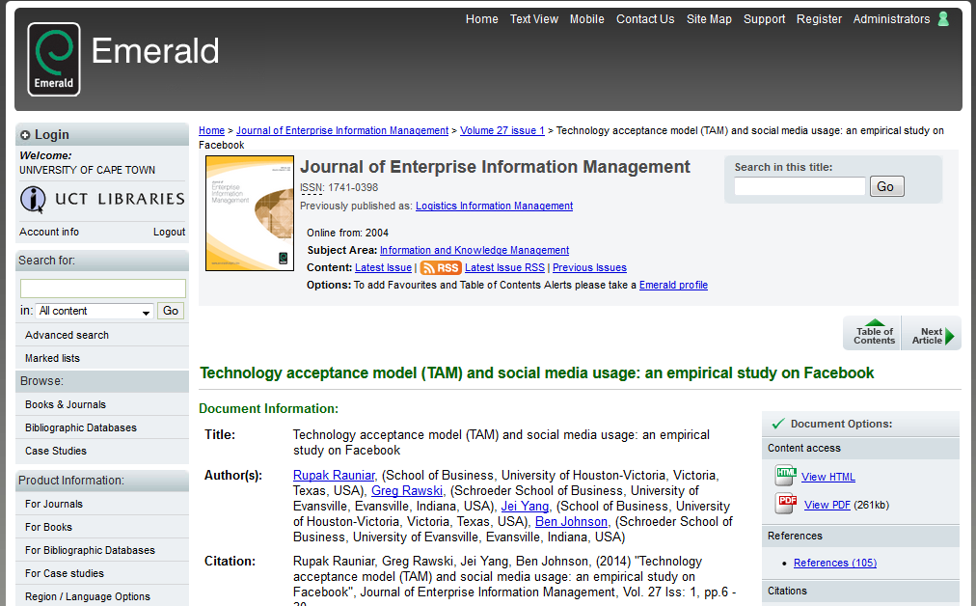
Download pdf

Slide 20
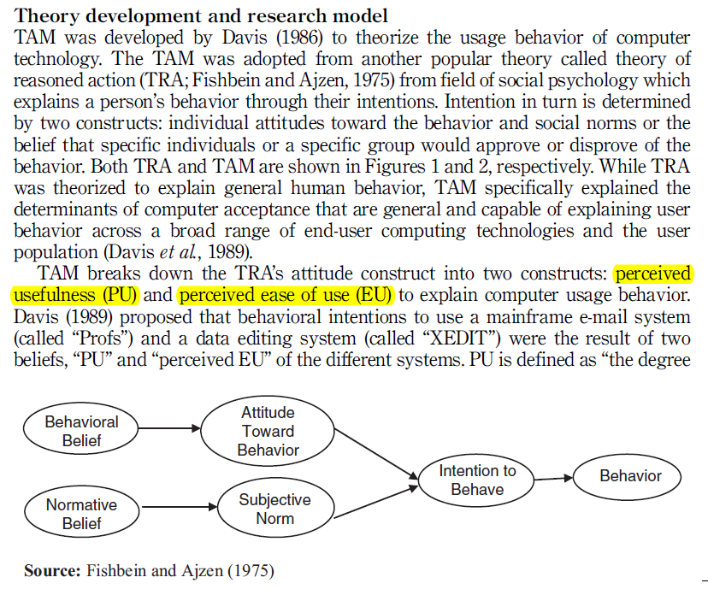
Rauniar et al. (2014) concept development

Slide 21
TIP – There may be more resources at UCT

Slide 22
Google Scholar search on concept theory “technology acceptance” facebook
78 results
Copy and paste title in search bar on UCT Library page

Slide 23
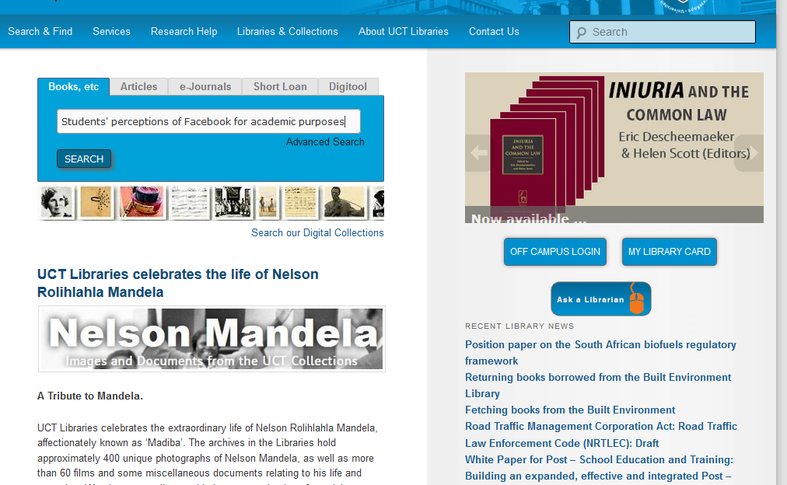
Paste title in search bar

Slide 24
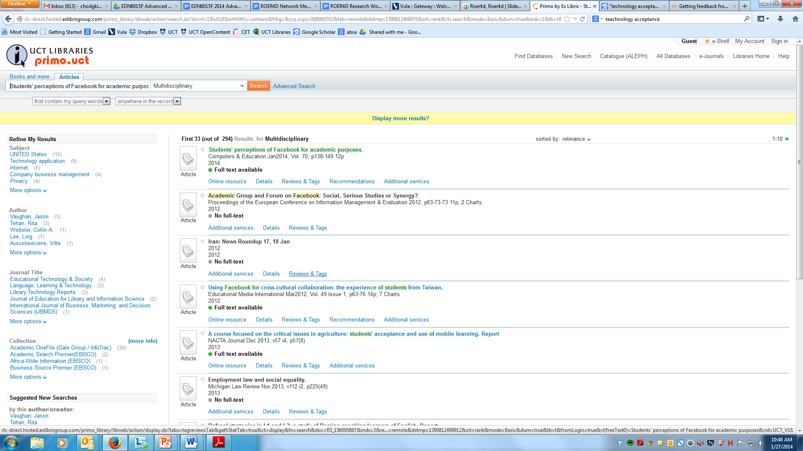

Slide 25
Now you do the same for the phenomenon that you are planning to investigate!

Slide 26
Written by Cheryl Hodgkinson-Williams
cheryl.hodgkinson-williams@uct.ac.za in 2014
This work is licensed under a Creative Commons Attribution 4.0 International License.

