Slide 1
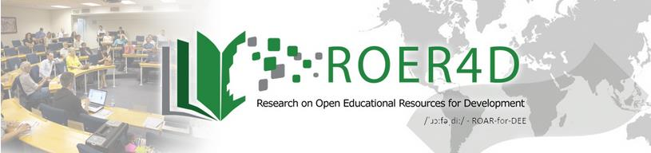





Ready or Not? OER workshops at 3 South African Universities
By Glenda Cox and Henry Trotter (University of Cape Town)

Slide 2
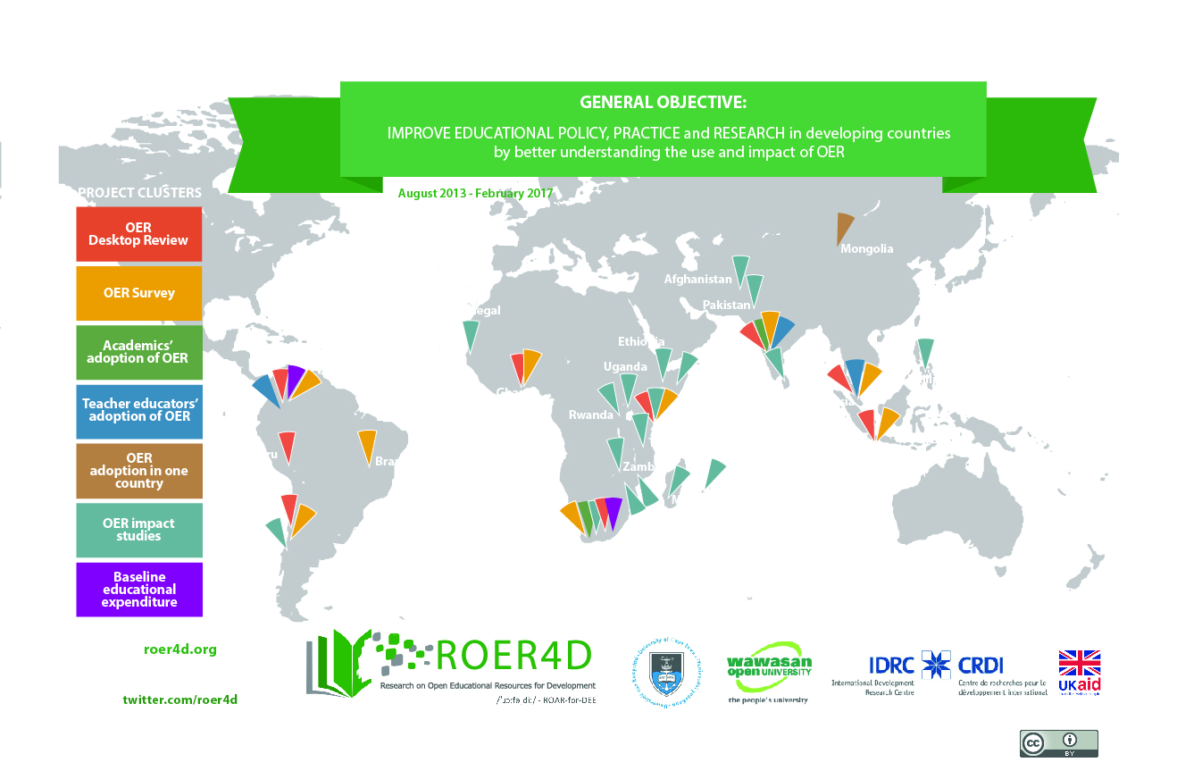

Slide 3
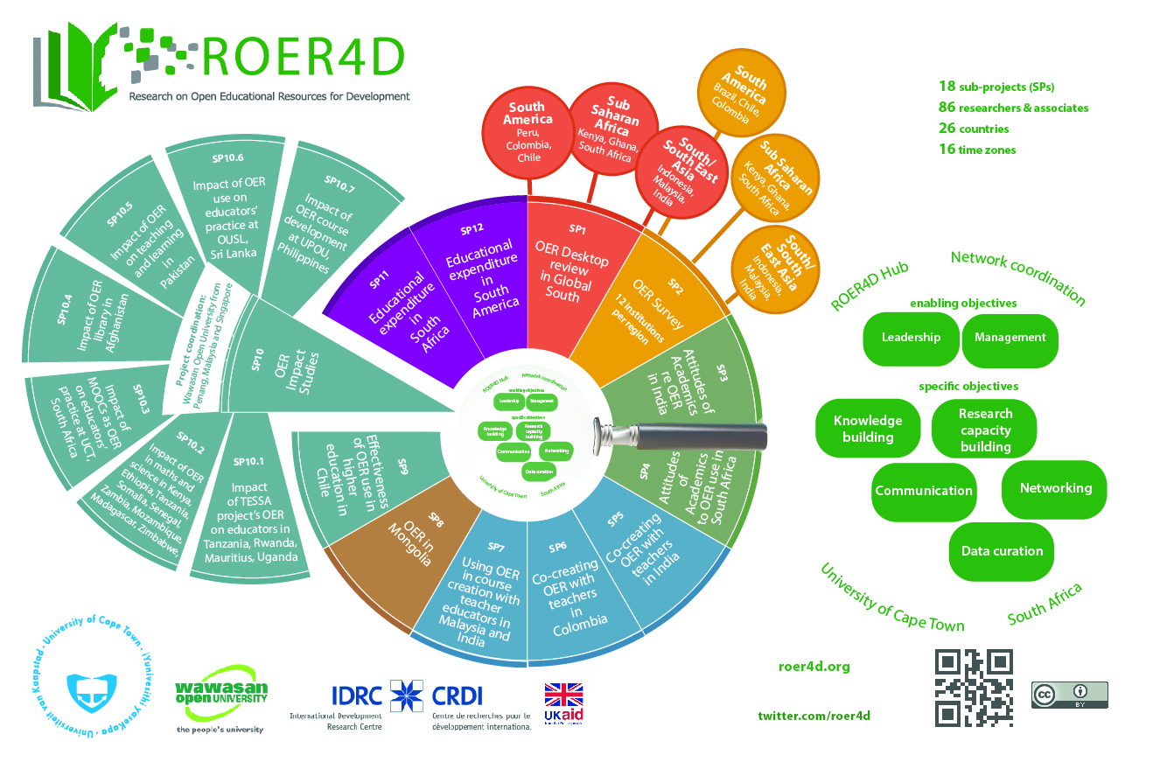

Slide 4
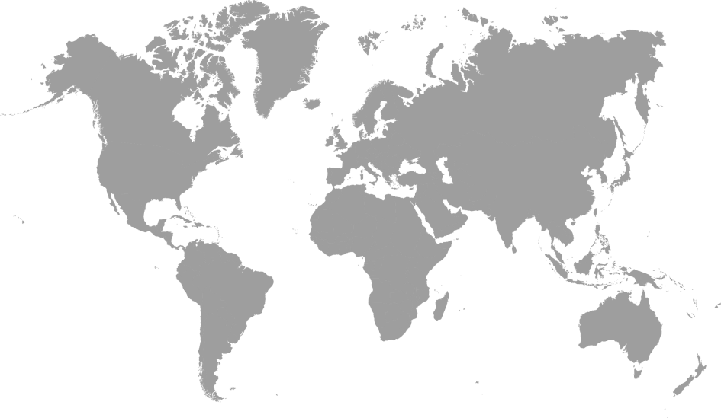
Sub-Projects 3 & 4: Academics’ adoption of OER
Prof Sanjaya Mishra &
Dr Ramesh Sharma
& Alka Singh
(New Delhi, India)
4 Indian HEIs
Glenda Cox
& Henry Trotter
(Cape Town, South Africa)
University of Cape Town,
University of Fort Hare, UNISA

Slide 5
Research into the Social and Cultural acceptability of Open Educational Resources (OER) in the Global South (South Africa)
Glenda Cox
Senior Lecturer, Centre for Innovation in Learning and Teaching (CILT), University of Cape Town
Henry Trotter
Researcher, CILT

Slide 6
Research question/questions
Why do people contribute or refuse to contribute OER and what are the conditions under which OER, contribution and use, would be considered socially and culturally acceptable?

Slide 7


South Africa/India comparison

Slide 8
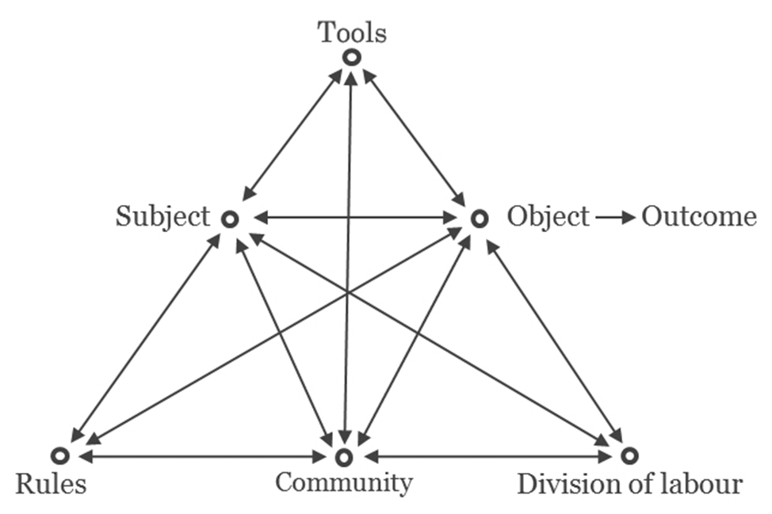
Development and data collection
Introduction to OER and Creative Commons Workshop
6 Interviews (collaboratively developed, in depth)
Attitudes survey (developed by colleagues in India)

Slide 9
Timeline
Idenitfy institutions
Ethical clearance UCT
1/1/2014
9/15/2014
Contact local co-ordinators
India OER workshop
Banff presentation
1/8/2014
10/6/2014
4/22/2015
2014
Jan
Mar
May
Jul
Sep
Nov
2015
Mar
May
Jul
Sep
Nov
2015
Today
30 days
Idenitify Institutions
1/1/2014 - 1/30/2014
61 days
Communication with local coordinators
1/31/2014 - 4/1/2014
304 days
Ethical clearance
4/2/2014 - 1/30/2015
29 days
Wokshop planning
1/31/2015 - 2/28/2015
16 days
SA workshops
3/3/2015 - 3/18/2015
58 days
Transcription
3/19/2015 - 5/15/2015
168 days
Analysis
5/16/2015 - 10/30/2015
62 days
10/31/2015 - 12/31/2015
Report writing

Slide 10
Selecting South African institutional partners

Slide 11
South Africa
26 public higher education institutions (3 new ones last year)
Varied focus some more vocational or technical
11 traditional (variable quality and access to resources)
Number of students: 938210 (2011)
Notes:
History, poised for readiness
What was before, our impact and what may come after….

Slide 12
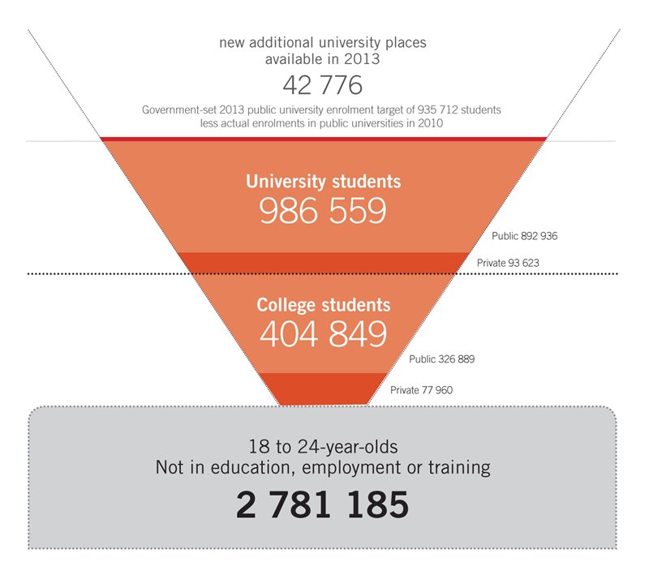
http://chet.org.za/files/uploads/data/CHET-Shape-of-Post-Secondary-Sector.png

Slide 13
Selecting institutional partners
Urban/rural
Distance/residential
OER platform or not

Slide 14
Management styles
Organisational cultural types (McNay 1995)

Slide 15



South African institutions
University of Cape Town (UCT) | University of Fort Hare | University of South Africa (UNISA)
Residential | Residential | Distance
26 000 students | 11 000 students | 400 000 students
Urban | Rural | Dispersed
Traditional | Traditional | Comprehensive
Collegial | Bureaucratic? | Bureaucratic

Slide 16
Methodology
Identify a local co-ordinator
Ethical clearance
Visit to India to observe a
workshop

Slide 17

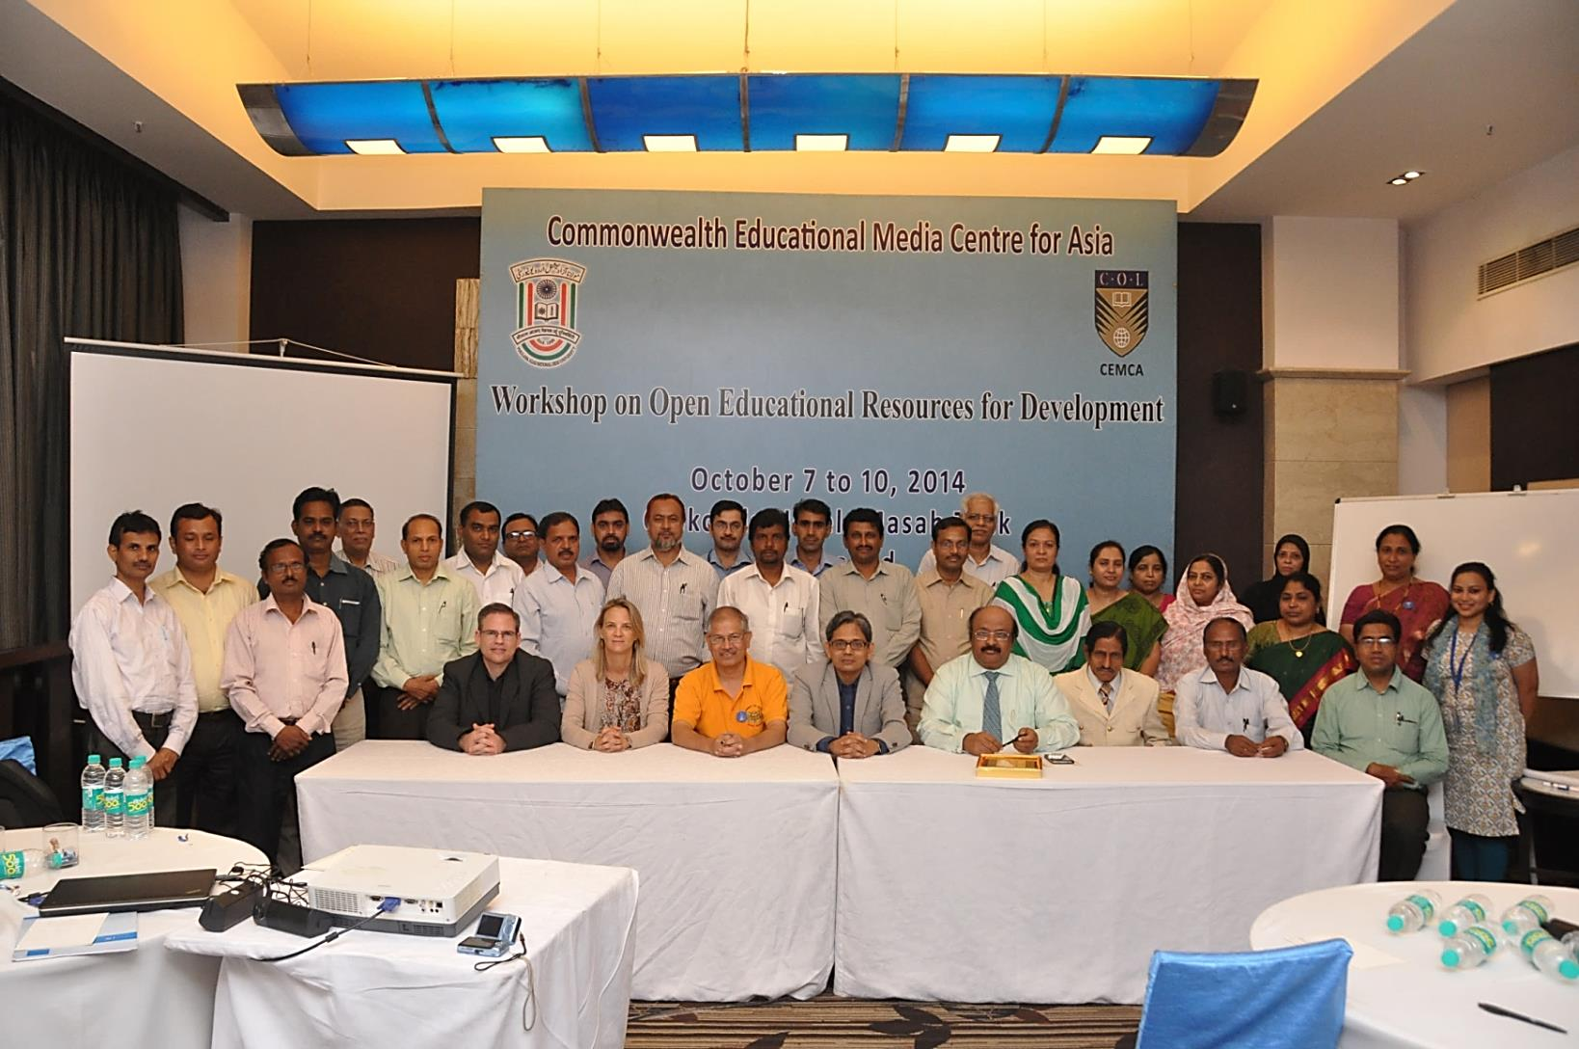
Maulana Azad National Urdu University
Notes:
October 2014

Slide 18
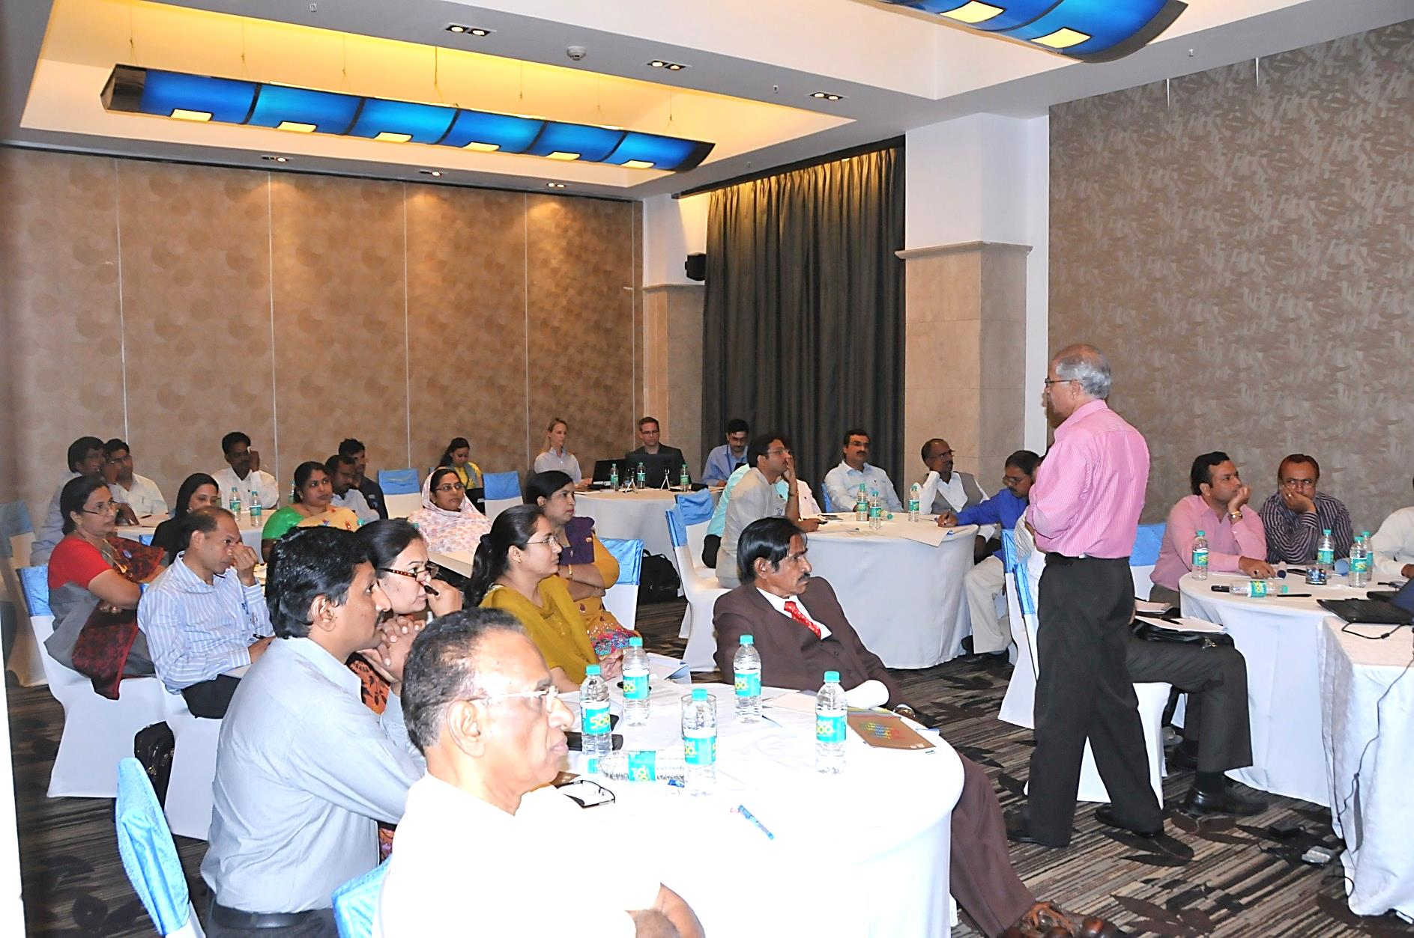
Notes:
Successful, well attended workshop.
Similar version replicated in South Africa

Slide 19
Conduct workshops and interviews and administer surveys.

Slide 20
Expectations as insiders and outsiders
Seen and unseen
Notes:
What is below the surface? Complexities, hints from local coordinators and informal conversations…

Slide 21
UCT expectations and challenges
Open agenda since 2007
We have an Open Access repository (2014)and previously had an Open Content (2010)directory.
Anticipated poor attendance
Insufficient incentive to attend
Notes:
Time in workshops
Those who would be interested had already attended a seminar or workshop

Slide 22
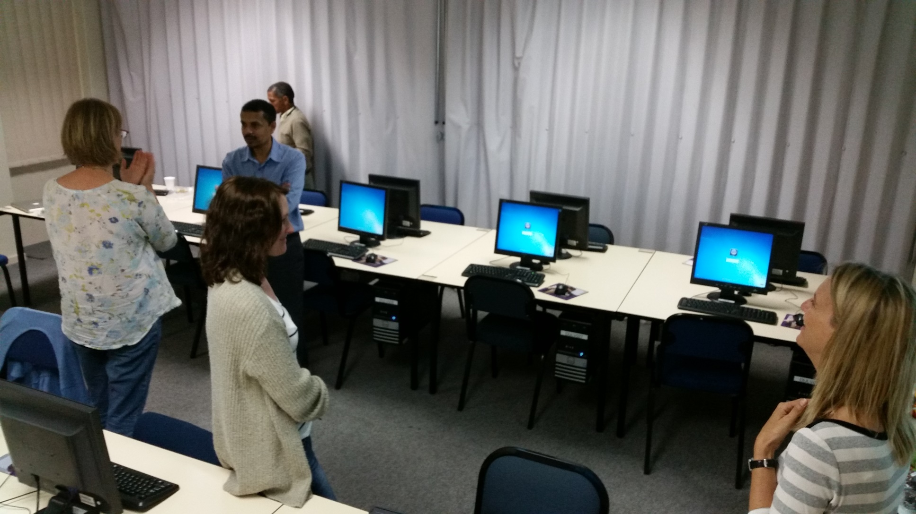
University of Cape Town: Part 1

Slide 23
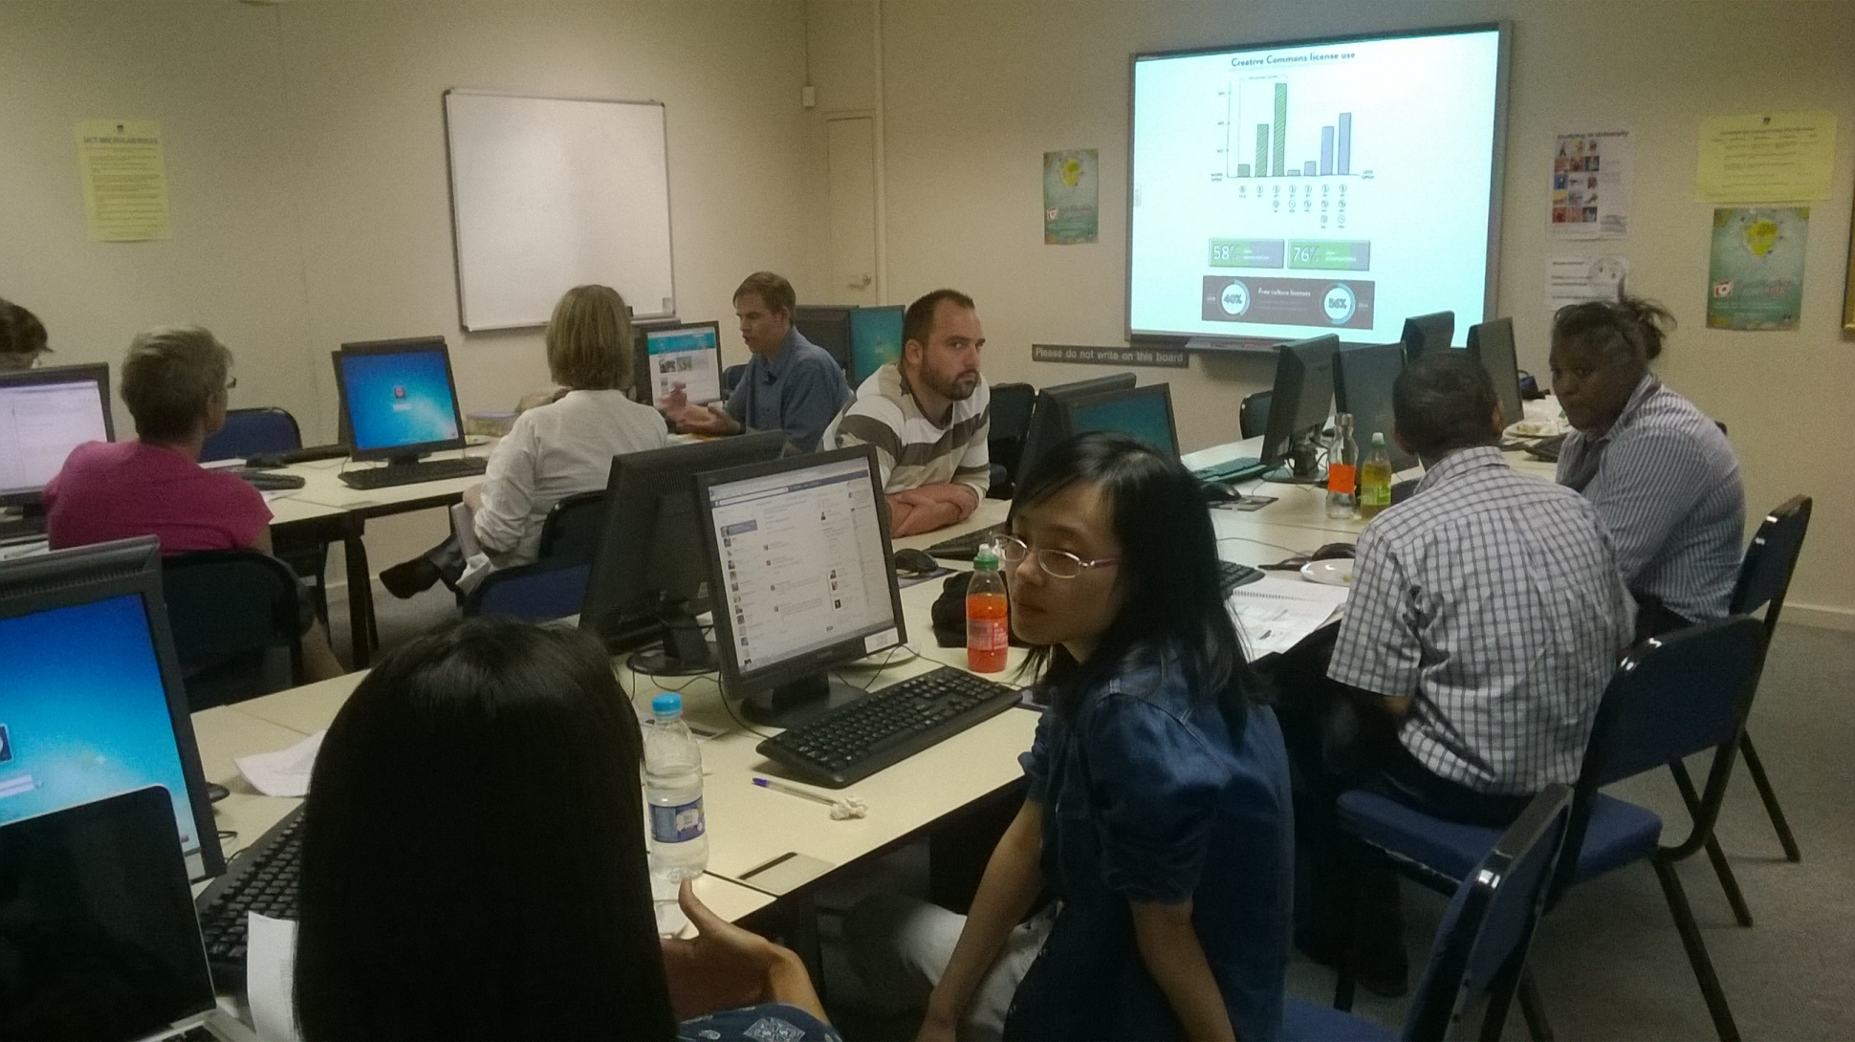
University of Cape Town: Part 2

Slide 24
University of Cape Town : WHO
 | Number
Students | 1
Academic staff | 4
Other staff* | 2
Non-UCT | 5
Librarians | -
TOTAL | 12
*Researchers/course facilitators

Slide 25
South African institutions
University of Cape Town (UCT) | University of Fort Hare | University of South Africa (UNISA)
 | Residential
 | 11 000 students
 | Rural
 | Traditional
 | Bureaucratic?

Slide 26
Fort Hare expectations and challenges
No OER at Fort Hare
Very little previous contact
Initial conversations with local coordinator were very encouraging
Very poor communication due to email system failing and power outages for up to 2 weeks!
Climbed on the plane hoping….

Slide 27
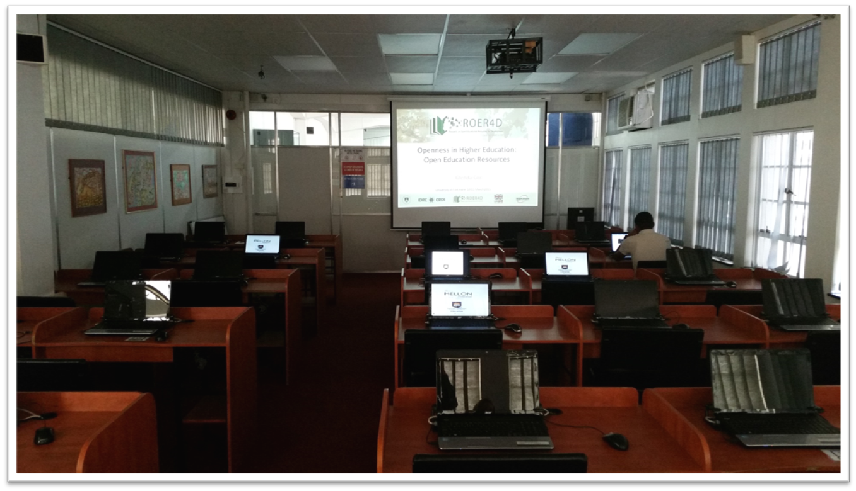
Fort Hare Day 1(9.30am)

Slide 28
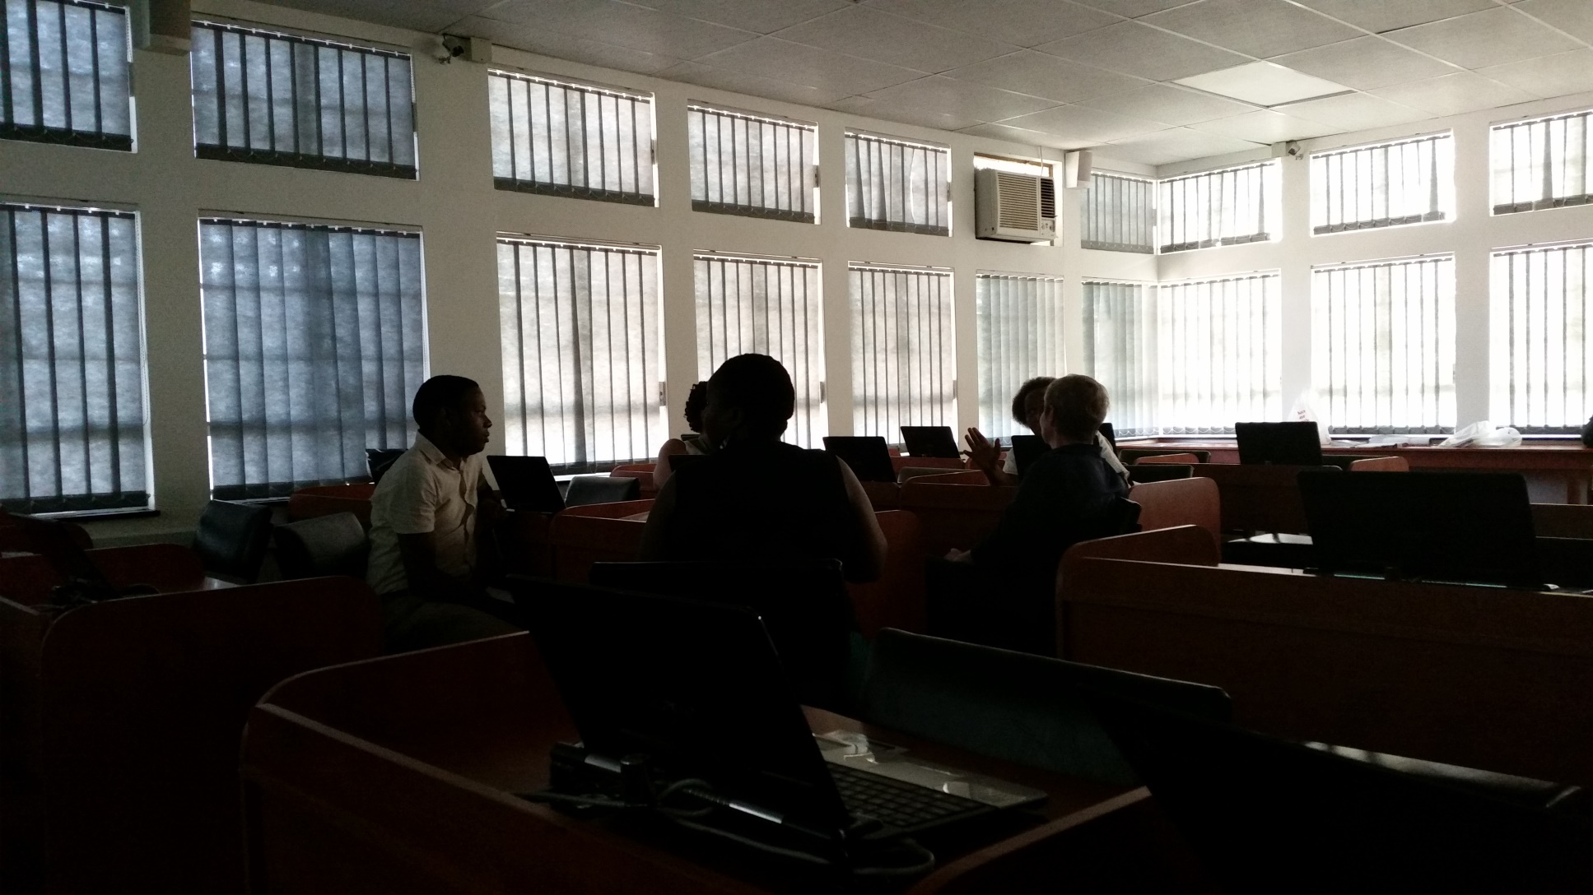
Fort Hare Day 1(10.30 am)

Slide 29
Fort Hare
 | Number
Students | 4
Academic staff | 3
Other staff* | 1
Non-UFH
Librarians | 3
TOTAL | 11
* Research unit manager

Slide 30
South African institutions
University of Cape Town (UCT) | University of Fort Hare | University of South Africa (UNISA)
 |  | Distance
 |  | 400 000 students
 |  | Dispersed
 |  | Comprehensive
 |  | Bureaucratic

Slide 31
UNISA expectations and challenges
Previous contact
Open Access drive
Policy to encourage OER
Bureaucratic mine field (felt from the outside)
Lecturers produce course materials (materiality)

Slide 32
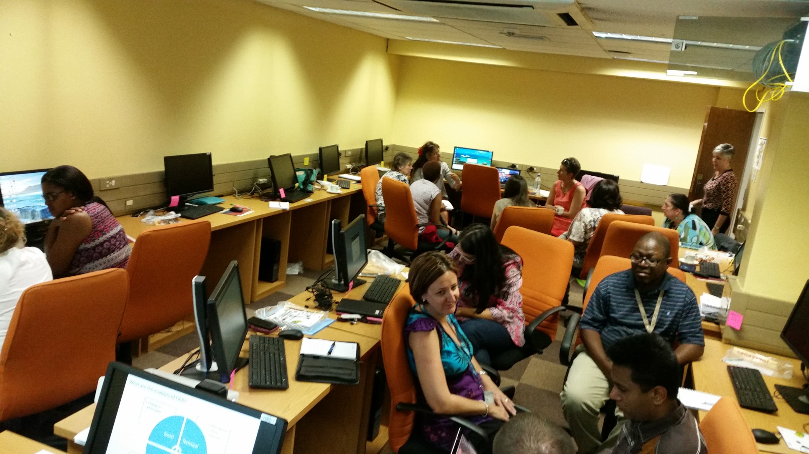
University of South Africa
Notes:
Impact- full workshop in two hours and as a result three workshops will be held over the next months

Slide 33
University of South Africa
 | Number
Students | 0
Academic staff | 14
Other staff* | 5
Librarians | 0
TOTAL | 19
*Support staff, UNISA Press, PVC office

Slide 34
Attitude Survey
Print Survey Code (for each respondent)
 | Institution
Answer Options | U of Cape Town | U of Fort Hare | UNISA | Response Count
 | 11 | 9 | 14 | 34
answered question |  |  |  | 34
skipped question |  |  |  | 0

Slide 35
Attitudes Survey

Slide 36

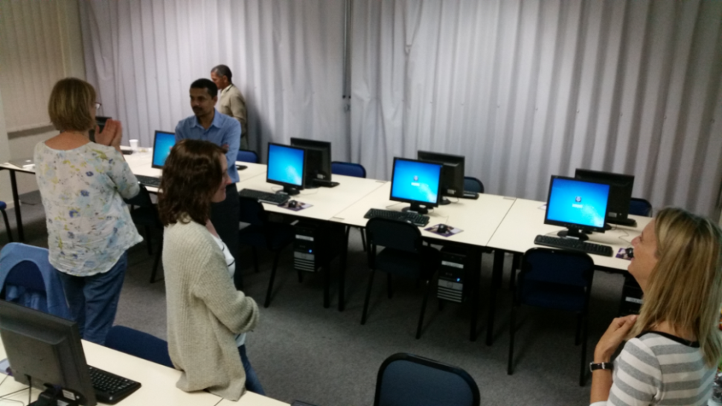

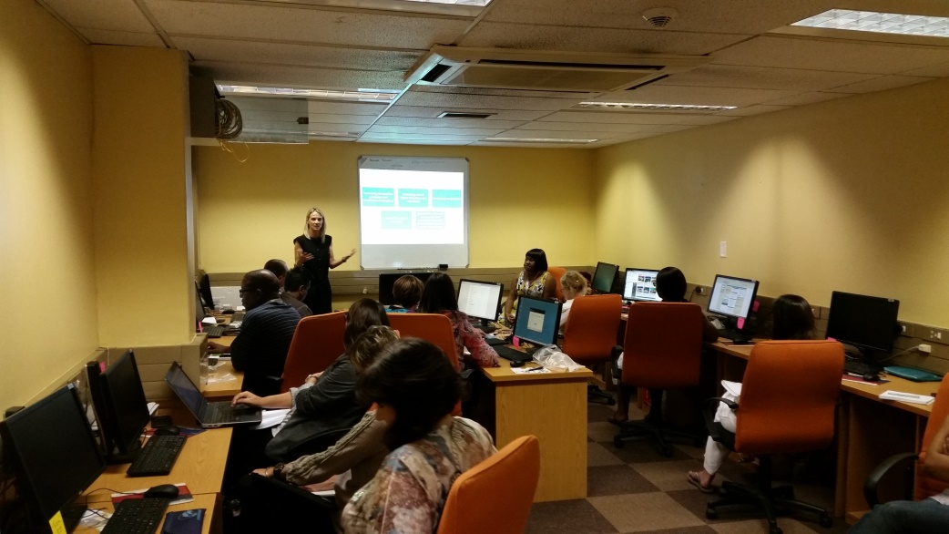
Hotel venue
Round tables
Lab space
Full venue
Majority male
NO devices!
Clinical
Poor lighting
Well resourced
Packed venue
Big lab, even on second day felt empty
Mostly women
Nice light,

Slide 37
Who is not ready? And who are we to decide this?
No impact where we felt we would like to make an impact
A real challenge to unravel the complexities of these institutions in SA and India
Notes:
From one visit of two days. Trying to take it all in and pick of snippets of how things work and don’t work. Mostly mysterious and have to rely on informal conversations and other reading…hoping interviews will reveal.
What will the implications be of this work? Will the workshop participants change their practice and become agents of change
.
Will they see the benefits of sharing-our perceived benefits? (empowering)
Moved into a context, we feel there is a need can we add value?

Slide 38
Next 7 months
Analysis of Survey data
Analysis of the Interviews
Comparison of some key findings across SA and India
Notes:
This is the D…in the ROER4D…or is it…are our subjects and institutions ready for D

Slide 39
