Slide 1
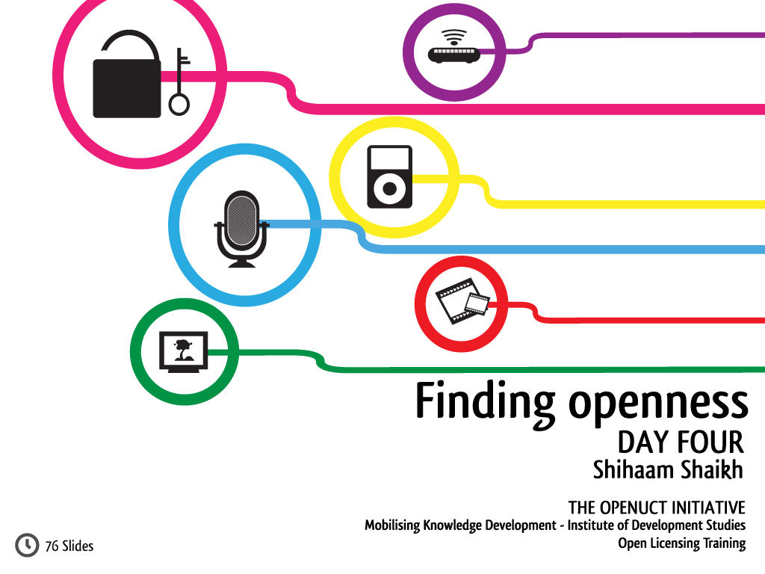


Slide 2


Slide 3
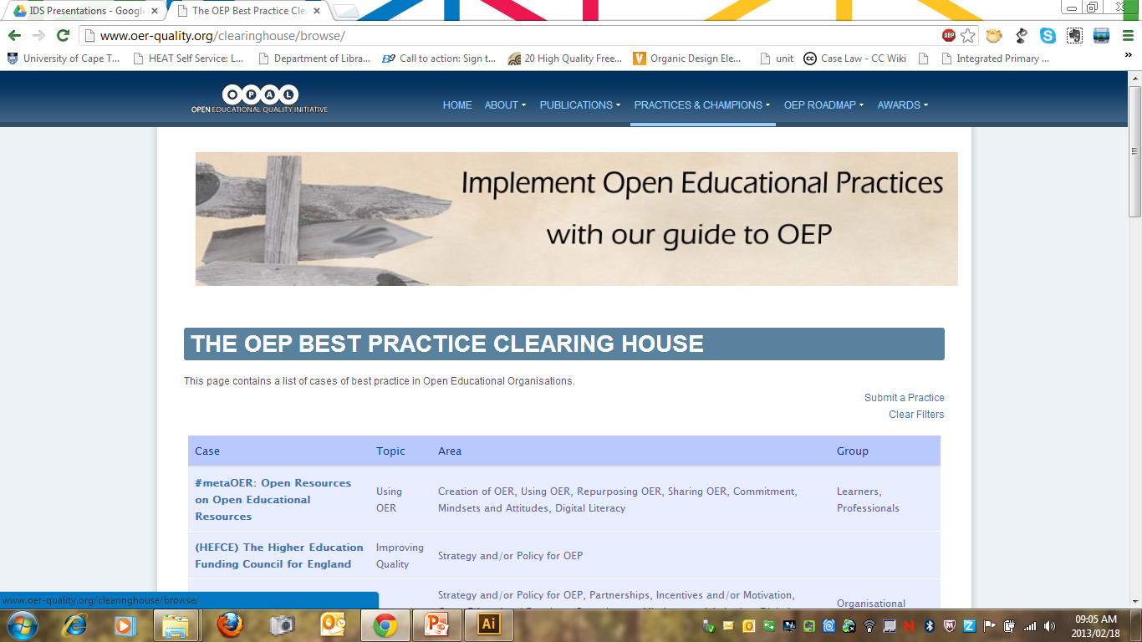
Notes:
http://www.oer-quality.org/clearinghouse/browse/

Slide 4
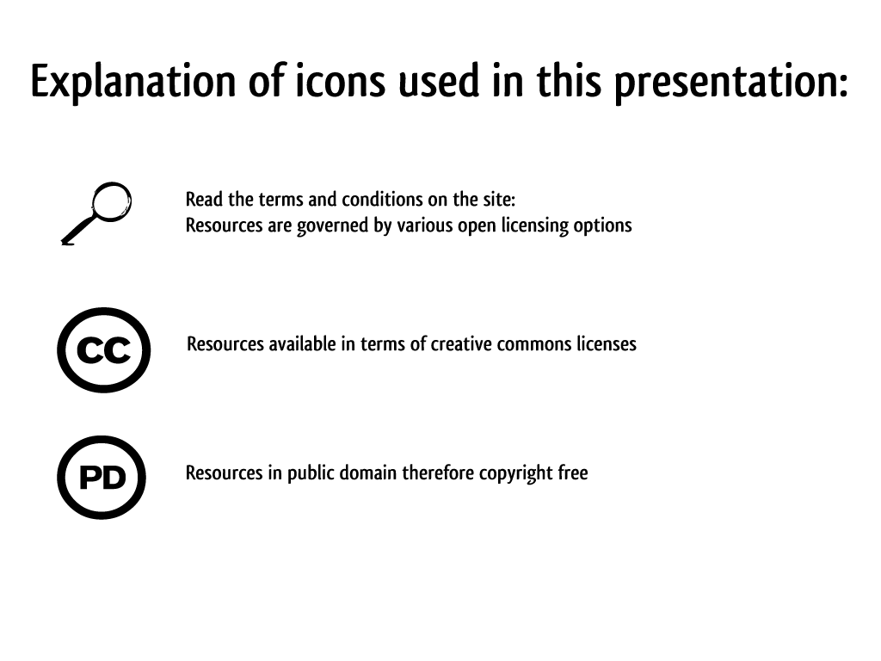

Slide 5
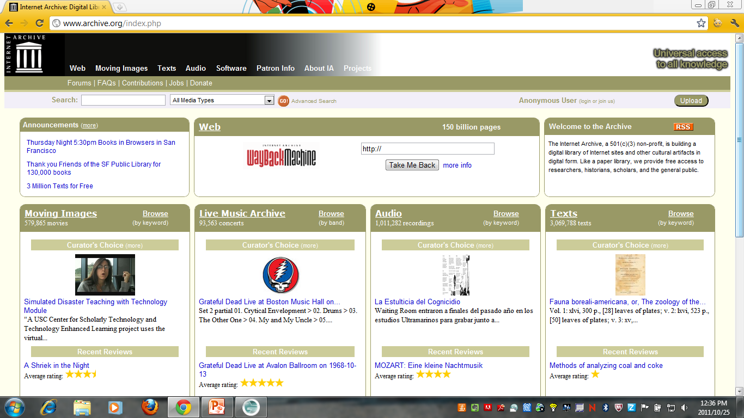

Internet Archive
Notes:
http://www.archive.org/
Not all of the resources on this site is available in terms of Creative Commons or been released into the public domain, however there is a large selection of open resources available.
Site terms and conditions: http://www.archive.org/about/terms.php
Stay updated with what they doing: http://blog.archive.org/

Slide 6
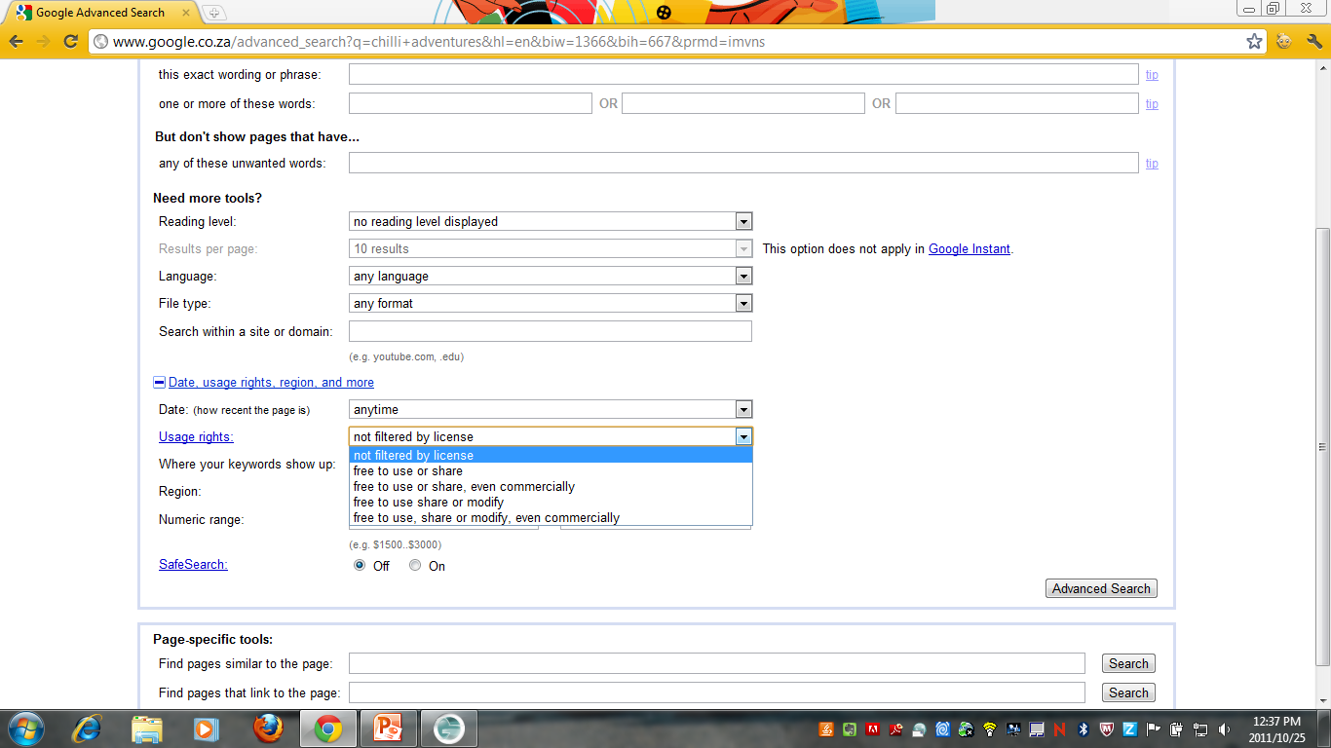
Google
Notes:
http://www.google.ca/advanced_search
By selecting various license options (usage rights) you can search for open images.
No info about the author on a website? Try Google Image Search and use an image to search for the source: http://www.google.com/imghp. All you need to do is drag your image into the search bar or upload the image from your PC. Google will show results where that same image is online elsewhere and this may help you track down the source of that image and acquire the proper permissions.

Slide 7
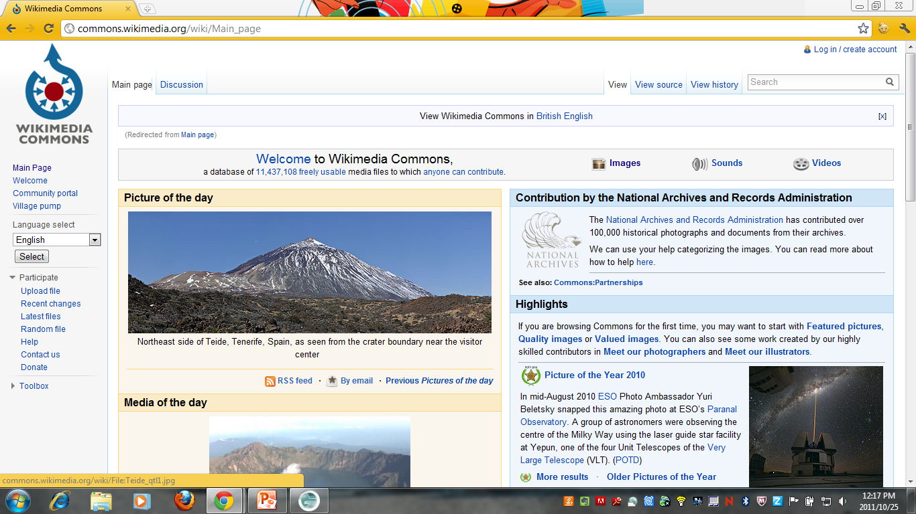
Wikimedia Commons
Notes:
http://commons.wikimedia.org/wiki/Main_Page
This site hosts a collection of media files that are either licensed in terms of Creative Commons or available as public domain works. Check each image for the license attached to the work and for author information.
Site terms and conditions: http://wikimediafoundation.org/wiki/Terms_of_Use

Slide 8
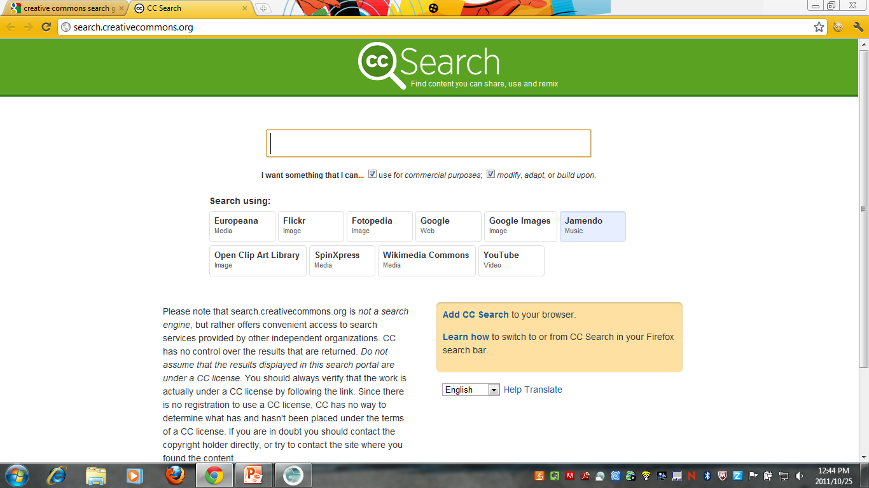

Creative Commons Search
Notes:
http://search.creativecommons.org/
Make sure to always check every site you go to and read their terms and condition or usage terms.

Slide 9
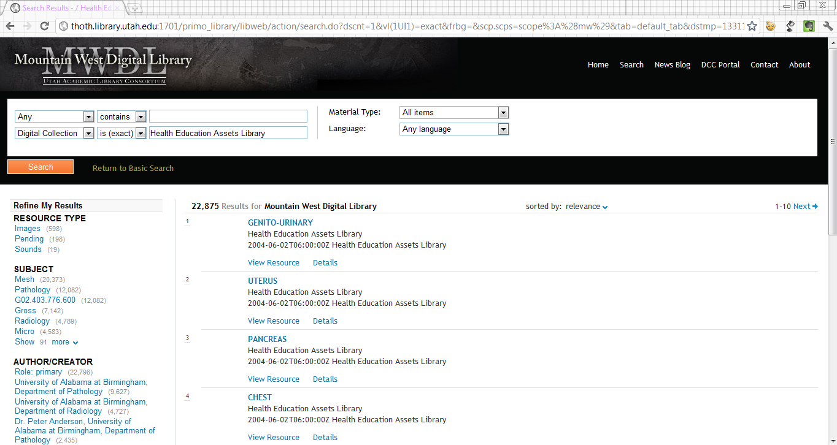
Heal Library
Notes:
http://www.healcentral.org/
Site still available via Mountain West Digital Library last time I checked – 07 March 2012.

Slide 10
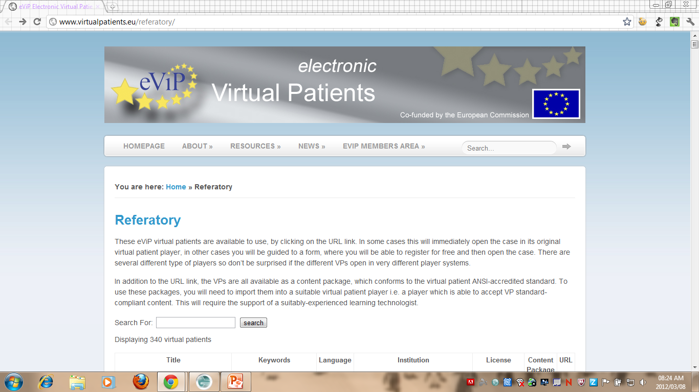
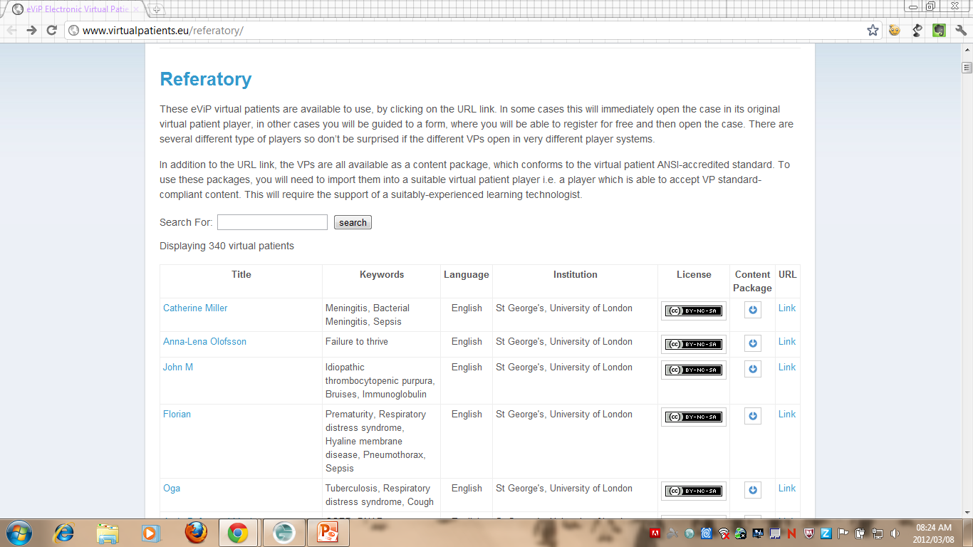
Electronic Virtual Patients
Notes:
http://www.virtualpatients.eu/referatory/
These eViP virtual patients are available to use, by clicking on the URL link. In some cases this will immediately open the case in its original virtual patient player, in other cases you will be guided to a form, where you will be able to register for free and then open the case.
The resources are governed by various Creative Commons licenses.

Slide 11
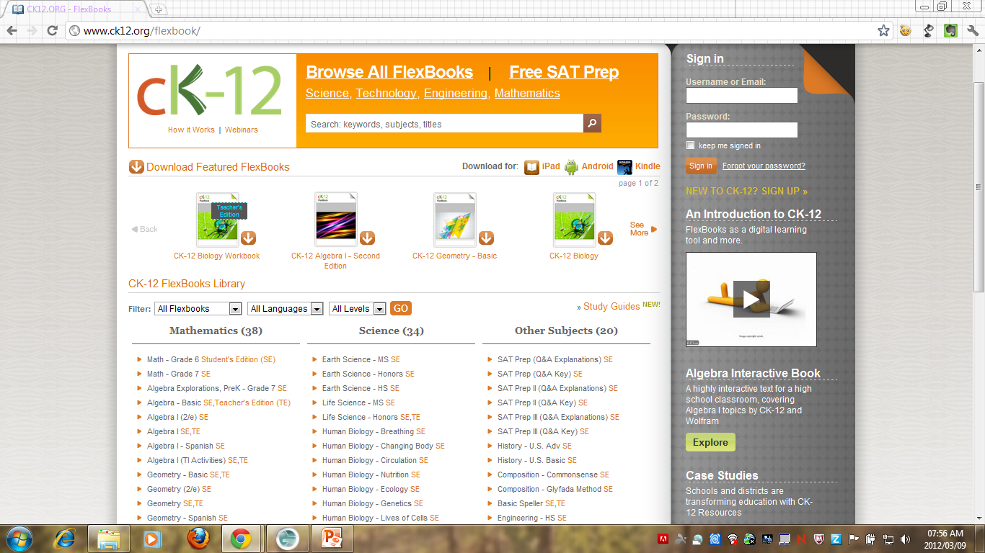
Flex Books
Notes:
http://www.ck12.org/flexbook/
This site contains Creative Commons licensed textbooks and study guides on human biology, physics, life sciences and earth sciences and is worth checking out.

Slide 12
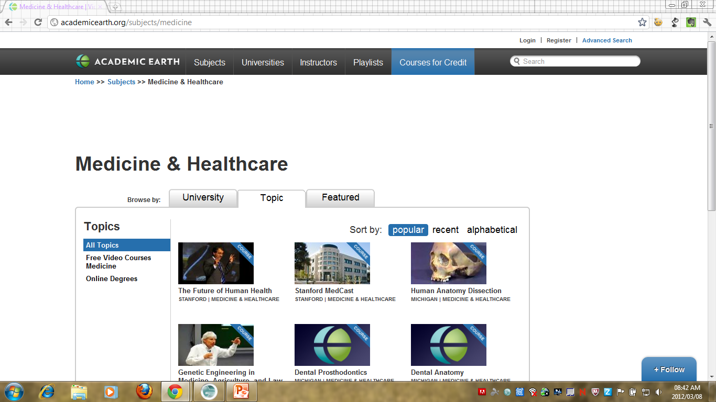
Academic Earth Medicine & Healthcare
Notes:
http://academicearth.org/
This site contains videos from a range of subjects and is available under various open licenses to make sure to check the video you wish to use. Find there medicine and healthcare resources here http://academicearth.org/subjects/medicine
Terms of use: http://academicearth.org/pages/terms-of-use

Slide 13
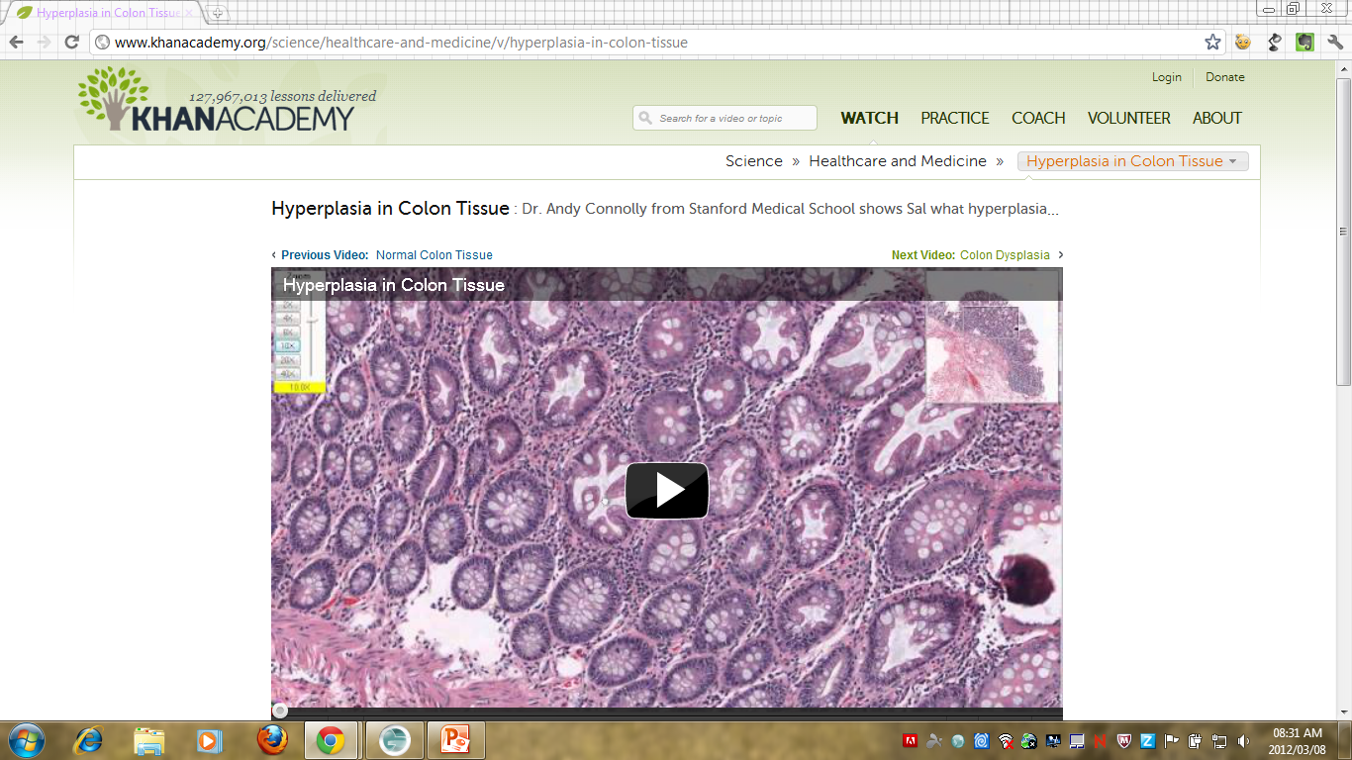
Khan Academy Healthcare & Medicine
Notes:
http://www.khanacademy.org/
This site’s resources covers a wide range of topics and caters for all educational levels – all the videos are free to use and you need to check each video you wish to use. Healthcare and medicine section can be found at http://www.khanacademy.org/#healthcare-and-medicine
Terms of use: http://www.khanacademy.org/about/tos

Slide 14
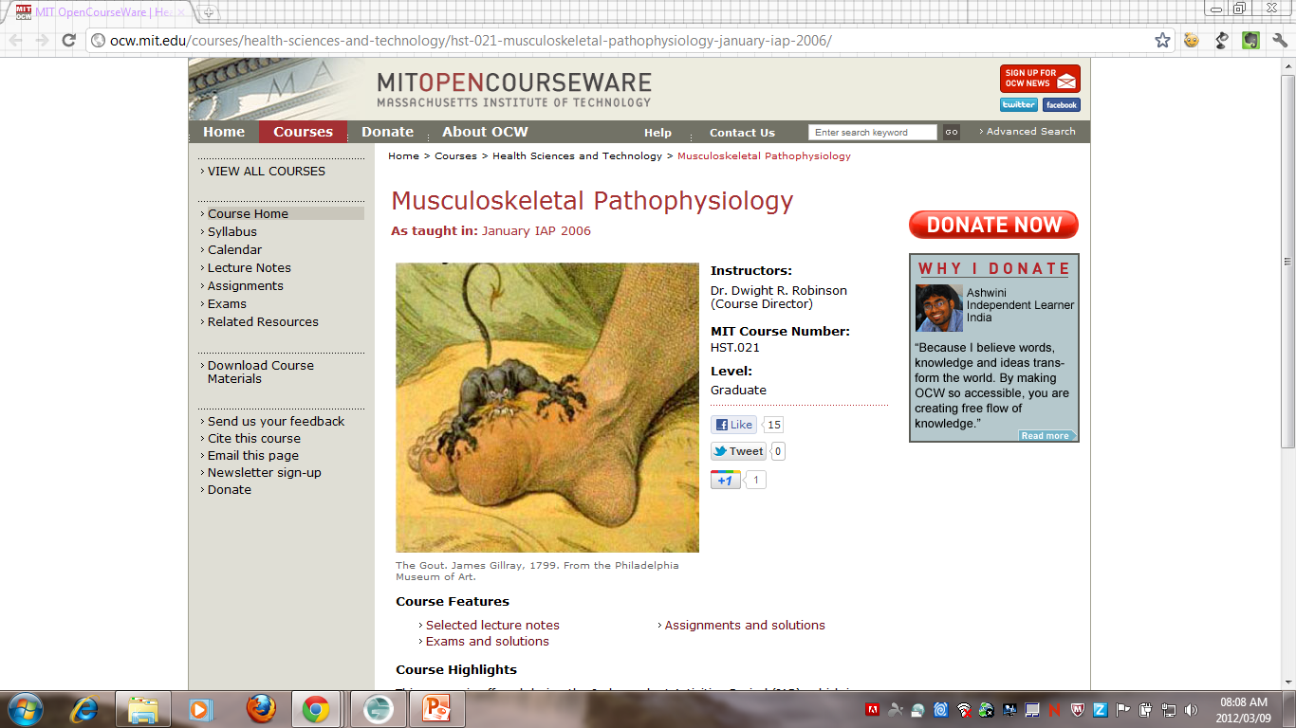
MIT OpenCourseWare Health Sciences
Notes:
http://ocw.mit.edu/courses/#health-sciences-and-technology

Slide 15
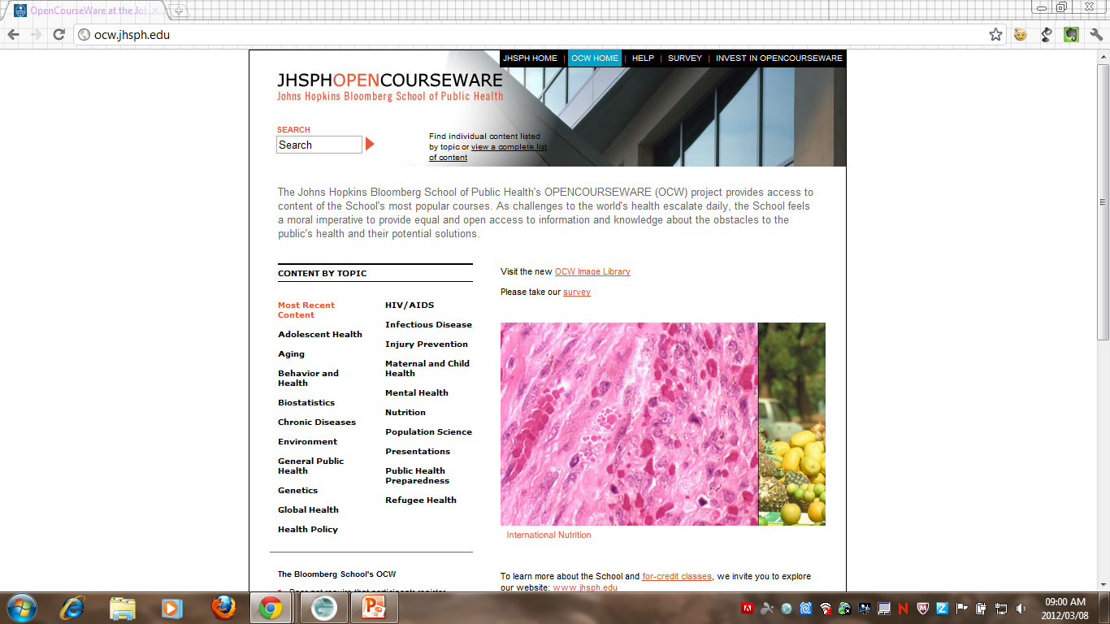
John Hopkins Bloomberg SPH
Notes:
http://ocw.jhsph.edu/
The Johns Hopkins Bloomberg School of Public Health's OPENCOURSEWARE (OCW) project provides access to content of the School's most popular courses. As challenges to the world's health escalate daily, the School feels a moral imperative to provide equal and open access to information and knowledge about the obstacles to the public's health and their potential solutions.

Slide 16
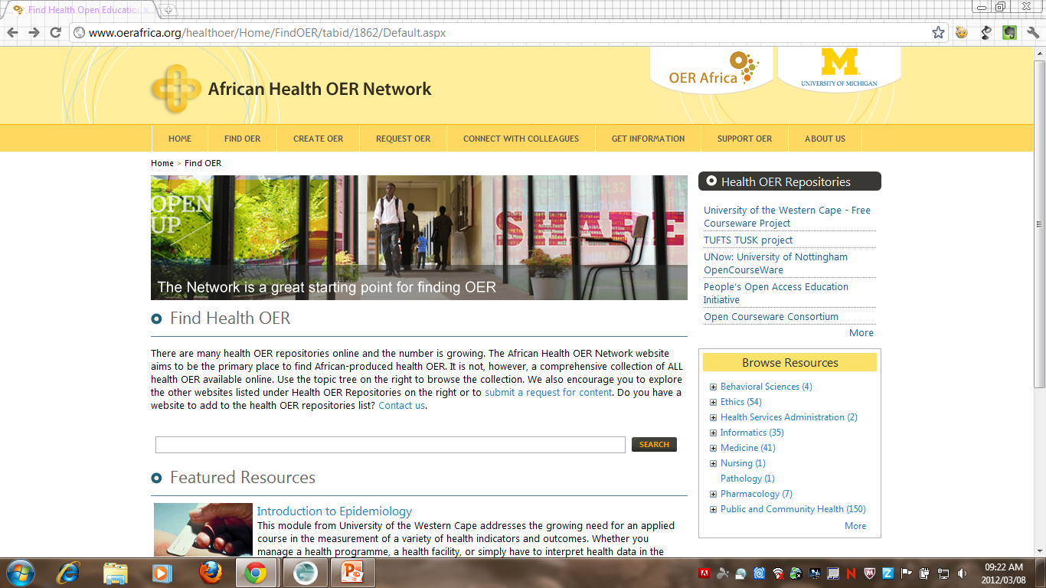
African Health OER Network
Notes:
http://www.oerafrica.org/healthoer/Home/FindOER/tabid/1862/Default.aspx
The African Health OER Network website aims to be the primary place to find African-produced health OER.

Slide 17
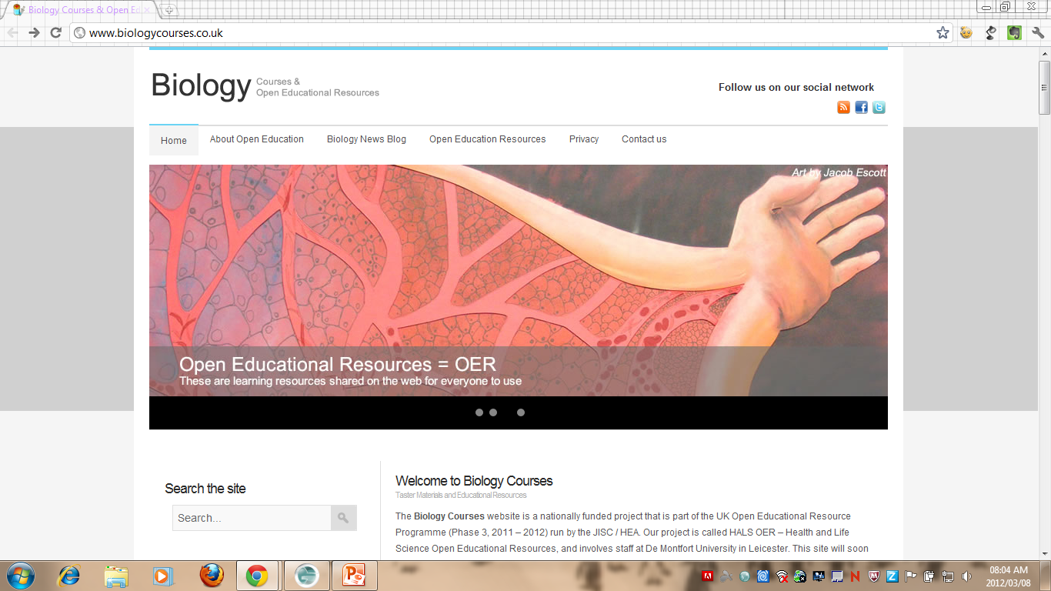
Biology Courses UK
Notes:
http://www.biologycourses.co.uk/
This UK-based open education website is funded by HEFCE as part of their national “Open Educational Resource Programme” Phase 3 run by the JISC and the HEA. This website contains biology resources or more specifically, Health and Life Science Open Educational Resources (HALSOERs). We have focused on medical science, biomedical science and forensic science, which are all degrees relevant to school and college students studying biology A level. Medical sciences as the name suggests often involves more human biology and medical-based subjects including toxicology and pathology perhaps. Biomedical science is a laboratory based discipline involved in methods of diagnosis and monitoring the effects of treatment by analysing tissues and samples. Forensic science is also a laboratory based discipline involving investigative approaches to analysing crime scenes.

Slide 18
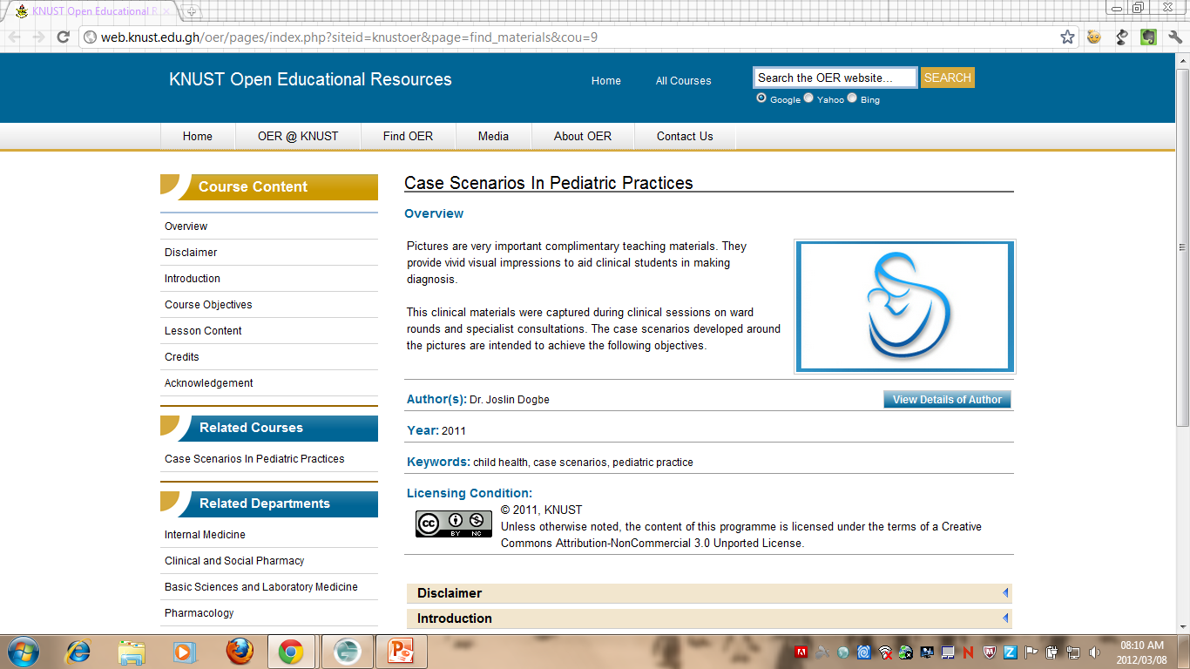
KNUST
Notes:
http://web.knust.edu.gh/oer/pages/index.php?siteid=knustoer&page=find_materials
KNUST Open Educational Resources is an initiative of the Kwame Nkrumah University of Science and Technology that seeks to promote open learning through an open exploration that enables faculty, students and the global academic community to access open licensed educational resources to maximize the impact and reach of their scholarly work through open sharing.
Available on this website are tools and resources to teach you about open education and you how you can be involved in this initiative. Learn how you can create OER with your own materials or use, "adapt" existing materials and publish works with appropriate licensing conditions. With collaborative support from other partner institutions involved in this growing international initiative, you will receive help in finding, using, creating and sharing openly licensed content.

Slide 19
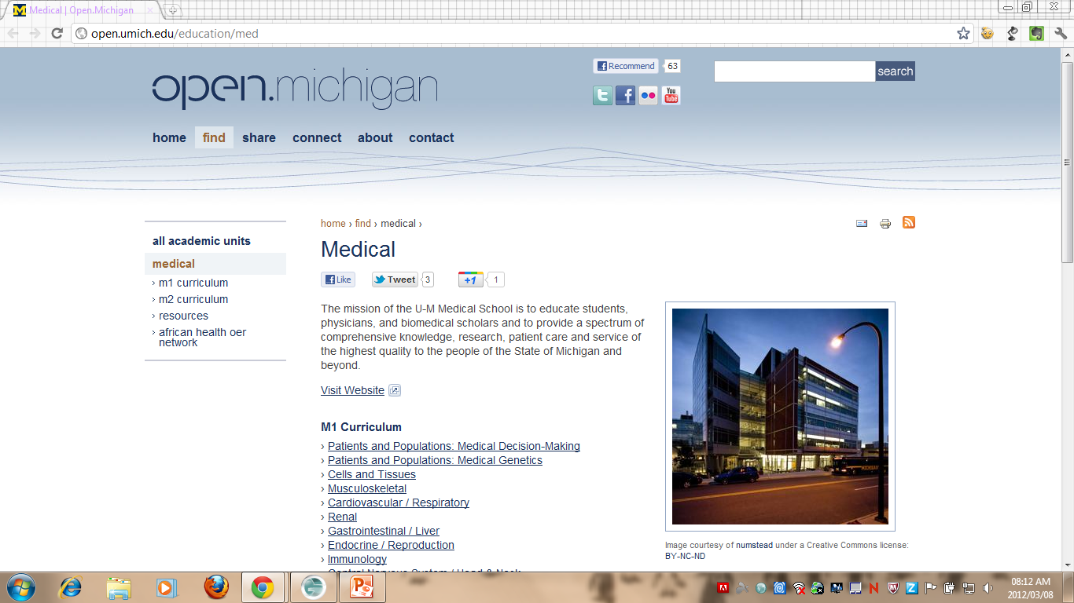
Open Michigan
Notes:
http://open.umich.edu/education/med
The mission of the U-M Medical School is to educate students, physicians, and biomedical scholars and to provide a spectrum of comprehensive knowledge, research, patient care and service of the highest quality to the people of the State of Michigan and beyond.

Slide 20
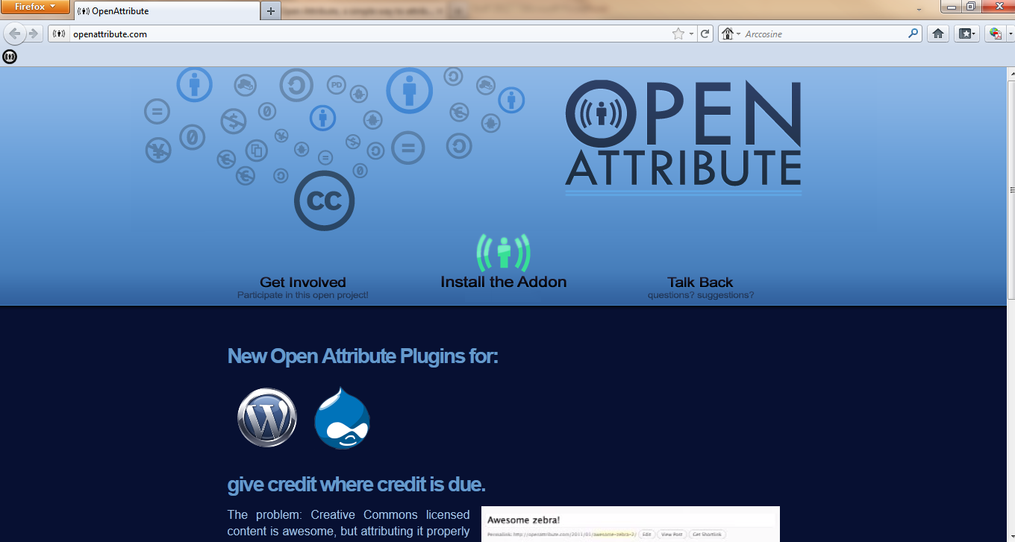
Open Attribute
Notes:
http://openattribute.com/
This add-on displays license and attribution information for Creative Commons licensed content – it is supported in Chrome, Firefox and Opera browsers.
Firefox: https://addons.mozilla.org/en-US/firefox/addon/openattribute/?src=search
Opera: https://addons.opera.com/en/addons/extensions/details/open-attribute/1.5/?display=en
Chrome: https://chrome.google.com/webstore/detail/ohkidpebfeojnggafnkbafjpagnkgjak
Open Attribute Link
This add on will check all the search results for CC licences when performing a Google Search in Firefox
Firefox: https://addons.mozilla.org/en-US/firefox/addon/openattribute-link/?src=search
Chrome: https://chrome.google.com/webstore/detail/cegnlobohmoekpdicnplajegemnjbhgp
There is also a Open Attribute Wordpress plugin that will allow users to enter licensing information for their blog posts. Get it at http://wordpress.org/extend/plugins/openattribute-for-wordpress/
There is also a Drupal module for this tool, available here http://drupal.org/node/1154150

Slide 21
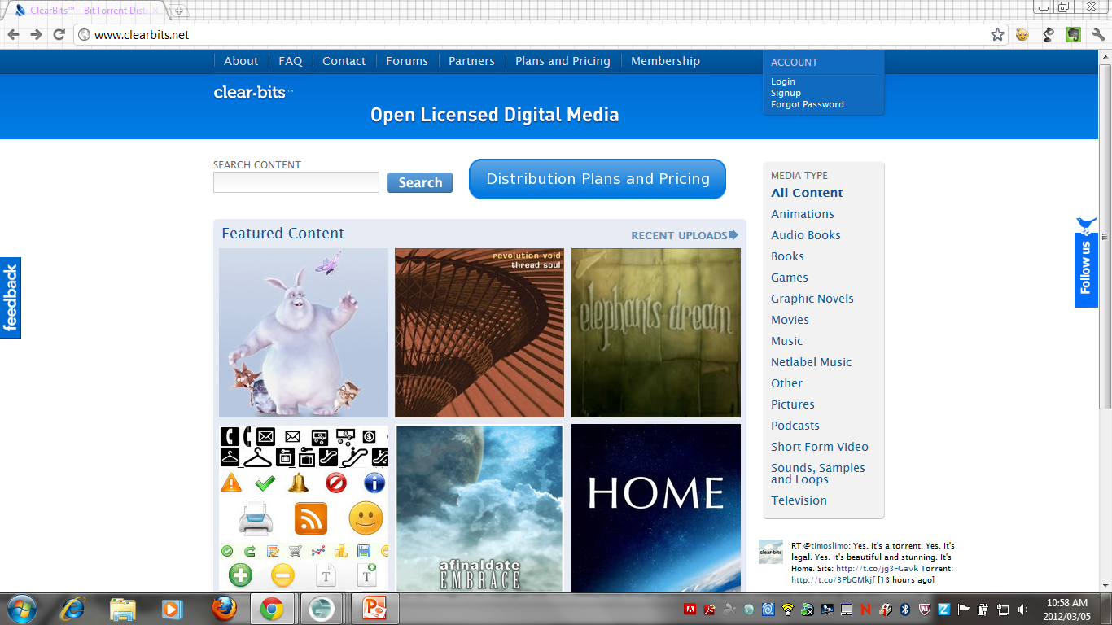
Clear-Bits
Notes:
http://www.clearbits.net/
Terms of Use:
http://www.clearbits.net/about/content_license_policy
Content on the ClearBits Website:
This includes content on the ClearBits website, including text, images, and torrent files and all materials not specifically listed as "Content:" on Content Creator profiles. These are provided under the Creative Commons Attribution NonCommercial 3.0 Unported license.
Please provide the following attribution: ClearBits.

Slide 22
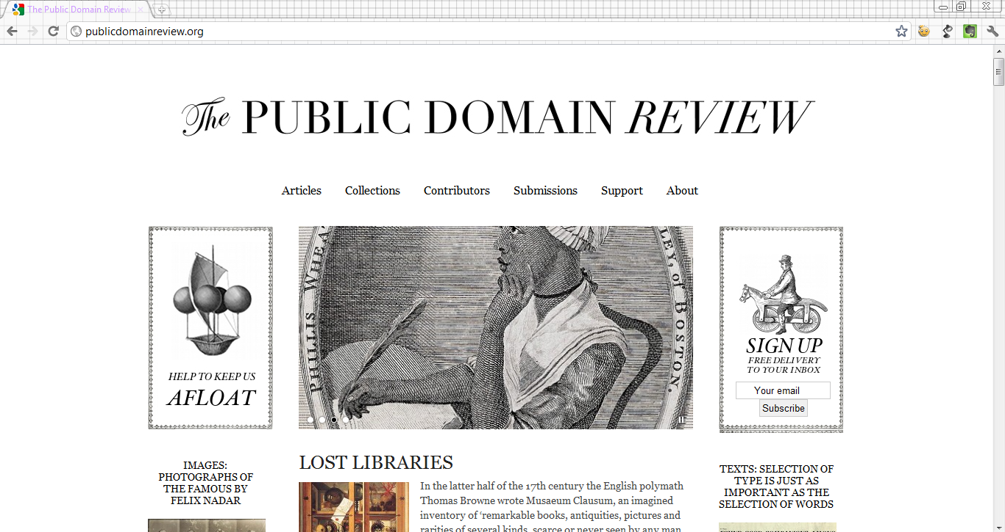

The Public Domain Review
Notes:
Thank you to Tarryn from Paper Right who alerted me to this during a workshop on Wednesday 7 March 2012.
http://publicdomainreview.org/
This website contains film, audio, text and images that are in the public domain.

Slide 23
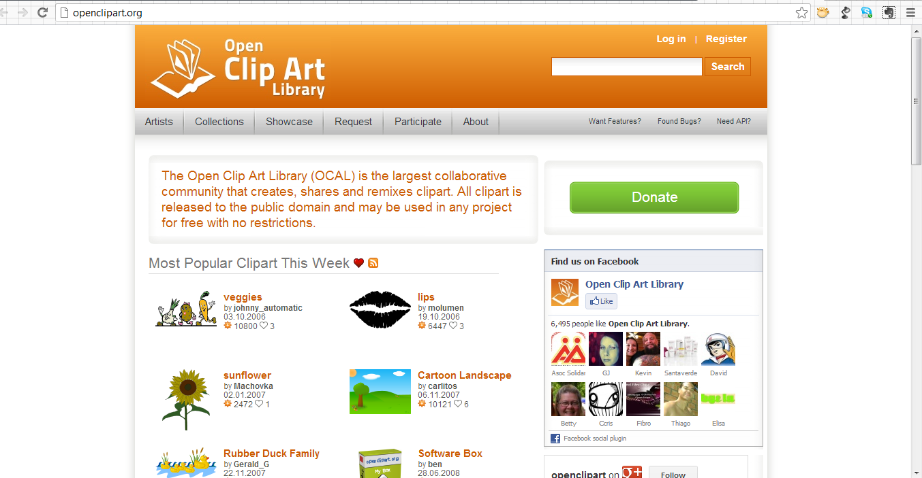
Open Clip Art Library
Notes:
http://openclipart.org/
Unless noted, content on this site is waived of all copyright and related or neighboring rights under the CC0 PD Dedication. See Policies.

Slide 24
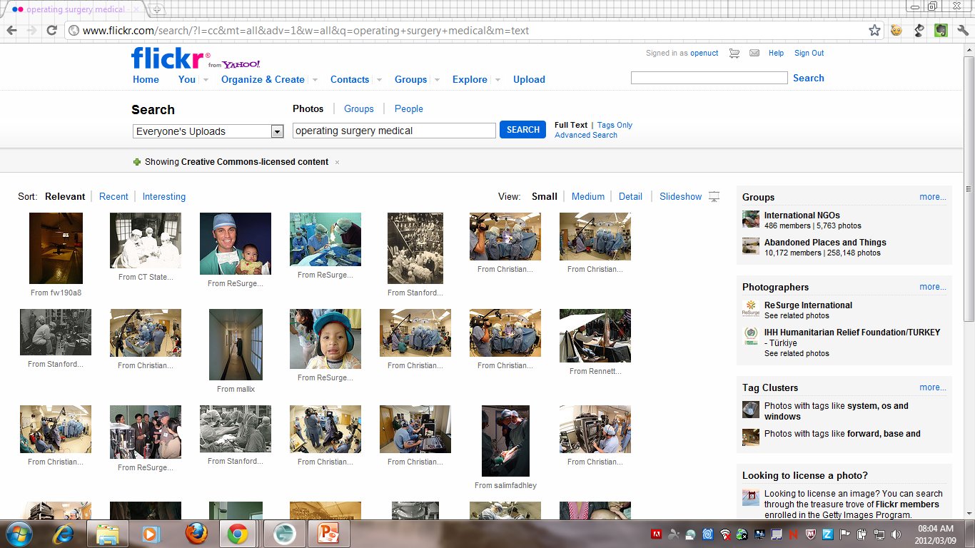
Flickr
Notes:
http://www.flickr.com/
This site has a wide variety of both full copyrighted and Creative Commons licensed images. Check each image for the attached usage restriction and make to properly attribute the author in the case of Creative Commons. Provide the title of the image (found directly below the image), provide the username of the user (found in upper right hand corner) and the license (located on the right hand side below tags and above the privacy section. Also remember to provide hyperlinks to the page where you found the image.
Eg: The featured image in this post is titled ‘Copyright’ by schmich and is licensed in terms of a CC-BY-SA license.
To search specifically for Creative Commons: http://www.flickr.com/creativecommons/
To search specifically through public photo collections: http://www.flickr.com/creativecommons/
Site copyright/IP policy: http://info.yahoo.com/copyright/us/details.html
For health sciences specific images, see http://www.flickr.com/photos/tags/medical/clusters/hospital-doctor-medicine/ and http://www.flickr.com/search/?l=cc&mt=all&adv=1&w=all&q=operating+surgery+medical&m=text

Slide 25

Compfight
Notes:
http://compfight.com/
This site is an image search engine allowing users to specifically look for Creative Commons licensed images.
FAQ about how to search effectively: http://compfight.com/faq

Slide 26
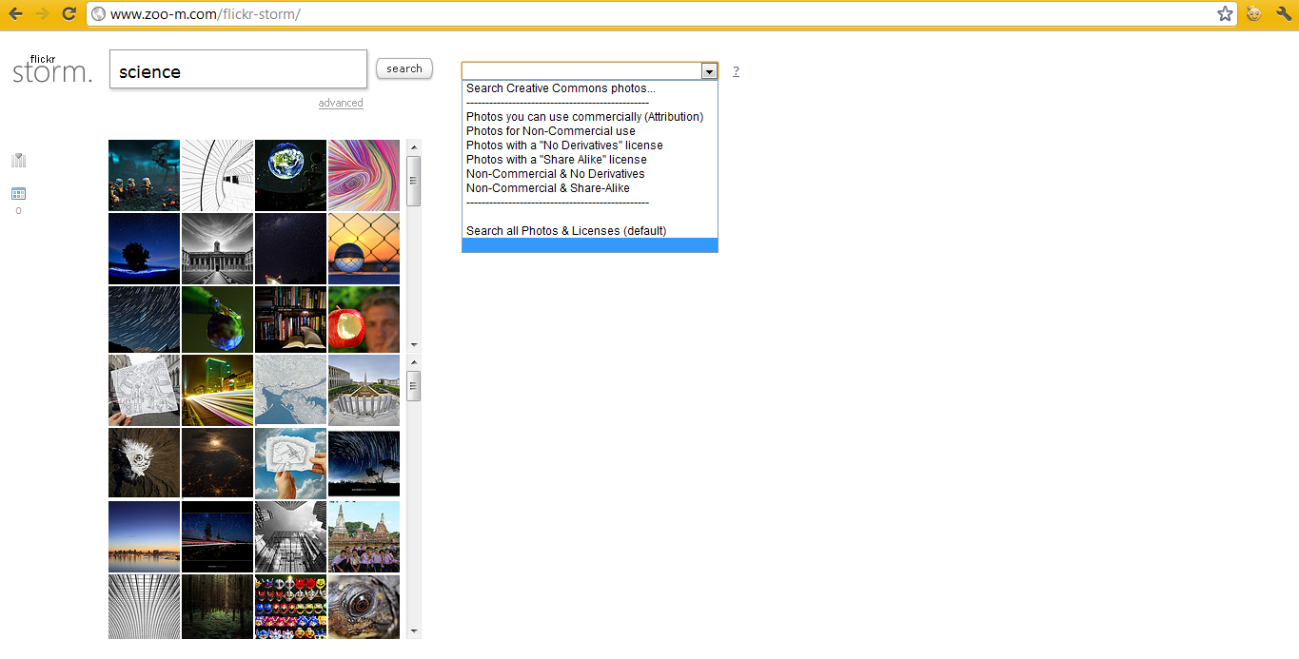
FlickrStorm
Notes:
http://www.zoo-m.com/flickr-storm/
This is a image search engine for Flickr – you are also able to specify license restrictions as a search filter.

Slide 27
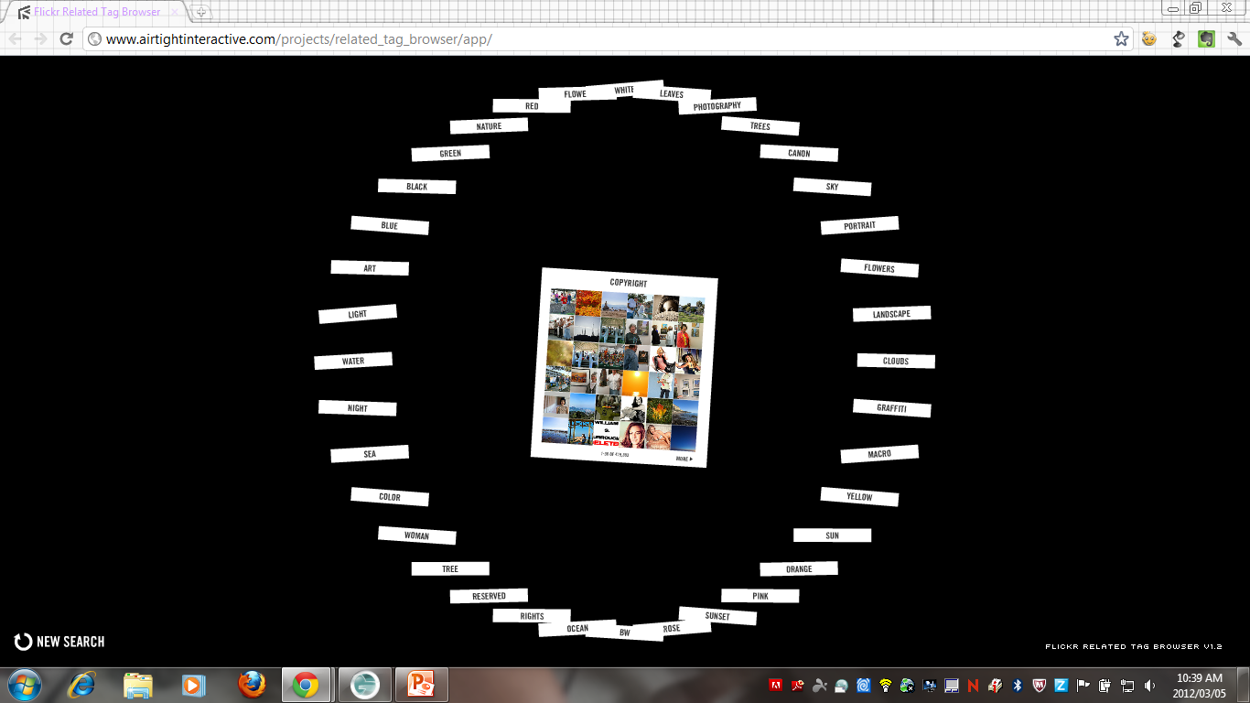
Airtight Interactive
Notes:
http://www.airtightinteractive.com/projects/related_tag_browser/app/
Each image will be governed by specific usage terms and conditions, so check out each image’s page on Flickr for usage terms.

Slide 28
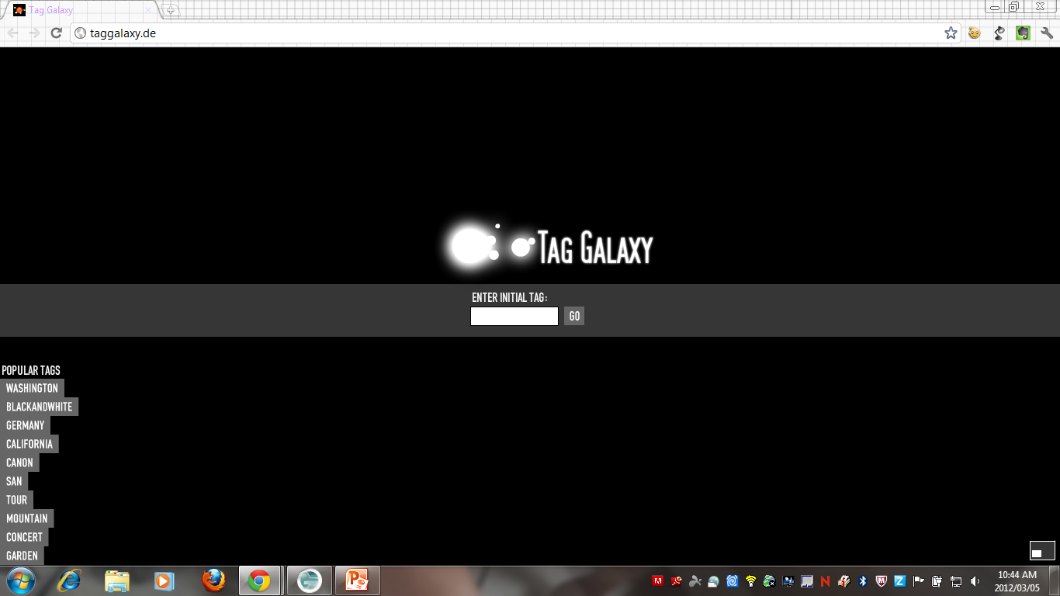
Tag Galaxy
Notes:
http://taggalaxy.de/
A Flickr based search engine using tags - Each image will be governed by specific usage terms and conditions, so check out each image’s page on Flickr for usage terms.

Slide 29
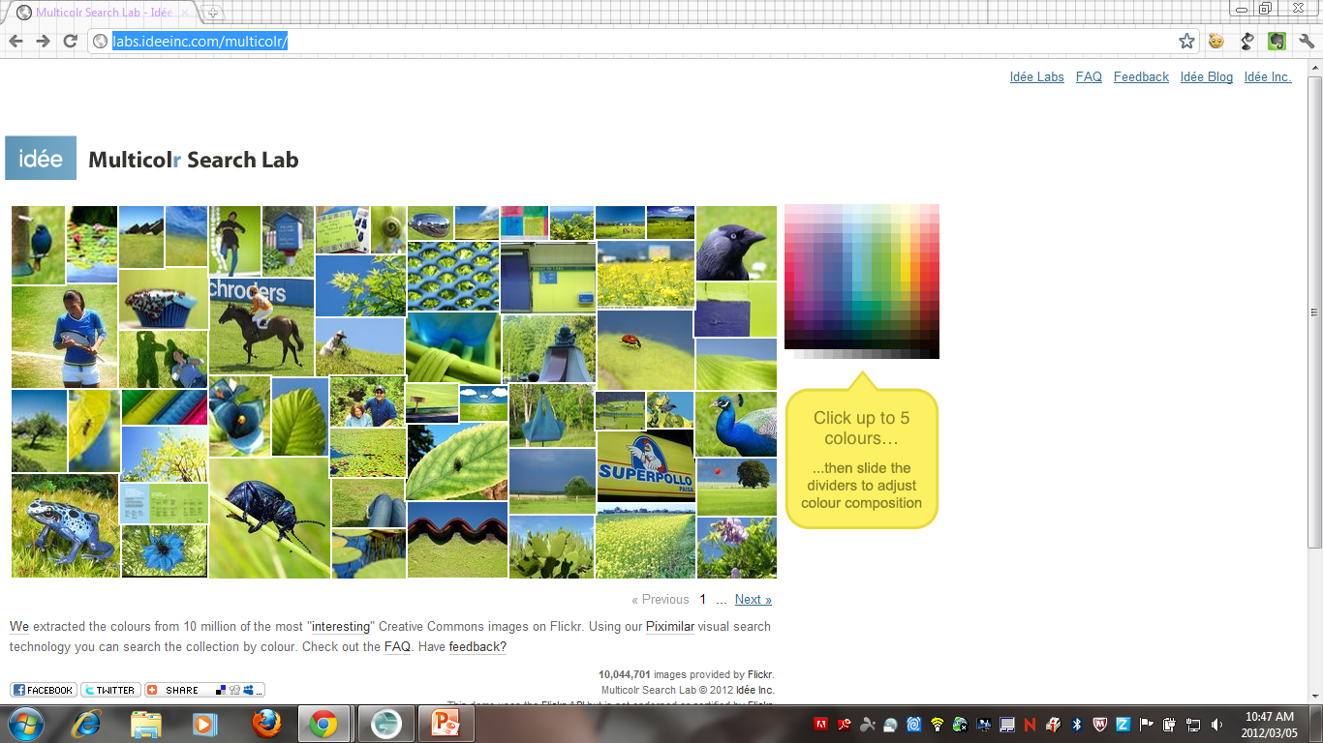
Multicolr
Notes:
Flickr search engine based on Creative Commons licensed images - http://labs.ideeinc.com/multicolr/

Slide 30
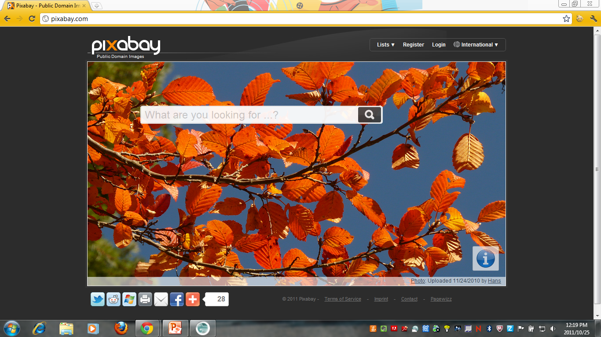
Pixabay
Notes:
http://pixabay.com/
The images on this site are in the public domain and therefore free from all copyright restrictions.
Site policy: http://pixabay.com/en/service/terms/

Slide 31
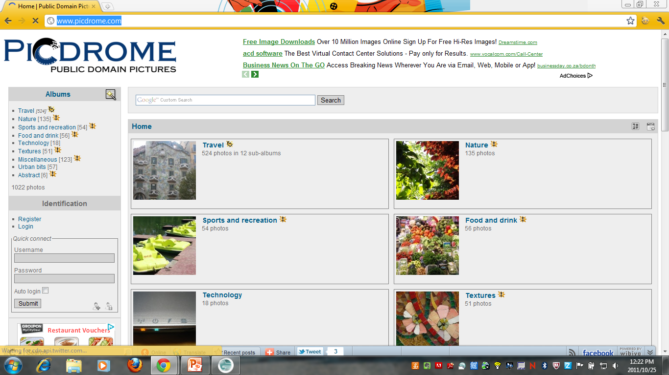
PicDrome
Notes:
http://www.picdrome.com/
This site’s images are free from copyright as it has been released into the public domain. You are free to use the images in any manner (commercial or adaptation) without asking for permission.
Site disclaimer: http://www.picdrome.com/index.php?/page/Disclaimer

Slide 32
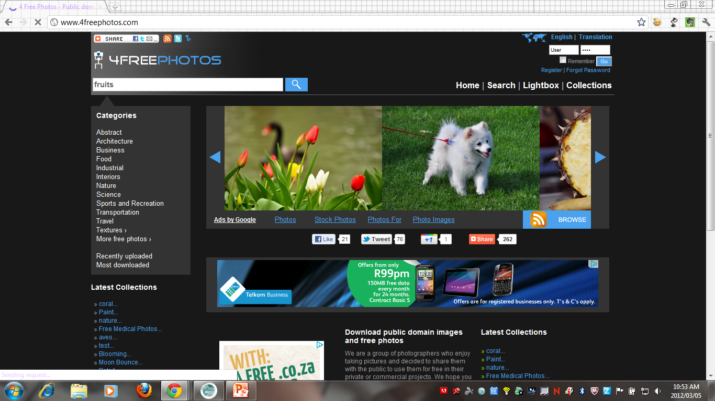
4 Free Photos
Notes:
http://www.4freephotos.com/
This site offers a selection of public domain images which are free to use without copyright restrictions.
Terms of Use:
http://www.4freephotos.com/terms.php#image_license
The images on this site are offered for free under the following Creative Commons license: CC-BY
If uploading images on another site please link back to us in order to support our efforts.
The photographers are offering these images and illustrations to the public, to use them for most of the commercial and personal purposes, free of charge under a Creative Commons license. The images do not have a model release so please be careful when using the images featuring products, trademark, people, works of art and propriety in commercial purposes or to endorse products or services.
Please note that we, the photographers, have offered these images for free to be useful for people in their projects without limiting how they are used, but we are not able to provide any legal counsel or warranties of any kind on the way they can be used in projects, especially commercial ones. The images are offered as is and without warranty.
Please note that it is your responsability if you do and we kindly ask you not to use the images:
- For pornographic, unlawful and immoral purpose, for spreading hate, discrimination, violence, or to defame other people;
- As part of a trade mark, logo, or to endorse products and services if it depicts a person, or a product;
As we spent great deal of time in putting togheter this website we have only two requirements in how you can use the content stored on our website including images. You are not allowed to copy the content of this website with an application or reuse a big part of the images (due to bandwith impact), code, and content for creating a similar website, or any other type of activity similar to the one our website is running, and you are not allowed to hotlink (use images on your webpage by loading them from our server) as this will mean stealing bandwith.

Slide 33
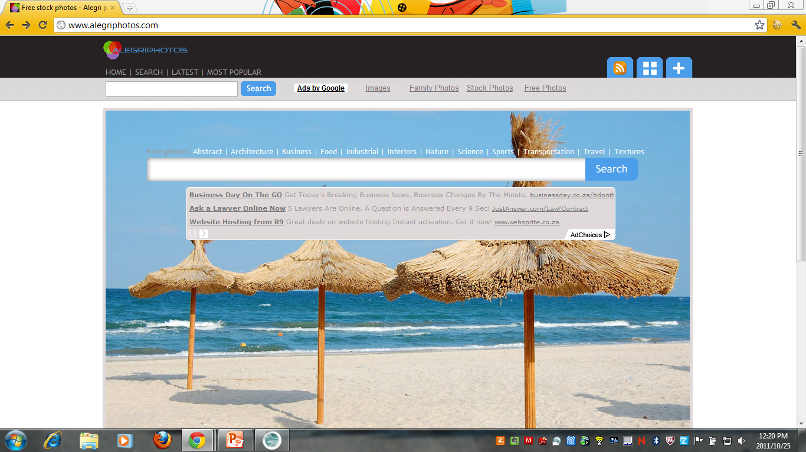
Alegri Photos
Notes:
http://alegriphotos.com/
The majority of the photos available on this site are licensed in terms of a Creative Commons attribution license so when using these images make sure to attribute the author/s. Other photos are public domain images so are free of all conditions and you are free to make use of them without attribution.
Site terms: http://alegriphotos.com/terms.php#image_license

Slide 34
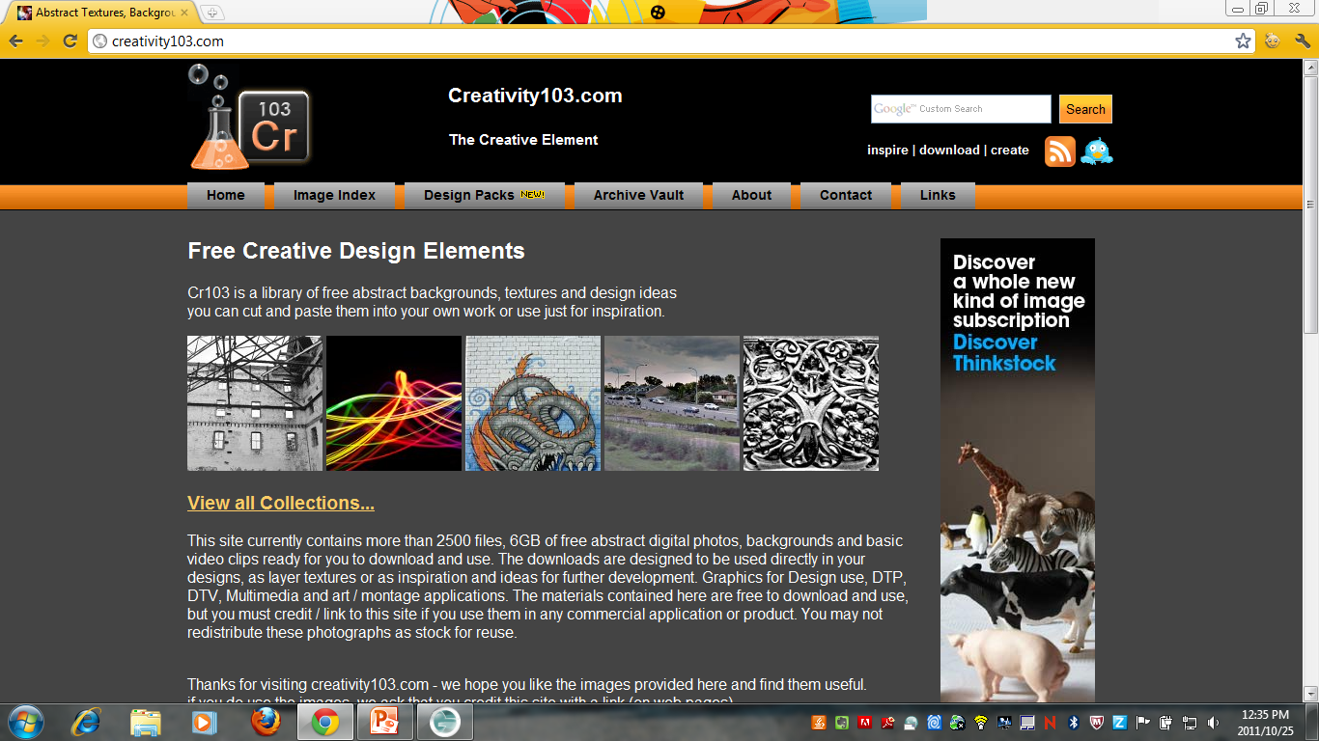
Creativity 103
Notes:
http://creativity103.com/
The majority of the photos on this site is licensed in terms of a Creative Commons Attribution license. You must attribute the site as author and link back to the website if you use these images.
Site terms: http://creativity103.com/linktous.htm#terms

Slide 35
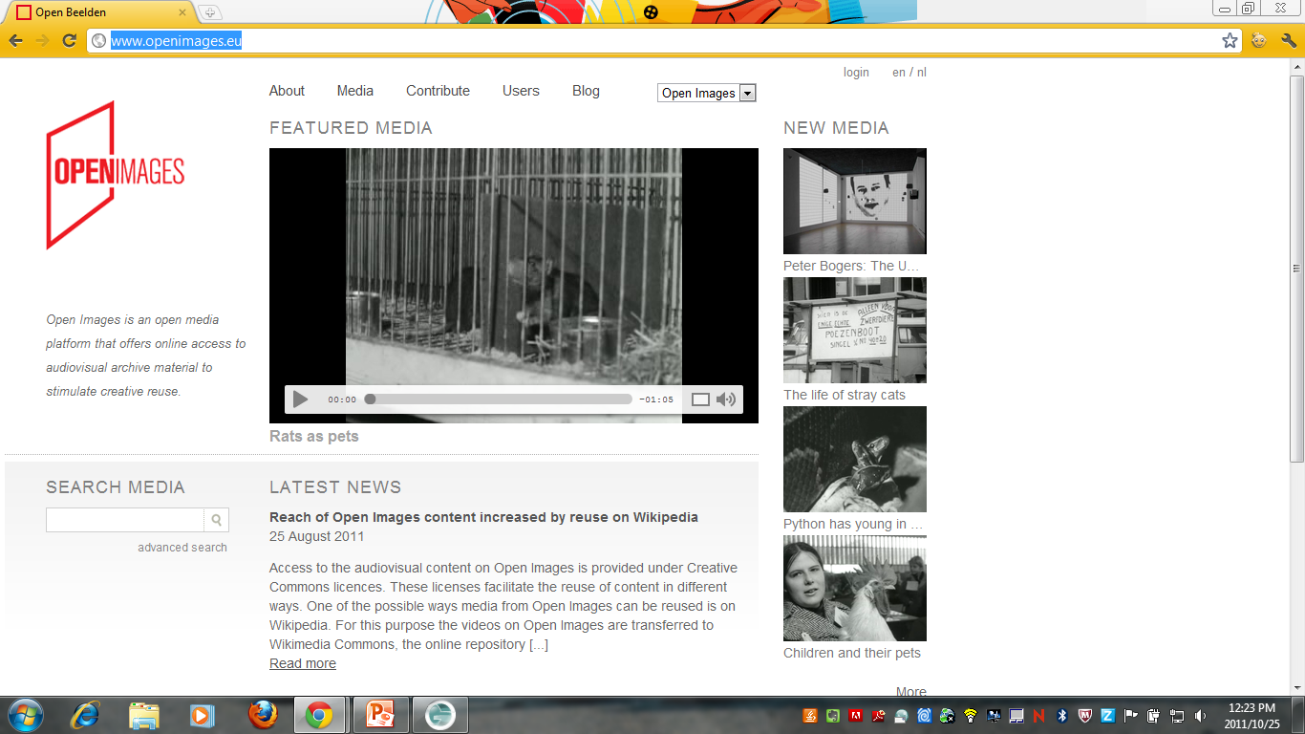
OpenImages
Notes:
http://www.openimages.eu/
This site contains audio, video and images all licensed in terms of Creative Commons.
Site terms: http://www.openimages.eu/about

Slide 36
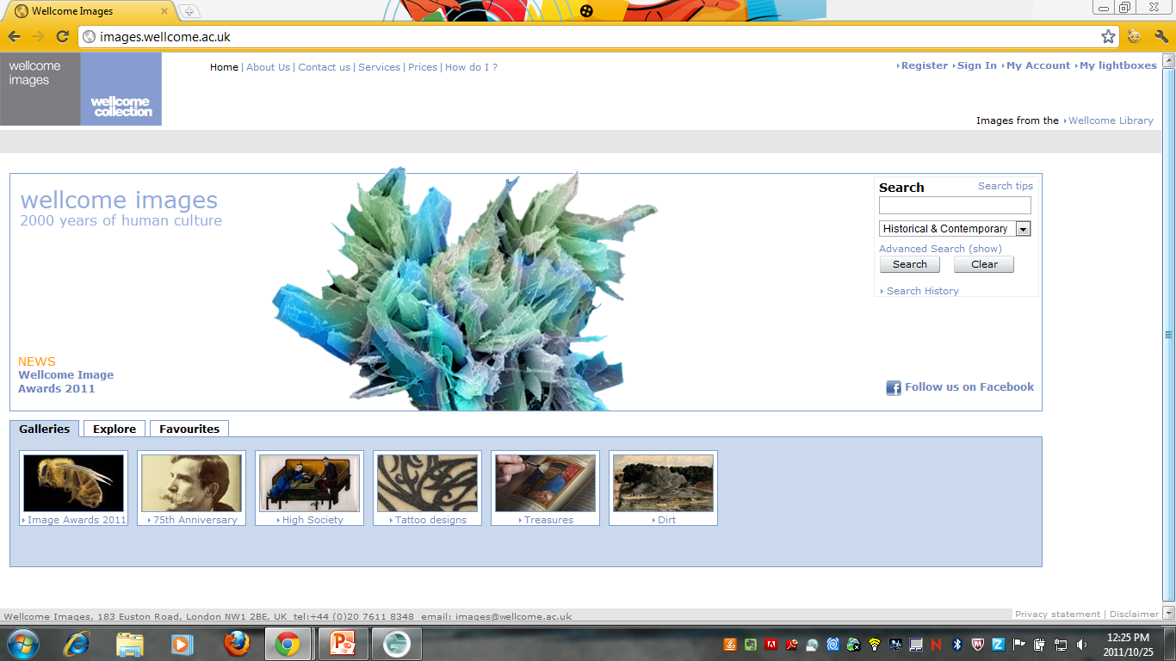
Wellcome Images
Notes:
http://images.wellcome.ac.uk/
The Biomedical Collection holds over 40 000 high-quality images from the clinical and biomedical sciences. Selected from the UK's leading teaching hospitals and research institutions, it covers disease, surgery, general healthcare, sciences from genetics to neuroscience including the full range of imaging techniques. Check the image you wish to use to make sure whether its governed in terms of a Creative Commons Non Commercial or Creative Commons No Derivatives Non Commercial license.
Site terms of use: http://images.wellcome.ac.uk/indexplus/page/Terms+of+Use.html?
These images may not be used for commercial purposes, however they have waived reproduction fees for the following uses:
examination papers
reproduction in an academic publication, being a book, monograph or professional journal article publishing the results of original research, with critical apparatus (notes etc.)
thesis submitted by a student at a higher or further education institution for the purposes of securing a degree
reproduction in teaching materials created in any medium by a teacher or lecturer at an educational establishment for the purposes of teaching. (This includes making printed copies of such materials for students and promoting and making such teaching materials available in electronic form, for example, via a virtual learning environment)
use in exhibitions by not-for-profit organisations including accompanying printed catalogue material (not including promotional merchandise offered for sale).
personal use by private individuals
use in Wellcome Trust funded projects

Slide 37
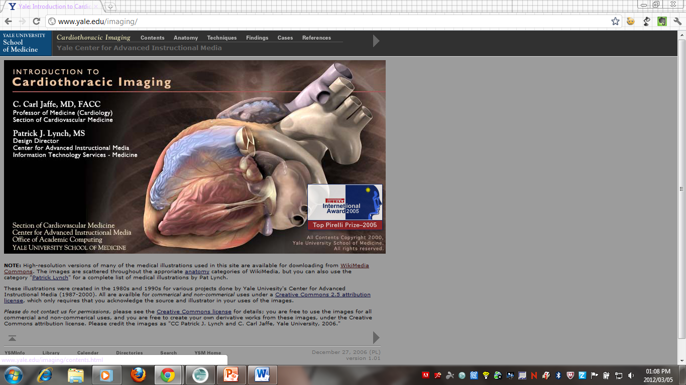
Cardiothoracic Imaging
Notes:
http://www.yale.edu/imaging/
You are free to use the images for all commercial and non-commercial uses, and you are free to create your own derivative works from these images, under the Creative Commons attribution license. Please credit the images as "CC Patrick J. Lynch and C. Carl Jaffe, Yale University, 2006."

Slide 38
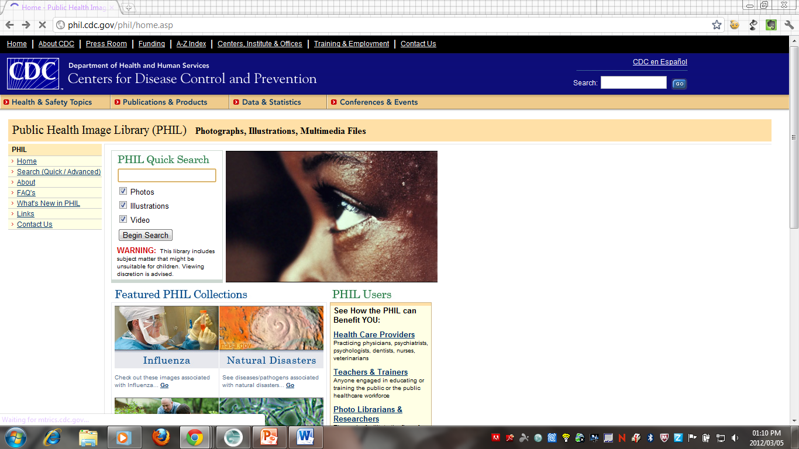
Public Health Image Library
Notes:
http://phil.cdc.gov/phil/home.asp
The content is organized into hierarchical categories of people, places, and science, and is presented as single images, image sets, and multimedia files.
Terms of Use:
http://phil.cdc.gov/phil/faq.asp#question6
Question 6: What regulations govern the use of images in the PHIL?
Answer: Images are either "Public Domain" (free use) or "Copyright Protected" (restricted, obtain permission before use)
Most of the images in the collection are in the public domain and are thus free of any copyright restrictions. If you look directly beneath the image you will see a fair use statement that tells you if the image is public domain or copyright protected.
Permission is not required for public domain images, but we do ask that you credit the original institution and contributor, when known, whenever the image is used in any publicly distributed media.
If the image is copyright protected, you will have to contact the content provider to obtain usage permission. PHIL does not have the authority to grant usage for any copyrighted images in the library. If you have difficulty contacting a content provider, we may be able to help, but we cannot act on their behalf.

Slide 39
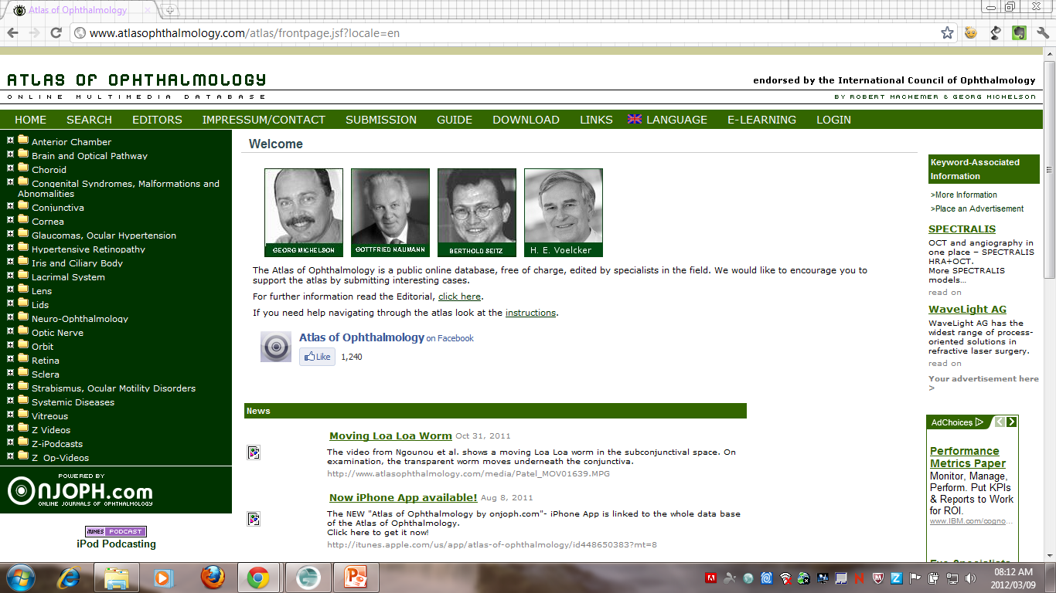
Atlas of Ophthalmology
Notes:
http://www.atlasophthalmology.com/atlas/frontpage.jsf?locale=en
This database contains over 2500 images of diseases of the eye. Please note the images are free to view but not available for download – it serves as a good reference resource for students.
The use of this atlas is free of charge as long as it is used for educational purposes, and as computers are becoming more and more affordable its information will be available to any health care personnel all over the world.
http://www.atlasophthalmology.com/atlas/text.jsf?node=7
Legal Information
1. Pictures can be reproduced with permission of the editor. Please contact Michelson@t-online.de.
2. Every effort has been made to provide correct information. We do not claim that the presented material is error-free and it should not be used without additional information of appropriate literature and/or consultation with an ophthalmologist.

Slide 40
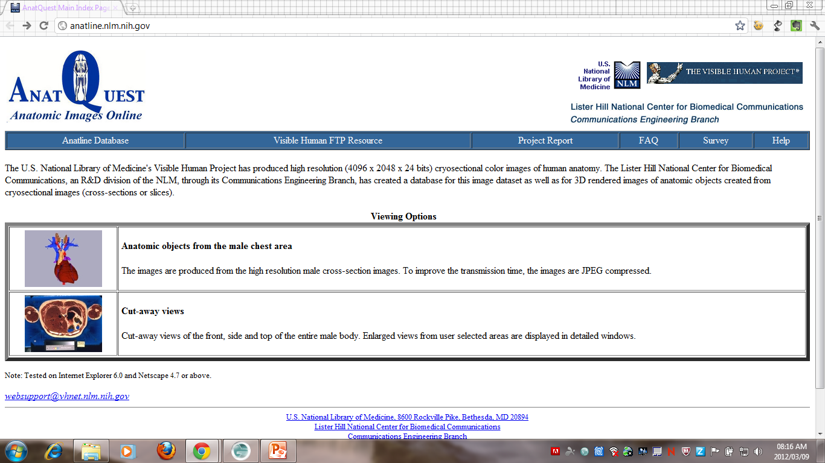
Anat Quest
Notes:
http://anatline.nlm.nih.gov/
These resources are in the public domain and can be used freely but it requested that you attribute the National Library of Medicine: http://www.nlm.nih.gov/copyright.html

Slide 41
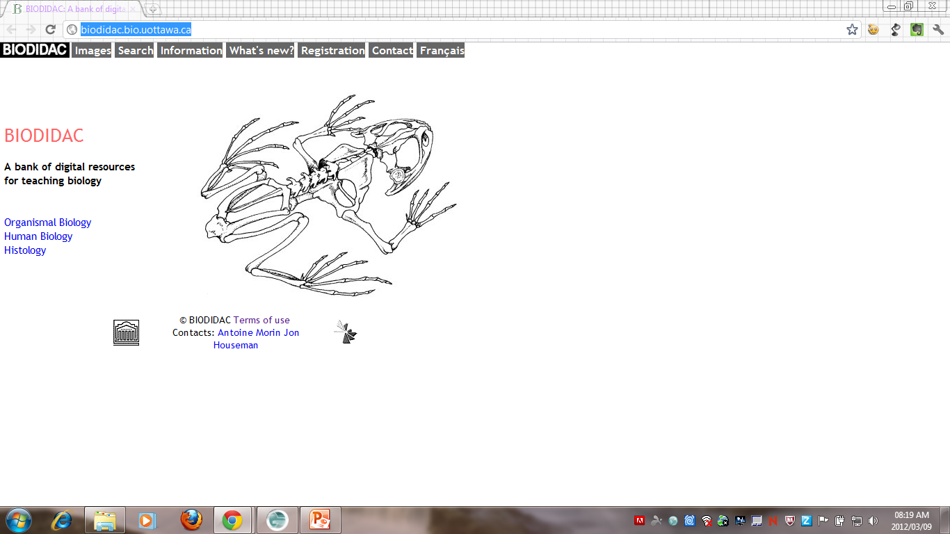
BioDadic
Notes:
http://biodidac.bio.uottawa.ca/
Copyright terms:
http://biodidac.bio.uottawa.ca/info/regles.htm
The copying of material, either with modifications or adaptations, and its subsequent distribution, is permitted with three conditions:
1. that it is not used for commercial purposes
2. that the source of the material is clearly indicated
3. and that its use is recorded in such a way that we can provide documentation to the sponsors of the project.

Slide 42
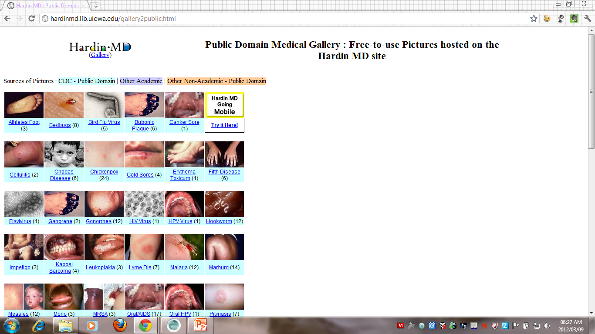
Hardin MD Medical Gallery
Notes:
http://hardinmd.lib.uiowa.edu/gallery2public.html
Public domain resources from the Hardin MD Library

Slide 43
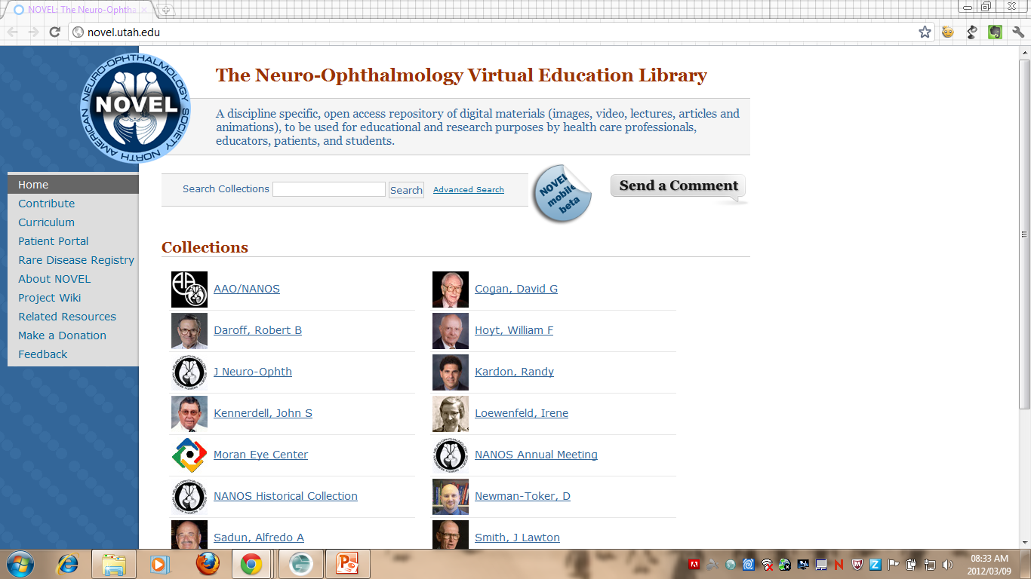
The Neuro-Ophthalmology Virtual Education Library
Notes:
http://novel.utah.edu/
A discipline specific, open access repository of digital materials (images, video, lectures, articles and animations), to be used for educational and research purposes by health care profess ionals, educators, patients, and students.
All work herein is licensed under a Creative Commons CC-BY-NC-ND license http://creativecommons.org/licenses/by-nc-nd/2.0/

Slide 44
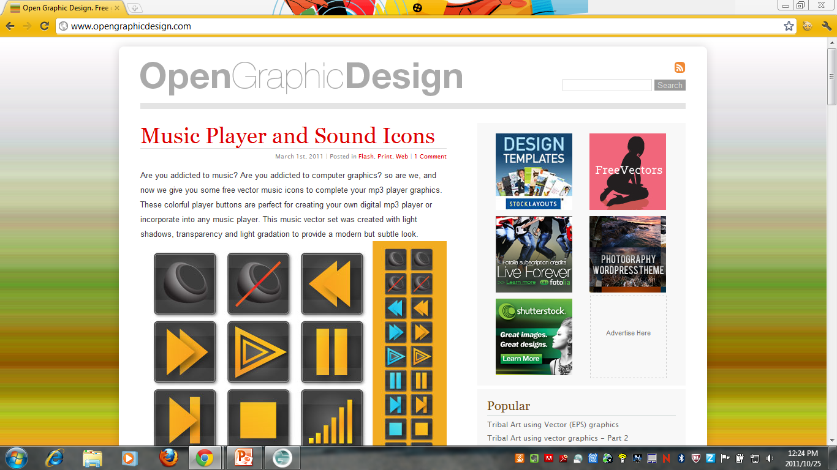
OpenGraphicDesign
Notes:
http://www.opengraphicdesign.com/
This site contains free vector images for use and adaptation and is available in terms of a Creative Commons Attribution license.
Terms of use: http://www.opengraphicdesign.com/terms-of-use/
Note: the list under “No” refers to the files as it is downloaded from the site – so particularly you’re not allowed to redistribute the files as you got them from the site.

Slide 45
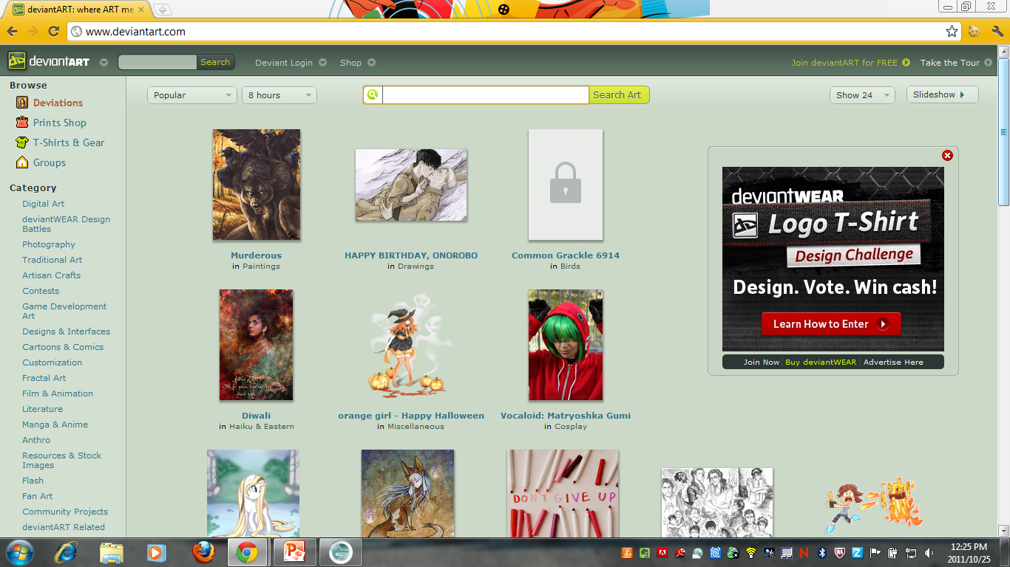
DeviantArt
Notes:
http://www.deviantart.com/
Not all the images on this site is free from full copyright restrictions so make sure to check each image.
Terms of use: http://about.deviantart.com/policy/copyright/

Slide 46

DryIcons
Notes:
http://dryicons.com/
This site offers high quality vectors and icons for free download and are governed by three different licenses depending on your intended use. For the free licensing terms go to: http://dryicons.com/terms/free/
Terms of use: http://dryicons.com/terms/

Slide 47
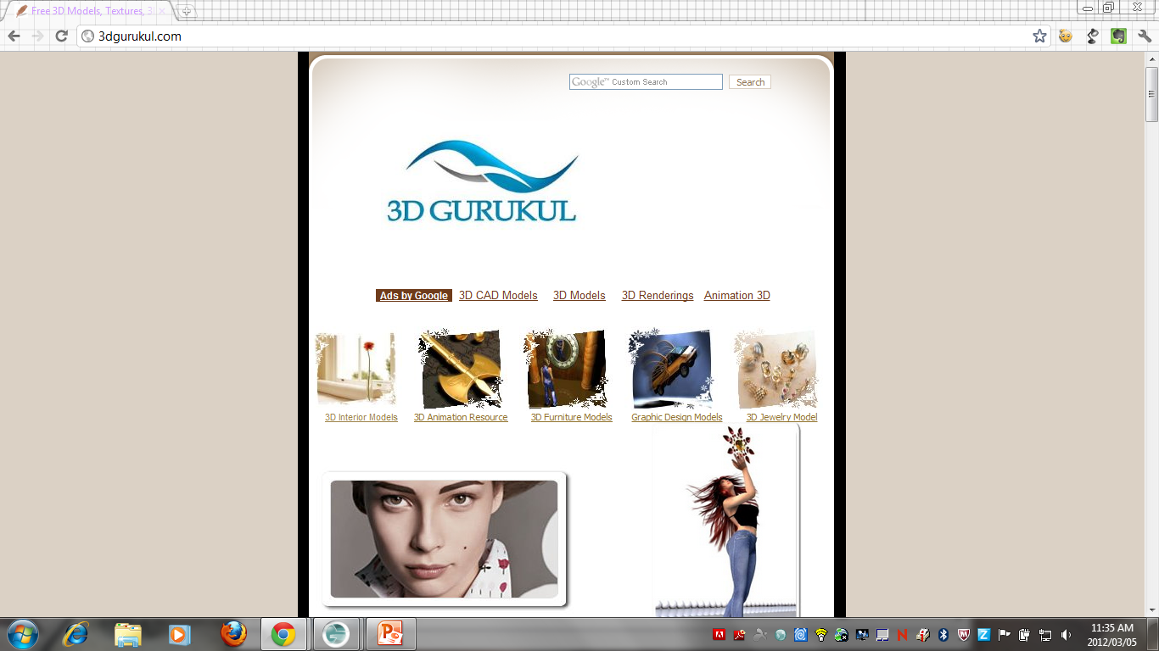
3D Gurukul
Notes:
http://www.3dgurukul.com/
The resources on this site is available in terms of a Creative Commons Attribution-Noncommercial-Share Alike 3.0 Unported license. It offers 3d animation, models, rendering and CAD models amongst others.

Slide 48
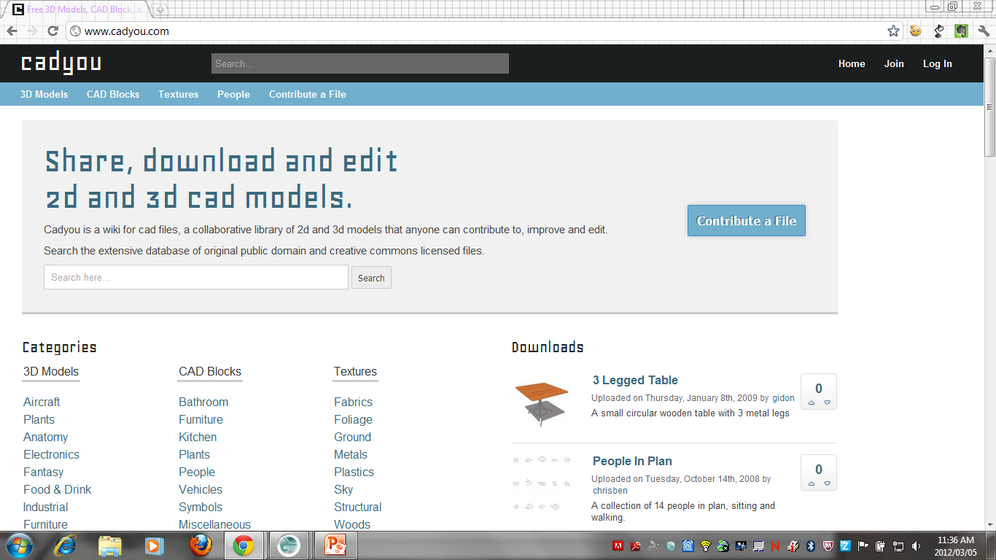
CadYou
Notes:
http://www.cadyou.com/
Cadyou is a new community for digital designers to find and share high quality 2d and 3d files. Our goal is to create a resource of free, high quality designs for everyone to use, licensed under Public Domain and Creative Commons licenses.
Even though the site’s footer contains an all rights reserved copyright notice – access each resource to view its usage terms and conditions.

Slide 49
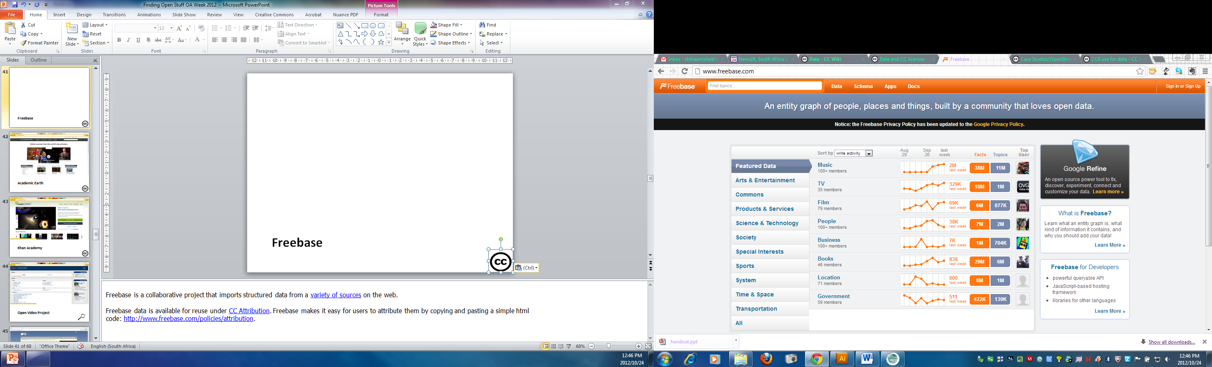
Freebase
Notes:
Freebase is a collaborative project that imports structured data from a variety of sources on the web.
Freebase data is available for reuse under CC Attribution. Freebase makes it easy for users to attribute them by copying and pasting a simple html code: http://www.freebase.com/policies/attribution.

Slide 50
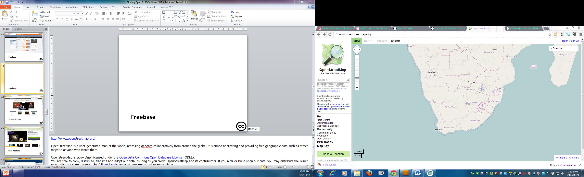
OpenStreetMap
Notes:
http://www.openstreetmap.org/
OpenStreetMap is a user-generated map of the world, amassing geodata collaboratively from around the globe. It is aimed at creating and providing free geographic data such as street maps to anyone who wants them.
OpenStreetMap is open data, licensed under the Open Data Commons Open Database License (ODbL).
You are free to copy, distribute, transmit and adapt our data, as long as you credit OpenStreetMap and its contributors. If you alter or build upon our data, you may distribute the result only under the same licence. The full legal code explains your rights and responsibilities.
The cartography in our map tiles, and our documentation, are licensed under the Creative Commons Attribution-ShareAlike 2.0 license (CC-BY-SA).

Slide 51
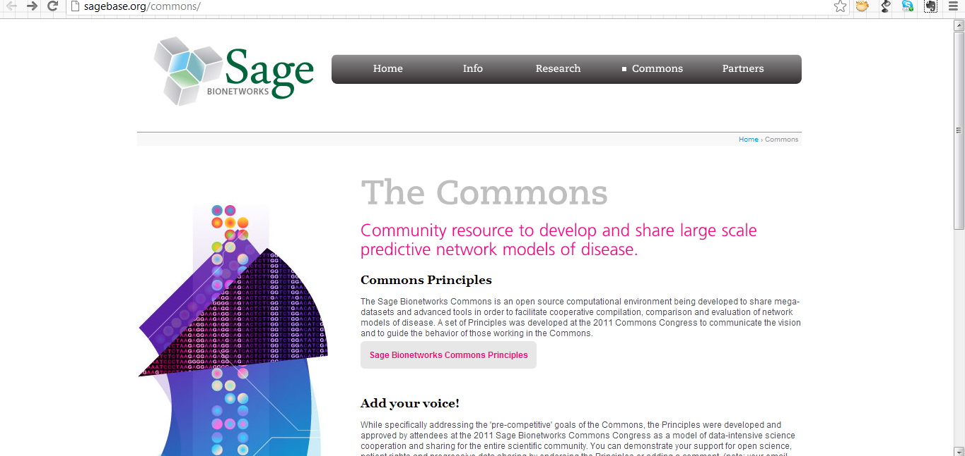
Sage Commons
Notes:
http://sagebase.org/commons/
Sage Commons is a public resource and information platform for scientists, research foundations, and research institutions to share and develop human disease and biological research.
Sagebase.org content is defaulted under CC BY. Sage Commons will enable the CC0 public domain dedication as an option for surrendering copyright in data hosted in the network.

Slide 52
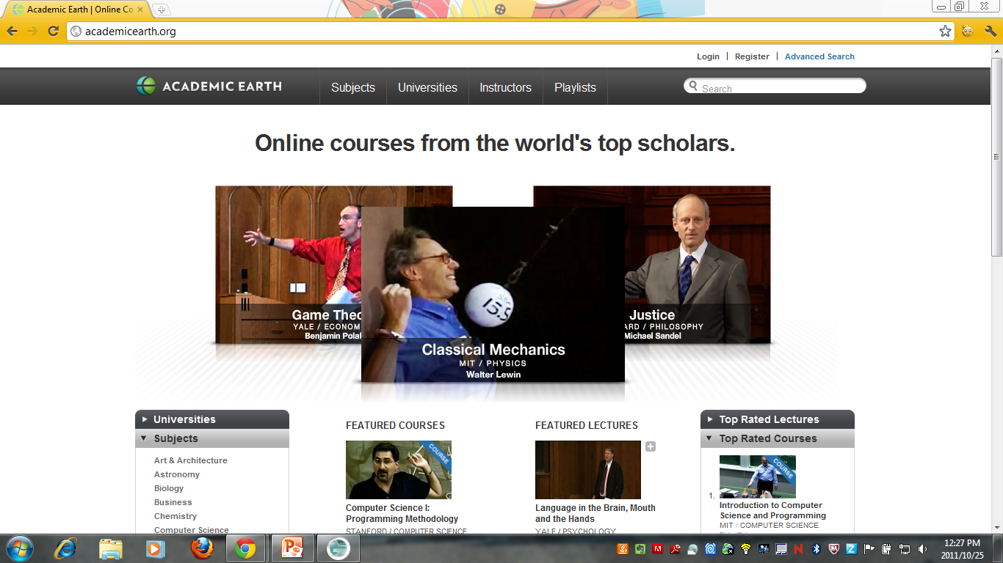
Academic Earth
Notes:
http://academicearth.org/
This site contains videos from a range of subjects and is available under various open licenses to make sure to check the video you wish to use.
Terms of use: http://academicearth.org/pages/terms-of-use

Slide 53

Khan Academy
Notes:
http://www.khanacademy.org/
This site’s resources covers a wide range of topics and caters for all educational levels – all the videos are free to use and you need to check each video you wish to use.
Terms of use: http://www.khanacademy.org/about/tos

Slide 54

Open Video Project
Notes:
http://www.open-video.org/
The site contains videos from different sources to make sure you check each video’s governing license or usage restrictions.
Terms of use: http://www.open-video.org/project_info.php
If you would like information on the implications of using videos from the internet, see: http://education-copyright.org/using-videos-from-the-internet-in-education/

Slide 55

BlocSonic
Notes:
http://blocsonic.com/
blocSonic is netlabel music, it’s creative commons music. We spotlight the best of creative commons and netlabel music. All netBloc compilations' art/booklets are released under a Creative Commons Attribution-Noncommercial-No Derivative Works 3.0 License. Individual tracks retain their original licenses and may be more restrictive. Please view compilation PDFs for complete track license information.

Slide 56

Sintel
Notes:
http://www.sintel.org
“Sintel” is an independently produced short film, initiated by the Blender Foundation as a means to further improve and validate the free/open source 3D creation suite Blender. The movie itself, and all of the work of the Durian team in the past 18 months will be released under the Creative Commons Attribution license, free for everyone to distribute, learn from or re-use. The 4-disc DVD set will provide all data to be able to recreate and rerender the film in its entirety. Read more at http://www.sintel.org/about/
View or download the movie in HD and 4K versions here: http://www.sintel.org/download

Slide 57

Common Currency Project
Notes:
http://currency.medicine.dal.ca/video.htm
These videos are licensed in terms of a CC-BY-NC-ND license and is available in various formats

Slide 58

Freesound
Notes:
http://www.freesound.org/
This site contains various sound files available to users either as public domain resources or under Creative Commons Attribution or Creative Commons Attribution Non Commercial licenses. Check the sound file you wish to use for the license.
Terms of use: http://www.freesound.org/help/faq/

Slide 59

Free music archive
Notes:
http://freemusicarchive.org/
The files on this site is available in terms of Creative Commons licenses, public domain or a custom license.
Terms of use: http://freemusicarchive.org/Terms_of_Use

Slide 60

Jamendo
Notes:
http://www.jamendo.com/en/
All the music available on this site is governed by Creative Commons licenses.
Specific search for CC licensed jamendo music: http://www.jamendo.com/en/creativecommons
Terms of use: http://www.jamendo.com/en/cgu_user

Slide 61

CCMixter
Notes:
http://ccmixter
This is a community music remixing site featuring remixes and samples licensed under Creative Commons.
See also: http://ccmixter.org/about

Slide 62

Free Loops
Notes:
http://www.freeloops.com/
This site contains files that can be used freely in music production only.
License agreement: http://www.freeloops.com/freeloops/license.phtml

Slide 63

IntraText
Notes:
http://www.intratext.com/
This site publishes a wide range of texts.
Terms of use: http://www.intratext.com/info/copyENG.htm

Slide 64

Feedbooks
Notes:
http://www.feedbooks.com/publicdomain
This site offers free public domain books for download in formats for Android tablets, IPAD, PC and Kindle.

Slide 65

Source Forge
Notes:
http://sourceforge.net/
Best site for a comprehensive list of open source software.

Slide 66

MIT OpenCourseWare
Notes:
http://ocw.mit.edu/index.htm

Slide 67

OCW Member Search
Notes:
http://www.ocwconsortium.org/en/courses/search
This site allows you to search for Open Courseware from OCW members. See the list of members here: http://www.ocwconsortium.org/en/members/members

Slide 68

OER Commons
Notes:
http://www.oercommons.org/

Slide 69

Connexions
Notes:
http://cnx.org/

Slide 70

UCT OpenContent
Notes:
The UCT OpenContent directory is the web portal for accessing open licensed teaching and learning content from the University of Cape Town.
http://opencontent.uct.ac.za/

Slide 71

xkcd
Notes:
http://xkcd.com
Cartoons available in terms of Creative Commons Attribution-Non Commercial licenses

Slide 72

Brown Sharpie
Notes:
http://brownsharpie.courtneygibbons.org
Cartoons available in terms of Creative Commons Attribution-NonCommercial-Share Alike 3.0 License.

Slide 73

Abstruse Goose
Notes:
http://abstrusegoose.com
Cartoons available in terms of Creative Commons Attribution-Noncommercial 3.0 United States License

Slide 74

Luke Surl
Notes:
http://www.lukesurl.com/about
The low resolution artwork which appears on the site is licensed under a Creative Commons Attribution-NonCommercial-ShareAlike 2.0 UK: England & Wales License, which allows for non-commercial use of the images and works derived from the image, as long as attribution is given. Sharing the comics on blogs and social networks is encouraged, but please provide a link to lukesurl.com (or, even better, the specific page of the comic). If you see a cartoon of mine being used in a blog without attribution, please let me know and I will contact the blog owner.

Slide 75

Frustrated Bunny
Notes:
http://www.frustratedbunny.com/
Frustrated Bunny by Mike Bonales is licensed under a Creative Commons Attribution-NonCommercial-NoDerivs 3.0 Unported License.
Other open licensed cartoons: http://education-copyright.org/list-of-open-licensed-cartoons/

Slide 76
Bitstrips
Notes:
http://www.bitstrips.com/
Create your own cartoons and use them in your presentations! When creating the cartoons you agree to release them under a Creative Commons Attribution-Noncommercial-Share Alike 3.0 Unported license.
Terms of use: http://www.bitstrips.com/terms.php

Slide 77

This work is licenced under the Creative Commons Attribution 2.5 South Africa License. To view a copy of this licence, visit http://creativecommons.org/licenses/by/2.5/za/
or
send a letter to Creative Commons, 171 Second Street, Suite 300, San Francisco, California 94105, USA.

