Slide 2

Openness in Higher Education: Open Education Resources
Glenda Cox

Slide 3


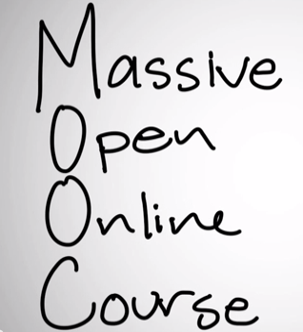
No cost
Degrees of openness depends on rights of the licence that the creator of content has granted to the user.
http://www.moddou.com/
Notes:
What is the meaning of “open” in education?
Open in the sense that there is access to education eg. The Open University in the UK. It is not free but anyone can sign up.
Open education and OER are taking this further to mean access and free
Massively open online courses (MOOCs) are accessible to everyone, not always free and many materials are copyrighted and closed

Slide 4
Open Educational Resources
Open Content / Open educational resources (OER) / Open Courseware are educational materials which are discoverable online and openly licensed that can be:
Shared freely and openly to be…
… redistribute and share again.
Shared
Redistributed
Used
… used by anyone to …
… adapt / repurpose/ improve under some type of license in order to …
Improved
Notes:
The key aspect of an OER is that it is both discoverable online – so that people can find it AND openly licensed - so that people can legally make use of it. OER includes texts, different forms of media, ideas, as well as documented teaching strategies/techniques or practices.
Advocates of openness would suggest that the value in OER is in its potential to support learning in many ways and in many contexts.

Slide 5
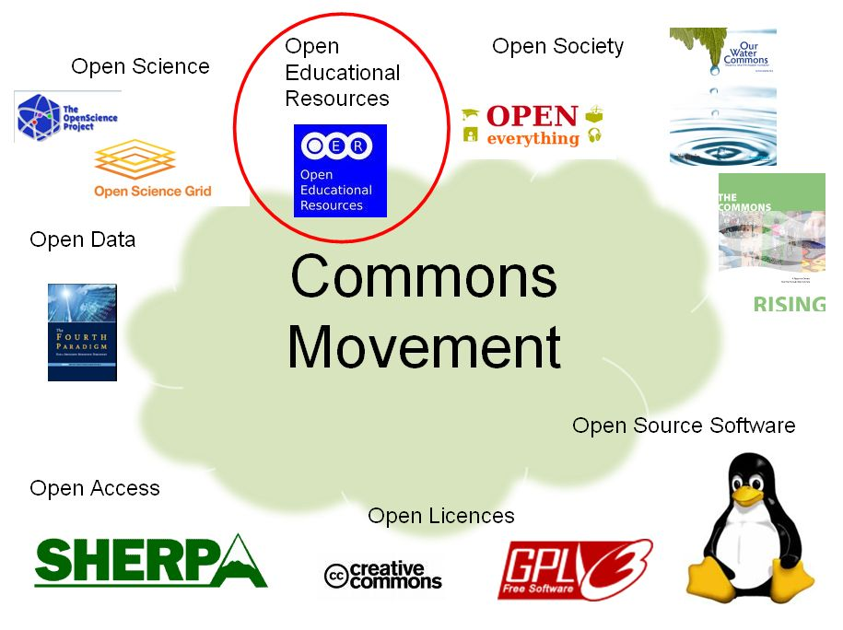
The commons movement

Slide 6
OER Movement internationally

Slide 7
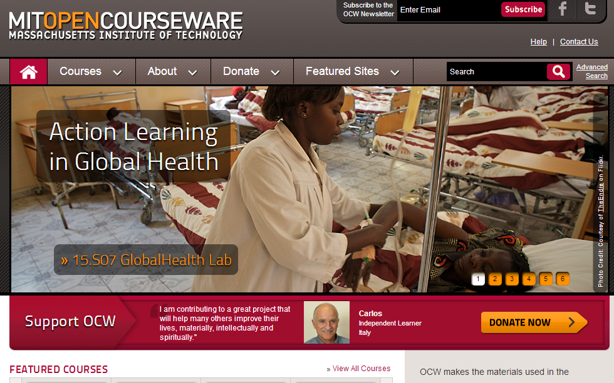
Notes:
How is OER emerging around the world?
In the late 1990s MIT was considering how it could use the Internet to potentially increase their revenue, but after a lengthy study which concluded that for a campus-based university such as theirs where the key was the hands-on engagement of students alongside researchers that it would not be possible to simulate this environment online. The then president of MIT, Charles Vest, is reported to have thought: … “is we are not going to try to make money from our educational material, maybe we should just give it away” (Attwood 2009)
To date they have 2000 of their courses as well as specific introductory courses that are suitable for high schools available on their site free of charge to use.
This of course does NOT mean that you can get a qualification from MIT this way – these are merely the teaching resources, not the complete educational experience that MIT offers.
This MIT development has spawned the Open Course Ware Consortium (http://www.ocwconsortium.org/members/consortium-members.html) which now boasts members from

Slide 8





















Some members of the Open Courseware Consortium (Open Education Consortium)
http://ocwconsortium.org
Notes:
More than 250 institutions and afflilated organistations

Slide 9
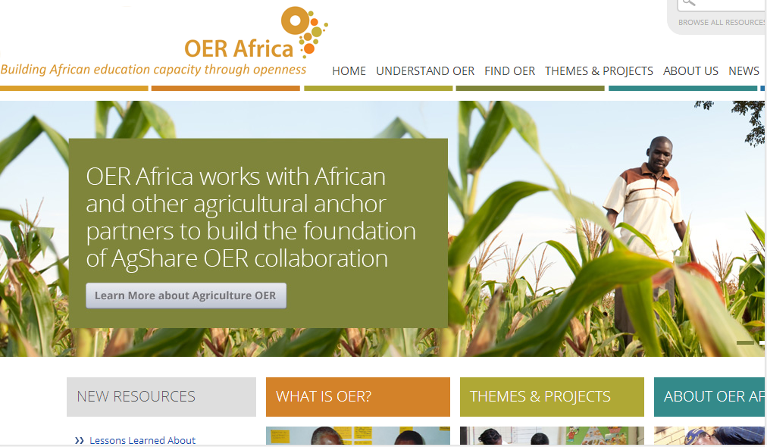
Notes:
In Africa we have the newly developed OER Africa specifically catering for OER for African Academics

Slide 10
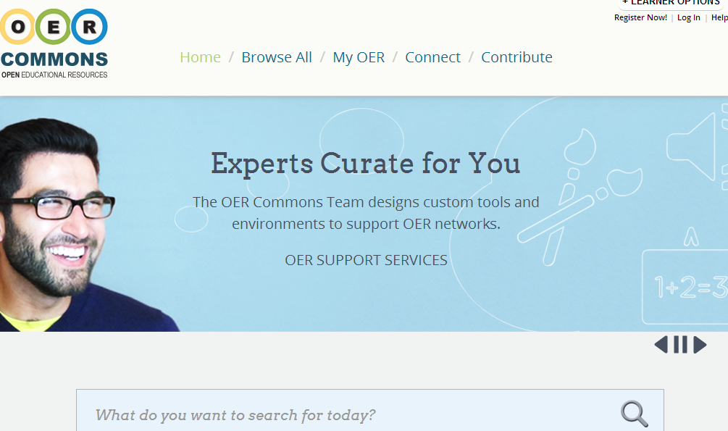
Notes:
OER Commons is a portal which links to other OER sites – e.g. MIT, OU and even UCT

Slide 11
OER at UCT

Slide 12





Open agenda at UCT
Scholar
Scholar
Scholar
Scholar
Student
Community
2007
Opening Scholarship
2008
2009
2010
2011
2012
Scholar
2013
2014
Scholar
Notes:
Scholar to scholar and scholar to community- traditional sites of open access movement
Scholar student – traditional site of elearning

Slide 13
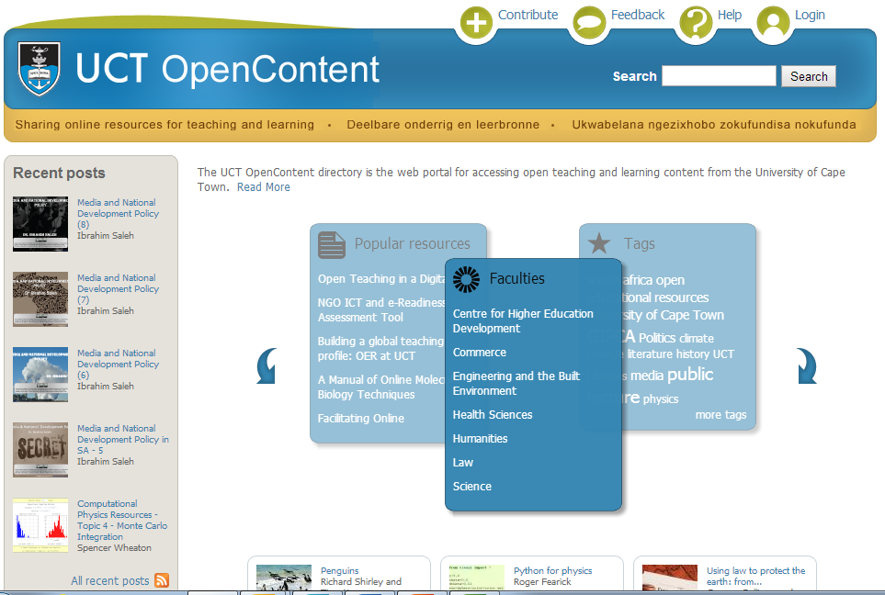
OER from UCT: OpenContent

Slide 14
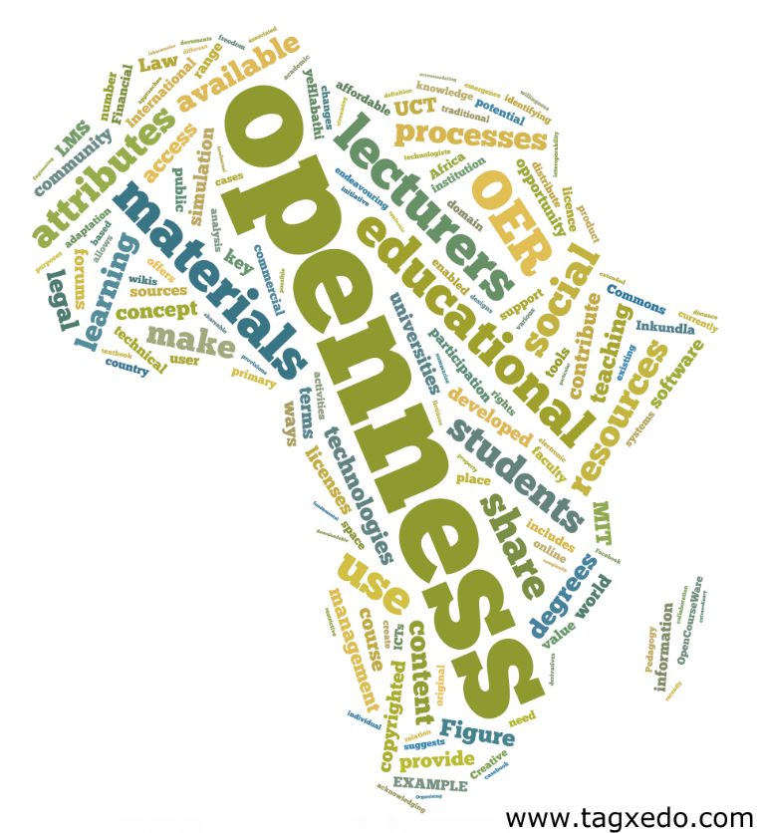
+200 000 visits
184 countries
UK: 6800
Germany: 1802
USA: 24 000
India: 7300
Philippines: 2400
Brazil:1750
Australia: 2152
South Africa
102 000

Slide 15
Resources by Faculty

Slide 16
Types of OER

Slide 17
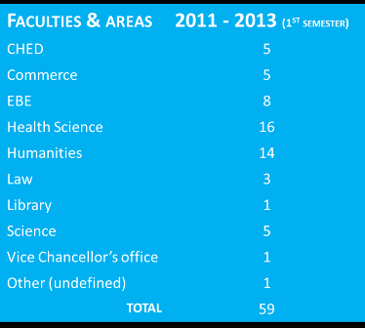
OpenUCT OER grants
15 grants still being worked on. So far 53 resources have been added.
Final round end March

Slide 18
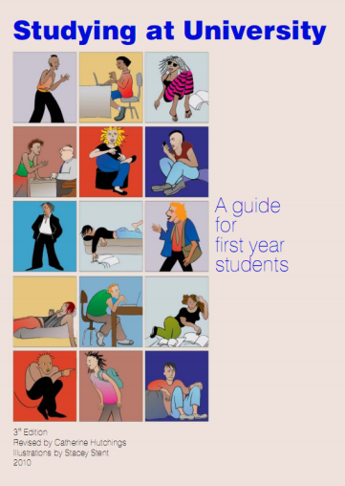
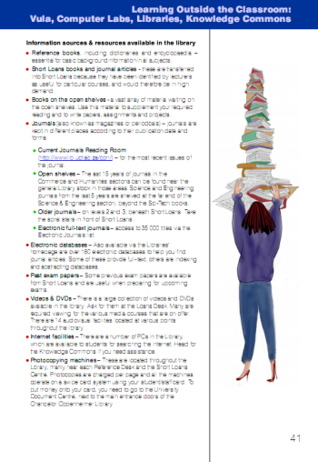
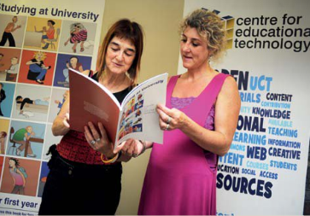
Studying at University: A guide for first year students
Used by Venda University and the University of the Western Cape with new students
Stellenbosch University uses some of the illustrations
The guide has been accessed over 6200 times via the directory and over 600 physical printed guides have been sold!

Slide 19
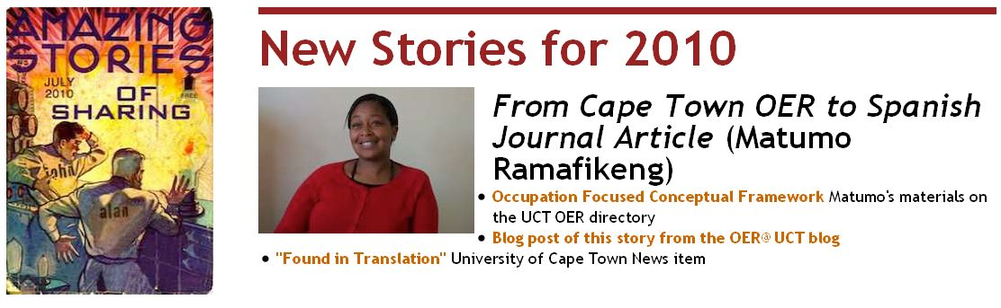
OpenContent becomes a Journal Article
Materials published as OER on OpenContent selected for publishing in the Journal of Occupational Therapy of Galicia, an open access journal for occupational therapists in the Spanish speaking world
http://blogs.uct.ac.za/blog/oer-uct/2010/12/06/sharing-knowledge-leads-to-opportunities

Slide 20
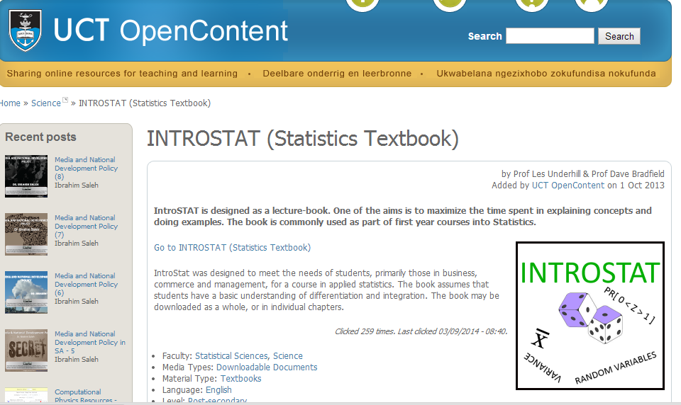
VC’s Student project (32 added more to come…)

Slide 21
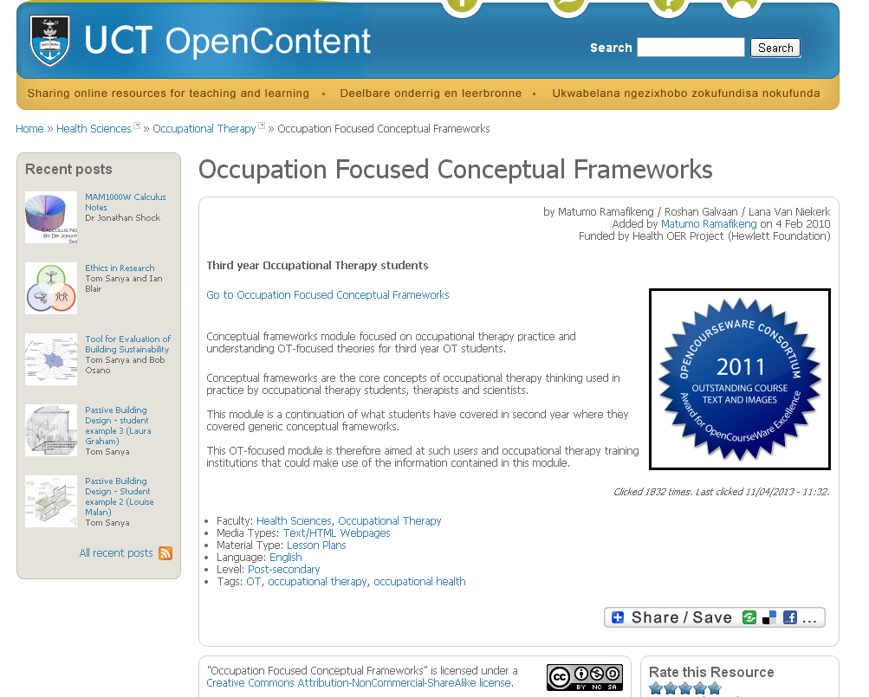
OCWC AWARD winners

Slide 22
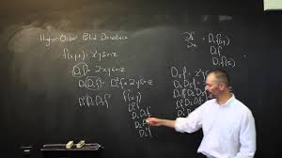
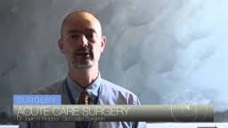
OCWC Educator award
Over 200 000 views
Dr Juan Klopper (FHS)
“I’m honoured to announce that I have been awarded the Open CourseWare Consortium 2014 Award for the category Individual Educator for my work on open education.
Previous award winner, Walter Lewin, Physicist at MIT, has been an inspiration and hero of mine and to be a recipient of the same award, is a truly humbling experience for me” http://www.juanklopper.com/
Notes:
EDUCATOR AWARD
The Educator award recognizes an educator who actively develops and/or uses open educational resources in creative and significant ways over a sustained period of time.

Slide 23
Feedback
Dear Course Moderator, Thank you so much for considering to provide Initial French Lessons through this medium. I found it very useful for my pursuit towards learning French language.
………………………
Hi Ms. Cox,
Greetings!
I am in India. The usefulness of online media is this, you have students from all over the globe. Thanks for asking.
Loveson
this site is priceless
this is my first visit, and i'm very impressed.
i really appreciate the idea of the site as i'm Syrian ENT fresh graduated doctor, and it's not that easy to get and afford the textbooks that you need.
i've already shared your site with colleagues in order to spread the knowledge.
thanks again
yours sincerely
Helal Alsaleh

Slide 24
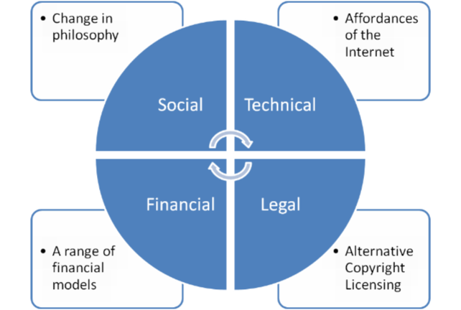
What are the enablers of OER?
Some evidence: Quotes from academics at UCT

Slide 25

Philosophy
Enabler
Constraint
Lack of awareness
Institutions are not always supportive of sharing
Individual academics need to believe in the value of sharing
Notes:
The Open Source Software movement led the way in showcasing the value of openness and the ‘architecture of participation’ (O’Reilly 2003)
OER is based on the philosophical view of ‘knowledge as a collective social product and the desirability of making it a social property’ (Prasad & Ambedkar cited in Downes 2007:1)

Slide 26

Technical
Enabler
Constraint
Not everyone has access
Digital divide between Global south and North
Lack of ability and skills
http://en.wikipedia.org/wiki/File:Internet1.jpg
Notes:
OER is premised on the simple and powerful idea that the world’s knowledge is a public good and that technology in general and the World Wide Web in particular provides an extraordinary opportunity for everyone to share, use, and reuse knowledge’ (Hewlett Foundation)

Slide 27

Financial
Enabler
Constraint
Support from external funders like Shuttleworth and Mellon is temporary
After seed funding institutions must then take over
http://www.flickr.com/photos/59937401@N07/5856660723/
Notes:
Donor funding – e.g. Hewlett Foundation
Marketing budget – e.g. Open University
Commission – e.g. MIT and Amazon
Endowment – e.g. Stanford Encyclopedia of Philosophy
Membership – e.g. Sakai Consortium
Government – e.g. UK £7.8 million grant

Slide 28

Legal
Enabler
Constraint
Academics are not aware of Creative Commons or how Creative Commons works
They are not that concerned about their Intellectual property ( although they do want attribution) but they are very concerned about infringing the copyright of others
“So actually I think you’re more protected if you make something legitimately an OER and then somebody else uses it.”
Notes:
Creative Commons
Copyright management solution that clarifies how resources can be used.
“So actually I think you’re more protected if you make something legitimately an OER and then somebody else uses it.”

Slide 29
Factors impacting OER
Cultural
Philosophy of openness.
Altruism
Structural
Technical-affordances of the internet
Legal-alternate copyright licensing
Individual
Pedagogy
Quality
Financial-models

Slide 30


Pedagogy
Creation: interactive teaching styles do not always result in online materials
Use: difficult to find relevant OER

Slide 31

Quality
“.. I think it will make everyone go over it two or three times, ya.”
If they’re ready for students to see, then they’re as ready as they’re going to get.
I think that each individual preparing their materials must be sure that their material is substantively correct, sound or critical.
they don’t look good enough to put out there
“But I would love to be able to give what I had to somebody and say does it… it’s sort of like is there cohesion, does it make sense”
Notes:
There is a general feeling that quality will improve if materials are available for peer scrutiny
But there are concerns about the readiness of materials
That some materials may be of poor quality
Different views on a quality check: one says up to author and user /other says a quality check would protect the institution and the individual

Slide 32
Complex interplay between factors impacting OER
Cultural
Philosophy of openness.
Altruism
Structural
Technical-affordances of the internet
Legal-alternate copyright licensing
Individual
Pedagogy
Quality
Financial-models

Slide 33
Why oer? What are the potential benefits of OER?

Slide 34
Global challenges in Higher Education
Increasing demand for education and insufficient institutions
Increasing cost of Higher education and text books
Increasing Competition
Asymmetries of power and wealth and curriculum from the Global North favoured over the Global south
Variable quality in teaching

Slide 35



Challenges for South Africa
Crisis in Basic education
Skills shortage/’persistent human Capital gap” (Taylor, 2011)
Higher education: high school graduates of varied ability
Higher education institutions quality variable
Notes:
Poor performance compared to comparator countries eg. 2007 Sample of Grade 6 reading and maths in the bottom half of 15 African countries
In terms of equity _gross inequalities with poorer kids receiving inferior schooling.
Higher Education
Ill prepared first year entrants
Poor throughput rates: low graduation rates ( partially influenced by UNISA the largest institution- rate of 9% in 2008. The total undergraduate rate was at 16% in 2009!

Slide 36


Slide 37
Why now for departments?
Increase institutional visibility, advancing competitiveness, attracting students and resources
Promote effective social responsiveness
Improve learning experience by selecting materials in pedagogically sound and innovative ways
Improve recruitment by helping the right students find the right programmes
Enhance teaching coherence across courses
Ensure better long-term archiving, curation and reuse of teaching materials
Attract alumni as life-long learners

Slide 38
Why now – individually?
Profile teaching and pedagogical idea sharing
Create record of teaching for teaching portfolio
Foster connections between other colleagues, departments and even other universities (especially cross-disciplinary studies)
Increase impact of teaching materials
Extend use of teaching materials to high school learners and life-long learners
Individual
Notes:
Lets drill down and talk about what this means to us as academics in the information age.
Why is this important?
OER allows us to profile and highlight our teaching and pedagogical ideas online (in addition to research)
It creates a record of our teaching material and leads to the development of teaching portfolios – essentially building a teaching profile in addition to your research profiles
Having our material online may foster connections between other colleagues, departments and even other universities especially cross-disciplinary studies.
It can increase the impact of our teaching materials and help us attract the right students by giving them some idea of what we teach at UCT
It may also extend the use of teaching materials to high school and life-long learners
38

Slide 39
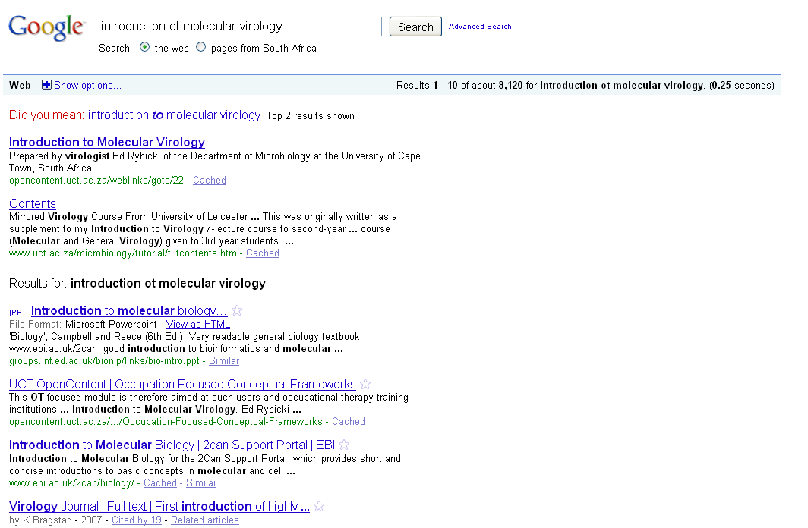
Increasing Visibility

Slide 40
Conclusion
Amazing work globally (eg COL, UNESCO)
OER repositories, networks and research continues to grow
Opportunity to use OER’s in MOOCs
Amazing opportunity to share resources across the world across the Global south, North to South but also North to South

Slide 41
Prepared by: Glenda Cox. Glenda.cox@uct.ac.za
Some of the slides were created by Michael Paskevicius : mike.vicious@gmail.com
OpenContent Directory: http://opencontent.uct.ac.za
OER UCT project blog: http://openuct.uct.ac.za/blog
Follow us: http://twitter.com/openuct

Slide 42

This work is licensed under the Creative Commons Attribution-Share Alike 2.5 South Africa License. To view a copy of this license, visit http://creativecommons.org/licenses/by-sa/2.5/za/ or send a letter to Creative Commons, 171 Second Street, Suite 300, San Francisco, California, 94105, USA.

