Slide 1
MOOCs
A UCT Discussion
Laura Czerniewicz
Sukaina Walji
Janet Small
Andrew Deacon
31 March 2014

Slide 2
Introduction

Slide 3
MOOCs- open & online
Open content
MOOC
Online courses

Slide 4
 | Open content | MOOC | Online course
Cost to user (for access) | Free |  | Student pays fees
Scale | Granular, single objects to courses |  | Small(er) scale
Entrance requirements | No |  | Yes, likely, just as for f2f courses
Interaction with lecturers and peers | No, content only |  | Yes, in variable ways
Providers | Many traditional universities, but other providers |  | Traditionally distance education providers
Analytics and automation | No |  | No, limited to date, as they tend to run on traditional LMS’s
Certification | No |  | Yes, equivalent to f2f
Synchronous (time limits) | Stand alone |  | Start date and end date, asynchronous within
Copyright | Open licenses (e.g. Creative Commons) or public domain |  | Generally proprietary, using textbooks as f2f courses do, may include some open content
Free
Free
Massive
Massive
No
No
No
Variable
Variable
Residential universities
Private-university partnerships
Residential universities
Public private partnerships
Yes
Yes, advantageous
No, not conventional
No, or not conventional
Start & end date, asynchronous within
Start & end date
Asynchronous within
Variable, open content not automatic, user generated content generally belongs to MOOC owner
Variable, open content not automatic, user generated usually belongs to MOOC provider

Slide 5
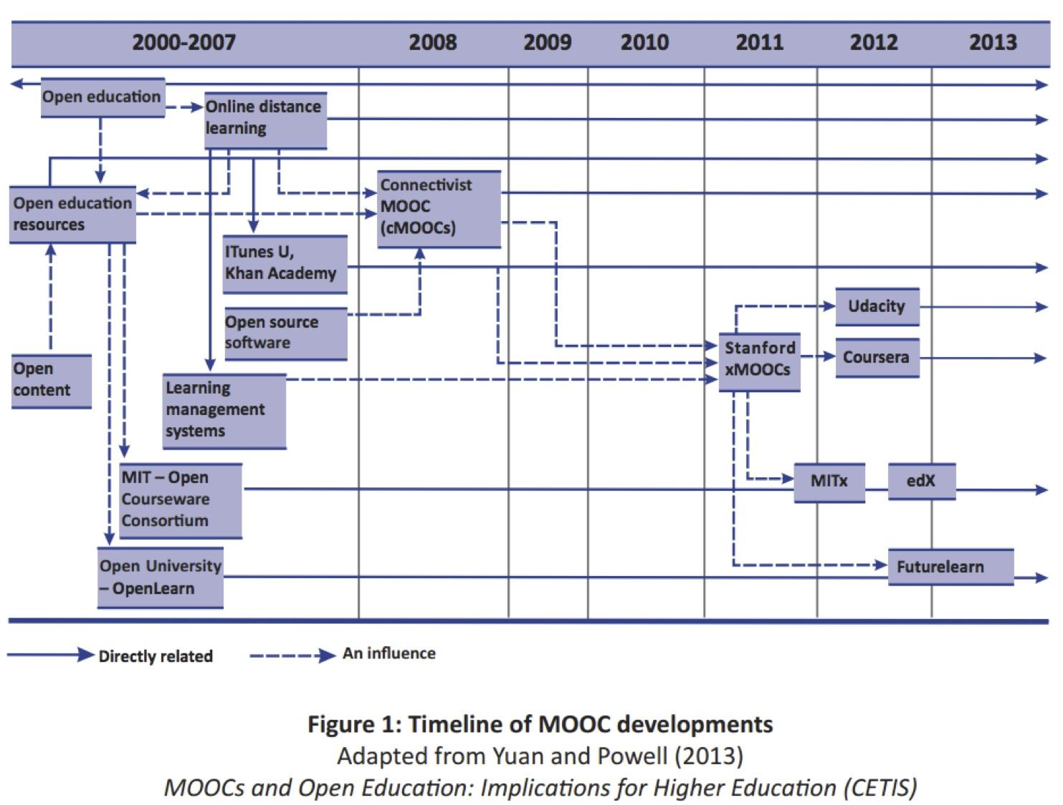
MOOCs didn’t just appear

Slide 6

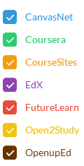
April 2012
http://edutechnica.com/moocmap
Notes:
http://edutechnica.com/moocmap

Slide 7
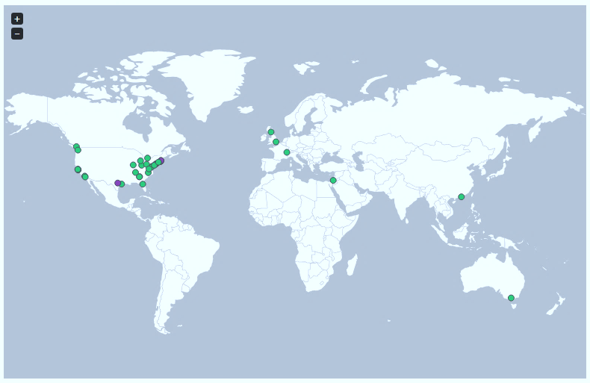
October 2012
http://edutechnica.com/moocmap
Notes:
http://edutechnica.com/moocmap

Slide 8
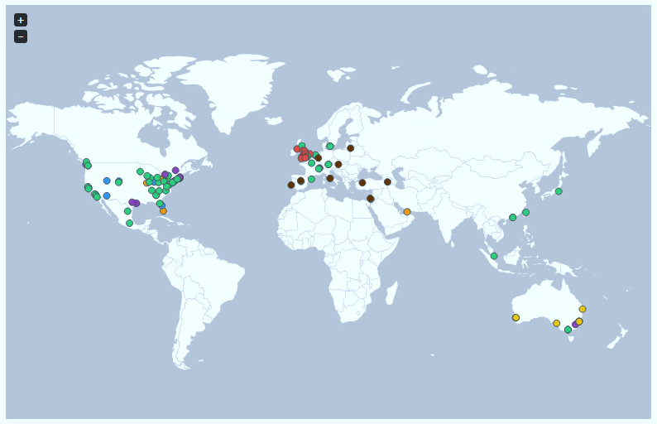
April 2013
http://edutechnica.com/moocmap
Notes:
http://edutechnica.com/moocmap

Slide 9
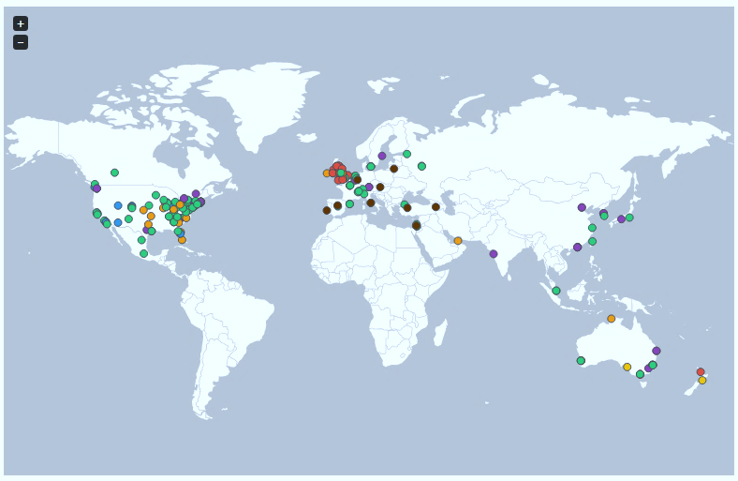
October 2013
http://edutechnica.com/moocmap
Notes:
http://edutechnica.com/moocmap

Slide 10
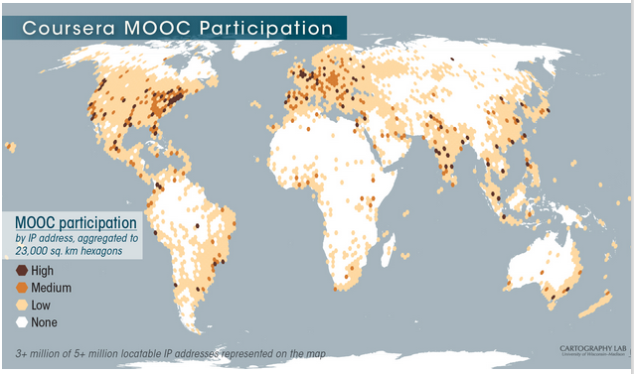
Participants

Slide 11
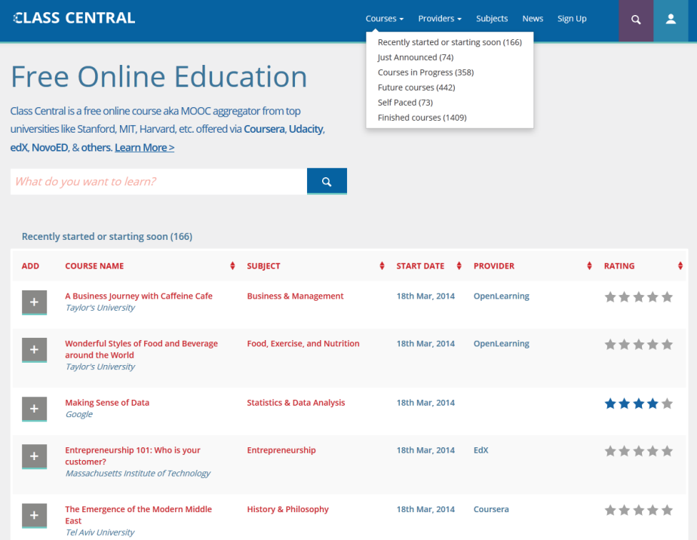
= 2522

Slide 12
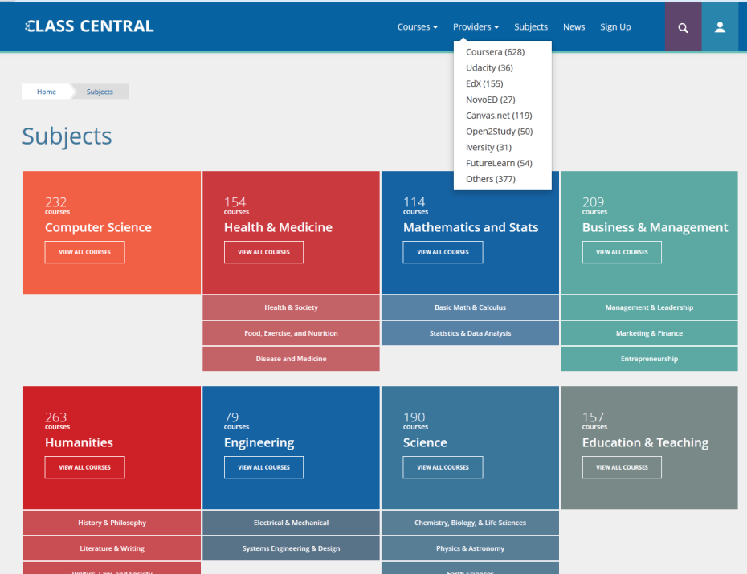

Slide 13
Value
Innovate & experiment in online education
  Learnings support pedagogy in general within the university
  Greater understanding of specific areas eg IP and access
  Preparing for the future
Support strategic goals of outreach, knowledge in service to society
University reputation and branding
Attract students
For UCT: African expertise
Reports from MIT, Edinburgh, Duke, Uni London, Uni Illinois
Notes:
UNIVERSITY OF EDINBURGH , MOOCs @ Edinburgh 2013 – Report , 10 May 2013, (https://www.era.lib.ed.ac.uk/handle/1842/6683)
The Pedagogy of the Massive Open Online Course: the UK view, Bayne, S & Ross,j. University of Edinburgh, The Higher Education Academy
2013
UNIVERSITY OF LONDON, Massive Open Online Course Report 2013 , University of London International Programmes
http://www.londoninternational.ac.uk/sites/default/files/documents/mooc_report-2013.pdf
UNIVERSITY OF LONDON, Massive Open Online Course Report 2013 , University of London International Programmes
http://www.londoninternational.ac.uk/sites/default/files/documents/mooc_report-2013.pdf
DUKE UNIVERSITY, Bioelectricity: A Quantitative Approach Duke University’s First MOOC , February 5, 2013
Yvonne Belanger Duke Center for Instructional Technology , Jessica Thornton Office of the Provost
MIT INSTITUTE-WIDE TASK FORCE ON THE FUTURE OF MIT EDUCATION—PRELIMINARY REPORT

Slide 14
MOOC options and opportunities

Slide 15

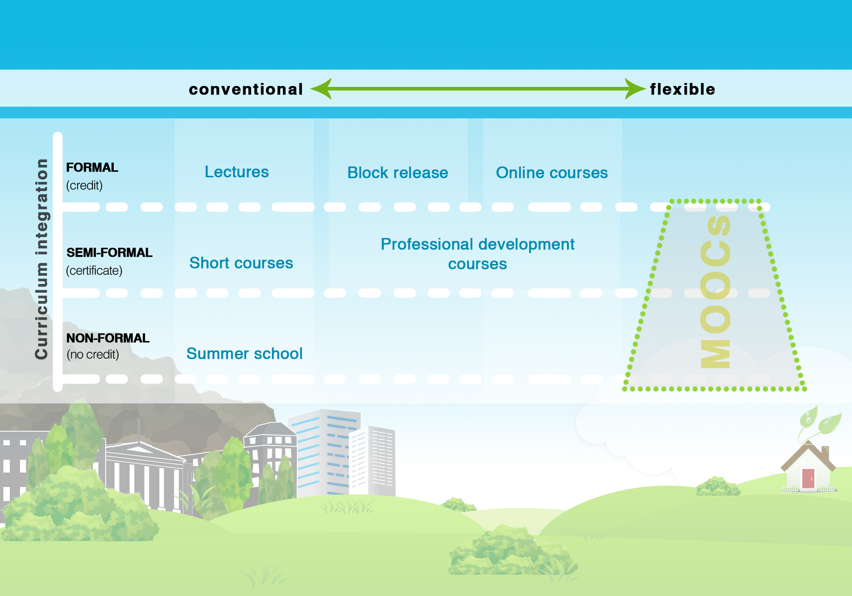

Slide 16
e.g. most degrees
e.g HS courses
e.g BUS courses
e.g Global Citizenship
e.g Write Science courses
e.g. GetSmarter coueses

Slide 17
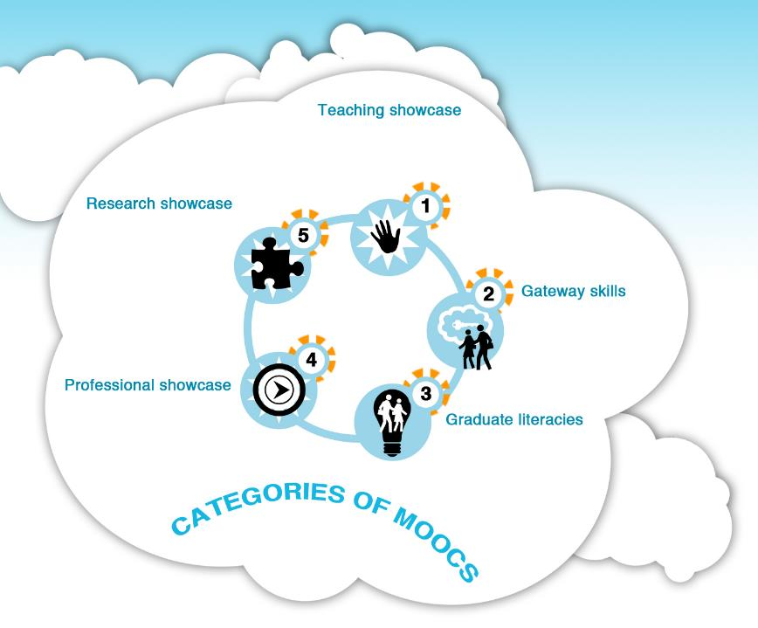

Showcase teaching and introduce topics with high-profile ‘rockstar’ presenters
Showcase research and special interest topics of interest to postgraduate level
Introduce fields and support students in undergraduate study
Showcase professional careers for continuing education and qualifications
Develop skills and introduce topics for postgraduate study.

Slide 18

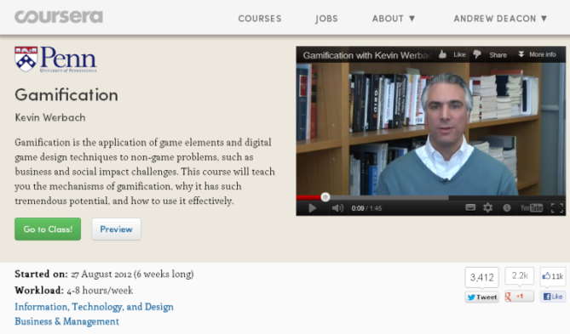
Category 1 Teaching showcase
General interest high profile course
Showcases the institution by means of an engaging subject or personality led.
Global interest and matches a popular understanding of high profile MOOCs
n
High production costs | high enrollment | loose curriculum ties
May attract external funding

Slide 19
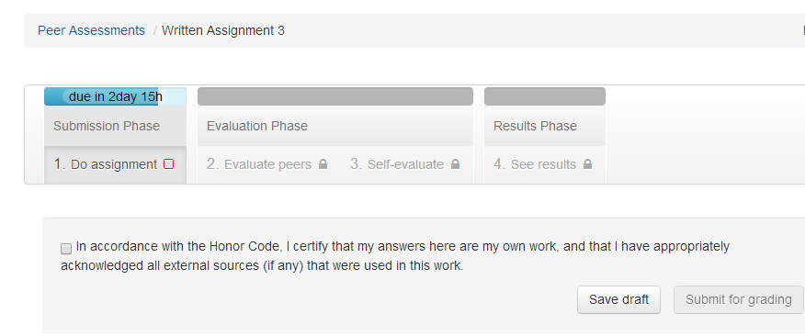
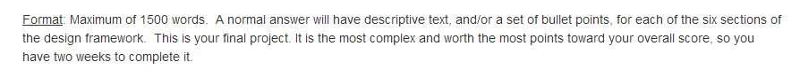
Category 1 Teaching showcase
General interest high profile course
Showcases the institution by means of an engaging subject or personality led.
Global interest and matches a popular understanding of high profile MOOCs
n
High production costs | high enrollment | loose curriculum ties
May attract external funding

Slide 20
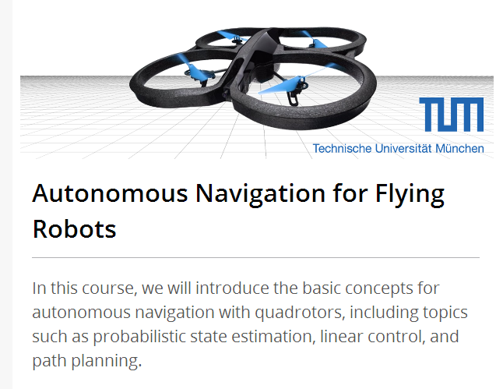
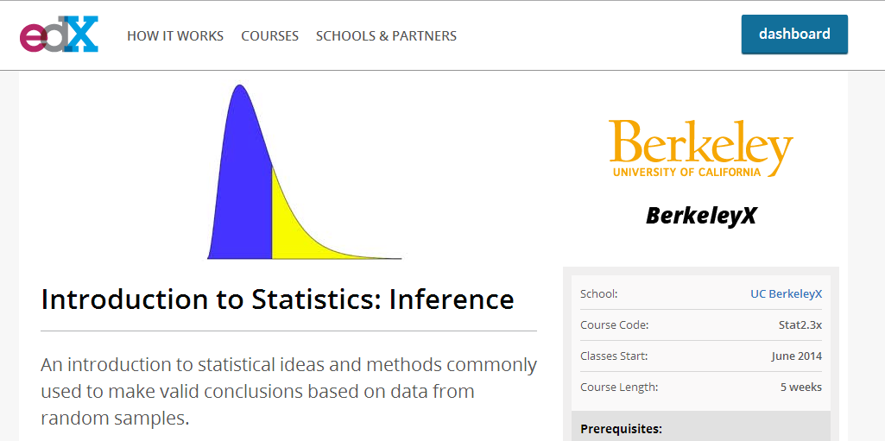

Category 2 Gateway skills
Provides foundational, bridging or enhancement skills for pre HE entry or during undergraduate pathways towards specialisation.
Could replace teaching for 'bottleneck courses.’
Local interest, either within the institution or at a country-wide setting.
Moderate production costs | low enrollment | close curriculum ties
May attract external funding |

Slide 21

Category 3 Graduate literacies
Post-graduate level courses to support application or programmes of study
Focussed on building postgraduate literacies.
Likely to be of local or national interest.
Moderate production costs | low enrollment | close curriculum ties
May attract external funding

Slide 22

Category 4 Professional showcase
Geared towards vocational skills development, re-tooling and professional development.
Could be offered in conjunction with professional bodies.
Likely to be of local interest, although some specialised topics may be globally relevant. .
Moderate to high production costs |medium to high enrollment
Close curriculum ties |May attract organisational funding
High potential for pathway to credit or revenue generation

Slide 23

Category 5 Research showcase
Showcase research or more specialised topics of interest
Offered at postgraduate level and assume some background in the topicstill geared towards general or leisure learning.
Likely to have global appeal.
Moderate/high production costs | medium/high enrollment
Loose curriculum ties

Slide 24

Category 5 Research showcase
Showcase research or more specialised topics of interest
Offered at postgraduate level and assume some background in the topicstill geared towards general or leisure learning.
Likely to have global appeal.
Moderate/high production costs | medium/high enrollment
Loose curriculum ties
Notes:
The types of activities in these types of MOOCs may be more activity or project-based with peer review and assessments also forming an important part of the learning experience.

Slide 25



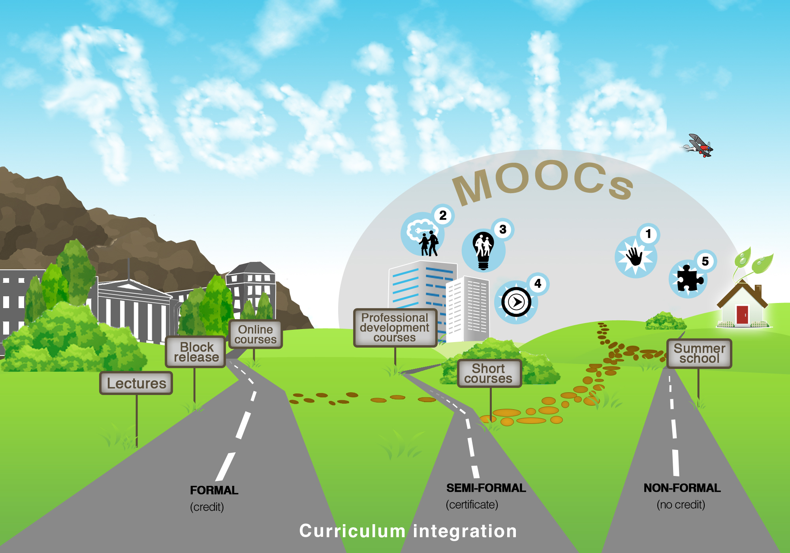





Notes:
Landscape re-imagined with MOOCs and now in the picture.

Slide 26
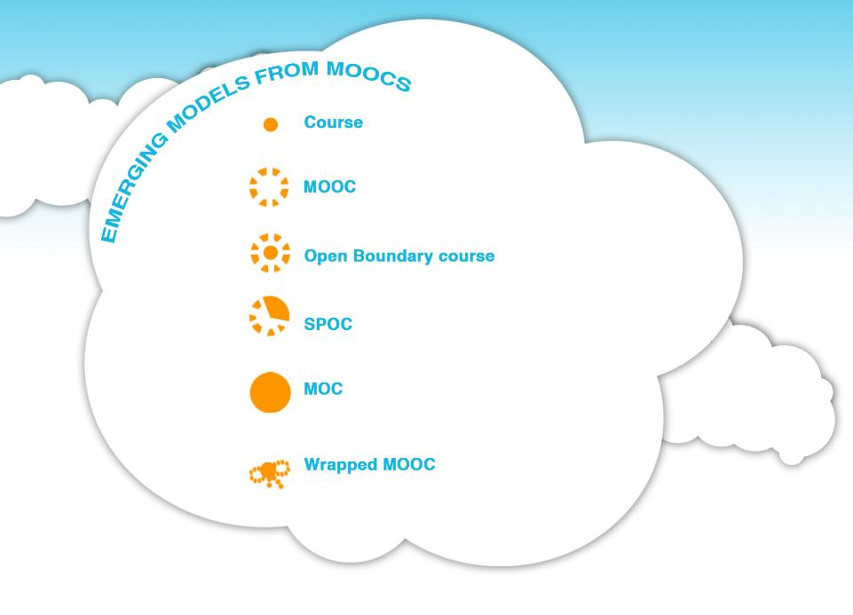
Formal course with lectures and support.
Massive Open Online Course
Course offered simultaneously as a formal and as a open course.
Small private open course nested inside a MOOC
Massive Online Course: formal course inspired by MOOC pedagogy
Students in a course taking a MOOC with added local support and additional material
Notes:
Movement between formal, semi-formal and non-formal domains allows for experimentation of course offering. Variant types of course offerings are emerging from MOOC experiments, either as a result of limitations of MOOCs or as a result of ideas emanating from MOOC pedagogy.

Slide 27
Wrapped MOOCs at UCT
Time | Topic
Group meets every -Monday for 5 weeks | Critical Thinking in Global Challenges https://www.coursera.org/course/criticalthinking
Group meets every -Thursday for 5 weeks | Principles of Written English https://www.edx.org/course/uc-berkeleyx/uc-berkeleyx-colwri2-2x-principles-1348
Group meets every -Monday for 6 weeks | Understanding Research: An Overview for Health Professionals https://www.coursera.org/course/researchforhealth
Group meets every second Wednesday for 5 weeks | Model Thinking https://www.coursera.org/course/modelthinking
Group meets every Monday for 6 weeks | Design and Interpretation of Clinical Trials https://www.coursera.org/course/clintrials
Group meets every Wednesday for 10 weeks | Data Analysis and Statistical Inference https://www.coursera.org/course/statistics
Group meets every Thursday for 6 | University Teaching 101 *NEW* https://www.coursera.org/course/univteaching101

Slide 28





Slide 29
Discussion
Why do you want to create a MOOC?
What are your interests?
What brought you here?
Why don’t you want get involved in creating a MOOC?
What are your concerns?

Slide 30
Practicalities

Slide 31
Imagining MOOCs
The six ‘P’s approach:
purpose
possibilities
pedagogy
platforms & partners
provisioning
process to roll out

Slide 32
Purpose
Broad institutional goals
Using the MOOC categories
Department / faculty goals
Individual goals

Slide 33
Possibilities
Having decided on audience, purpose and category - what are the possible topics?
Make a proposal for an actual MOOC (or variant) – develop a concept

Slide 34
Pedagogy
How you want your MOOC to be taught online? (which will depend on your target audience, course purpose and expected learning outcomes, as well as costs and possibly platform affordances)
Notes:
Part of the concept would have to include a consideration of how we expect people to learn on this course – linked to audience needs and expected learning outcomes

Slide 35
Platform and Partners
Which platform partner will suit your MOOC and work best for UCT?
Other stakeholders and funders

Slide 36
Provisioning
Two levels:
1. Institutional - applies to all Massive Online courses at UCT
2. Course level – applies to each course
Notes:
INSTITUTIONAL: (linked to platform)
contract agreements with the platform partner (including licensing provisions for institution and individual academics)
- regulatory environment within UCT (how it will fit within UCT short courses policy)
- video & learning materials production capacity
- systems for quality assurance; monitoring and evaluation (institutional research so we can learn from the process)
COURSE LEVEL (linked to choices about pedagogy)
funds for academic and support staff (put in some costs - variability) Quotes about how expensive it is
- negotiating academic’s time (between 200 & 500 hours during production & delivery)
- dedicated course support team (eg. graduate students?)
- lining up production capacity (CILT) including online curriculum developers, learning technologists, learning materials developers, video production and editing equipment and personnel
- materials identification - copyright clearance of all materials - use of suitable OERs

Slide 37
Process & roll-out
identifying an academic or team of academics willing to devote the necessary time to the project
constituting a course development team (CILT staff, academics & student assistants from department who will be offering course)
initiate course design
course production schedule
test materials
launch course
Running/supporting/monitoring
Evaluation

Slide 38
What to expect
The key themes:
sheer workload involved in planning and developing the content,
the resources required for video production on top of the individuals’ ‘regular’ jobs.
Creating effective strategies to manage the large number of participants in the MOOC forums was also reported as a challenge.
University of London 2013 report on MOOCs

Slide 39
Considerations - opportunities
EdX has already enabled MIT professors to reach hundreds of thousands of students in a year… An MIT professor might reach more students in a single edX class than in a lifetime of conventional teaching.
Duke University professor: Dr. Barr noted that it would typically take him 10 years or more to teach more than 300 students Bioelectricity in its usual face to face format. The instructor not only reached many more students than he would have in a campus course, but he also observed that it was a broader and deeper range of students, many with expertise in topics closely related to bioelectricity. (12 000 enrolled; 8 000 active in week 1; 1000 engaging each week)

Slide 40
Consideration - time
Over 600 hours of effort were required to build and deliver the course, including more than 420 hours of effort by the instructor. (Report on Duke’s first MOOC)
time preparing before MOOC began (excluding filming), 83% of respondents spent at least 10 hours a week, the remainder working 5-10 hours each week on preparation. Once their MOOC started, majority of teams (66%) spent at least 10 hours a week managing their MOOC (University of London’s first 4 MOOCs)

Slide 41
Considerations - risks
adherence with copyright laws for use of all images, figures, journal articles, etc.;
licensing agreements for any software that is used by course-takers;
export control over any software or other technology that course-takers might have access to;
complaints or suits from course-takers who experience damages to their computers as a result of downloading course software;
accessibility issues (e.g., closed captioning, translation); and
                culturally-related concerns about course content (e.g., sexual, religious, or politically-related language or images). (Univeristy of Illinois 2013 (p 16)

Slide 42
Immediate steps:
Today: interested parties to explore possibilities
After the meeting: produce an outline concept and discuss feasibility with CILT
One month: Concepts for decision
One year: produce UCT’s first MOOC
Eighteen months: more MOOCs from UCT?

Slide 43

Contact
Laura.Czerniewicz@uct.ac.za
Andrew.Deacon@uct.ac.za
Janet.Small@uct.ac.za
Sukaina.Walji@uct.ac.za
This work is licensed under the Creative Commons Attribution-Share Alike 2.5 South Africa License. To view a copy of this license, visit http://creativecommons.org/licenses/by-sa/2.5/za/ or send a letter to Creative Commons, 171 Second Street, Suite 300, San Francisco, California, 94105, USA.

