Slide 1
OER as a tool for empowerment
Some experiences from OER Africa
UCT Open Access Symposium 2016
Cape Town, South Africa, 4-9 December

Slide 2
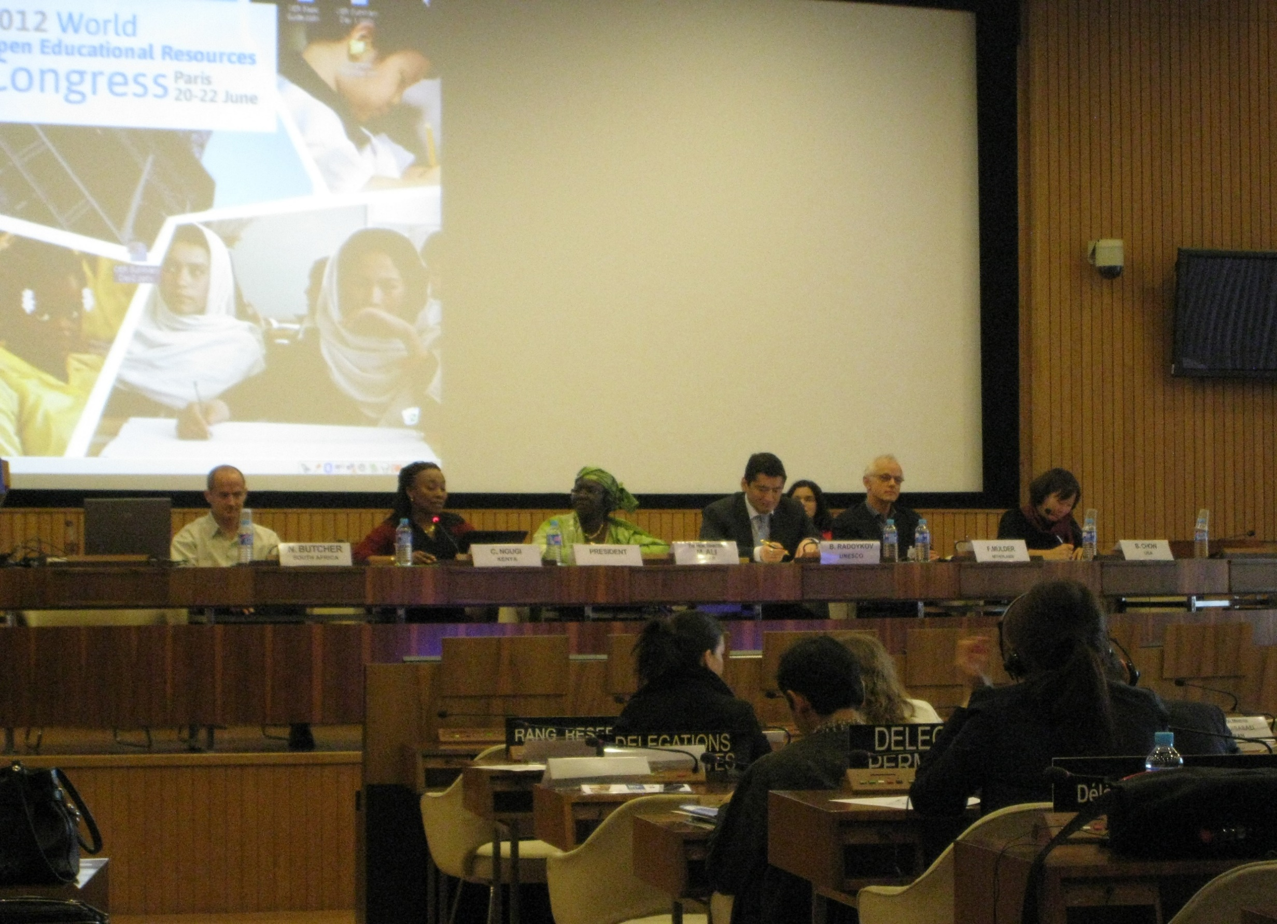

Slide 3
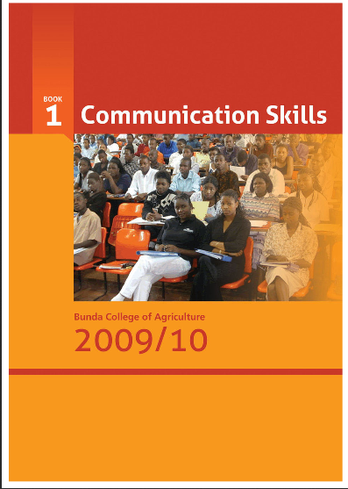


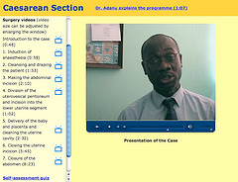

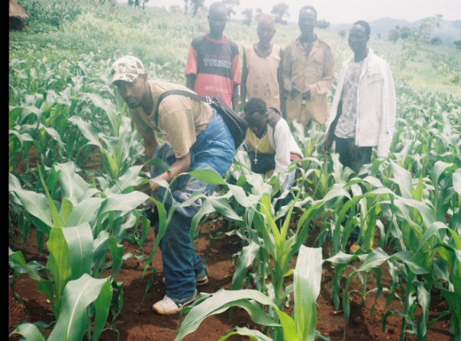
Access to Relevant OER
Dr. Adanu’s multi-media module
OER DVD for students at Kamuzu College of Nursing

Slide 4
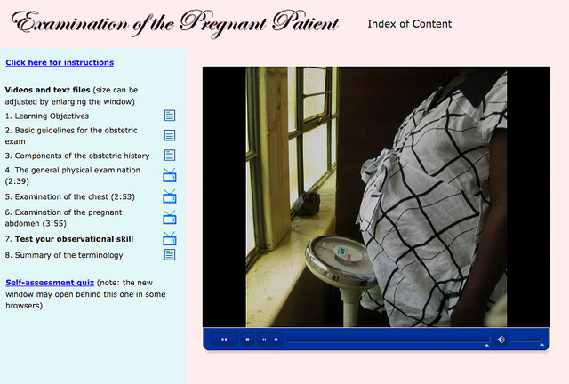
Notes:
Use of OER

Slide 5

OER as a cost-saver
Notes:
Picture: Kamuzu College of Nursing, (OER Africa archives)

Slide 6
Institutionalizing OER
OER Africa is working, over 3 years, with 4 universities in Kenya, Tanzania, and South Africa to
support the deepening of pedagogical practices that employ open educational resources (OER) and use information and communication technologies (ICT) to improve teaching and learning at both faculty and institutional levels
build an evidence base from the emerging lessons of experience, which would give impetus to the application of similar strategies in other African institutions of higher education.

Slide 7


How is OER being used to transform Pedagogy?
ANU – Africa Nazarene University
unforeseen demand for its limited portfolio of DE courses resulted in a need for a standardised model for materials development - OER introduced into development of more DE modules and supportive T&L materials.
OUT – Open University of Tanzania
innovative approach of involving faculty in the design of an OER-based Digital Fluency course to capacitate staff to make the best possible use of OER and available technologies

Slide 8


How is OER being used to transform Pedagogy?
OP - Onderstepoort
OER being used to support block teaching method of its flagship veterinary sciences degree programme. Restructuring delivery to incorporate resource-based learning and ICT becomes a logical consequence of this pedagogical change.
UFS – University of the Free State
CTL + ULD strategy which incorporates 1) effective development, adaptation, and use of OER to deliver language development courses for UFS students and, 2) ongoing research into the effectiveness of ULD strategies.

Slide 9

Emerging Lessons
Notes:
Image source: http://www.learninghouse.com/wp-content/uploads/2015/08/940x434-bg-slider.jpg

Slide 10
What are we learning about OER & pedagogy?
Interactive teaching and learning materials considered a qualitatively positive development and OER viewed as an enabler to such improved quality.
In some instances, scarcity of topical resources (due to their high cost) meant that making readily available to students any well-presented learning materials was also deemed a marker of quality
Such perceptions of pedagogy suggest that, for many academics, the mere application of OER and / or ICT, is deemed a marker of improved teaching and learning.
OER Concept and its potential for improving teaching and learning, not widely understood
OER Africa-led workshops and project partners’ need for relevant OER and ICT have facilitated discussions about how they might transform teaching and learning.

Slide 11
What are we learning about pedagogy, OER & quality?
Growing sense that judicious use of OER can help to improve the quality of courses,
  e.g. in the development of the capacity of CTL support staff to harness OER as part of the course design activities they undertake with UFS academics
OER & ICT deployed to contain the costs of course materials design and/or to save time spent on content development.
Iterative process of course design completion, licensing, piloting, use and review of materials, necessary to demonstrate efficacy of innovation

Slide 12


How Do Faculty Perceive OER & ICT?
Academics and academic support staff increasingly interested in using OER and sharing their work under open licenses
Technology increasingly part of the lived experience of the digital era
Interest in relevant Intellectual Property (IP) Policies
Notes:
IMAGE SOURCE – Copyright Logo: http://cdn.mg.co.za/crop/content/images/2015/02/25/mtnzambia_landscape.jpg/633x356/
IMAGE SOURCE – child & device in bed: http://cdn.mg.co.za/crop/content/images/2015/02/25/mtnzambia_landscape.jpg/633x356/

Slide 13


What is the Role of Institutional Policy?
OER policy issues intertwined with ICT, IP/copyright & HR issues
Different strategies at the different institutions
Misaligned practices v policies common
Mitigation strategies in place
Notes:
IMAGE SOURCE – open binder: https://encrypted-tbn2.gstatic.com/images?q=tbn:ANd9GcRkStQjG5GGy2JYpJwqbQOj5aTiuV6LSS_iXUFsASsape00P8mj-A
IMAGE SOURCE – scrabble logo: http://www.sigmaweb.org/media/oecdorg/satellitesites/sigma/policy-making-reg-520x328.jpg

Slide 14
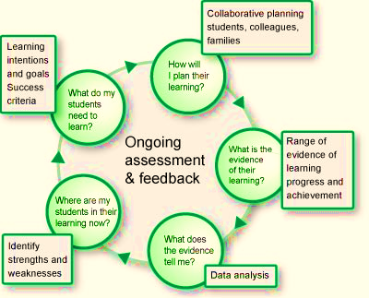
Why Research Teaching & Learning?
Pedagogical reforms should be driven by grounded research
Research into pedagogical practices unusual outside faculties of education
Notes:
IMAGE Source: http://www.insight.vic.edu.au/SiteAssets/assessment-and-the-learning-and-teaching-cycle/LearningCycle_XS.jpg

Slide 15
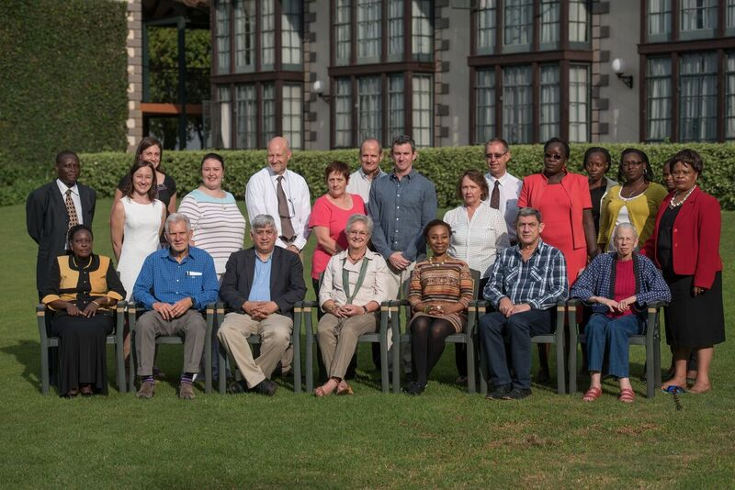
OER Africa – some conclusions
Notes:
Image – OER Africa 2016 Convening

Slide 16
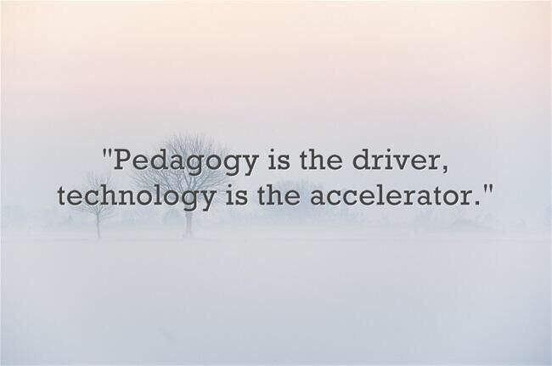
OER & Pedagogical Research
Research themes most commonly identified as important when exploring OER issues:
Using student research to generate, collect, and process OERs;
Examining the impact of using OER and measuring improvements in student performance;
Undertaking financial analysis of relative costs of using OER in course design.
Notes:
Image source: https://s-media-cache-ak0.pinimg.com/736x/e3/95/17/e39517c643e2320d0f993af79cb6f2c9.jpg

Slide 17
Research – a Central Pillar
Interest expressed – but limited progress made in
surveying needs, monitoring processes and evaluating impact, primarily in terms of improved student performance
CTL at UFS a notable exception with entrenched PAR program whereby staff support academic faculties to improve teaching and learning practices
Excellent example of structured institutional commitment to critical reflection on effective pedagogy

Slide 18
OER & Pedagogical Transformation
4 institutions each demonstrating diverse activities and approaches towards institutionalization of improved pedagogies
All recognise need for resource-based flexible provision
  e.g. flipped classrooms, part-time studies, distance education, and online learning
Growing willingness to deploy OER practices to improve teaching & learning
Some barriers to researching pedagogical innovation being addressed through Policy
Faculty still face various constraints to institutionalize OER practices, e.g.
  traffic, academic administration, culture of creating from scratch

Slide 19
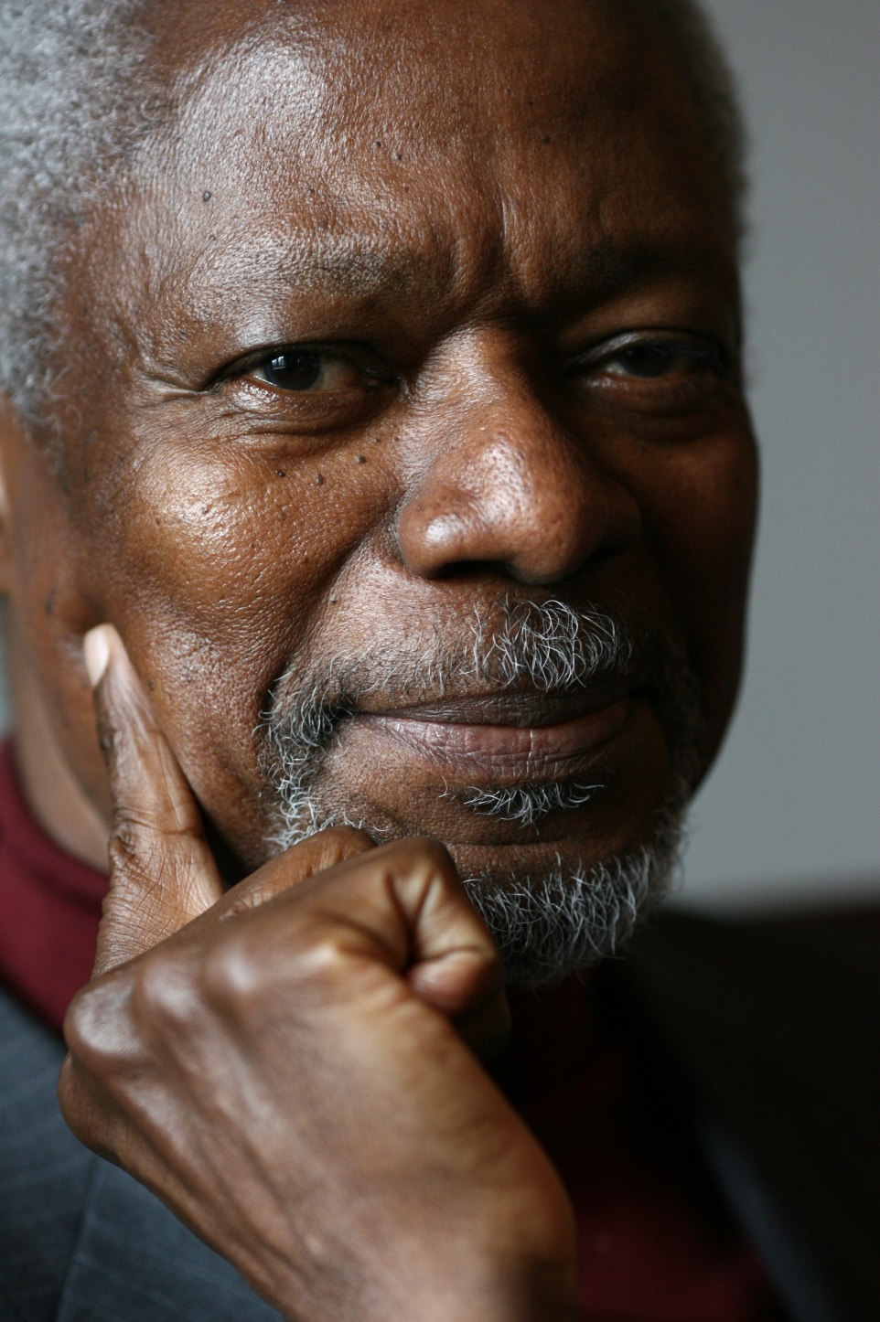
Kofi Anan
Nobel Laureate, 2001
“Education is a human right with immense power to transform. On its foundation rest the cornerstones of freedom, democracy and sustainable human development.”
Notes:
Picture: http://static.goal.com/100000/100084.jpg
Quote from : http://www.unicef.org/sowc99/sowc99a.pdf – The State of the World’s Children (1999) [downloaded Sept 20th 2014)
Kofi Annan was awarded the Peace Prize for having revitalized the UN and for having given priority to human rights. The Nobel Committee also recognized his commitment to the struggle to contain the spreading of the HIV virus in Africa and his declared opposition to international terrorism.
(http://www.nobelprize.org/nobel_prizes/peace/laureates/2001/annan-facts.html)
He served as the seventh Secretary-General of the United Nations from January 1997 to December 2006.

Slide 20
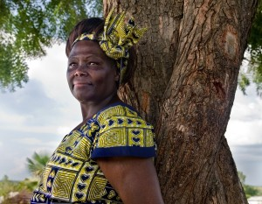
Prof. Wangari Maathai (1940-2011)
Nobel Laureate, 2004
“Human rights are not things that are put on the table for people to enjoy. These are things you fight for and then you protect.”
Notes:
Source of image: http://infinitefire.org/info/wp-content/uploads/Wangari-Maathai-e1423836218320-600x466-300x233.jpg
Source of quote: http://www.azquotes.com/author/9190-Wangari_Maathai

Slide 21
Thank you
Catherine Ngugi
catherine.ngugi@oerafrica.org / catherine.ngugi@gmail.com

