Slide 1
The Changing Journals Landscape
Eve Gray and Laura Czerniewicz
ERP Seminar 4 October 2011

Slide 2
@UCT
Centre for Educational Technology (CET)
Scholarly Communication in Africa Programme (SCAP)
OpenUCT Initiative (OUI)
Laura.czerniewicz@uct.ac.za
Michelle.willmers@uct.ac.za
Eve.gray@uct.ac.za

Slide 3
From the Royal Society and Philosophical
Transactions...
(1655)...

Slide 4


Slide 5
...to PLOS ONE

Slide 6
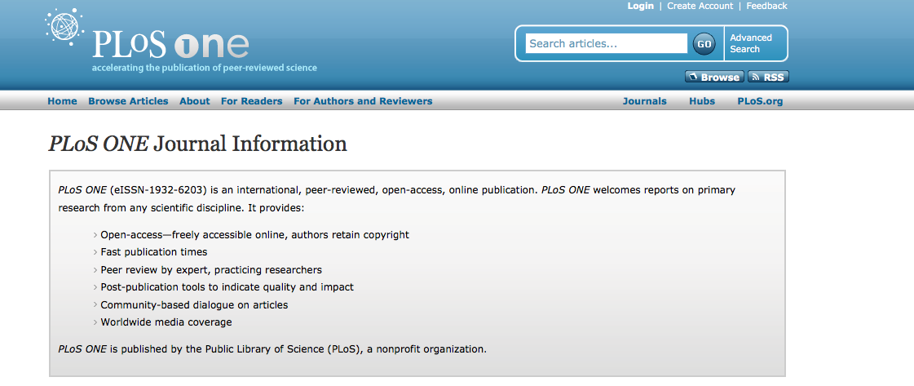

Slide 7
Getting back to the roots...

Slide 8
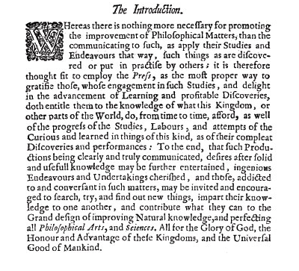

Slide 9
Journals as...
Exchange of ideas and sharing of knowledge in a community of scholars;
Importance of effective communication with a wider audience;
Recognition of the value of research and innovation;
Contribution to the ‘Universal good of Mankind’.

Slide 10
The trajectory of journal publishing
From 17th to 20th century, mostly society and independent journals, slow growth;
1655 Transactions and Journal des Savans; by 1850, 100 journals;
Most journals were society journals.
Alma Swan 2011; McGuigan and Russell 2008; Jean-Claude Guedon 2001.

Slide 11
The rise of the journal industry
The trajectory of journal publishing
Post war, the information society provides opportunities for commercial players;
Massification of universities fuels journal growth;
Now around 25,000 journals;
Promotions and recognition driven by industry-controlled metrics

Slide 12
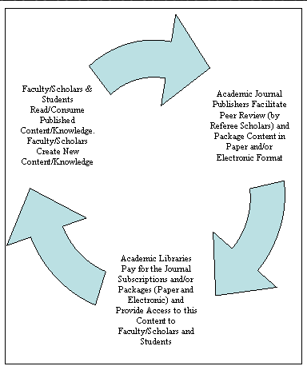
The start of the ‘journals crisis’
Monopolisation of the industry - Elsevier, Springer and Wiley control 42% of the market;
Price increases erode library budgets: ARL expenditure increased 302% between 1986 and 2005.
Glenn S McGuigan and Robert D Russell, The Business of Academic Publishing: http://southernlibrarianship.icaap.org/content/v09n03/mcguigan_g01.html

Slide 13
Countervailing forces - scholarship goes digital

Slide 14
Journals move online - a mixed blessing
Easier and more comprehensive access;
A licensing model - pay-per-view and limitations on ownership;
The leveraging of reputation becomes a business - the ‘impact factor’;
‘Bundling’ and subscription monopolies.

Slide 15
New digital publishing models emerge
Depend upon linking and interoperability;
Collaboration and inter-disciplinarity;
Web 2.0 and community building;
New ‘freemium’ business models: adding content and adding value.

Slide 16
‘I think of Nature as a scientific communication company rather than a journal publisher.’
Timmo Hannay (Nature Publishing), Publishing Open Content (video) 2008. Produced by Belsizen3ws. http://www.youtube.com/user/belsizenw3

Slide 17
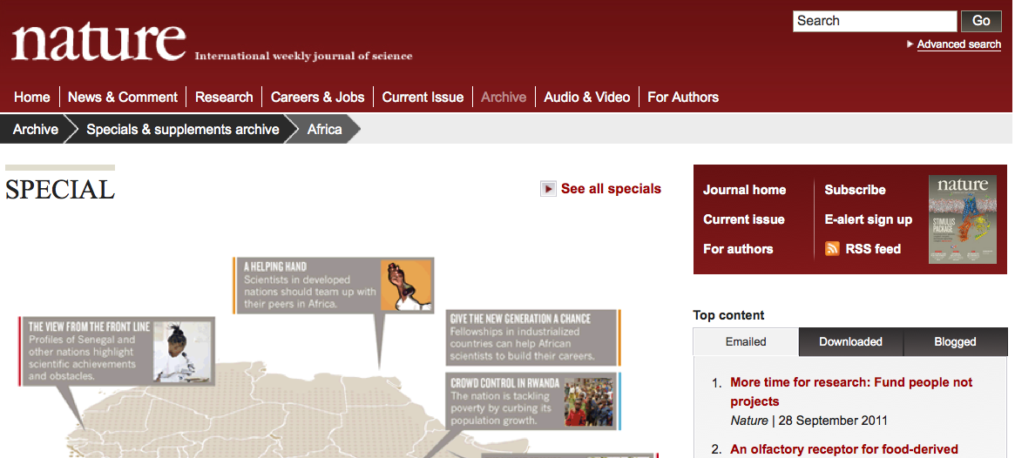

Slide 18
Linking and interoperability

Slide 19
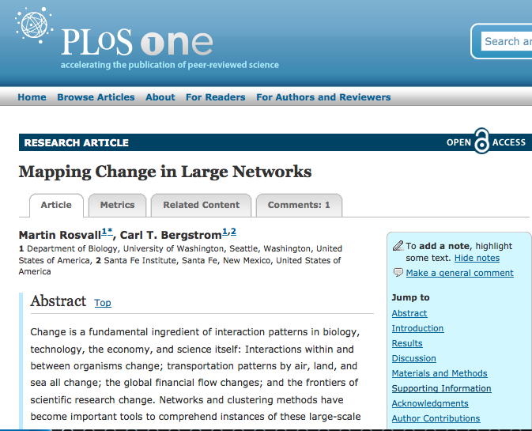

Slide 20
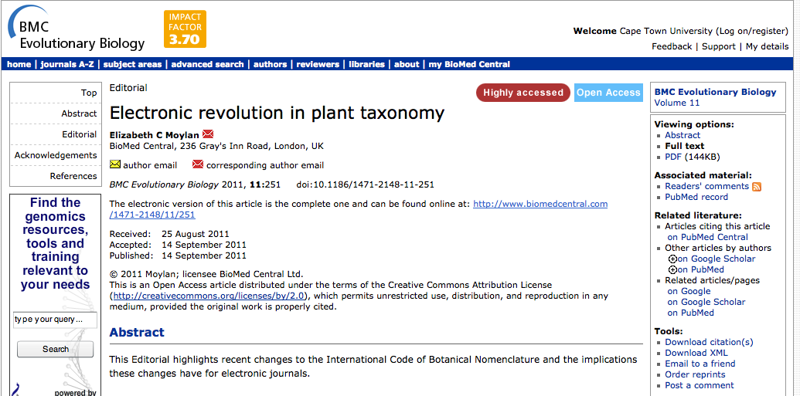

Slide 21
Linking to data resources becomes important

Slide 22
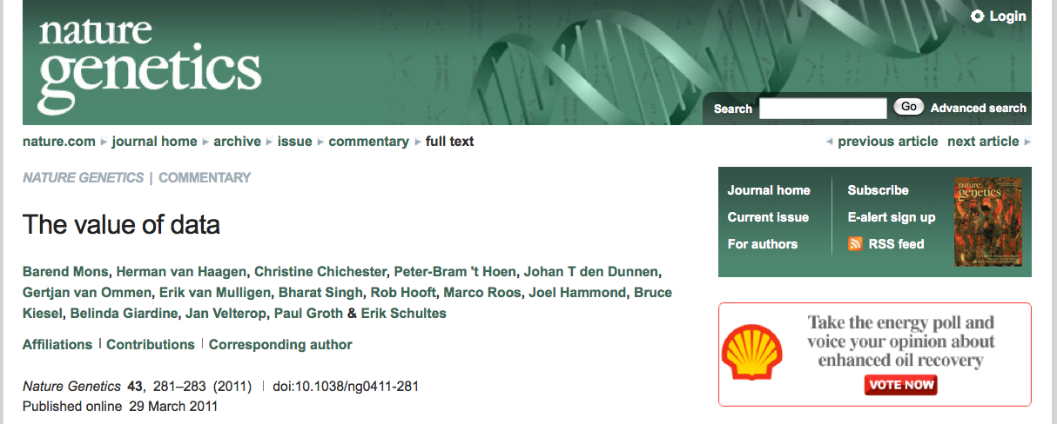
http://www.nature.com/ng/journal/v43/n4/full/ng0411-281.html

Slide 23
Collaboration and interdisciplinarity

Slide 24
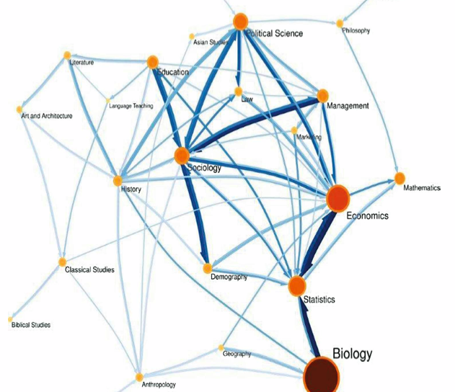
Jevin D West http://chronicle.com/article/Maps-of-Citations-Uncover-New/128938/?sid=wc

Slide 25
New business models: ‘freemium’ and value-add

Slide 26
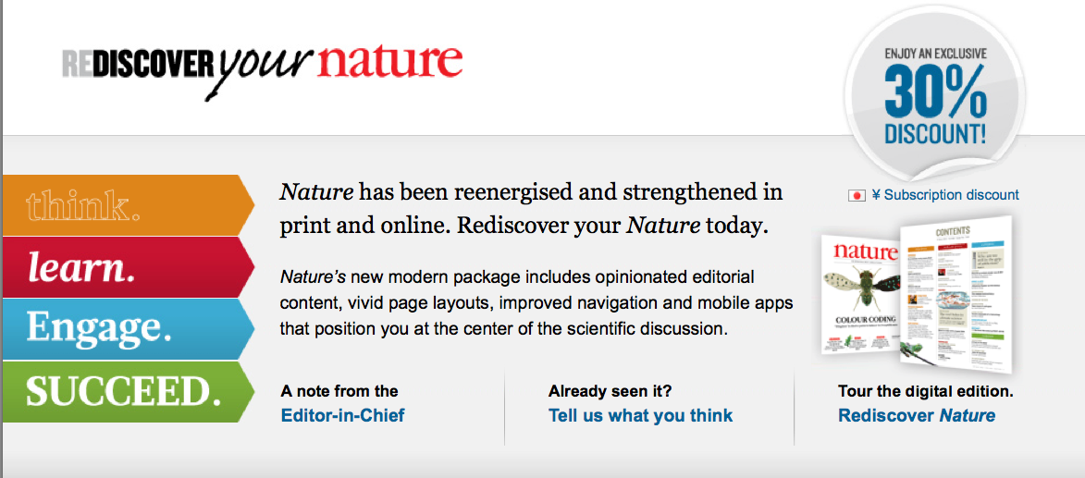

Slide 27
Community building

Slide 28
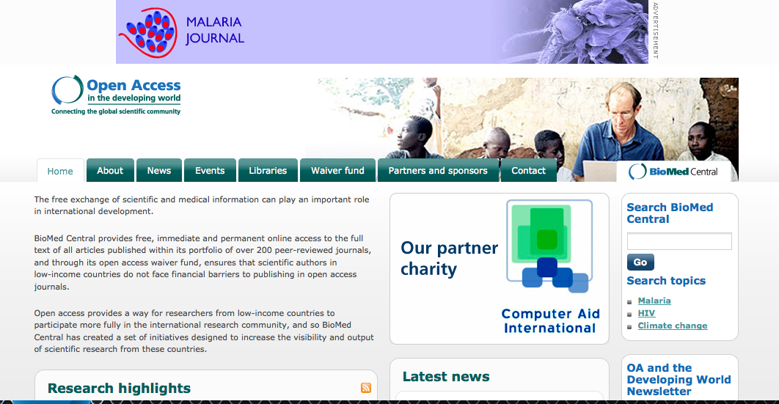

Slide 29
The emergence of Open Access

Slide 30
An old tradition and a new technology have converged to make possible an unprecedented public good. The old tradition is the willingness of scientists and scholars to publish the fruits of their research in scholarly journals without payment, for the sake of inquiry and knowledge. The new technology is the internet. The public good they make possible is the world-wide electronic distribution of the peer-reviewed journal literature and completely free and unrestricted access to it by all scientists, scholars, teachers, students, and other curious minds. Removing access barriers to this literature will accelerate research, enrich education, share the learning of the rich with the poor and the poor with the rich, make this literature as useful as it can be, and lay the foundation for uniting humanity in a common intellectual conversation and quest for knowledge.
The Budapest Open Access Initiative, December 1-2 2001.
Open Society Institute http://www.soros.org/openaccess
The Budapest Open Access Initiative

Slide 31
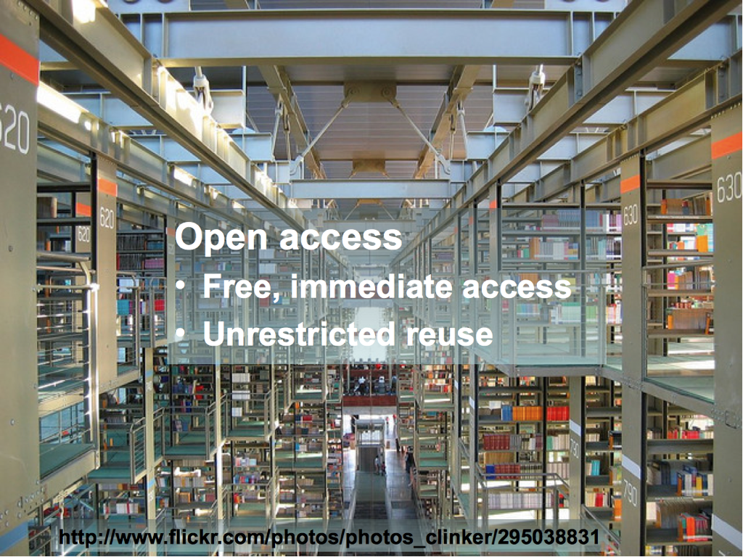

Slide 32
OA journals
Non-profit open access journals - Public Library of Science;
Thousands of smaller independent and university-based journals;
Repositories - PubMed Central, supported by National Institutes of Health;
Commercial open access - Biomed Central;
Rapid growth of open access publishing - now 7,000 journals listed and 600,000 articles
Laakso M, Welling P, Bukvova H, Nyman L, Björk B-C, et al. (2011); S. Miele, CERN OAI17

Slide 33
OA- the developing world
SciELO in Latin America - 800 journals, 300,000 articles;
SCiELO South Africa, supported by the DST, run by the Academy of Science of SA;
Bioline International provides a platform for developing country journals.
Alma Swan 2011, http://www.wsis-community.org/mod/file/download.php?file_guid=371469

Slide 34
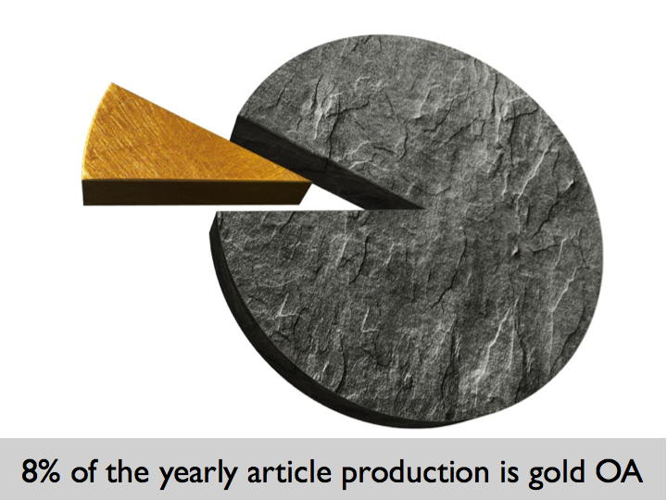
Salvatore Miele CERN OAI17 2011

Slide 35
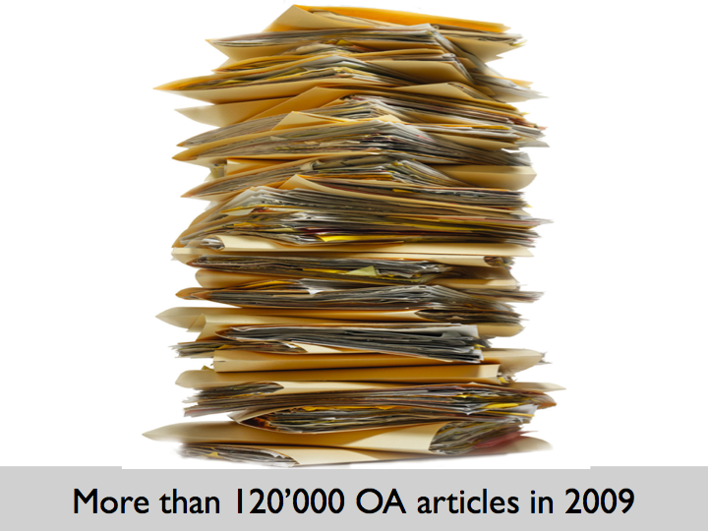
Salvatore Miele CERN OAI17 2011

Slide 36
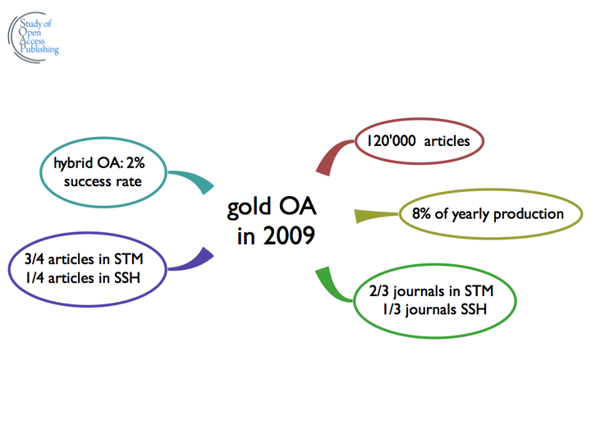
Salvatore Miele CERN OAI17 2011

Slide 37
OA and impact
The jury is out overall re increased citations
30 studies showing up to 600% increase in impact
About 35 studies show no difference
There is little doubt that there are strong advantages for developing countries.
Alma Swan 2011, http://www.wsis-community.org/mod/file/download.php?file_guid=371469

Slide 38
Open Access journals come of age

Slide 39
PLOSOne - a disruptive model
Broad cross-disciplinary publication;
Splitting of technical and impact peer review;
Linking of supplementary content - the article becomes part of a hub;
Article as part of research in progress;

Slide 40
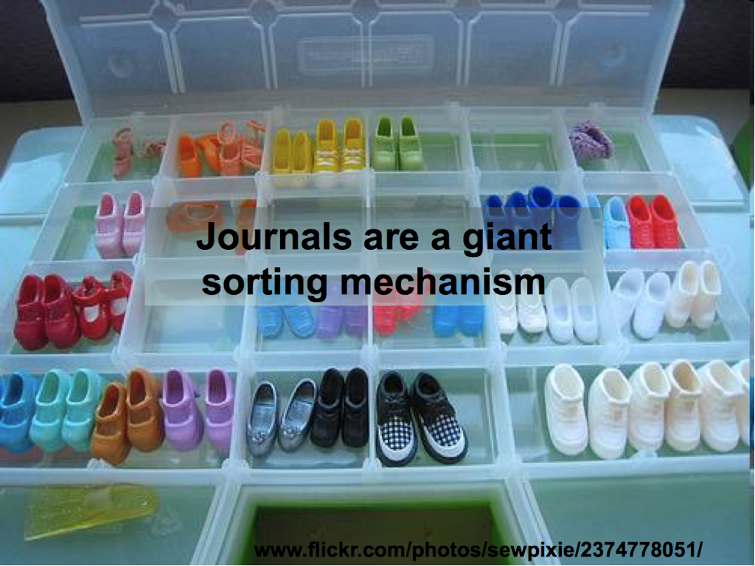

Slide 41
The article as research in process not the end result

Slide 42
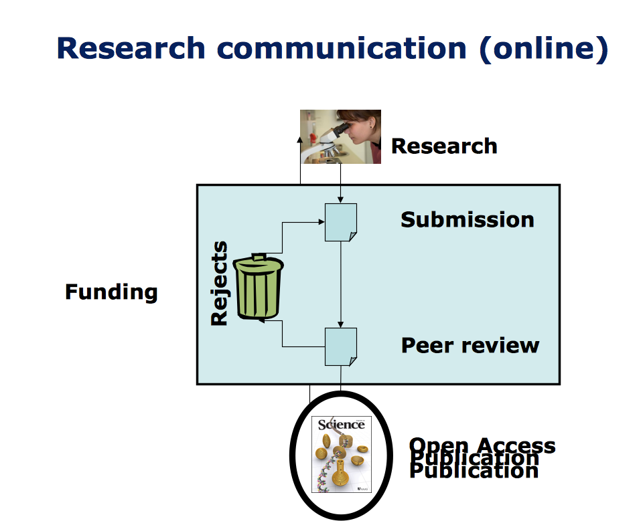
Mark Patterson, CERNOAI17 2011

Slide 43
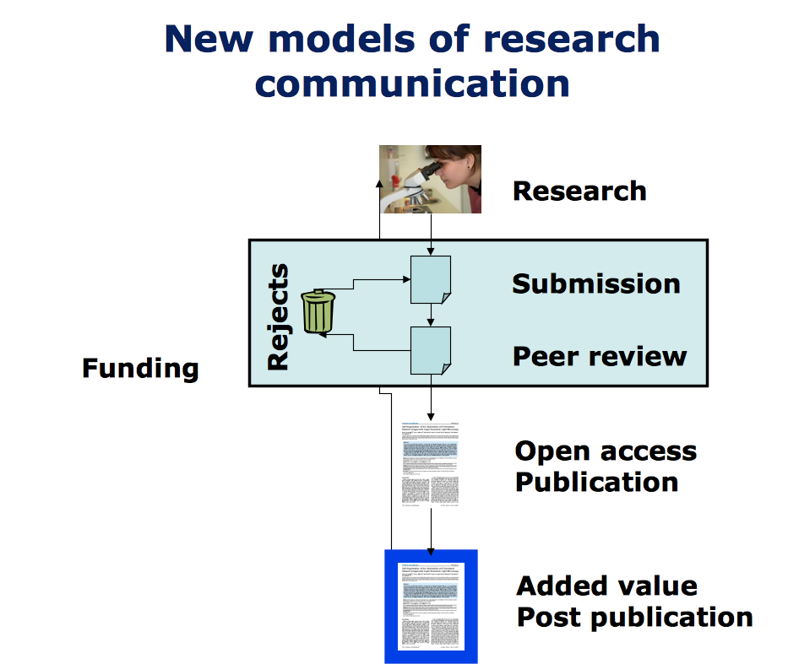
Mark Patterson, CERN OAI17 2011

Slide 44
Commercial publishers follow suit

Slide 45
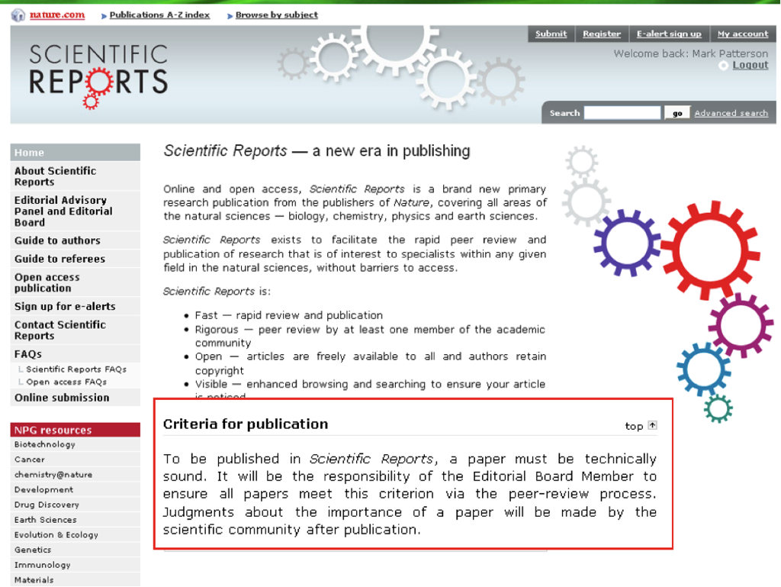

Slide 46
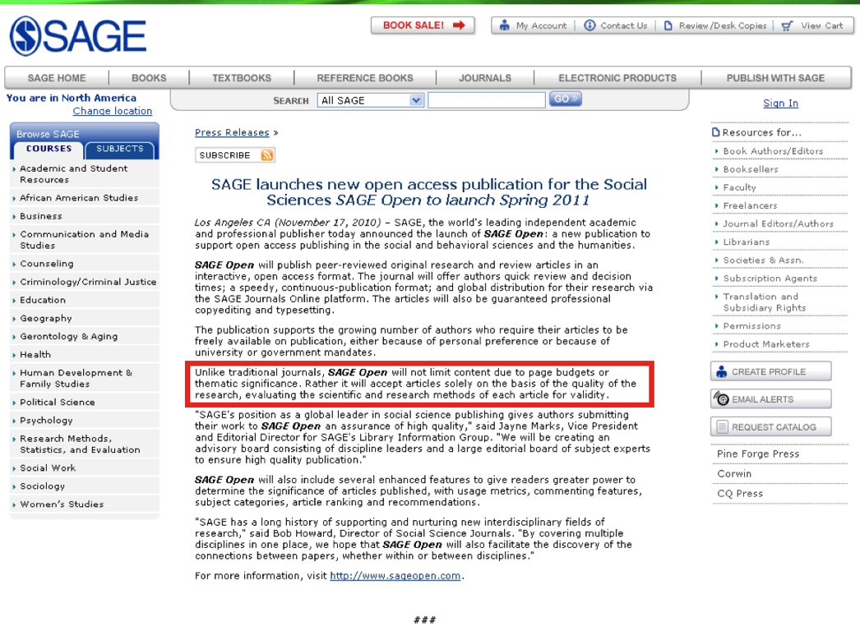

Slide 47
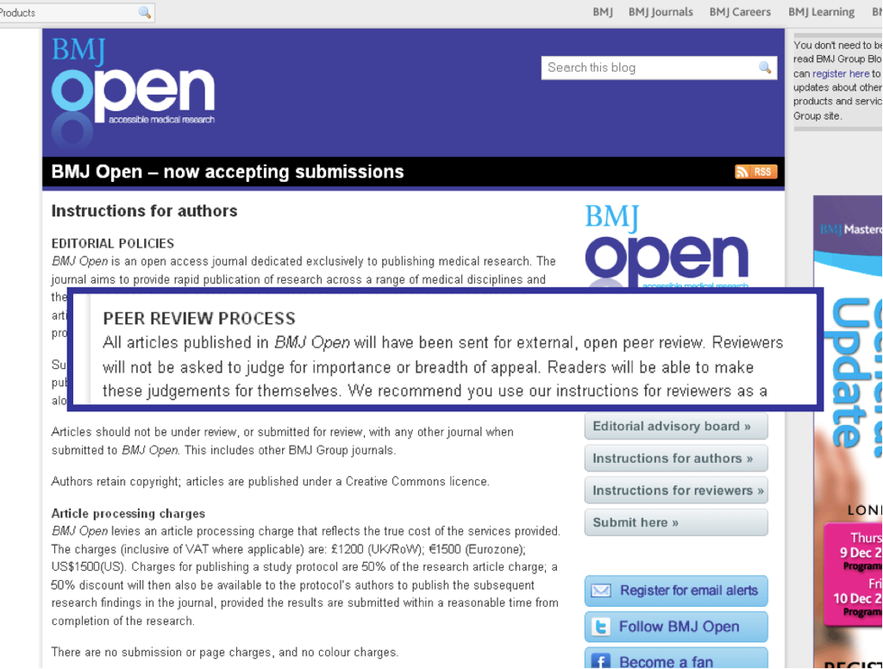

Slide 48
The tide has turned
The reaction against commercial
journals goes mainstream
UNESCO supports OA
Leading research organisations back OA

Slide 49
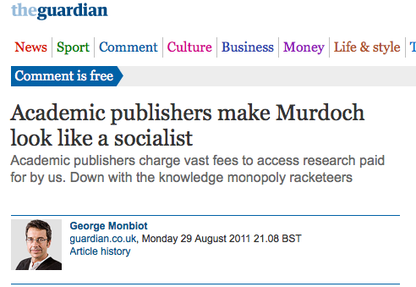
The Monbiot moment

Slide 50
References
Guédon, JC (2001), In Oldenburg's Long Shadow : Librarians, Research Scientists, Publishers, and the Control of Scientific Publishing, Association of Research Libraries
Hannay, T (2008) Publishing Open Content (video) Nature Publishing, Produced by Belsizen3ws. http://www.youtube.com/user/belsizenw3
Laakso M, Welling P, Bukvova H, Nyman L, Björk B-C, et al. (2011) The Development of Open Access Journal Publishing from 1993 to 2009. PLoS ONE 6(6): e20961. doi:10.1371/journal.pone.002096 , http://www.plosone.org/article/info:doi/10.1371/journal.pone.0020961
Maidment –Otlet, D and Redfearn, R (2010) A Research Revolution: The Impact of Digital Technologies. Ariadne, Issue 62, January 2010 , ttp://www.ariadne.ac.uk/issue62/maidmentOtlet-redfearn/
McGuigan, G and Russell R , (2008) The Business of Academic Publishing: A Strategic Analysis of the Academic Journal Publishing Industry and its Impact on the Future of Scholarly Publishing. Electronic Journal of Academic and Special Librarianship 9 (3) http://southernlibrarianship.icaap.org/content/v09n03/mcguigan_g01.html
Miele, S (2011) Open Access Publishing: what publishers offer, what scientists want. Final results from the SOAP projects. CERN OAI17 Conference, Geneva 22-24 June 2011
Patterson, M ( 2011) Re-engineering the functions of journals. CERN OAI17 Conference, Geneva 22-24 June 2011.
Swan, A (2011) Policy Guidelines for the Development and Promotion of Open Access to Scientific Information and Research. (Draft for discussion) UNESCO. http://www.wsis-community.org/mod/file/download.php?file_guid=371469

