Slide 1



Making MOOCs
What has it meant to CILT?
Laura Czerniewicz
14 July 2016

Slide 2
Half way through the CILT 3-year 12 MOOC project, we paused and asked ourselves
What has making MOOCs meant to us
as individuals
as a Centre?
We used a shared online space (of course!)
Here are some of our views

Slide 3
A learning experience
Making MOOCs has already taught me new ways to think(KE)
I was one of the most severe early critics…[but]the team worked with infectious energy and there was so much learning happening that it was impossible not to be swept along with the excitement and sense of achievement (JJ)
Prior to joining CILT I had not realised the work that goes into making a MOOC (AS)

Slide 4
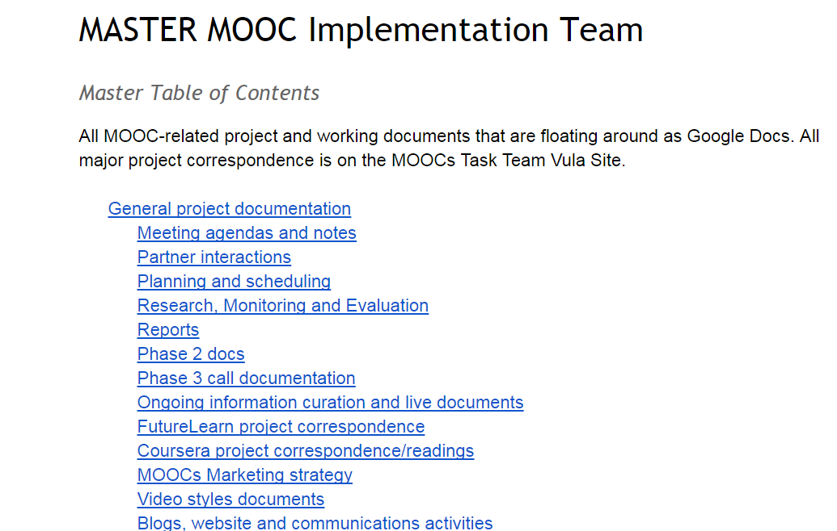
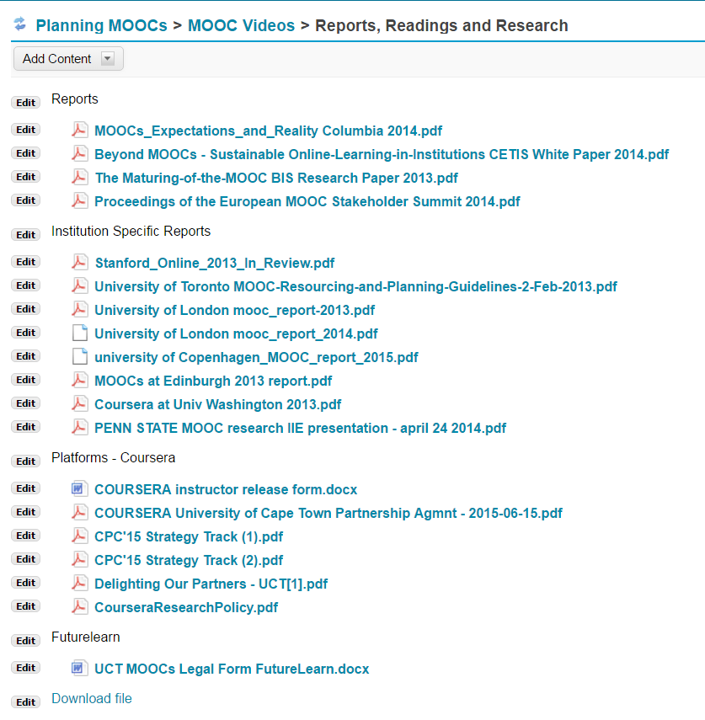
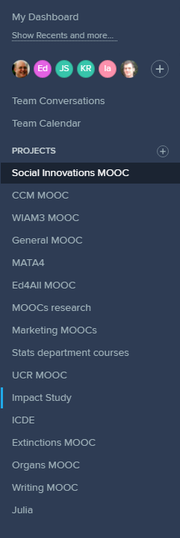

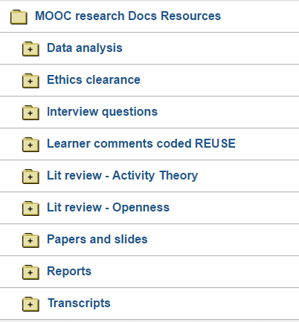
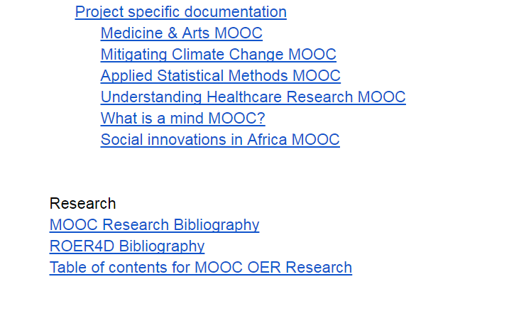
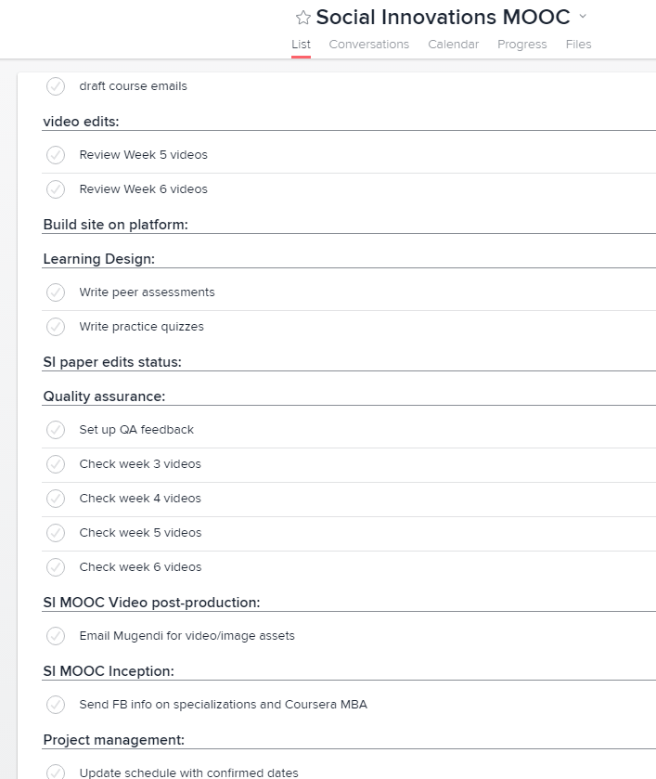

Slide 5
An opportunity for collaboration
A unique experience of being part of an extraordinarily talented team of professionals (JS)
It has been amazing to see the levels of sharing and learning in this space. Everyone has a part to play in the process (KE)

Slide 6
An opportunity for innovation
The privilege of working with really passionate academics in creating something totally new (JS)
As someone who has experienced the frustrations and limitations of both traditional video production and traditional higher education, it is exhilarating to be working in uncharted territory (DL)

Slide 7
Pushing the boundaries pedagogically & design wise
I think the MOOC space is so different from our regular face to face spaces that it forces to really think about why we do what we do...making MOOCs encourages us to question the things we take absolutely for granted - like when has learning happened, whose feedback really counts, or when should a student stop being in a class? (SG)
It has been a wonderful experience to see the scaffolding of OER content with a specific curriculum and pedagogical strategy (TK)

Slide 8
An intellectual space
I have benefited from the project through the intellectual interrogation this project has stimulated in our Centre (CB)

Slide 9
A contribution to research
The project has fed directly into postgraduate research at UCT as well as other externally funded research projects (CB)
Another very important part of having MOOCs created by CILT is that they have also been rigorously researched (CHW)

Slide 10
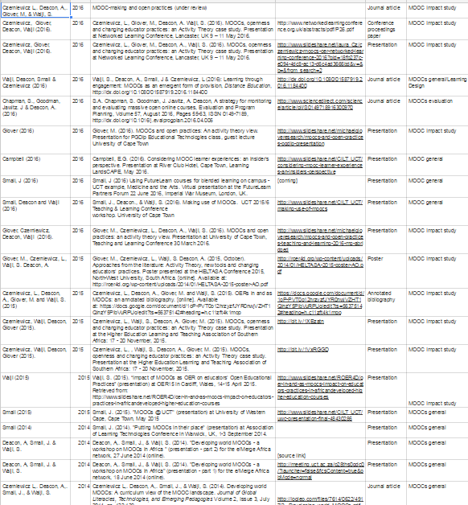
Research outputs
https://goo.gl/JAXId8

Slide 11
A contribution to formal teaching
To date all of the MOOCs have been incorporated in part into formal university courses either at UCT or at other institutions around the world (MG)
Its important for us to try out these different modes of learning and teaching as we teach one of the few postgraduate programs in Educational Technology in Africa and our students benefit from the experiences and knowledge gained through this process (CB)

Slide 12
Have made it possible for UCT teaching to become visible
MOOCs have opened up the university, making it much easier for me to share and show what is happening (AD)

Slide 13
Have put online on the agenda
The MOOCs have provided a crucial staff development opportunity. UCT lecturers can now imagine what high quality online learning looks and feels like (NC)

Slide 14
Growing expertise & confidence
Its shown we can do exceptional creative and pedagogically sound (and even award winning) fully online courses. MOOCs have shown CILT can do “online”, we can do video, we can do scale. I think we have proven ourselves through this project(CB)
Offering support to curriculum and course design is a complex set of services … The UCT MOOCs Project has been an opportunity to develop such processes and teams with a clear goal (AD)

Slide 15
Growing expertise & confidence
The MOOCs project has shown that when faced with a mammoth task and nascent know-how, CILT staff and leadership can rise to the challenge in a multitude of capacities to produce what was required – high-quality online courses to specification and to deadlines.
This should provide enormous confidence in CILT’s ability to go forward into new innovative spaces in the future (SW)

Slide 16
Making a difference
MOOCs is the tipping point for transforming access to education and I have finally found my purpose by working at CILT (ND)
I love that I am part of the global movement for providing free and accessible education (TJ)
Developing new ways of teaching and learning and contributing to global education is incredibly important. That is the future of education (KE)

Slide 17
Making a difference
The demand for online courses is growing quickly across a number of sectors and I think CILT and UCT now have many cards to play (with real financial and social rewards opening up)(MG)
MOOCs, I think, will in one way or another shape the future of higher education - whether it turns out to be a Cinderella story or more like Rumpelstiltskin - and CILT needs to be there leading the charge, which I think we are (KR)
We are not onlookers but participants in a major global movement for educational provision on a massive scale (SW)

Slide 18
Making MOOCs @CILT has been (about)
A learning experience
An opportunity for collaboration
An opportunity for innovation
Pushing the boundaries pedagogically & design wise
An intellectual space
A contribution to research
A contribution to formal teaching
Making it possible for teaching to become visible
Putting online on the agenda
Growing expertise & confidence
Making a difference
An enriching enabling extraordinary adventure

Slide 19
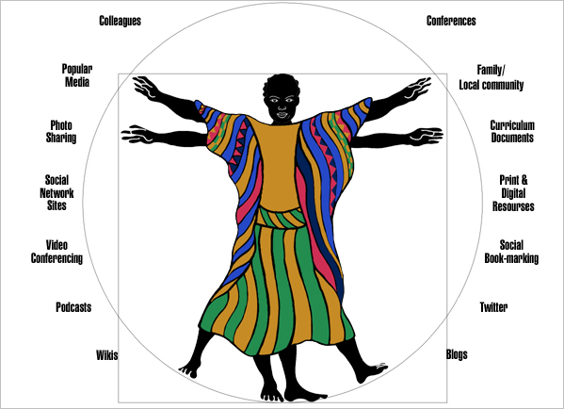
Thank you
Image: Stacey Stent

