Slide 1


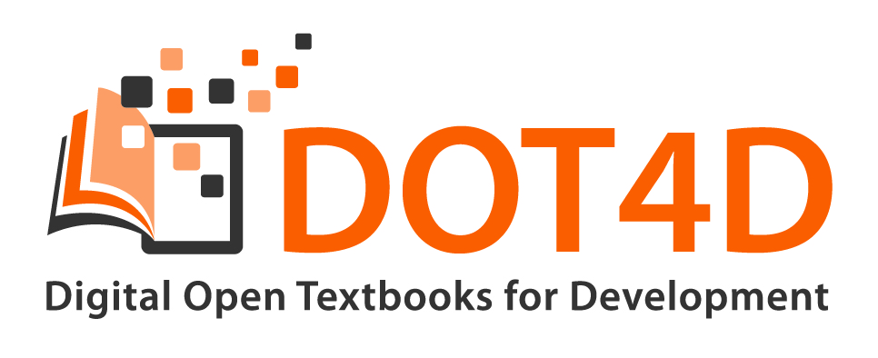
Open Textbooks
Towards a Sustainable Model for South African Universities
NMMU OpenEdColloquium20 Webinar series
By Glenda Cox, Bianca Masuku & Michelle Willmers
Digital Open Textbooks for Development project, Centre for Innovation in Learning and Teaching,
University of Cape Town

Slide 2


This work is carried out with the aid of a grant from the International Development Research Centre, Ottawa, Canada.
It is licensed under a Creative Commons Attribution 4.0 International licence.

Slide 3
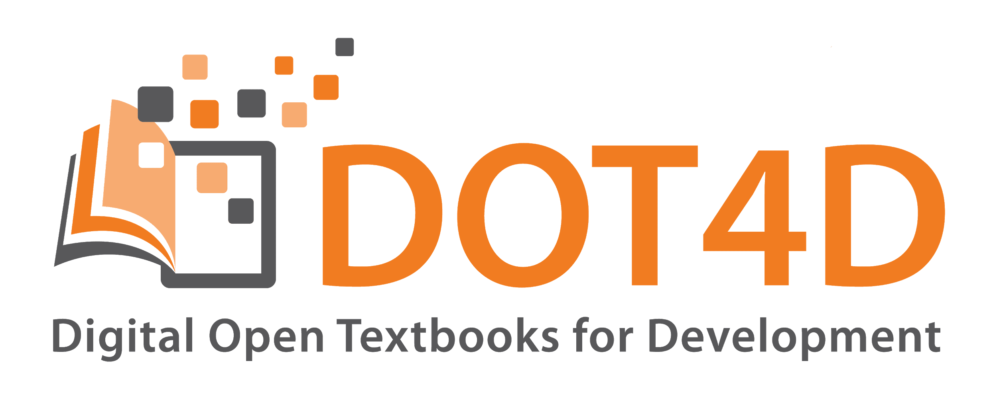
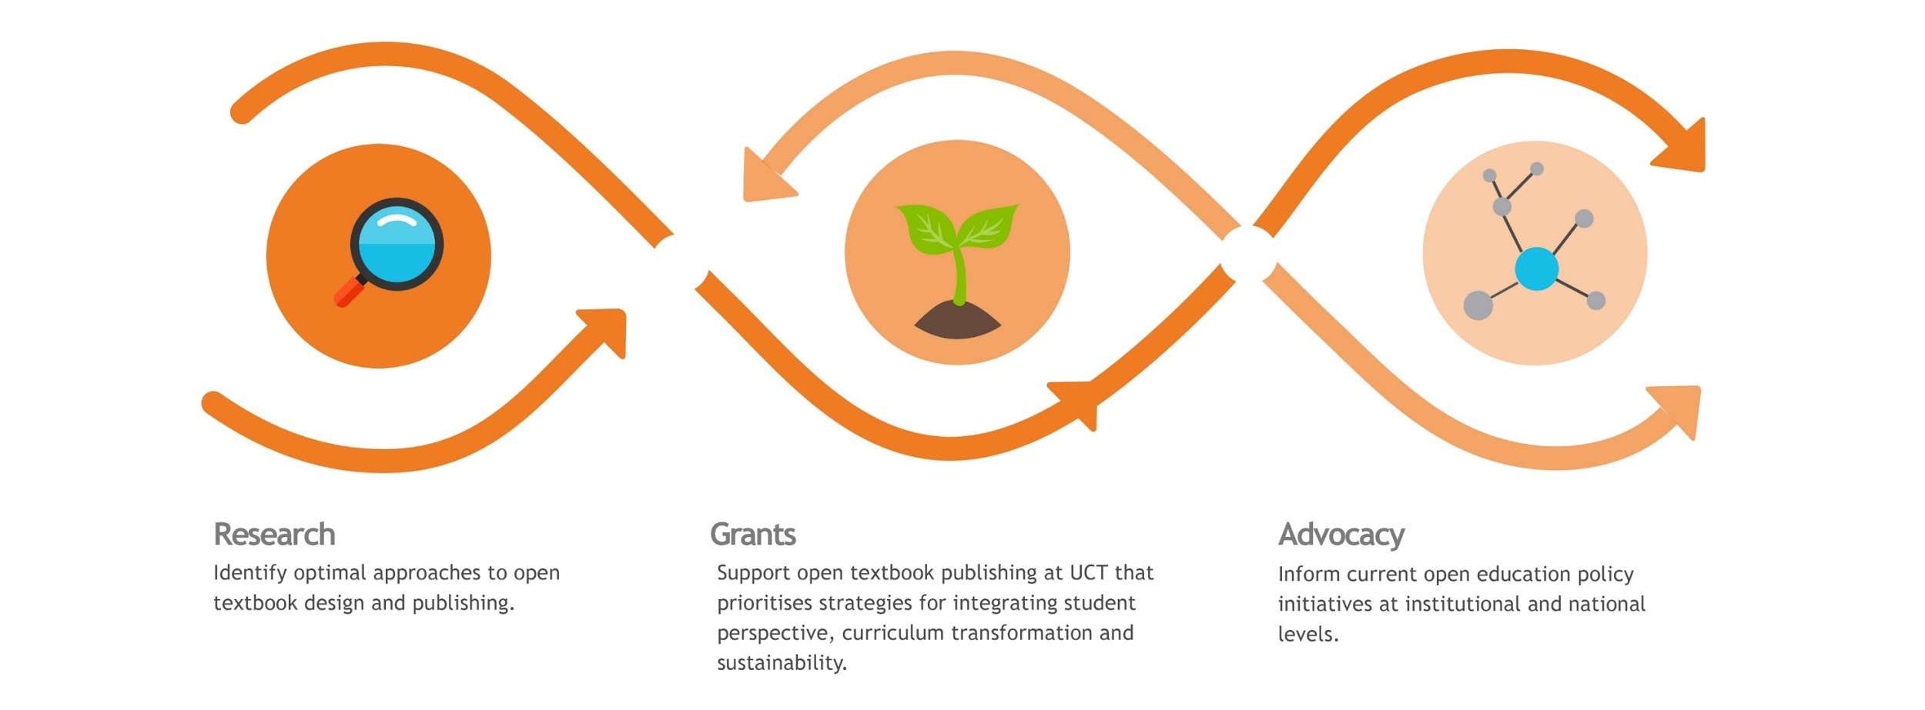
http://www.dot4d.uct.ac.za/
Notes:
Project specific objectives:
Articulate and identify the best approaches to designing an open textbook.
Support open textbook publishing activity at UCT that prioritizes strategies for integrating student perspective, curriculum transformation, and sustainability.
Inform current textbook publishing policy-development initiatives at institutional and national levels.

Slide 4
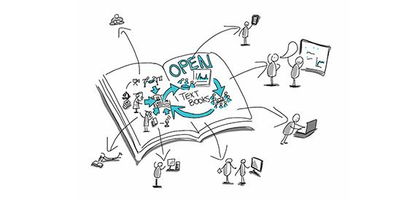
Definition
Open textbooks are digital, freely available collections of scaffolded teaching and learning content published under an open licence on platforms and in formats that provide affordances for content delivery on a range of devices, the integration of multimedia, and incorporation of content from varying sources through collaborative authorship models. In some instances, they also provide affordances for print and low bandwidth access strategies.

Slide 5
Social justice approach
Social justice is a concept that requires the organisation of social arrangements that make it possible for everyone to participate equally in society. Fraser (2005) considers social justice as ‘participatory parity’ economically, culturally and politically.

Slide 6
Fraser (2005) social justice framework
Dimension | Injustices | Affirmative response Addresses injustice with ameliorative reforms | Transformative response Addresses the root causes of inequality
Economic | Maldistribution of resources: economic inequality
Cultural | Misrecognition attributes of people & practices accorded less respect, status inequality
Political | Misrepresentation Lacking right to frame discourse

Slide 7
Social justice framework in the open textbook context
Cultural: Misrecognition
Attributes of people & practices accorded less respect, status, inequality
Economic:
Maldistribution
of resources Economic inequality
Political: Misrepresentation
Lacking right to frame discourse, lacking power to make decisions
Injustices in current textbook practices
Cost and value Inequality of access
Textbooks from the Global North and the need for curriculum transformation
Lack of power/lack of voice of for eg. students in materials
Cost savings and access to materials
Open accessible textbooks created with local, relevant content
Students create and review content
Affirmative response
Transformative response
Institutional, national or regional funding mechanisms
Policy that mandates and rewards collaboration and student inclusion
Policy that mandates and rewards the creation of local, relevant, open textbooks

Slide 8
What is emerging?
Academics at UCT are aware of the challenges related to the cost and utility of traditional textbooks and are experimenting with new approaches towards resource creation through open practice.
Open textbook authors are attempting to make content more accessible in terms of relevance, format and genre in order to promote greater inclusivity.
Academics at UCT acknowledge that there is a legacy of gatekeeping in the selection of prescribed textbooks which serves to perpetuate political misframing and exclusion.
Open textbook authors at UCT are including students in content development processes in order to shift power dynamics and build confidence in terms of students’ ability to contribute.
Cox, G., Masuku, B. & Willmers, M. 2020. Open Textbooks and Social Justice: Open Educational Practices to Address Economic, Cultural and Political Injustice at the University of Cape Town. Journal of Interactive Media in Education, 1 (2):pp. 1–10. Available at: https://open.uct.ac.za/handle/11427/31887

Slide 9
Why do we need to articulate sustainable models for South African universities?
Build on lessons learned in pilot initiatives that advance social justice. Need for indication of best practice and most appropriate tools and technologies.
Need for indication of what kinds of infrastructure and resource support institutions need to provide.
Need for indication of how to scale activity to other South African and African universities.
Advocacy tool to inform policy-making for sustainable open textbook practice that advances social justice.

Slide 10
CASES

Slide 11
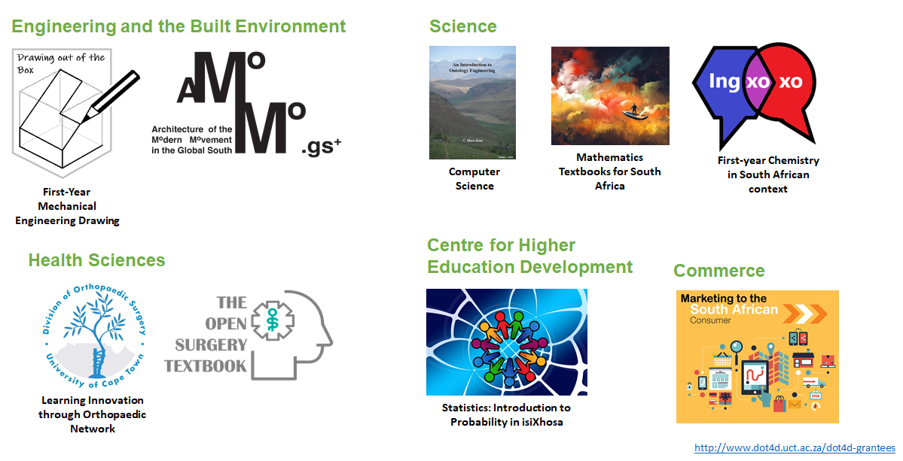
DOT4D grantees

Slide 12
Drivers and social justice imperatives
Pedagogical change
Collaboration and curriculum transformation
Cost
Accessibility and multilingualism

Slide 13
Driver:
Pedagogical change

Slide 14
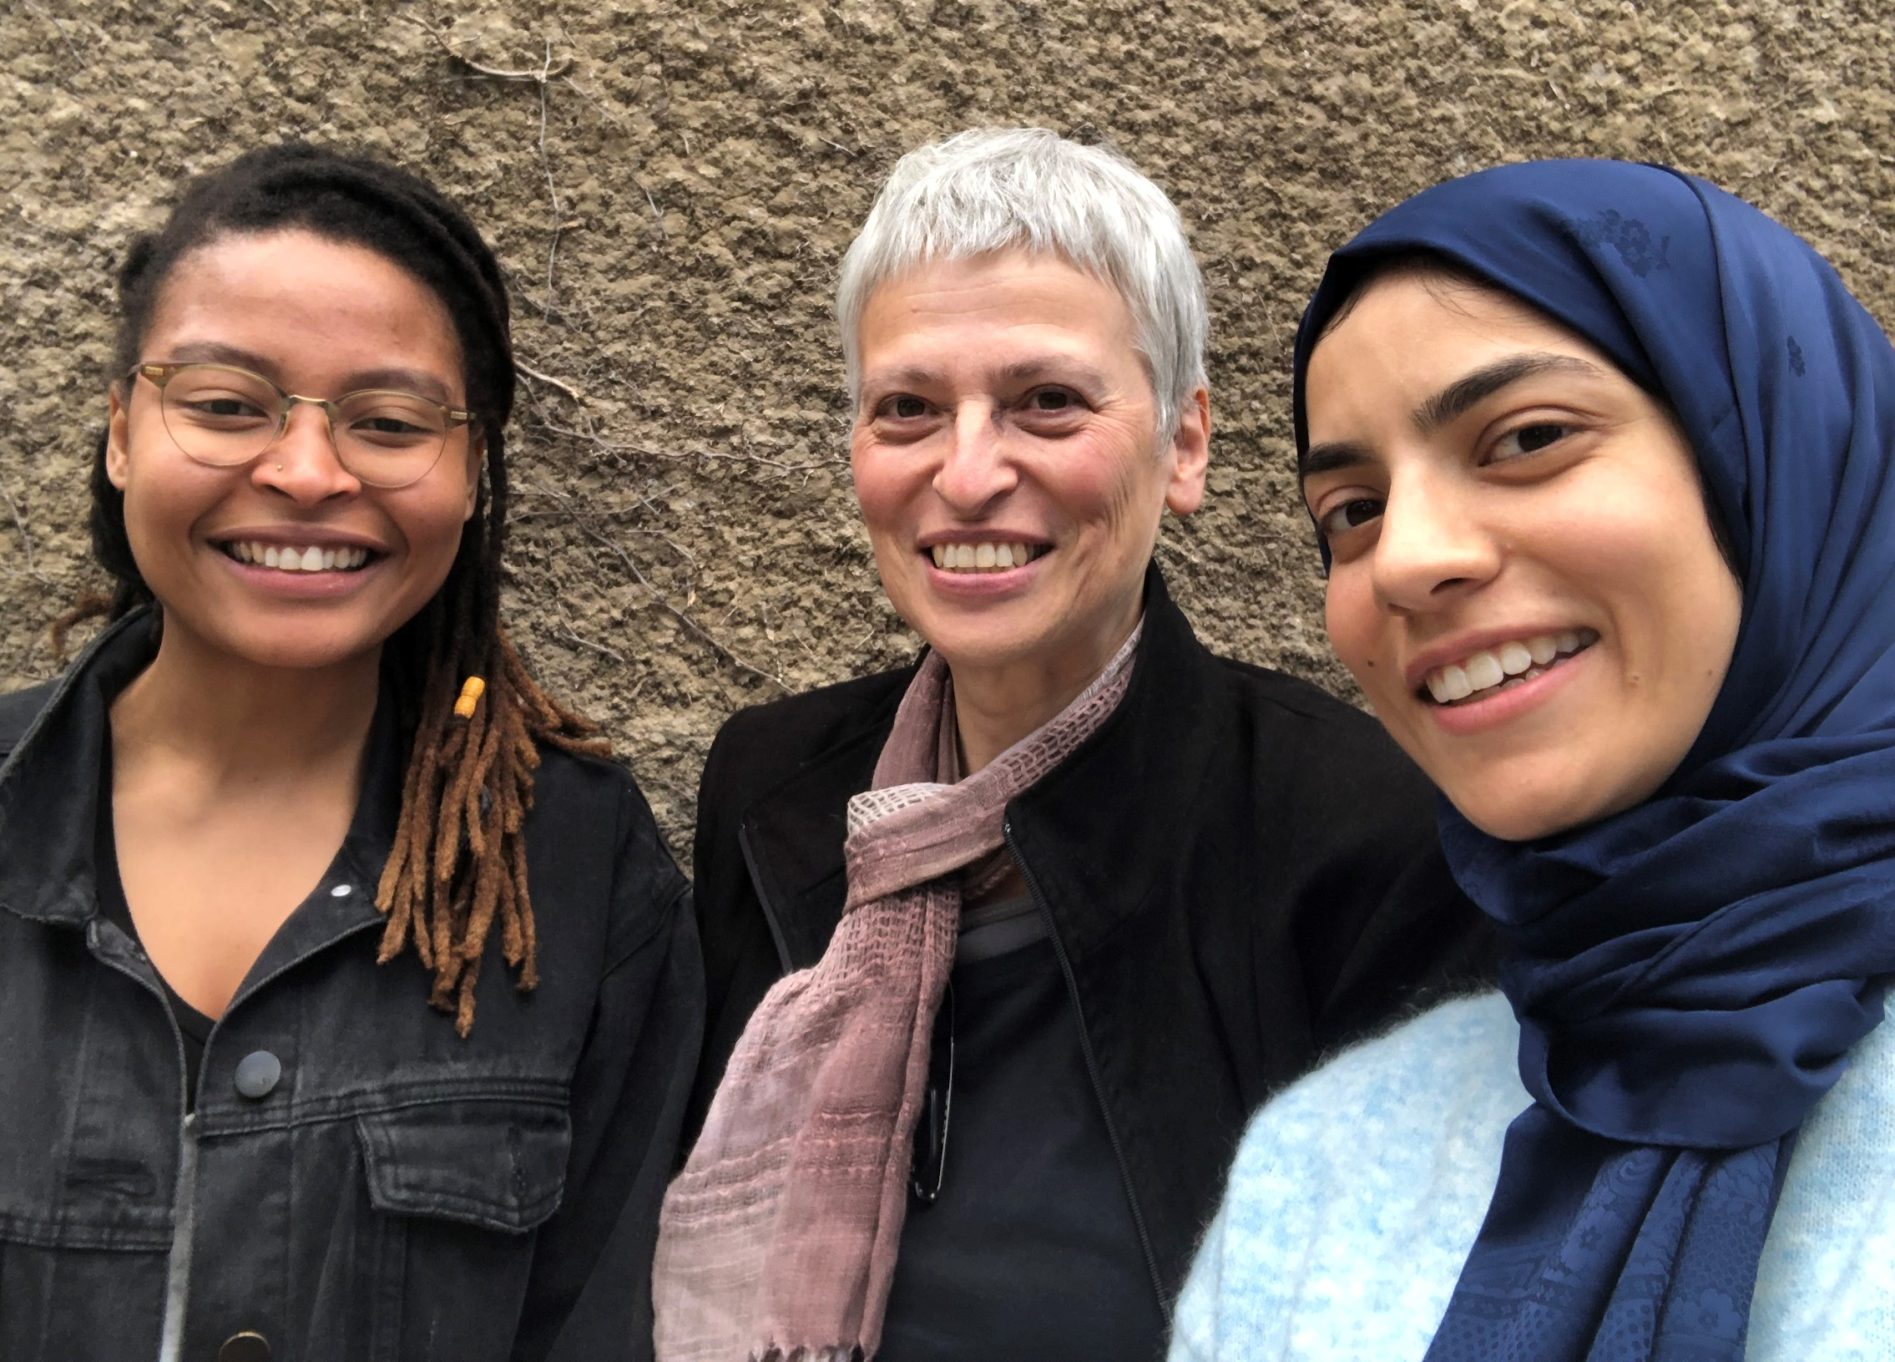

School of Architecture, Planning and Geomatics
Architecture of the Modern Movement in the Global South
“It’s making me think more critically around my teaching. Putting me in a position to challenge my teaching and to really ask the difficult questions and try and actually deal with them”
Valerie Lehabe, Stella Papanicolaou and Maashitoh Rawoot
Notes:
-Senior Lecturer
-School of Architecture Planning and Geomatics in the Faculty of Engineering and the Built Environment at the UCT
-recognised that modern buildings from the global north dominated the publications referenced by architecture students and professionals
-open textbook initiative aimed to contribute towards a knowledge base for modern architecture from a global south perspective
-her process involved contributions from students in her class who assisted with gathering information for the open textbook
-believed that her open textbook process was “making her think more critically around her teaching…”

Slide 15
Driver:
Collaboration and
curriculum transformation

Slide 16
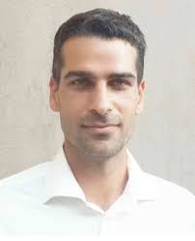

Health Sciences
“The power of a networked approach towards building a curriculum that is appropriate for the South African context”
Orthopaedics for Primary Health Care
Dr Michael Held
https://www.ortho.capetown/primary-care-orthopaedics
Notes:
-Director of the Orthopaedic Research Unit
-Faculty of Health Sciences
-recognised that current orthopaedic learning resources were mainly based on guidelines and textbooks from the Global North and that there was a severe lack of African learning materials which were tailored to local pathology and local circumstances, and written by local experts.
-initiative aimed to provide an interactive educational platform for medical students and primary care providers that would provide accessible learning material that is practical and relevant to undergraduate medical students in Southern Africa
-his process involved a multi-authorship approach to content development, involving students, academics and practitioners, with himself in the role of author and editor, with his content development intrinsically linked to the curriculum transformation process for the undergraduate orthopaedics course.
-in his work, he believed in “the power of a networked approach towards building a curriculum that is appropriate for the SA context”

Slide 17
Driver:
Cost

Slide 18
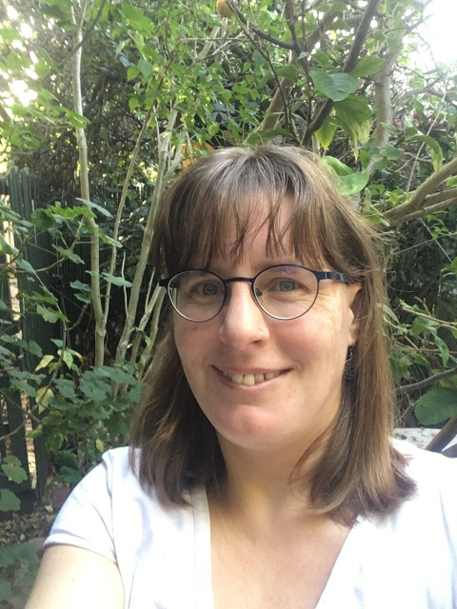
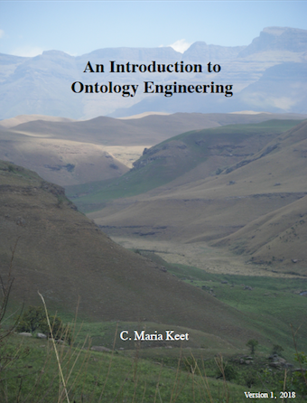
Computer Science
Introduction to Ontology Engineering
“Market analysis has shown that a textbook of this kind would cost at least 80-100 Euros, if not more. In the previous year at UCT when OE was taught, it had 30 students enrolled … hence, [the open textbook] would collectively save about R22 100 per year for UCT students alone”
Assoc. Prof. Maria Keet
https://open.uct.ac.za/handle/11427/28312
Notes:
-Associate Professor
-based in the Department of Computer Science at UCT
-recognised that there was a gap in educational material for ontology engineering in the world and that this was compounded by the issue of cost as a barrier for students being able to access commercially published textbooks within this field
-her initiative aimed to update and enhance her original ‘Introduction to Ontology Engineering’ work into an online textbook package with more educationally relevant software, exercises and tutorials, that would be openly accessible to all through the use of a Creative Commons licence
-her process involved working as a solo author in the production of her open textbook but collaborating with colleagues and students in certain aspects
-in emphasizing the issue of the cost barrier, she stated that, “market analysis had shown that a textbook like hers would cost 80-100 Euros…”
-through her initiative, she emphasized that knowledge should be available free of charge so that it can increase possibilities for further new research, scholarship and application and open education resources play an important role in this cost-saving endeavour
-believes cost savings can help to facilitate redirection of resources into parallel activities, such as translation of content into multiple languages.

Slide 19
Driver:
Accessibility and multilingualism

Slide 20
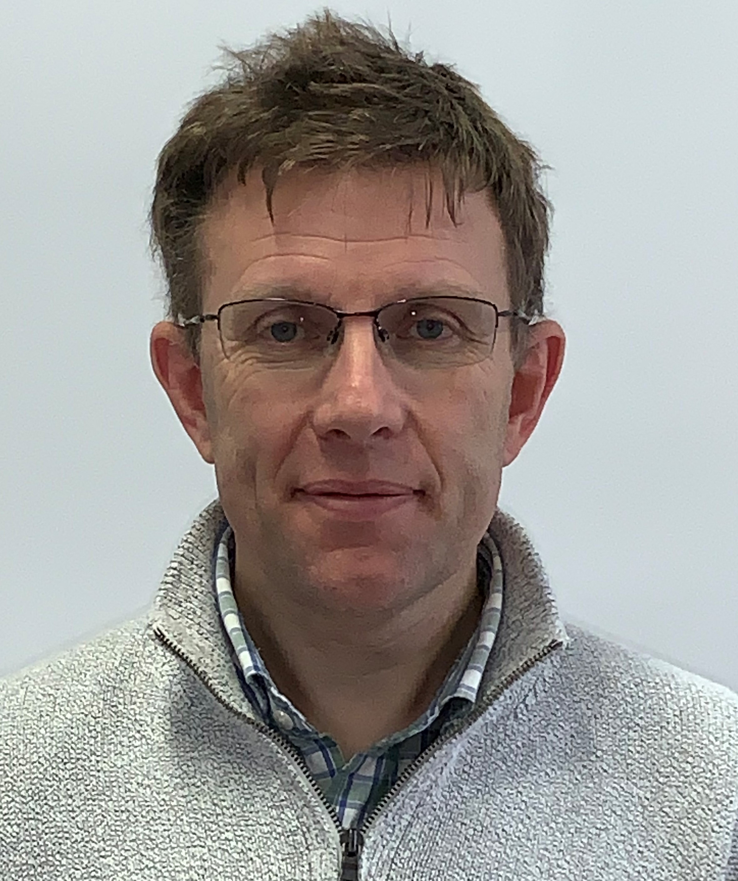

Faculty of Commerce
Introstat (multilingual edition)
“Transformation through greater inclusivity, localisation and multilingualism"
Tim Low
Notes:
-Senior Lecturer in mathematics and statistics
-Faculty of Commerce
-recognised the disparities between high school mathematics and the new material that students are exposed to when they enter university and he recognised the barriers and challenges faced by first-year university students who have English as a second or third language when they learn statistics for the first time at university.
-initiative aimed to create a localised, openly licensed resource which provides a translation of components of UCT first-year statistics textbook into isiXhosa as a way to support the UCT Language Policy whose objective is to develop multilingual awareness and proficiency
-his process involved working with language specialists from the Department of Linguistics at UCT as well as Xhosa-speaking statistics students and tutors who would add value to the content creation process
-his work seeks to contribute to, support and advocate for, “transformation through creating greater inclusivity, localisation and multilingualism”

Slide 21
MODELS

Slide 22
Authorship models
Abimbola | Claire | Kensley | Stella | Michael | Maria | Jonathan | Tim | James | Ingxoxo
Solo author + student involvement | Solo author + student involvement | Solo student author + staff involvement | Lead author as editor-in-chief with student co-authors | Lead author as editor-in-chief with student and colleague co-authors | Solo author + student involvement | Lead author as editor-in-chief with student and colleague co-authors | Content development facilitator with student and colleague co-authors | Lead author as editor-in-chief with colleague co-authors | Content development facilitator with student and colleague co-authors
Solo author + student involvement
Solo student author + staff involvement
Lead author as editor-in-chief with student co-authors
Lead author as editor-in-chief in with student and colleague co-authors
Content development facilitator with student and colleague co-authors
3
1
1
Content review
2
3
Graphics production

Slide 23
Quality assurance models
Abimbola | Claire | Kensley | Stella | Michael | Maria | Jonathan | Tim | James | Ingxoxo
Professional editing and proofreading Student review Publisher peer review | Student review Proofreader | Supervisor review Institutional Intermediary editorial support | Student review Institutional Intermediary editorial support Institutional Intermediary publishing support | Delphi consensus study Colleague review Community review | Student review Colleague review | Student review Colleague review | Student review Colleague review | Student review Colleague review Institutional Intermediary editorial support Institutional Intermediary editorial support | Student review Colleague review
Delphi consensus study
Institutional intermediary editorial support
Institutional intermediary publishing support
Student review
Colleague review
1
3
2
8
6
Professional editing and proofreading
Supervisor review
Publisher peer review
2
1
1

Slide 24
Publishing models
Abimbola | Claire | Kensley | Stella | Michael | Maria | Jonathan | Tim | James | Ingxoxo
Author as self-publisher with external publishing partner | Initiative as self-publisher | Author as self-publisher | Initiative as self-publisher | Initiative as self-publisher | Author as self-publisher with external publishing partner | Initiative as self-publisher | Initiative as self-publisher | Institution and department as co-publishers | Initiative as self-publisher
Author as self-publisher
Initiative as self-publisher
Author as self-publisher with external publisher
Institution and department as co-publishers
1
6
1
2
Notes:
Future work is to explore relationships between three ‘models’ components

Slide 25
CHALLENGES, INSTITUTIONAL SUPPORT & SUSTAINABILITY

Slide 26
What is challenging about trying to articulate open textbook creation and publishing models?
Disciplinary divergence
Varying levels of technical proficiency (staff and students)
Avoid straight-jacketing creative practice

Slide 27
Time it takes… “time is a problem ... time and energy”
Collaboration
Technology and tools choice
….
...
Content development
Publishing process

Slide 28
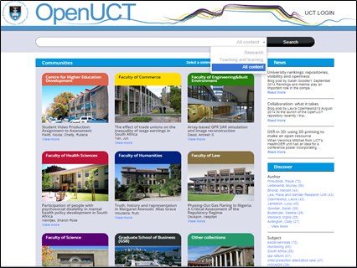



Institutional support
Notes:
Institutional support
Grants
OT expertise
Library

Slide 29
Addressing sustainability
There is a nascent cohort of open textbook authors (including students and academics) and other collaborators at UCT.
Cost Savings |  | Need for curriculum transformation
Cost in terms of time for academics | Current austerity measures in HE | Need for expertise to produce OTs | Distributed approach
Hypothesis: Partnerships are critical for sustainability

