Slide 1


Open access for excellence and equity
Laura Czerniewicz
Berlin 9 Conference
November 2011

Slide 2
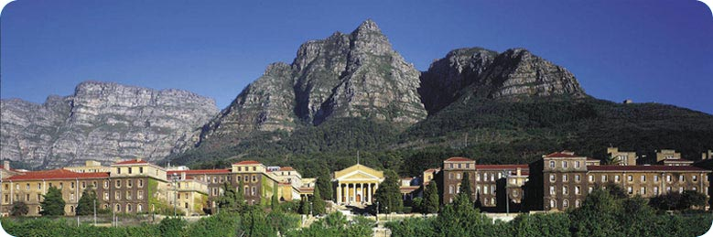
107

Slide 3
University of Cape Town
Oldest South African university
Top ranked African university
QS World University Rankings
The Times Higher Education World University Rankings
Academic Ranking of World Universities
Medium sized – 25 000 students
Changed demographics since apartheid ended in 1994

Slide 4
Prestigious research
Africa Earth Observatory Network [(AEON)] http://www.aeon.uct.ac.za, an Earth Science initiative to promote Earth Stewardship through science, partners in Germany & France.
The Department of Mathematics and Applied Mathematics is an international centre for research in the fields of cosmology and topology.
The Department of Physics is home to the UCT-CERN research centre, which is partially responsible for the software design of the High Level Trigger component of the ALICE experiment at the Large Hadron Collider, as well as other activities related to ALICE.
The Department of Electrical Engineering is involved in the development of technology for the Karoo Array Telescope (KAT). KAT is a precursor to the Square Kilometer Array, a proposed International project to build the world's largest radio telescope by 2020. Research groups in RF design and digital design contribute to the RF front-end and digital back-end of the KAT project.
The Institute of Infectious Disease and Molecular Medicine [(IIDMM)] http://www.uct.ac.za/depts/iidmm is engaged in research on candidate tuberculosis vaccines, and is developing candidate HIV vaccines matched to the South African epidemic.
The MRC/UCT Medical Imaging Research Unit [(MIRU)] http://www.miru.uct.ac.za, inspired by the work of alumnus Allan McLeod Cormack who won a Nobel Prize for the CAT-scanner, studies brain and cardiac function and develops diagnostic imaging tools, one of which has led to the spinout of CapeRay.

Slide 5
South Africa
South Africa is the 7th most unequal country in the world (as determined by Gini co-efficient)
SA is at 145 out of 151 countries - Gini index 57.8%
The USA is 86 with an index of 40.8%
65% of SA population live on less than $3000 a year
The poorest 20% of the population account for 2% of consumption: the richest 20% of the population account for 66.5% of total consumption (Achar 2005).
14.1 mill social grant recipients in 2010 (50 million)
Notes:
The UNDP HDR (2004) reports a consumption survey which suggests that
The number of social grant recipients increased from 2.6 million in 1997 to 14.1 million in 2010. (South African Social Security Agency) (2011-06-08)
Namibia is the most unequal country in the world with a Gini index of 74.3% SA is at 145 with a Gini index of 57.8%. See http://www.visionofhumanity.org/gpi-data/#/2011/gini/. Azerbaijan is the lowest with a Gini index of 16.8%. US has index of 40.8% (86 on list out of 151)
Prabhala, A (2005) “Economic Analysis of Income and Expenditure Patterns in South Africa: Implications for the Affordability of Essential Learning Materials,” A2LMSA working paper, Johnnesburg. http://www.aca2k.org/en/projects/a2lmsa.html

Slide 6
Need for graduates
“Firstly, skills deficits and bottlenecks, especially priority and scarce skills, contribute to structural constraints on our growth and developmental path. Secondly, a skilled and capable workforce is critical for decent work, an inclusive economy, labour absorption, rural development, the reduction of inequalities and the need for a more diversified and knowledge intensive economy,”
Minister for Higher Education and Training, Dr. Blade Nzimande
3 May 2011 Pretoria

Slide 7
Schooling system taking strain
Serious disparity of learning achievement by socioeconomic status & geography
eg 10% of Gr 6 students from poorest quartile reading at Gr 5 level
yet 70% from wealthiest quartile were
SA rated 138th out of 142 countries ito maths and science education (Global Competitiveness Report 2011/12)

Slide 8
Higher education Inequity of participation
Country | %
Nigeria | 10%
South Africa | 15%
United Kingdom | 60%
Australia | 72%
United States | 83%
South Korea | 91%
Higher Education Gross Enrolment Rate of the relevant age group
Total enrolment as percentage of 20-24 age-group
GRE = total enrolment - of any age - in a grade or phase is pressed as a percentage)
UNESCO figures in Scott 2009
Notes:
Scott, I. 2009. First-year experience as terrain of failure or platform for development? Critical choices for higher education. In B. Leibowitz, A. van der Merwe and S. van Schalkwyk (eds.) Focus on first-year success. Stellenbosch: SUN Press.
Scott, I. 2009. Towards an Agenda for SoTL in Africa? International Journal for the Scholarship of Teaching and Learning Volume 3, Number 1, January 2009. http://academics.georgiasouthern.edu/ijsotl/v3n1/invited_essays/_Scott/index.htm

Slide 9
HE Gross Enrolment by race
Total enrolment in 2005 as percentage of 20-24 age-group
White | 60%
Indian | 51%
Coloured | 12%
Black/African | 12%
Source: Scott, Yeld and Hendry 2007

Slide 10
Inequity of outcomes
30% of students graduate within five years
It is estimated that under 45% of the intake will ever graduate.
Even in the the ‘contact’ universities (excluding distance education), only 50% of the intake graduate within five years.
Drop-out in vocational diplomas is much higher, around 60%.
In most contact university programmes, black graduation rates are under half of those for whites, and (despite the enrolment and population demographics – under 10% of the population is white) there are fewer black than white graduates.
The net effect is that under 5% of the 20-24 year-old black age-group are succeeding in any form of higher education.
Scott 2009
Notes:
First-time entering student cohort studies (Scott, Yeld and Hendry, 2007; Letseka and Maile, 2008)
http://www.ieasa.studysa.org/resources/Study_SA/Facts_Figures_section.pdf

Slide 11
Response
Multipronged response including curriculum support, extended programmes etc
Need for adequate, available, appropriate resources critical
Scholars
Students
Community
The quadruple helix (university, government, industry, civil society organisations)(Cooper 2011)
Notes:
The University in Development: Case Studies of Use-Oriented Research by David Cooper 2011 HSRC Press (http://www.hsrcpress.ac.za/product.php?productid=2286&cat=0&page=1&featured)

Slide 12
Scholarship – Boyer (1990)
Conceptualisation
Data Collection
Findings
Engagement
Translation
Data Analysis
Scholarship of teaching
Scholarship of discovery
Scholarship of engagement
Notes:
Boyer's model of scholarship is In the 1990 publication "Scholarship Reconsidered", Ernest Boyer introduced an academic model advocating four types of scholarship According to Boyer, traditional research, or the scholarship of discovery, had been the center of academic life and crucial to an institution's advancement but it needed to be broaden and made more flexible to include not only the new social and environmental challenges beyond the campus but also the reality of contemporary life. His vision was to change the research mission of universities by introducing the idea that scholarship needed to be redefined.
He proposed that scholarship include these four different categories:
The scholarship of discovery that includes original research that advances knowledge.
The scholarship of integration that type involves synthesis of information across disciplines, across topics within a discipline, or across time.
The scholarship of application (also later called the scholarship of engagement) that goes beyond the service duties of a faculty to those within or outside the University and involves the rigor and application of disciplinary expertise with results that can be shared with and/or evaluated by peers.
The scholarship of teaching and learning that the systematic study of teaching and learning processes. It differs from scholarly teaching in that it requires a format that will allow public sharing and the opportunity for application and evaluation by others.
Wikipedia

Slide 13
Teaching and learning resources

Slide 14
Teaching and learning resources
Most university textbooks imported
Numbers beyond 1st year too small for local publishers to publish for
Cost of textbooks, high
SA study - the cost of a year’s learning materials up to one third of the cost of tuition. (Achar 2005)
Content often unsuitable, lack of local case studies, lack of local issues
Notes:
small/few local textbooks beyond first year

Slide 15
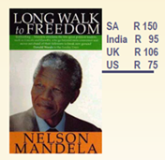
Relative affordability
0.2% of GDP/capita – US
6.5% of GDP/ capita – SA
Prepared to pay $316?
Achar 2005

Slide 16
Availability
Book sellers under-order
Imported text often can’t be replenished on time
Photocopying
Students
Desperate lecturers
Textbooks torrents

Slide 17
OERs critical

Slide 18
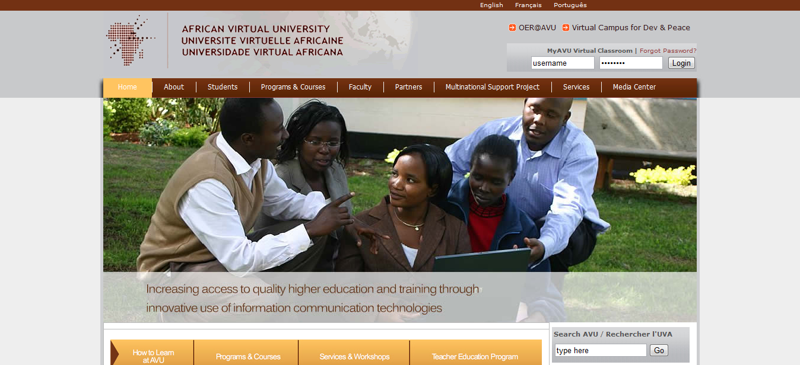
Notes:
An example is the African Virtual University (AVU) which through its Open Education Resources Portal provides an example of both community building and contribution. Through the AVU Portal launched in January 2011, the AVU has made available 219 open educational modules in three languages (largely in maths and science). These were developed collaboratively by clusters in 10 African countries and the resources have been downloaded by 142 countries, with significant numbers from Brazil and the United States (Diallo 2011). The Portal has been internationally recognised, receiving the Best Emerging Initiative Award in the OpenCourseware People’s Choice Awards in 2011.

Slide 19
Launched January 2011
219 open educational modules in three languages
Developed collaboratively by clusters in 10 African countries
Downloaded by 142 countries
significant numbers from Brazil and the United States
Diallo 2011

Slide 20
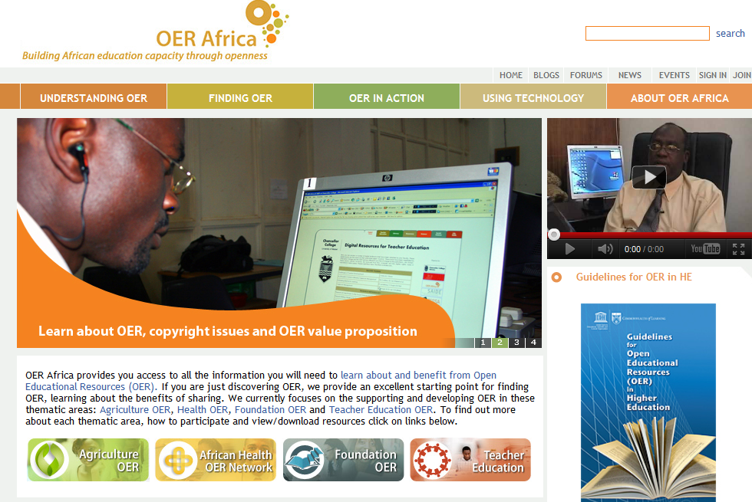
Notes:
OER Africa (www.oerafrica.org) was established in 2008, with funding from the William and Flora Hewlett Foundation, as a new initiative of the South African Institute for Distance Education (SAIDE). Its goal is to leverage African experts and expertise to harness the concept of open educational resources (OER) to benefit higher education systems, institutions, academics, and students on the Continent and around the world. The African Health OER Network (www.oerafrica.org/healthoer/) was launched in 2009 in conjunction with a consortium of African medical schools and the University of Michigan in order to facilitate the creation and sharing of educational resources in the health sciences - both on the Continent and globally. The Network is collaborating with a large number of institutions around the world.

Slide 21
Opening Scholarship
The OpenContent Directory

Slide 22
OpenContent Directory
Development funded by Shuttleworth
Located in CET, Teaching & Learning Resources
Launched February 2010
To date 800 downloadable items
Different granularity
63,835 site visits from 179 countries

Slide 23
It has made the university more visible because our OER are out there…Lately KNUST is priding itself on being the best university in Ghana and this is partially based on the Webometrics ranking of the university’s visibility. And OER have contributed, I think, in a small way, towards making the university more visible.
Peter Donkor 2011
Provost College of Health Science, Kwame Nkrumah University of Science and Technology
Notes:
http://www.oerafrica.org/FTPFolder/Website%20Materials/Health/case_studies/2011.05%20Knust_Low_Res.pdf

Slide 24
Open access offers students more

Slide 25
Scholarship
Student
Literature Reviews
Conceptual Frameworks
Bibliographies
Conceptualisation
Data Collection
Findings
Engagement
Translation
Data Analysis
Proposals
Presentations
Recorded interviews
Lectures
Data sets
Notes
Images
Audio records
Interviews
Reports
Closed inefficient provision of learning resources for students as present
Books
Conference papers
Journal articles
Technical papers

Slide 26
Open Scholarship new possibilities for students
Literature Reviews
Conceptual Frameworks
Bibliographies
Conceptualisation
Data Collection
Findings
Engagement
Translation
Data Analysis
Proposals
Student
Notes
Recorded interviews
Lectures
Data sets
Presentations
Images
Reports
Audio records
Interviews
Books
Conference papers
Journal articles
Technical papers

Slide 27
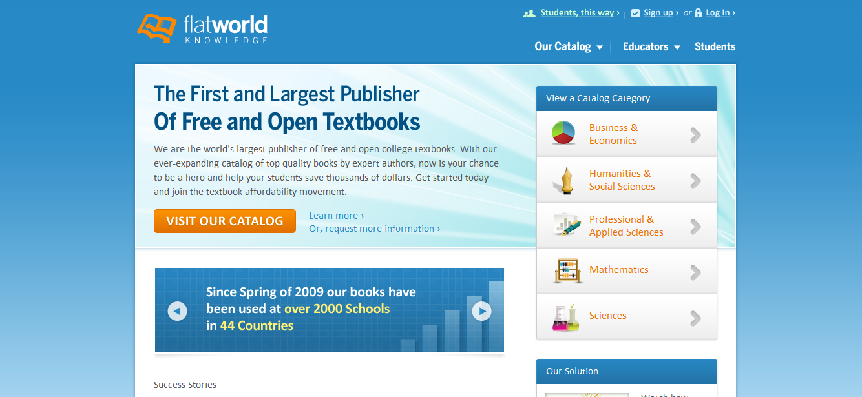
Notes:
Flat World Knowledge was created to address dissatisfaction with traditional textbooks. We kept what works - peer-review, expert authors, editorial development, and teaching supplements. We fixed what doesn’t.
The average cost of textbooks per year for students is often upwards of $950, and prices only continue to increase. Our books are free online, with affordable offline options also available. Students are able to select the format and price they want. We offer print-it-yourself copies, black-and-white and full-color soft cover editions, at a fraction of the cost of the average hardcover book.
Our books are open and customizable. You are able to modify them if you like, to fit your course.
New editions are on your terms. Flat World never forces you into a new edition.
What format options are available to students?Students can read free online as often as they like. If they prefer a printed book, we offer a variety of offline formats designed to suit nearly any personal preference and budget.
Print it Yourself (PIY) PDFs can be downloaded to your students’ local hard drive and printed out.
Black and Whitesoft cover copies can be received within 4-10 business days, depending on the method of shipping the student chooses.
Full Color soft cover copies can be received within 4-10 business days, depending on the method of shipping the student chooses.
Individual PIY Chapters are also available, for a nominal per chapter fee.
Audio Versions of the books are also available – ideal for the student on-the-go or aural learners.
eBooks are available for those with e-Readers or e-Reader software (i.e. Amazon Kindle, Barnes and Noble nook, iPad, etc).

Slide 28
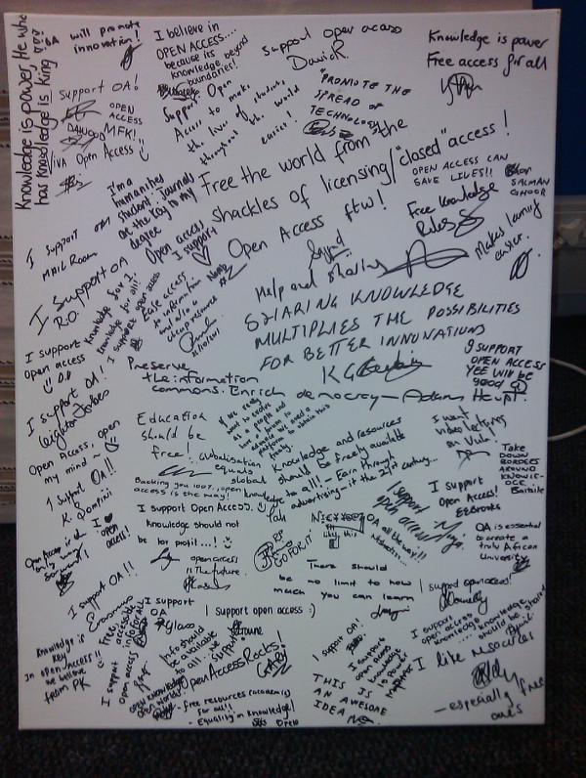
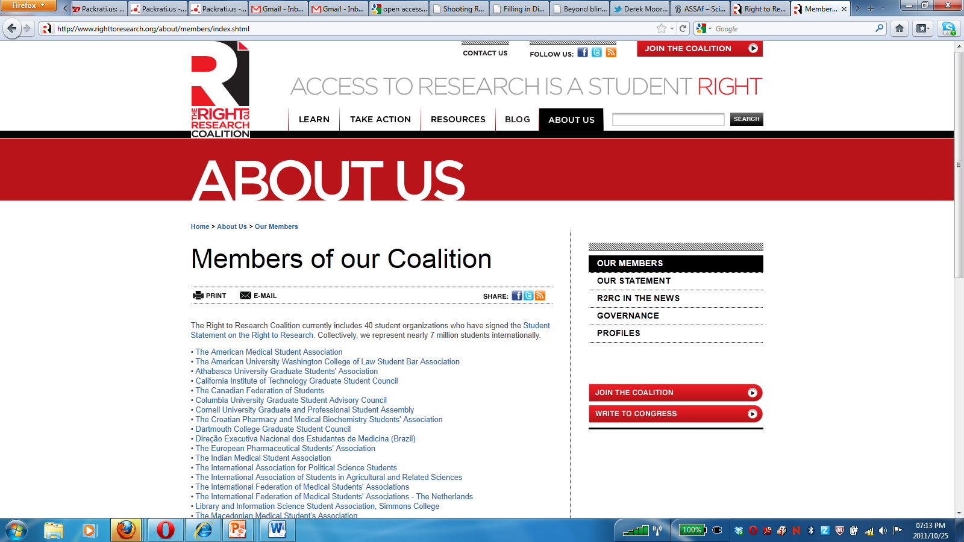
Student support for OA
Notes:
7 million students internationally, canvas on right University of Cape Town students during Open Access Week October 2011

Slide 29
Research- teaching continuum

Slide 30
Changing post-graduate space
Internationalisation
Life long learning
Commodification
Professionalisation
Modes of engagement:
Classroom, group
Modes of engagement:
Individual, supervision
UG
PG
Resources: pedagogised
Resources: not pedagogised
Concept- Lucia Thesen 2011

Slide 31
Scholarship of engagement

Slide 32
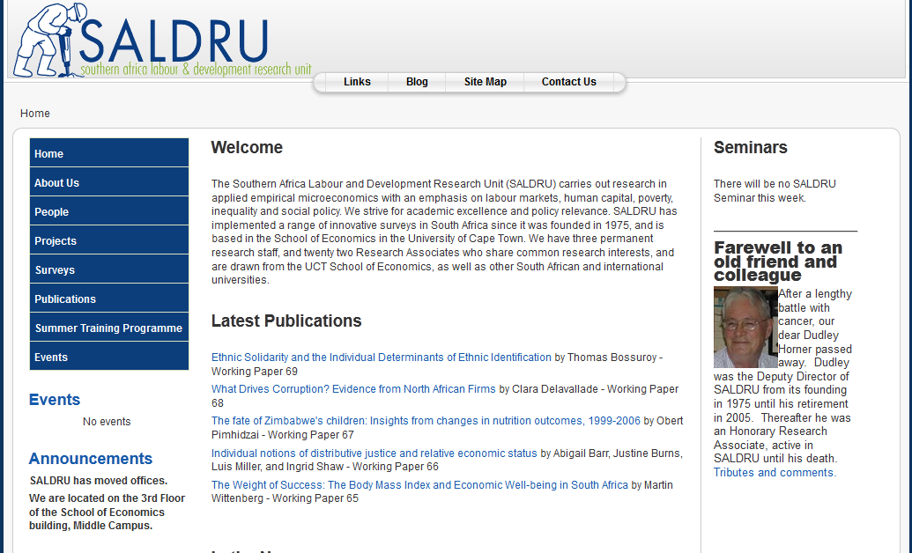

Slide 33

OA supports all core business
Research
Teaching
Engagement
Notes:
New modes of research and new types of research groupings
The University in Development, Case studies in use Oriented Research Dave Copper HSRC Press 2011 `

Slide 34

Strategic goals
Internationalising UCT via an Afropolitan Niche
Transformation of UCT Towards Non-Racialism - Redress, Diversity, Inclusiveness and the Recognition of African Voices
A Vision for the Development of Research at UCT: Greater Impact, Greater Engagement
Enhancing the Quality and Profile of UCT's Graduates
Expanding and Enhancing UCT's Contribution to South Africa's Development Challenges

Slide 35
How will it be possible?
The technology

Slide 36
Mobiles broadly
“always-connected” devices, ie sim enabled devices
Non-WAP enabled cell phones
WAP phones
Smartphones
Tablets
Ereaders
Notes:
More adults in SA have cell phones than flush toilets (According to AMPS2010 25.1 million adults (15+) personally own, rent or have use of a cellphone. 20.7 million have a flush toilet in the homes or on their properties.)

Slide 37
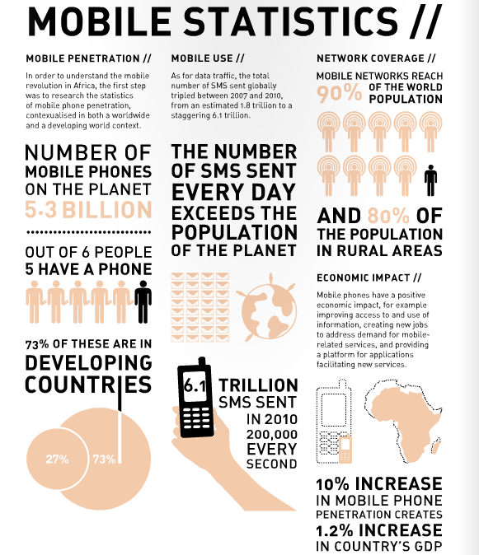
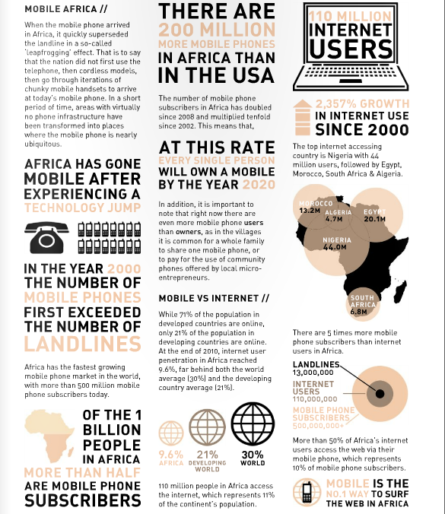

Slide 38
The stats
500 million+ mobile phone subscribers in Africa today, more than half of the continent’s population.
Of the 110 million Africans who do use the internet, more than half do so via their mobile phone
Mobile cell coverage is at nearly 90% of the population
Notes:
Jenni Parker 2011, MOBILE, LEARNING TOOLKIT\
The Mobility 2011 research project, conducted by World Wide Worx and backed by First National Bank, reveals that 39% of urban South Africans and 27% of rural users are now browsing the Internet on their phones. The study excludes “deep rural” users, and represents around 20-million South Africans aged 16 and above. This means that at least 6-million South Africans now have Internet access on their phones.
The most dramatic shift of all, however, is the arrival of e-mail in the rural user-base and its growth among urban users. There has been a substantial shift among the latter, with urban use rising from 10% in 2009 to 27% at the end of 2010. While the percentage growth among rural users is lower, the fact that it was almost non-existent a year before means the 12% penetration reported for 2010 indicates mobile e-mail becoming a mainstream tool across the population.
While cameras, diaries and games continue to dominate the list of features used on phones, FM radio and music players have become part of a mobile “Big Five”. However, there is a significant difference in the features preferred by urban and rural phone users. Three quarters of urban respondents (75%) use their phone cameras, but little more than half of rural respondents (55%). Music players on the phone get the vote of 53% of urban users, versus 36% of rural users. Surprisingly, the gap is reversed when it comes to games on the phone: 54% of urban users enjoy these, compared to 65% of rural users

Slide 39
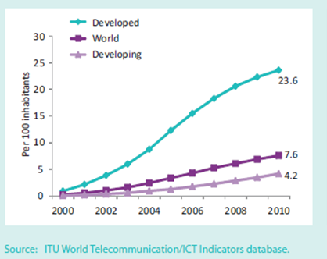
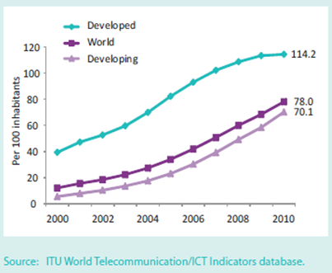
Mobile
Fixed broadband subscriptions
200-2010
Mobile cell subscriptions 2000-2010

Slide 40
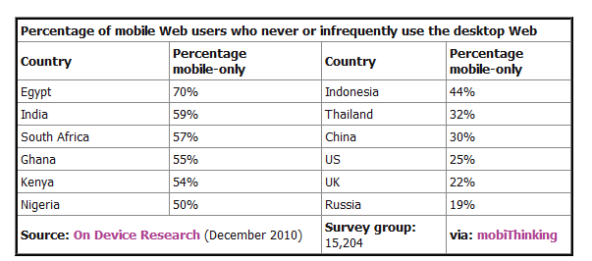
Mobile web dominance
dotMobimobiThinkingmobiForgeready.mobiDeviceAtlasgoMobi
Notes:
Specific details of cell phone ownership and use by all South African students are not available. Research amongst school children research shows that 98-99% of high school learners across all school types owned a cell phone (Tustin, D, van Aardt, I & Shai, 2009, New media usage and behaviour among adolescents in selected schools of Gauteng, UNISA).

Slide 41
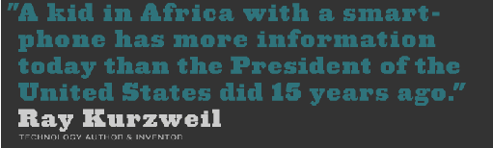
The rise of smartphones
Estimate for SA 8 million
Estimate for SA students 70%
and
Emergence of cheap tablets
/
Tarrant, September 2011, memeburn; Student Village 2011
Notes:
Kurwel quote from http://lonewolflibrarian.wordpress.com/2011/10/17/how-opencourseware-is-democratizing-the-college-classroom-10-17-11
Apps images from Information 2.0 and Beyond: Where are we, where are we going? Kristen Purcell, Ph.D.Associate Director, Research Pew Internet Project Presented at APLIC 44th Annual Conference March 29th, 2011 Washington, DC
With millions of smartphones in South Africa, where are all the apps? 19 inShare By Hilton Tarrant: Columnist
http://memeburn.com/2011/09/with-millions-of-smartphones-in-south-africa-where-are-all-the-apps/?utm_source=feedburner
StudentVillage 2011- survey re smartphones

Slide 42
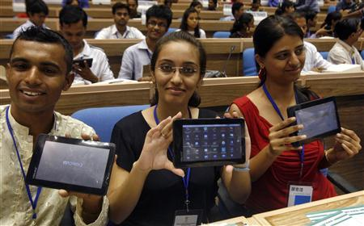
Notes:
India launched what it dubbed the world's cheapest tablet computer Wednesday, to be sold to students at the subsidized price of $35 and later in shops for about $60.
(http://www.reuters.com/article/2011/10/05/us-india-tablet-idUSTRE7940YV20111005)

Slide 43

Open content
Open access
Open Scholarship

Slide 44

Laura.czerniewicz@uct.ac.za @czernie

