Slide 1
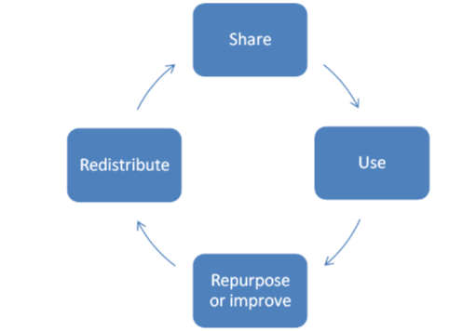
Review of
Open Educational Resources
Cheryl Hodgkinson-Williams & Stephen Marquard
ASAUDIT Meeting
16 October 2012
University of Stellenbosch

Slide 2
Brief
Cheryl approached by Dale Peters to provide:
  an overview of OER in general and
  OER in South Africa

Slide 3

Philosophy of OER
  OER is based on the philosophical view of ‘knowledge as a collective social product and the desirability of making it a social property’ (Prasad & Ambedkar cited in Downes 2007:1)

Slide 4
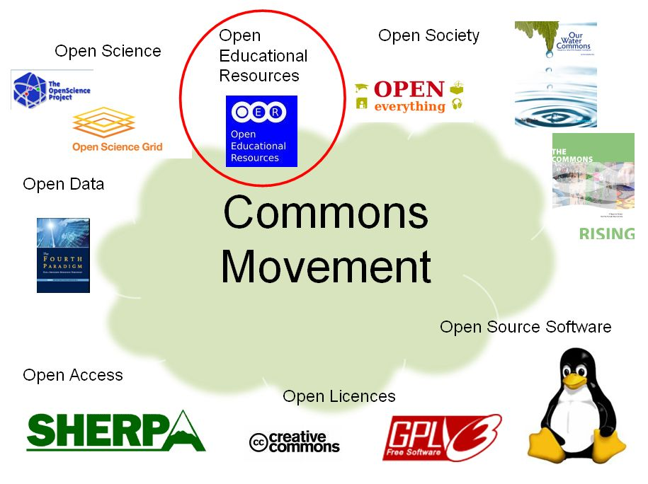
OER part of the “open movement”

Slide 5
What is OER?
  Open educational resources (OER) are educational materials (usually digital) that are:
    shared freely and openly
    for anyone to use under some type of license
    to repurpose/ improve and
    redistribute

Slide 6
eLearning materials
OER
Stored in the LMS/
CMS
Not necessarily
openly licensed
Used to support
students learning
Available online
Openly licensed
Used to support
students' learning
intersection represents open,
electronic, instructional resources
Adapted from: Fons, G. (2009). Beyond Open Access: Creating Open Educational Resources. Enriching Scholarship, May 2009. Available online: https://open.umich.edu/wiki/Open_Content_How-to
Notes:
I would like to draw your attention to the relationship between eLearning materials, which you are all probably familiar with, and OER’s. eLearning materials can be designated as OER’s if they are openly licensed and made available openly.

Slide 7
The paradox of sharing
The OECD reflects that "although learning resources are often considered as key intellectual property in a competitive higher education world, more and more institutions and individuals are sharing digital learning resources over the Internet openly and without cost, as open educational resources (OER) (2007:9).
Culture of contribution
Culture of competition
Notes:
The OECD reflects that "although learning resources are often considered as key intellectual property in a competitive higher education world, more and more institutions and individuals are sharing digital learning resources over the Internet openly and without cost, as open educational resources (OER) (2007:9).

Slide 8
Alternative copyright licensing
Previously copyright was binary: All rights retained or public domain
Copyright © |  | Public domain
Now alternative licensing options such as the GNU General Public License and Creative Commons provide a range of options where some rights are reserved
Copyright © | Some rights reserved | Public domain

Slide 9
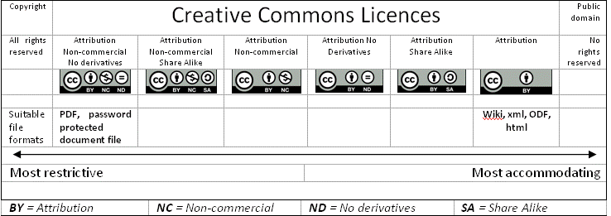
Degrees of openness
Notes:
In terms of degrees of openness – CC gives us a space to operate between all rights reserved and the public domain.
Here we demonstrate how the licenses an be combined for example non commercial AND no derivatives
Note that as you apply more restrictive clauses the material becomes more difficult for others to use.
Also note that certain media formats are easier to adapt, such as wiki and xml formats which are easily edited (built upon) and translated between applications

Slide 10
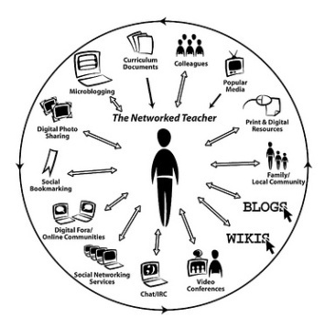
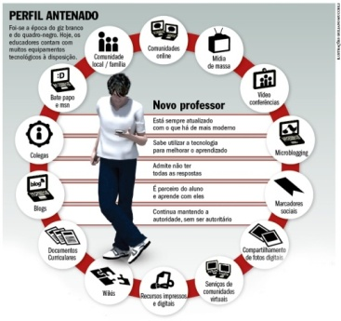
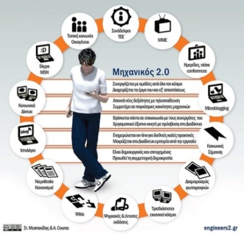
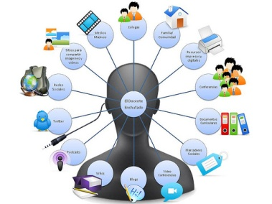
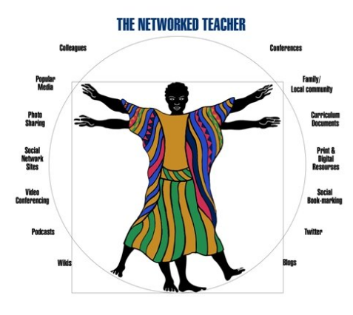
Example of OER development
Original diagram in a PhD thesis …
Improved and adapted for the Portuguese context …
Translated into Greek …
Adapted and translated to Spanish …
Adapted at the University of Cape Town
Notes:
Image 1: http://www.flickr.com/photos/courosa/2922421696/
Image 2: http://veja.abril.com.br/imagem/professorantenado.jpg
Image 3: http://www.flickr.com/photos/stylianosm/3706684606/
Image 4: http://www.flickr.com/photos/langwitches/3460307056/

Slide 11
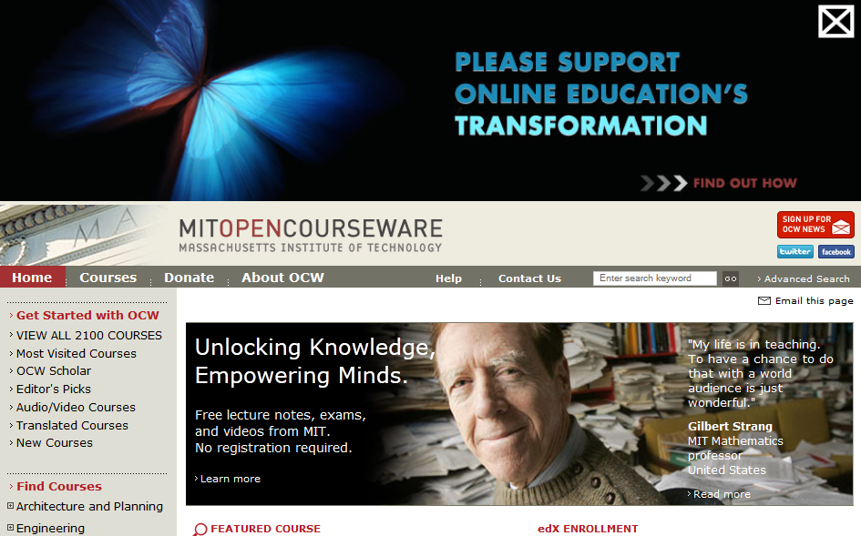
Early adopters internationally
MIT
Notes:
ocw.mit.edu/
“In 1999, MIT Faculty considered how to use the Internet in pursuit of MIT's mission—to advance knowledge and educate students—and in 2000 proposed OCW. MIT published the first proof-of-concept site in 2002, containing 50 courses. By November 2007, MIT completed the initial publication of virtually the entire curriculum, over 1,800 courses in 33 academic disciplines. Going forward, the OCW team is updating existing courses and adding new content and services to the site.” (http://ocw.mit.edu/about/our-history/ )
Today: 2100 courses, leads the OCW Consortium

Slide 12
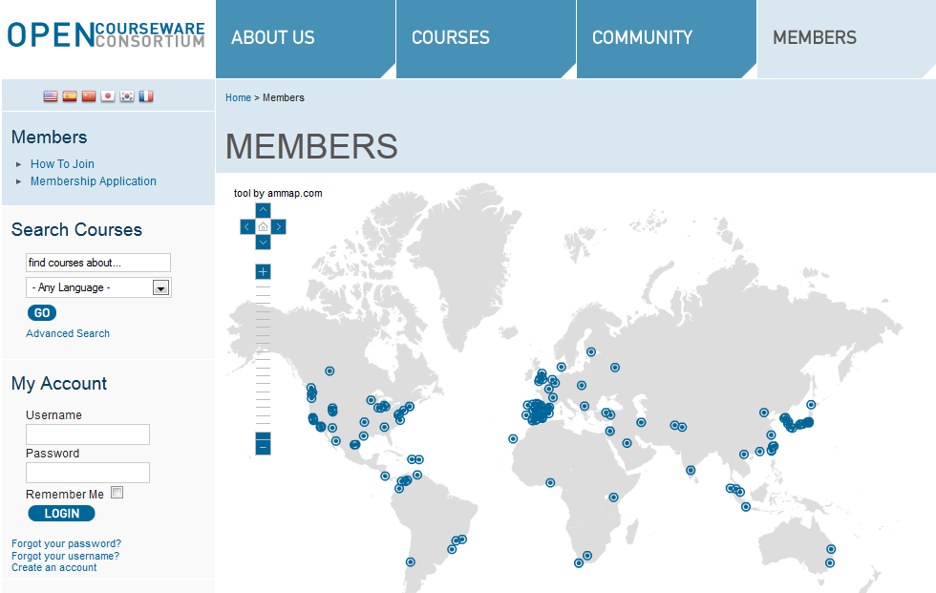
OCW Consortium
Notes:
http://www.ocwconsortium.org/

Slide 13
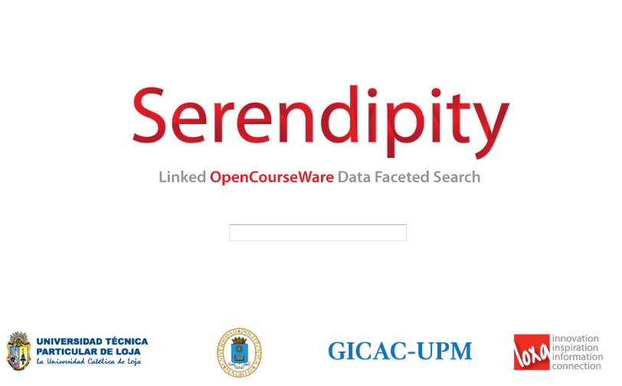
OCWC – In development
Notes:
Serendipity, unlike other traditional OCW search engines, allows users to:
· Explore OCW in an integrated and incremental manner, from any of the repositories of institutions that publish OpenCourseWare.
· Have guided navigation, starting with a basic keyword and going through several filters to refine the desired search (faceted search).
· Get more accurate and complete results, since it locates OCWs using different metadatas and data elements, providing the user with visible options that help clarify and refine the queries.
· Access the full description of the courses as published by the home institution, along with complimentary information such as language, license, author, country, geographic location of the institution and other semantically related information available via the Web.

Slide 14
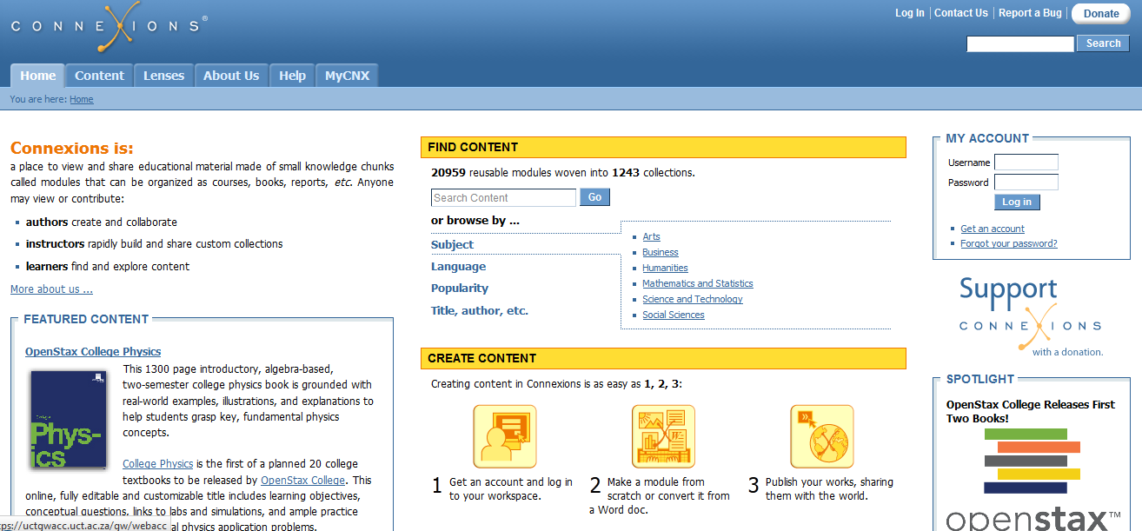
Early adopters internationally
Connexions (Rice University)
http://cnx.org/

Slide 15
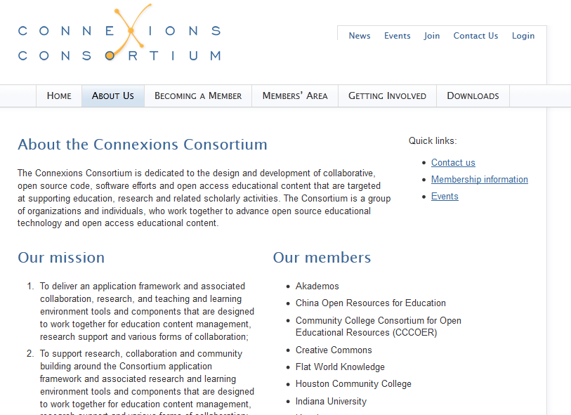
Connexions Consortium

Slide 16
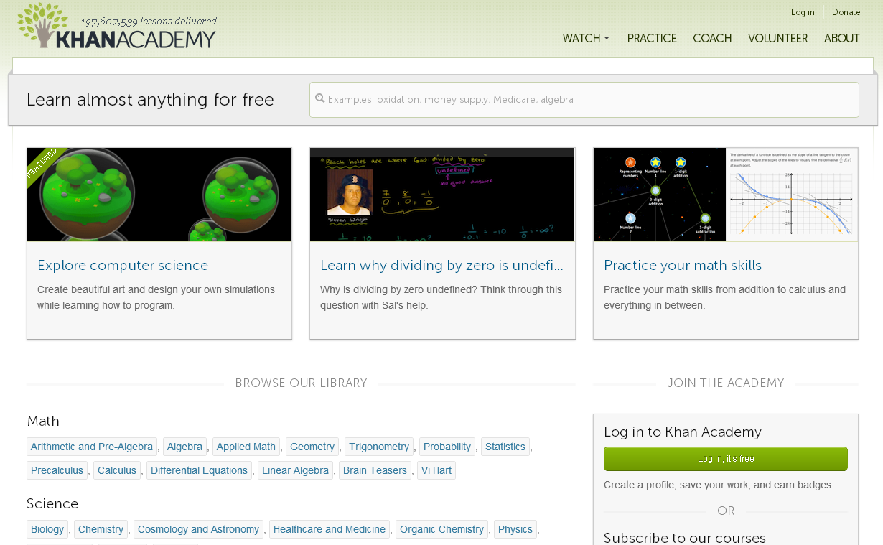

Slide 17
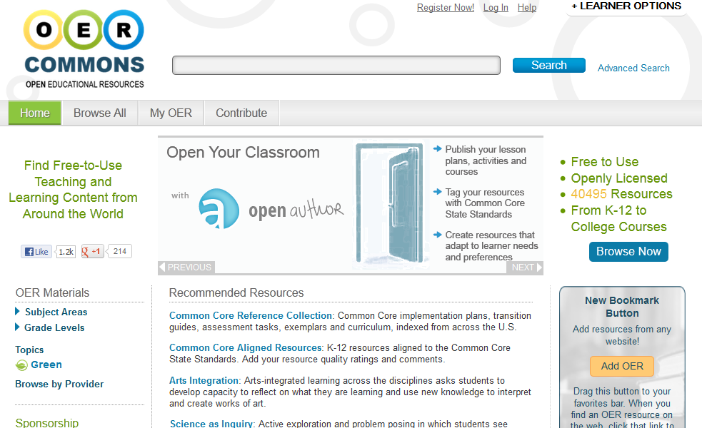
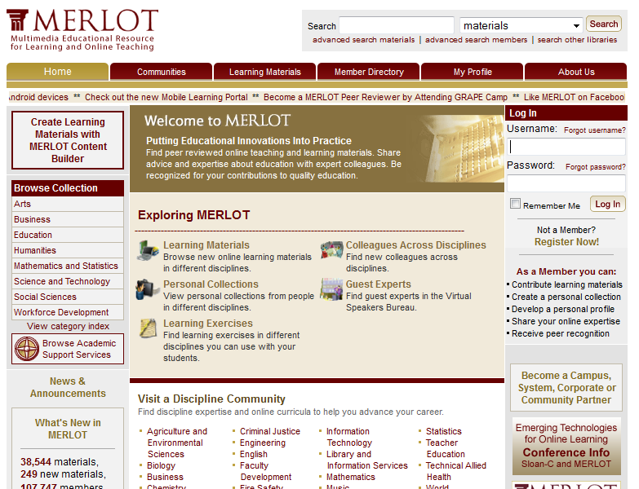
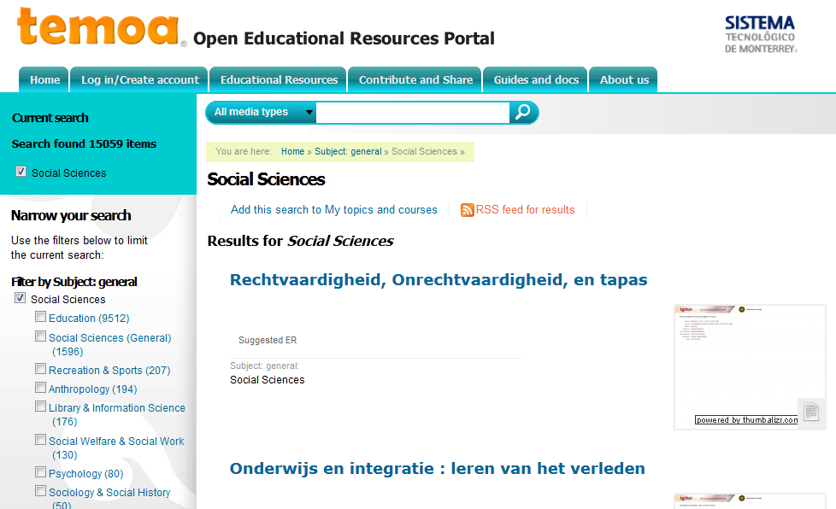
International OER Portals
Notes:
http://www.oercommons.org/
http://www.temoa.info/

Slide 18
Why OER internationally?
Increasing demand for education
Increasing cost of tuition
Increasing cost of textbooks
Rapid change in course content
Increasing competition for good students – marketing opportunity

Slide 19
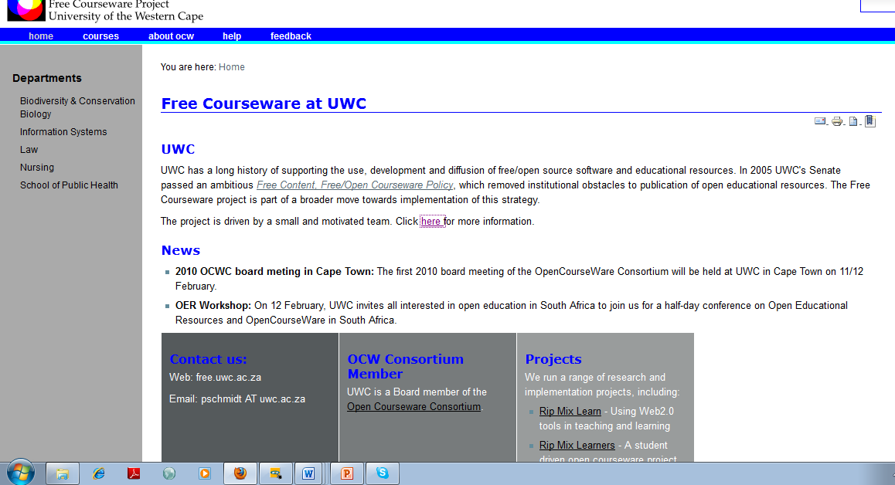
Early adopters in South Africa:
University of the Western Cape
2005
http://freecourseware.uwc.ac.za/freecourseware
Notes:
http://freecourseware.uwc.ac.za/freecourseware

Slide 20
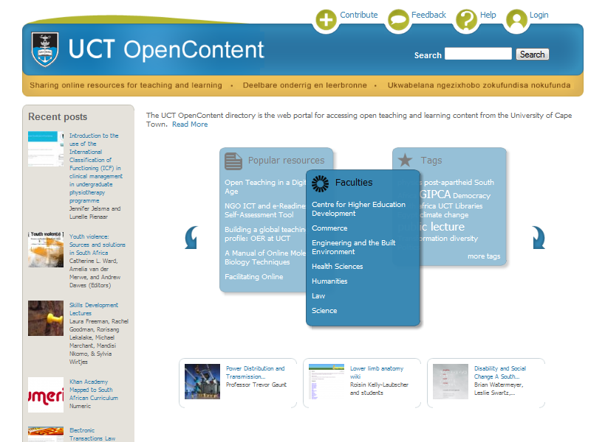
Early adopters in South Africa:
University of Cape Town
Feb 2010
http://opencontent.uct.ac.za/

Slide 21
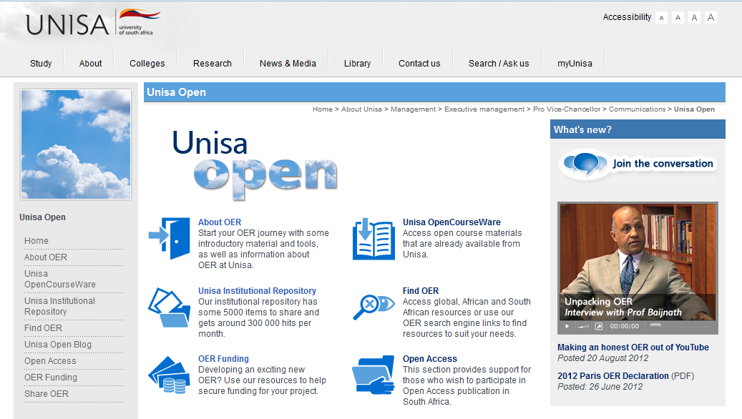
Adopters in South Africa:
UNISA
2011/12
http://www.unisa.ac.za/default.asp?Cmd=ViewContent&ContentID=27721

Slide 22
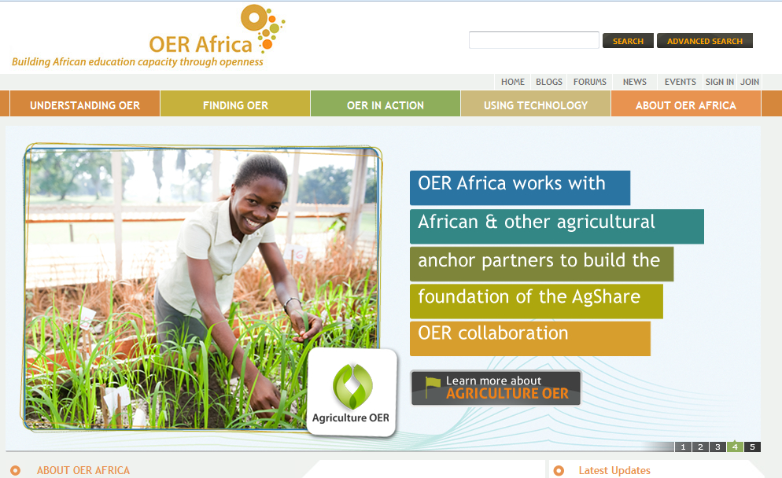
OER Africa
http://www.oerafrica.org/
Notes:
http://www.oerafrica.org/

Slide 23
Why OER in South Africa?
Increasing demand for education
Increasing cost of tuition
Increasing cost of textbooks
Rapid change in course content
Increasing competition for good students – marketing opportunity
Specifically mentioned in the Draft Policy Framework for the Provision of Distance Education in South African Universities (May 2012)
Notes:
http://www.che.ac.za/documents/d000235/DHET_Draft_Policy_Framework_on_Distance_Education_in_South_African_Universities_May_2012.pdf

Slide 24

History of UCT OpenContent
Opening Scholarship Project
(2007-2008)
Open Access
OER UCT
(March 2009 –
Feb 2010)
Open Educational Resources
Open Community
Advocating openness
(2009)
Open Access
Health OER
(2009-2010)
Open Educational Resources in Health
Open Educational Resources
Funded by the Hewlett Foundation
Funded by the Shuttleworth Foundation
Funded by the Shuttleworth Foundation
Notes:
The OER UCT project which officially commenced in March 2009 and officially ended in February 2010 was an implementation project that grew out of the Shuttleworth Foundation sponsored Opening Scholarship project which aimed at exploring the opportunities that Information Communication Technologies (ICT) and open dissemination models could offer for enhanced communication and more effective knowledge dissemination in one South African university, namely UCT (http://www.cet.uct.ac.za/OpeningScholarship). It paid attention to issues around Open Access, Open Educational Resources and what we termed “Open Community” – the kind of social engagement / responsiveness activities that universities often include in their mission statements alongside Research and Teaching. Proposals for two follow-up implementation projects were presented to the Shuttleworth Foundation to take forward ideas for creating an OER initiative at UCT and for continuing to advocate for Open Access within and beyond UCT. At the same time a separate Health-specific OER initiative sponsored by the Hewlett Foundation which is a collaboration between the University of Michigan, OER Africa, Kwame Nkrumah University of Science and Technology (KNUST), the University of Ghana (UG), the University of Cape Town (UCT), and the University of the Western Cape (UWC) (http://www.oerafrica.org/healthproject/HealthProjectHome/tabid/956/Default.aspx).

Slide 25
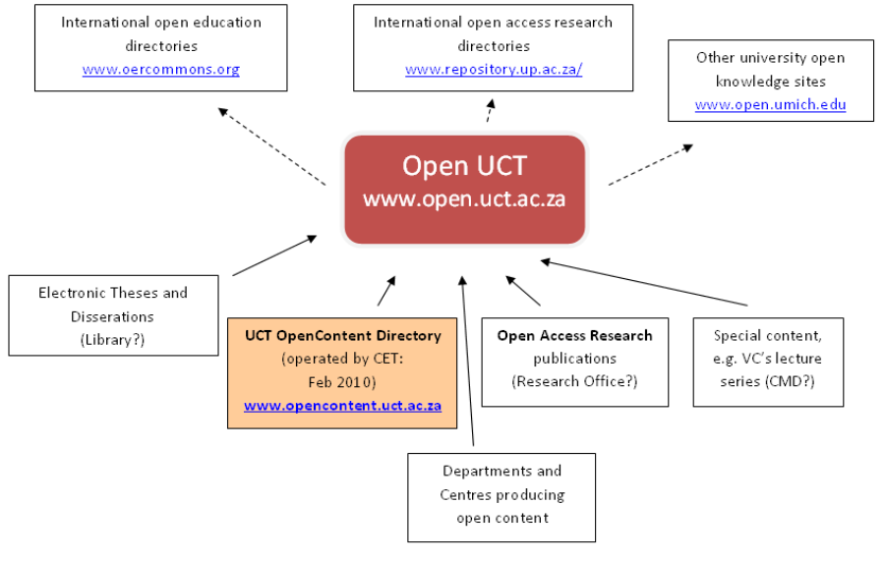
OpenUCT
Notes:
Finally we just wanted to remind you of the coming OpenUCT project which should begin to unite the various open facing projects happening at UCT. The OpenUCT project has significant funding from the Mellon Foundation will link together the various open initiatives at UCT and help engage the community. So while the UCT OC initiative is still quite small, we hope to be able to feed quite well into the larger OpenUCT project.

Slide 26
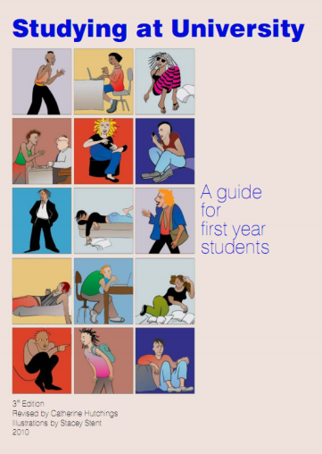
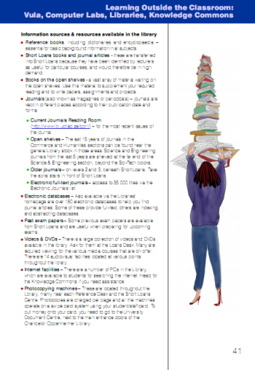
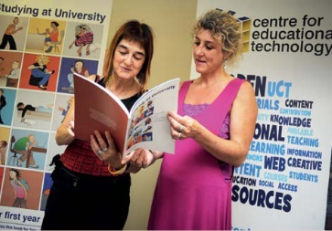
Studying at University: A guide for first year students
Created by UCT, but used by Venda University and the University of the Western Cape with new students
Stellenbosch University uses some of the illustrations
The guide has been accessed over 4398 times via the directory and over 600 physical printed guides have been sold!
Notes:
Of course the A guide for first year students, which was a resounding success and has been used by the University of Venda and the University of the Western Cape to help new students acclimate to the university environment.

Slide 27
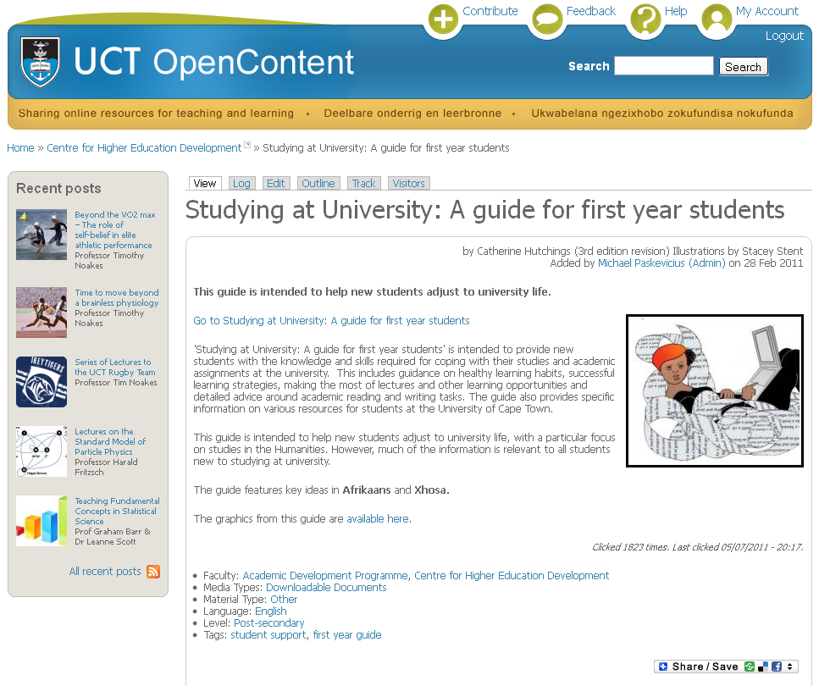
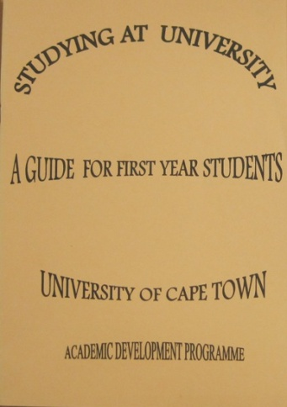
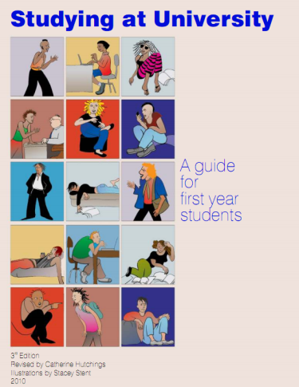
Indexing of resources
Listing content in OpenContent allows you to add metadata which increases the discoverability of a resource
This particular resource is hosted in Vula, but described and shared in OpenContent
Notes:
The OpenContent directory allows you to add context to your online resource by adding metadata which describes what it is. This makes it searchable, discoverable, and furthermore makes it part of the UCT collection of open online educational content. I think there is a real benefit, in being part of the collection of open resources we make available from UCT. We share our listings with other international directories, so that people searching all around the world
You can submit your link and describe your content, no matter where it is hosted online. This particular resource, originally printed and published in the late 90’s found new life after having a makeover and being shared in the OC directory. The pdf version of the manual is hosted on Vula, but we use OC do describe it so that people can discover it online.

Slide 28
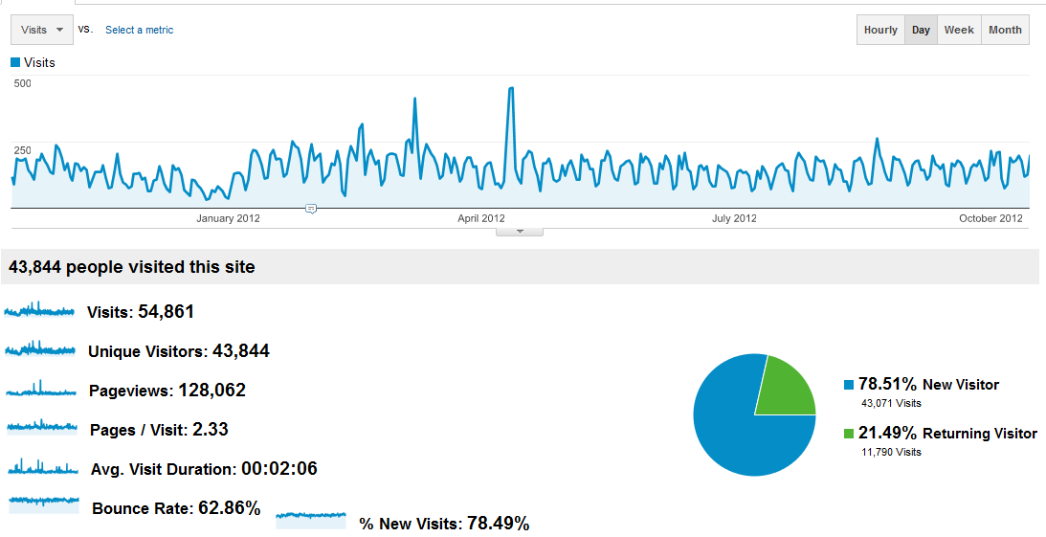
OpenUCT visits
15 Oct 2011- 15 Oct 2012

Slide 29
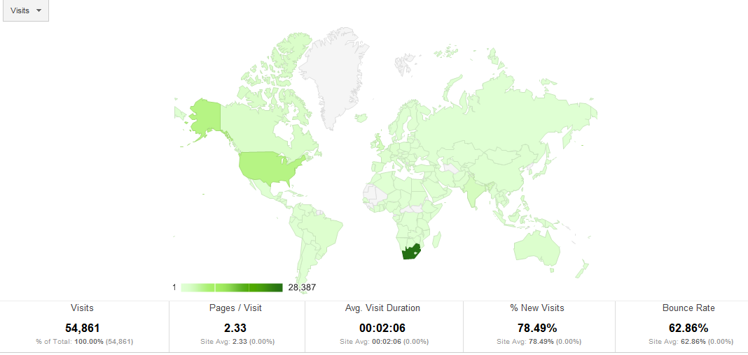
OpenUCT location of visits
15 Oct 2011- 15 Oct 2012

Slide 30
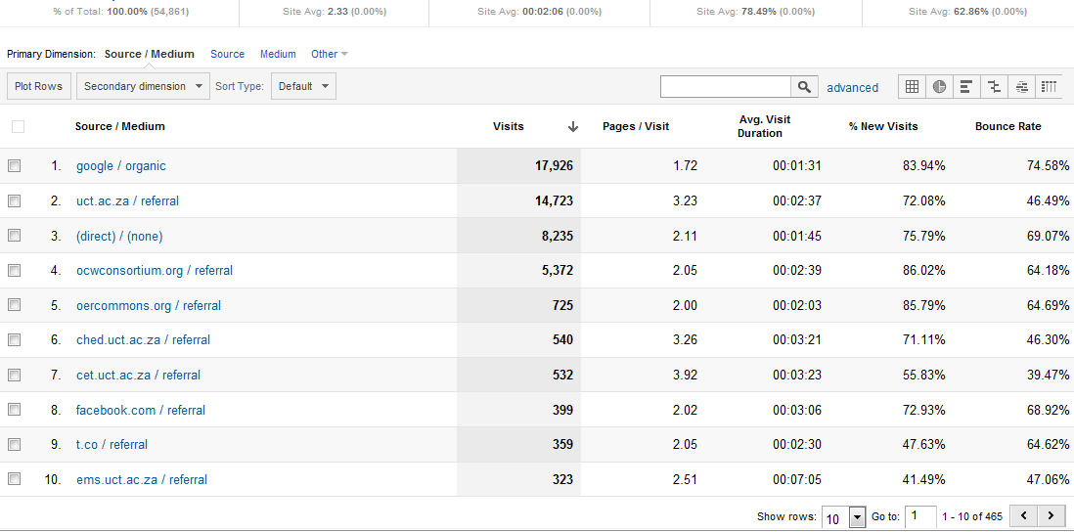
OpenUCT traffic & referrals
15 Oct 2011- 15 Oct 2012

Slide 31
Hosting
OERs come in many different types of media
  e.g. PDF, Powerpoint, Prezi, audio, video, static websites (HTML), dynamic websites (e.g. wiki)
Initial approach of UCT OpenContent is to link to the underlying content via URL: flexible but fragile
Some types of media are best hosted in cloud / social media platforms (e.g. video on Youtube), but institutions should still retain original highest-quality versions for long-term preservation (and subsequent format conversion)
Planning to implement a DSpace repository for UCT OpenContent (store some types of content internally)

Slide 32
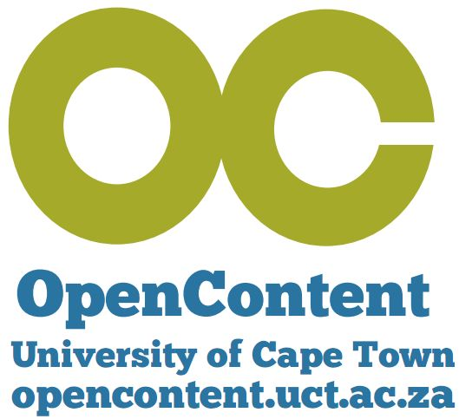
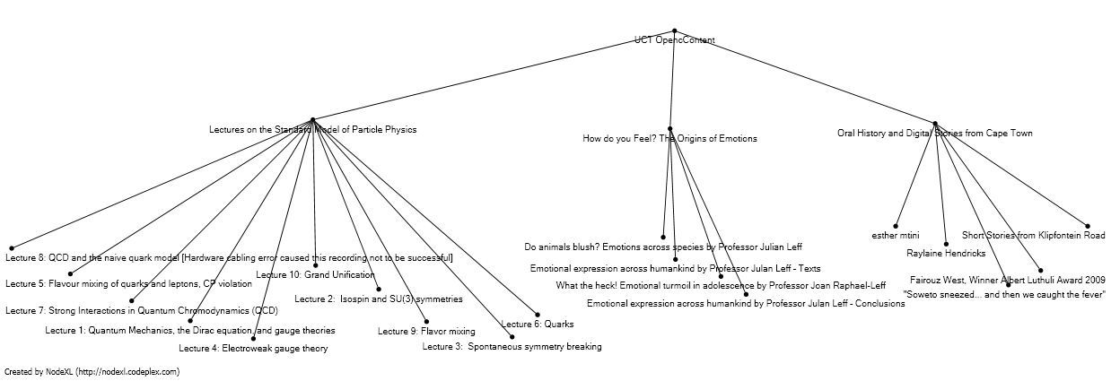
Granularity of materials
Notes:
But the growth in content alone does not tell the whole story of what is available there. Many of the items listed in the directory contain many sub-resources. In total the directory currently makes available 697 teaching and learning resources from UCT. One of our resources from the Physics department has a over 50 independent teaching and learning resources associated with one of their entries on OC.

Slide 33
Metadata and harvesting
“Metadata is like a toothbrush. Everyone knows they need it but no one wants to use someone else's.” (@geometadata on Twitter)
Users don’t like entering metadata.
Some metadata is added in the moderation process.
Repositories need to present (some) standard metadata so that their content can be harvested.
Different harvesters may require different metadata, or the classification schemes may vary (e.g. OERCommons / UCT OpenContent subjects)

Slide 34
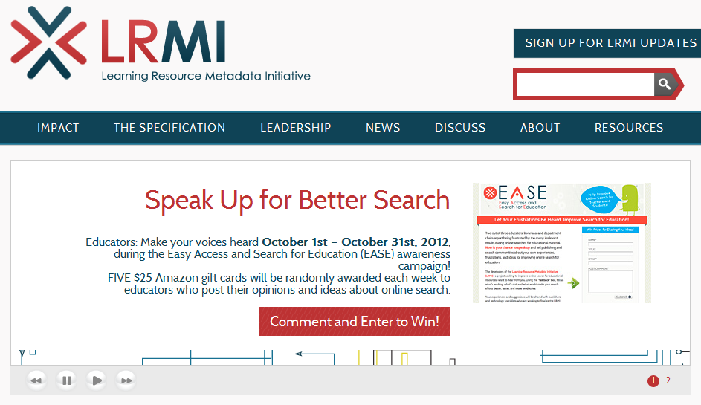
Key issues: Metadata
http://www.lrmi.net/

Slide 35

Prepared by Cheryl Hodgkinson-Williams
Cheryl.Hodgkinson-Williams@uct.ac.za
& Stephen Marquard
Stephen.Marquard@uct.ac.za
OpenContent Directory: http://opencontent.uct.ac.za
OER UCT project blog: http://blogs.uct.ac.za/blog/oer-uct
This work is licensed under the Creative Commons Attribution-Share Alike 2.5 South Africa License. To view a copy of this license, visit http://creativecommons.org/licenses/by-sa/2.5/za/ or send a letter to Creative Commons, 171 Second Street, Suite 300, San Francisco, California, 94105, USA.

