Slide 1
Exam Preparation and Writing
Exams Don’t Need to Be Stressful!

Slide 2
Lecture Structure:
What are Exams All About?
Exam Revision
The Purpose of Slides (and notes)
Presenting Tips

Slide 3

What are Exams All About?
What students think exams are:
An exercise in showing off knowledge
This causes students to:
Not read questions properly
‘Word vomit’
Try prove to the marker that they have studied

Slide 4

What are Exams All About?
What markers think exams are:
An exercise in carefully reading and strategically answer questions
What markers want to see:
That the question has been read, understood and answered
That the answer is relevant
That the answer is well-argued
That the answer is well-supported

Slide 5
What Should You Study:
Study sources:
Lecture notes – important, but not the only study source
Course readings - crucial
Past papers – good practice
Returned course assignments
Peer study

Slide 6
Practical Study Tips:
Review course outline
Make a revision timetable
Summarise topics on one page
Put yourself under exam conditions
Remember, if you ‘spot’, do so wisely and with caution!

Slide 7
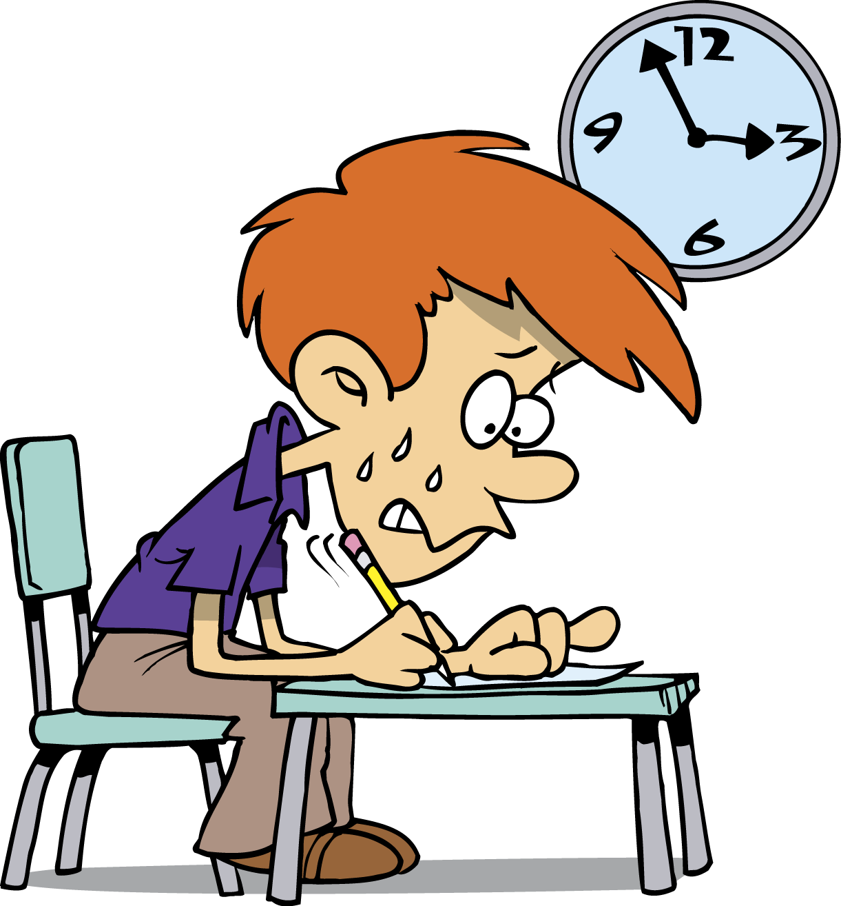
In the Exam:
Exam strategies:
Read the question
Plan
Manage your time

Slide 8
General ‘Calming’ Tips:
Be prepared
Stay away from stressful friends
Bring an extra pen
Write neatly
Demonstrate salient knowledge
Dress comfy

Slide 9

Any questions?

