Slide 1

OPEN ACCESS IN NEPAL
Dr. Roshan Karn
Director
Open Access Nepal

Slide 2


Slide 3
INTRODUCTION TO OPEN ACCESS NEPAL
Open Access Nepal is an autonomous, non political, non profit and non governmental organization.
OA Nepal is the official student chapter of Right to Research Coalition in Nepal
Includes members from different streams of education (medicine, engineering, accountancy, public health)
With the central chapter based at Institute of Medicine, OA Nepal has local chapters in 3 universities, 17 medical colleges and 2 engineering universities

Slide 4
The main objective of Open Access Nepal is to promote the principles and policies of open access, open education and open data throughout the country .
The ultimate goal of OA Nepal is to come up with a concrete national policy related to OA.

Slide 5
What have we achieved so far?
We have organized series of official and unofficial meetings with the librarians of universities, government officials and policy makers from the Ministry of Health and Population as well as the Ministry of Education
We have successfully organized talk programs with students, researchers, faculty heads, professors, deans and campus chiefs from different universities
We have collaborated with Nepal Medical Students’ Society (NMSS), Open Knowledge Foundation (OKF), Wikipedia Nepal, Tribhuwan University Central Library (TUCL), Nepal Library Information Consortium (NELIC), Nepal Health Research Council (NHRC), Right to Research Coalition (R2RC), Electronic Information for Libraries (EIFL), OCSDNET and INASP.

Slide 6
We have drafted a national Open Access Policy in collaboration with EIFL, CC, TUCL and MOE.
Successful in capacity building of students around the country, enabling them to do independent open access events.
In 2016, we were successful in developing an institutional open access policy in Nepal.

Slide 7
2014
International Open Access Week 2014 in Nepal
  Day 1: Conference on “ Introduction to Open Access, Open Educational Resources and Open Data”
  Day 2: Workshops on Open Access, Open Science and Collaborative Research and Open Data
Chief Guest: Iryna Kuchma (Open Access Programme Manager – EIFL)
Speakers from different organizations including government officials
Alliance with Open Knowledge Foundation Network and Open Nepal

Slide 8
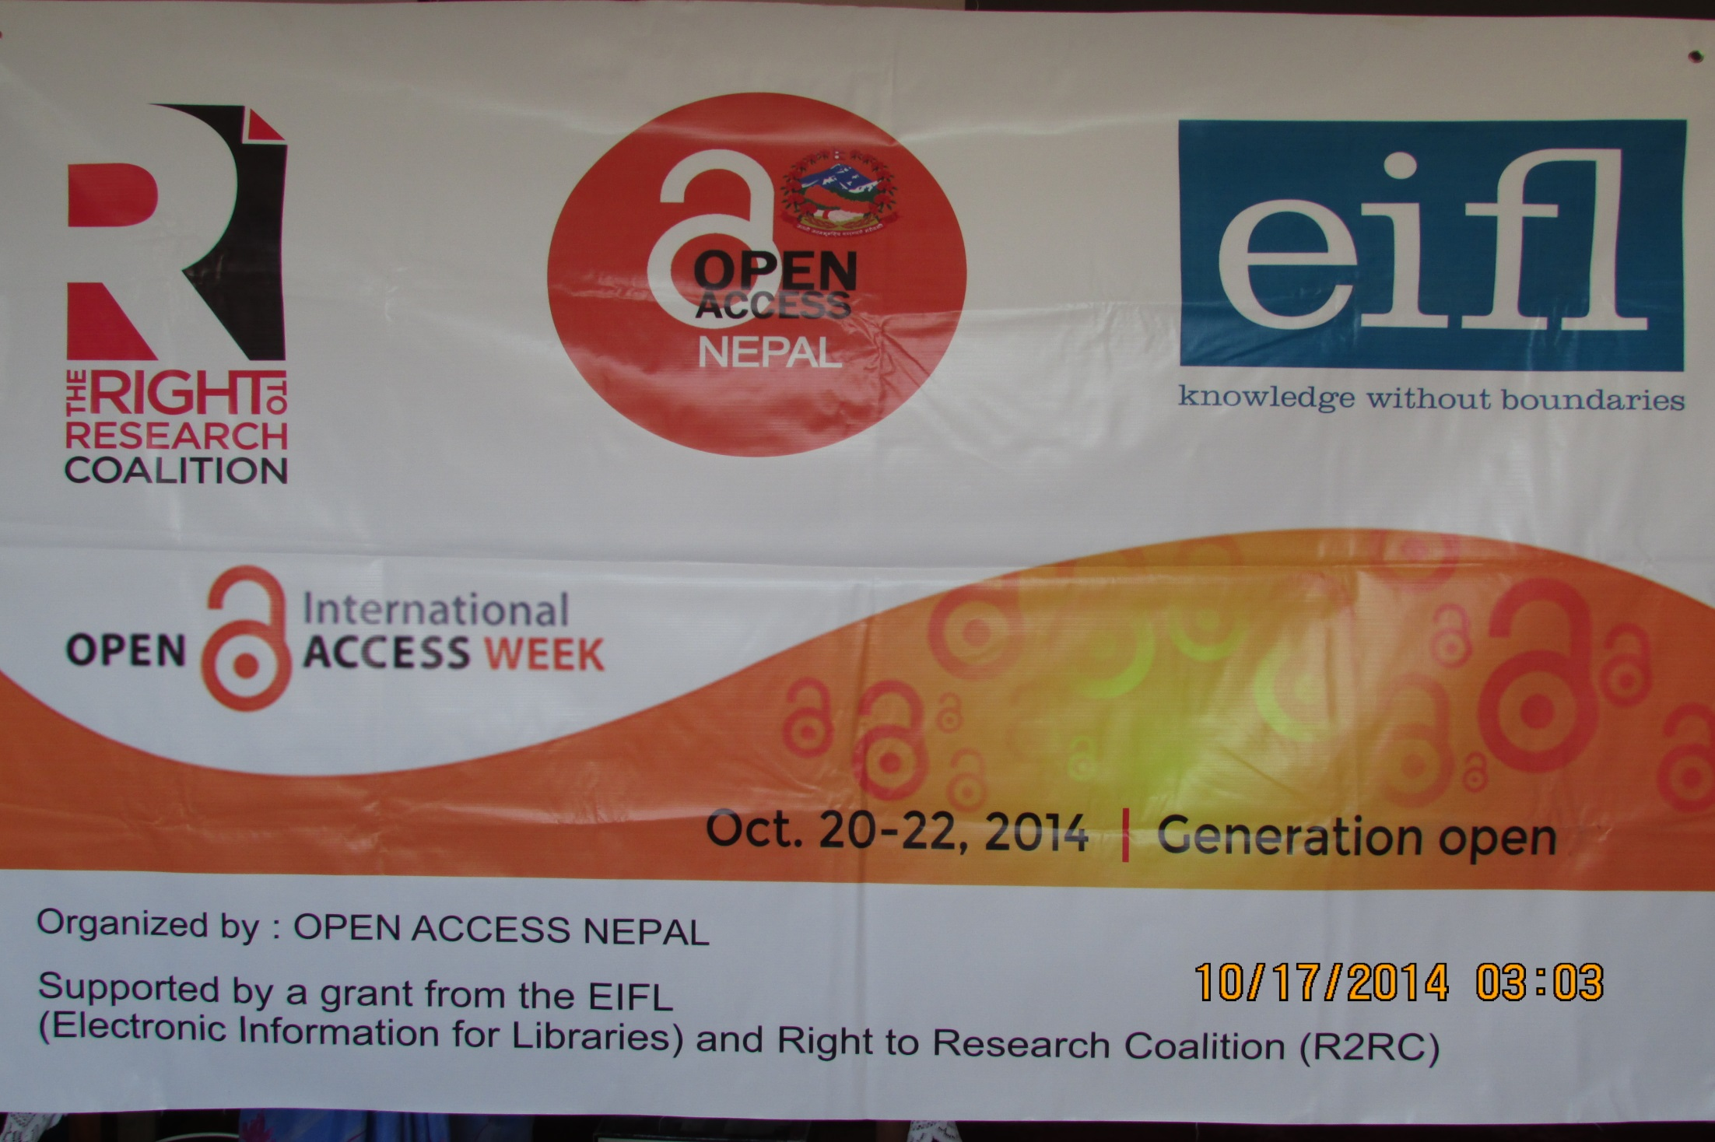

Slide 9


Slide 10
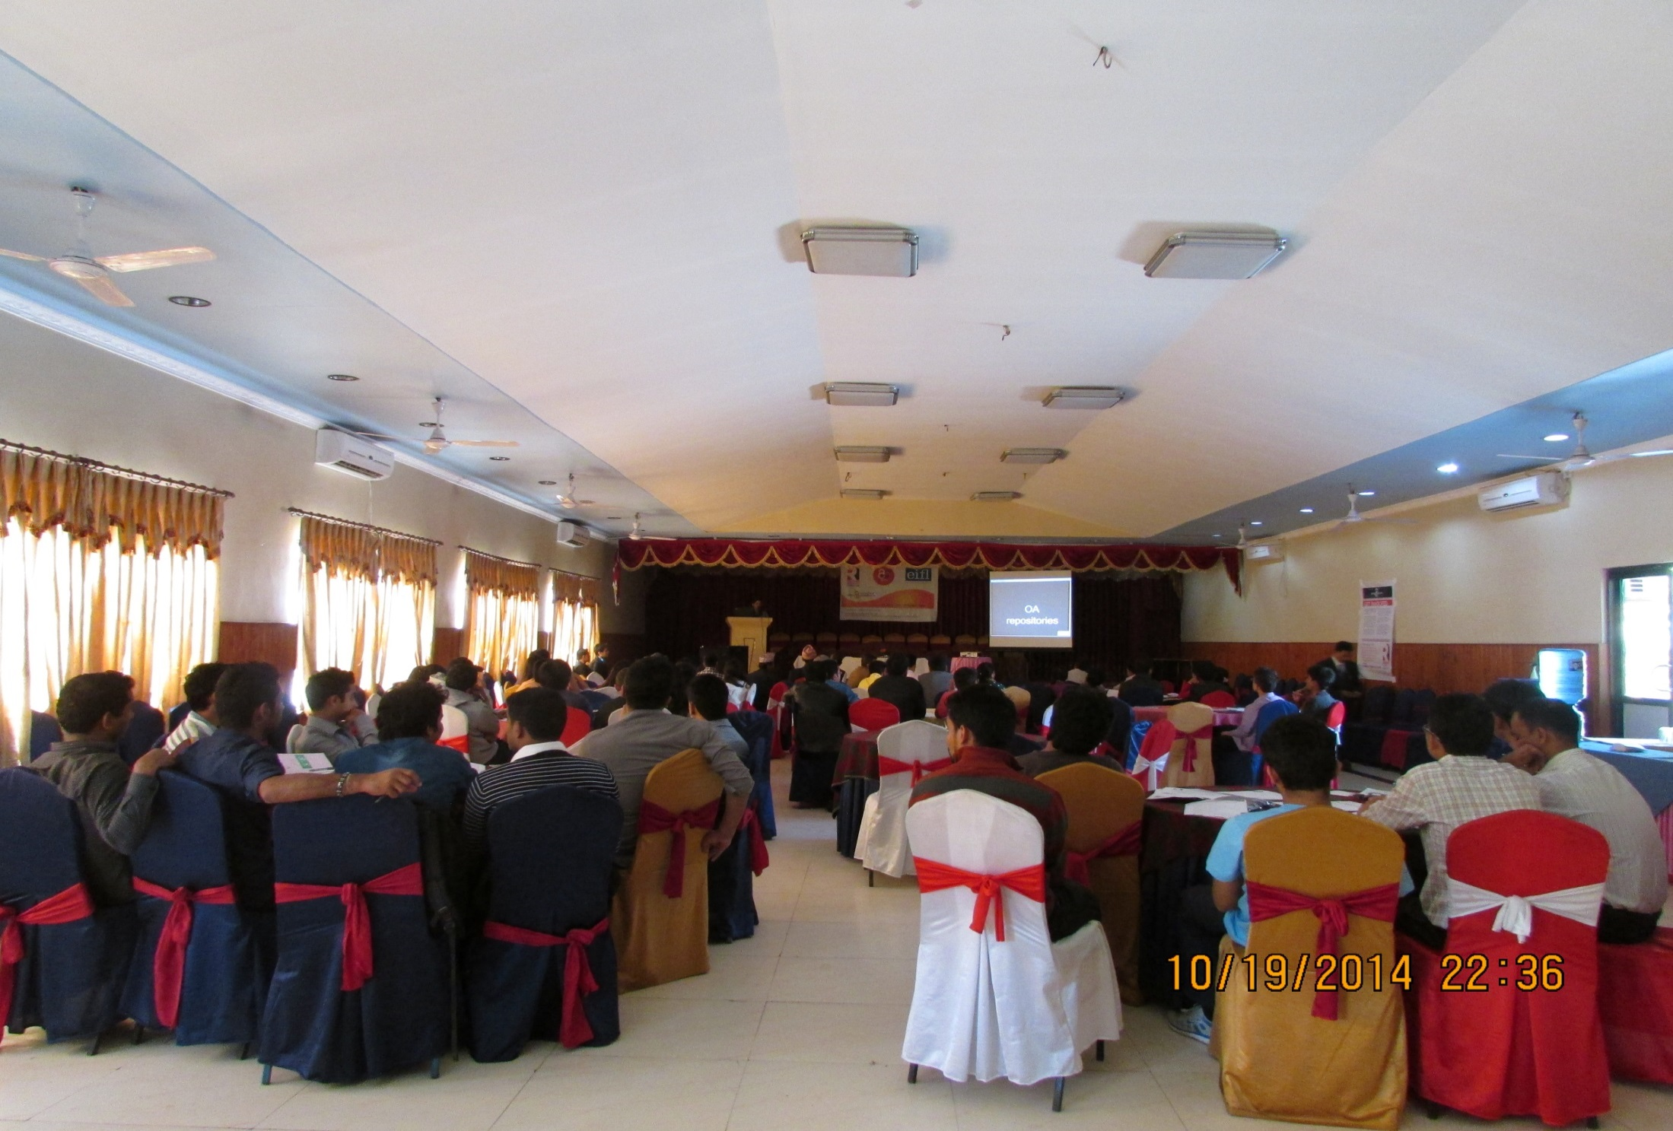
Participants during the Open Access Week Event 2014

Slide 11
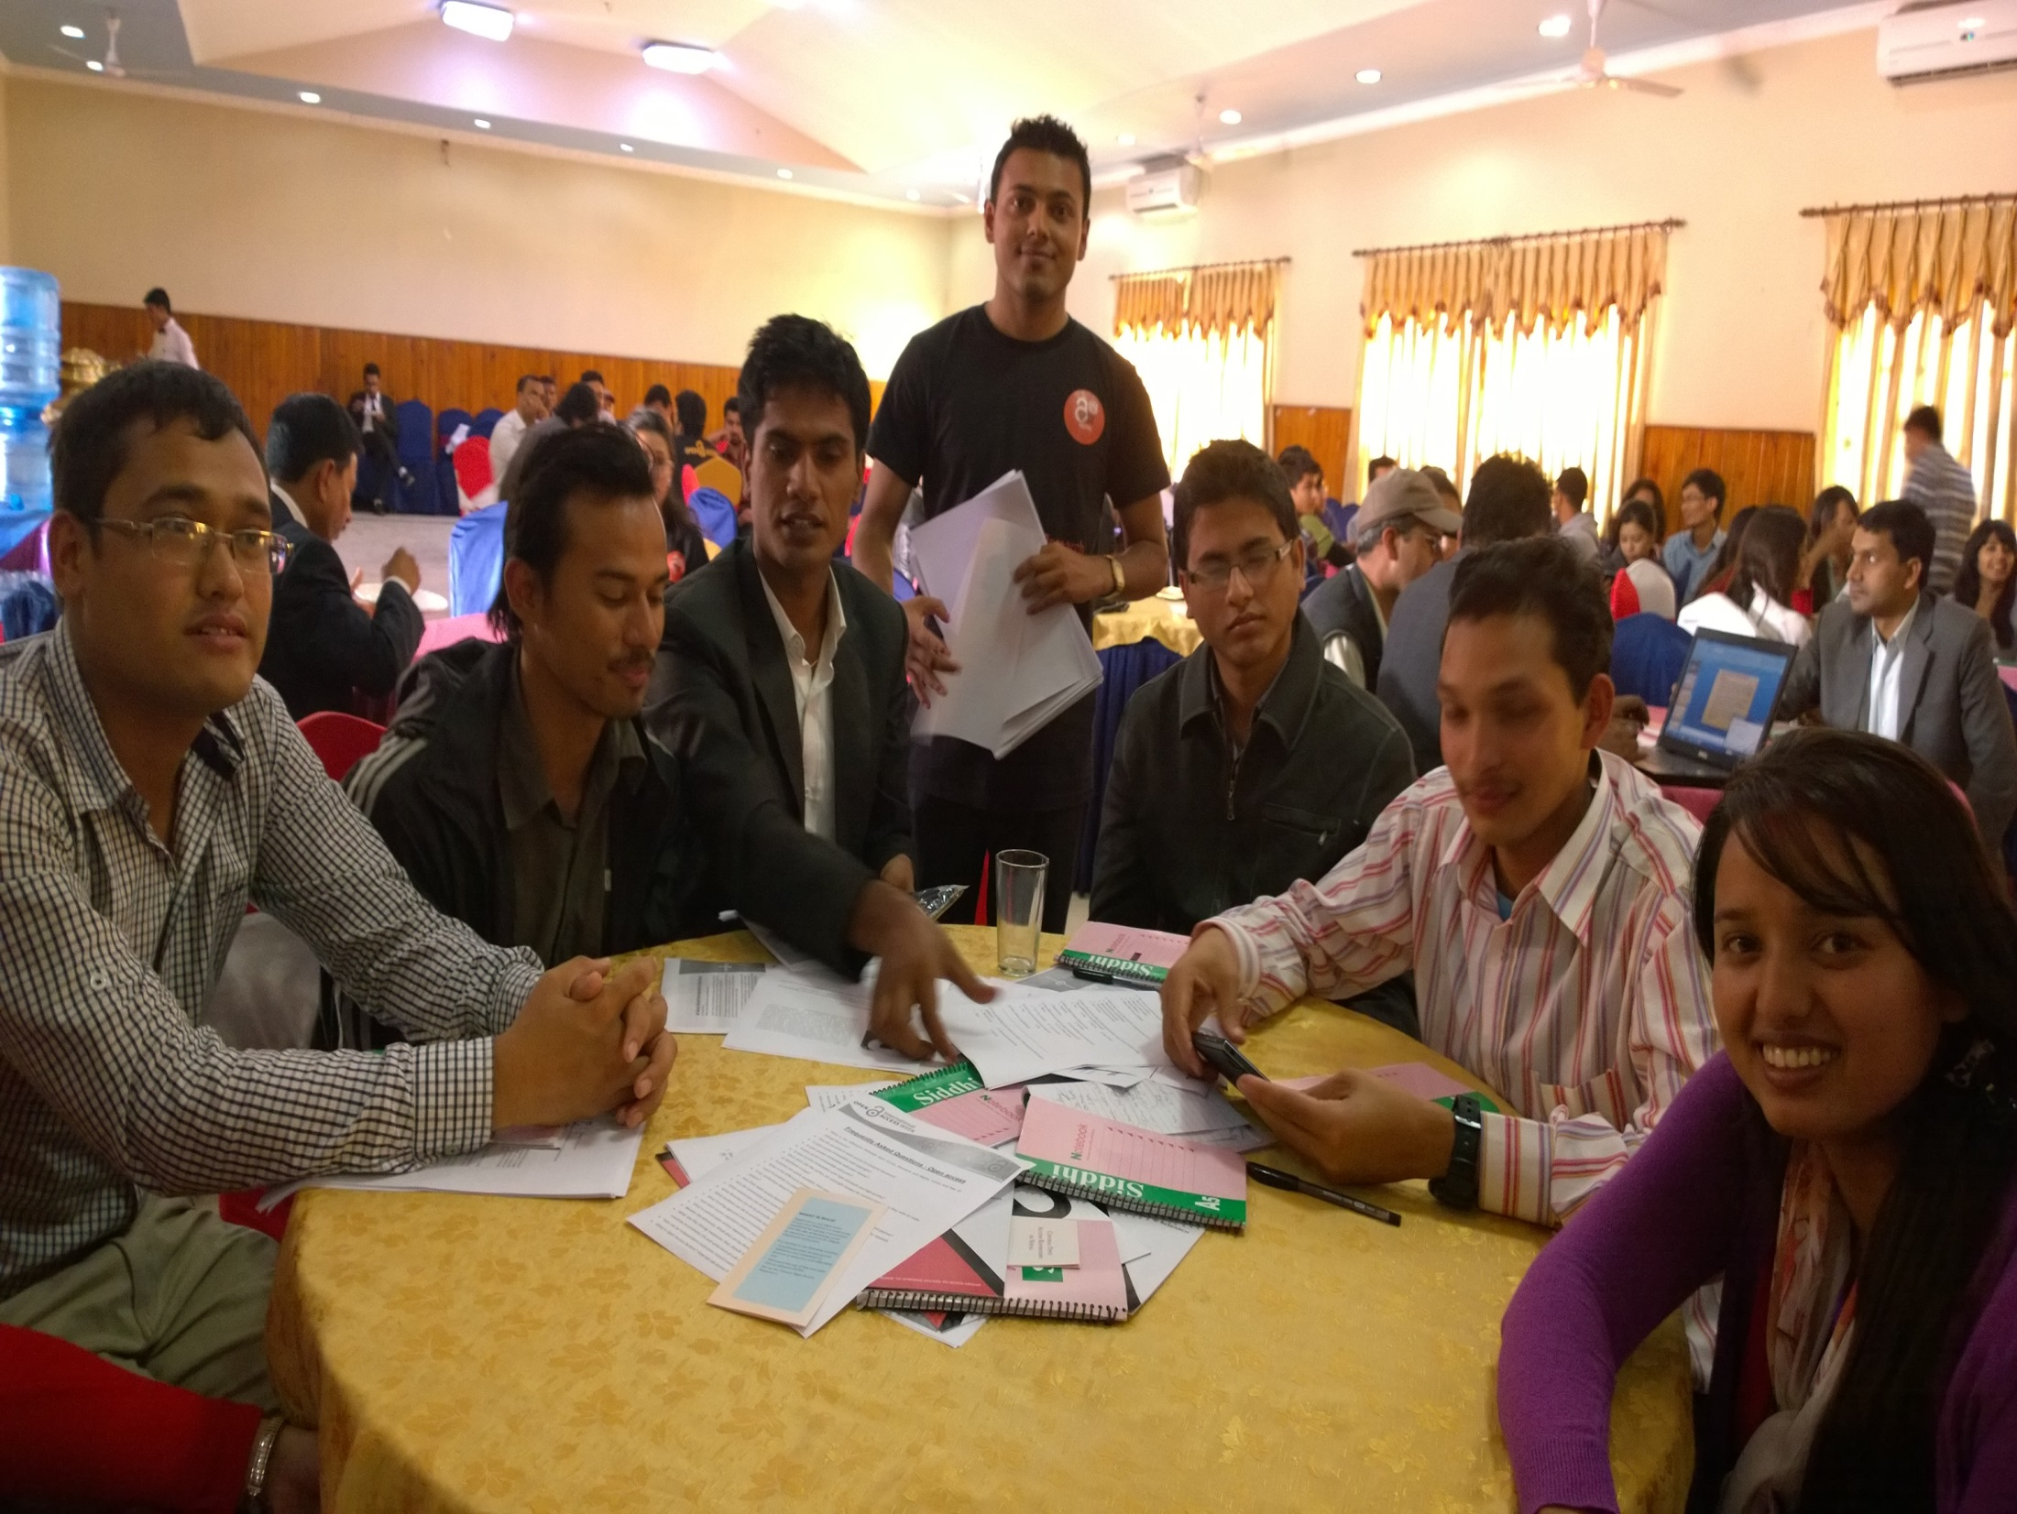

Slide 12
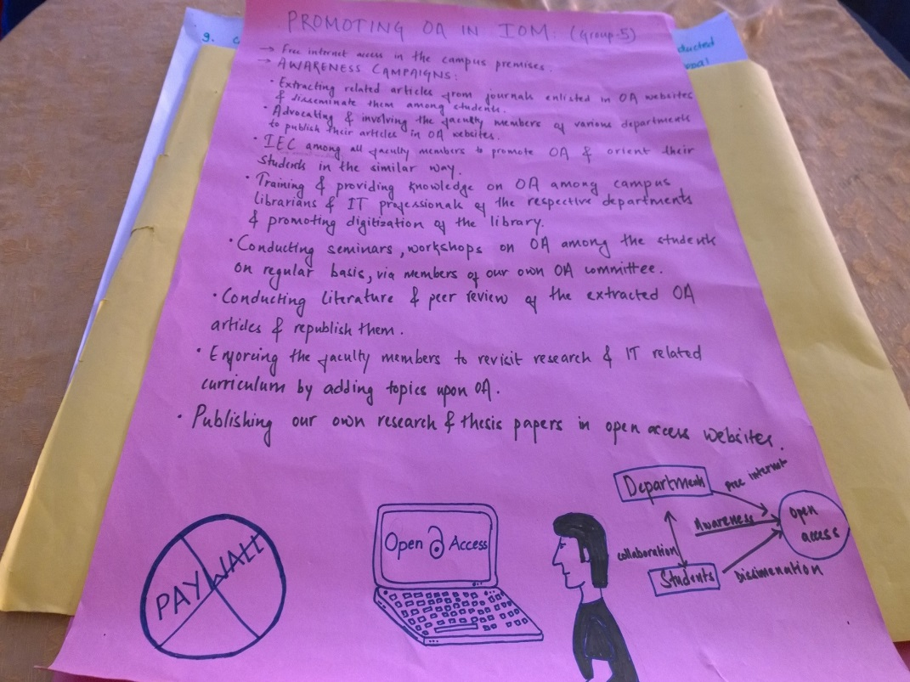
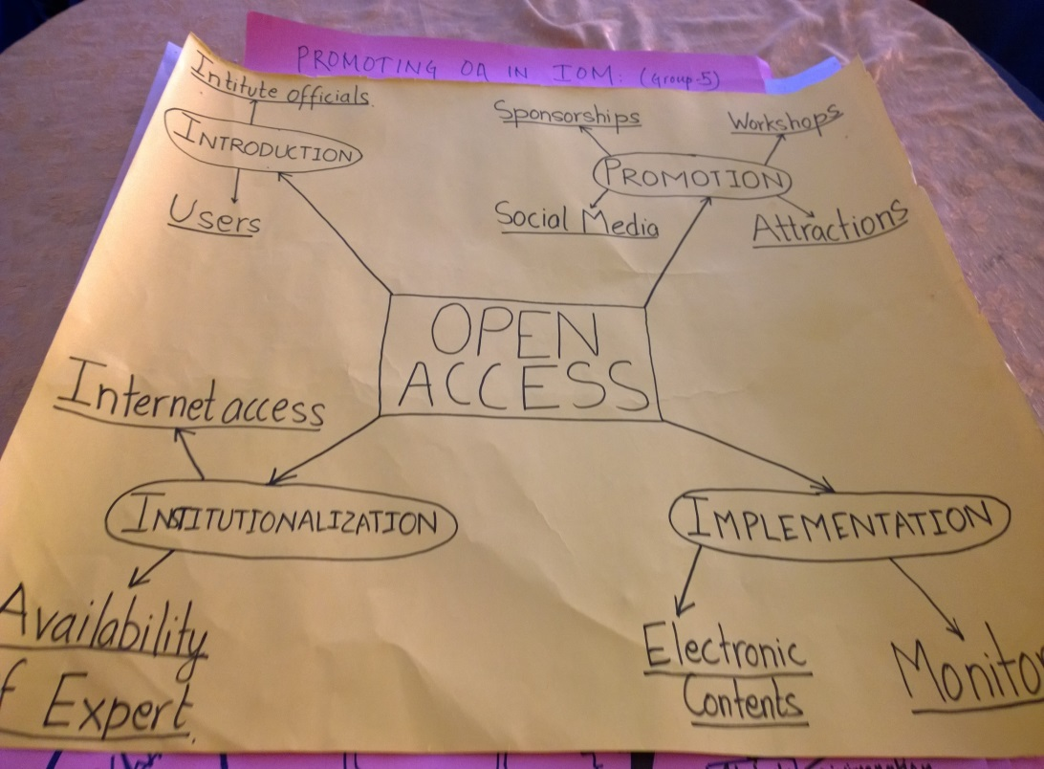
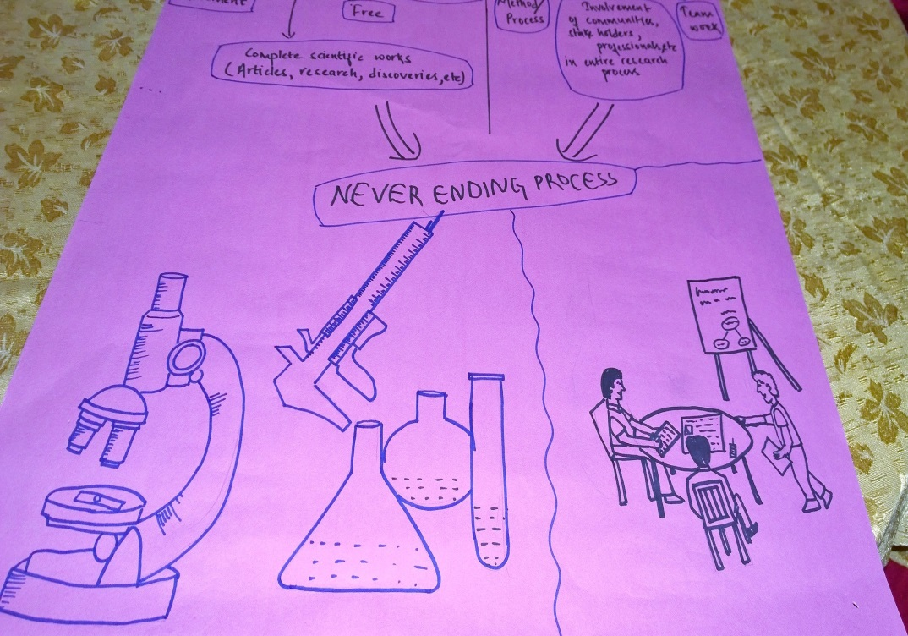
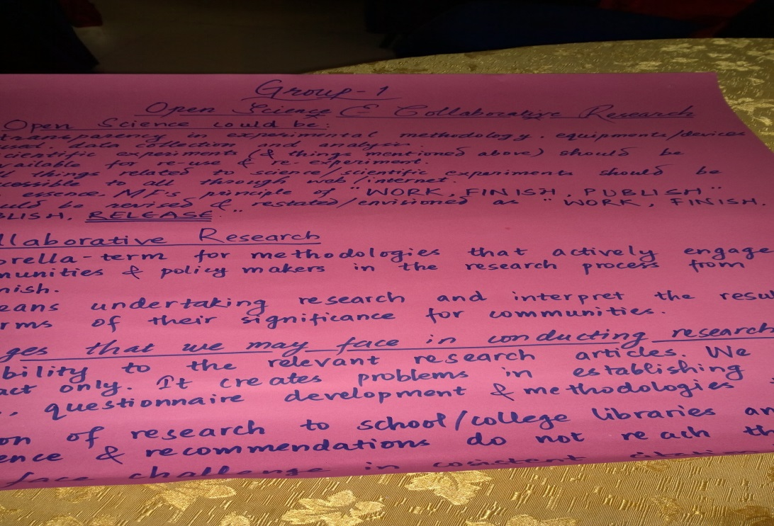

Slide 13
2015
Open Access Nepal launched a 6 month long project called “Open Access: Greater Reach for Research” in 2015
All the development regions were targeted during this project
Open Access advocacy campaigns were done in major universities and campuses within each development region

Slide 14
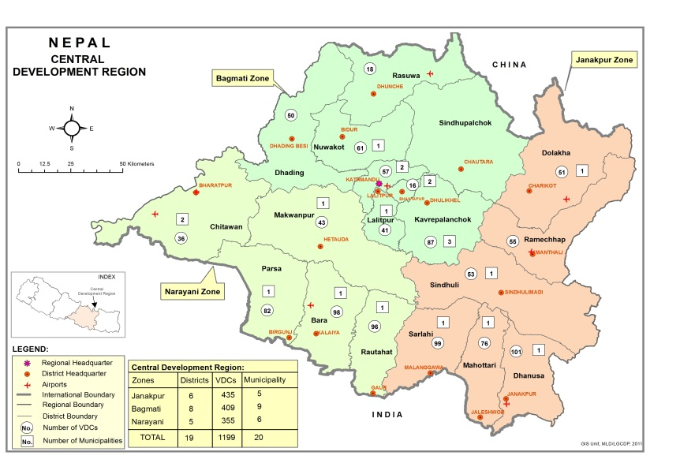
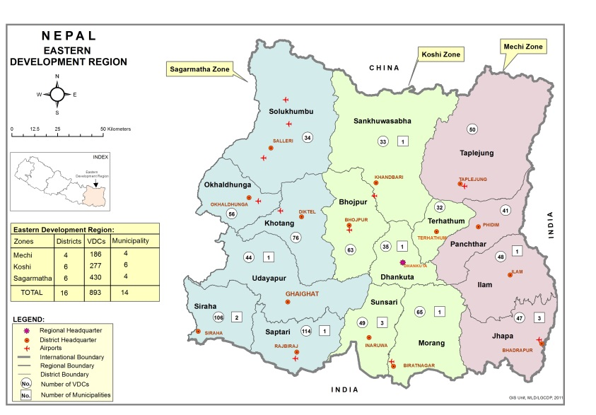
Central Development Region
Tribhuvan University
Chitwan Medical College
Nawlaparasi Campus
Eastern Development Region
B.P. Koirala Institute of Health Sciences

Slide 15
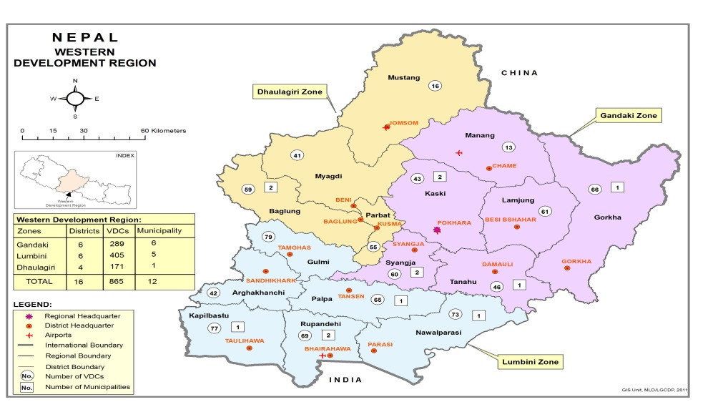
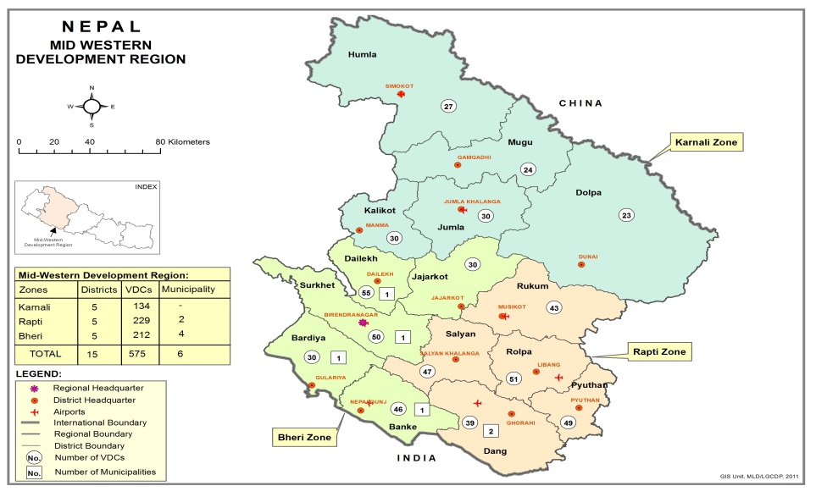
Western Development Region
Pokhara University
Mid-Western Development Region
Nepalgunj Medical College

Slide 16
A team of 7 members travelled to one institute at the end of each month
It’s a 2 day event in each university
Day1: Orientation about Open Access, Open Educational Resources, Open Data and Open Access Repository
Day2: Workshops on topics such as Open Access Advocacy at local level, OER, Open Policy, Finding and Accessing Open Resources, Issues and Challenges related to Open Access and Digital Repository

Slide 17
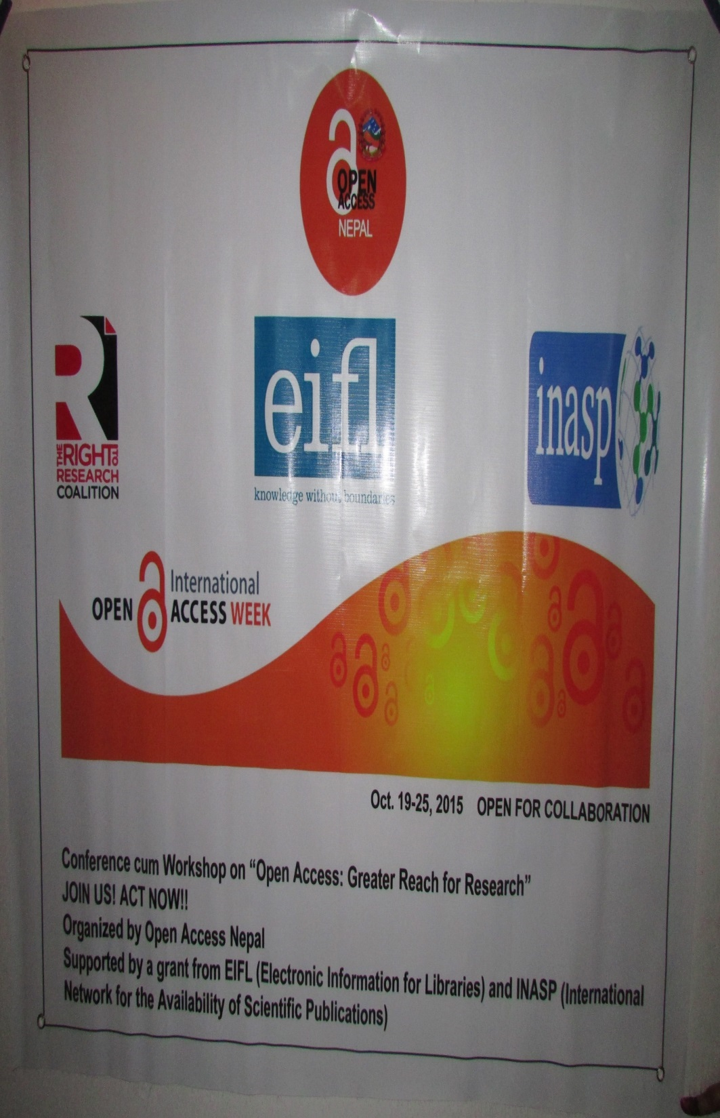
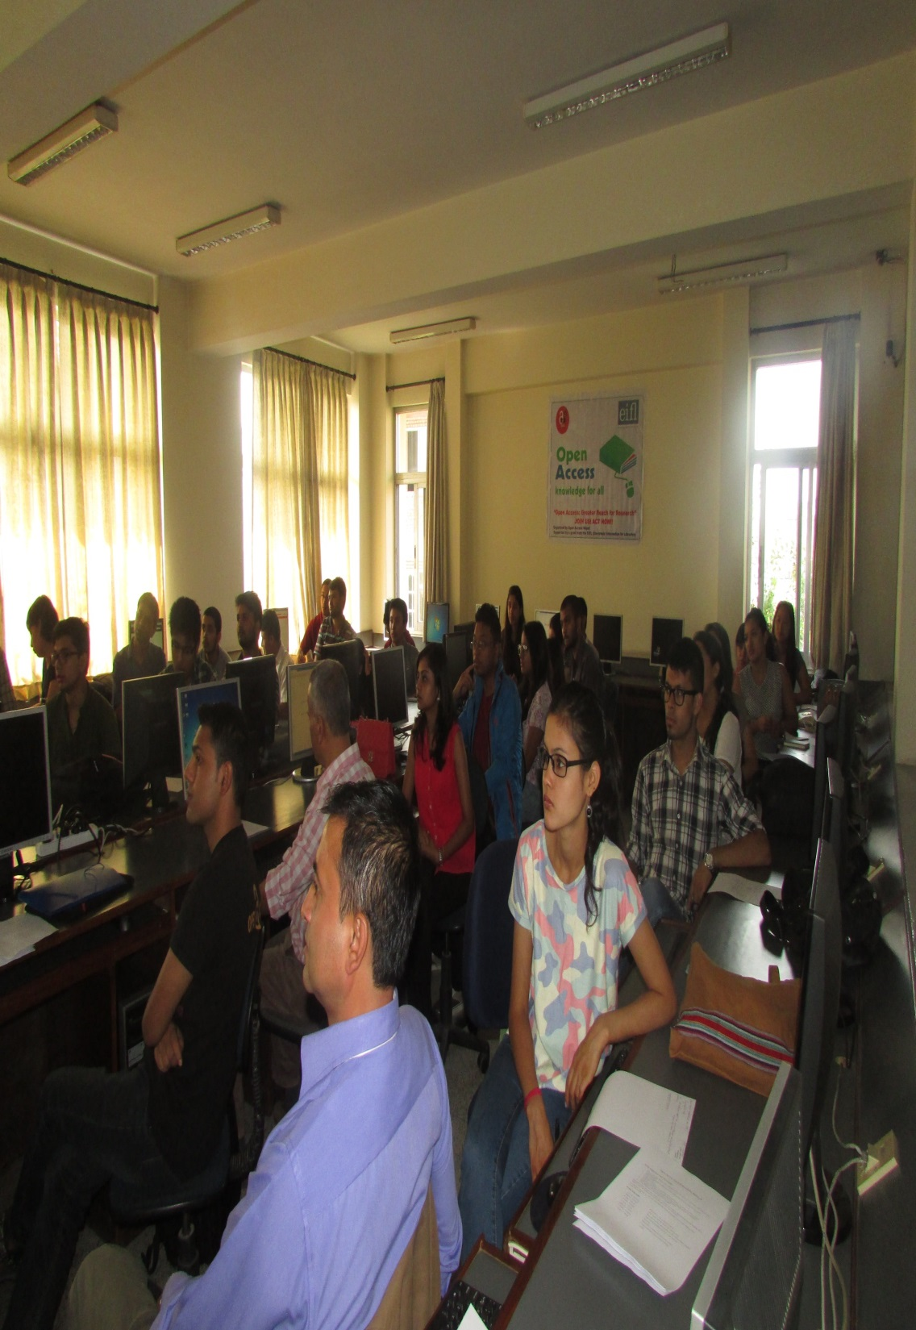

Slide 18
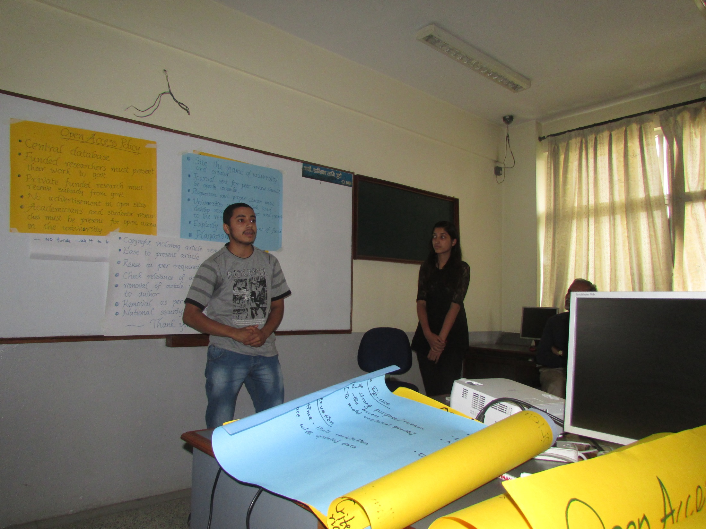

Slide 19
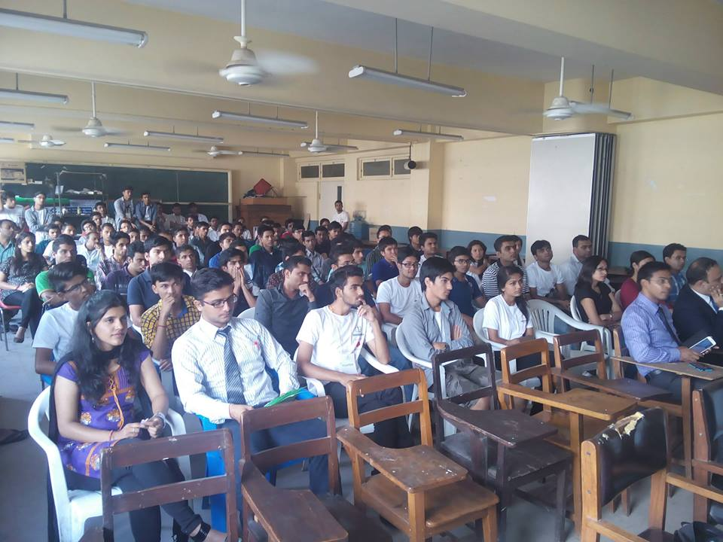

Slide 20
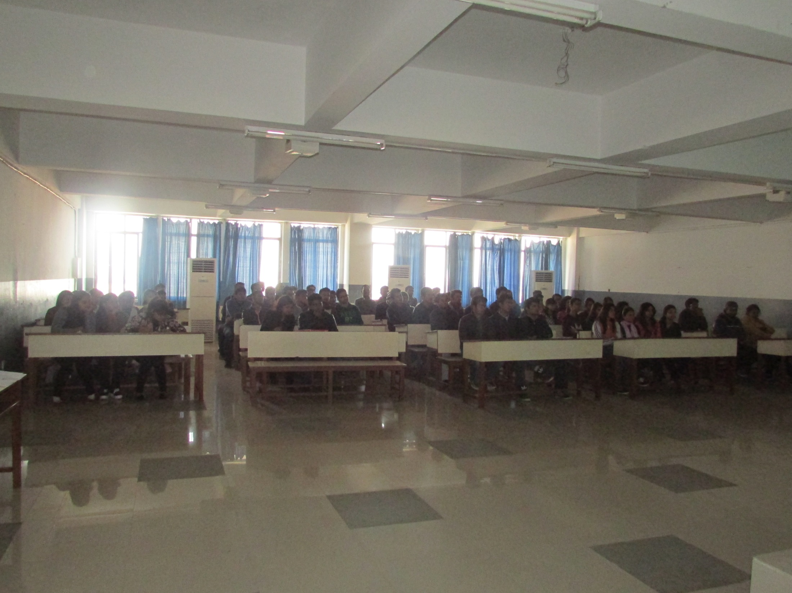

Slide 21
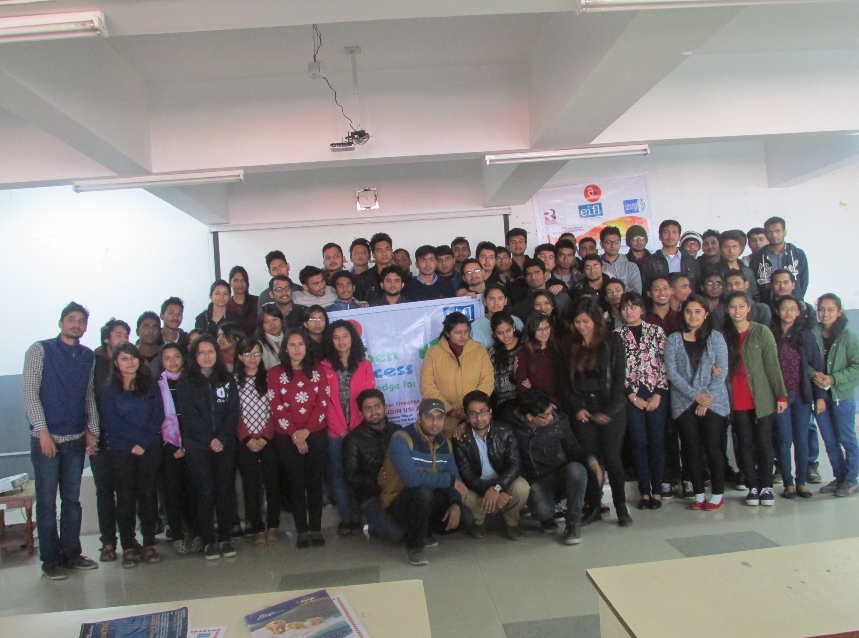

Slide 22
2016
A project titled “Open Access: Starting out in Research” will begin next week
Research training programs will be conducted for 3 times in in collaboration with the Govt. of Nepal (Nepal Health Research Council)
Research training will be offered in two modules (Module 1 lasting for 2 days and Module 2 lasting for 1 day). There will be a gap of 10 days between each module.
The gap between the modules is intended to provide the participants time to use and develop the skills taught during Days 1 and 2 of Module 1, and to spend time developing a research question and start to formulate a proposal.

Slide 23
Module 1 (Day 1 and 2)
Searching the Literature ( OPEN LITERATURE)
Understanding statistics
Critical Appraisal
Obtaining ethical approval
Writing research protocol
Module 2 (1 day after a gap of 10 days from Module 1)
Selecting robust outcome measures
Using and developing a questionnaire
Getting Research funding
Disseminating research

Slide 24
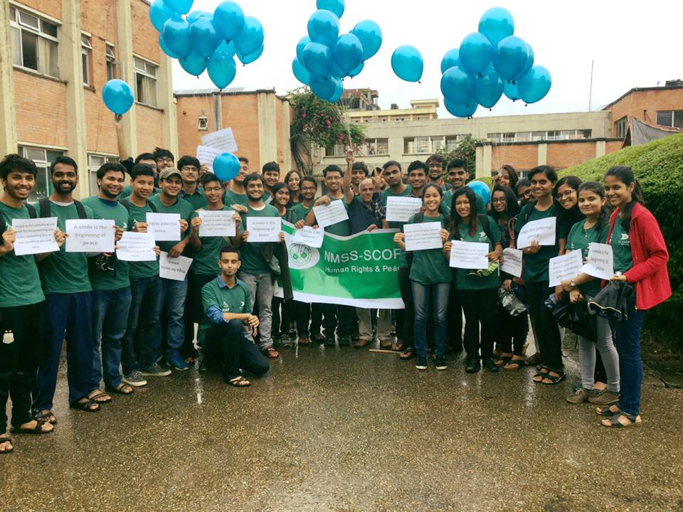
OPEN ACCESS WEEK 2016

Slide 25
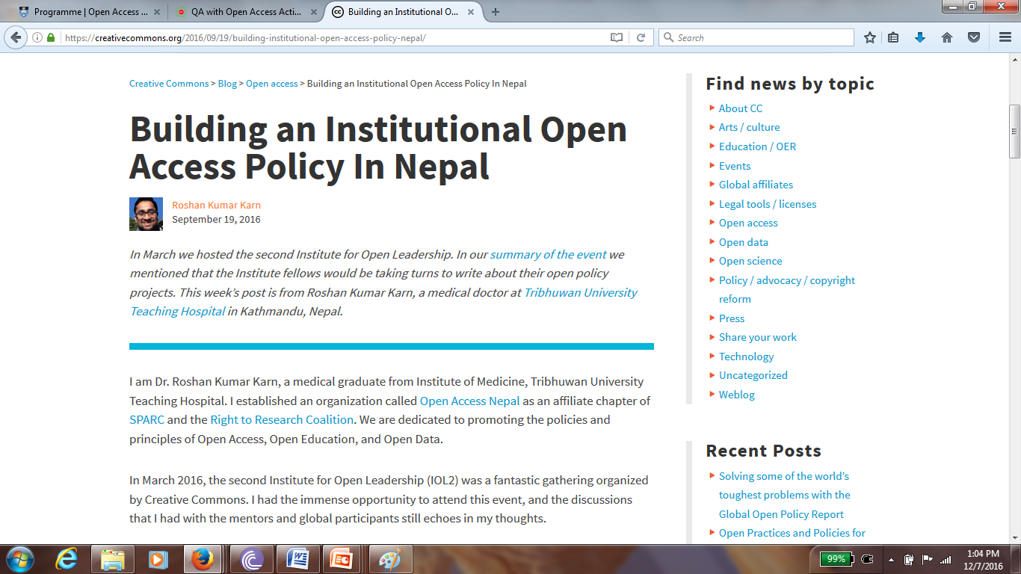

Slide 26
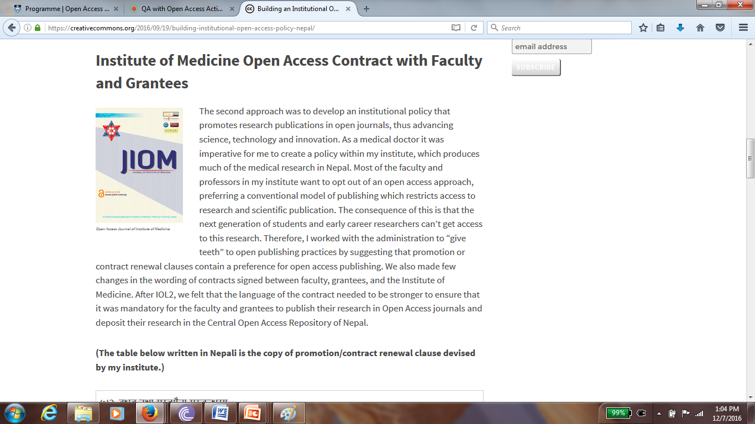

Slide 27
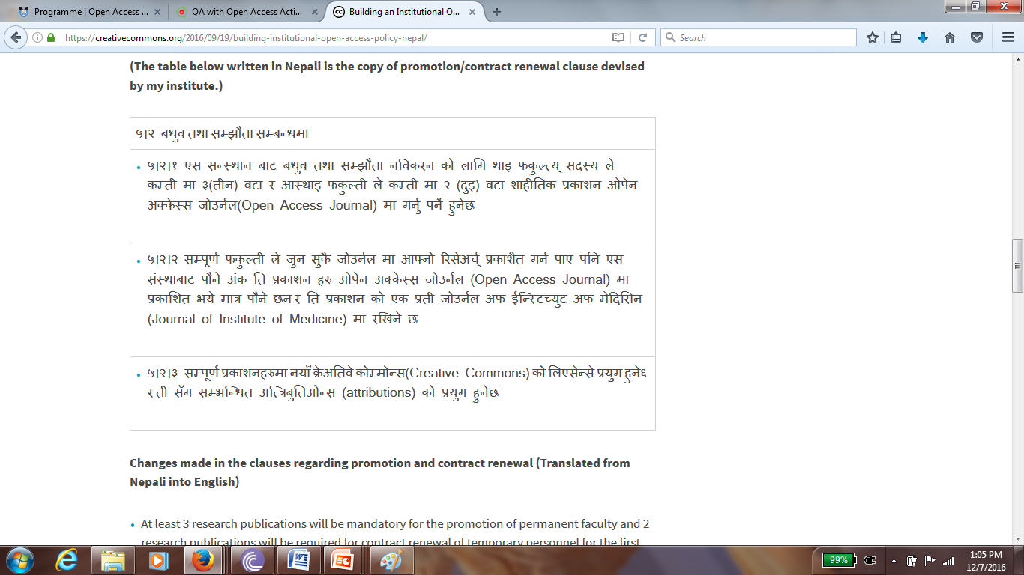

Slide 28
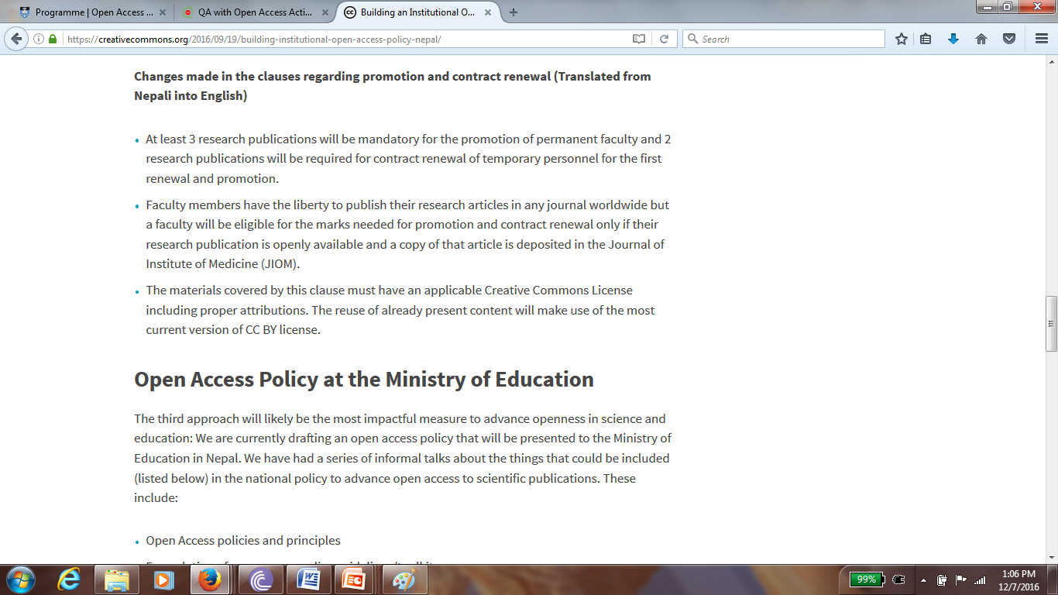

Slide 29


