Slide 1
Lecturer: Eduard Campbell
E-mail: CMPEDU001@myuct.ac.za
May 2015
This work by Eduard Campbell is licensed under aCreative Commons Attribution-NonCommercial-ShareAlike 4.0 International License.

Slide 2
What is Digital Storytelling (DST) and why is it relevant to the English classroom as a method of teaching?

Slide 3

…reading? Explain…
Photo by Erin Kelly

Slide 4

…writing? Explain…
Photo by dotmatchbox at flickr

Slide 5

…speaking? Explain…
Photo by JohanDiew0107

Slide 6

…listening? Explain…
Source: Pixabay (no attribution required)

Slide 7
…and…?

Slide 8

…digital literacies?
Illustration by CURSORCH

Slide 9
STOP EVERYTHING!
Are you still evaluating MY use of Digital Literacies in class? What do you have to say about the images I just used?

Slide 10
Definitions of DST:
“a process of connection where teachers work with their students to help them harness the power of voice and imagery…by using technology that is relevant to the way we live today” (Hagood, 2009)
“constructing narrative and/or expository texts through combining multiple media including images… voice, music, video, transitions, titles, and movement” (Hagood, 2009)

Slide 11
1. Choose a topic 2. Visualising “warm-up” 3. “The River of Life” 4. The story circle 5. Storyboarding/Writing the story 6. Choosing pictures 7. Recording sound 8. Putting everything together on a video editing application
The 8 steps of DST

Slide 12
How can DST be adapted to suit badly resourced schools and very well-resourced schools? How can DST be adapted to address the digital divide in the classroom?
Group discussion:

Slide 13
1. Choose a topic 2. Visualising “warm-up” 3. “The River of Life” 4. The story circle 5. Storyboarding/Writing the story 6. Choosing pictures 7. Recording sound 8. Video editing
The 8 steps of DST
“Non-digital”/Low-tech components. Will be done in class today
“Digital”/higher tech components. For those who pick topic 1 of Assignment 4.

Slide 14
According to Assignment 4, Topic 1 – “Explore some dimension of your own life journey in relation to education and/or English” (aim for a video of about 3 to 6 minutes – roughly 400 to 600 words… but this may vary)
1. Choose a topic

Slide 15
You have ONLY 2 minutes to draw a picture of where you are in your life at the moment
2. Visualisation “warm-up”

Slide 16
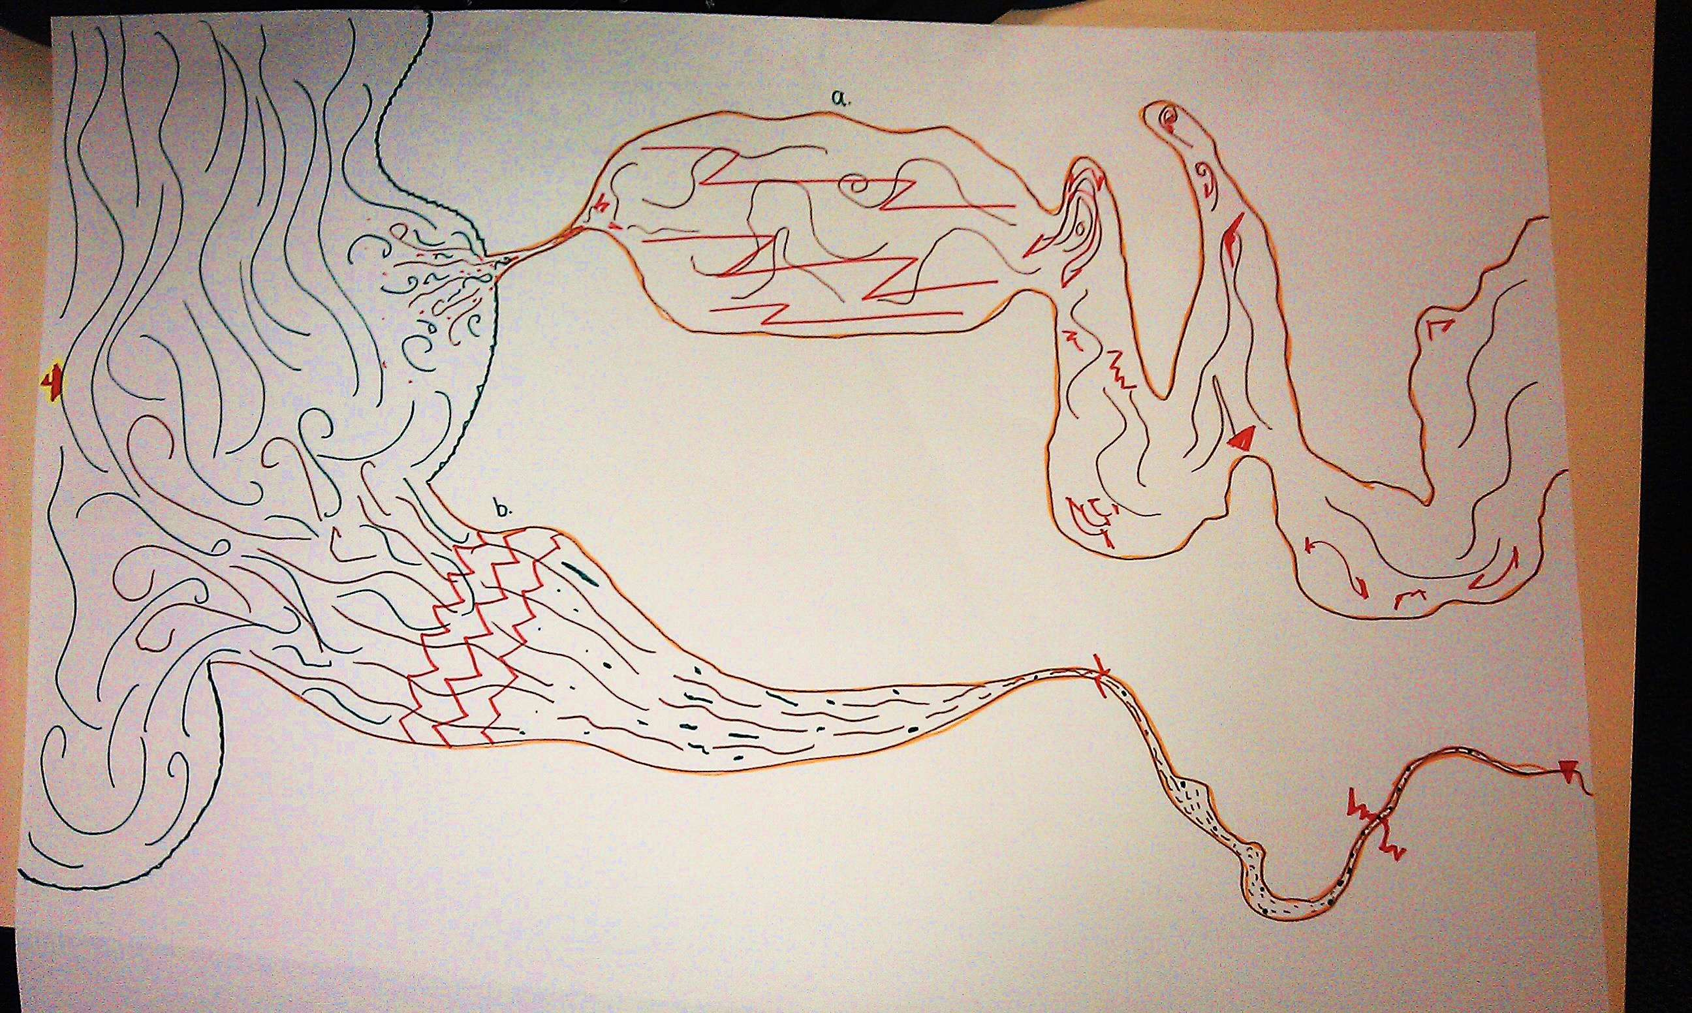
3. “The River of Life” (my version)

Slide 17
Divide into groups of 8 to 10. Each member of the group gets time to “tell” his/her story by referring to the river of life he/she just made.
4. The story circle
* What are the possible problems when doing this in your classes? How can we cater for these problems?

Slide 18
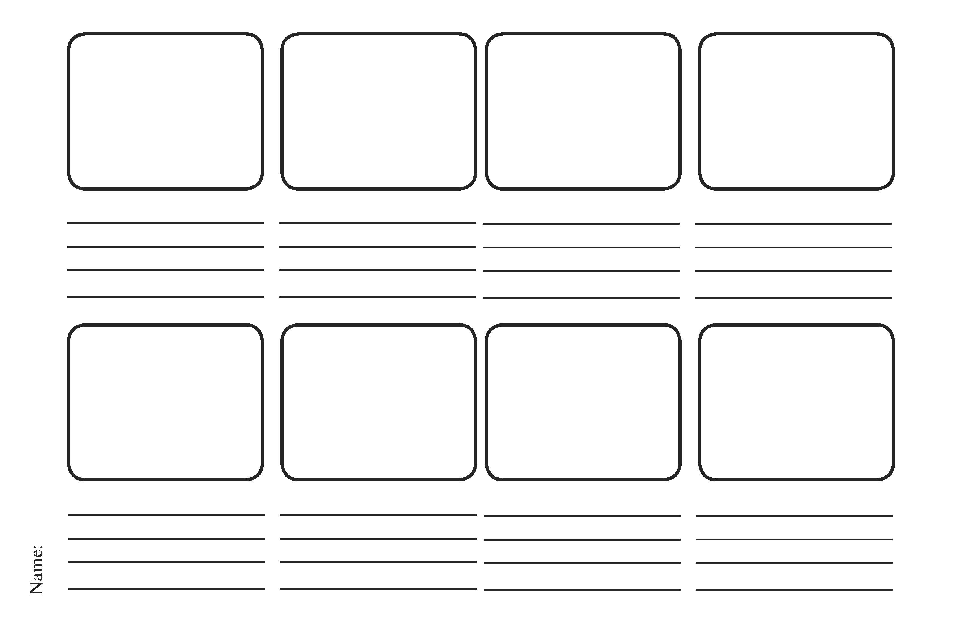
5. Storyboarding/Writing the story
If you are still not sure… go to Google Images to see more examples…

Slide 19
Sound editing: use any digital audio workstation like Audacity (free!) youtube.com/watch?v=3uqCNjbQn54 Video editing: Picasa, iMovie, MovieMaker, WeVideo… there are so many… youtube.com/watch?v=JrD4s5_fqgM
Steps 6 to 8 (for those who will be doing a story for Assignment 4)

Slide 20
If you have any questions or need any guidance: CMPEDU001@myuct.ac.za Possible issues: copyright on pictures (use creativecommons.org if you want to be safe), file formats (google “audio/video online file converter”)
Steps 6 to 8 (continued)

Slide 21


Slide 22
Reference and a useful resource
Hagood, C. (ed) 2009, New Literacies Practices, First Edition edn, Peter Lang Publishing, New York.
http://storycenter.org/educator-workshop/

