Slide 1

SPARC in an
Age of Openness
December 7, 2016
Nick Shockey (@nshockey)
Director of Programs & Engagement, SPARC

Slide 2
bit.ly/sparcopensymp
case sensitive!

Slide 3


Slide 4
Taking Action Despite Uncertainty
1.

Slide 5


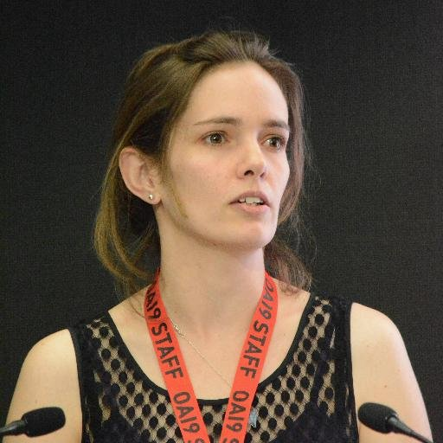

Slide 6
“We are the ones we have been waiting for.”
June Jordan
Poem for South African Women

Slide 7
Identify & Target the Leverage Points
2.

Slide 8
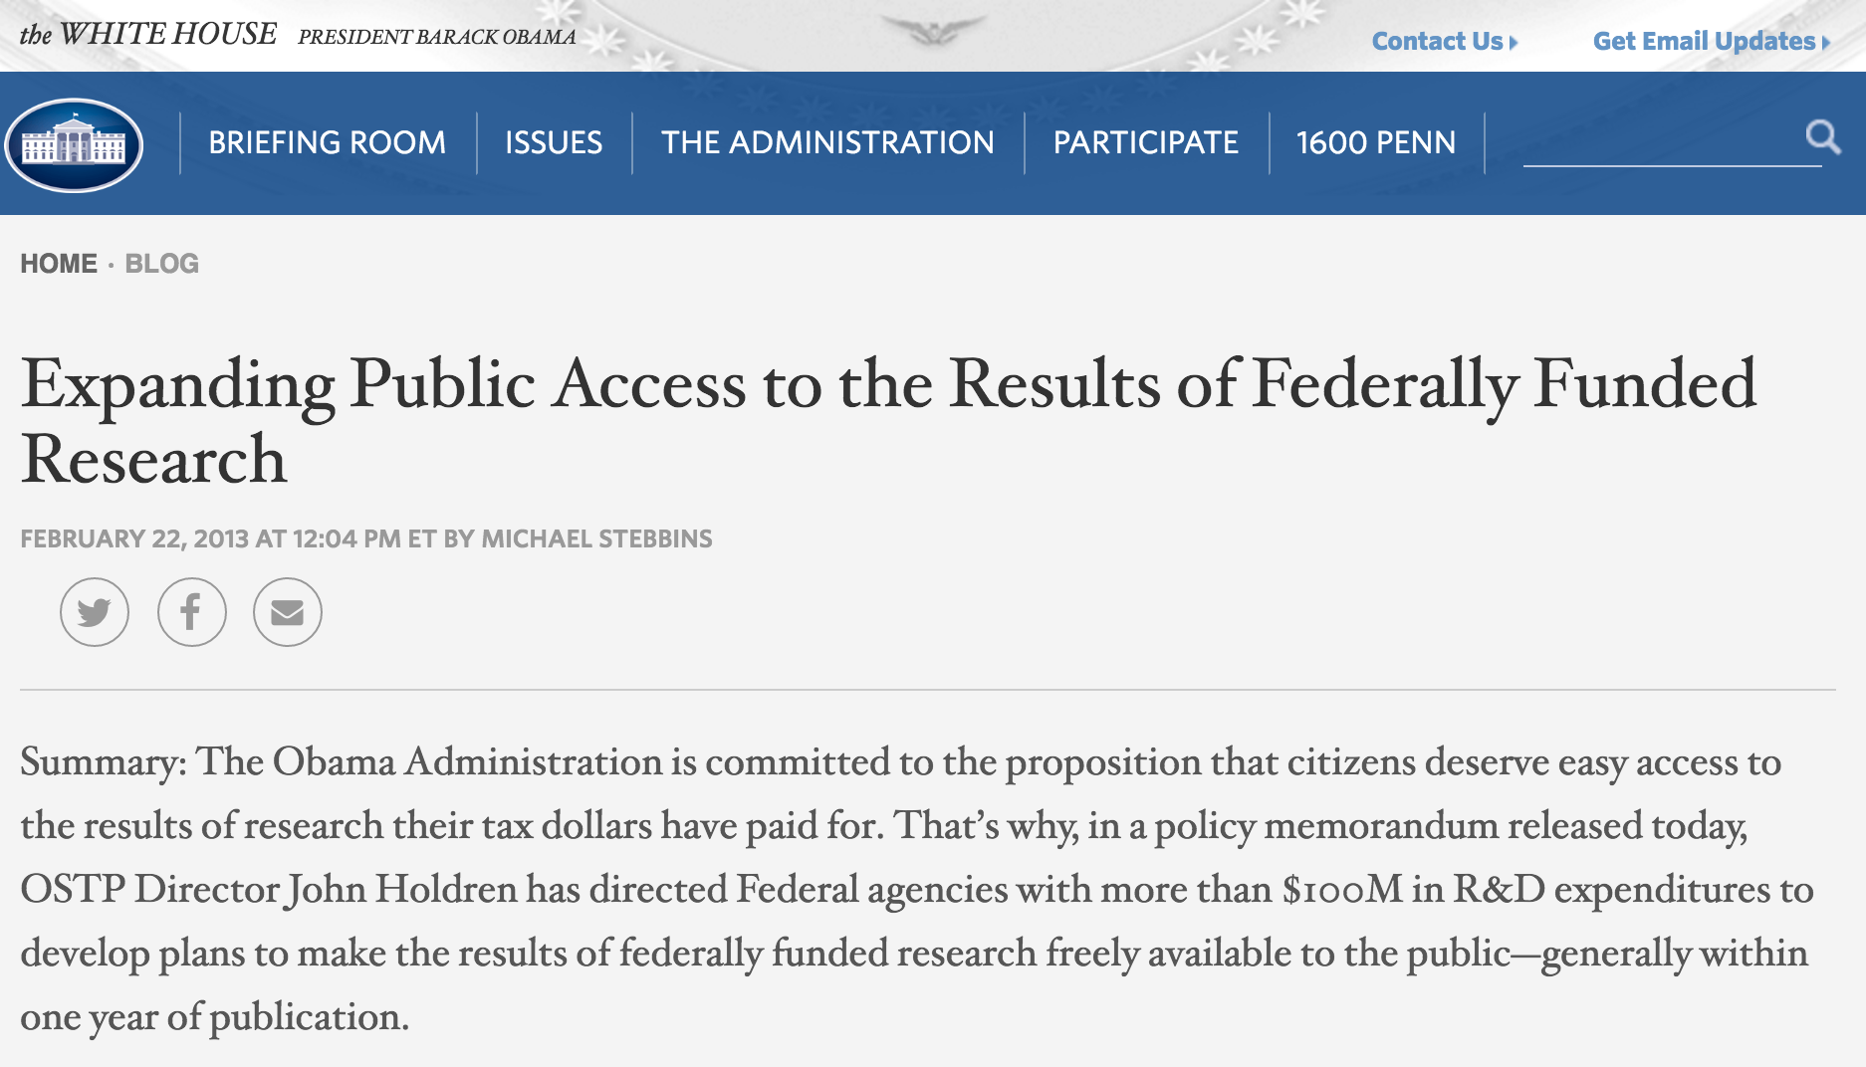

Slide 9
“Open in order to…”
Cold Knowledge &
Warm Knowledge
3.

Slide 10
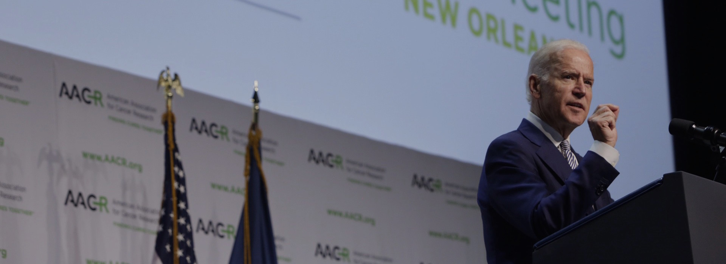
“Taxpayers fund $5 billion a year in cancer research every year, but once it’s published, nearly all of that taxpayer-funded research sits behind walls. Tell me how this is moving the process along more rapidly.”
- Vice President Joe Biden: April 21, 2016

Slide 11
Building Community as a Support Structure
4.

Slide 12


Slide 13


Slide 14
Nick Shockey
nick@sparcopen.org
@nshockey / @SPARC_NA
www.sparcopen.org

