Slide 1

Open Access Nigeria

Slide 2
INTRODUCTION
Openness in Africa
Research output
Infrastructure
Internet penetration
Cost of Publishing
Perceptions of open

Slide 3


Slide 4

OA TREND IN A NIGERIAN MEDICAL COLLEGE
2013 Scholarly Publication By Adeyemo WL., et al
1255 Articles from CMUL in PubMed between 1976 & 2013
Only 124 were Open Access
15 OA articles between 1976 & 2000 (24 years)
11 OA articles between 2001 & 2005 (5 years)
44 OA articles between 2006 & 2012 (5 years)
54 OA articles between 2011 & 2013 (3 years)

Slide 5
WHAT WE DO
Organize meetings, presentations, workshops, trainings
Targeting:
Undergraduate & Postgraduate students
Researchers
Librarians
University administrators & Faculty
Policymakers & Legislators

Slide 6
HOW WE DID IT
RECRUITMENT
Met other students locally
Focused on students with interest in research
Discussed and shared my experience at Berlin 11
Shared resource materials on OA

Slide 7

RECRUITMENT (cont…)
Requested them to read more
Later sold the idea about being part of an organization
Organized an inaugural meeting/Workshop
Workshop helped clarify grey areas

Slide 8
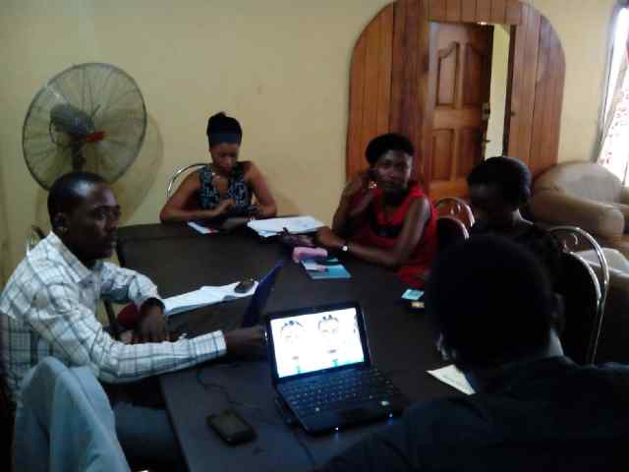
Inaugural Meeting/ Workshop for Directors

Slide 9
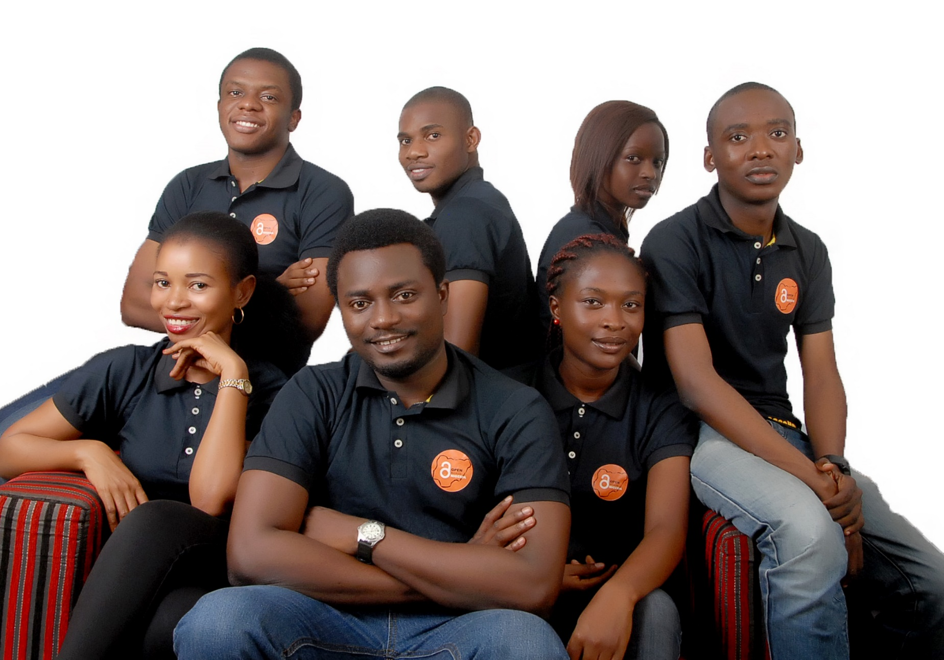
OA Nigeria HQ

Slide 10
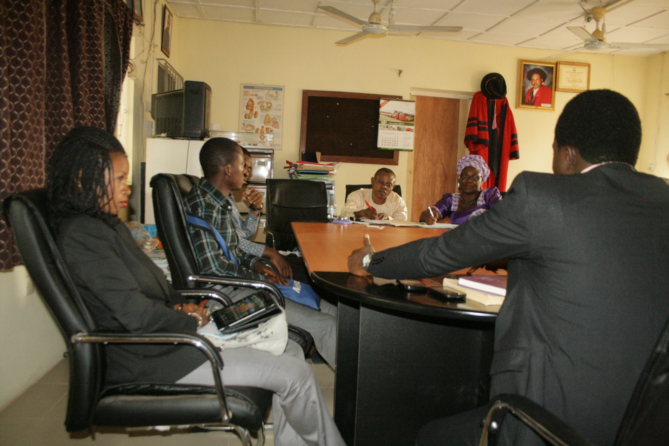
Met with the college administration
Discussed, obtained support

Slide 11
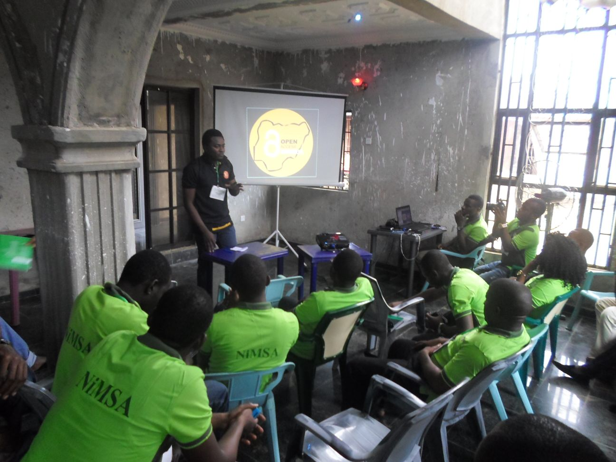
Organised a workshop for NiMSA officials at their National Executive Council Meeting

Slide 12
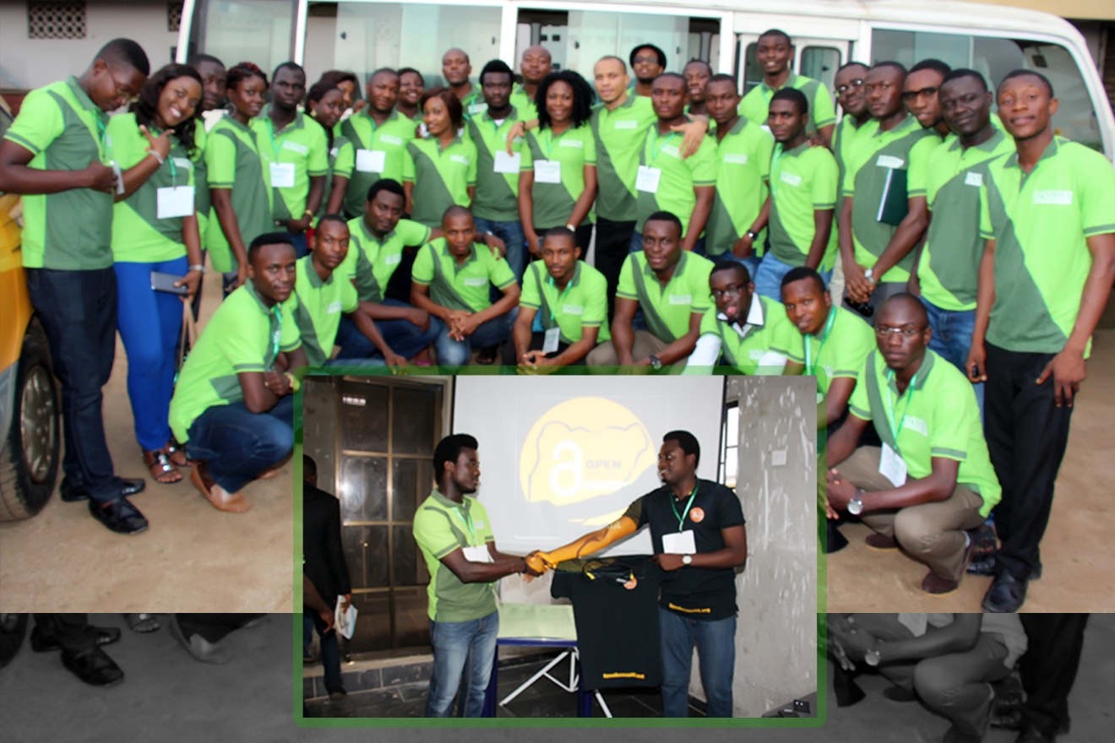
Started a Partnership with NiMSA

Slide 13
CAMPUS COORDINATORS IN 19 UNIVERSITIES
Appointed Campus Coordinators via an online application process
Google forms, propagated via facebook, twitter and email groups
Was able to appoint Campus Coordinators and Team Members in 12 universities this way.
Headhunted in 7 others

Slide 14
PRIOR TO OA WEEK 2014
We conducted
4 presentations
3 workshops
Over 1,000 students and early career researchers
More than 50 faculty members and librarians
Initiated contact with 2 National Legislators

Slide 15
DURING OA WEEK
Led OA week activities on 19 campuses
E-mailed the entire academic & library staff at CMUL
Gathered 200 stakeholders from academia for a symposium and panel discussion at CMUL
Distributed 3000 pamphlets/trifold brochures & 1000 flyers

Slide 16
DURING OA WEEK (cont…)
Information booth
Twitter interview
Awareness rally
Courtesy visits

Slide 17
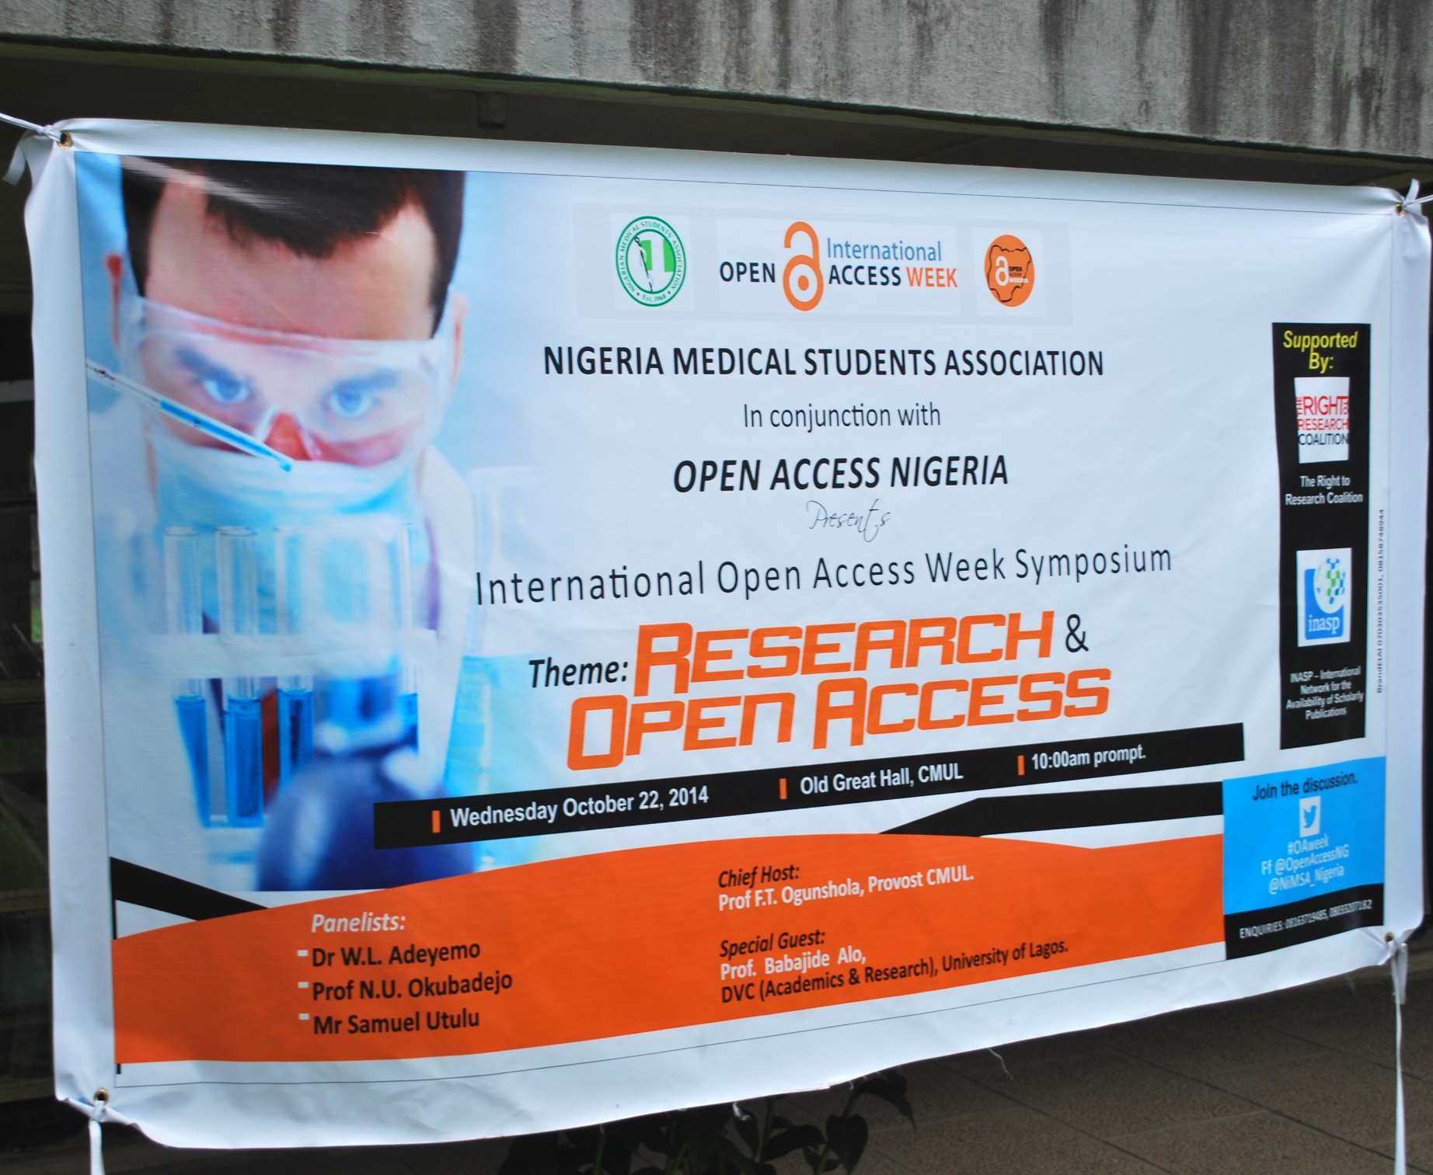


Slide 18
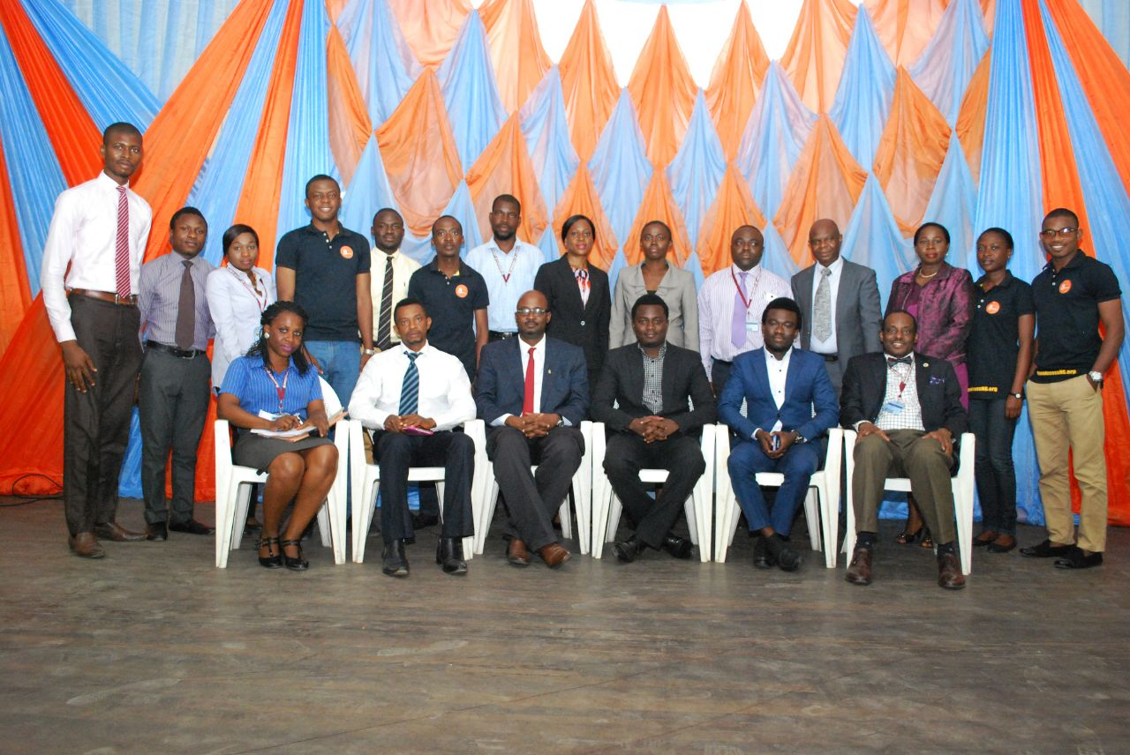
OA Week organizers
with University
Administrators and
Panelists (CMUL)

Slide 19
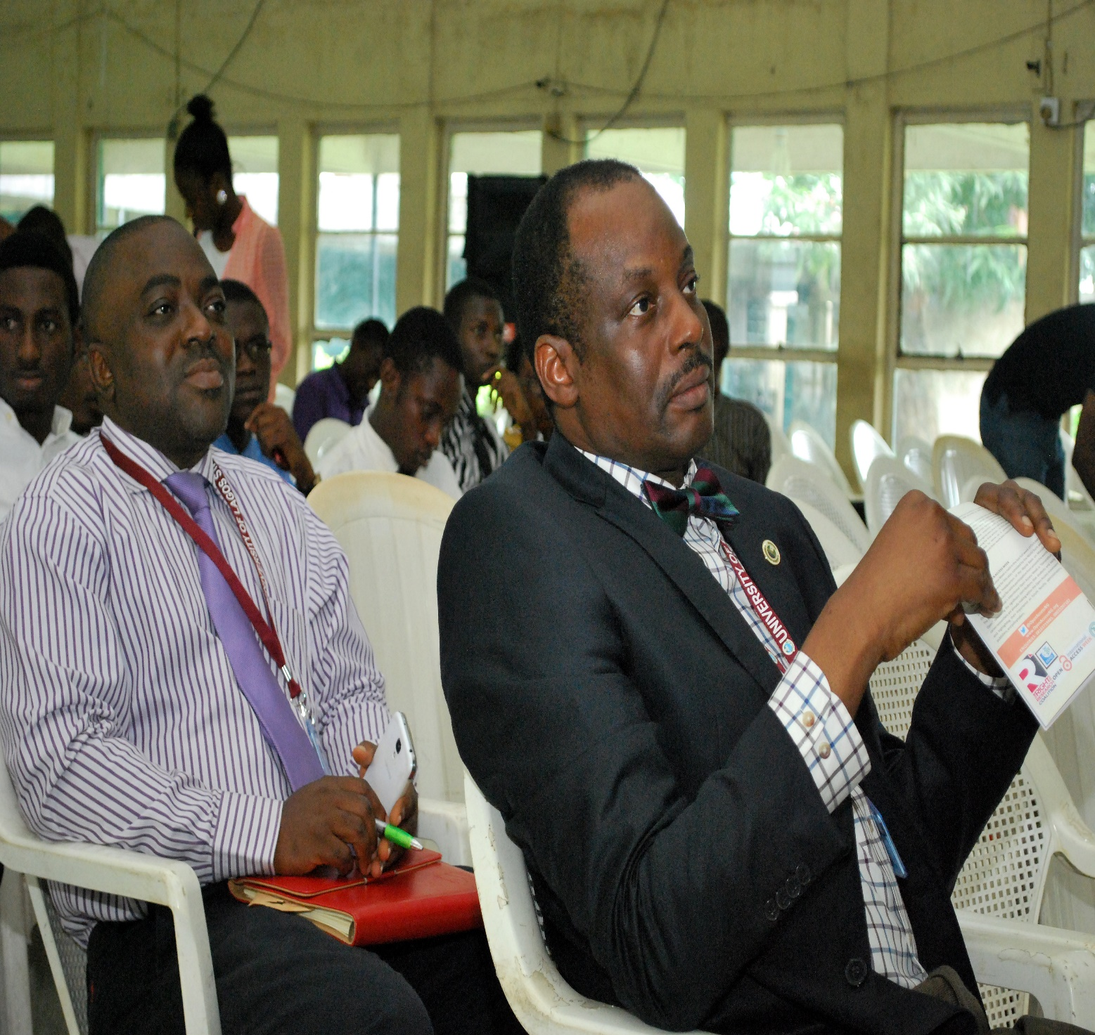
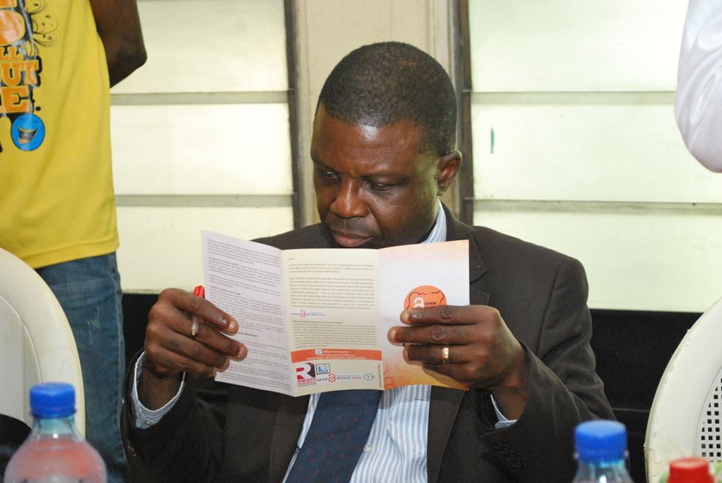
Dean, Faculty of Clinical Sciences, Prof. Leshi & Deputy Provost Prof. Okanlawon, College of Medicine University of Lagos (CMUL) at the Symposium/Panel Discussion

Slide 20
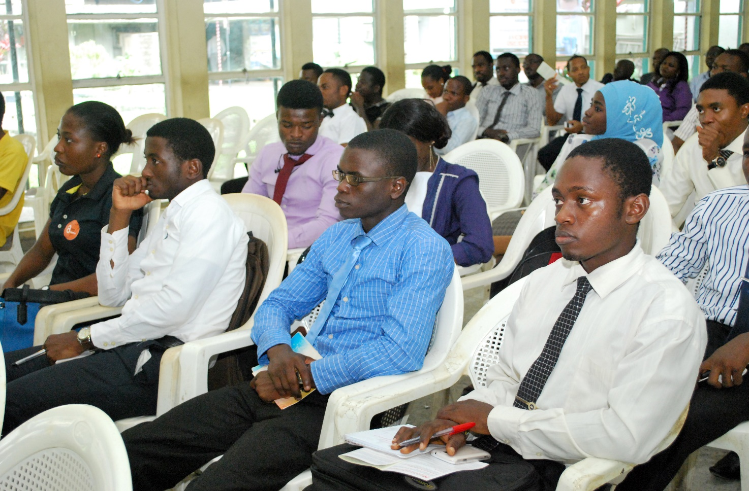
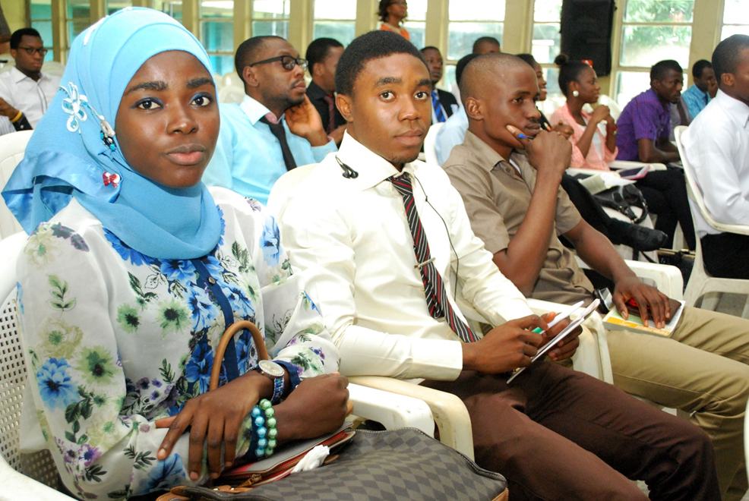
Cross-section of Participants at the
Symposium/Panel Discussion (OA Week)

Slide 21
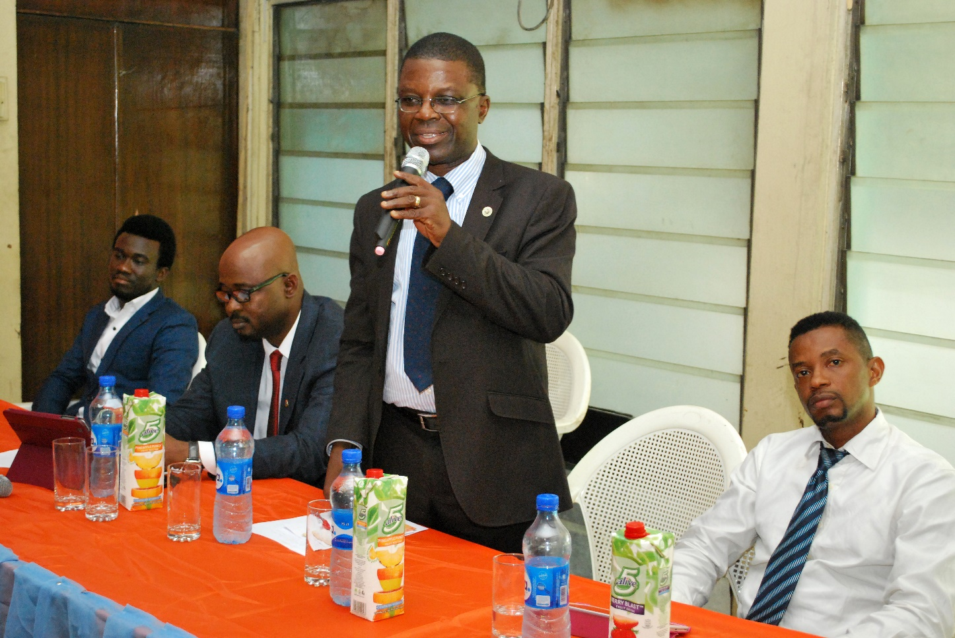
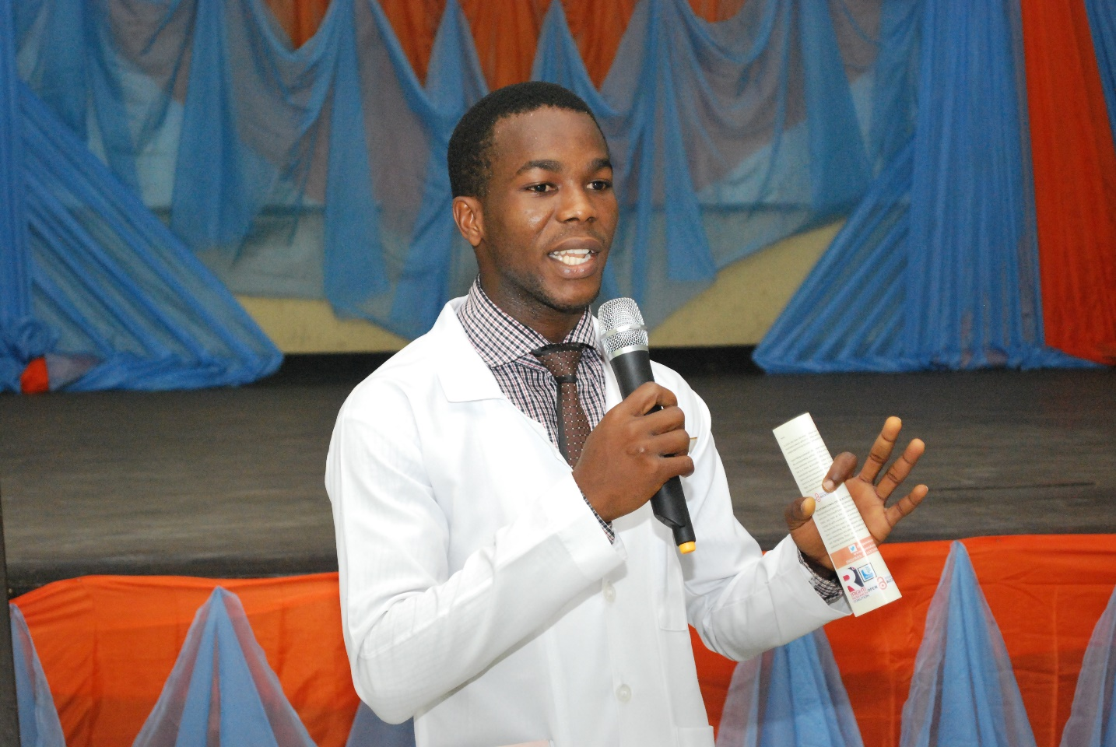
A student engages the Panelists
Deputy Provost, Prof Okanlawon
flanked by 2 Panelists, Dr. WL Adeyemo
And Mr. Samuel Utulu. NiMSA President
Mr. Eche Ugo on the far left.

Slide 22
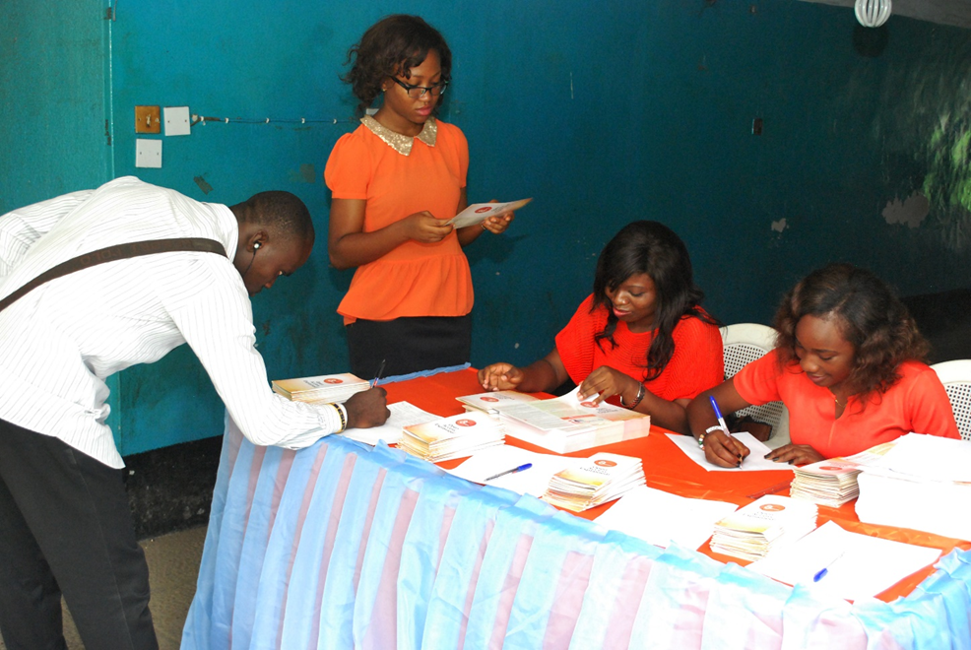
Information Booth

Slide 23
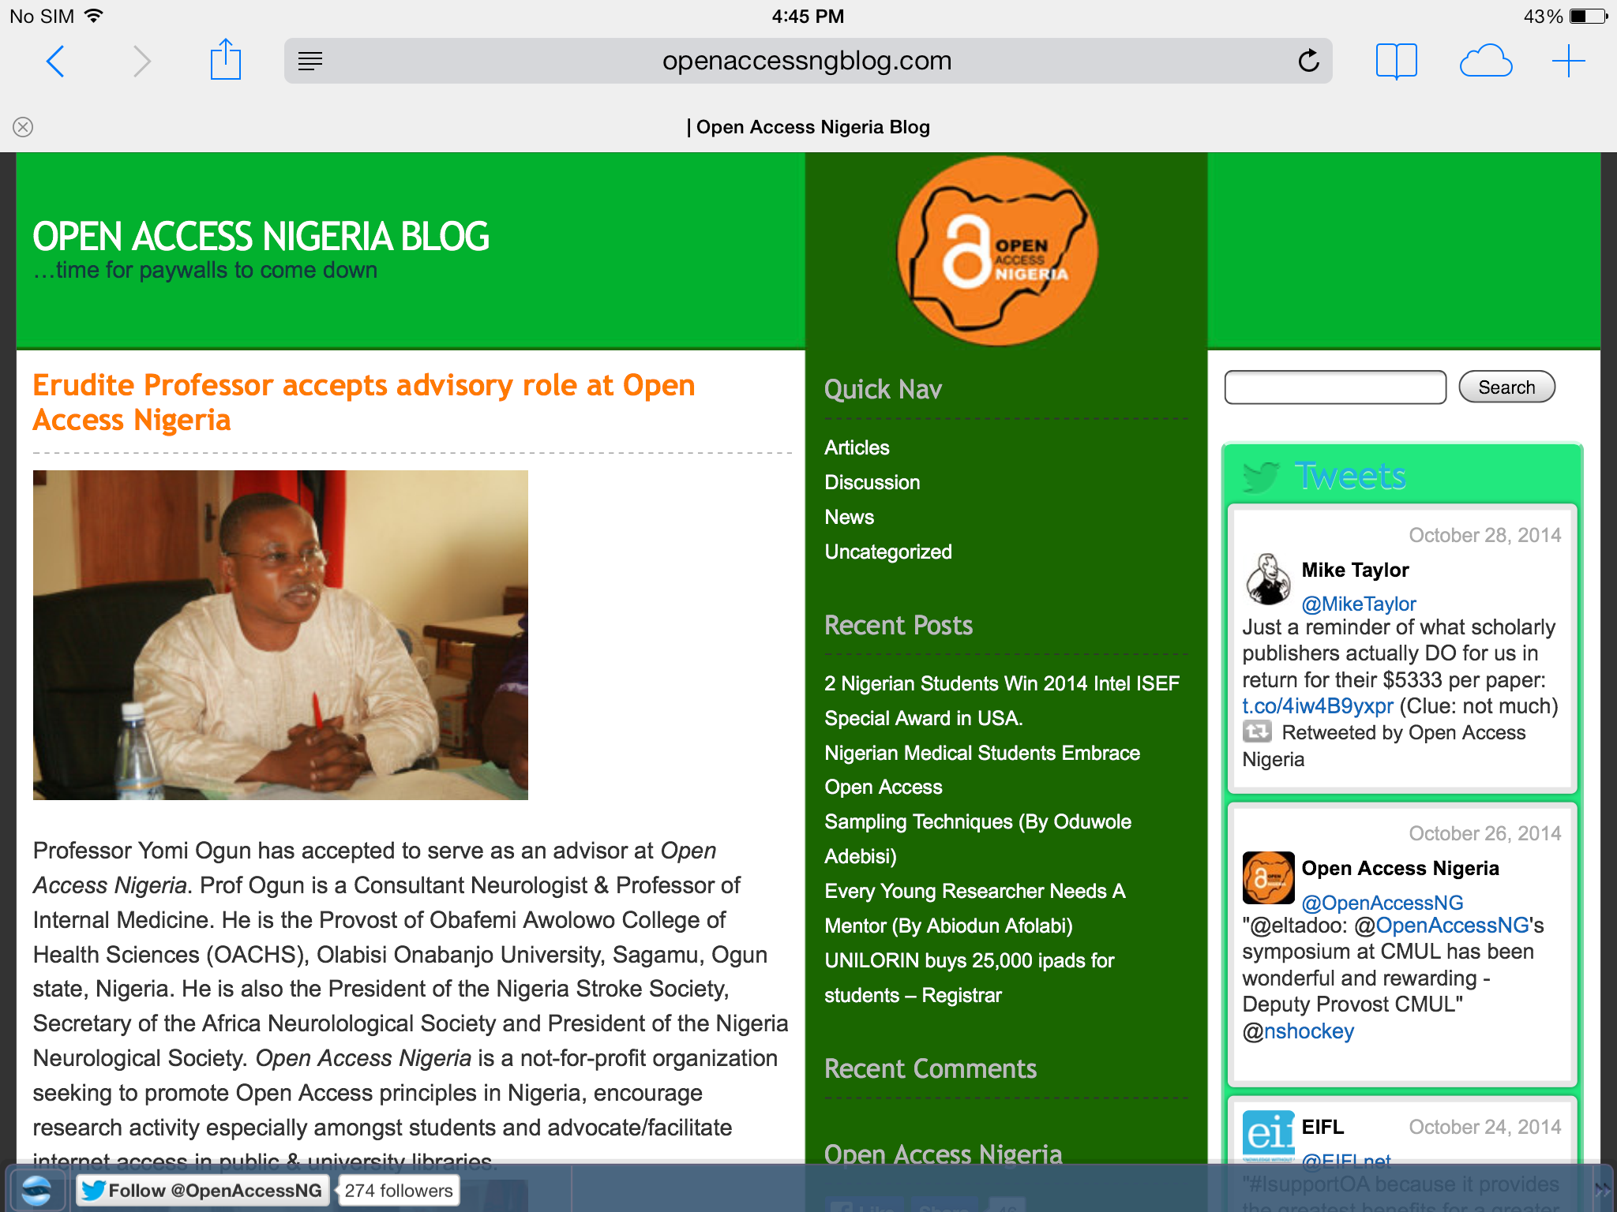

Slide 24
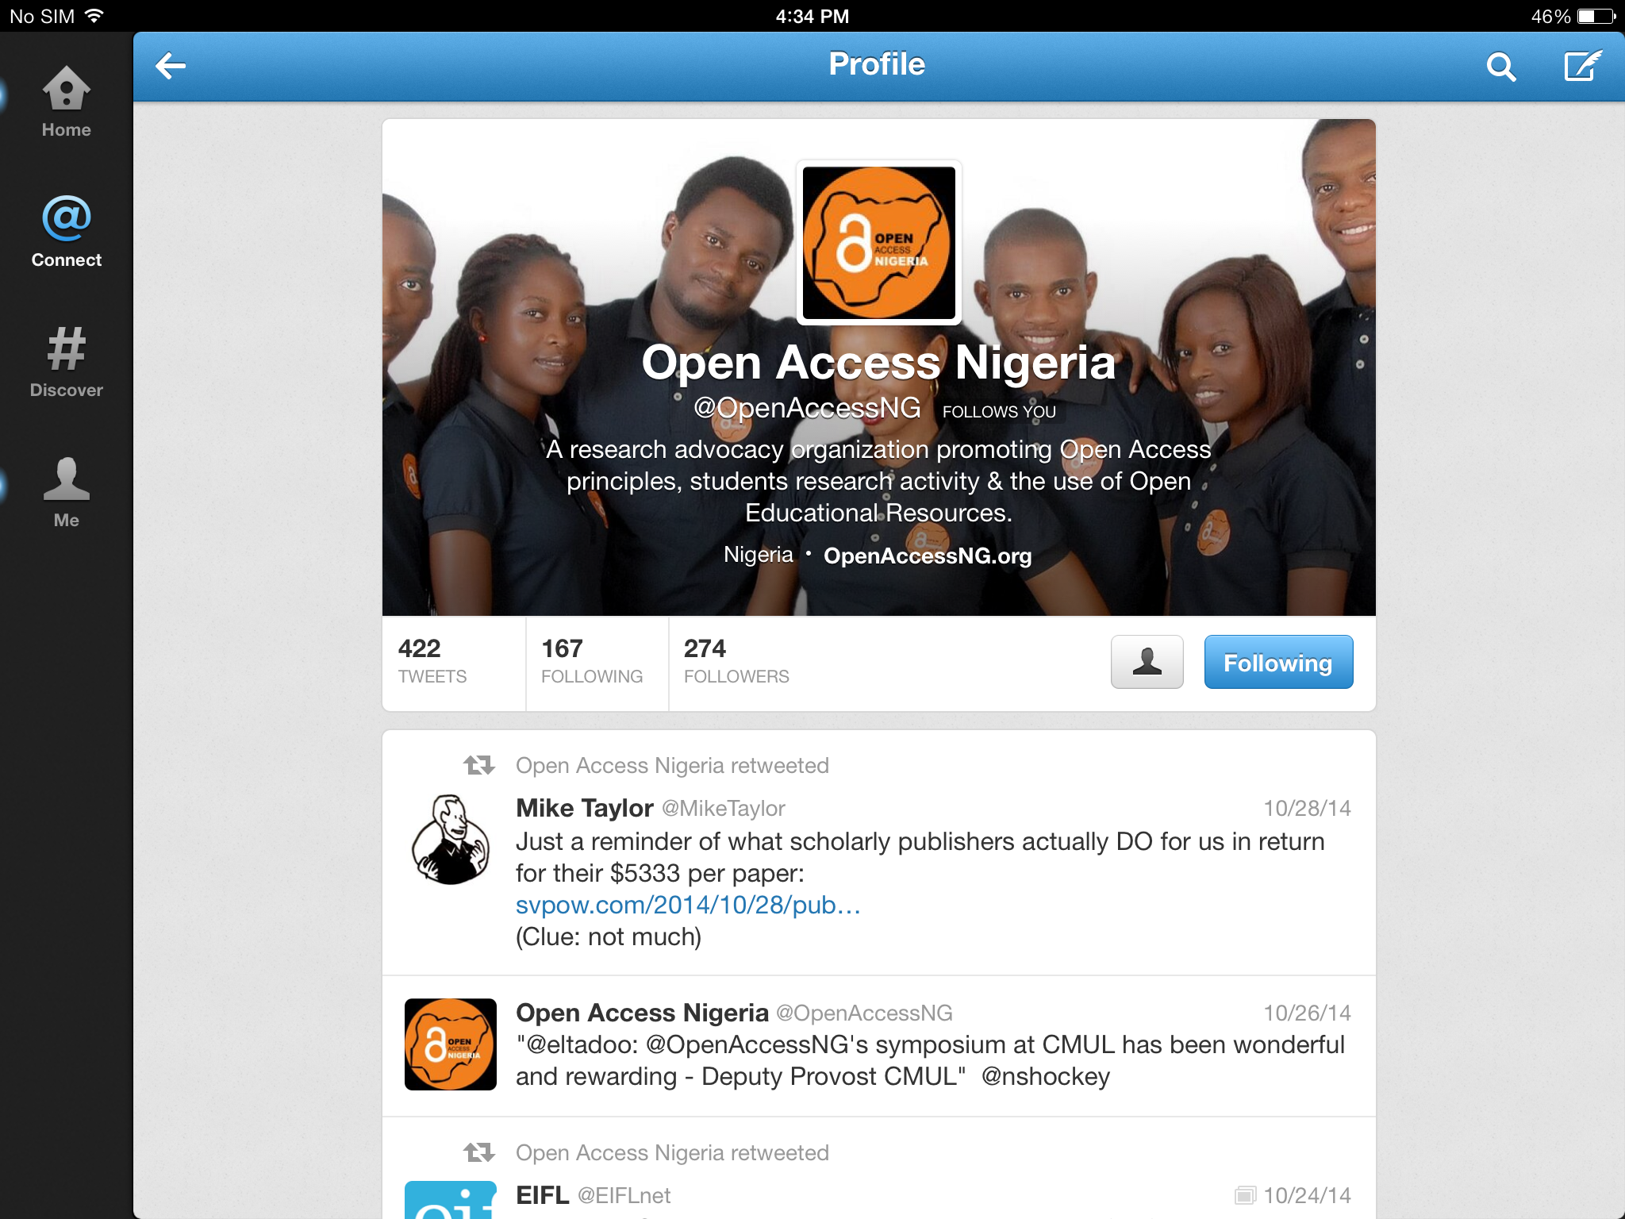

Slide 25
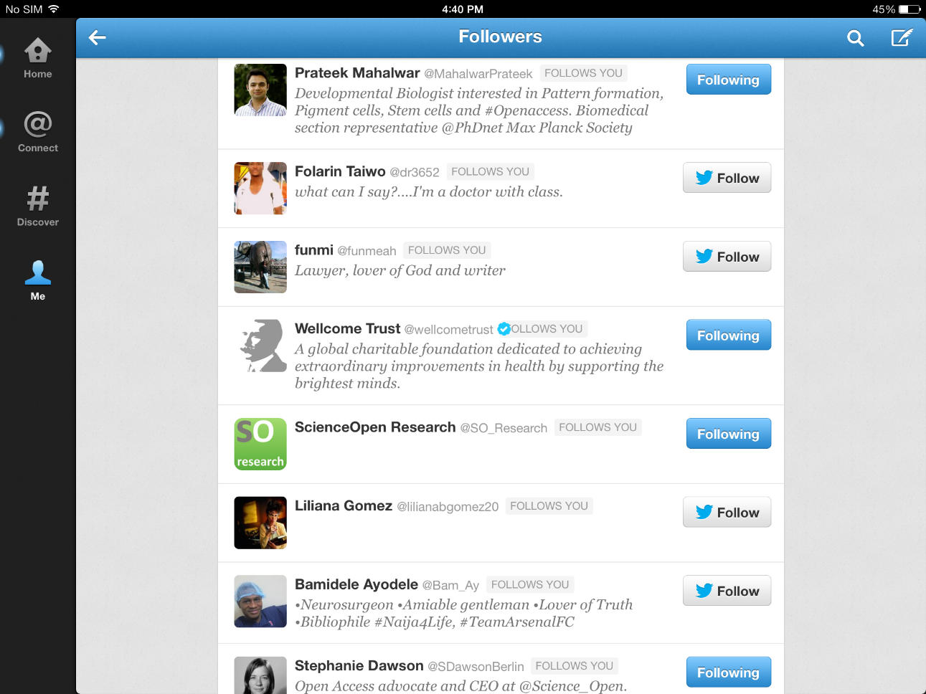

Slide 26
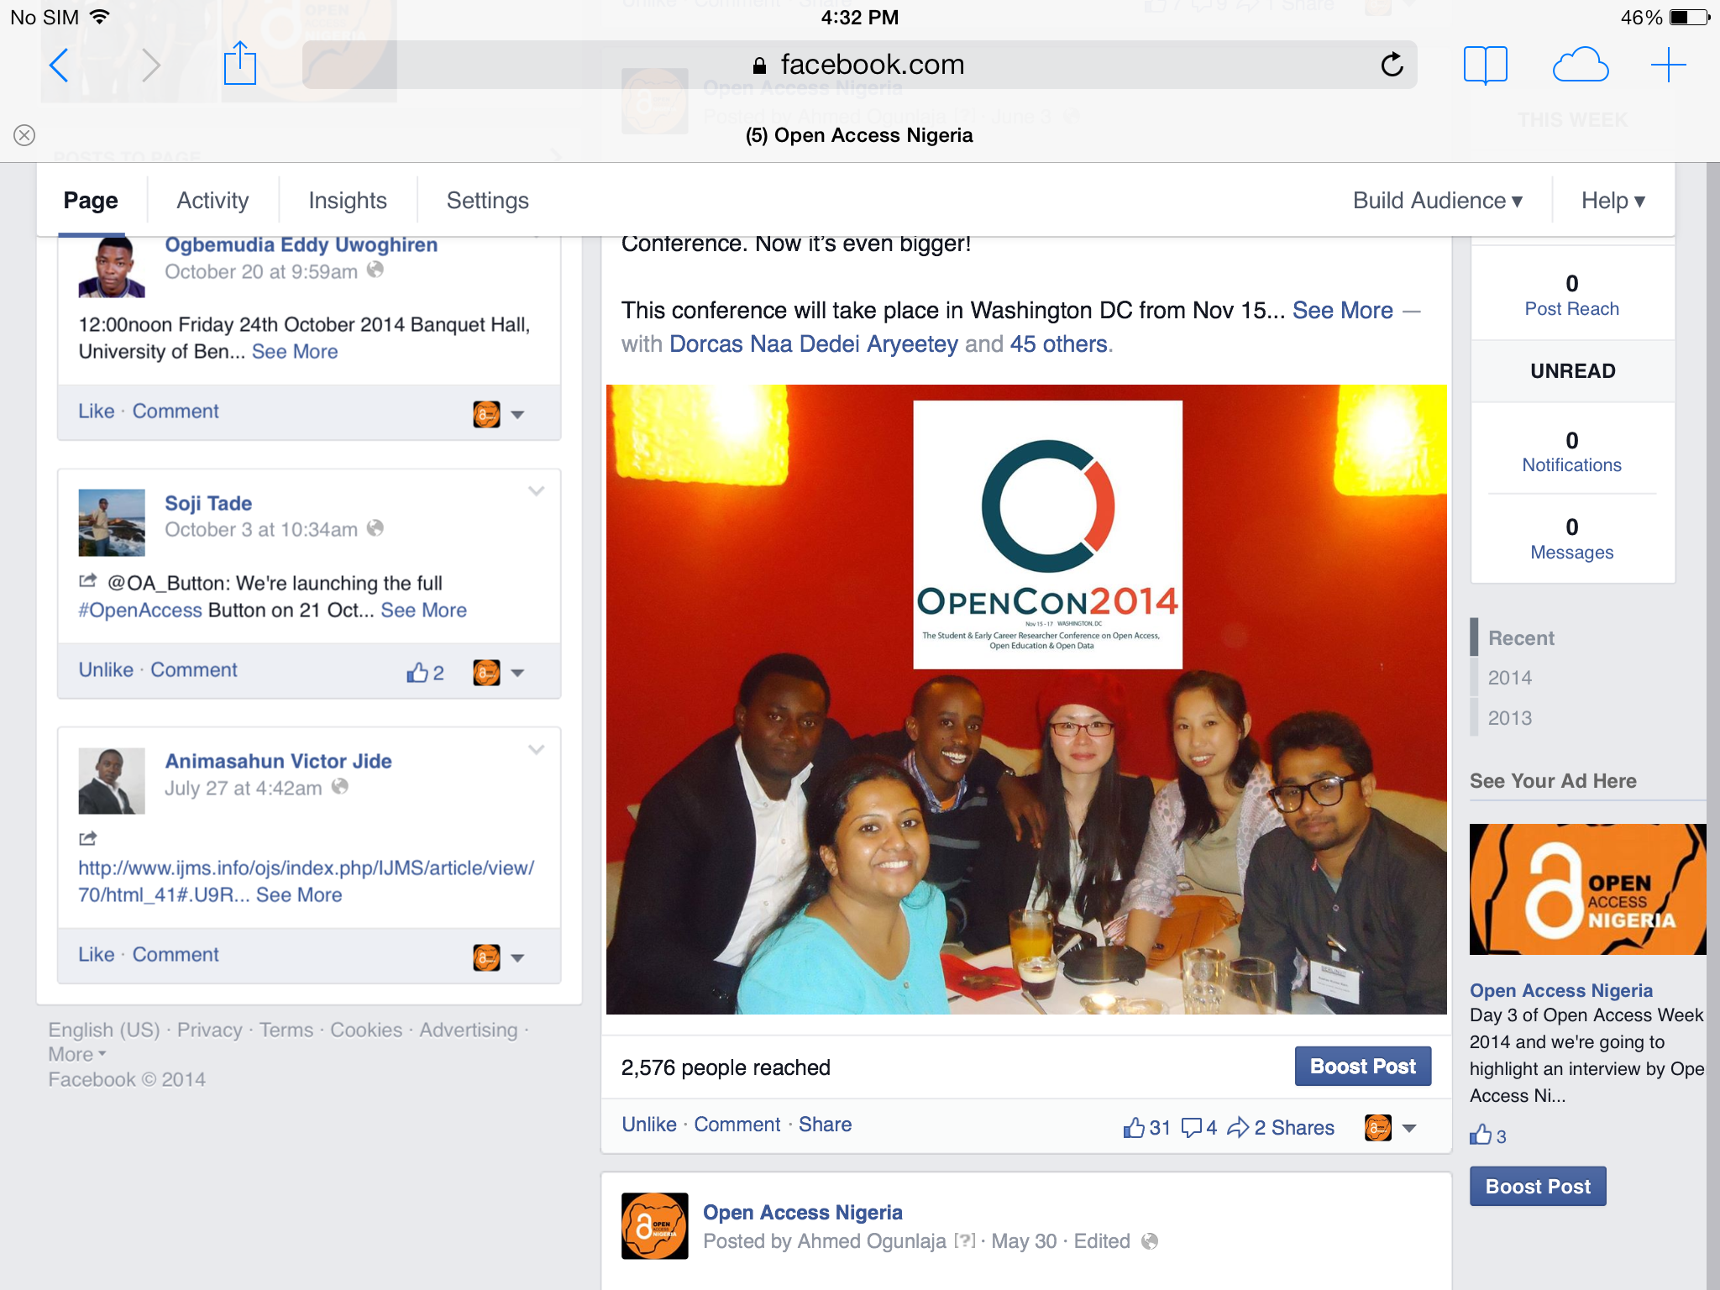

Slide 27
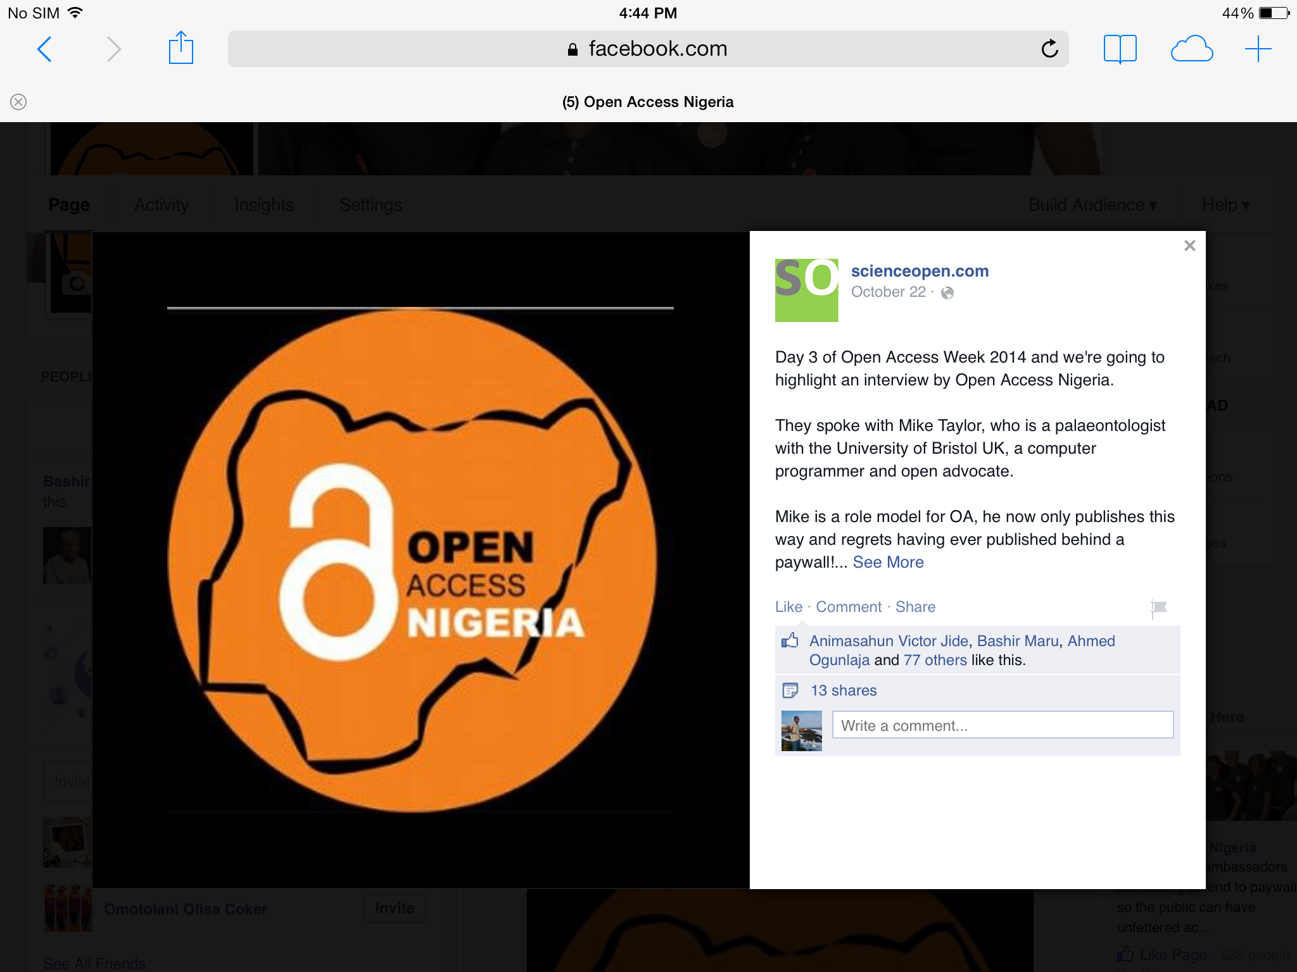

Slide 28
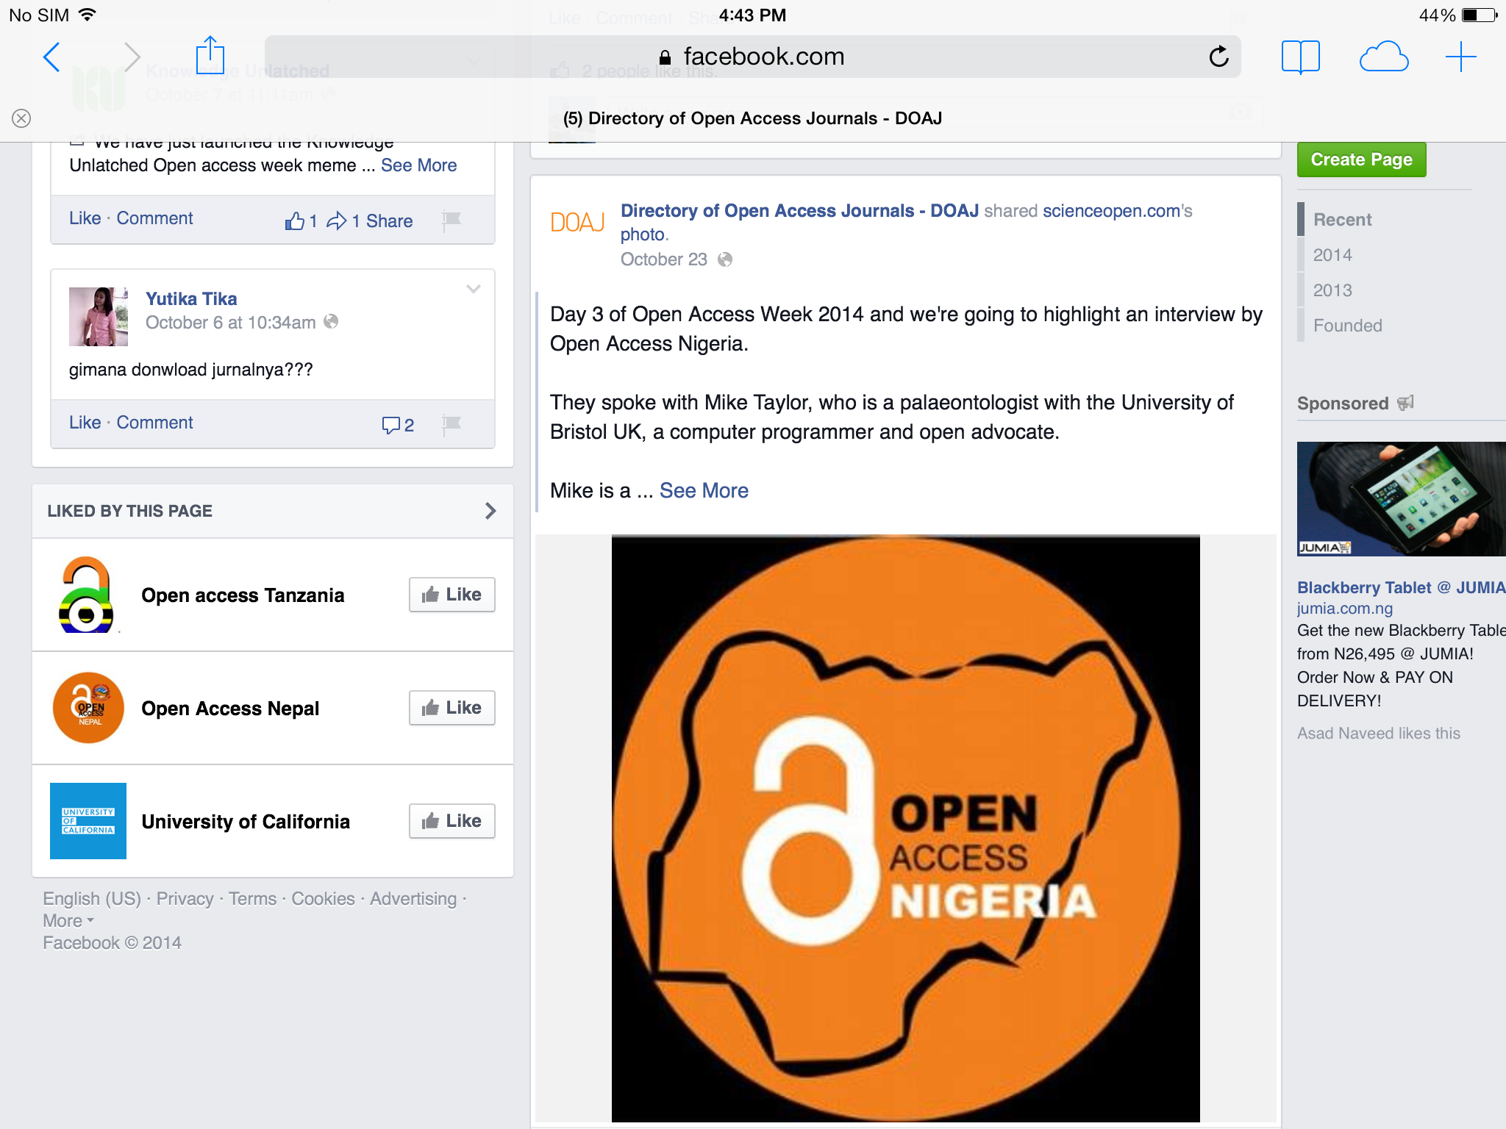

Slide 29
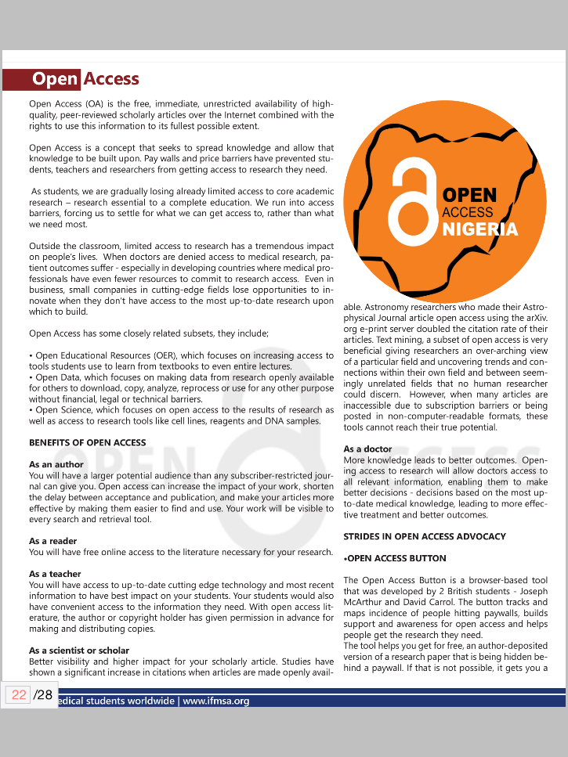
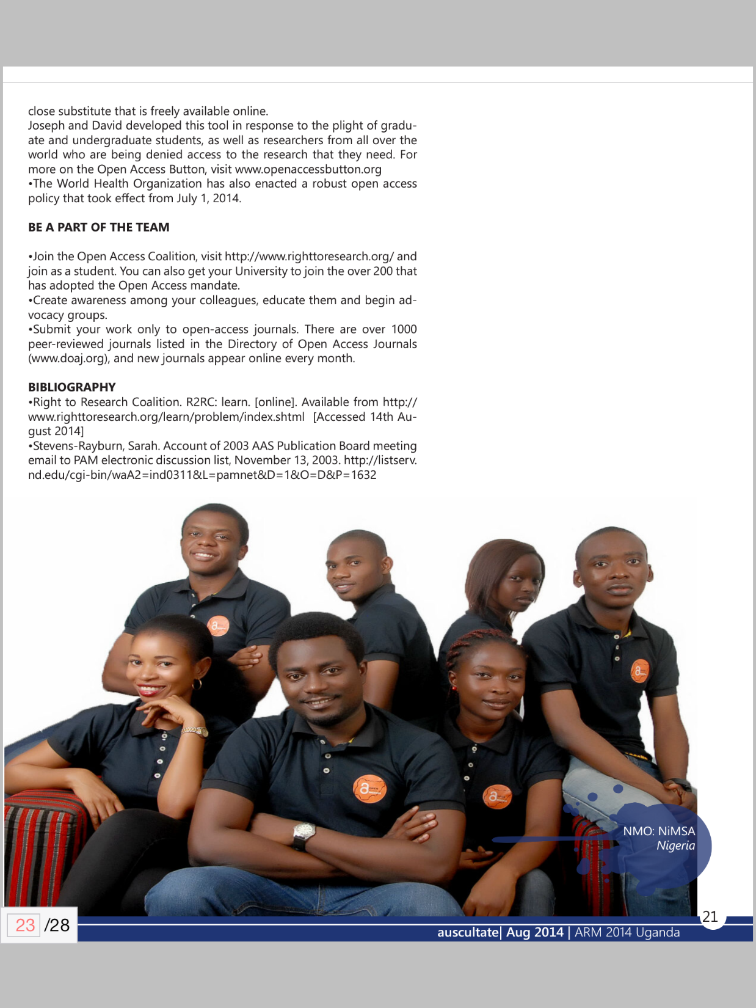
Article by Tade Adesoji
in the December 2014
edition of Auscultate,
the IFMSA
Africa Magazine

Slide 30
Thank You
Website: www.OpenAccessNG.org
Facebook : www.facebook.com/OpenAccessNG
Blog: www.OpenAccessNGblog.com
Twitter: www.twitter.com/OpenAccessNG
@OpenAccessNG

Slide 31
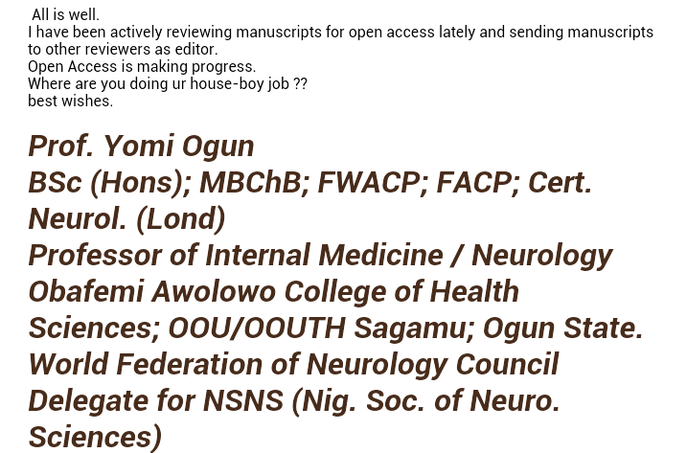

Slide 32
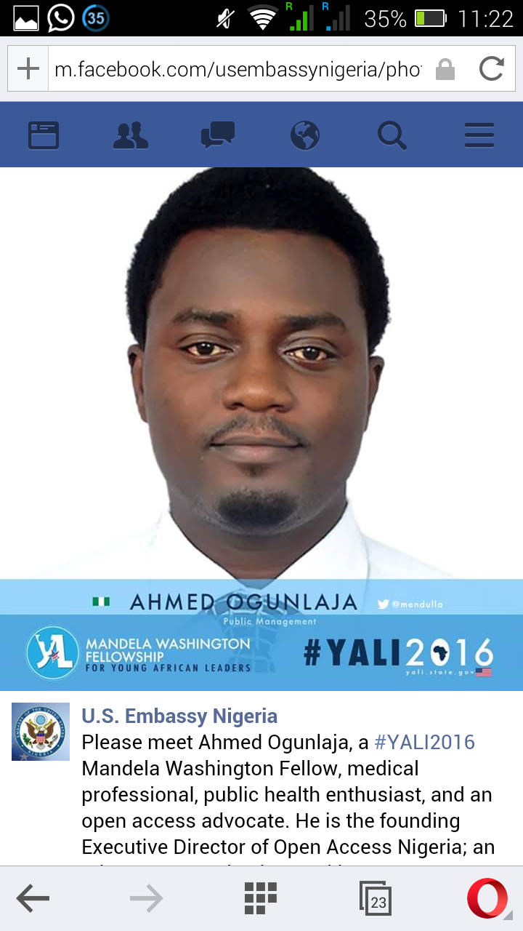
.
.

Slide 33
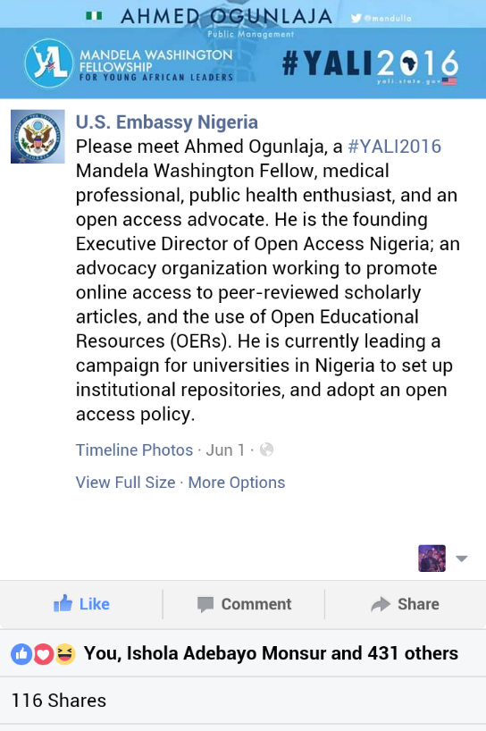
.
.

Slide 34



