Slide 1
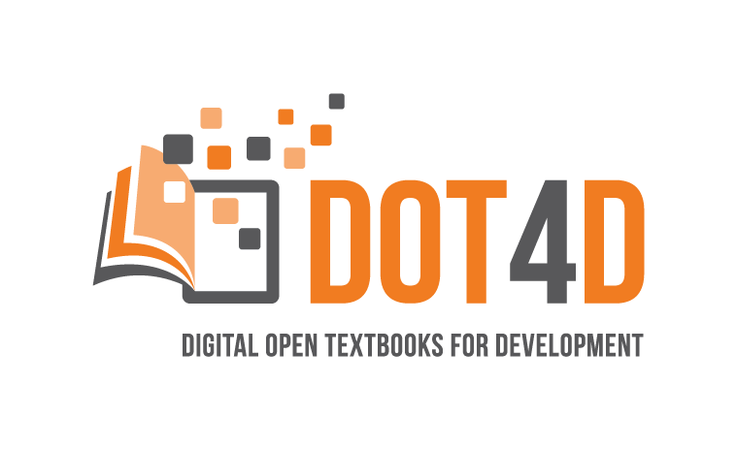




Use of ChatGPT for student co-creation of open textbooks
by Glenda Cox, Michelle Willmers, Robyn Brown & Michael Held
Centre for Innovation in Learning and Teaching & Department of Orthopaedic Surgery
University of Cape Town
28 February 2024

Slide 2
Background context
DOT4D and ‘students as partners’

Slide 3
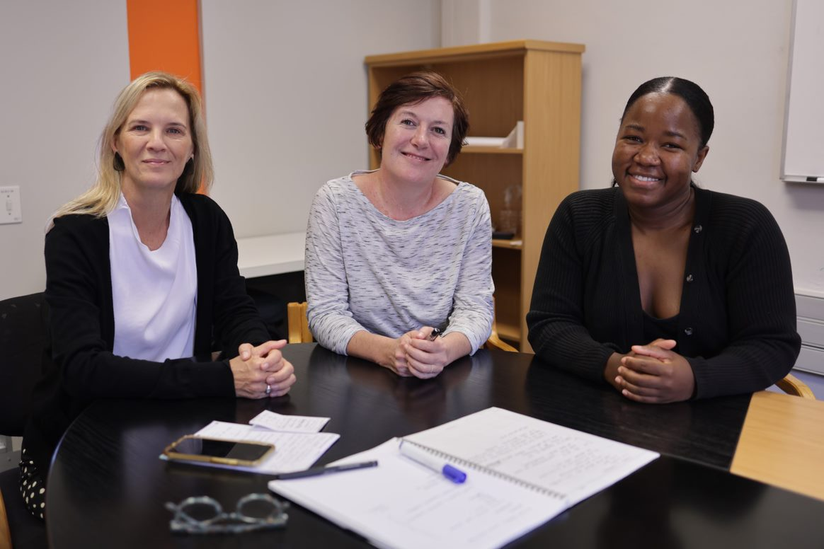

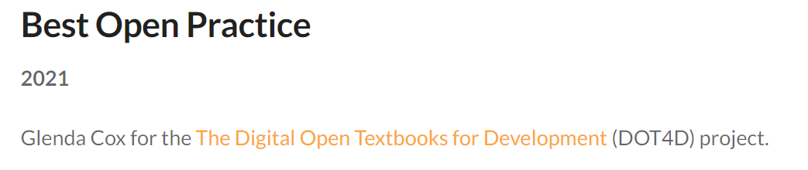
Digital Open Textbooks for Development (DOT4D)
Disclaimer
Initiated as a three-year (2018–2021) research, advocacy and implementation project funded by the Canadian IDRC, following in wake of Research on Open Educational Resources for Development (ROER4D) and other CILT open education initiatives.
Now an institutionally funded initiative.
Glenda Cox
Principal Investigator
Michelle Willmers Publishing & Implementation Manager
Bianca Masuku Researcher

Slide 4


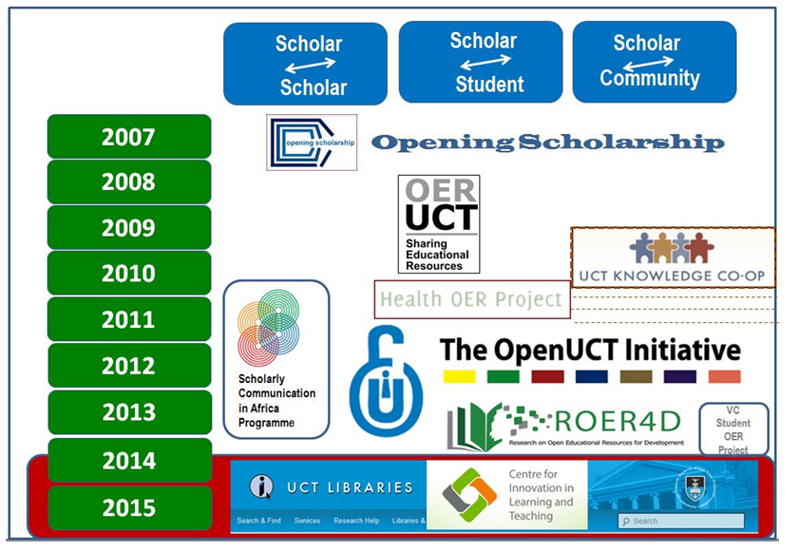






16 years of open education at UCT (2007–2024)
Mellon Health Sciences OER Project
Vice-Chancellor’s Student
OER Project
Notes:
UCT the home of Open…
Add 2016 and IP Law- Tobias CC legal Lead SA

Slide 5


















National community

Slide 6
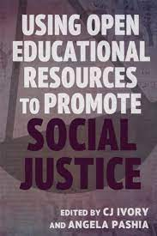
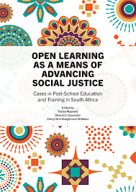
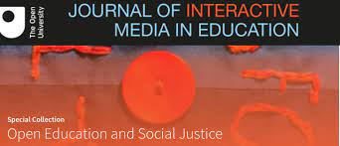
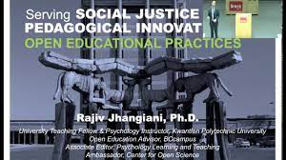
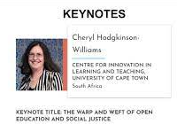

Social justice imperative

Slide 7

Social justice as a framework to understand the potential of open education
“At the heart of the open educational resource movement is the intention to provide affordable access to culturally relevant education to all … in a manner consistent with social justice.”
(Hodgkinson-Williams & Trotter, 2018)

Slide 8
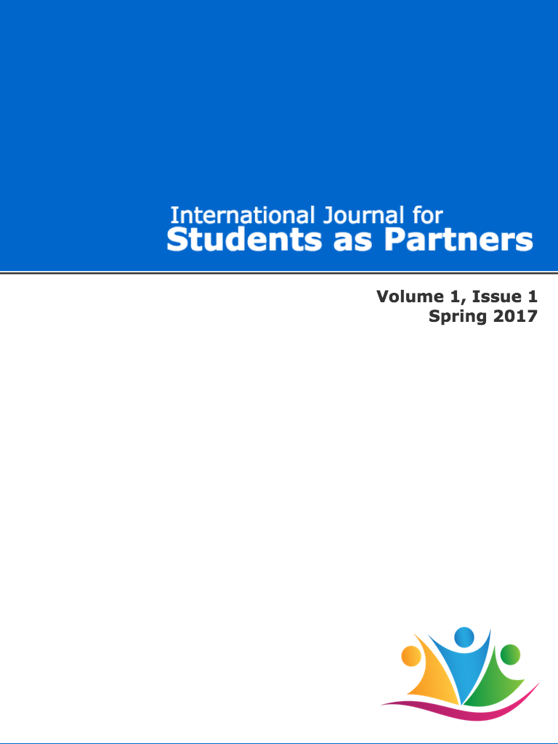
'Students as partners' and co-creators … a global movement to include students in course design, facilitation and research
Open textbook co-creation as a means to engage students as partners, address epistemic representation in teaching materials and build students’ sense of agency and belonging through recognising and valuing their contributions.
Principles:
Respect,
Reciprocity
Shared responsibility

Slide 9
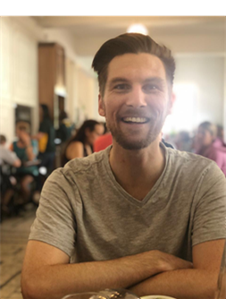
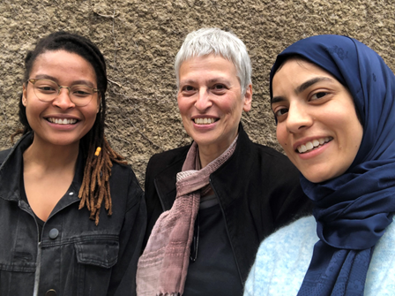
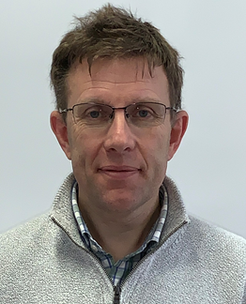
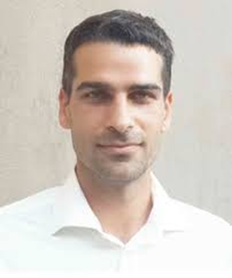
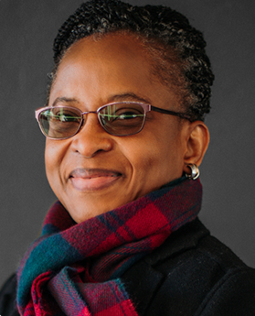
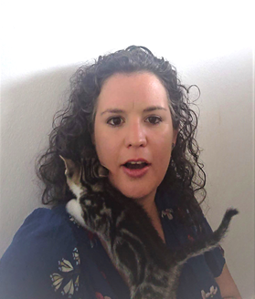
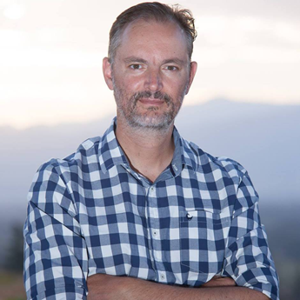
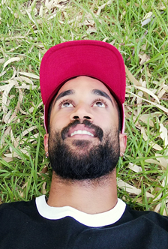
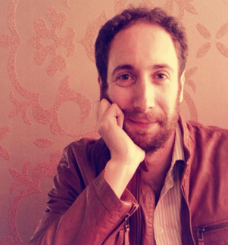
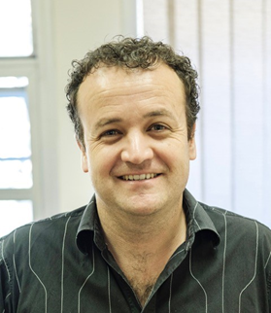
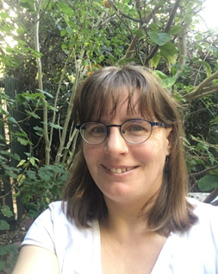

UCT open textbook authors in DOT4D grants programme and models study

Slide 10
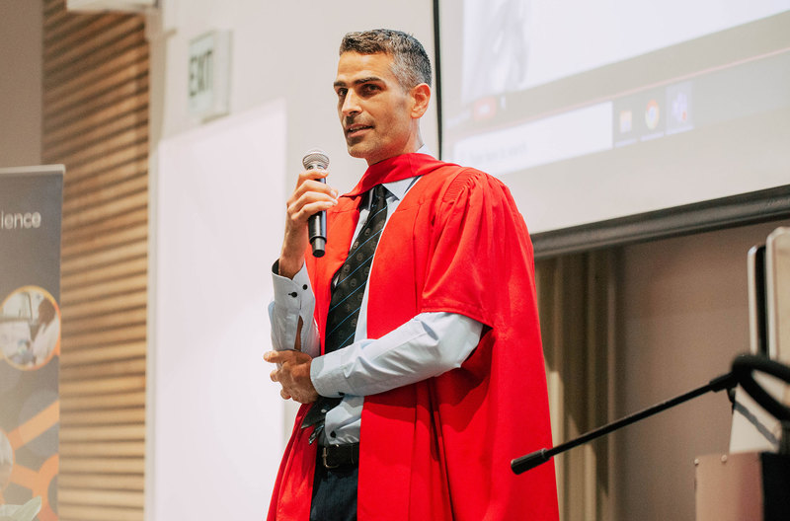
“Because there is a lot of input from students themselves, students have been seen to be more engaged in the content. We have tried to bring students in, flatten the hierarchy and create from within.”
Professor Michael Held, Department of Orthopaedic Surgery

Slide 11
The process
DOT4D, student and academic innovator co-authorship

Slide 12

First approach to DOT4D
"I would like to use ChatGPT to create initial chapters, then have students review and also add images to it.
I would like to generate 5 to 10 MCQs and re-write each chapter with the ChatGPT/student combination.
May I ask you, if you have advice on how to reference this and if this is legit reg open access licence? I don't want us to get in trouble later with copyright, etc."
Notes:
In response we sent a few links on referencing AI and I sent a link to a blog where an open educator had worked with students to update chapters of an open textbook.

Slide 13

First supervised study module (SSM) meeting with DOT4D
(Four SSM students & Prof Held)
Concerned
Worried about referencing and Turnitin, as project would be assessed
Critical
Aware of shortcomings in accuracy and referencing
Confident
Aware of Creative Commons licensing and ethical concerns. Engineering own processes
Notes:
https://www.timeshighereducation.com/campus/teaching-ai-literacy-how-begin
Inspired by 1) the pedagogical innovation and respectful, encouraging manner of the lecturer
2) the students incredible critical AI digital literacy

Slide 14
A collaborative, cross-disciplinary co-authorship approach
STUDENT: ROBYN BROWN (fourth-year MBChB student)
ACADEMIC INNOVATOR: PROF MICHAEL HELD
Responded to call for voluntary participation from SSM students
Brought into process as a paid Research Assistant
Played an important role in:
  Data gathering
  Liaising with fellow SSM students on process (consent, verification, etc.)
  Verification of our analysis
  Commenting on overarching scope and structure
  Filling in important details and adding nuance
  Writing student perspective pieces
  Final review and input based on peer review comments
Participated in a one-hour interview on key salient features and gaps in fieldnotes data
Played an important role in:
  Facilitating engagement with SSM students and process (as far as ethically permitted
  Verification of our analysis
  Commenting on overarching scope and structure
  Filling in important details and adding nuance
  Final review and input based on peer review comments

Slide 15
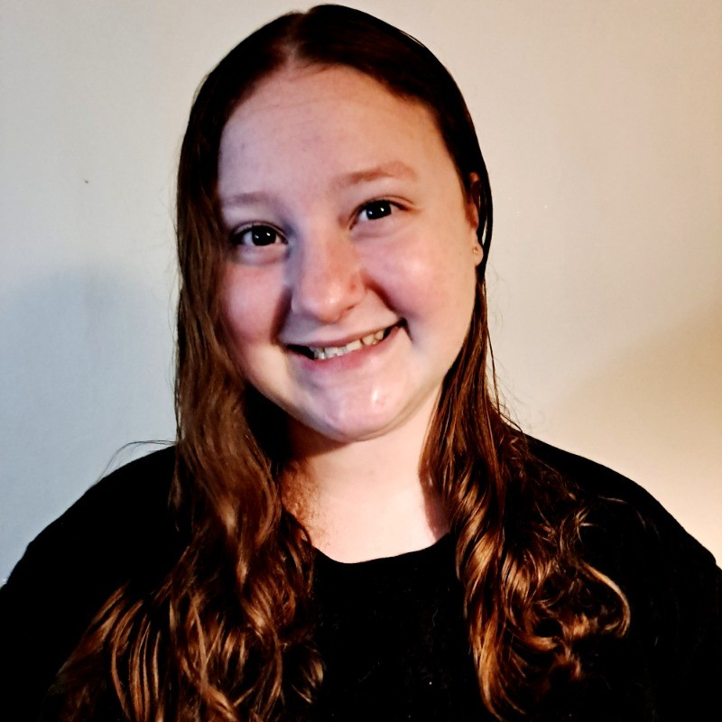
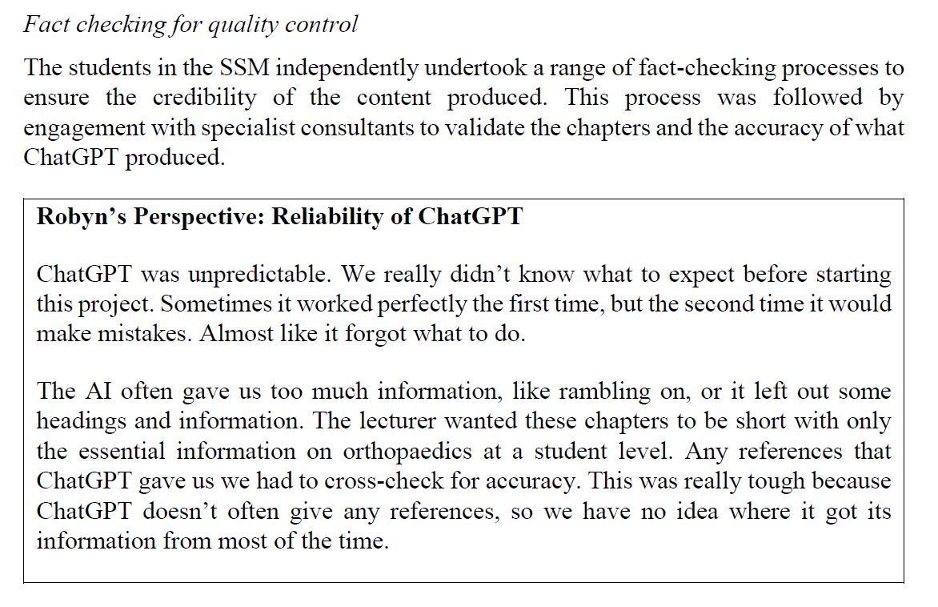

Slide 16
The paper
Learning along the way: A case study on a pedagogically innovative approach to engage medical students in the creation of open educational resources using ChatGPT
Mousaion: South African Journal of Information Studies https://unisapressjournals.co.za/index.php/LIS/article/view/15331

Slide 17

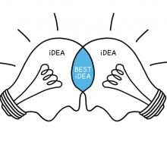

Open education and the production of OER
Student as partners pedagogical approaches
AI powered tools in education
Notes:
https://ctl.utexas.edu/programs-initiatives/students-partners-initiative

Slide 18
Method
Field notes gathered during two meetings with the students and the lecturer.
The prompt (instruction for ChatGPT) and assessment rubric.
Reflections of the SSM students gathered by the student co-author of this paper.
A 60-minute interview with the lecturer exploring the conceptual threads presented in this paper.

Slide 19
Literature review
C | Clarity | Clearly define the task or intent of the prompt, including specific information about the output.
R | Relevant info | Provide relevant details, including specific keywords and facts, the tone, audience, format and structure.
E | Examples | Use examples in the prompt to provide context and direction for the output.
A | Avoid ambiguity | Focus on the key information and delete unnecessary details in the prompt.
T | Tinker | Test and refine the prompt through multiple iterations. Explore different input versions to discover the best results.
E | Evaluate | Continuously evaluate the output and adjust the prompt as needed to improve the quality.
Critical AI Literacy
Prompt crafting and frameworks
Copyright and referencing
OER and AI
The CREATE framework for high quality prompt craft in AI tools (Source: Barrett, 2023)

Slide 20
Role/persona
Clarity
You are an orthopaedic department in Southern Africa which teaches medical students and updates GPs on orthopaedics for primary care. You have generated a textbook in form of co-creation with medical students, orthopaedic trainees and orthopaedic consultants for this purpose. This is part of a transformational student-centred approach to educational content creation. Students appreciated that it is free and accessible online. Do you understand your role?
You are going to use the open educational resource textbook as a base but rewrite it to make it more up to date with changes to the field. Also, you do this in an engaging, friendly and collegial but firm and professional voice. Every time that you rewrite a section include some notes to what changes you made. Please also include the references you use in Vancouver style at the end of the chapter. Do you understand your duty?
I am going to provide you with a template from an example of a textbook chapter for a case-based chapter and I would like you to write a 3 to 5 page chapter on the topic of ' Sport Knee Injuries and the approach to treating them'. Do you understand this?
Context
Relevant information
Task 1
Tone
Exemplar
Example
Task 2
Avoid ambiguity
Using craft prompt and analysis by Motsa (2023) and Barrett (2023)

Slide 21
Students working with ChatGPT
Critical AI digital literacy skills in three areas: prompt crafting, fact checking and referencing, and paying attention to ethical and legal issues such as consent and licensing of images sourced for the open textbook.
Two approaches:
  One student did preliminary online research and found textbooks that had information on their specific chapter topic before initiating the prompting process. They then copied relevant information from the textbook into ChatGPT to create the chapter draft.
  Three students let ChatGPT do its own research to create the initial chapter draft based on the prompt and then undertook multiple rounds of refinement (13 in Robyn’s case).
Engaged medical consultants in wards as expert reviewers for quality/accuracy

Slide 22
Lecturer’s perspective
(quality assurance and critical digital AI literacy)
The students took on the fact checking process without any guidance and the lecturer expressed that he was “really surprised to have all these checks and balances … without me or without us actually telling them what to do … they came up with it themselves”.

Slide 23
Lecturer’s pedagogical style and philosophy
Importance of relinquishing control for students to learn and grow
  “You obviously can control and standardise, but if you just leave it open and the process unfolds, I'm always surprised to see I can actually learn a lot more from them [the students] than they do from me.”
Importance of ‘finding yourself’ in the learning process
  “I think that students can grow their professional attitude when we give the freedom to explore it’ And importantly: it's not always about the actual content, it's more about finding them themselves.
Open, freeform approach, mindful of the correlation between degrees of freedom students are given in a task and their sense of agency as a co-author (and how they lose agency when you tell them what to do)
  “To really have a student move from becoming a participant in a project to actually being a co-creator … you have to almost let them figure it out themselves.”
Imperative around localisation so that students can see themselves and their lived reality in the content
  Global South focus central to ChatGPT prompting process and sourcing images

Slide 24
Challenges experienced by the lecturer
He felt he was 'winging it’ and would have liked a framework for prompting
ChatGPT was a 'double-edged sword’ … although it was much quicker to produce chapters, the quality was not better (he thought it would be...)
He was not sure how to assess the student's work – he used the existing SSM rubric and adjusted it to give the most marks for attention to process and engagement with ChatGPT
Notes:
“had a look at the prompts that they gave … and how they reacted to what they were given, how they tried to inquire about the information that that was provided … are they accepting the knowledge? … are they cross referencing?” The lecturer felt this process of engagement and interest shown by the student was most important and that: “someone who was completely engaged with the process, with the group and in dialogue with ChatGPT scored very high”; as opposed to someone that just accepted and submitted the chapter and didn't really participate in discussion.

Slide 25
Game changer
ChatGPT has the potential to be the game changer needed to help boost OER production in the Global South and facilitate better epistemic representation.
It provided a unique opportunity for the lecturer to create new open textbook chapters in orthopaedic surgery, authored by students with guidance and review by local experts. These chapters include relevant local content and images.
This case study is a meaningful example of enabling student’s epistemic access through using their voices to author texts that are accessible and make sense to them.
A real advantage was the speed at which first drafts of chapters could be created.

Slide 26
Ongoing research agenda: Exploring a way forward in student co-creation in terms of process, content and publication
More projects with student co-creation in various roles to create open textbooks and other open educational resources
Student agency to build ownership of knowledge and sense of belonging
Students embraced the idea of publication
Institutional support: CILT, DVC Teaching & Learning
Reward? Grants? More research? UCT as a leader?

Slide 27
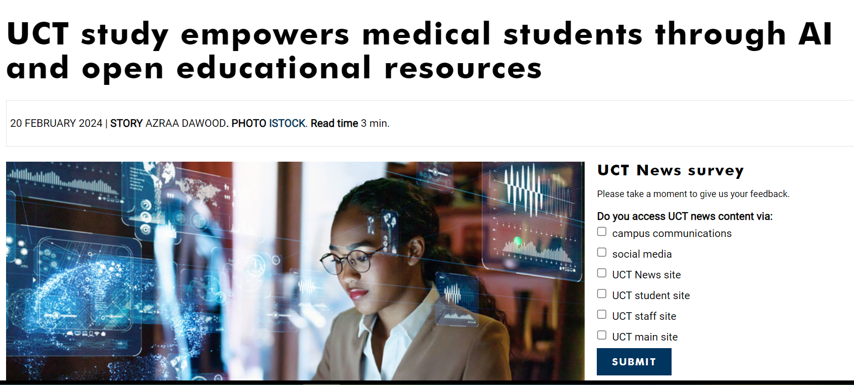
https://www.news.uct.ac.za/article/-2024-02-20-uct-study-empowers-medical-students-through-ai-and-open-educational-resources

