Slide 1
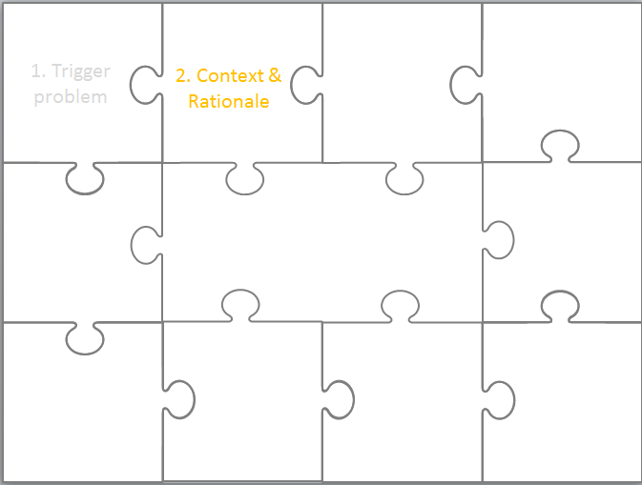
2. Context & Rationale
EDN6015F
Cheryl Hodgkinson-Williams
3-8 February 2014

Slide 2
1. Trigger problem
2. Context & Rationale

Slide 3
Once upon a time I was …
concerned/intrigued about … because in my (context e.g. institution, country)
there is a real problem/possible opportunity because ...

Slide 4
Purpose
The main purpose of the ‘Context and Rationale’ section in your dissertation is to accurately describe the context in which the study will take place, and justify the focus on the problem/possibility in the context.

Slide 5
“Having identified the question or problem you wish to address through your research project, you need to say something about how/why this question has arisen. For some students, the research project emerges out of a theoretical interest, for others it emerges out of issues of practice. Whatever the case, you should signal briefly why you have chosen the question that you have, and what contribution you think the completed research project might make to our understanding of the field.” (UCT Faculty of Humanities Guidelines for Research, p2)

Slide 6
The context of research
In essence the context of the research will need to:
Explain the problem/concern in the light of global, national and local forces (or local, then national and then global)
Briefly indicate what prior research has been done at a global, national and local level and where there are still gaps (note that the detail of this will come later in the literature review - this is just a ‘heads-up’ to the reader to note the key focus area and how it fits into the broader body of existing research)

Slide 7
Fail to learn from before …
In the field of ICTs in Education we face a particular problem because the rapid pace of change lulls us into thinking that our research is brand new and we fail to learn from what has gone before and fail to situate our research within the existing body of research.
  “Many—perhaps the majority—of current learning technologists fail to take advantage of the lessons of earlier projects. They do not link what went before with what is now. This may be because of the excitement of working with leading-edge technology so that there is no time to lose. Perhaps it is because they are unused to the effects of disruptive technologies. It may also be because the research and development is driven, not by learning technologists but by information technologists who are unaware of what has gone before” (Rushby & Seabrook 2008b:198).

Slide 8
Activity 1
Think about the value of developing an Annotated Bibliographies
Share ideas of what you established has “gone before” in your particular area of interest – what problems did you encounter?

Slide 9
Rationale for research
In short the rationale for the research will need to:
Justify the particular aspect of the problem that your research will focus upon
So that the practices (or policies – not always possible in a minor dissertation) you hope to influence are clear and compelling

Slide 10
Key questions for justification
The rationale for the research may come from a theoretical gap (which is usually the case for a PhD) or a practical gap (which is often the case for a minor dissertation - i.e. why there is a gap in YOUR context). The ‘litmus test’ for the rationale is to ask these question of your self:
Who will care about my research findings?
Who might actually want to listen to what I have to say?
How might my research findings help to promote some type of policy change or change in practice?
Who might be most influenced by my research?

Slide 11
Activity 2
Referring to the entries you and your class mates wrote in your Annotated Bibliographies use the questions above to analyse the context and the rationale they provide:
What is the problem/concern they identify in the light of global, national and local forces?
What gaps do they identify?
Who will care about their research findings? Who might actually want to listen to what they have to say?
How might their research findings help to promote some type of policy change or change in practice?
Who might be most influenced by their research?

Slide 12
Maxwell’s types of goals for research
Maxwell (2008) differentiates between different kinds of goals of research which help illuminate the underlying rationale for research. He refers to:
Personal goals
Practical goals
Intellectual goals

Slide 13
Activity 3
Read the extract from Maxwell (2008:220) and then reflect on what your personal, practical and intellectual goals might be.
  Besides your personal goals, there are two other kinds of goals that I want to distinguish and discuss, ones that are important for other people, not just yourself: practical goals (including administrative or policy goals) and intellectual goals. Practical goals are focused on accomplishing something—meeting some need, changing some situation, or achieving some goal. Intellectual goals, on the other hand, are focused on understanding something, gaining some insight into what is going on and why this is happening. Although applied research design places much more emphasis on practical goals than does basic research, you still need to address the issues of what you want to understand by doing the study and how this understanding will contribute to your accomplishing your practical goals.(Maxwell 2008: 220)

Slide 14
Research interests
According to Conole & Oliver “e-learning research raises a plethora of issues, which can be grouped around four main themes” (2007:12):
Pedagogical
Technical
Organisational
Socio-cultural
I am adding “Political” to cover policy and funding issues.

Slide 15
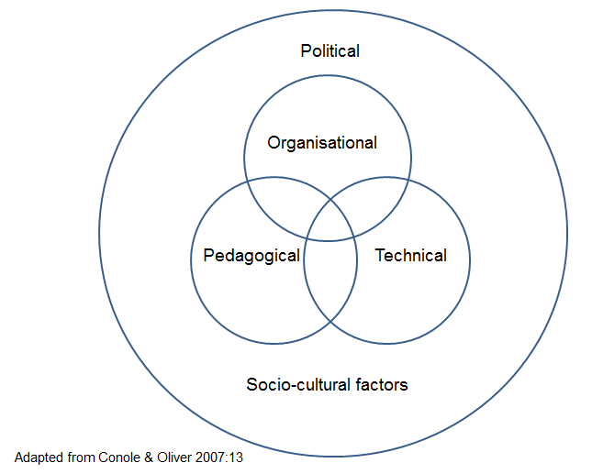
Research interests
Which is your key research interest?
  Pedagogical
  Technical
  Organisational
  Socio-cultural
  Political

Slide 16
Pedagogical research themes
Understanding the learning process
Development of e-learning materials
Delivery and integration of e-learning
Support of e-learning
Evaluation and quality assurance

Slide 17
Technical research themes
Standards and architecture
Tools and technologies
Functionality and uses

Slide 18
Organisational research themes
Users of e-learning
Structures and processes for development
Contextual and cultural issues that enable or constrain use of e-learning

Slide 19
Socio-cultural research themes
Legal & ethical issues
Accessibility & special needs
Gender
Linguistic issues
Cultural issues
Subject disciplinary issues

Slide 20
Policy issues
International level declarations
County level policies, white-papers
Institutional level policies, rules and procedures

Slide 21
References
Conole, G. & Oliver, M. (Eds.) (2007). Contemporary perspective in e-learning research: Themes, methods and impact on practice. London: Routledge (UCT Main Library 378 1734 CONT).
Maxwell, J.A. (2008). Designing a qualitative study. In Bickman, L. & Rog, D.J. (2008) The Sage handbook of applied social research methods, (pp. 214-253). London: Sage. Available online: http://www.corwin.com/upm-data/23772_Ch7.pdf (Last accessed 12 January 2013).
Rushby, N. & Seabrook (2008a). Editorial: Understanding the past—illuminating the future. British Journal of Educational Technology, 39(2), 195-197.
Rushby, N. & Seabrook, J. (2008b). Understanding the past—illuminating the future. British Journal of Educational Technology, 39(2), 198-233.
UCT Faculty of Humanities Guidelines for Research. Available online: http://www.humanities.uct.ac.za/downloads/humanities/postgrad/gradschool/navthesis/start/research_proposal.pdf

Slide 22
Written by Cheryl Hodgkinson-Williams
cheryl.hodgkinson-williams@uct.ac.za in 2013 and adapted in 2014
This work is licensed under a Creative Commons Attribution 4.0 International License.

