Slide 1

Research Data Management at CPUT:
Partnerships and Collaboration
Zanele Mathe
Senior Librarian: Research Support
and
Elisha R.T. Chiware
Director: CPUT Libraries

Slide 2

FOCUS AREAS
Strategic partnerships successes
Challenge experienced
Possible solution
On-going activities
The Future

Slide 3
CPUT eRESEARCH STRATEGIC PARTNERSHIP

Slide 4

eResearch Partners at CPUT
Research & Innovation
(Research Directorate, CPGS, TTO, Research partnerships)
CPUT Libraries
(Co-ordinating role)
KITS
[CTS, MIS, ICT Innovation & Development, Library, eLearning
CPUT
eResearch project
International Partners
CPUT Research Community
Notes:
MULTIPLE PROFESSIONAL SKILL bases need to be drawn on to address the whole issue, including, of course, those of researchers themselves
Bringing a diverse group of stakeholders to work on a single complex problem is a challenging task
Diversity of data:
The data that researchers create and use is extremely diverse across different fields of research.
The very term ‘data’ is not commonly used in all disciplines.
Standards for such data and methods of preservation are correspondingly diverse.
The scale of the issue is also very large because of the number and the increasing size of datasets being produced even in small-scale research, and the sheer number of researchers and projects being undertaken across a single university.
The way that data is used in the research process is also complex and the tools in use vary enormously across disciplines (RIN, 2009)
It is in this highly-complex environment that institutions are beginning to establish policies and plan new services to support research data management (RDM) (Corrall et al., 2013; Cox and Pinfield (forthcoming); Pryor et al., 2014; Tenopir et al., 2012).

Slide 5

Research, Technology, Innovation and Partnership
Action
Successes
Shared commitment on eResearch objectives
Governance
eResearch objectives integrated into RTI Blueprint – 2012 Library – leading role
Formation of Institutional working Group – 2013. Chair: Director:RTIP
Policy development and approval 2014
Senate Research, Senate Library, ICT Committee – Progress reporting and decision making
Other structures, e.g. Faculty board, Faculty research committees, etc.

Slide 6
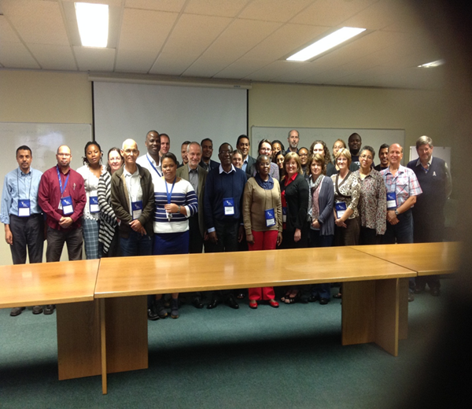
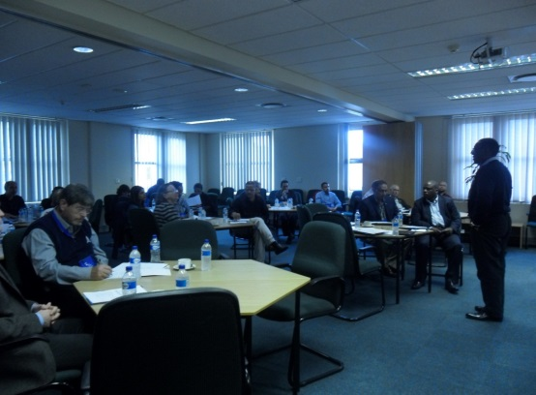
Partnership with research community
Action
Successes
Communicate the vision, seek buy-in and form coalition
Two workshops conducted
27 February 2014 (concept discussion, Policy discussion & input)
24 – 25 March 2014 (requirements gathering, identification of pilot partner, final input to draft policies)

Slide 7
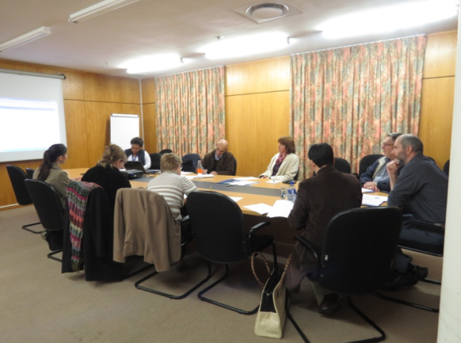
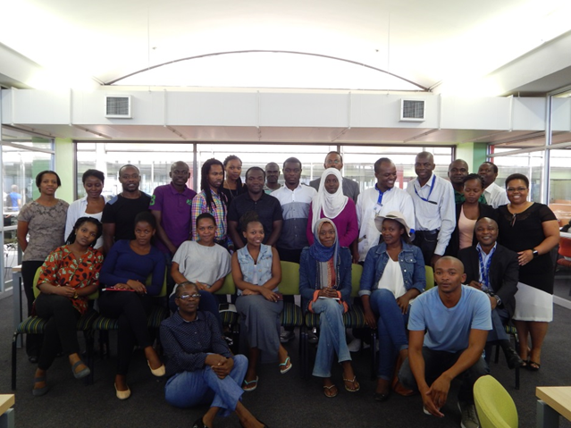
Partnership with research community
Action
Successes
Gaining pilot project partners
Requirements gathering done
IBMB research group –RDM practices
Bio-resource Engineering research group – focus on Postgraduates RDM practices
Training offered to both groups

Slide 8
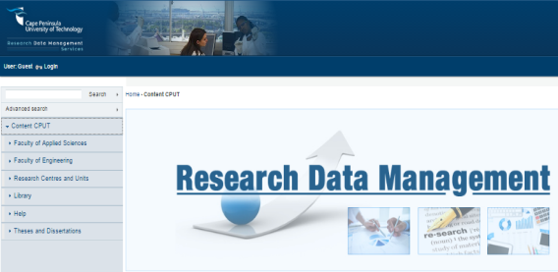
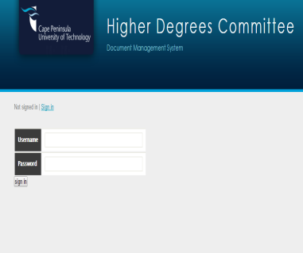
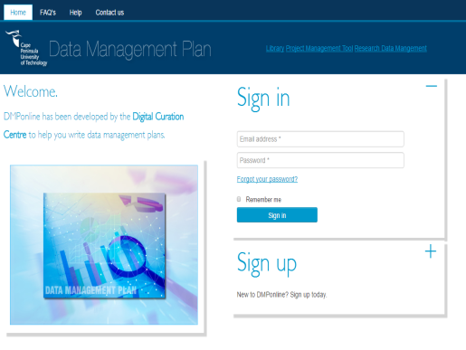
KITS
[CTS, MIS, ICT Innovation & Development, Library
Action
Successes
Collaboration on infrastructure development
Appointment – Developer
1st phase of CPUT RDM platform
CPUT DMP tool developed
Discussions on system integration & interoperability, e.g. DK, HDC Digital and RIMS

Slide 9
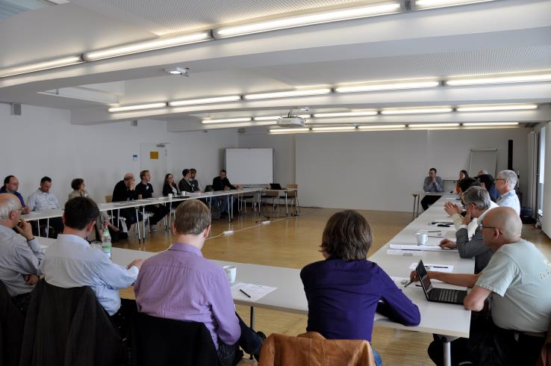
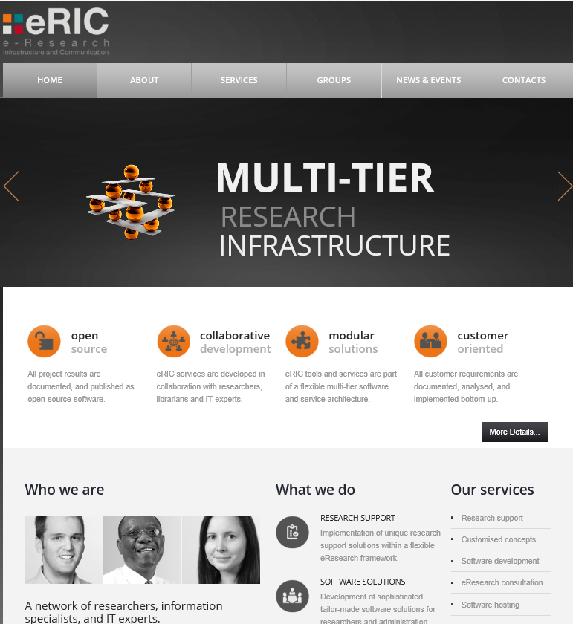
International Partnership
Action
Successes
Participation on eResearch international collaboration
Set up international working groups on various RDM development aspects
Jointly developing an Open Source Platform for managing RDM cycle
Have institutional working group feeding into the development of the Open Source Platform
Monthly online meetings to update each on institutional developments

Slide 10
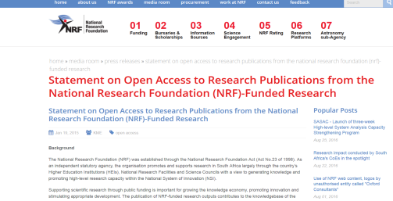
External partners
Action
Success
NRF - Alignment, monitoring and evaluation
ORCID integration
Communicated funder requirements institutionally
Progress - improving relevant workflows
Platforms responsive to the NRF requirements.
2. Licence signed with ORCID and currently exploring integration
Notes:
Funders introducing policies prescribing data management and sharing approaches gives the issue a degree of urgency.

Slide 11
CHALLENGES EXPERIENCED!

Slide 12
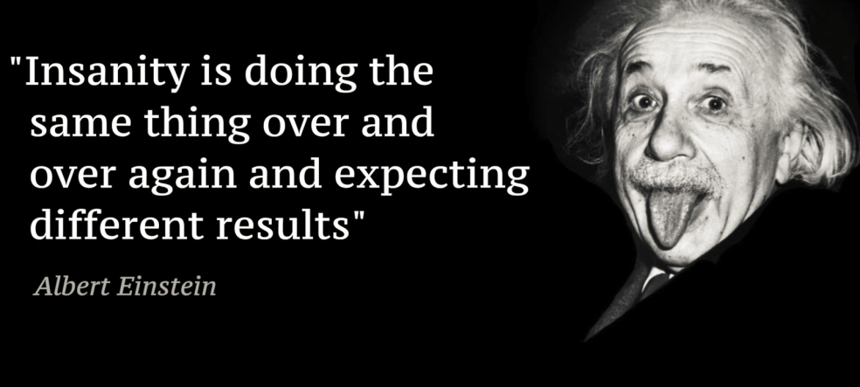
ADAPTING TO CHANGE
Low service uptake - still fall back to old practices
Low commitment to deposit data on the newly developed platform
There is still much to be done to embed the necessary research data management and curation skills into the daily workflows of all re-searchers and support staff (Davidson 2016:64)
Notes:
Davidson, J., 2016. Fostering open science practice through recognising and rewarding research data management and curation skills. P 63-75.

Slide 13
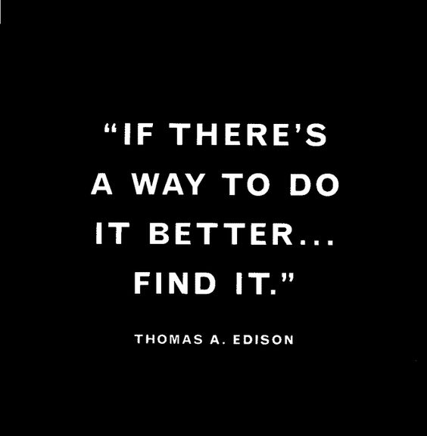
POSSIBLE SOLUTION?
Notes:
There is still much to be done to embed the necessary research data management and curation skills into the daily workflows of all re-searchers and support staff. Davidson 2016:

Slide 14
PROCESS IMPROVEMENT
Action
Methodology
Revisit processes and work on improving them
Qualitative document analysis (NRF statement, RDM, OA and other research policies; RTI Blueprint;
Identify & audit relevant processes to improve - Quick win, e.g. HDC and Grant application process
Review literature on BPI, PM and CM
Follow-up interview with Process owners and staff performing on workflows respectively
Process improvement plan developed
Findings shared with process owner and affected parties (HDC committee, librarians, IT, )
Notes:
RDM is a complex and iterative process with interdependencies meaning that each phase of the development is dependent on the other to make a cohesive whole, hence it has to be approached using systems thinking

Slide 15
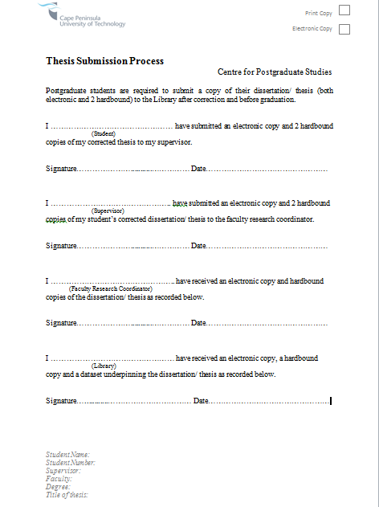
Quick win – HDC process
Well established relationship
Library & CPGS theses submission process implemented - 2013
Roll out approval granted - 2013
  Submission of a thesis to the library is a prerequisite for graduation

Slide 16
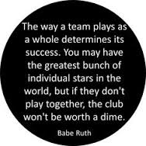
Stakeholder buy-in and commitment
CPGS Director – Process owner
Library Director – Project Sponsor
IT Director – System architecture
Higher Degrees Committee
Senate research Committee
Librarians
Postgraduate students

Slide 17
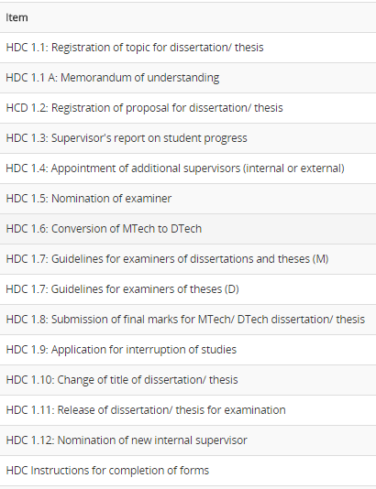

HDC Process – As Is

Slide 18
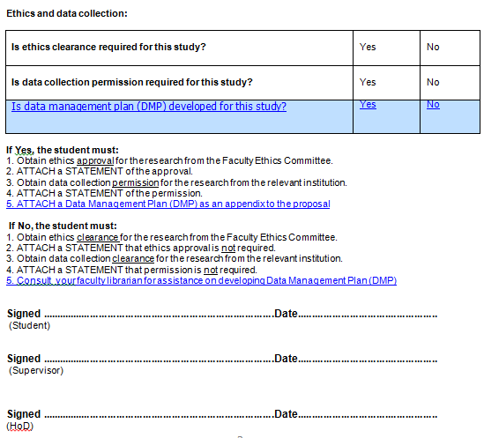
HDC Process - To be HDC 1.2
Notes:
What we were trying to do here in terms of CM steps was to make sure that we get rid of obstacles that can hinder this change.

Slide 19
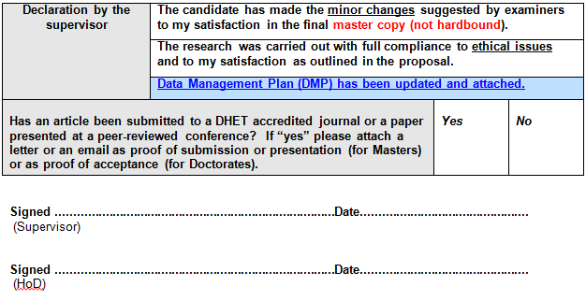
HDC Process - To be (HDC1.8)

Slide 20
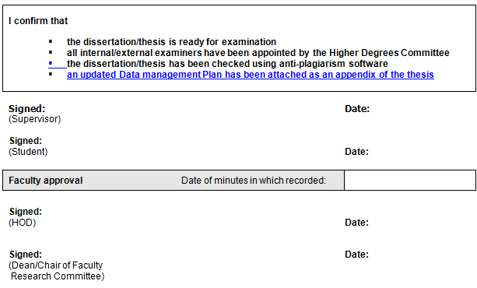
HDC Process – To be (HDC 1.11)

Slide 21
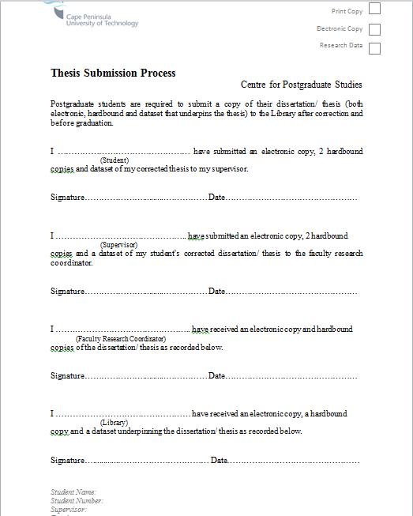
THESIS SUBMISSION PROCEDURE
Theses submission - To be

Slide 22
ACHIEVEMENTS
Communicated RDM project objectives, Gap analysis and recommended solutions to HDC committee workshop (22 September) – Committee accepted
Recommendations presented at Senate and approved (October 2016)
January – June 2017 focus – wider communication / marketing, training & development; system integration.
July 2017 full roll-out

Slide 23
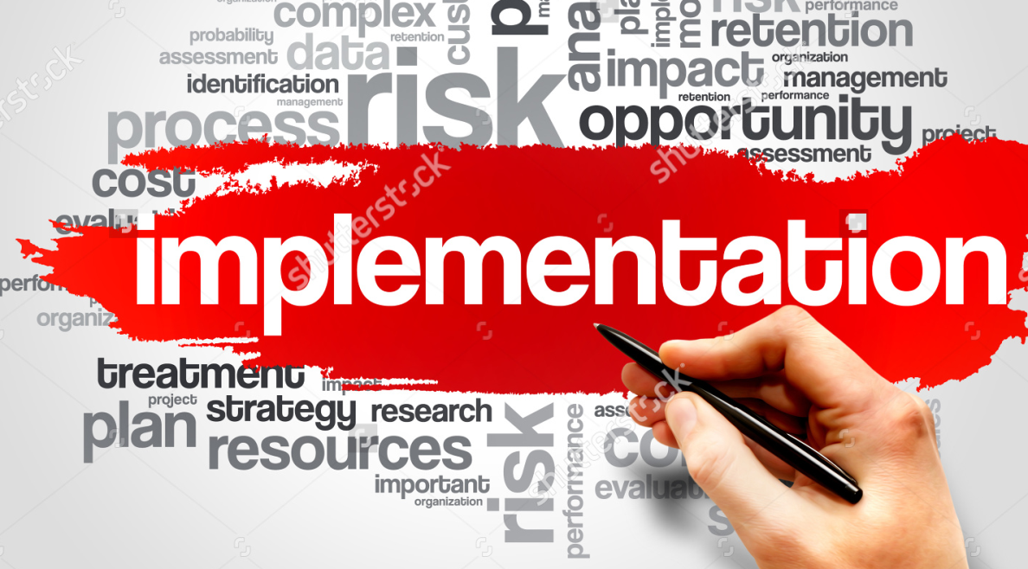
IMPLEMENTATION

Slide 24
Communication and Training plans
Communication Plan
Training Plan
Continue with training for librarians
Currently developing training programs for stakeholders
Integrated training for supervisors into CPGS academic support program & Human Capital Development (HR)
Training for students integrated in Postgraduate forum training activities and the Library Advanced IL program
Continuously improve plan
Communication between researchers and library/university
Communication within the eRIC infrastructure
Constantly update stakeholders on progress, e.g. Faculty boards
2017 Open access week initiative – identified vehicle to market new services
Website content updates
Notes:
Communicate latest developments
The training, marketing and roll out – before 2017 launch

Slide 25
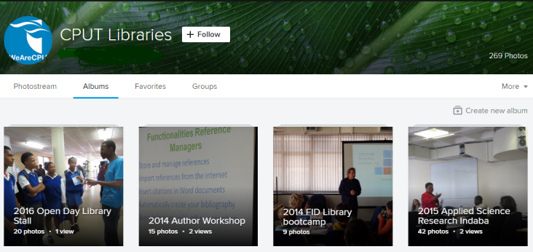
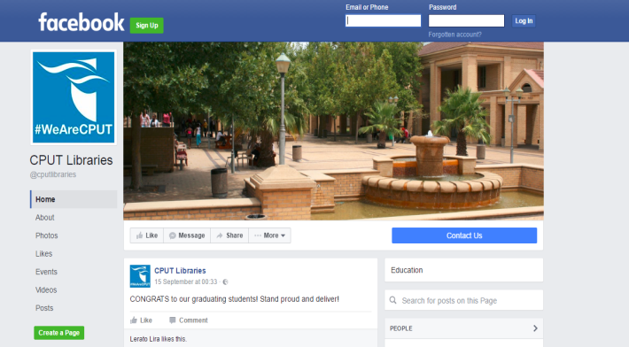
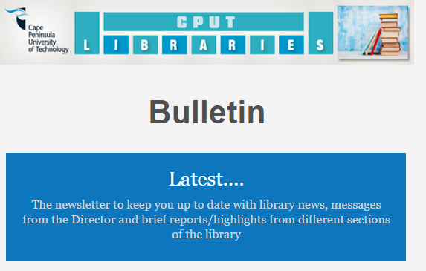
MARKETING PLAN
Marketing HDC process
Plan for Marketing campaigns – with CPGS
Library marketing team and Marketing, Communication and Development Team
Faculty Librarian marketing plan
Notes:
We are trying to use every vehicle possible to communicate the improved process

Slide 26
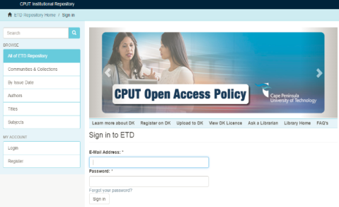


Systems integration
Systems identified for integration:-
HDC Digital CPUT eTD
SA_ETD NDLTD
Cost saving benefits for Postgraduates
Reduction of administrative burden
Process effectiveness and efficiency
Compliance with NRF requirements
Compliance with CPUT RDM and OA
Responsible conduct in research
Notes:
Kotter - Consolidating Improvements and Producing Still More Change

Slide 27
THE FUTURE!

Slide 28
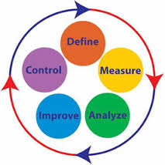
Future - Continuous Improvement
Discuss and agree on performance indicators and measurements for the HDC process
Filter into PMC’s
Engage on incentives discussions for RDM – e.g. RDM adhominem promotion, support for APC? (endless possibilities)
Keep measuring value and maximize it, monitor level of compliance and report progress
Notes:
Kotter - Recognizing and rewarding employees involved in the improvements (Incentivise)
-

Slide 29
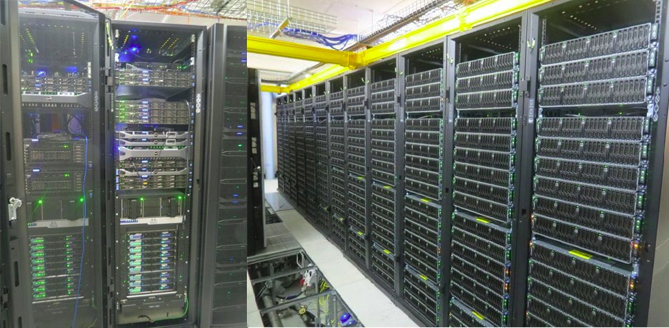
Future ENGAGEMENTS
Western Cape Tier2 Data Intensive Research Facility
  DST (Department of Science & Technology) funded
    - Led by UCT with UWC, SU, CPUT as partners

Slide 30
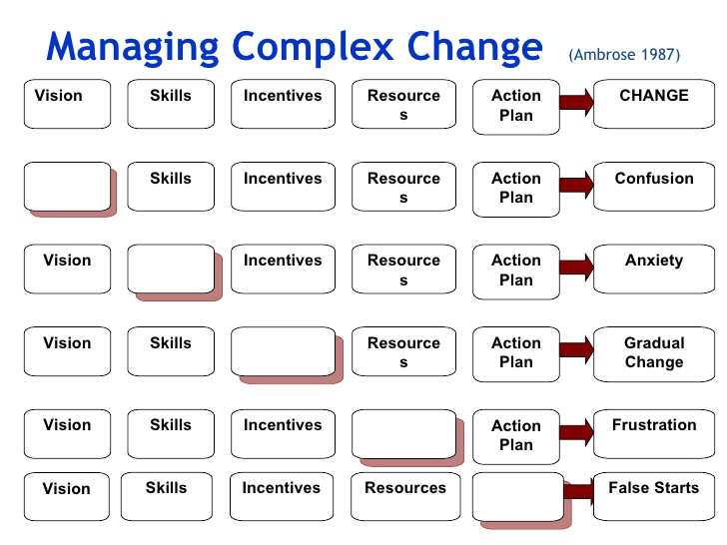
CONCLUSION
There is no one size fit all solution for RDM -complex problem
Explore multiple approaches that offer some interesting precepts for solving wicked problems

Slide 31
CONCLUSION
Wicked problem – Rittel and Webber (1973) – IS [Kunz and Rittel (1972) - Inf Sc,; McLeod and Childs (2013) Electronic Records Mngt; Childs and McLeod, 2013 on RDM; Cox, Pinfield and Smith (2014) – RDM; Awre, et al (2015) - RDM]
Design thinking – Tim Brown, 2008; Dunne and Martin, 2008 – [Bell, S (2007,2008,2010) – DT & User Exp., DT and HE; Howard and Davis (2011) – DT and evidence based librarianship]
Integrative thinking – Roger Martin (2008) - how highly successful business people think
Notes:
There is no one size fit all solution for solving RDM as a complex problem:
We must start being creative in our approaches, apply a number of methodologies that offer some interesting precepts for solving wicked problems
Wicked problem – Rittel and Webber (1973) – IS [Kunz and Rittel (1972) - Inf Sc,; McLeod and Childs (2013) Electronic Records Mngt; Childs and McLeod, 2013 on RDM; Cox, Pinfield and Smith (2014) – RDM; Awre, et al (2015) - RDM]
Design thinking –Brown, 2008; Dunne and Martin, 2008 – [Bell,S (2007,2008,2010) - DT& User Exp., DT, DT and HE; Howard and Davis (2011) – DT and evidence based librarianship]
Social messes - Horn and Weber (2007)
The concepts have been widely applied in many fields, mostly in Information systems research, yet there are very few applications in librarianship (apart from in Bell’s (2008, 2010) work on design thinking. Cox, Pinfield and Smith (2014) attest to this challenge
Rittel and Webber (1973) proposed a distinction between the ‘tame’ problems of natural science and the ‘wicked’ societal problems faced by planners
A wicked problem in contrast is one that is unique and highly complex, whose definition itself is disputed by those involved, and whose solution is likely to remain unclear.
This is a resource page for information about design thinking and how it can be applied by library practitioners to improve their libraries and create better user experiences for their user communities http://stevenbell.info/design.htm
Bell SJ (2007) Design Thinking & User Experience. Available at: http://stevenbell.info/design.htm (accessed 31 January 2014).
Bell SJ (2008) Design thinking. American Libraries 39(1): 44–49.
Bell SJ (2010) ‘Design thinking’ and Higher Education. Available at: http://www.insidehighered.com/views/2010/03/02/bell (accessed 31 January 2014).
Bell SJ and Shank J D (2007) Academic Librarianship by Design: A Blended Librarian’s Guide to the Tools and Techniques. Chicago, IL: American Library Association.

Slide 32
THANK YOU FOR YOUR ATTENTION!
Stakeholder collaboration: CPUT libraries making collaboration impactful
by Zanele Mathe is licensed under a Creative Commons Attribution-NonCommercial-ShareAlike 3.0 South Africa License.

