Slide 1
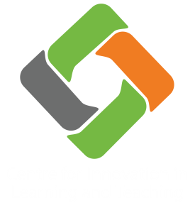
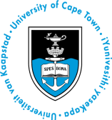
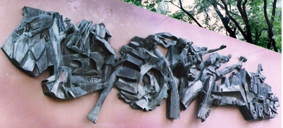
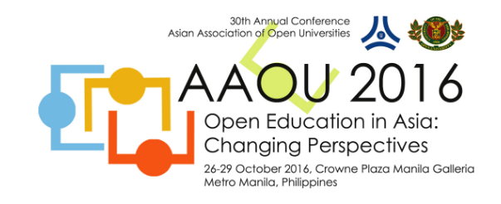
Challenging Open Education
Laura Czerniewicz
@czernie
Open Education in Asia, Manila, 28 October 2016
Castrillo (1974) Consolidated Growth EducationPolytechnic University of the Philippines
Notes:
Don Vaughan tide sculpture, David Lam Park Vancouver, photo by Taz, CC BY 2.0
https://upload.wikimedia.org/wikipedia/commons/b/ba/Vancouver_tide_sculpture_in_david_lam_park.jpg
By Judgefloro (Own work) [CC BY-SA 4.0 (http://creativecommons.org/licenses/by-sa/4.0)], via Wikimedia Commons
Dancing Rings, "Ang Pagbabago: Peace-Love" (Jose F. Datuin, Rizal Park, Manila) Artworks in the Park (Replica of the same sculpture that won 1st Prize besting 35 countries, in the 2008 International Olympic Committee Sport and Art Contest at Lausanne, Switzerland, 2008 Beijing Olympics; Winner of the 1980 Moscow Olympic Poster Design Competition, USSR "Ang Pagbabago: Peace-Love" Mosaic Murals, It represents the Filipino ideals of peace, love, unity and prosperity. It serves as a call to national renewal and change; by the National Parks Development Committee, Department of Tourism, Hyundai Asia Resources, Inc. and Bizassa Philippines, Inc. Mosaico Rizal Park, Ermita, Manila, City of Manila; Note: Judge Florentino Floro, the owner, to repeat, Donor Florentino Floro of all these photos hereby donate gratuitously, freely and unconditionally all these photos to and for Wikimedia Commons, exclusively, for public use of the public domain, and again without any condition whatsoever).

Slide 2
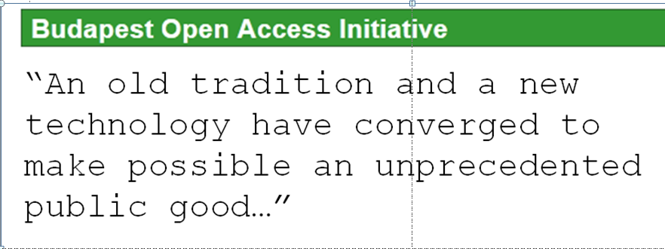
www.soros,org/openaccess
2002
2006

Slide 3
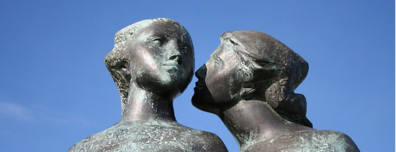
Open education brings together
  A set of values – access & public good
  Assumptions about shareable knowledge
  Assumptions about enabling technology
Secret by Susan S CC BY-NC 2.0 https://flic.kr/p/8tddH
Notes:
Photographer Susan S “secret” CC BY-NC 2.0

Slide 4
Is it?
Open education seems to be a coherent response to troubles in higher education
Ja nee

Slide 5
Challenging open education
Open education as a new field of practice
Key tensions in open education
  Digital
  Free
  Legal
Some responses

Slide 6
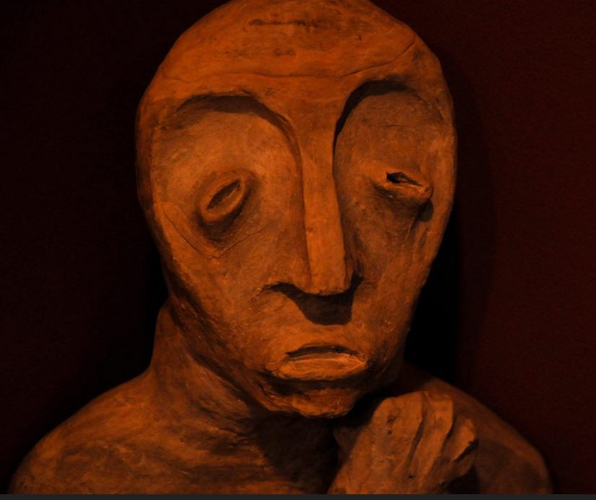
Open education
A nascent heterogonous field of practice
Patrick M Burke Thinking Man by Katherine https://www.flickr.com/photos/73981677@N00/5371872790/ CC BY 2.0

Slide 7
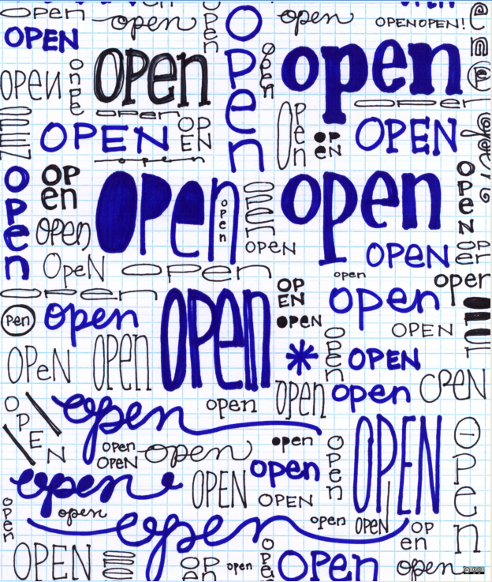
Open education
is varied & multidimensional
Open education resources
Open education practices
Open licensing
Open access
Open scholarship
Open data
Open research
Open science
Open web
Open knowledge
opensourceway CC BY-SA 2.0
http://www.flickr.com/photos/opensourceway/5535034664/sizes/o/in/photostream/

Slide 8
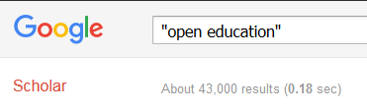
Open education
is a nascent field of practice & research
Curated bibliography
  Research on Open Education Resources for Development (ROER4D)’s bibliography has over hundreds of references
  See http://tinyurl.com/ROER4D-Bibliography

Slide 9
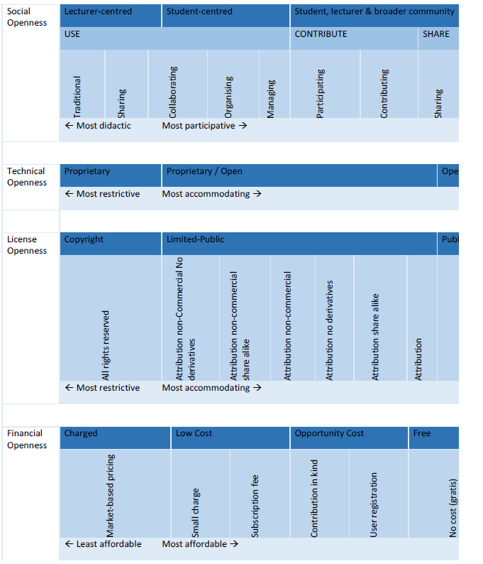
Open education
exists
in types
and
in degrees
(Hodgkinson-Williams & Grey 2009)
Notes:
Hodgkinson-Williams, C., & Gray, E. (2009). Degrees of openness: The emergence of Open Educational Resources at the University of Cape Town. International Journal of Education and Development using ICT, 5(5). Retrieved from http://www.editlib.org/p/42198/
State of the Art Review of Quality Issues related to Open Educational Resources (OER) Anthony F. Camilleri Ulf Daniel Ehlers Jan Pawlowski Report EUR 26624 EN 2014

Slide 10
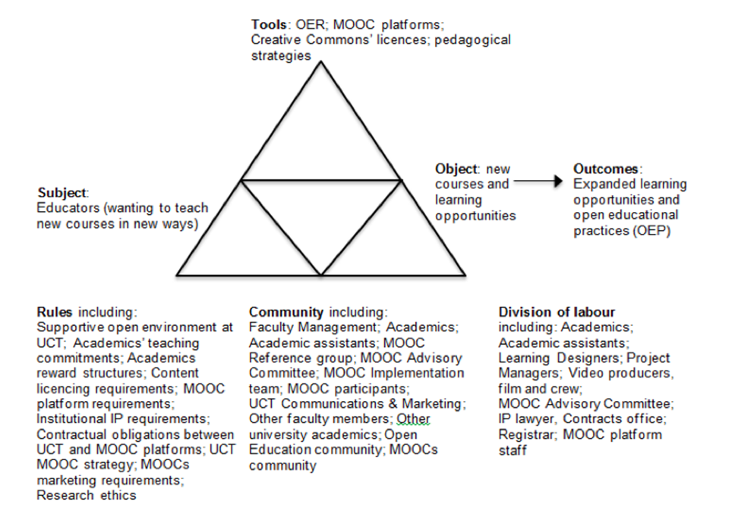
Open education
always occurs in historical cultural contexts
(Czerniewicz et al 2014)
Notes:
Value

Slide 11
Open education
occurs in unequal contexts
Situated openness
  Considers how open and shared knowledge practices can democratize knowledge, while also recognizing how such notions are embedded within colonial histories that explicitly deployed openness as a way to legitimate the taking of indigenous peoples’ knowledge
  Aims to develop practices of knowledge production responsive to hierarchies of power and inequality, so collaborative research production might involve simultaneous modes of being open, closed, sharing, and restrictive
(Forster 2016)
Notes:
Forster, L (2016) Empowering Indigenous Peoples and Knowledge Systems Related to Climate Change and Intellectual Property Rights, presentation at Force11, Portland, Oregan, April 2016, presentation at
https://www.force11.org/media/video/empowering-indigenous-peoples-knowledge-systems-related-climate-change-and-intellectual, slides at ocsdnet.org/wp-content/uploads/2015/01/FOR-UPLOAD_Natural-Justice.pdf

Slide 12
Open education
Sounds simple
  “Openness is not reducible to a simple definition because it is a complex assemblage of social, political and technological elements developed over time”
  (Jones 2015)

Slide 13
Openness is complex
In open education, openness
  is relational: always exists in relation to closure
  exists on a continuum
  is permeable
  is not necessarily positive
  has a shadow side
  is not intrinsically afforded by technology
  (Oliver 2015)

Slide 14
Key tensions
The nature of digital
Different understandings of free
The legal underpinnings
CC BY 2.0 Patrick M Burke https://www.flickr.com/photos/73981677@N00/5371872790/

Slide 15
Key tension
The nature of the digital
CC BY 2.0 Patrick M Burke https://www.flickr.com/photos/73981677@N00/5371872790/

Slide 16
The Digital
The “Age of Abundance”
  “the end of content scarcity as digital distribution achieves ubiquity” (Colombani & Videlaine 2013)
The cost of the digital product
  “digital goods have a marginal cost that approaches zero - making digital copies, whether 10 or 10,000 - essentially costless and exhibit no degradation” (Pon 2015)
The explosion of user- generated content
  Eg 300 hours of video content uploaded to Youtube every minute (Jarboe 2014)

Slide 17
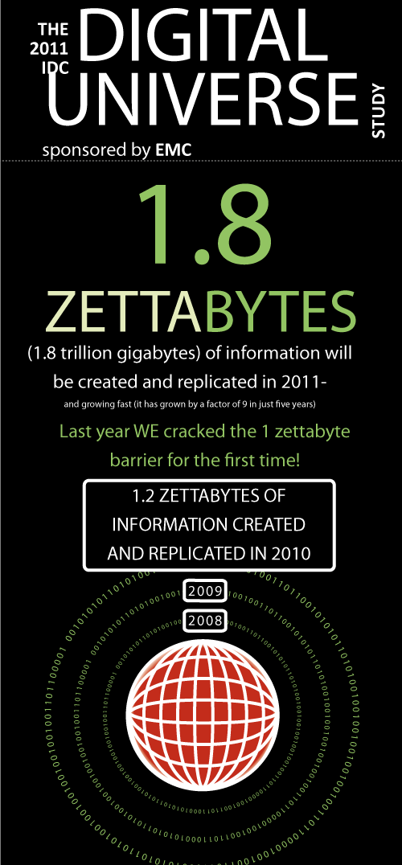
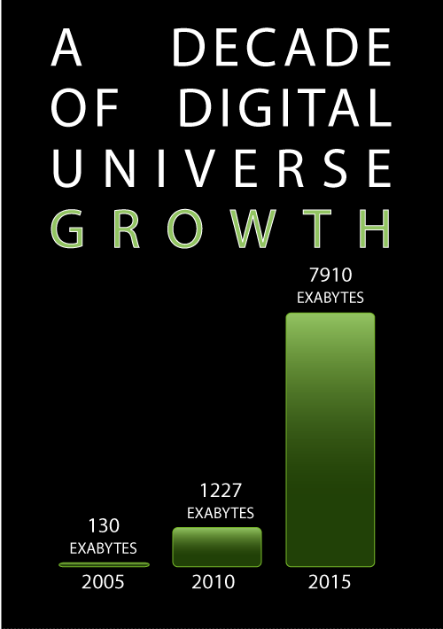
IDC Report: The 2011 Digital Universe Study: Extracting Value from Chaos, June 2011
https://www.emc.com/collateral/analyst-reports/idc-extracting-value-from-chaos-ar.pdf

Slide 18

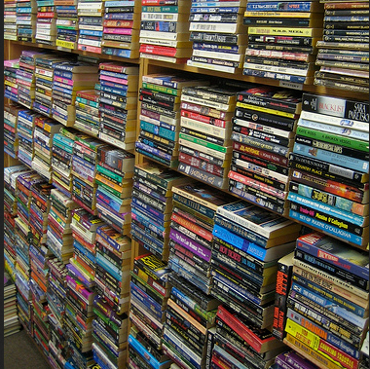
Digital = open?
Digital affords “open” but it also affords closed
Analogue has affordances that can be more open than digital
W.Rebel CC BY 3.0 https://commons.wikimedia.org/wiki/File:BinaryData50.png
hawkexpress CC BY-NC-ND 2.0 https://www.flickr.com/photos/hawkexpress/328322067
Notes:
W.Rebel. Creative Commons Attribution 3.0 Unported license.
Books hawkexpress https://www.flickr.com/photos/hawkexpress/328322067
CC BY-NC-ND 2.0

Slide 19
Affordances of digital
From products to services
  From tangible to intangible
From ownership to license
Digital Rights Management
  “the practice of imposing technological restrictions that control what users can do with digital media” (defectivebydesign.org)

Slide 20
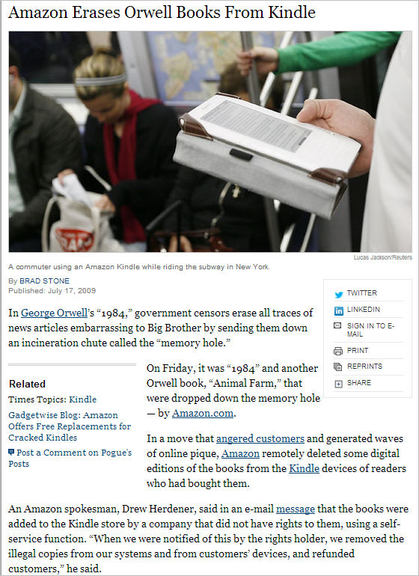
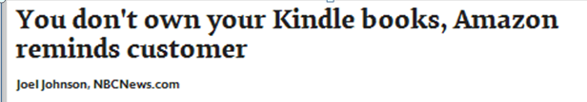
(NY Times 2009)
Notes:
http://www.nytimes.com/2009/07/18/technology/companies/18amazon.html?_r=0

Slide 21
New ecologies of access
Analogue
Books
Textbooks
Journals
Photocopying
Some
photocopying
Legal
Illegal
E-books
Journal databases
Pirate sites
File sharing
Open content
Digital

Slide 22
Key tension
Different understandings of free
CC BY 2.0 Patrick M Burke https://www.flickr.com/photos/73981677@N00/5371872790/

Slide 23
What does free mean?
“OERs are educational materials and resources that are offered freely,
are openly available to anyone and, under some licences, allow others to reuse, adapt and redistribute them with few or no restrictions.”
(COL/UNESCO 2011)
Notes:
Commonwealth of Learning Butcher, N (2011) A Basic Guide to Open Educational Resources (OER) Commonwealth of Learning & UNESCO , Vancouver, Canada

Slide 24
Public domain is increasingly understood as ‘publically available”
Legally, “public domain” = not in copyright
  Copyright has expired
  Creator’s intentional decision
  Not covered by copyright
So
  Public domain = publically available
  Publically available does not automatically = public domain

Slide 25
Free in open education means
  The creator/author kept copyright ownership and provided permissions upfront
  or public domain
But
  Online is generally understood to be free

Slide 26
Assumption - online is free
New cultural practices
  Piracy cultures
    “All over the world, we are witnessing a growing number of people building media relationships outside those institutionalized sets of rules...” (Castells & Cardoso 2012)
  An affective economy
    “Filesharing has emerged as one of the most popular dimensions of the new affective economy, in which it simply feels good to share and then it feels even better to embellish, remix, and share again.” (Fleming 2012)

Slide 27
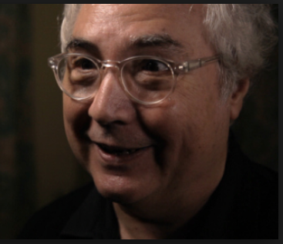
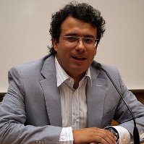
“a very significant proportion of the population is building its mediation through alternative channels of obtaining content
(Castells &
Cardoso 2012)
piracy cultures have become part of our everyday life in the network society, sometimes even without us, fully acknowledging them as such.
the pirates are more often than not all of us”
Notes:
2012, p287

Slide 28
Quiet encroachment
The central role of the informal
Blurring of boundaries and breaking of rules, as the norm everywhere
  Netherlands
    Only 10 % of all ebooks on devices paid for, most digital books pirated (Kozlowski 2014)
  UK
    Up to 76 % of 50 popular textbooks used by students available as free pirated e-books (Izundu 2013)
  Russia
    92 percent of ebook readers obtained books by illegally downloading (Indvik 2013)

Slide 29
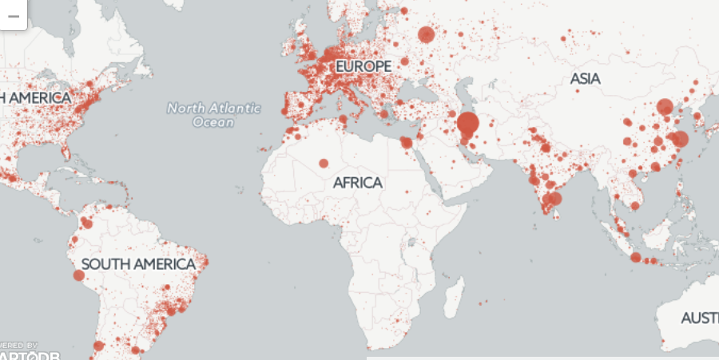
A global phenomenon
Academics everywhere
Sci-hub downloads Sep 2015 – Feb 2016, 48 million articles
Notes:
Bohannon, J (2016) Who’s downloading pirated papers? Everyone Science 28 April 2016, http://www.sciencemag.org/news/2016/04/whos-downloading-pirated-papers-everyone
Server log data for the website Sci-Hub from September 2015 through February paint a revealing portrait of its users and their diverse interests. Sci-Hub had 28 million download requests, from all regions of the world and covering most scientific disciplines.
The United States is the fifth largest downloader after Russia, and a quarter of the Sci-Hub requests for papers came from the 34 members of the Organization for Economic Cooperation and Development, the wealthiest nations with, supposedly, the best journal access. http://www.sciencemag.org/news/2016/04/whos-downloading-pirated-papers-everyone Who's downloading pirated papers? Everyone
By John BohannonApr. 28, 2016 , 2:00 PM

Slide 30
With its story on Sci-Hub in April 2016, Science ran a survey with 11k respondents:
  All ages, all disciplines
  60% had used Sci- Hub
  Both developed and developing countries
  85% said it is not wrong to download scholarly articles
  Primary reasons for using it
    50% of respondents - lack of journal access
    17% - simple convenience
    23% objected to the profits publishers make
(Travis, 2016)
Notes:
Travis, J (2016) In survey, most give thumbs-up to pirated papers Science 6 May 2016 http://www.sciencemag.org/news/2016/05/survey-most-give-thumbs-pirated-papers

Slide 31
“I don’t endorse illegal tactics, However, a lawsuit isn’t going to stop it, nor is there any obvious technical means.
Everyone should be thinking about the fact that this is here to stay.”
Peter Suber, Harvard, 2016
Notes:
,” says Peter Suber, director of the Office for Scholarly Communications at Harvard University and one of the leading experts on open-access publishing.
In Bohannon , J 2016

Slide 32
Global Research
Assumption that all digital resources are OERs
  Many teachers assume all digital resources are OER. They are often willing to share, and often don’t understand or use open licensing.
OER not understood under the terms typically used in the literature
  Survey of OER use among students and teachers indicates that the concept of OER is not understood under the terms typically used in the OER literature
http://roer4d.org/wp-content/uploads/2014/01/FA_ICDE-Poster_A0_Oct2015.pdf
(ROER4D 2015)
Notes:
Research on Open Educational Resources for Development (2015) Researching OER adoption and impact in the Global South – an overview of the Research on Open Educational Resources for Development (ROER4D) project. Poster presented at ICDE Conference Sun City South Africa , http://roer4d.org/wp-content/uploads/2014/01/FA_ICDE-Poster_A0_Oct2015.pdf

Slide 33
Local research: a Case Study
South African university students
  Survey and focus groups
Found
  Students did not know the difference between legal and illegal resources
  They felt that they had a right to educational and scholarly resources
  They distinguished between attribution and copyright
(Czerniewicz, 2016)
Notes:
The findings from the survey show that students are accessing learning resources both legally and illegally and that they do not always know the difference.
Students were asked what percentage of sources they downloaded from sources they believed to be legal. Their answers showed an even spread in both ends of the legal spectrum, with 20.88% of the respondents saying that all of their materials came from legal download sources. Notably, 23.93% of the respondents said that none of their materials were acquired via sources believed to be legal. The remaining answers, which account for a little over half of the respondents (55.1%), fell somewhere in the middle, with around 37% of the respondents claiming that half or less of their sources were legal with the remaining 17% saying that in between 50 and 80% of all materials came from legal sources.
There was an intriguing discrepancy in replies when the same question was asked differently. When asked specifically what percentage of materials was downloaded illegally, almost two thirds (64.48%) said “none” and 18.5% said less than 20% was. Only a minute percentage (2.56%) claimed that over 80% came from illegal sources, with the remaining 14.43% (n 141) falling somewhere in between 40 and 80%. This is a striking contradiction: if two thirds report that none of their materials were illegally downloaded this does not square with the reported 20% of legal downloads when the question was phrased differently. The reasons for this could be that students did not understand the question, or that students were less likely to answer a question framed as illegality honestly

Slide 34
Local research: a Case Study
Student voices
“Is it unethical to want to be educated or is it unethical to charge so much [for books]?..
“Even though in my head I know it’s [illegal downloading]wrong, it’s just a technical thing. Substantively speaking,
it’s the right thing to do”
“It just seems, morally, if anything, we should have that stuff available”
(Czerniewicz, 2016)

Slide 35
Local research: a Case Study
Attribution vs copyright
“….plagiarism, you’re lying but I mean, copying a textbook, you’re not trying to harm anybody… it’s your education”
“With plagiarism, it’s more like, ‘this is mine’, claiming this is your own and that’s why it’s scarier [than copying or downloading material]”
(Czerniewicz, 2016)

Slide 36
Local research: a Case Study
Everything should be open
“These resources and tools being so expensive makes it only accessible to a certain group of people…
everything should be open”
(Czerniewicz, 2016)

Slide 37
Key Tension
The legal underpinnings
CC BY 2.0 Patrick M Burke https://www.flickr.com/photos/73981677@N00/5371872790/

Slide 38
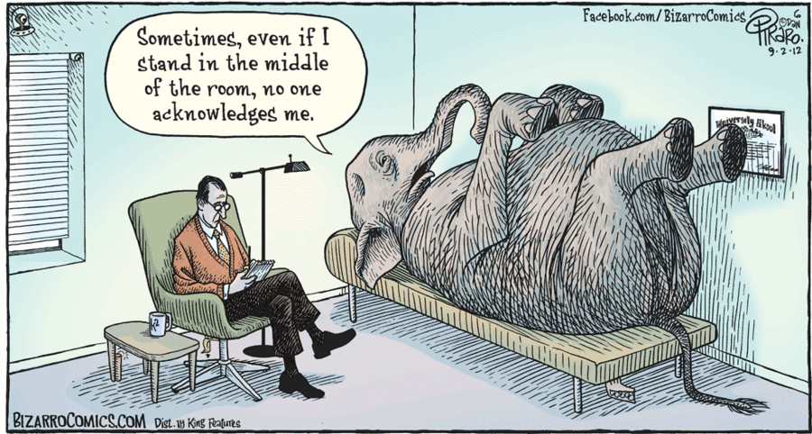
http://bizarro.com/comics/september-2-2012/
Notes:
https://www.facebook.com/FreudQuotes/photos/a.1495139577378076.1073741828.1491977031027664/1918041418421221/?type=3 By - Bizarro:
Thanks to Jolanda De Villiers Morkel for posting on FB!

Slide 39

The Legal
We need to talk about

Slide 40

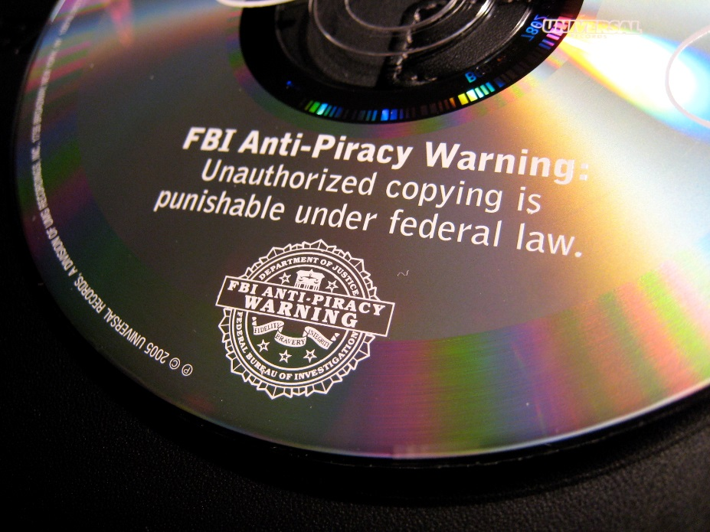
The Legal: copyright
Key discourses: criminality & commodity
Notes:
Image left: Image made available to the Public Domain. Available at: https://upload.wikimedia.org/wikipedia/commons/f/f5/FBI_anti_piracy.jpg
Image right: Image made available by Bizmac (http://www.flickr.com/photos/bizmac/1128597509/sizes/l/in/photostream/) under a CC BY licence. Available at: http://www.flickr.com/photos/bizmac/1128597509/sizes/l/in/photostream/

Slide 41
Copyright has always been regarded as a necessary evil
  As short a term as possible
  benefit to the producer, not the intermediary
  Balancing creator rights with user rights

Slide 42
The Legal: copyright
The original intention
“Copyright is monopoly, and produces all the effects which the general voice of mankind attributes to monopoly. [ . . .] It is good that authors should be remunerated; and the least exceptionable way of remunerating them is by a monopoly. Yet monopoly is an evil. For the sake of the good we must submit to the evil; but the evil ought not to last a day longer than is necessary for the purpose of securing the good.”
  Thomas B. Macaulay, a speech delivered in the House of Commons (5 February 1841), in VIII The Life and Works of Lord Macaulay. Longmans, Green, and Co. 1897, p201.
Notes:
Slides re cases from: Digital CopyrightPeer Production, User-Generated Content, Access, Enclosure and the Public Domain, Giancarlo F. Frosio 27/09/2015, http://slideplayer.com/slide/6380572/

Slide 43
The original intention
“the limited scope of the copyright holder’s statutory monopoly, like the limited copyright duration required by the Constitution, reflects a balance of competing claims upon the public interest: Creative work is to be encouraged and rewarded, but private motivation must ultimately serve the cause of promoting broad public availability of literature, music, and the other arts. The immediate effect of our copyright law is to secure a fair return for an “author’s” creative labour. But the ultimate aim is, by this incentive, to stimulate artistic creativity for the general public good. ‘The sole interest of the United States and the primary object in conferring the monopoly,’ this Court has said, ‘lie in the general benefits derived by the public from the labours of authors.’”
  Fox Film Corp. v. Doral, 286 U.S. 123, 127 (1932)

Slide 44
The Legal: copyright
The premise that knowledge should be free
“science and learning are in their nature publici juris, and they ought to be as free and general as air or water.”
  Donaldson v. Beckett, 2 Brown's Parl. Cases 129, 1 Eng. Rep. 837; 4 Burr. 2408, 98 Eng. Rep. 257 (1774) (Lord Cadmen)
"[i]n a word, I have no difficulty to maintain that a perpetual monopoly of books would prove more destructive to learning, and even to authors, than a second irruption of Goths and Vandals."
Hinton v Donaldson, Mor 8307 (1773) (Lord Kames)

Slide 45
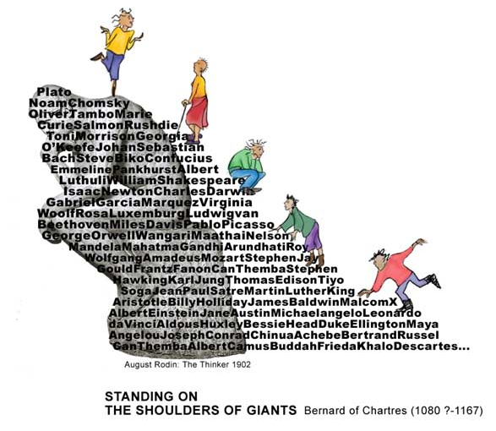
Premise that knowledge is an accretion
Notes:
Made famous by Isaac Newton on 1676

Slide 46
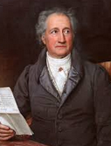
Knowledge is an accretion enabled by openness
“What am I then? Everything that I have seen, heard, and observed I have collected and exploited. My works have been nourished by countless different individuals, by innocent and wise ones, people of intelligence and dunces... I have often reaped what others have sowed. My work is the work of a collective being that bears the name of Goethe.”
Goethe 1749 - 1832

Slide 47
The Legal: copyright
The public domain
“the public domain is not an unintended by product, or ‘graveyard’ of copyrighted works but its very goal.”
  Birnhack M (2006) More or better? Shaping the public domain. In The future of the public domain: identifying the commons in information law L Guibault & P Hugenholtz eds. Kluwer Law International, p60.
“Initially, the practices of people operated on the presumption that everything was in the public domain, except where otherwise stated, and copyright did not play much of a role. The history of copyright has centred on a reversal of this presumption to the extent that everything is assumed to be protected unless specifically stated to be in the public domain.”
(Liang 2005)

Slide 48
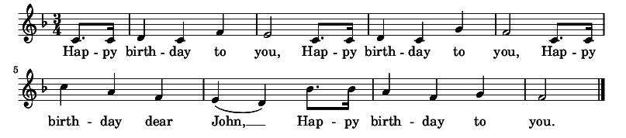
The Legal: copyright
The fight for the public domain is current
The Happy Birthday song
  Originally written by 2 sisters and published in their book Song Stories for the Kindergarten in 1893
  Warner has been earning $2million a year in royalties
  22 September 2015 Warner’s copyright claim was declared invalid,
  and the song is effectively now in the pubic domain
(Wikipedia)

Slide 49
But
The vice grip of commerce
“we are in the midst of
an enclosure movement in our information environment.”
  Benkler Y (1999) Free as the air to common use: First Amendment constraints on the enclosure of the public domain, New York University Law Review 74, p354.

Slide 50
“information that used to be “free” is now increasingly being privatized, monitored, encrypted, and restricted. The enclosure is caused by the conflicts and contradictions between intellectual property laws and the expanded capacities of new technologies. It leads to speculation that the records of scholarly communication, the foundations of an informed, democratic society may be at risk.”
  Hess C & Ostrom E (2006) Introduction: an overview of the knowledge commons. In Understanding knowledge as a commons: from theory to practice C Hess & E Ostrom eds. MIT Press, pp3-26.

Slide 51
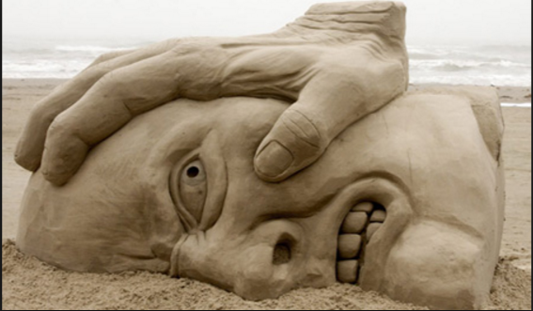
The existing copyright regime that underpins open education is under serious pressure
http://www.toxel.com/wp-content/uploads/2009/07/sand13.jpg

Slide 52
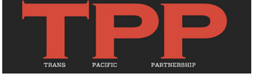
The Legal: copyright
IP issues in strange places
Trans-Pacific Partnership (TPP) is “one of the most ambitious free trade agreements ever signed”
  US, Japan, Malaysia, Vietnam, Singapore, Brunei, Australia, New Zealand, Canada, Mexico, Chile and Peru
  qll 12 signed TPP on 4 February 2016
  The agreement will enter into force after ratification by all signatories, if this occurs within two years.
  If the agreement is not ratified by all before 4 February 2018, it will enter into force after ratification by at least 6 states
  which together have a GDP
  of more than 85%
  of the GDP of all signatories

Slide 53
The Legal:
The dangers of the TPP
“The agreement exports some of the worst aspects of US copyright law and policy, without many of the balancing benefits…it locks developing countries …into policies that hurt local creativity, restrict access to knowledge and slow innovation.
It also threatens to lock US law and policy into a regime designed for the 20th century, hurting the ability for Congress to make necessary reforms.”
(Rossini, in New, 2014)
Notes:
Leaked TPP Draft Reveals Extreme Rights Holder Position Of US, Japan, Outraged Observers Say
17/10/2014 BY WILLIAM NEW, INTELLECTUAL PROPERTY WATCH 4 COMMENTS
http://www.ip-watch.org/2014/10/17/leaked-tpp-draft-reveals-extreme-rights-holder-position-of-us-japan-outraged-observers-say/

Slide 54
The Legal
The dangers of the TPP
20-year copyright term extension is unnecessary and unwarranted:
  The agreement requires member nations to increase their term of copyright protection to life of the authors plus 70 years. Six of the twelve participating countries will have to increase their copyright terms 20 years past the baseline required by existing international treaties.
The mention of the public domain is lip service, at best:
  Text has been removed which more actively supported the public domain as a key policy objective.
Enforcement provisions are mandatory, while exceptions and limitations are optional:
  Instead of securing mandatory limitations and exceptions for uses of copyrighted works under TPP, all of the provisions that recognize the rights of the public are voluntary, whereas almost everything that benefits rights holders is binding.
(Vollmer, 2015)
Notes:
Vollmer, T (2015) Trans-Pacific Partnership Would Harm User Rights and the Commons
Timothy Vollmer, November 16th, 2015, https://blog.creativecommons.org/2015/11/16/trans-pacific-partnership-would-harm-user-rights-and-the-commons/

Slide 55
The Legal
.
The dangers of the TPP
Potentially drastic infringement penalties, even for non-commercial sharing:
  The agreement allows for infringement penalties that are disproportionate to harm, providing for the possibility of imprisonment and excessive monetary fines for lesser infringements.
Criminal penalties for circumventing digital rights management on works:
  The agreement adopts a mechanism that would prohibit the circumvention of technological protection measures (DRM) on works, and treats this type of violation as a separate offense regardless of any copyright infringing activity on the underlying content.
Investor-state dispute settlement mechanism may be leveraged for intellectual property claims:
  Copyrighted materials can be subject to the investor-state dispute settlement (ISDS) mechanism, meaning that a private company could bring a lawsuit against a TPP country if that country adopts a law that the company claims would harm its right to exploit its copyright interest.
(Vollmer 2015)

Slide 56
The role and requirements of private companies are foregrounded and more dominant than those of
  individuals
  institutions
  countries
What is needed for education?
What do developing countries need?

Slide 57
The Legal
Copyright itself needs rethinking
“in the digital world copying is such an essential action, so bound up with the way computers work, that control of copying provides, in the view of some, unexpectedly broad powers, considerably beyond those intended by the copyright law.”
  National Research Board (2000) The digital dilemma: intellectual property in the information age. National Academy Press, p140.

Slide 58
The Legal
Copyright itself needs rethinking
The intellectual property frameworks which shape higher education engagement with knowledge are anachronistic and outdated, out of sync with the urgent needs of a digitally-mediated and extremely unequal world

Slide 59
The Legal
It really matters in education
What happens in the copyright IP arena matters profoundly to education
  Institution and educator awareness is crucial
At present, educators’ copyright
  For teaching resources often owned by institutions
  For research, usually given to companies
Educators/academics need to take control

Slide 60
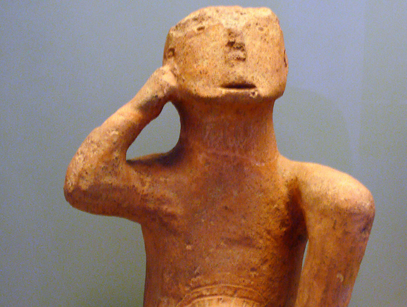
In conclusion
Some responses
Xuan Che CC BY 2.0 https://www.flickr.com/photos/rosemania/5581093141
Notes:
Xuan Che
neolithic man
https://www.flickr.com/photos/rosemania/5581093141
Attribution 2.0 Generic (CC BY 2.0)

Slide 61
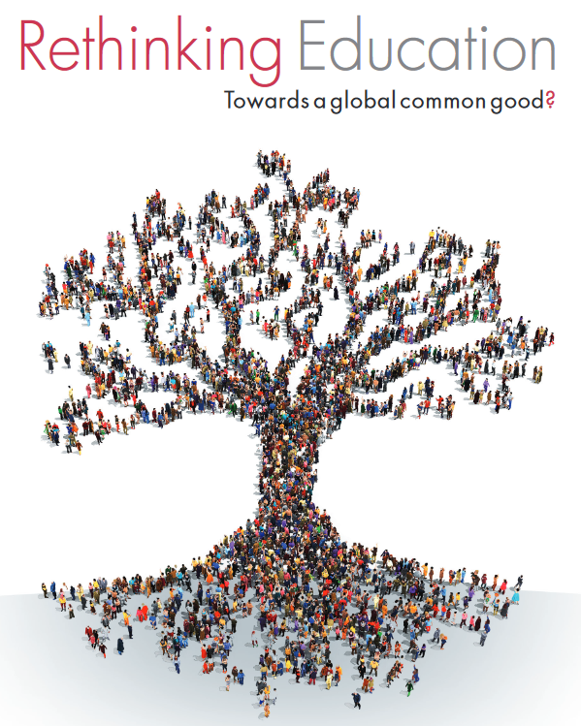
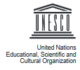
Reclaim education as a common good
Notes:
www.unesco.org/new/fileadmin/MULTIMEDIA/FIELD/.../RethinkingEducation.pdf

Slide 62
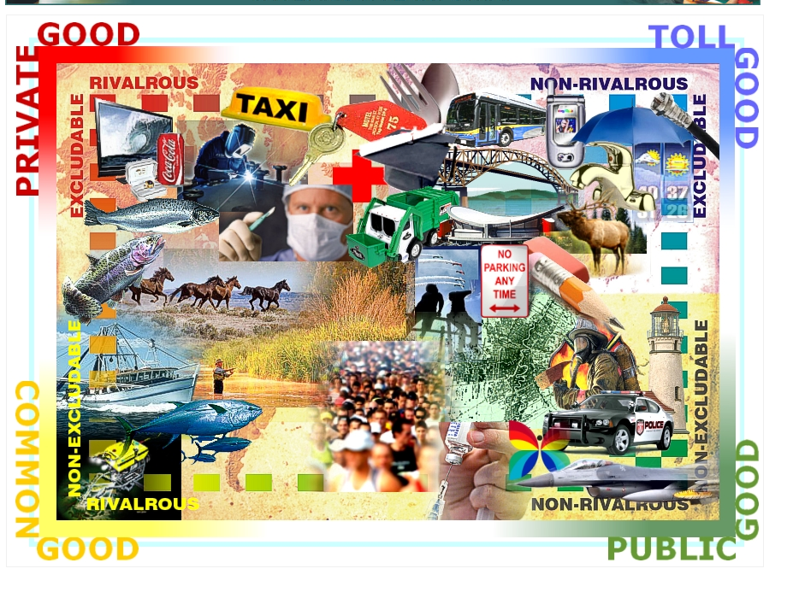
Reclaim knowledge as a public good
a public good is non-rivalrous in consumption
-a good whose use by one person does not compete with or rival its use by another person-
&
non-excludable - no person can exclude other persons from its use

Slide 63
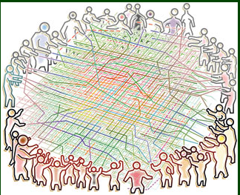
Reclaim the commons
Shift from a knowledge economy for some
to a knowledge commons for all

Slide 64
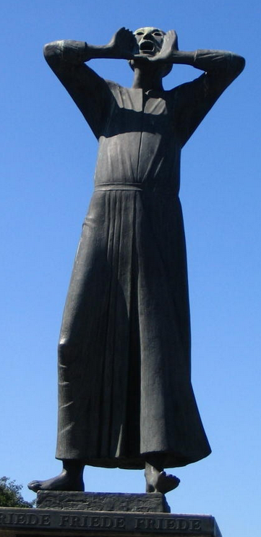
Reclaim open education
Open education
as a means to an end
Open education as one – important - strategy towards
an equitable, democratic and peaceful world
http://ronhudson.blogspot.co.za/2005/08/berlin.html
Cries of ‘peace, peace, peace’ Berlin

Slide 65
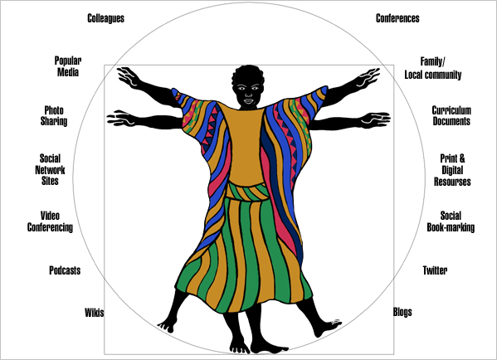
Thank you
Image: Stacey Stent

Slide 66
References
Adesoye A & Amusa O (2011) Investigating the information needs of sandwich and part-time students of two public universities in Ogun State, Nigeria. Inkanyiso: Journal of Humanities and Social Sciences 2(2):98-107. DOI: 10.4314/ijhss.v2i2.63481
Aoki K, Boyle J & Jenkins J (2008) Bound by law: tales from the public domain. Duke Center for the Study of the Public Domain. Available at: http://web.law.duke.edu/cspd/comics/
Bohannon, J (2016) Who’s downloading pirated papers? Everyone Science 28 April 2016, http://www.sciencemag.org/news/2016/04/whos-downloading-pirated-papers-everyone
Boyle J (2002) Fencing off ideas: enclosure and the disappearance of the public domain. Daedalus 131(2):13.
British Council (2012) The shape of things to come: higher education global trends and emerging opportunities to 2020 – Going Global 2012. Available at: https://www.britishcouncil.org/sites/default/files/the_shape_of_things_to_come_-_higher_education_global_trends_and_emerging_opportunities_to_2020.pdf
Budapest Open Access Declaration (2002) Retrieved from: http://www.budapestopenaccessinitiative.org/read
Butcher, N (2011) A Basic Guide to Open Educational Resources (OER) Commonwealth of Learning & UNESCO , Vancouver, Canada
The Cape Town Open Education Declaration (2007). Retrieved from: http://www.capetowndeclaration.org/read-the-declaration
Castells M & Cardoso G (2012) Piracy cultures – editorial introduction. International Journal of Communication 6:826–33.
Chikoko V (2010) First year Master of Education (M.Ed.) students’ experiences of part-time study: a South African case study. South African Journal of Higher Education 24(1):32–47.
Colombani L & Videlaine F (2013) The age of curation: from abundance to discovery. Forum d’Avignon: Bain & Company. Available at: http://www.bain.com/publications/articles/the-age-of-curation-from-abundance-to-discovery.aspx
Czerniewicz, L (2016): Student practices in copyright culture: accessing learning resources, Learning, Media and Technology, DOI: 10.1080/17439884.2016.1160928
Czerniewicz L, Brown C, Deacon A, Fife M, Glover M, Small, J & Walji S (2014) OER in and as MOOCs: an analysis of impact on educators’ practices in African-developed Higher Education courses. Proposal for a study within the Research on Open Education Resources for Development (ROER4D) Project. IDRC.
“What is DRM?” Defective By Design (01 December 2015). Retrieved from: http://www.defectivebydesign.org/what_is_drm_digital_restrictions_management
Fleming (2012) Poisoning the affective economy of RW culture: re-mapping the agents. International Journal of Communication 6:669–88.
Forster, L (2016) Empowering Indigenous Peoples and Knowledge Systems Related to Climate Change and Intellectual Property Rights, presentation at Force11, Portland, Oregan, April 2016, video at https://www.force11.org/media/video/empowering-indigenous-peoples-knowledge-systems-related-climate-change-and-intellectual, slides at ocsdnet.org/wp-content/uploads/2015/01/FOR-UPLOAD_Natural-Justice.pdf
/

Slide 67
Frosio G (2015) Digital copyright: peer production, user-generated content, access, enclosure and the public domain. Available at: http://slideplayer.com/slide/6380572
Gregson J, Brownlee J, Playforth R & Bimbe N (2015) The future of knowledge sharing in a digital age: exploring impacts and policy implications for development. Institute of Development Studies. Available at: http://opendocs.ids.ac.uk/opendocs/bitstream/handle/123456789/5946/ER125_TheFutureofKnowledgeSharinginaDigitalAge.pdf?sequence=1
“Happy Birthday to You”. Wikipedia (01 December 2015). Retrieved from: https://en.wikipedia.org/wiki/Happy_Birthday_to_You#2013_lawsuit
Hardin G (1968) The tragedy of the commons. Science 162(3859):1243-48
Hess C (2013) Crafting new commons: designing for robust collaboration, participation, and sustainability. Keynote address, Infrastructuring the Commons Conference, Aalto University, School of Arts, Design, and Architecture, Helsinki, 7 November 2013.
Hodgkinson-Williams C & Gray E (2009) Degrees of openness: the emergence of Open Educational Resources at the University of Cape Town. International Journal of Education and Development using ICT 5(5). Available at: http://www.editlib.org/p/42198/
Hopper M (2015) The sharing economy comes to education. generationopportunity.org. 24 September. Retrieved from: https://generationopportunity.org/articles/2015/09/24/the-sharing-economy-comes-to-education/
IDC Report (2011) The 2011 Digital Universe Study: extracting value from chaos. Retrieved from: https://www.emc.com/collateral/analyst-reports/idc-extracting-value-from-chaos-ar.pdf
Indvik L (2013) 92% of e-book downloads in Russia are pirated. mashable.com. 10 July. Retrieved from: http://mashable.com/2013/07/09/russia-ebook-piracy/#VeTdYNkGvaqL
Internet.org (2014) State of connectivity 2014: a report on global Internet access. Retrieved from: https://fbnewsroomus.files.wordpress.com/2015/02/state-of-connectivity_3.pdf
Izundu, C (2013) Students ‘worst’ at e-book piracy, says data monitor. BBC. 17 October. Retrieved from: http://www.bbc.co.uk/newsbeat/article/24540745/students-worst-at-e-book-piracy-says-data-monitor
Jarboe G (2014) What 300 hours of video uploaded to YouTube every minute means for advertisers. ReelSEO.com. 1 December. Retrieved from: http://www.reelseo.com/300-hours-video-youtube-advertisers/#ixzz3nbPwwWHA
Jones C (2015) Openness, technologies, business models and austerity.
Learning, Media and Technology 40(3):328-49. DOI: 10.1080/17439884.2015.1051307
Kozlowski M (2014) eBook piracy a big deal in the Netherlands. goodereader.com. 5 February. Retrieved from: http://goodereader.com/blog/e-book-news/ebook-piracy-big-deal-netherlands
Liang L (2005) Copyright, cultural production and open-content licensing. The Indian Journal of Law and Technology 1:96-157. Available at: http://ijlt.in/wordpress/wp-content/uploads/2015/08/Liang-Copyright-Cultural-Production-and-Open-Content-Licensing-1-Indian-J.-L.-Tech.-96.pdf
Liang L (2009) Piracy, creativity and infrastructure: rethinking access to culture. Alternative Law Forum. DOI: 10.2139/ssrn.1436229

Slide 68
Mansell R (2013) Imagining the internet: open, closed or in between. In Enabling Openness: The future of the information society in Latin America and the Caribbean F Girard & B Perini eds. IDRC.
New, W (2014) Leaked TPP Draft Reveals Extreme Rights Holder Position Of US, Japan, Outraged Observers Say, in Intellectual Property Watch, http://www.ip-watch.org/2014/10/17/leaked-tpp-draft-reveals-extreme-rights-holder-position-of-us-japan-outraged-observers-say/
OECD (2014) Education at a glance 2014: OECD indicators. OECD Publishing. DOI: 10.1787/eag-2014-en
Oliver M (2015) From openness to permeability: reframing open education in terms of positive liberty in the enactment of academic practices. Learning, Media and Technology 40(3):365-84. DOI: 10.1080/17439884.2015.1029940
Pon B (2015) Locating digital production: How platforms shape participation in the global app economy. AAG 2015 workshop on Geographies of Production in Digital Economies of Low Income Countries. Available at: http://cariboudigital.net/wp-content/uploads/2015/04/Pon-AAG-Platforms-and-app-economy.pdf
Research on Open Educational Resources for Development (2015) Researching OER adoption and impact in the Global South – an overview of the Research on Open Educational Resources for Development (ROER4D) project. Poster presented at ICDE Conference Sun City South Africa , http://roer4d.org/wp-content/uploads/2014/01/FA_ICDE-Poster_A0_Oct2015.pdf
Seery E & Arendar C (2014) Even it up: time to end extreme inequality. Oxfam. Available at: http://www.oxfamamerica.org/static/media/files/even-it-up-inequality-oxfam.pdf
Seidenberg, S (2015) US perspectives: TPP’s Copyright Term Benefits US, Burdens Others In Intellectual Property Watch 23 March 2015 http://www.ip-watch.org/2015/03/23/tpps-copyright-term-benefits-us-burdens-others/
Travis, J (2016) In survey, most give thumbs-up to pirated papers Science 6 May 2016 http://www.sciencemag.org/news/2016/05/survey-most-give-thumbs-pirated-papers
Vollmer, T (2015) Trans-Pacific Partnership Would Harm User Rights and the Commons, November 16th, 2015, https://blog.creativecommons.org/2015/11/16/trans-pacific-partnership-would-harm-user-rights-and-the-commons/
Acknowledgement
With thanks to Giancarlo Frosio for the slides quoting from legal cases. In Frosio G (2015) Digital copyright: peer production, user-generated content, access, enclosure and the public domain. Available at: http://slideplayer.com/slide/6380572
.

