Slide 2


Openness at UCT
A brief history
About OpenUCT
Laura Czerniewicz
Director: OpenUCT Initiative
University of Cape Town
laura.czerniewicz@uct.ac.za

Slide 3
Some premises about openness
OERs overlap with Open access and Elearning
OER part of a broader open movement
Innovation usually starts with soft funding (external & internal)
Institutional context and culture critical to how OER and open agenda play out
Open access
OER
Elearning

Slide 4
Openness in context:
Institutional cultural types
Policy definition:
Loose
Collegium
Bureaucracy
Control of implementation:
Loose
Control of implementation:
Tight
Enterprise
Corporation
Policy definition:
Tight
McNay, I. (1995). From collegial academy to corporate enterprise: The changing cultures of universities.
Notes:
McNay, I. (1995). From collegial academy to corporate enterprise: The changing cultures of universities. In T. Schuller (Ed.), The changing university. Buckingham: Society for
Research into Higher Education and Open University Press.
A study of the relationship between institutional policy, organisational
culture and e-learning use in four South African universities
Laura Czerniewicz *, Cheryl Brown in Computers & Education 53 (2009) 121–131

Slide 5
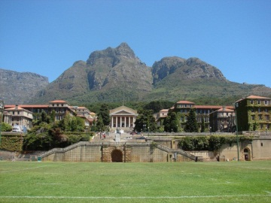
Institutional cultural types
Policy definition:
Loose
Collegium
Bureaucracy
Control of implementation:
Loose
Control of implementation:
Tight
Enterprise
Corporation
Policy definition:
Tight

Slide 6





Open agenda at UCT: projects
Scholar
Scholar
Scholar
Scholar
Student
Community
2007
Opening Scholarship
2008
2009
2010
2011
2012
2013
2014
Notes:
Scholar to scholar and scholar to community- traditional sites of open access movement
Scholar student – traditional site of elearning

Slide 7
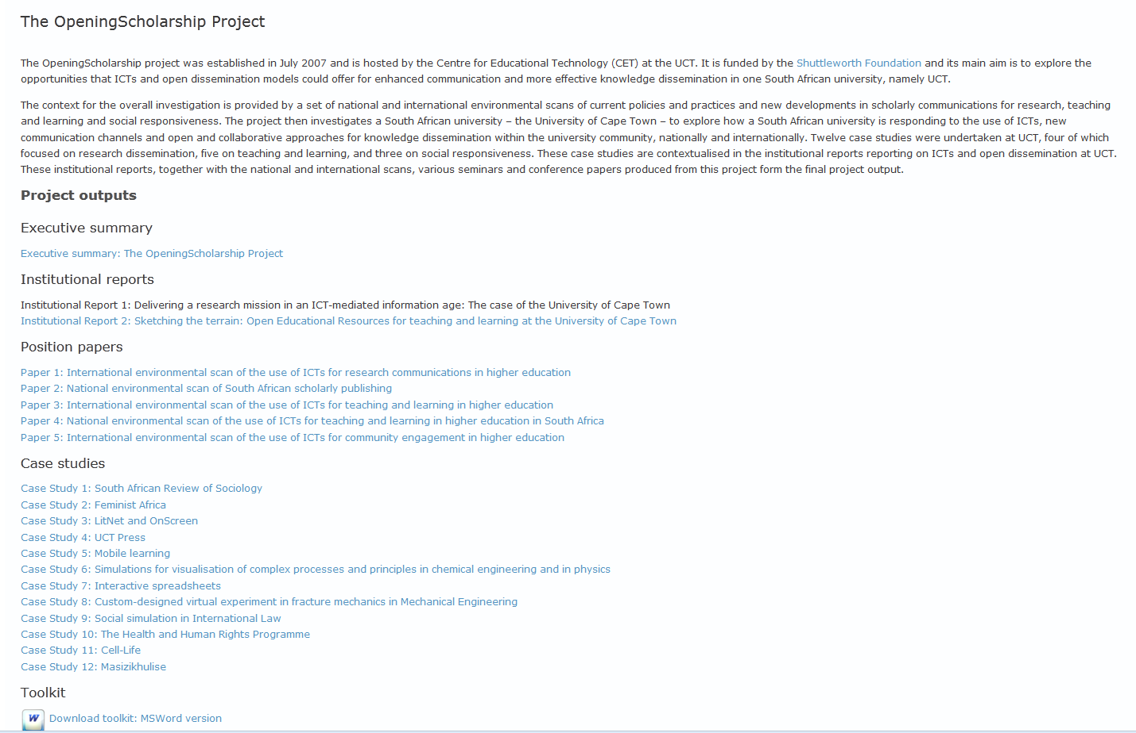
http://www.cet.uct.ac.za/OpeningScholarship

Slide 8
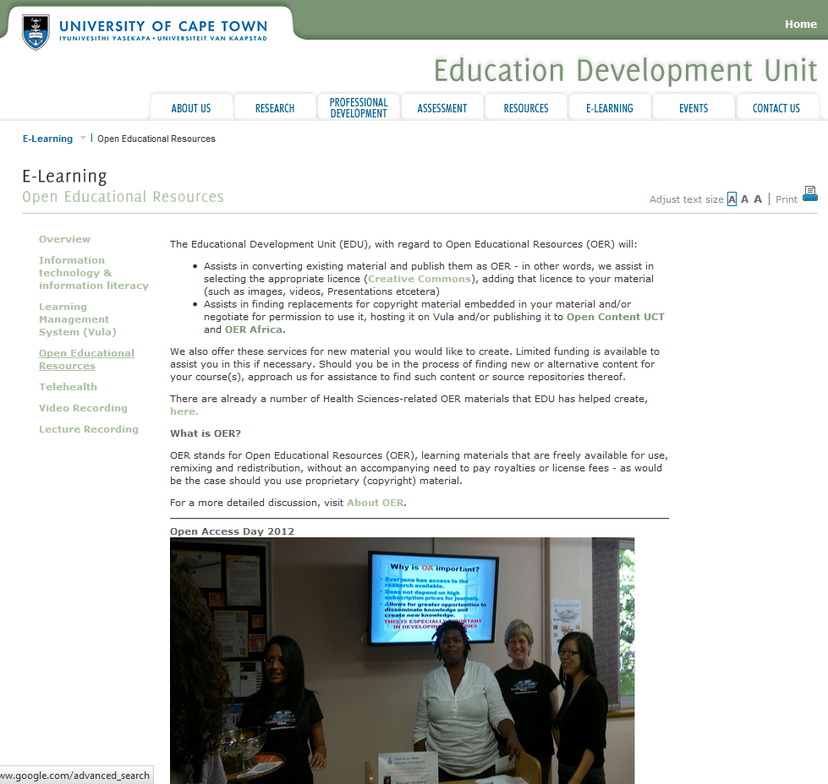
http://www.healthedu.uct.ac.za/about/

Slide 9
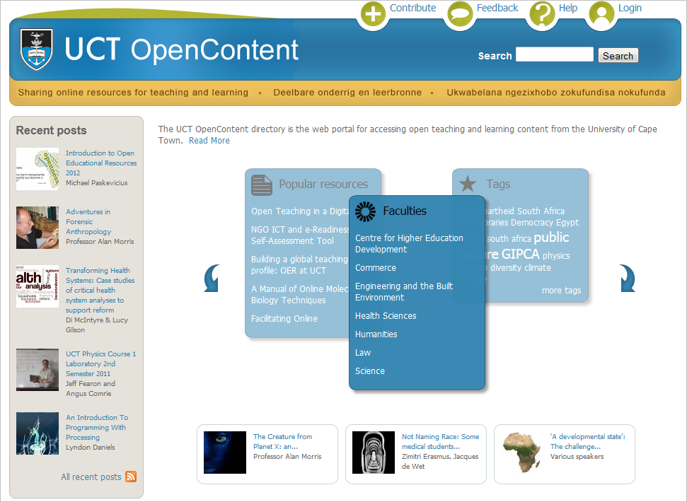

Slide 10
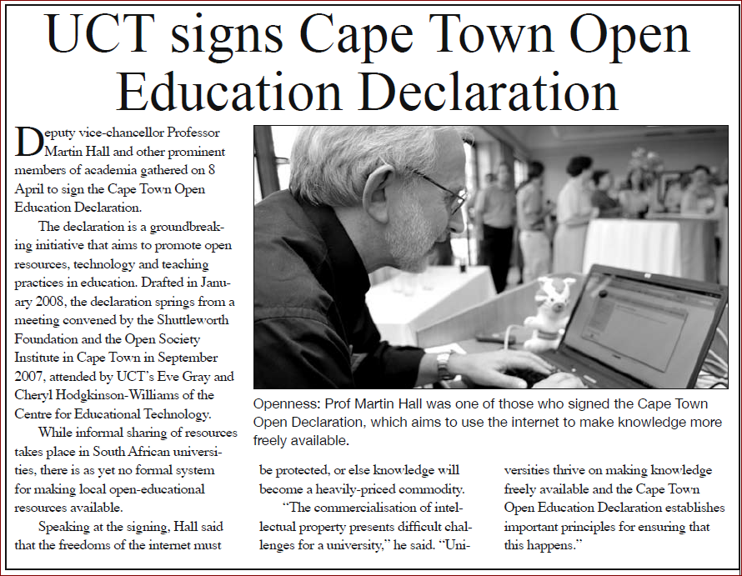
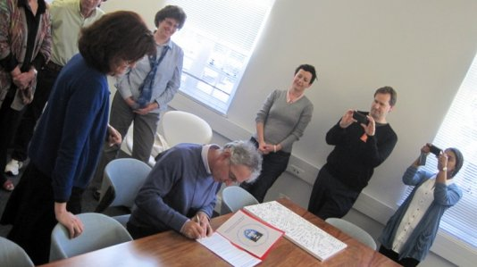
Symbolic support
At senior level
  DVC signs Cape Town Declaration (2008)
  VC signs Berlin Declaration (2011)

Slide 11
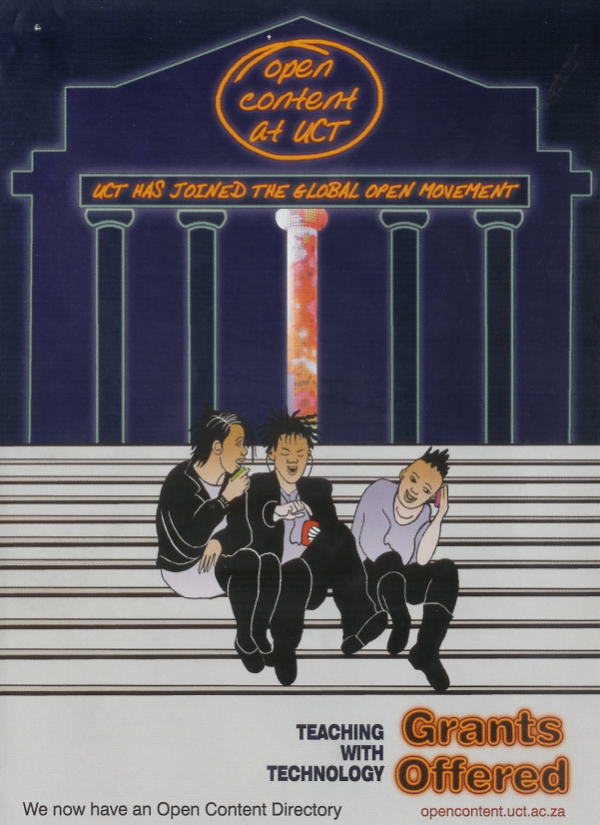

Incentives: small grants
(ends 2014)

Slide 12
IP policy
Work enabled by new UCT IP Policy
  Specifically addresses issues relating to the creation of OER resources and the licensing processes to be followed
  Expressly states the support for publication of materials under Creative Commons licenses
Notes:
Intellectual Property policy and OER
Creators of Open Educational Resources (OER) are to take note of and act in accordance with the newly-updated Intellectual Property (IP) policy of the University of Cape Town. The updated version now specifically addresses issues relating to the creation of OER resources and the licensing processes to be followed. The policy also now expressly states the support for publication of materials under Creative Commons licenses.
In term of the updates, an Intellectual Property (IP) Advisory Committee is to be established to manage the processes relating to IP for UCT. Section 9 of the policy relates to creators of OER resources. It states that software development projects involving Open Source Licensing (OER) should, from the outset, submit the intended type of license agreement for review to the Research Contracts and Intellectual Property Services (RCIP) office for review in terms of compliance to South Africa’s Intellectual Property Rights (IPR) Act and guidelines.
Notable aspects of the updated policy also include IP related to the creation and licensing of films as a teaching learning medium/tool. Others are (Section 8.2):
UCT automatically assigns to the author(s) the copyright, unless UCT has assigned ownership to a third party in terms of a research contract, in:
Scholarly and literary publications Paintings, sculptures, drawings, graphics and photographs produced as an art form
Recordings of musical performances and musical compositions
Course materials, with the provision that UCT retains a perpetual, royalty-free, nonexclusive licence to use, copy and adapt such materials within UCT for the purposes of teaching and or research
Film.

Slide 13


Open agenda at UCT:
Scholar
Scholar
Scholar
Scholar
Student
Community
2007
Opening Scholarship
2008
2009
2010
2011
2012
2013
2014
Main
streamed
2015 +
Notes:
Scholar to scholar and scholar to community- traditional sites of open access movement
Scholar student – traditional site of elearning

Slide 14
OpenUCT
A little more about

Slide 15
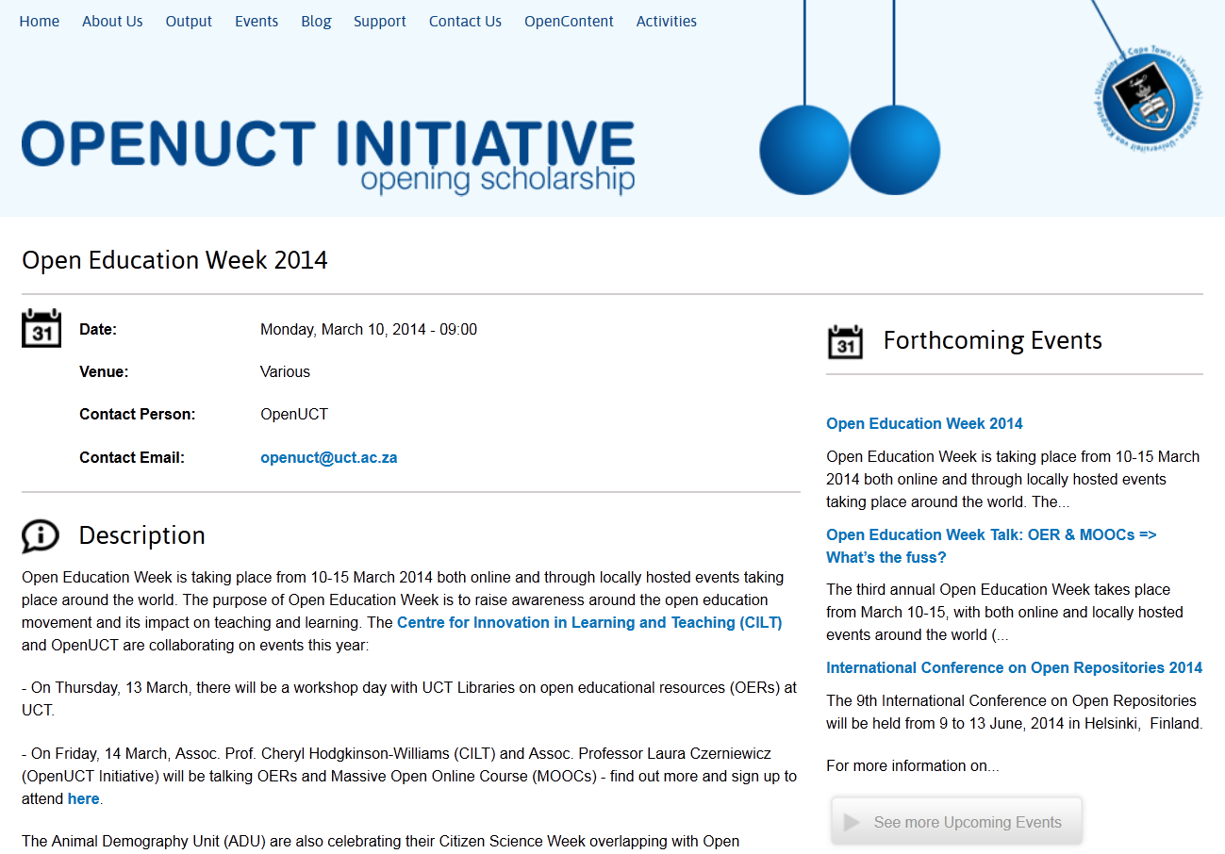

Slide 16
Activities
UCT Policy
  Open access policy
    Been to numerous committees
    to Senate 14 March 2014
  Supports open scholarship and open education
  Encourages all scholarship types
CHE Policy workshop

Slide 17
Advocacy & communication
Events
  40-50 events a year
  Talks, seminars, workshops, keynote addresses
  Through existing UCT mechanisms
    Research Office: PERC, ERP
    Teaching with Technology
    RCIPS
    Savvy Searchers etc
    Special events (OA Week, OEd Week)
  Also Western Cape & nationally

Slide 18

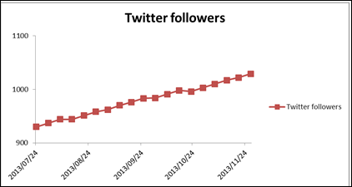
Communication
Social media
  Web site incl blogs
  Facebook
  Twitter

Slide 19

Resources
http://openuct.uct.ac.za/output
Development of useful resources eg
  Finding Open Stuff
  Academics’ Online Presence Guidelines
  About open licensing

Slide 20
Partnership activities
ACDI academics
  Preparing content
  Visibility support
Poverty and Inequality pilot
Also
  Open science workshop
  Global Congress on IP and the Public Domain
  Discoverability workshop (Carnegie)

Slide 21
Technical work
Currently working with Belgium company to build new UCT OpenContent
DSpace
Default repository, assumes academics may also deposit elsewhere
Will be space for all scholarly and educational types
Working with ICTS & UCT Library

Slide 22
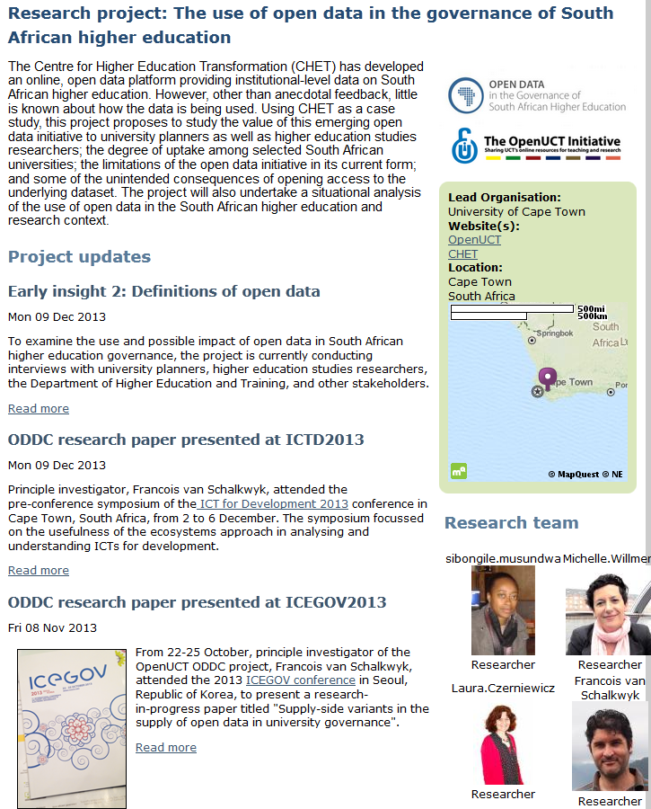
Research
Open data
Visibility of
climate change
online
Access to
learning resources

Slide 23
OERs
CET/CILT advocacy
Student OER project
Support /moderation of deposit (workflows)

Slide 24
Going forward with Open Education Resources and all things open @ UCT
UCT Libraries and CILT partnership

