Slide 1


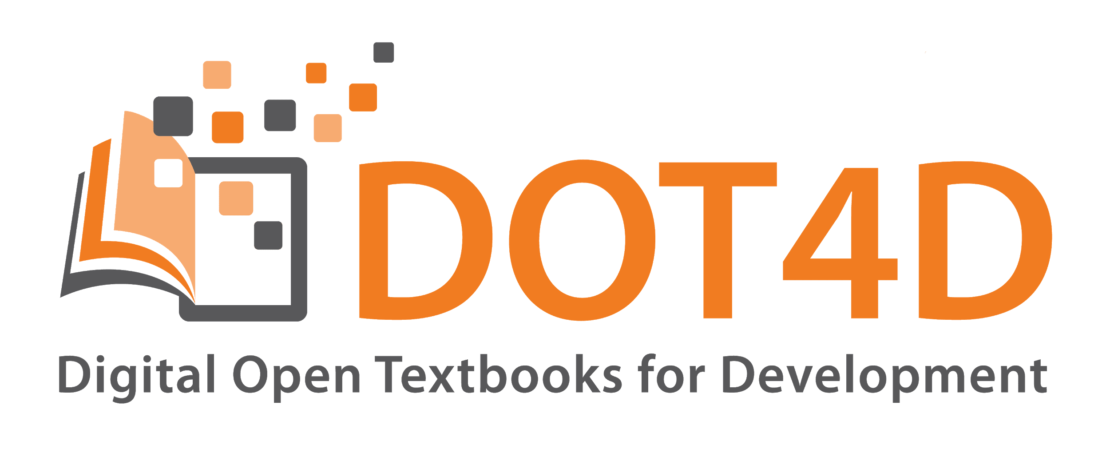


Digital Open Textbooks for Development: Research and implementation to advance equitable access at UCT
Dr Glenda Cox & Michelle Willmers
Centre for Innovation in Learning and Teaching
University of Cape Town
Notes:
UCT, like many other South African universities, is grappling with how to respond meaningfully and creatively to the call for more relevant curricula and pedagogies (Luckett Shay, 2017). Added to the imperative of curriculum transformation, the cost of textbooks is increasingly prohibitive, resulting in an access crisis where students are forced into either simply not having the resource (thereby compromising the learning process) or participating in various kinds of “shadow library” activities and informal sharing of key resources (Gray & Czerniewicz, 2018). The #RhodesMustFall and #FeesMustFall movements encapsulate this complex set of interrelated challenges, calling for both socio-economic redistribution and cultural recognition.
Current modes of scholarly production, including textbook production and authorship of other teaching and learning materials, is a crucial area of investigation in pursuing this agenda as it relates to the power dynamics associated with content production and the question of whose knowledge is foregrounded. A significant response to the challenges of textbook provision and challenges around inequalities of representation in current forms of knowledge production is the creation of open textbooks. Broadly defined as digital collections of open educational resources and open access materials published under open licences on platforms in formats that provide affordances for integration of multimedia, remixing of various content components, printing and redistribution, open textbooks provide educators with a means to build on openly published materials while integrating a more localised approach in terms of examples used and assessment activities.
This presentation will provide an overview of Digital Open Textbooks for Development, an initiative in the Centre for Innovation in Learning and Teaching which is aimed at conducting research on open textbook publishing at UCT, providing support to academics interested in pursuing this as a content-generating strategy, and undertaking advocacy activity to promote policy development that supports more open, inclusive textbook publishing models.
References
Gray & Czerniewicz, (2018, in press). Ecologies: Access to learning resources in post-Apartheid South Africa. In J. Karaganis(Ed.), Shadow libraries. Cambridge, MA: MIT Press.
Luckett, K. & Shay, S. (2017). Reframing the curriculum: a transformative approach. Critical Studies in Education, 1-16.

Slide 2
Curriculum change in Higher Education in South Africa
What Knowledge? Whose Knowledge?
Representativity
Exclusion and inclusion
Positionality
Gaps, silences and absences
Invisibility
Marginalisation
Potential of Open Textbooks
# feesmustfall
Economic dimension
# Rhodesmustfall
Cultural dimension
Political dimension

Slide 3
Affordances of the open movement

Slide 4
Open Educational Resources
Open content / Open educational resources (OER) / Open Courseware are educational materials which are discoverable online and openly licensed that can be:
Shared freely and openly to be…
… redistribute and share again.
Shared
Redistributed
Used
… used by anyone to …
Improved
… adapt / repurpose/ improve under some type of license in order to …
Examples: images, texts, course materials, teaching strategies and textbooks
Notes:
The key aspect of an OER is that it is both discoverable online – so that people can find it AND openly licensed - so that people can legally make use of it. OER includes texts, different forms of media, ideas, as well as documented teaching strategies/techniques or practices.
Advocates of openness would suggest that the value in OER is in its potential to support learning in many ways and in many contexts.

Slide 5
OER have the potential to address two key areas of concern in Global South context...
Cultural inequality and misrepresentation, as localisation made possible by adaptation affordances of open licensing.
Economic injustice of access/cost barrier, as resources are typically free to the user.
Source: Hodgkinson-Williams (2018)

Slide 6
The full transformational value proposition of open educational resources is manifest in the practices that accompany them, rather than the resources themselves … particularly when adopting a collaborative approach to generating knowledge and sharing resources.

Slide 7
Key value propositions of open educational practices
● Conceptualise alternative epistemic views on educational issues and
curricula.
● Create OER collaboratively with colleagues or co-create with students.
● Circulate or share these OER with other colleagues or students.
● Open these up for critique by others so that they can be quality
assured and possibly recognised for formal certification.
Source: Hodgkinson-Williams (2018)

Slide 8
Open textbooks

Slide 9
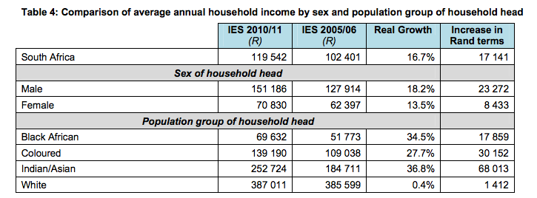
Relative expense: the cost of textbooks
UCT International Academic Programmes Office estimates cost of textbooks and stationery as R 7 000 per semester
  > 10.05% of average black household annual household income (21% / annum)
  > 5.85% of average South African annual household income (11.7% / annum)
Source: Czerniewicz (2017)
Statistics South Africa (2012) Income and expenditure of households 2010/2011. Pretoria: Statistics South Africa. P5. Retrieved from http://www.statssa.gov.za/publications/P0100/P01002011.pdf

Slide 10
Models of textbook provision
Analogue
A form of copyright provision where permissions for use are granted up front
Materials are usually free to the user,
or have a minimal cost
Print textbooks
Print open texbooks
Full
Copyright
Open
licensing
Digital
textbooks
Digital Open Textbooks
Source: Czerniewicz (2017)
Digital

Slide 11
What are open textbooks?
Openly licensed materials (usually digital).
Published in formats that facilitate integration of multimedia.
Comprised of multiple granular elements, which can be remixed or translated from other content collections (and be integrated into other content collections).
Allow for legal hosting on repositories/websites, printing and redistribution.
Notes:
Digital does not equal open

Slide 12








Where can you find existing open textbooks?
www.openculture.com/free_textbooks
www.gutenberg.org/
http://openstaxcollege.org/
www.ck12.org/
www.siyavula.com/
www.collegeopentextbooks.org/
http://open.bccampus.ca/
www.intratext.com/
Notes:
For repositories that provide open books or open textbooks, you can also see:
Project Gutenberg: https://www.gutenberg.org/
Open Culture: http://www.openculture.com/free_textbooks
IntraText: http://www.intratext.com/
Siyavula: http://www.siyavula.com/
CK-12: http://www.ck12.org/
College Open Textbooks: http://www.collegeopentextbooks.org/
OpenStax College: http://openstaxcollege.org/
BC Campus Open Ed: http://open.bccampus.ca/

Slide 13
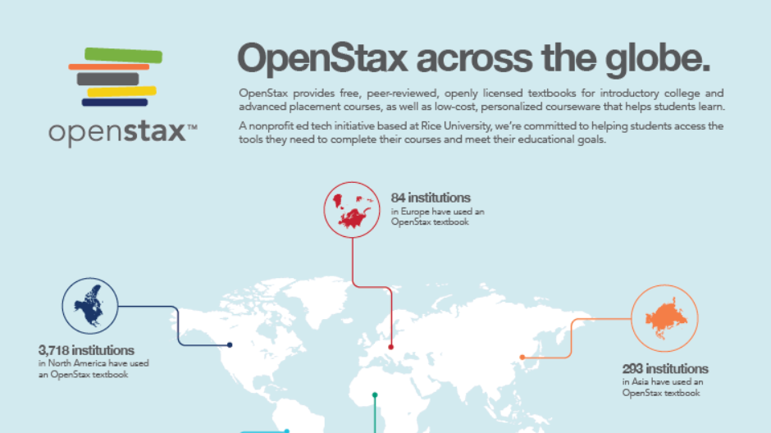
Open textbooks used and reused anywhere

Slide 14
Open textbooks at UCT

Slide 15
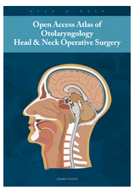
Early adopters sharing teaching materials...
Open Access Atlas of Otolaryngology Head & Neck Operative Surgery
by Johan Fagan
1 download every 90 seconds
85 chapters
Multiple authors
Translated into Spanish and French
Published under Creative Commons Attribution Non-Commercial (CC BY-NC) 4.0 licence
Notes:
https://vula.uct.ac.za/access/content/group/9c29ba04-b1ee-49b9-8c85-9a468b556ce2/Open%20access%20textbook%20of%20general%20surgery/index.html

Slide 16
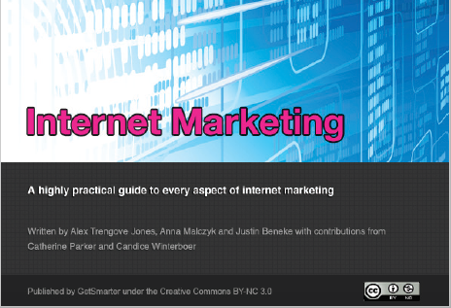
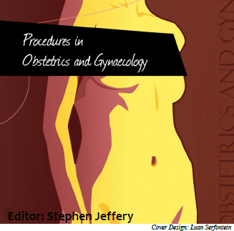

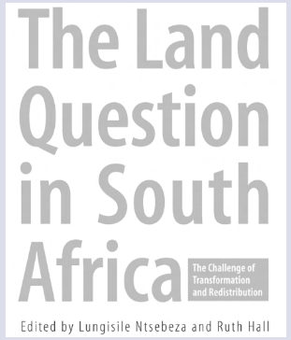
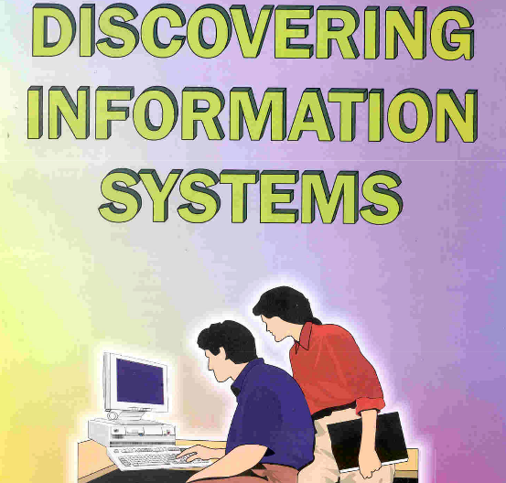

Slide 17
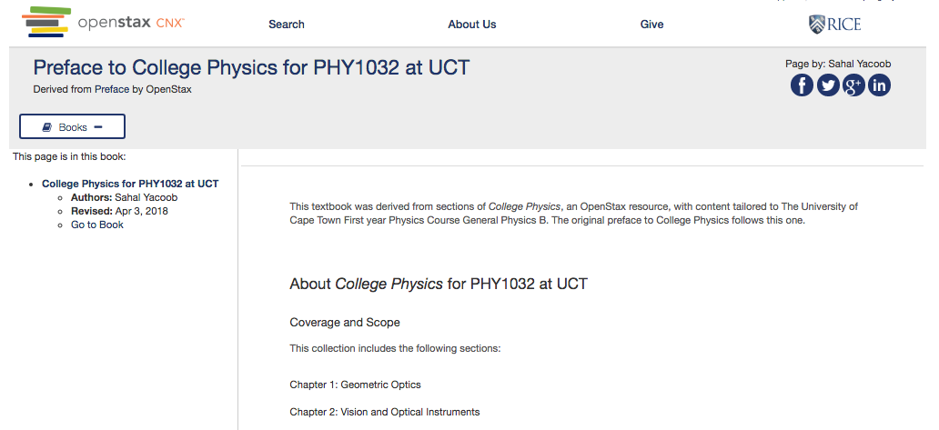
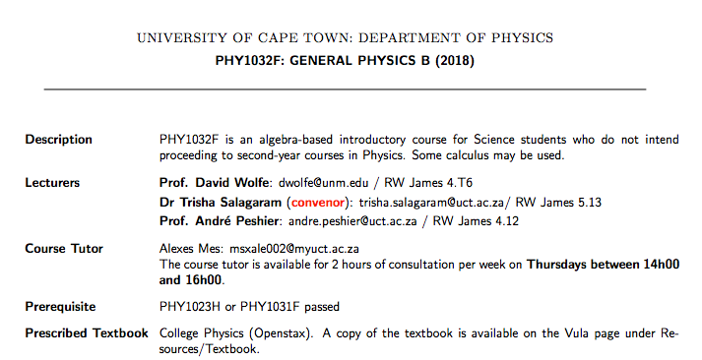
… and cutting textbook costs.
Open textbook use and adaptation at UCT
Notes:
http://www.phy.uct.ac.za/sites/default/files/image_tool/images/281/current/phy1032f_info.pdf

Slide 18
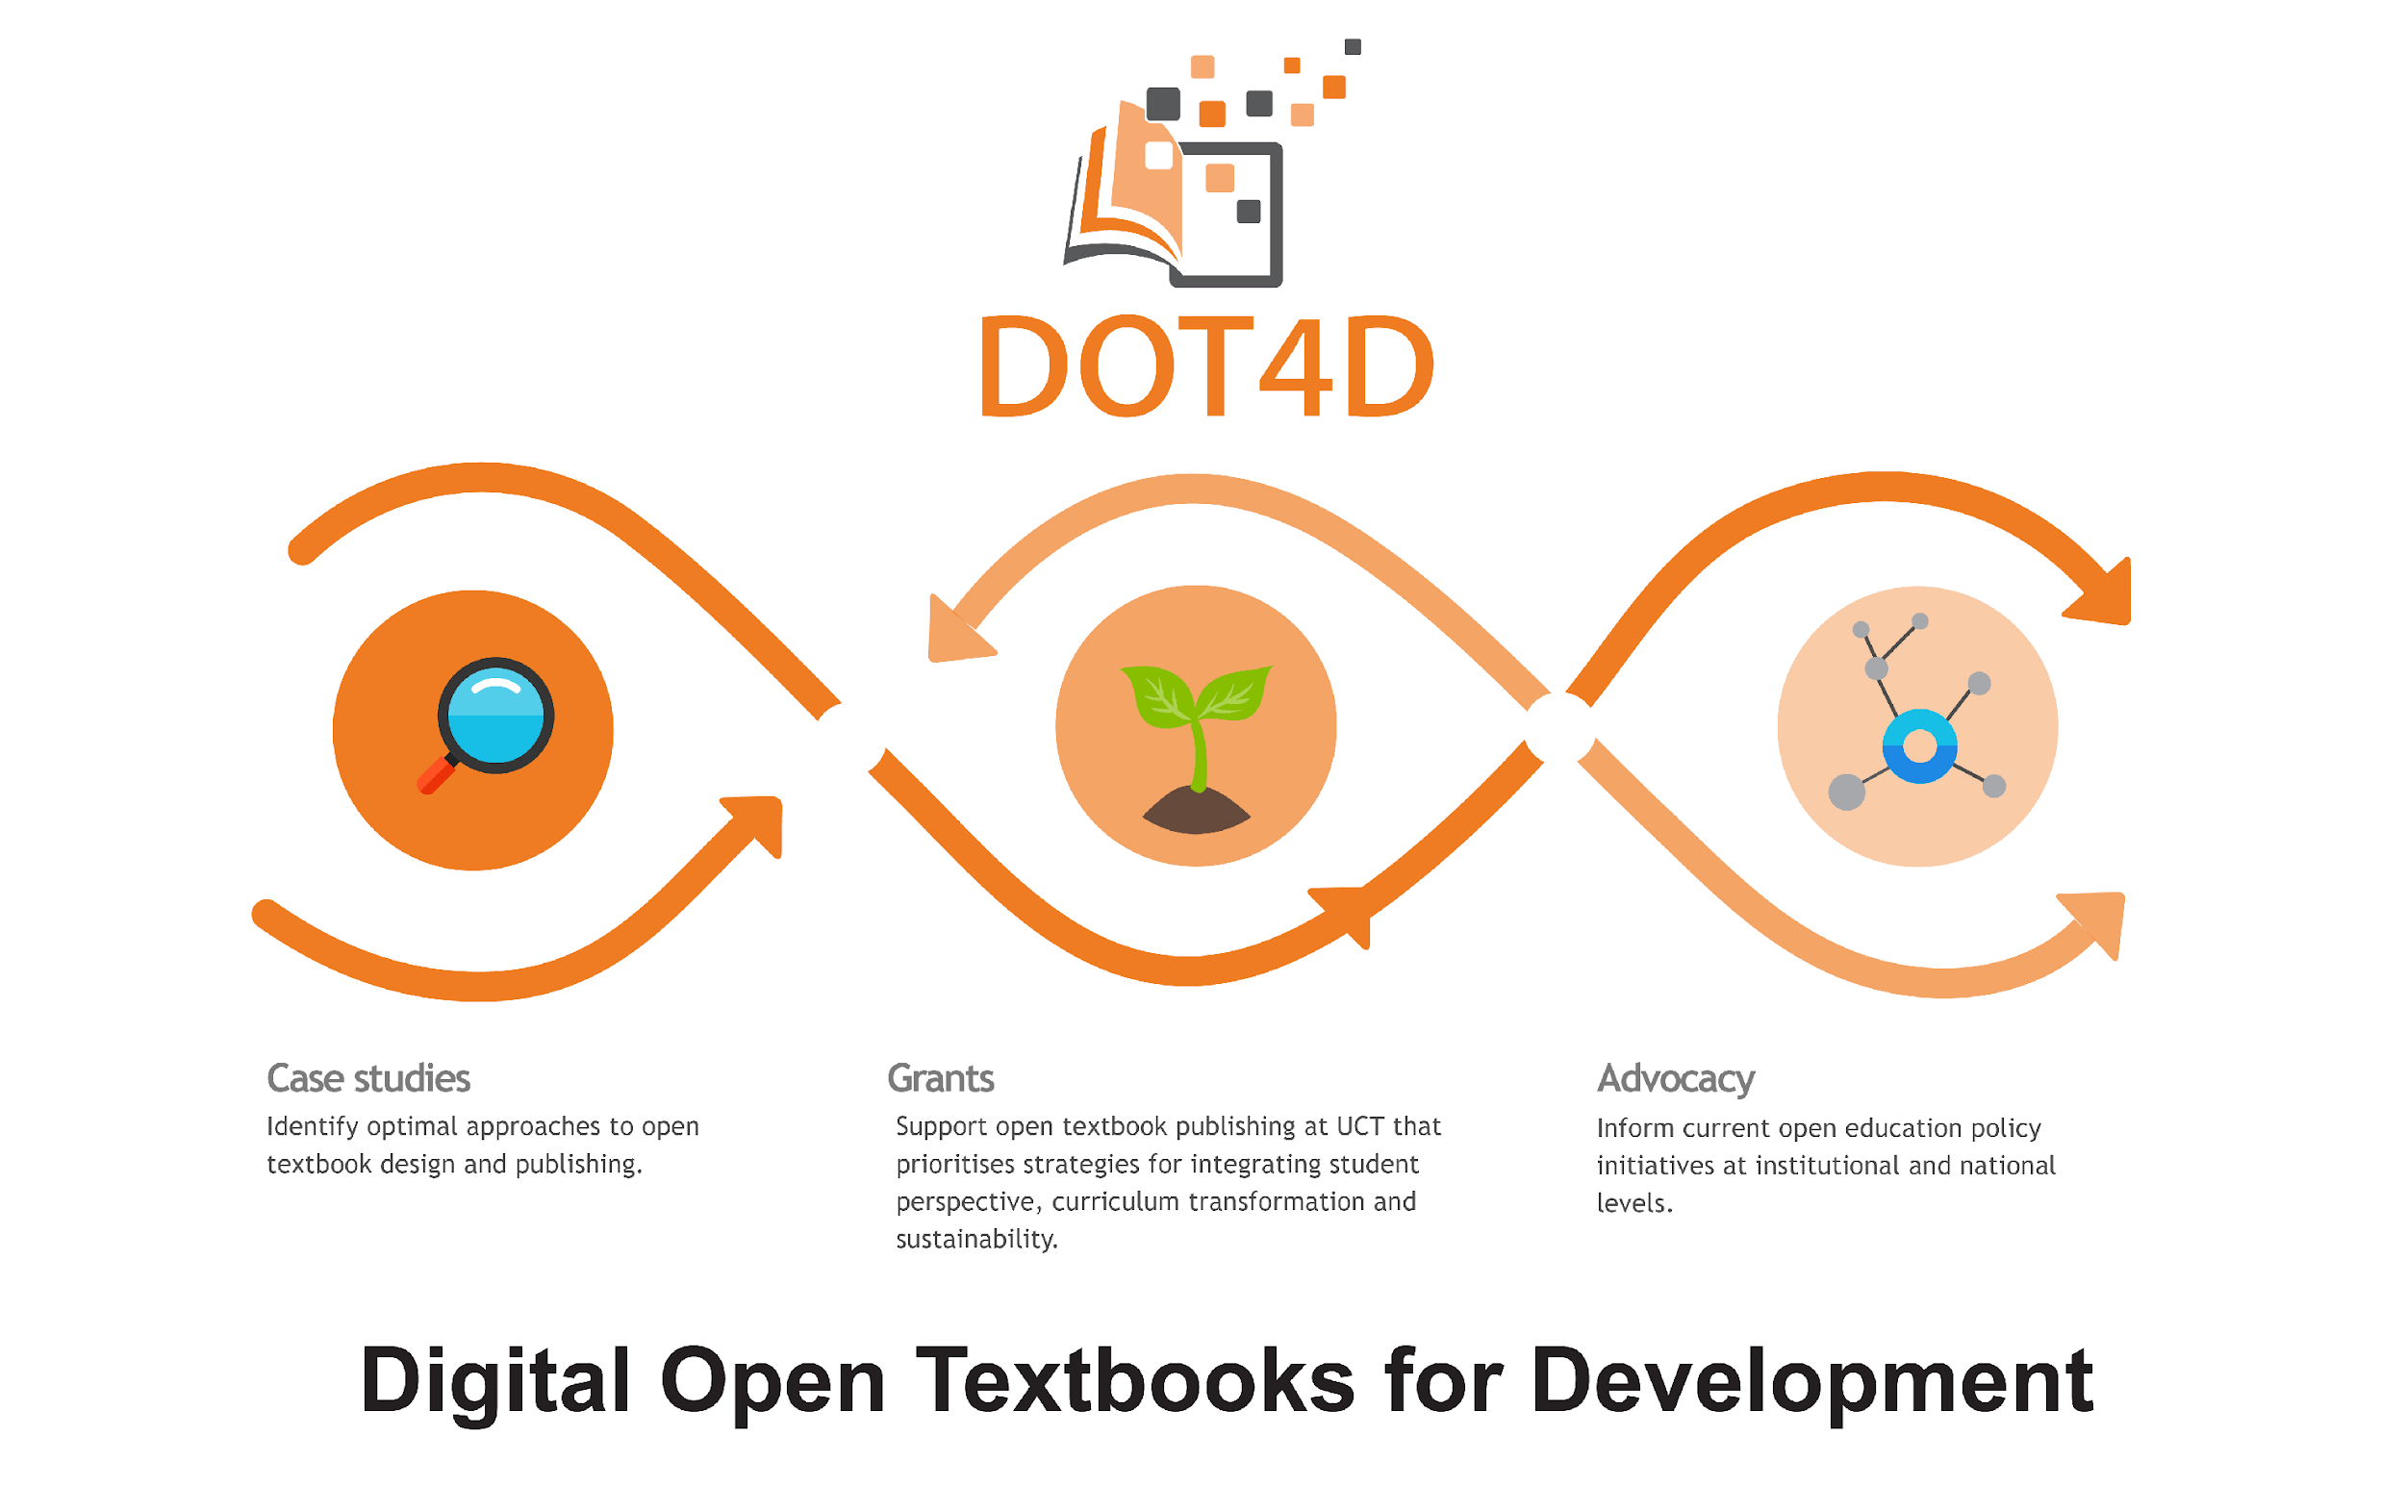
Notes:
Project specific objectives:
Articulate and identify the best approaches to designing an open textbook.
Support open textbook publishing activity at UCT that prioritizes strategies for integrating student perspective, curriculum transformation, and sustainability.
Inform current textbook publishing policy-development initiatives at institutional and national levels.

Slide 19
Project general objective:
To contribute to improving inclusion in South African higher education
by addressing equitable access to appropriate and relevant learning resources.

Slide 20
Social Justice (Fraser, 2005)
Fraser’s concept of social justice as “parity of participation”
Dimension | Injustices
Economic | Maldistribution of resources: economic inequality
Cultural | Misrecognition attributes of people & practices accorded less respect, status inequality
Political | Misrepresentation Lacking right to frame discourse

Slide 21
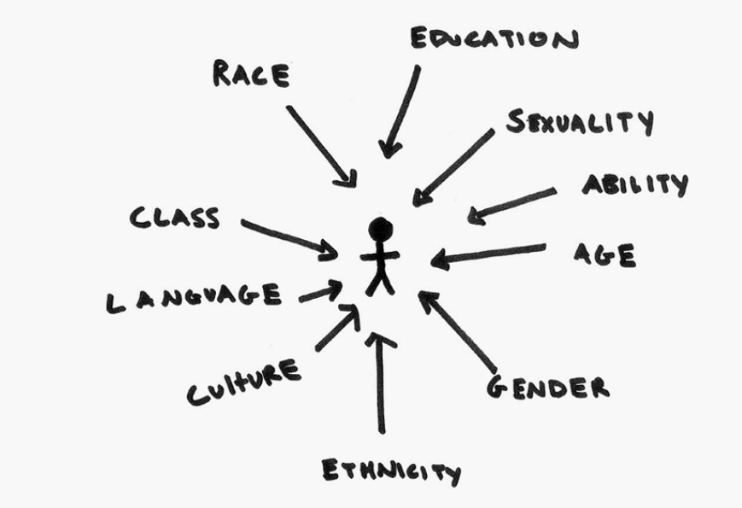
Intersectionality
the interconnected nature of social categorizations such as race, class, and gender as they apply to a given individual or group, regarded as creating overlapping and interdependent systems of discrimination or disadvantage (Crenshaw, 1989)
https://iwda.org.au/what-does-intersectional-feminism-actually-mean/

Slide 22
An approach that goes beyond numbers that addresses all aspects of transformation; the economic, the cultural, and political. An approach that holds at its core the agency of the textbook authors and enables /empowers them to realise their projects and concerns.

Slide 23
References
Archer, M. S. (2003). Structure, agency and the internal conversation. Cambridge: Cambridge University Press.
Cox, G, Trotter, H, Hodgkinson-Williams, C, Arinto, P, Cartmill, T and King, T. (2018) Surfacing agency and power: A social realist perspective on select findings from the ROER4D projects. OER18, April London, Englan
Crenshaw, K. (1989). Demarginalising the intersection between race and sex: A black feminist critique of antidiscrimination doctrine, feminist theory and antiracist politics. Retrieved from https://philpapers.org/archive/CREDTI.pdf
Czerniewicz, L (2018). Open Textbooks presentation to Universities South Africa. Slides on request.
Fraser, N. (2005). Reframing justice in a globalizing world. New Left Review, 36, 69–88. Retrieved from https://newleftreview.org/II/36/nancy-fraser-reframing-justice-in-a-globalizing-world
Hodgkinson-Williams, C., Arinto, P. B., Cartmill, T. & King, T. (2017). Factors influencing Open Educational Practices and OER in the Global South: Meta-synthesis of the ROER4D project. In C. Hodgkinson-Williams & P. B. Arinto (Eds.), Adoption and impact of OER in the Global South (pp. 27–67). Retrieved from https://doi.org/10.5281/zenodo.1037088
Hodgkinson-Williams, C.A. & Trotter, H. (forthcoming). A social justice framework for understanding open educational resources and practices in the Global South, Journal of Learning for Development.
Walji, S. & Hodgkinson-Williams, C. (2017). Understanding the nature of OEP for OER adoption in Global South contexts: Emerging lessons from the ROER4D project. Presented at OER17, 5–6 April 2017. London, UK. Retrieved from https://www.slideshare.net/ROER4D/understanding-the-nature-of-oep-for-oer-adoption-in-global-south-contextsemerging-lessons-from-the-roer4d-project
This work is carried out with support from the International Development Research Centre, Ottawa, Canada.

