Slide 1

Opening Everything:
Considerations for African Institutions
Michelle Willmers and Laura Czerniewicz
CC-BY-SA

Slide 2
The history of scholarship and the evolutionary progress of open academic principles

Slide 3

St Benedict of Nursia (480-547)
Notes:
Father of Western monasticism. Advocates of removal of property and monastic lifestyle. Focus on immersion in reflection and reading gives birth to earliest form of Western scholarship (for the purpose of the glory of God).

Slide 4
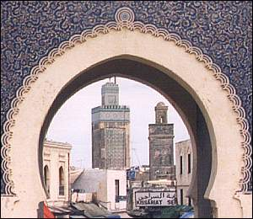
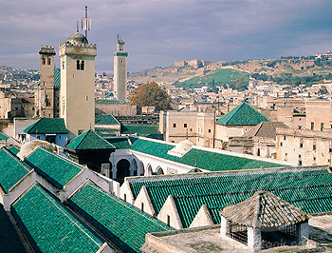
University of
Al-Karaouine (859)
Notes:
Established 859 as spiritual and educational centre of Muslim world when Al-Fihri family migrated from Tunisia and joined migrant community. Sisters Fatima and Mariam inheritance led to establishment in order to serve community. Today exists as one of the oldest universities in the world.

Slide 5
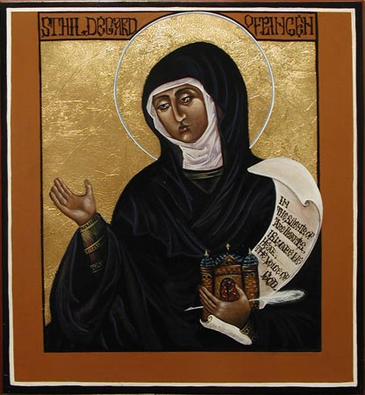
St Hildegard of Bingen (1098-1179)
Notes:
Seer and prophet whose ill health led to utilisation of plants for therapeutic purpose. Could not read or write, but visions recorded by spiritual director and Church granted permission to share. Despite illiteracy entered into considerable correspondence across Europe helping physical/spiritual ailment. “The labours of knowledge must have public benefit.”

Slide 6
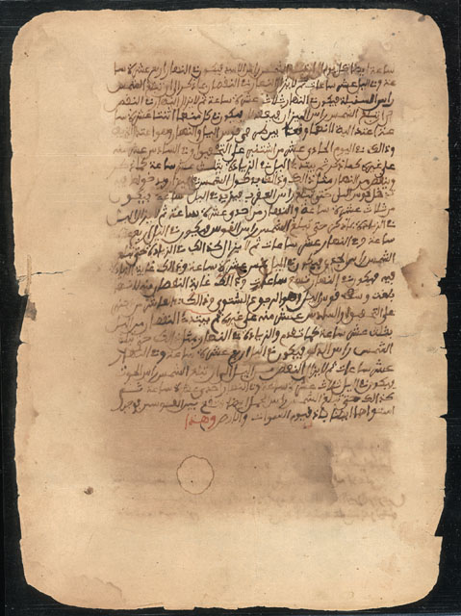
Timbuktu Manuscripts (1200 AD)
Notes:
As many as 18 000 manuscripts, many from ancient libraries, are now housed in the Ahmed Baba Centre, named after the famous 15th century Timbuktu scholar, Ahmed Baba. he Timbuktu Manuscripts - or Mali Manuscripts - reams of written manuscripts dating as far back as the 13th century, are ancient Arabic texts that hark back to the Malian city of Timbuktu's glorious past, when it existed 500 years ago as a gold trading port and centre for academics and scholars of religion, literature and science. The manuscripts provide a written testimony to the skill of African scientists, in astronomy, mathematics, chemistry, medicine and climatology in the Middle Ages. Discourse and commentary on manuscripts dating centuries later indicate an African scholarship system that existed independent of European scholarship. [Note glossary space around text for commentary.]

Slide 7
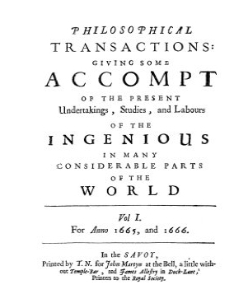
Notes:
Philosophical Transactions (1665) first scholarly journal.

Slide 8
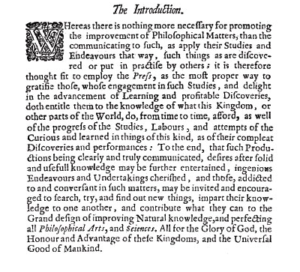
Notes:
From Transactions (1665): “nothing more necessary for promoting the improvement … than the communication of such”

Slide 9
The Trajectory of Journal Publishing
1655 Transactions and Journal des Savans
17th-20th century, mostly society and independent journals, slow growth
By 1850, 100 journals
Post war, the information society provides opportunities for commercial players
Massification of universities fuels journal growth
2011 approx. 25 000 journals
Promotions and recognition driven by industry-controlled metrics
Swan 2011; McGuigan and Russell 2008; Guedon 2001.

Slide 10
Countervailing forces - scholarship goes digital

Slide 11
Notes:
A look at new, cross-disciplinary, “mega-journals”. “Beyond the journal article.” PLoS established 2006 as platform for primary science from any discipline in science and medicine. Internal and external pre-publication peer review, but no exclusion on basis of perceived importance to field/audience. Focus on collaborative, post-publication peer review. Publishes daily. In 2009 pioneered article-level metrics. Enables HTML, PDF and XML download. 2010: 6749 articles published. (“The largest journal in the world.”) Impact factor: 4.41. Five Nobel laureates among author base. Editorial board: 14 000 academics. First four years: 35 000 external reviewers. [Figures as at October 2011.]

Slide 12
Notes:
“Comments” view of article. Note ‘View all corrections’. Transparency in process key.

Slide 13
Notes:
“Metrics” view of article.

Slide 14
A Brief History of Open Everything (so far)

Slide 15

Notes:
Open Source acknowledge as “Father” of the open movement, with birth in the 1950s/60s. Software produced by academics and shared as other knowledge was at the time. Source code originally distributed with hardware for self-modification until rise of software industry in late 1960s. ‘Request for Comments’ initiative to develop telecomms network protocol in 1960s led to birth of the internet in 1969.

Slide 16


Slide 17
Budapest Open Access Initiative (2001)
An old tradition and a new technology have converged to make possible an unprecedented public good. The old tradition is the willingness of scientists and scholars to publish the fruits of their research in scholarly journals without payment, for the sake of inquiry and knowledge. The new technology is the internet. The public good they make possible is the world-wide electronic distribution of the peer-reviewed journal literature and completely free and unrestricted access to it by all scientists, scholars, teachers, students, and other curious minds. Removing access barriers to this literature will accelerate research, enrich education, share the learning of the rich with the poor and the poor with the rich, make this literature as useful as it can be, and lay the foundation for uniting humanity in a common intellectual conversation and quest for knowledge.

Slide 18
Gold Route
- Primary publication in open-access journals.
- 7 070 journals (DOAJ 2011)
Open Access Publishing
Green Route
- Self-archiving of scholarly content in open access repositories prior to, in parallel with, or after publication.
2085 repositories worldwide (DOAR 2011)
http://poeticeconomics.blogspot.com/2011/09/dramatic-growth-of-open-access.html

Slide 19

Free!
Notes:
“Free as in information, not as in beer.”

Slide 20
Rise of new business models: ‘freemium’ and value-add
Who Pays?
Notes:
As movement matures, the exploration of various business models becomes key to sustainability. Many adopt hybrid models based on what works in context.

Slide 21

Notes:
OER origins in the 1990s and formalised as movement in early 2000s. Encourages open sharing of teaching and learning content with appropriate licensing mechanisms for sharing, translation, remixing of content.

Slide 22
Notes:
MIT OpenCourseWare as most well-known example. Offers full courses (currently 2000 available).

Slide 23
http://opencontent.uct.ac.za/
Notes:
Portal for accessing OER from the University of Cape Town. This directory more granular approach and includes content from full textbooks to slide presentations and simulations. Launched February 2010. Currently 148 resources (October 2011).

Slide 24

Notes:
Open Research exploring space beyond the journal article and more dynamic system of open exchange of “research objects”. Promotes expansive, collaborative approach, which has had particular success in making progress in biomedical sciences, astronomy. Most notably, led to identification of biomarkers for alzheimers.

Slide 25
Open Research
Replicable (transparency - method)
Reusable (results free for re-use and appropriation)
Replayable (tools available for appropriation)
Collaborative
Interdisciplinary
Granular
Immediacy factor
Suited to addressing socio-economic imperatives
Notes:
A few commonly acknowledge characteristics.

Slide 26

Notes:
Open research heavily contingent on open data practice.

Slide 27
Notes:
Significant challenges and barriers to sharing open data, particularly around metadata and curation considerations. Various large-scale organisations working at global interoperability of systems and standards.

Slide 28
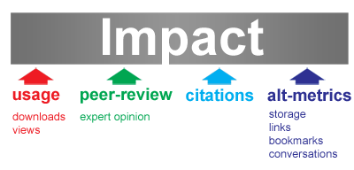
http://altmetrics.org/manifesto/
Notes:
Open, technologically-driven practice leads to a new, expanded conception of impact.

Slide 29
“Open access advocates might centre their vision on integrating open access with a new type of digital and global infrastructure that includes all results in real time … Therefore, the question that policy makers should be making is how to articulate open access as an essential part of the new infrastructure that merits institutional investment.”
Chris Armbruster, Implementing Open Access (2010)
Notes:
Open access as one of many considerations. Infrastructure requires institutional investment.

Slide 30
How do we participate (as contributors)?
Factors and considerations for African universities

Slide 31
African HE at a glance
Current est. 1 billion population
Lowest tertiary enrolment rate in the world at 5%
  Compared to OECD targets of 50-60% and ‘Asian tiger economies’ of 30-40%
Numbers of tertiary enrolments more than tripled in 20 years, imposing great strain
-- 1985 (800,000 enrolments) to 2002 (3 million)
200 public universities in Sub-Saharan Africa (UK alone with 60 million population has 126 universities and over 1 million enrolments)
Private tertiary providers emerging to fill demand gap and over-burden in public sector
Absence of quality systems in many countries/lack of linkage between quality and national funding
Materu, P., (2007), “Higher education quality assurance in sub-Saharan Africa: status, challenges, opportunities and promising practices”, A Report for the World Bank: Washington.
Notes:
Important to consider realities of African HE environment for foundational understanding of context in which open practice takes place for African universities. Particularly significant is teaching focus (up to new millenium), resource challenges and low number of researching academics.

Slide 32
African Research Participation
Africa home to only 2.3% of world’s researchers
169 researchers per one million inhabitants
Apart from having the lowest density of researchers in the world, investment in research and development in Africa stands at 0.9%
Excluding South Africa, intensity in research and development in Sub-Saharan Africa is 0.3%
Mamdani (2011): Corrosive culture of consultancy
“The culture of consultancy has radically changed postgraduate education and research as consultants presume that research is all about finding answers to problems
defined by a client.”
Mamdani (2011)
http://tinyurl.com/6czxv6e

Slide 33
1. Enabling Environment
Policy, regulation and infrastructure (national and institutional).
National support for OA and acknowledgement that communication crucial part of research.
Structures and business models to enable (e.g. channels for payment of OA publication fees).
Support for changing models of scholarly communication (e.g. support for exploring Web 2.0 professional application).
Protection and control of IP in digital environment through exploration of alternative licensing options suitable to public domain (e.g. Creative Commons).
Notes:
Based on evidence gathered and observations of Scholarly Communication in Africa Programme and OpenUCT initiative. Outputs forthcoming.

Slide 34
2. e-Infrastructure
Investment in curation
- Data centres
- Repositories
Investment in systems and processes to track impact
Balanced local and regional perspective
Harmonised regional collaborative approach
- Grid services
- Bandwidth
Notes:
Based on evidence gathered and observations of Scholarly Communication in Africa Programme and OpenUCT initiative. Outputs forthcoming.

Slide 35
3. Re-asserting Academics’ Agency /
The Rise of the Global Networked Scholar
Clear articulation of individual academics’ rights in sharing content.
Examination of repository deposit routes and clear articulation of expectation around author contribution (coupled with investigation to see where breakdown occurs).
Tracking and evaluation of funder’s requirements in line with institutional policy around OA.
Focus on authors as users (in addition to depositors).
Armbuster C (2010) Implementing Open Access: Policy Case Studies. Max Planck Digital Library
Notes:
Based on evidence gathered and observations of Scholarly Communication in Africa Programme and OpenUCT initiative. Outputs forthcoming.

Slide 36
Notes:
Return to original thinking around “The Role of the University in a Developing Country” by Prof Setidisho, University of Botswana Rector, 1978.

Slide 37
Setidisho NOH (1978) The Role of the University in a Developing Country. Pula: Journal of African Studies 1(1): 3
Notes:
Imperative: Address development issues.

Slide 38
Setidisho NOH (1978) The Role of the University in a Developing Country. Pula: Journal of African Studies 1(1): 4

Slide 39
michelle.willmers@uct.ac.za
http://www.scaprogramme.org.za/

