Slide 1

Copyright, creative commons and other legislation influencing sharing of information
Part A: copyright
Prof Caroline Ncube
Department of Commercial Law
University of Cape Town
Caroline.Ncube@uct.ac.za
@caro_ncube

Slide 2


Introduction
Copyright & openness: philosophically and practically congruent?
How do publishing contracts & practices impact sharing?

Slide 3
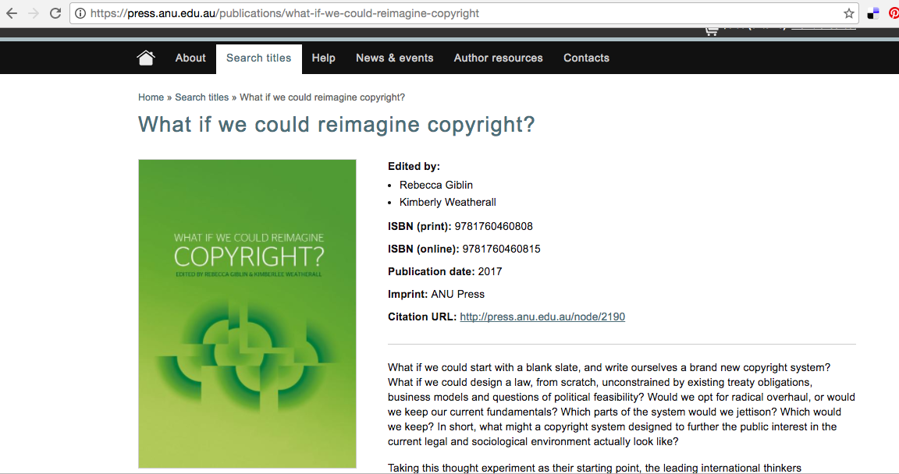

Slide 4

Regulatory framework
International
Treaties
Free trade agreements
National
laws
policies
Institutional
policies
practices

Slide 5




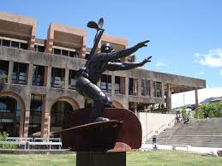

territorial statutory right, granting its holder exclusive economic rights over protected content and moral rights to the author for a specific duration

Slide 6

Originality
Material form (incl digital)
Location of author/first publication
Automatic protection/no registration required

Slide 7


© holder’s exclusive rights/restricted acts
Open Access
Reproduction
Publication
Performance
Adaptation
Letting/offering or exposing for hire by way of trade
Public display
free,
immediate,
online availability
rights to use fully in the digital environment

Slide 8

OER
Retain
Reuse
Revise
Remix
Redistribute

Slide 9

Default & automatic All Rights Reserved situation
Permission is required for most uses of most works
Unless a copyright exception and limitation applies

Slide 10

exceptions and limitations

Slide 11

Permissions/licensing
NEGOTIATED Licenses (blanket or transactional)
OPEN Licenses
creative commons

Slide 12
You can only economically exploit the work or permit/license others to do so if you are the copyright holder by default or assignment
Check:
Statutory provisions regarding © ownership
Institutional policy regarding © ownership
Publishing agreements
>> where necessary use an Author’s Addendum

Slide 13
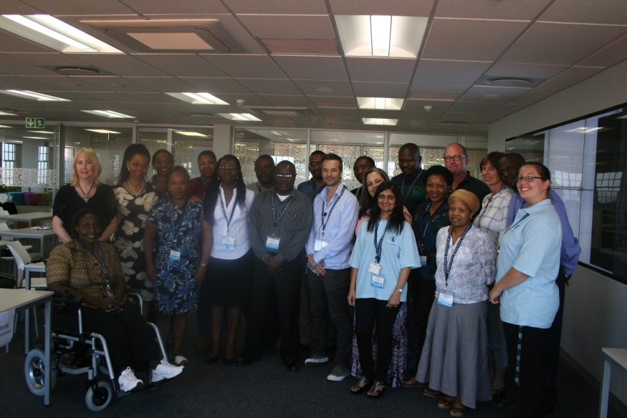
“Copyright, as an economic control mechanism, limits, or hinders, content availability and accessibility” - Dick Kawooya
“I am very much an advocate for OA as I believe it is essential for creating an access-enabling environment” - Tobias Schonwetter
“The most impactful knowledge is open and shared knowledge” – Caroline Ncube
Workshop 3: Legislation, copyright and funder agreements

Slide 14
Copyright, creative commons and other legislation influencing sharing of information
Part B: licensing options
Dr. Tobias Schonwetter
Director: IP Unit
Department of Commercial Law
University of Cape Town tobiasschonwetter@uct.ac.za
@tobyschonwetter

Slide 15

Default & automatic All Rights Reserved situation

Slide 16
Sounds great at first …
But what happens if you actually want to share your material more freely?

Slide 17
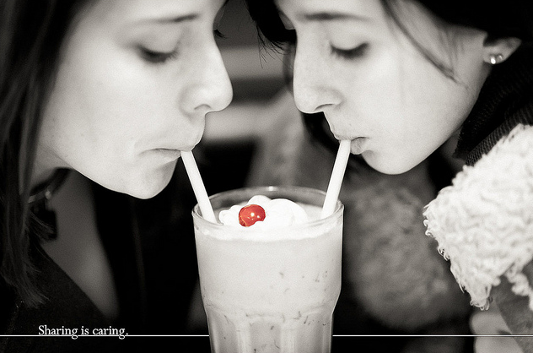


E.g., because your main objective is widest-possible dissemination rather than making money?

Slide 18
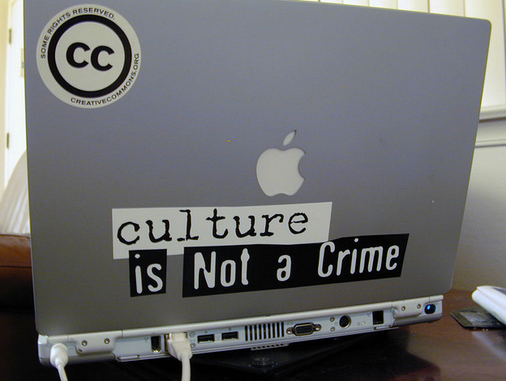
Should we really create and accept private ownership and monopolies in cultural and knowledge material
As this can severely hamper access to knowledge and, e.g., educational material?

Slide 19
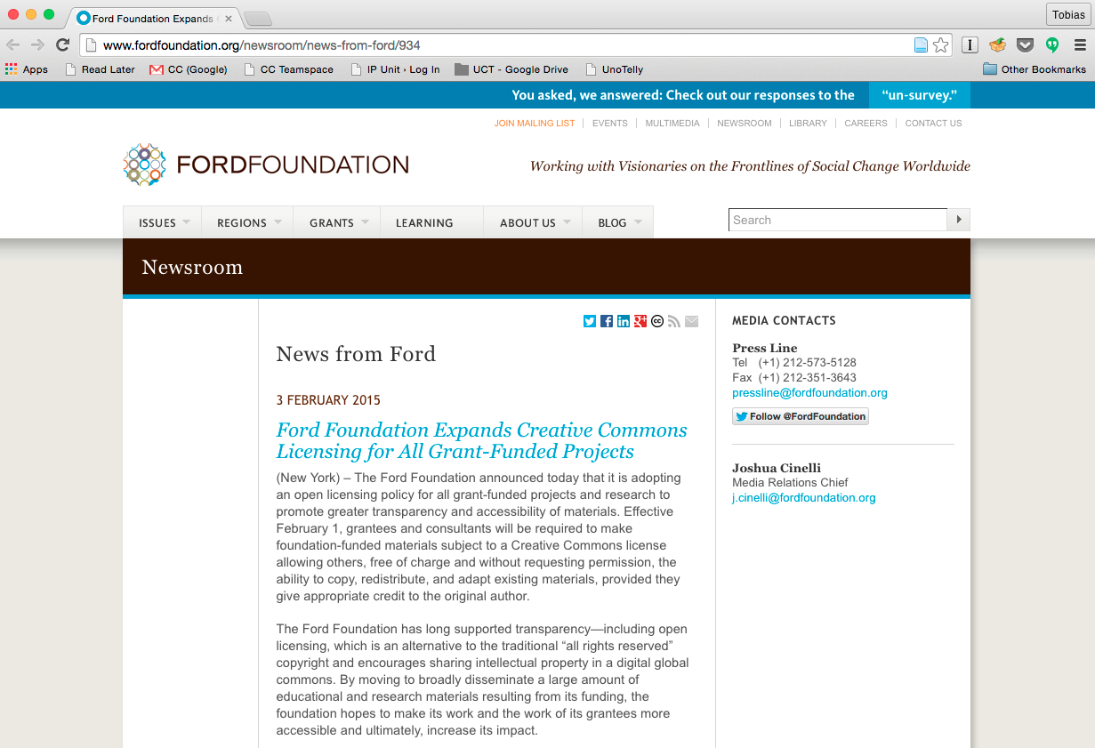
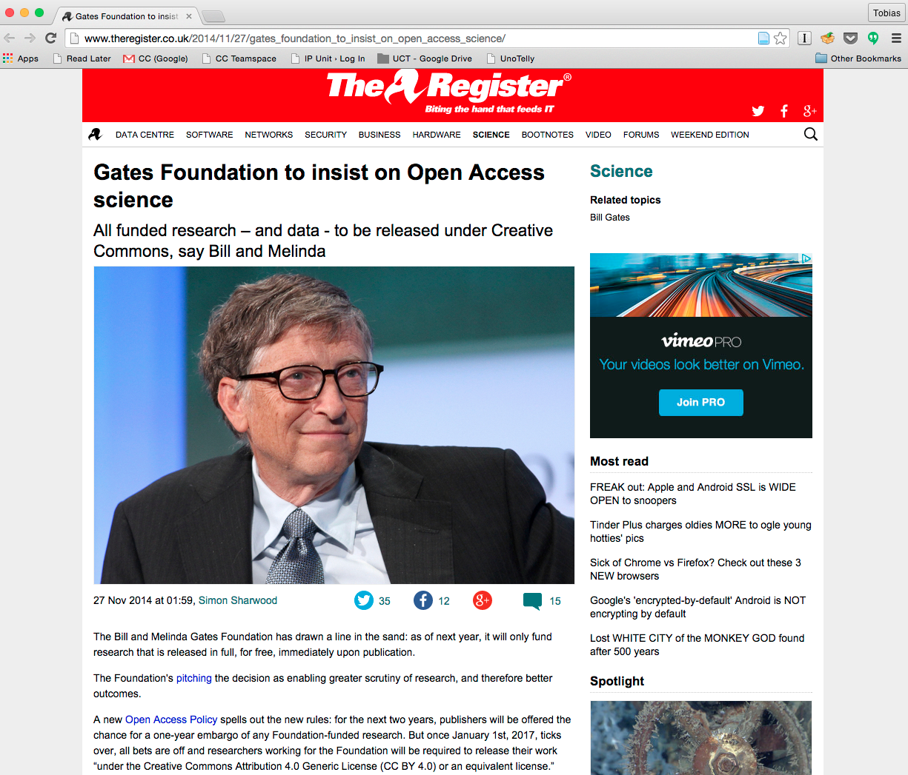


Or simply because funders / institutions increasingly request scholars to publish project results openly
Notes:
Pressure from funders

Slide 20


Then you need an open licence; either bespoke open licences or – in the interest of licence compatibility – standard licences like Creative Commons

Slide 21

Creative Commons provides free licences that make it easier for people: to disseminate their works and share and build upon the work of others consistent with the rules of copyright.
Notes:
Recognising these issues, …

Slide 22
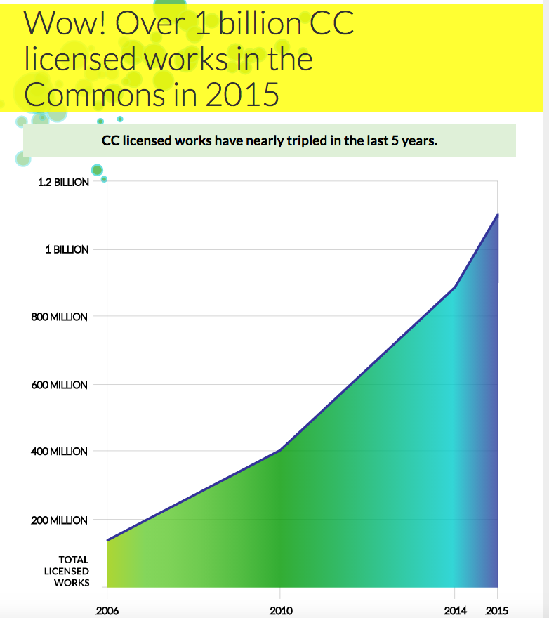

Slide 23

A set of pre-formulated licences

Slide 24


Slide 25
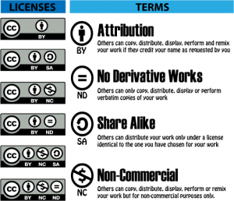
6 licences to choose from, by combining 4 key licence terms

Slide 26

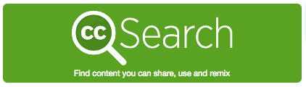

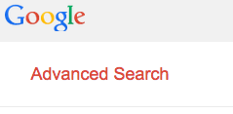

If you want to use CC licensed material created by others, just look out for a symbol like this:
or

Slide 27

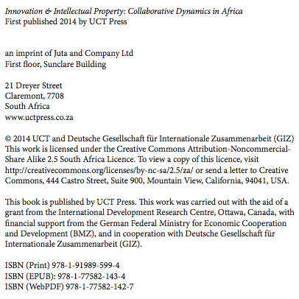

Slide 28
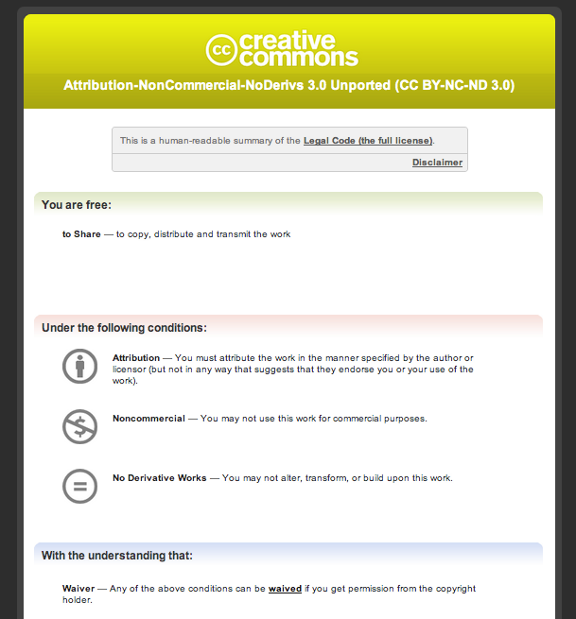

Slide 29
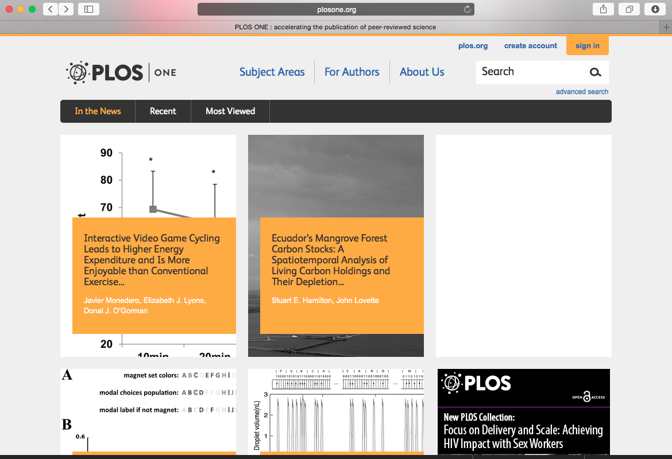
If you want to disseminate your work under a CC licence...
Notes:
Recognising these issues, …

Slide 30
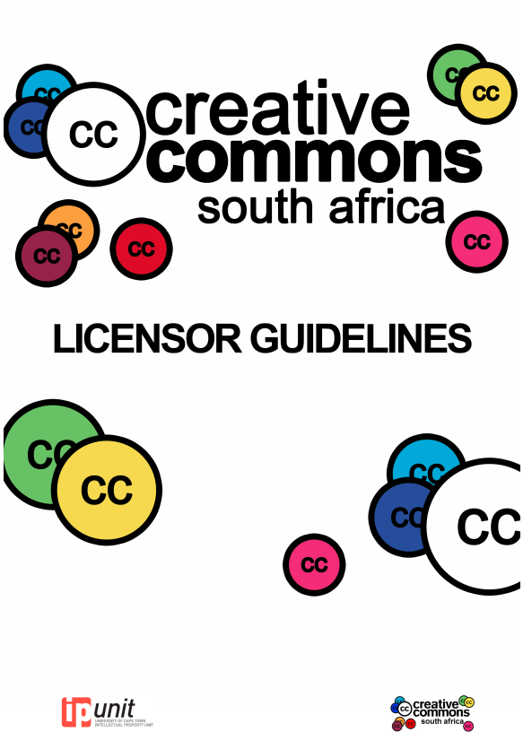
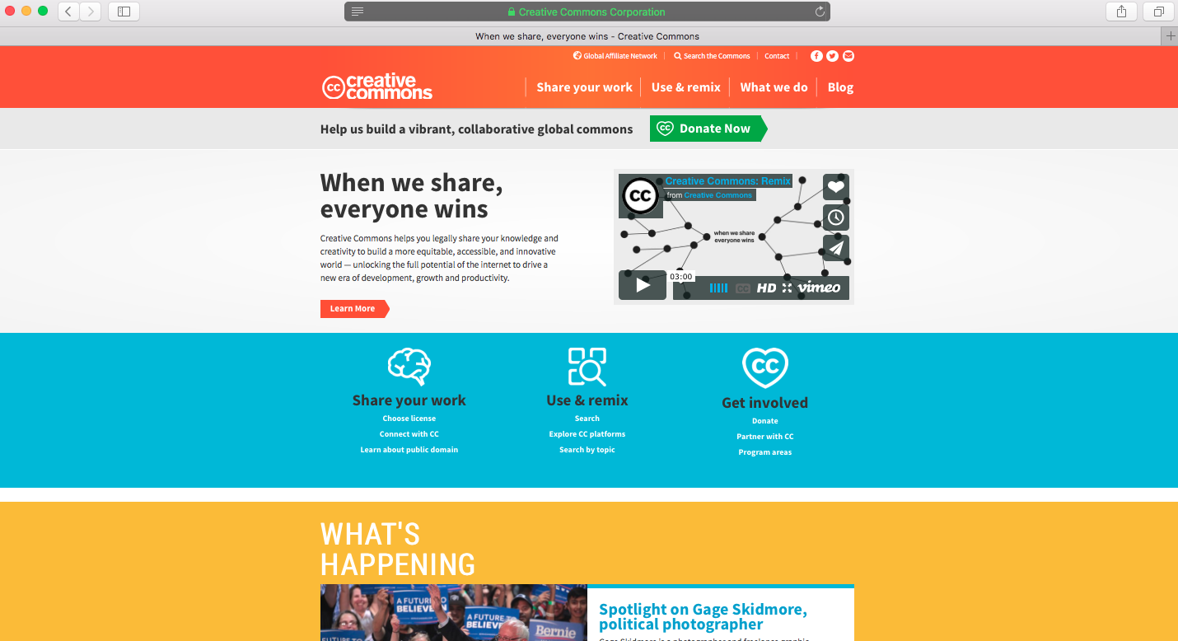
More information: http://ip-unit.org/wp-content/uploads/2015/02/CC-Guidelines.pdf
If you want to disseminate your work under a CC licence...
Notes:
Recognising these issues, …

Slide 31

Notes:
Recognising these issues, …

Slide 32

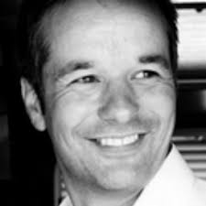
Thank you!
Any questions?
caroline.ncube@uct.ac.za
@caro_ncube
tobias.schonwetter@uct.ac.za
@tobyschonwetter

