Slide 1


Does Africa Need the
Bretton Woods Institutions?
Dr. Mark Ellyne
Challenges in Africa
July 2013
Notes:
I have chosen a big question with many great texts

Slide 2
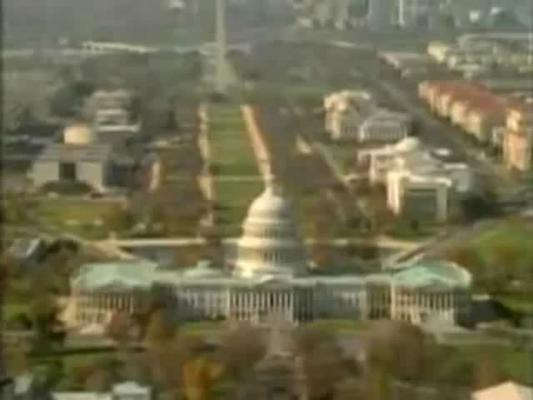
Who Are the New Rulers of the World?
Notes:
Many mainstream journalists see the IMF & WB as new rulers of the World; This piece from more serious journalist John Pilger, a recognized journalist

Slide 3
Conspiracy or Cooperation?
International Conspiracy to
Impose Western Hegemony
on Africa/Developing World?
or
Western economic support
to Africa/low income countries
to raise their economic development?
Notes:
The questions that we want to consider is:

Slide 4
Secret Plan For IMF World Dictatorship
Identified by the Illuminati (5/11/2005)
…a British-steered attempt to impose the dictatorship of the International Monetary Fund (IMF) on the entire planet, …
Under this plan, the IMF would dictate the economic policies of all states. The IMF orthodoxy is austerity, sacrifice, deregulation, privatization, union busting, wage reductions, free trade, a race to the bottom, and prohibitions on advanced technologies. These policies would strangle humanity.
Source: http://www.conspiracyarchive.com/Blog/ The Illuminati Conspiracy Archive
Notes:
You will hear that the IMF is part of conspiracy; from the Illuminati Conspiracy on the web

Slide 5
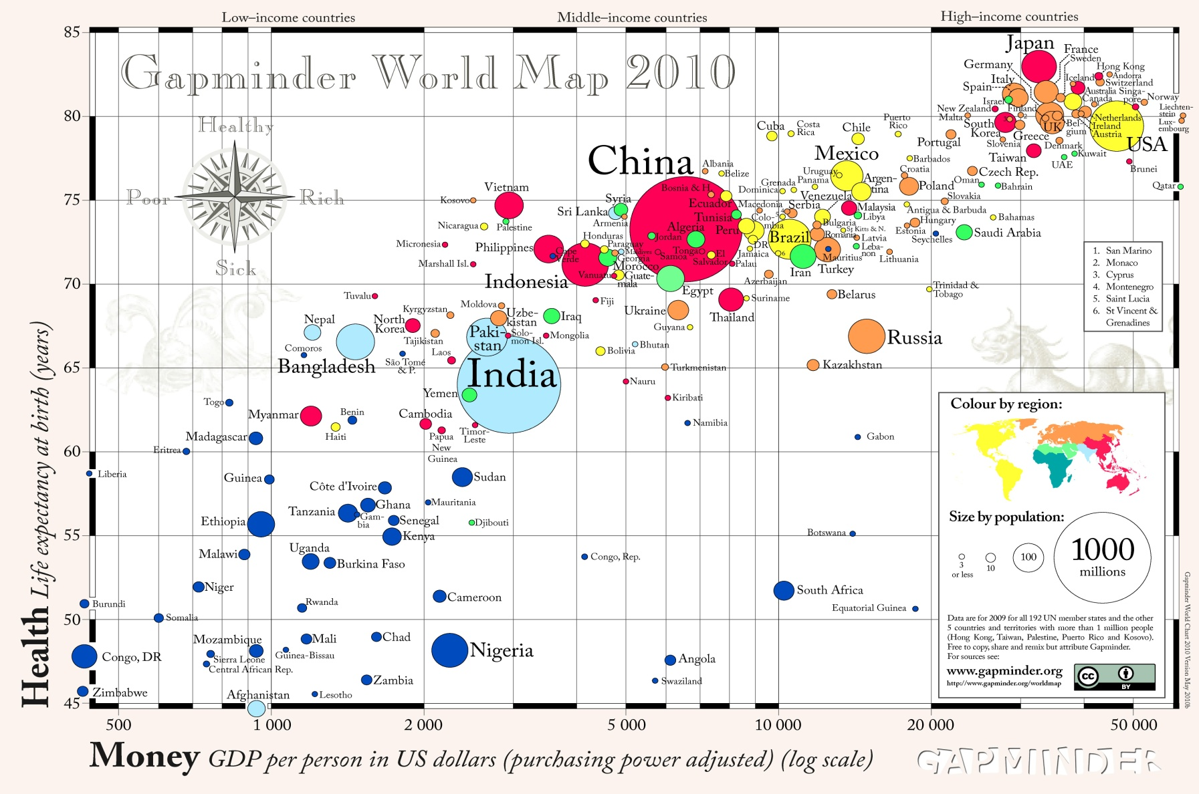
Why is Africa so Poor?
Notes:
Explain graph--show Africa
Here I leave you with the big question and the many answers to choose from.

Slide 6
Who Are the
Bretton Woods Institutions?
IMF
Promote global financial stability
Promote macro-economic stability
World Bank
Promote economic development
World Bank motto: “Our dream is a world free of poverty”
World Trade Organ.
Develop global rules of trade
Provide mechanisms to resolve trade disputes
Notes:
All created after WWII as part of new world order
Prevent another great depression
Facilitate growth and trade
Promote exchange rate stability and convertibility
Lender of last resort for balance of payments problems
Policy based lending

Slide 7
Purpose of the IMF
Prevent another great depression
Promote exchange rate stability and convertibility
  Facilitate growth and trade
Lender of last resort for balance of payments problems
  Policy based lending
Notes:
Forum for econ discussion on international economic issues
Center for applied research
Provider of specialized technical assistance to governments
Producer of public data
Fund of $500 bn

Slide 8
World Bank vs. IMF
World Bank
Development projects
Raises money on international markets
Mission is to reduce poverty
IMF
Policy-based lending
Use members’ contributions
Mission is to maintain financial and economic stability
Notes:
Can understand IMF by comparing to WB

Slide 9
IMF Intervention Model
Economic problem/shock affects country’s balance of payments, i.e. ability to pay for imports
Government invites IMF assistance
IMF proposes loan and demands conditionality
Notes:
1. Problem can be temporary oil shock—easy
Or inflation-depreciation spiral
2. IMF send team – what I did
3. IMF is catalyst
4. policeman

Slide 10
World Bank Intervention Model
Economic development affects country’s income and poverty
Government asks for loans and technical assistance for large-scale investment projects
WB finances development projects to reduce poverty and raise income

Slide 11
Poverty is Linked to Growth
Why hasn’t Africa improved as much as Asia?

Slide 12
The downturn in growth beginning in 1980 led Africa to seek advice from the IMF.
1960s
1970s
1980s
Notes:
Looking back African econ history
Problem emerged in the 1980s
GDP/pop is best measure of std of living

Slide 13
Economic Growth Theory
Y = TFP K^{α}L ^{(1-α)}
Growth depends on:
Capital accumulation
Labour force growth,
Education and skills,
Technological progress
Notes:
Growth is best way to raise living standards
@10% double in 7 years; 3% double in 24 years
Explains most growth for most countries….

Slide 14
Africa’s Growth is Lower than Theory Predicts
Sub-Saharan African countries (48) have statistically grown slower than other regions, even after taking account of standard economic variables.
Notes:
Growth model overpredicts for Africa, Africa underperforms.
Sometimes we summarize the problems with Africa by talking about the african dummy,
Dumny means that other unidentified factors are reducing growth

Slide 15
Until the mid-1990s, growth in SSA was driven primarily by factor accumulation in all country groups.

Slide 16
What Makes Africa Different?
Why is TFP growth lower than elsewhere?
Geography?
Demographics?
Culture?
Resource endowment?
Politics: Internal & External?
Institutions
Governance?
Policies?
Notes:
Many are non-quantitative factors
Tropics/poor quality land;
Ethnic diveristy;
Abundant mineral resources;
Social conflict;
Colonial exploitation & slavery
Cold war
Poorly developed instituions

Slide 17
Why Does Africa Grow Slower?
Geography
(Bloom and Sachs)
Geography and Climate: African soils, topography, and disease ecology raise obstacles to growth, including low agricultural productivity and high disease burdens.
“Geography, Demography, and Economic Growth in Africa” (Bloom and Sachs 1998)

Slide 18
Why Does Africa Grow Slower?
Geology
Resource Curse
Heavy dependence on a small number of primary exports, which have shown long-term price declines (terms of trade declines) and high volatility;
Lifting the Oil Curse: Improving Petroleum Revenue Management in Sub-Saharan Africa (IMF 2004)

Slide 19
The Problem is “The Resource Curse”
The exploitation of Africa’s prolific natural resources encourages rent seeking (payments for nonproductive work), and ultimately the Dutch Disease (a high value-added export appreciates the exchange rate and may make traditional exports noncompetitive).

Slide 20
Why Does Africa Grow Slower?
Politics
External politics
The legacy of the slave trade;
Colonial rule;
Cold War manipulations of African politics; and
Foreign aid

Slide 21
The IMF Explanation
Poor economic policies
Excessive protectionism--inefficient;
Excessive government regulation--slows business and creates rents;
Excessive fiscal spending;
Tendency for governments to print money, which causes inflation;
High economic rents (corruption), and
Lack of domestic capital.

Slide 22
To Alleviate Capital Shortage,
Donors Gave Loans During the 1980s
Notes:
Response to lack of capital diagnosis;
Lend capital to raise Investment
Afr debt 25% -> 70%; Asia 15%->30%

Slide 23
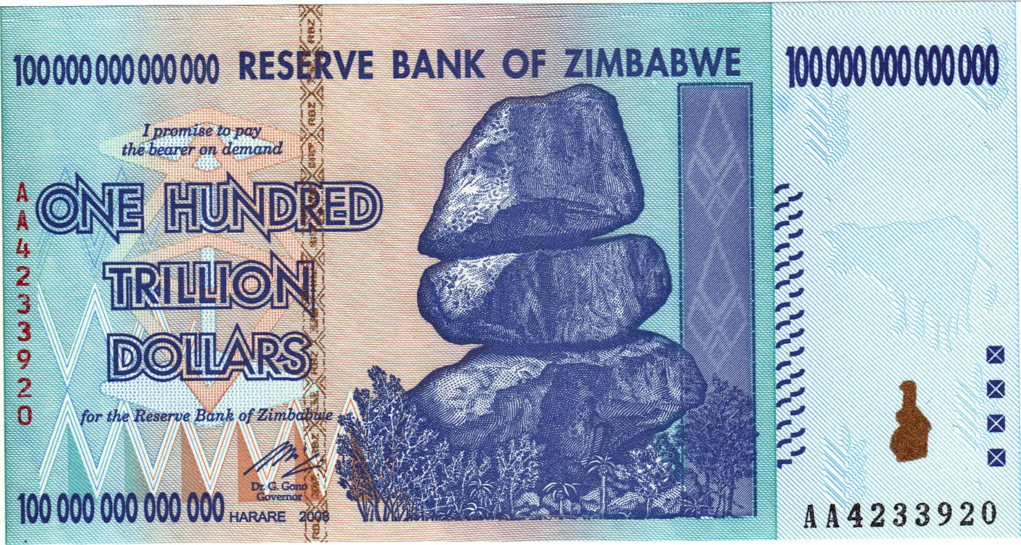
Bad Government Policies Are
Often the Source of the Problem
Notes:
Cant resist highlightling Gov’s unique ability print money
I went to Zim in 1997, xr=10:1; 2009 xr=1 trillion:1

Slide 24
The BWI Solution to
Africa’s Deficient Policies
Structural Adjustment Programs (SAPs), created in the 1980s, promoted the traditional economic wisdom of the time, which became embodied in what was called the Washington Consensus (1999), which was at the center of adjustment policies. (“Neoliberal policies”)
Notes:
The WC was summary for policies used, not a toolkit
Lets look at WC = neoliberalism;

Slide 25
Washington Consensus
Fiscal Policy
Fiscal discipline is good;
Public expenditure priorities should be social infrastructure and public goods;
Tax reform should broaden the tax base.
Notes:
Country like a household

Slide 26
Implied Policy Prescriptions
Reduce the fiscal deficit
  To take pressure off interest rates, stop crowding out the private sector, and reduce the current account deficit
  Raise taxes or cut expenditure
  Painful
Notes:
WC sounds logical, but what are the implications

Slide 27
Washington Consensus
Price Liberalization
Deregulation to encourage market-determined prices, which create more efficient allocation. Eliminate price controls and subsidies;
Maintain a single exchange rate determined by the market.

Slide 28
Implied Policy Prescriptions
Depreciate the exchange rate to increase competitiveness
  To raise exports and reduce imports, (reduce the trade deficit) and stimulate domestic production
  Raises inflation
  Painful

Slide 29
Washington Consensus
Free Trade
Trade liberalization is good for growth and consumer welfare.
Encourage privatization and eliminate barriers to foreign direct investment to encourage more & efficient investment.

Slide 30
Washington Consensus
Liberalize the financial sector to obtain efficient allocation of capital, including market interest rates, including free flow of international capital.
Create secure property rights to encourage investment.
Maintain macroeconomic stability.
Notes:
WC sounds reasonable, but what are implication:
Importance of Property rights- Hernando deSoto Polar, Peruvian
Mystery of Capital (2000)
Focussed on granting property rights to peruvian coca farmers
Legal reform and land titles to peasants give them stake in system

Slide 31
Implied Policy Prescriptions
Raise the real interest rate
  To reduce inflation, encourage savings, and make efficient use of capital.
  Hurts business and reduces jobs
  Painful

Slide 32
Results of Policies in Africa
Notes:
“I once heard an official in LIC say that taking money from the IMF was like making love to a Gorilla—you can’t stop until he does”
So why didn’t the WC work?

Slide 33

The Counter Attack to the WC
Stiglitz (2002)
Notes:
Counter attack against SAP by many, but epitimized by Stiglitz, who was chief econ at WB and Nobel prize winner
The Stiglitz Attack was important because he was a member of the establishment
Attach began in 1998

Slide 34
Attack on the
Washington Consensus
We don’t live in textbook neoclassical world - incomplete information and imperfect markets.
Shock therapy is worse than the gradualist approach—especially for transition economies
Notes:
Too many prior conditions not met
Speed of implementation is critical

Slide 35
Attack on the
Washington Consensus
Need to build new institutions, like land titles, commercial courts, and relevant laws before implementing new policies.
Notes:
Sequencing

Slide 36
Attack on the
Washington Consensus
Privatization is not always the answer
  State-owned enterprises may provide socially beneficial services and employment.

Slide 37
Attack on the
Washington Consensus
Fiscal austerity was wrong policy approach for East Asia
  All problems are not fiscal problems
  Need countercyclical fiscal policy

Slide 38
Attack on the
Washington Consensus
Trade liberalization need to done slowly and may not always be good
  Should consumers pay more to facilitate domestic employment?
  Protection may give an infant industry a chance to succeed
Notes:
Given criticisms: Heard one done say that taking money from the IMF is like making love to a Gorilla...

Slide 39
Attack on the
Washington Consensus
Financial liberalization:
  Can be dangerous without appropriate supervision
  Free flow of capital may be dangerous, especially for small economies
Notes:
Given criticisms: Heard one done say that taking money from the IMF is like making love to a Gorilla...

Slide 40

Trevor Manuel: Market Failures were the Problem (2003)
Notes:
Trevor manuel, former Min Fin,
noted that domestic and intl market failures were responsible for failure of WC
IMF F&D 2003

Slide 41
Trevor Manuel: Market Failures were the Problem (2003)
World trade regime not favourable to Africa. External shocks very damaging to undiversified exporters.
International financial system and aid practices caused frequent disruptions to developing country markets
Grants were needed in place of loans

Slide 42
Domestic Market Failures
State-owned enterprises can be good (Asia) but the African State was too weak to manage them
Shortage of social capital--needed more human capital and physical infrastructure
Africa’s rural economy is to dependent on the more modern urban and fiscal sectors

Slide 43
Does IMF Create Austerity?
The IMF Response
“Saying the IMF causes austerity is like saying doctors cause plagues because you often find them around sick people.”
“Emerging-market debtors typically come to the IMF only when their finances are under extreme duress ... and other creditors have turned their backs.”
The IMF Strikes Back By Kenneth Rogoff , Economic Counselor and Director of the Research Department International Monetary Fund
Notes:
Here is how the IMF responds to the attacks that it is at fault.
Rogoff is Harvard prof; was chief economist at IMF
Countries would have to cut government budget in any case,
and without external support

Slide 44
What Was Wrong with SAP Advice?
Fundamentally flawed?
Faulty implementation?
Reform program not wrong, but incomplete?

Slide 45
New Thinking
Joseph Stiglitz – How to make Globalization Work
Jeff Sachs – The End of Poverty
Dembisa Moyo – Dead Aid
Paul Collier – The Bottom Billion;
Wars, Guns and Votes
Governance
Notes:
A few important thinkers on Development

Slide 46

Solutions to the Problem

Slide 47
The End of Poverty:
Economic Possibilities for Our Time
Jeffrey Sachs (2005) argues that extreme poverty—defined by the World Bank as incomes of less than 1 dollar per day—can be eliminated globally by the year 2025, through carefully planned development aid, that reaches the "bottom rung" of the ladder.

Slide 48
Sachs: More Aid
In order to achieve the goal of eliminating global poverty, development aid must be raised from $65 billion globally as of 2002 to between $135 and $195 billion a year by 2015, including debt cancellation for the world's poorest countries.

Slide 49

Dead Aid by Dambisa Moyo
(2009)
Notes:
New Commentator with new ideas: Zambian African woman

Slide 50
Moyo’s Hypotheses:
Foreign aid fosters dependence;
Foreign aid fosters corruption;
Foreign aid encourages bureaucracy;
Foreign aid reduces tax revenue;
Foreign aid reduces private investment;
Foreign aid creates bottlenecks;
Notes:
Government is less answerable to its citizens than to intl donors

Slide 51
Donor Aid And Corruption
Historically:
“Corrupt governments do not receive less Foreign aid.”
“Countries that receive more aid, tend to have higher levels of corruption.”
Source: Do Corrupt Governments Receive Less Foreign Aid? (NBER Working Paper No. 7108)
Notes:
Corruption is an unproductive tax from poor to rich.

Slide 52
Moyo: Less Aid - More Business
Advanced economies should reduce aid while increasing trade
LIC governments should use bond markets to raise funds—not the central bank or donor grants
LICs should welcome foreign investment
Governments must make “Doing Business” easier
Notes:
On the other hand
Africa got only 17 / 400 $bn of FDI to developing countries
Doing business: time to get license, days completing forms;

Slide 53
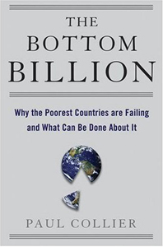
Paul Collier
The Natural Resource Trap - The exploitation of Africa’s prolific natural resources encourages rent seeking (payments for nonproductive work), and can stifle other economic activity (Dutch Disease).
Africa is heavily dependent on a small number of primary exports that have shown long-term price declines (terms of trade declines) and high volatility.
Notes:
Collier is Scholar at Oxford and former Chief economist at W
Dutch disease is when one important export tends to appreciate the exchange rates and causes traditional exports to no longer be exportable. e.g. Nigeria was agicultural exporter before oil
TOT volatility is damanging for doing business and for policy

Slide 54

Paul Collier
Political risk is results from conflict and is one of the greatest risk factors reducing investment in Africa.
Ethnic loyalty to leaders, regardless of their competence/performance, reduce their incentive to perform well.
Notes:
Other book, Collier talks about conflict and politics
Risk reduce domestic and foreign investment

Slide 55
Paul Collier
The Conflict Trap - civil wars and coups have an estimated average cost of $64bn each, according to Collier.
Notes:
Other book, Collier talks about conflict and politics
Risk reduce domestic and foreign investment

Slide 56
Political Risk is High in Africa
2009: Index of Failed States
Top 5 failed states were in Africa (Somalia, Chad, Sudan, Zimbabwe, DRC)
10 of top 15 in Africa
21 of 37 States that US Government has on its Alert list for Failed States are in Africa
Notes:
Recently found this measure of political risk:
Foreign Policy journal and US govern track failed states
Central Government is weak or ineffective and has little control over much of its territory.
Measure of instability

Slide 57
Average Corruption Perception Index:
African Countries in Yellow (2010)
Notes:
Average of WB, AFDB, TI, … by Asian Devel Bank
178 countries worldwide
4: top 50
9: 50-100
19: 100-150
11: 150-178

Slide 58
Has the IMF Changed Since SAPs?
The 2nd Generation of Reforms:
Concern about poverty; creation of the Poverty Reduction and
Growth Facility (1999)
Emphasis on good governance (accountability and transparency in public finances)
Demands government ownership of policies
Notes:
Good governance means accountability and transparency of public finances

Slide 59
Has the IMF Changed Since SAP?
Increased concern over financial system regulation and supervision
Provides more capacity building and technical assistance
Offered debt relief for first time (MDRI, 2006)
Notes:
Debt relief: Someone always pays
For IMF—if forgiven, less money left to lend
So members voluntarily contributed to buyback fund

Slide 60
Some Old Messages Persist
Growth is the key to poverty reduction
International trade and foreign investment (new technology) are critical for long-term growth
Governments must avoid excessive domestic and foreign debt
African countries need more flexible exchange rates, and more flexible goods and labour markets

Slide 61
The Alternatives to the BWIs
Hold more reserves to protect against shocks
Need more commercial borrowing (expensive)
Take more bilateral aid (more political strings attached)

Slide 62
Africa is Experiencing a Resurgence of Growth Since 2000
Notes:
1980 – 2000 lost decades

Slide 63
Africa’s New Growth Surge?
Notes:
Does this mean that IMF/WB are working??

Slide 64
Since the mid-1990s, TFP growth has Generally Improved

Slide 65
TFP Growth has Improved

Slide 66
Conclusions and Policy Implications
Summary of key messages
Until the mid-1990s, growth in SSA was driven primarily by factor accumulation in all country groups.
Since the mid-1990s, TFP growth has improved strongly in all country groups, except for fragile countries.
TFP accelerations associated with improvements in terms of trade, higher aid, and lower economic and social instability
CFA zone countries have a propensity for TFP decelerations
Dan Ghura (2007). Growth Accounting in Africa, IMF

Slide 67
Is African Resurging?
Just a fluke:
Just a commodity boom
Due to China and India
No real industrialization
This time is different:
More democracy and ownership
More institutional development
More consumerism
More beneficiation

Slide 68
BWI/IMF Balance Sheet
PROs
Facilitates international cooperation
Provides public information on all economies
Technical assistance and policy advice
Provides lender of last resort financing
Voice for Africa (LICs)
CONs
Economic policeman/auditor
Requires policy conditionality (even if county is not be ready)
Favours creditors over debtors
Favours efficiency (private) over equity (government)
Overly conservative
Notes:
Where do we stand
Lender of last resort reduces need for reserves
Need economic policeman; and lender of last resort
IMF represent Africa/LICs at G7 meeting
IMF favors rich – asysmetrical standards
but no conspiracy.

Slide 69
IMF is Disliked by All Sides
From the right: Nationalists are dislike supranational institutions;
From the left: Socialists dislike polices that hurt poor elements of society;
IMF is run by rich countries;
IMF follows bad “neoliberal” policies.
Notes:
IMF remains disliked by all...
Eg USA dislikes UN

Slide 70
Future of the BWIs in 2006
They hoped to avert future crises by setting up multilateral institutions to act as a stabilising influence during the post-war reconstruction. The bank’s first job was rebuilding Europe; the IMF oversaw the fixed exchange-rate system established at Bretton Woods. Later on, the pair sought new roles as the stewards of global economic development and financial stability.
Now the IMF and World Bank have fewer jobs to do. Markets work better, as do other financial institutions. Helped by improved economic theory, the world has grown richer and more stable. As for helping the poorest, a multilateral model of giving poor countries money and advice for running their economies is under fire from both left and right. Conservatives argue that such interventions cause more problems than they solve. The left complains that developing nations get too little money and not enough control over how it is spent. Both sides fear that the institutions’ structures are outdated, hinting, increasingly loudly, that retirement is due.
Economist, September 19, 2006

Slide 71
Back from the dead:
But the IMF is not quite ready for the future
“THE International Monetary Fund has had a good crisis. Two years ago the world’s main international economic institution was heading for irrelevance, its homilies ignored by rich countries, its advice despised in poorer ones and its lending unnecessary in a world flush with private capital. Today the fund is widely hailed as a flexible and innovative crisis-responder. It has committed over $160 billion in a host of new loans and credit lines, up from barely more than $1 billion in 2007. Its lending capacity is being trebled to $750 billion.”
From The Economist, Sept. 17th 2009

Slide 72
Discussion
Is the IMF (BWIs) a conspiracy to undermine the economies of low income countries?
Are Africa’s problems a result of discrimination, bad advice, or poor policy implementation?
Should the IMF (BWIs) be replaced?
And with what?
Notes:
I leave you with these questions

