Slide 1
Physics 1025F Mechanics
KINEMATICS
Dr. Steve Peterson
Steve.peterson@uct.ac.za

Slide 2
Distance vs Displacement
We make a distinction between distance and displacement.
Displacement is how far the object is from its starting point, regardless of how it got there.
Distance traveled is measured along the actual path.

Slide 3
Displacement
Displacement is the change in position of a body
written as: or

Slide 4
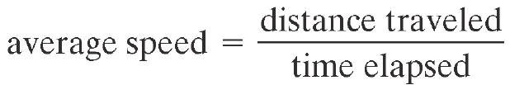
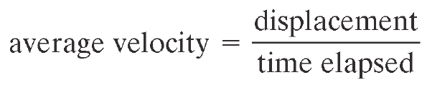
Speed vs Velocity
Speed is how far an object travels in a given time interval
Velocity includes directional information:

Slide 5
Velocity
Velocity is the rate of change of displacement
The magnitude of v is:
The direction of v is: in the same direction as

Slide 6
Acceleration
Acceleration is the rate of change of velocity
The magnitude of a is:
The direction of a is: same direction as , not v
Acceleration is a vector, although in one-dimensional motion we only need the sign.

Slide 7
Deceleration
There is a difference between negative acceleration and deceleration:
Negative acceleration is acceleration in the negative direction as defined by the coordinate system.
Deceleration occurs when the acceleration is opposite in direction to the velocity.

Slide 8
Kinematic Equations
The full set of equations describing motion in a straight line under constant acceleration is:
Always remember that Δx is displacement or change in position, therefore if the body is originally at position x₀, and after time t, it is at position x, then

Slide 9
Motion Graphs
Three Types of Motion Graphs
Position versus Time
Velocity versus Time
Acceleration versus Time
Notes
A graph of “A versus B” means that A is graphed on the vertical axis and B on the horizontal axis.
A graph is not a picture of the motion, but an abstract representation of the motion

Slide 10
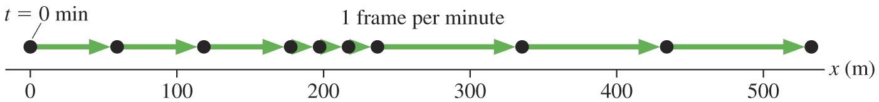
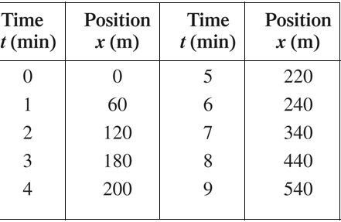
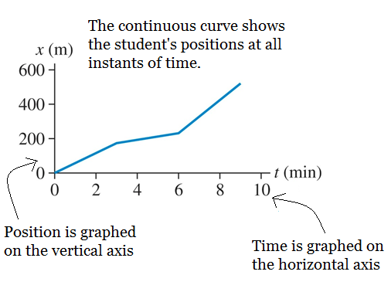
Position versus Time
Motion diagram (student walking to school)
Table of data
Graph

Slide 11
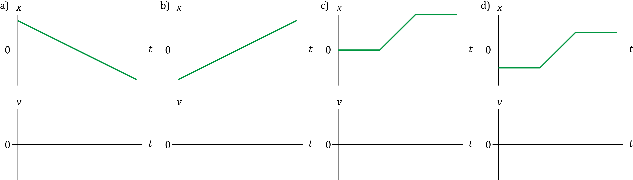
Example: Velocity vs Time
Below are four position versus time graphs, draw the corresponding velocity versus time graphs.

Slide 12
Free Fall
One of the best examples of motion in a straight line under constant acceleration is “free fall.”
In the absence of air resistance all objects fall at the same acceleration under the influence of gravity.
g = 9.80 m/s²
(i.e. ≈ 10 m/s²)

Slide 13
Example: Free Fall
A ball is thrown directly up into the air at 30 m/s.
How high does it go?
What is the time of flight?
What is the speed with which it hits the ground?
Sketch a vs t, v vs t, Δx vs t.

Slide 14
Chapter 3: Projectile Motion
A projectile is an object moving in two dimensions under the influence of Earth’s gravitational field; its path is a parabola.
It can be understood by analysing the horizontal and vertical motions separately

Slide 15
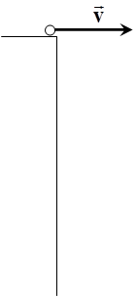
Example: 2D Free Fall
Let’s follow the motion of a ball rolling off a table at a velocity of 2 m/s.

Slide 16
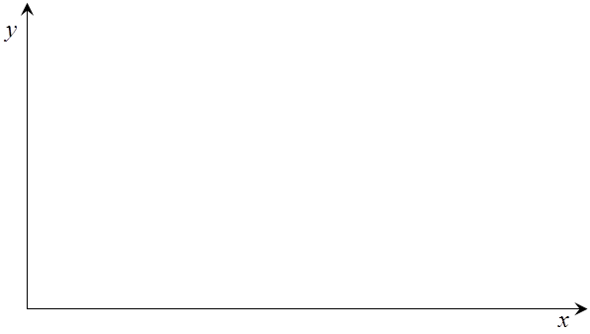
Example: Projectile Motion
Let’s give the ball a horizontal (x-dir) and vertical (y-dir) component to its velocity (v_{x} = 10 m/s & v_{y} = 30 m/s). What would its motion look like (starting from the origin)?

Slide 17
Projectile Motion Example 1
A plane drops a package of emergency rations to a stranded hiker. The plane is traveling horizontally at 40.0 m/s at a height of 1.00 x 10² m above the ground. Where does the package strike the ground relative to the point at which it was released?
Notes:
Vuille/Serway Example 3.5 (page 65)

Slide 18
Projectile Motion Example 2
A stone is thrown upward from the top of a building at an angle of 30.0° to the horizontal and with an initial speed of 20.0 m/s. The point of release is 45.0 m above the ground.
(a) How long does it take for the stone to hit the ground?
(b) Find the stone’s speed at impact.
(c) Find the horizontal range of the stone. Neglect air resistance.
Notes:
Vuille/Serway Example 3.8 (page 68)

