Slide 1


Slide 2
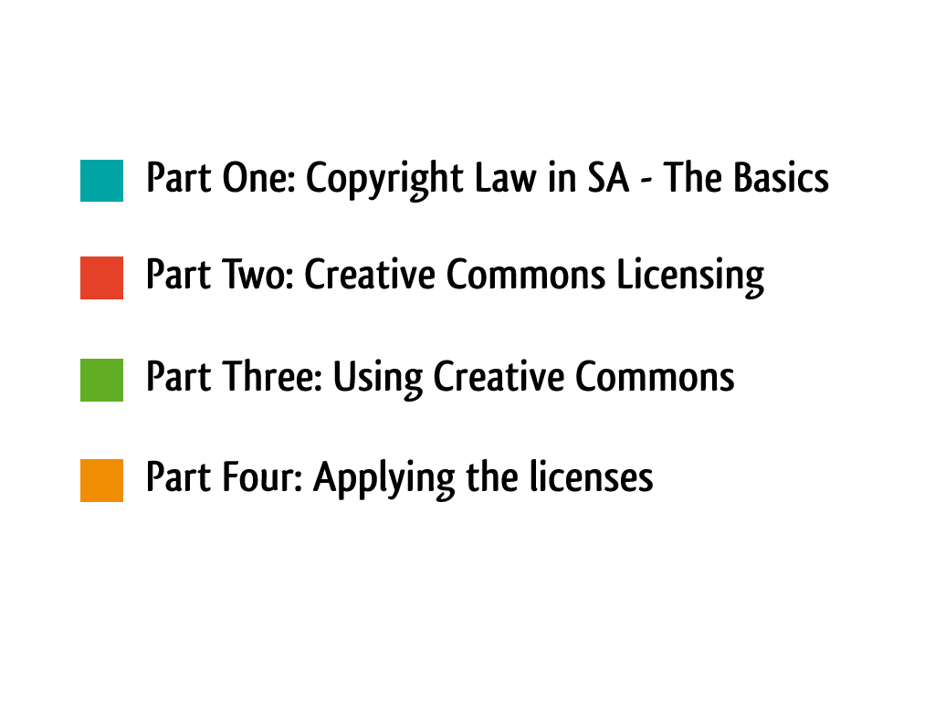

Slide 3
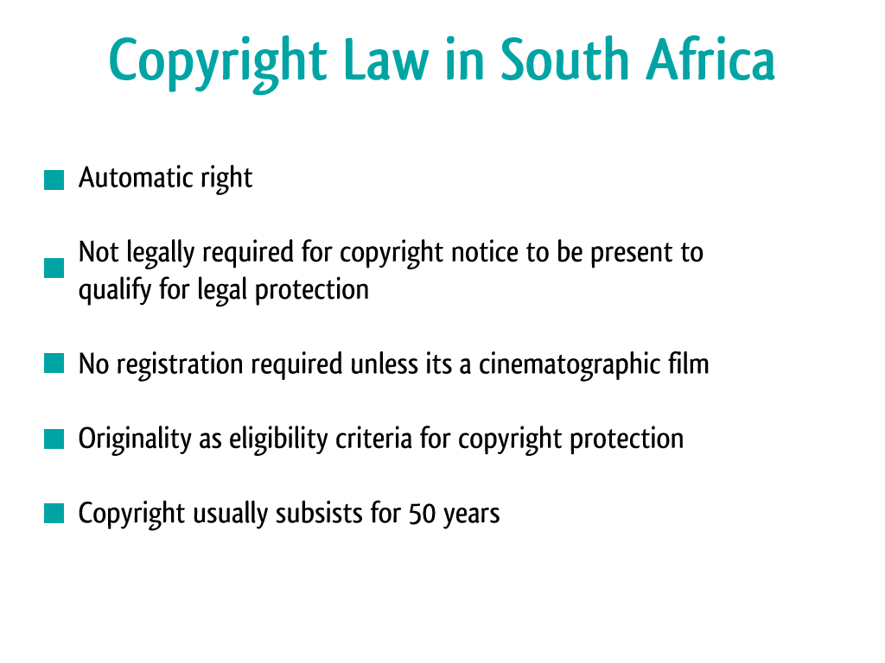

Slide 4
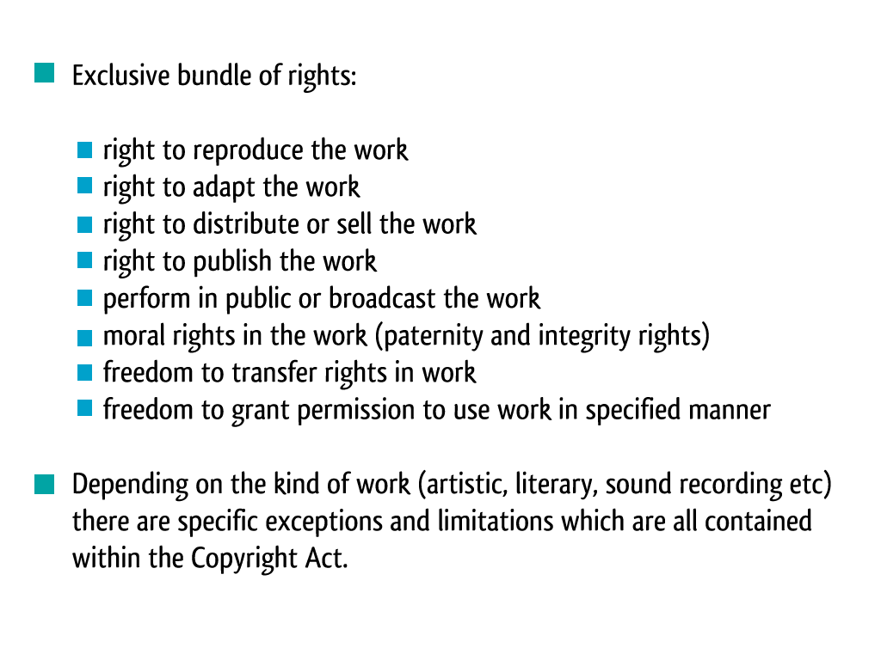

Slide 5
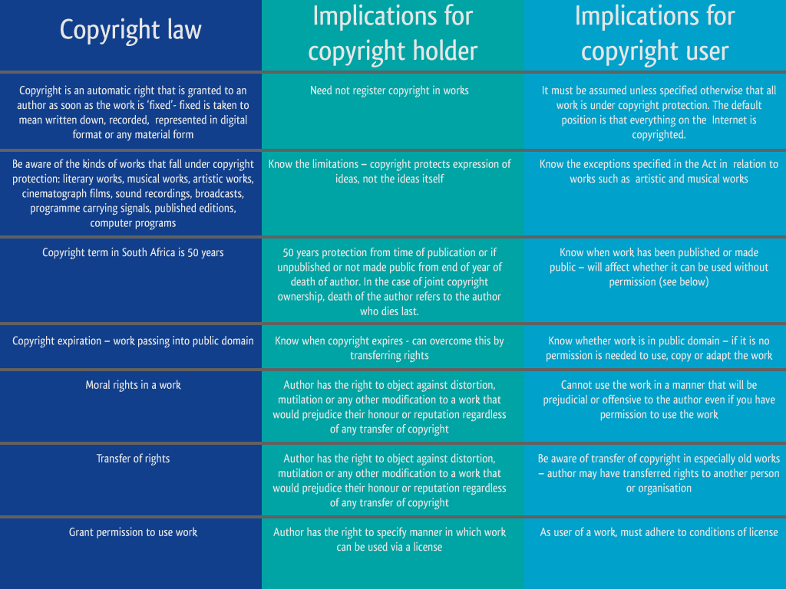

Slide 6
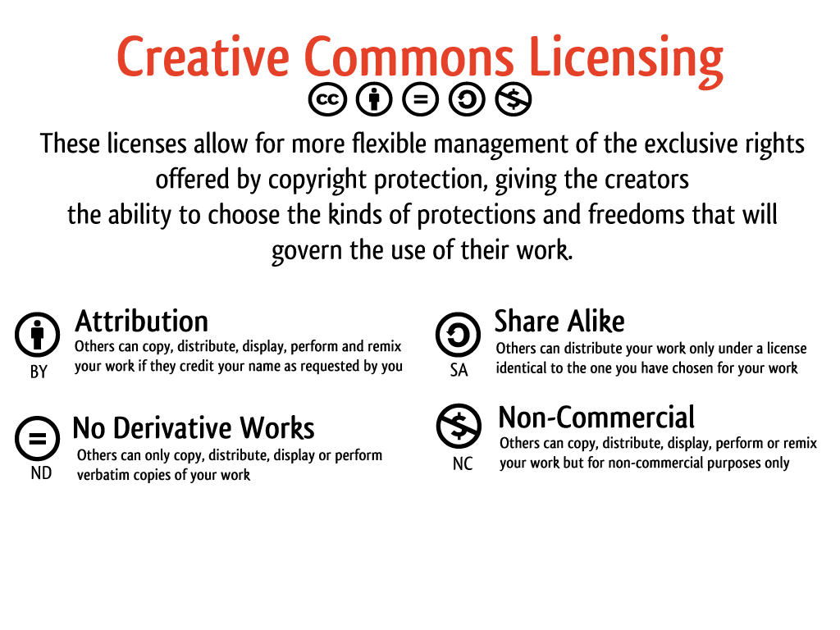

Slide 7
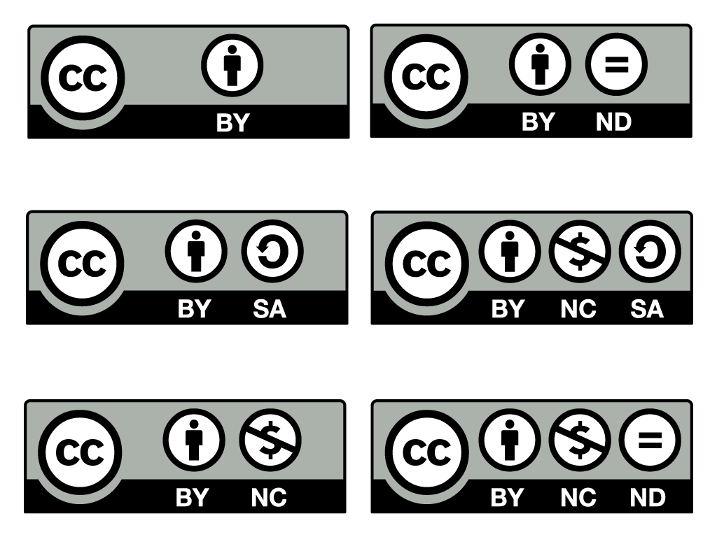

Slide 8
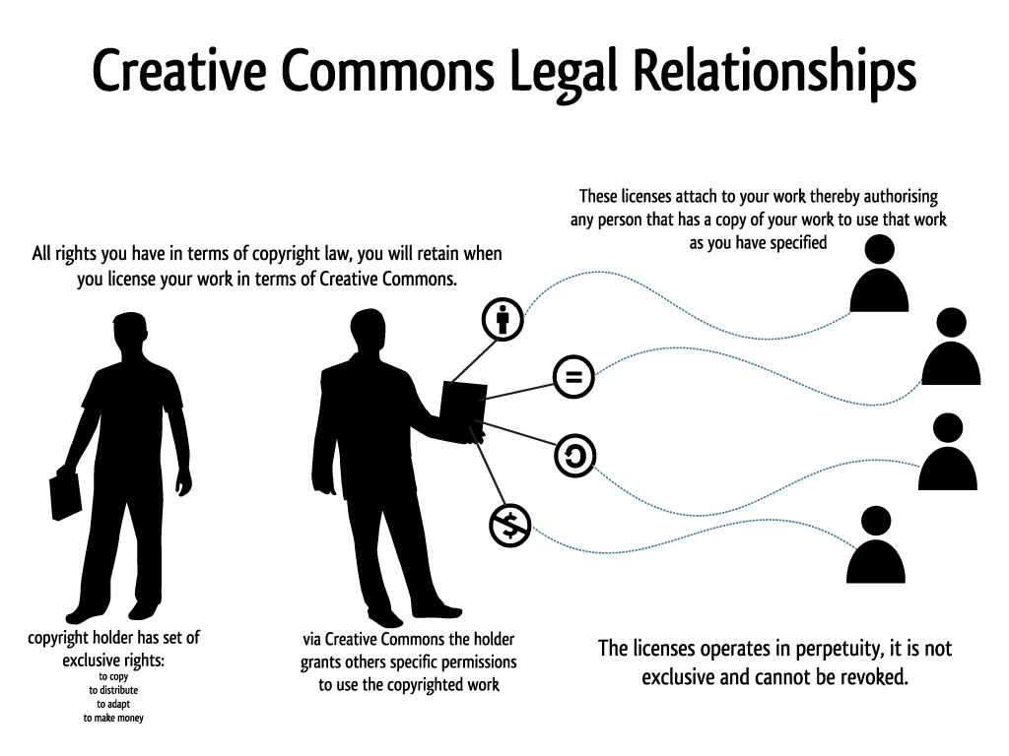

Slide 9
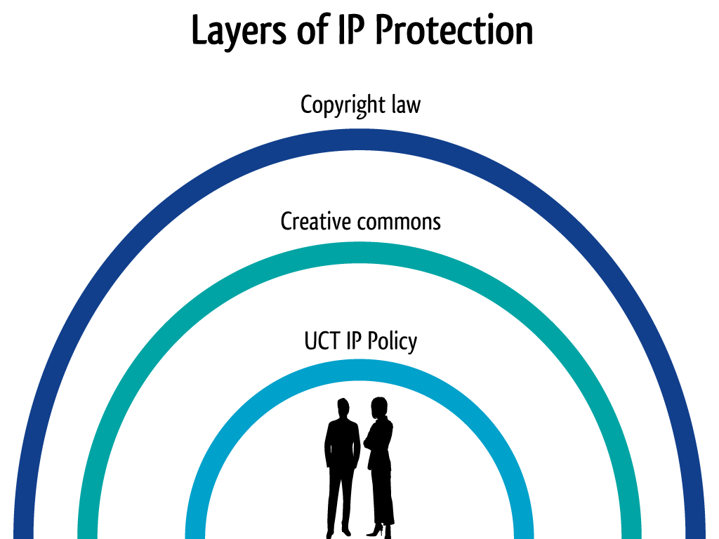

Slide 10
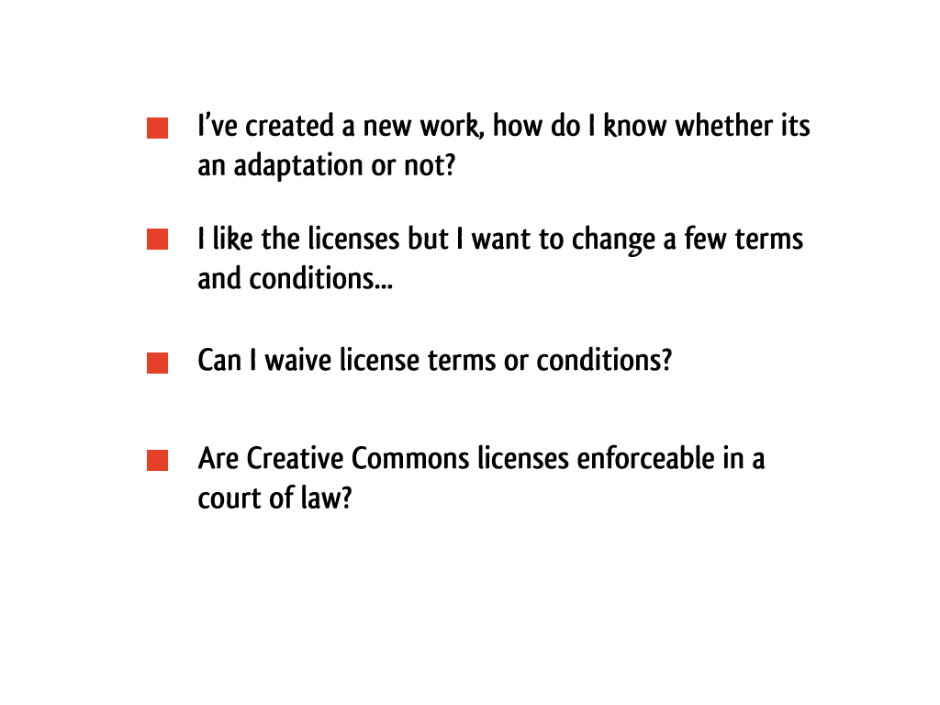

Slide 11


Slide 12
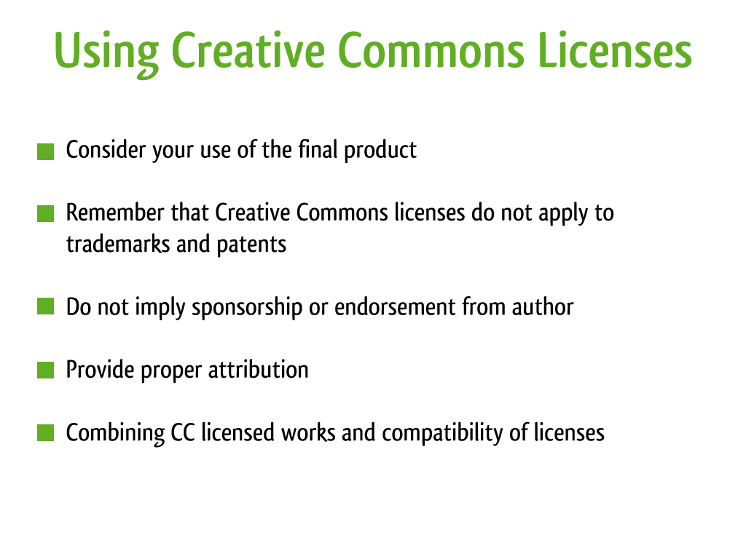

Slide 13
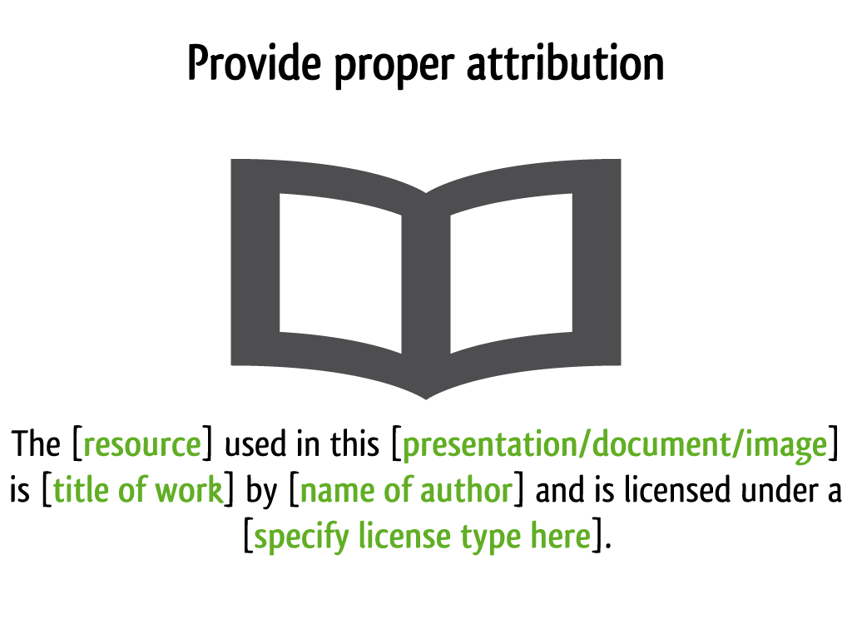

Slide 14
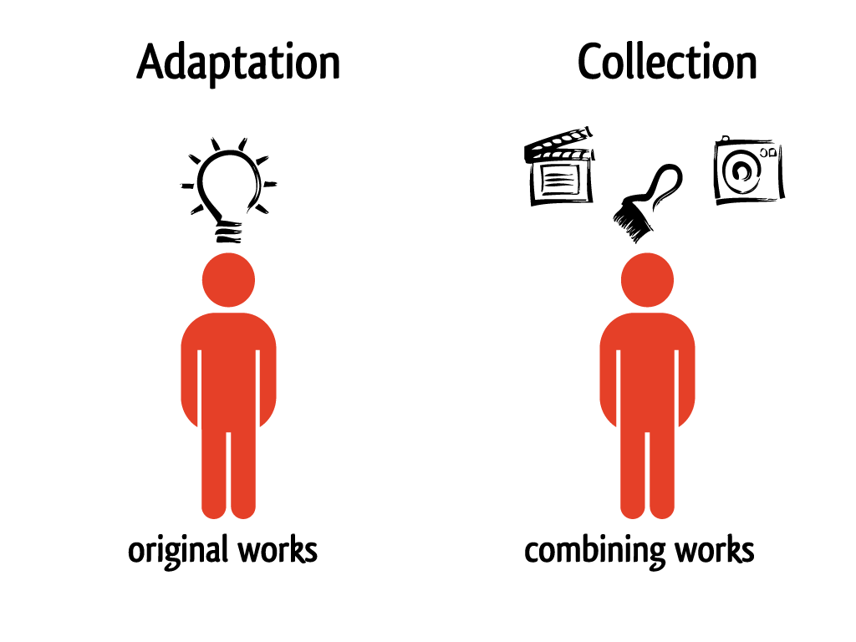

Slide 15
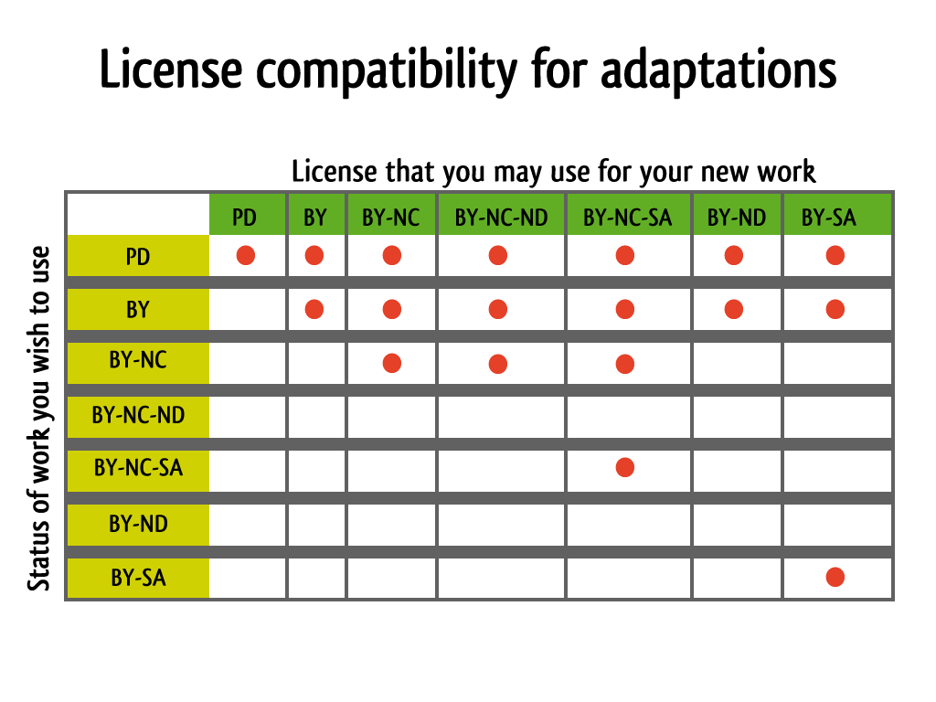
Notes:
Information sourced from: http://wiki.creativecommons.org/FAQ

Slide 16
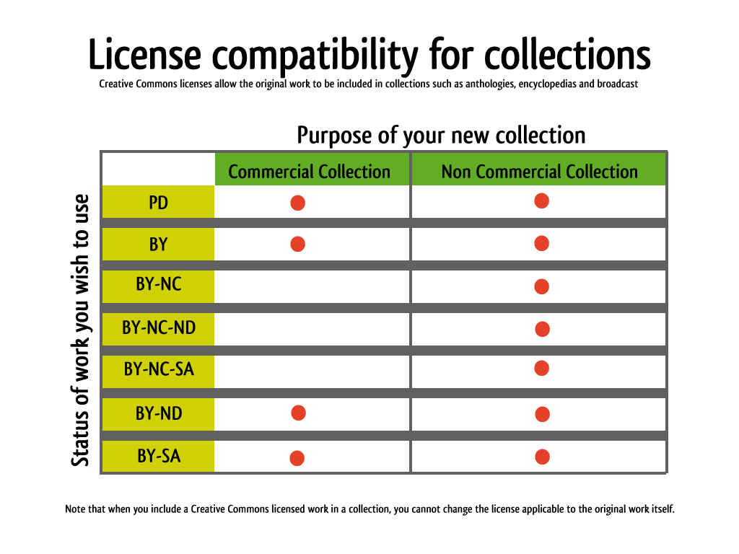
Notes:
Information sourced from: http://wiki.creativecommons.org/FAQ

Slide 17
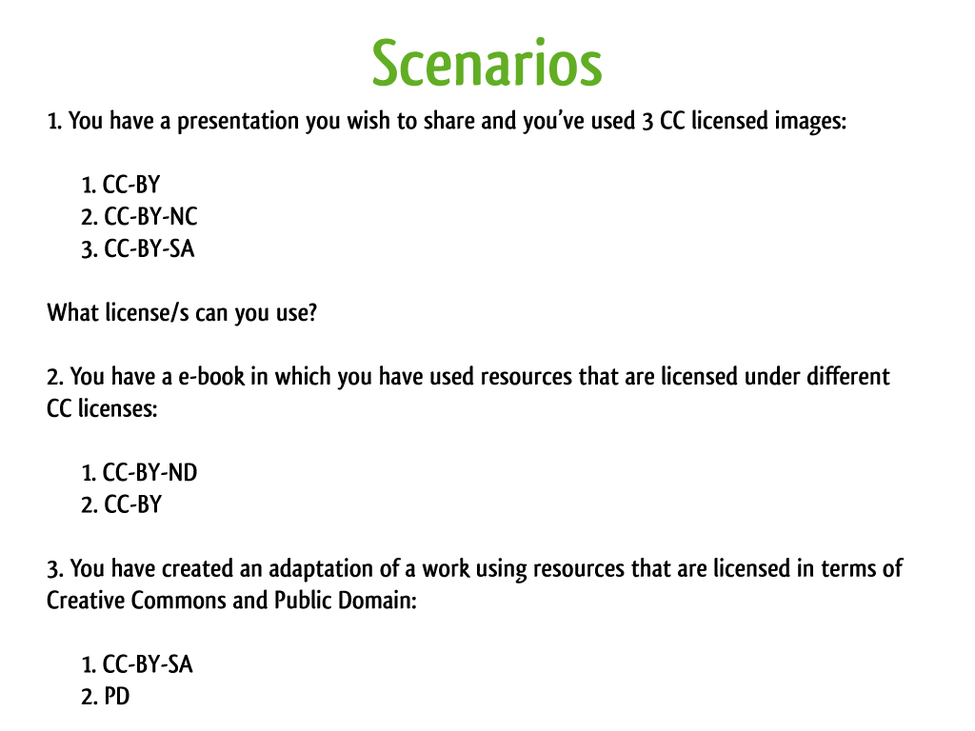
Notes:
http://www.web2rights.com/OERIPRSupport/creativecommons/

Slide 18
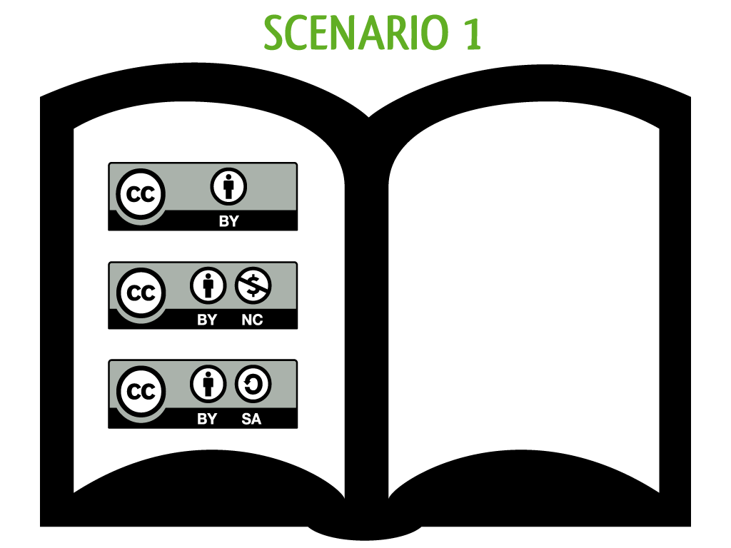

Slide 20
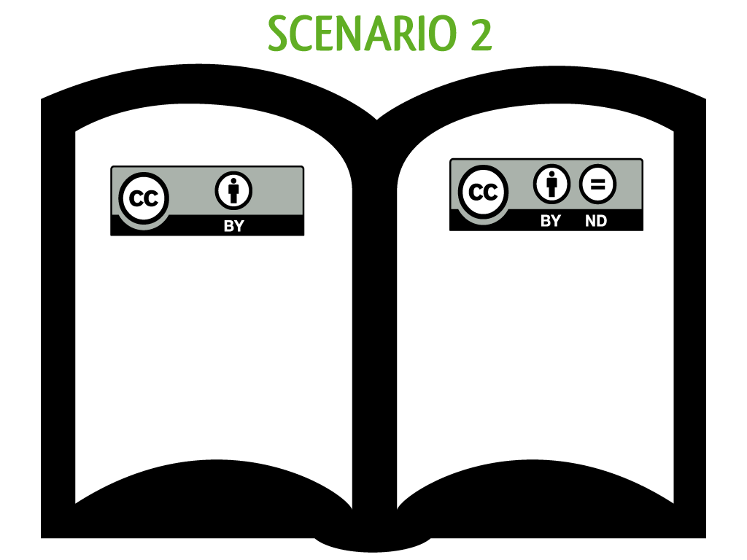

Slide 22
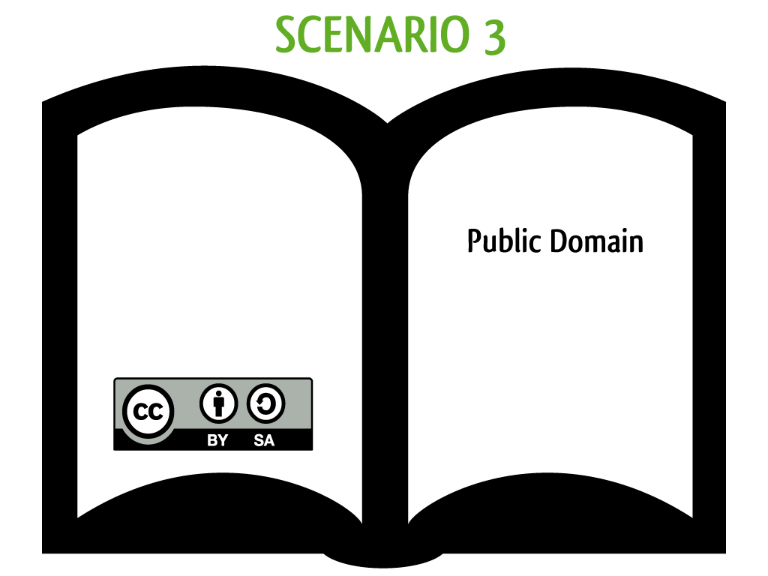

Slide 23
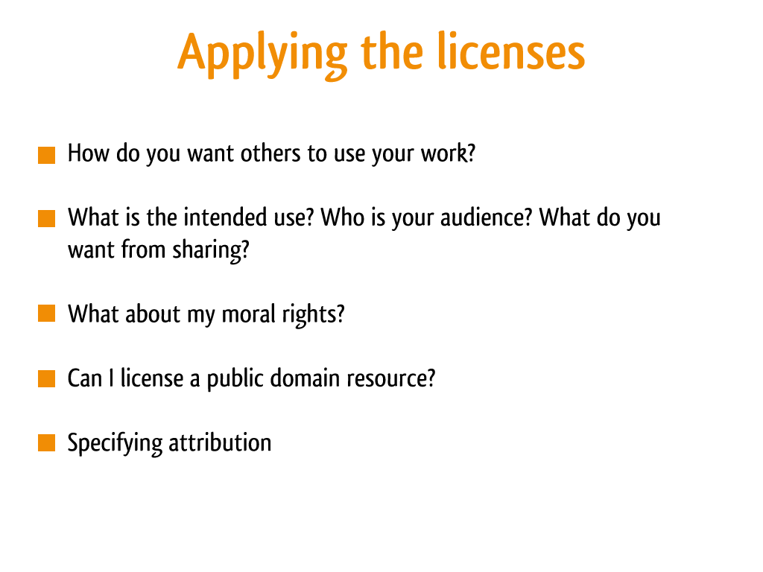

Slide 24
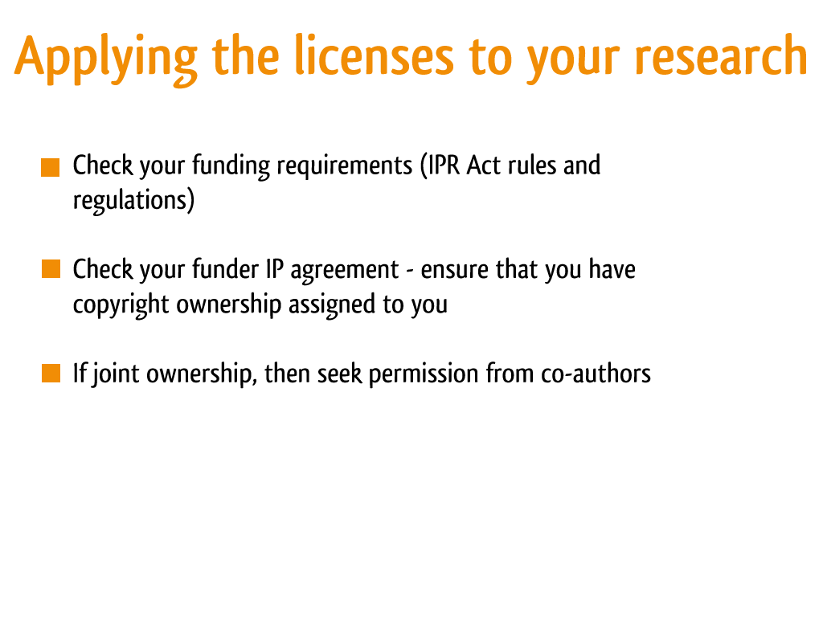

Slide 25
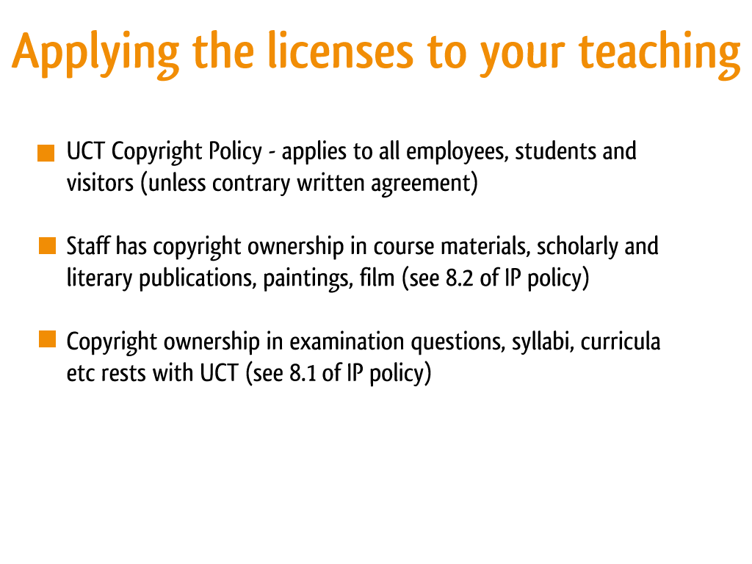

Slide 26
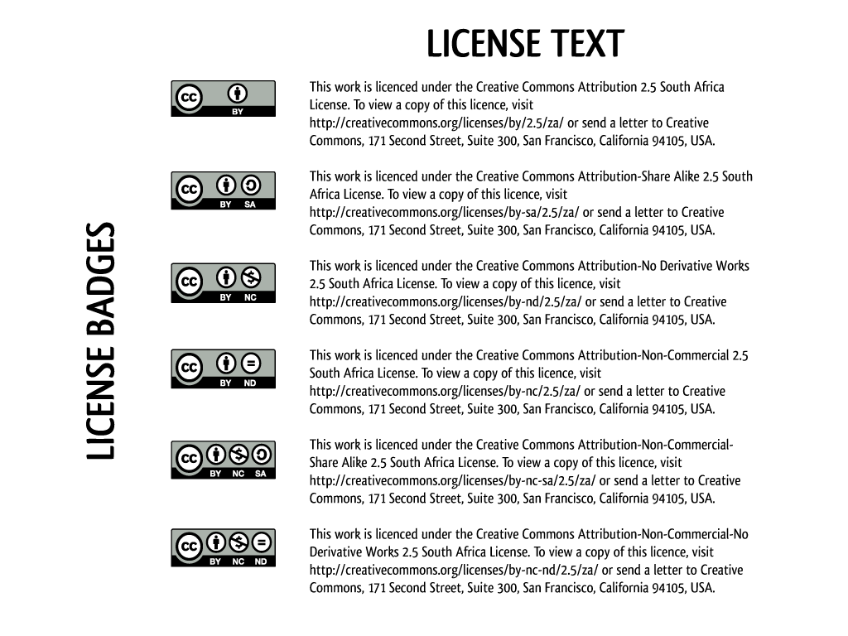

Slide 27

This presentation is licenced under the Creative Commons Attribution-Share Alike 2.5 South Africa License. To view a copy of this licence, visit http://creativecommons.org/licenses/by-sa/2.5/za/
or
send a letter to Creative Commons, 171 Second Street, Suite 300, San Francisco, California 94105, USA.

